Slide 1
Home and Office Security Scanner (HOSS)
Created By: Ricardo Castellanos, Luis Cortez, Diego Flores, Adrian Holloway, Jivan Karapetian, Minsu Lee, Asahel Monroy, Ashley Pablo - Ramirez, Garrett Stewart, Guang Wu
Liaison: Dr. Anson Fong
Faculty Advisor: Dr. Huiping Guo

Slide 2
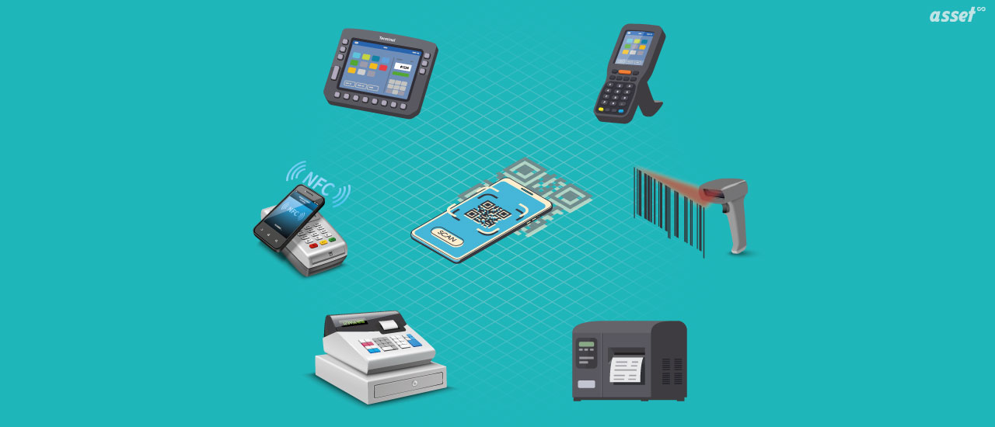
Agenda
What is The Internet of Things
What is HOSS and how does it work?
The Purpose and Interface of HOSS
Data flow diagram and modules
Planned software and future plans
Q&A
Image Source: Assetinfinity.com

Slide 3
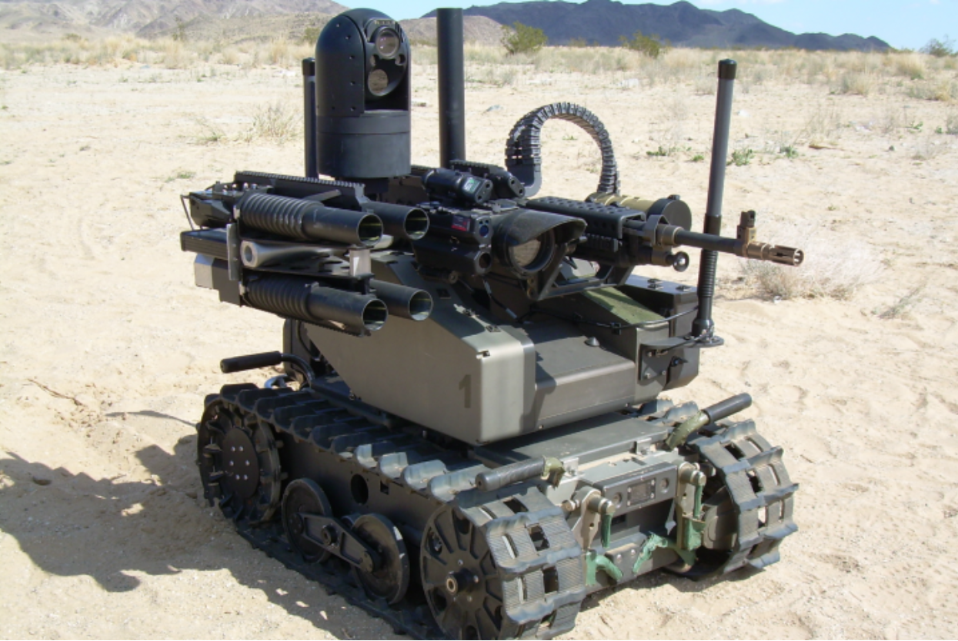
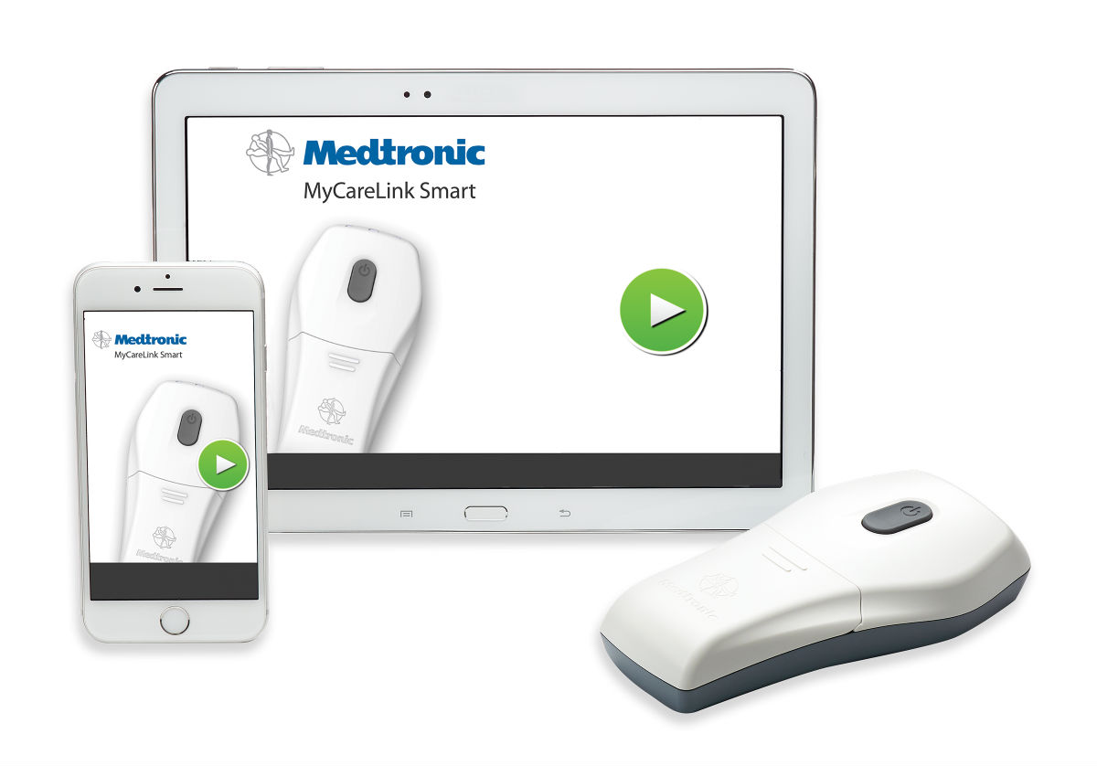
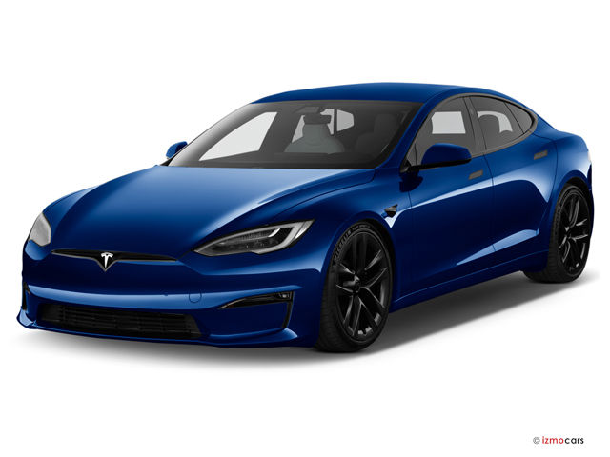
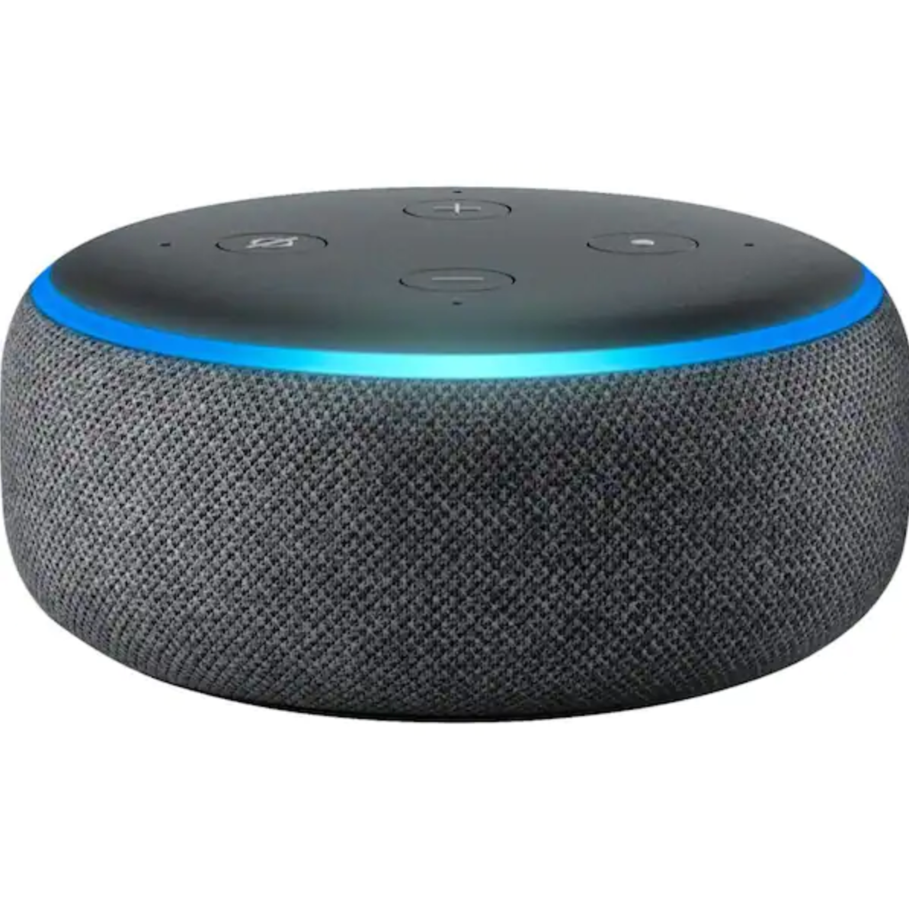
The Internet of Things
Merriam-Webster describes the Internet of Things (IoT) as “the networking capability that allows information to be sent to and received from objects and devices…using the Internet “
These devices can have capabilities such as sensors, video and voice recording, and processing abilities.
Applications of IoT: Smart Vehicles, Smart Home (We will focus on Smart Home Devices)
Image sources: www.qinetiq.com, www.medicaldesignandoutsourcing.com/,
www.tesla.com www.amazon.com
Notes:
Add some pictures/diagrams. (picture source/link).

Slide 4
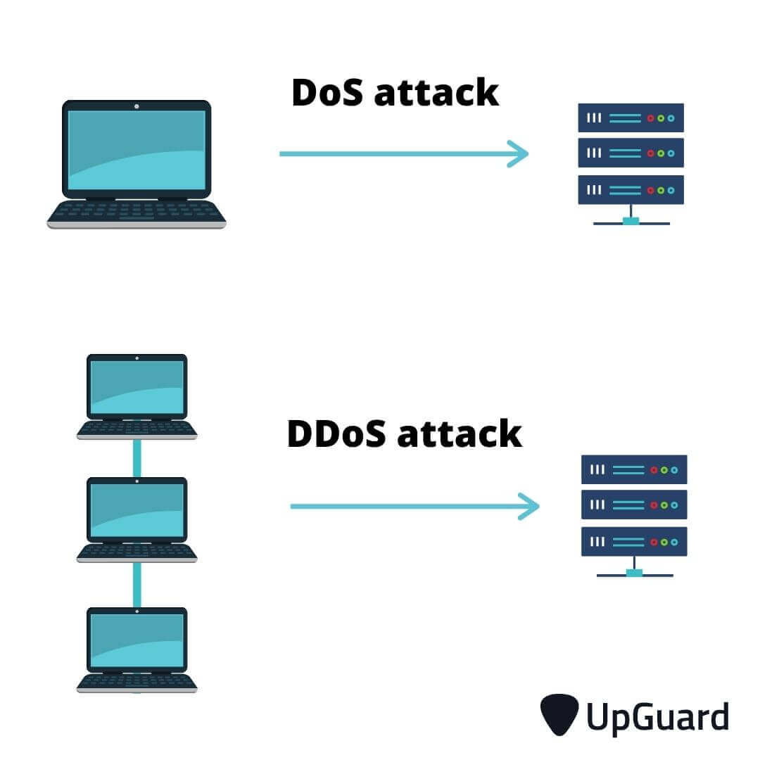
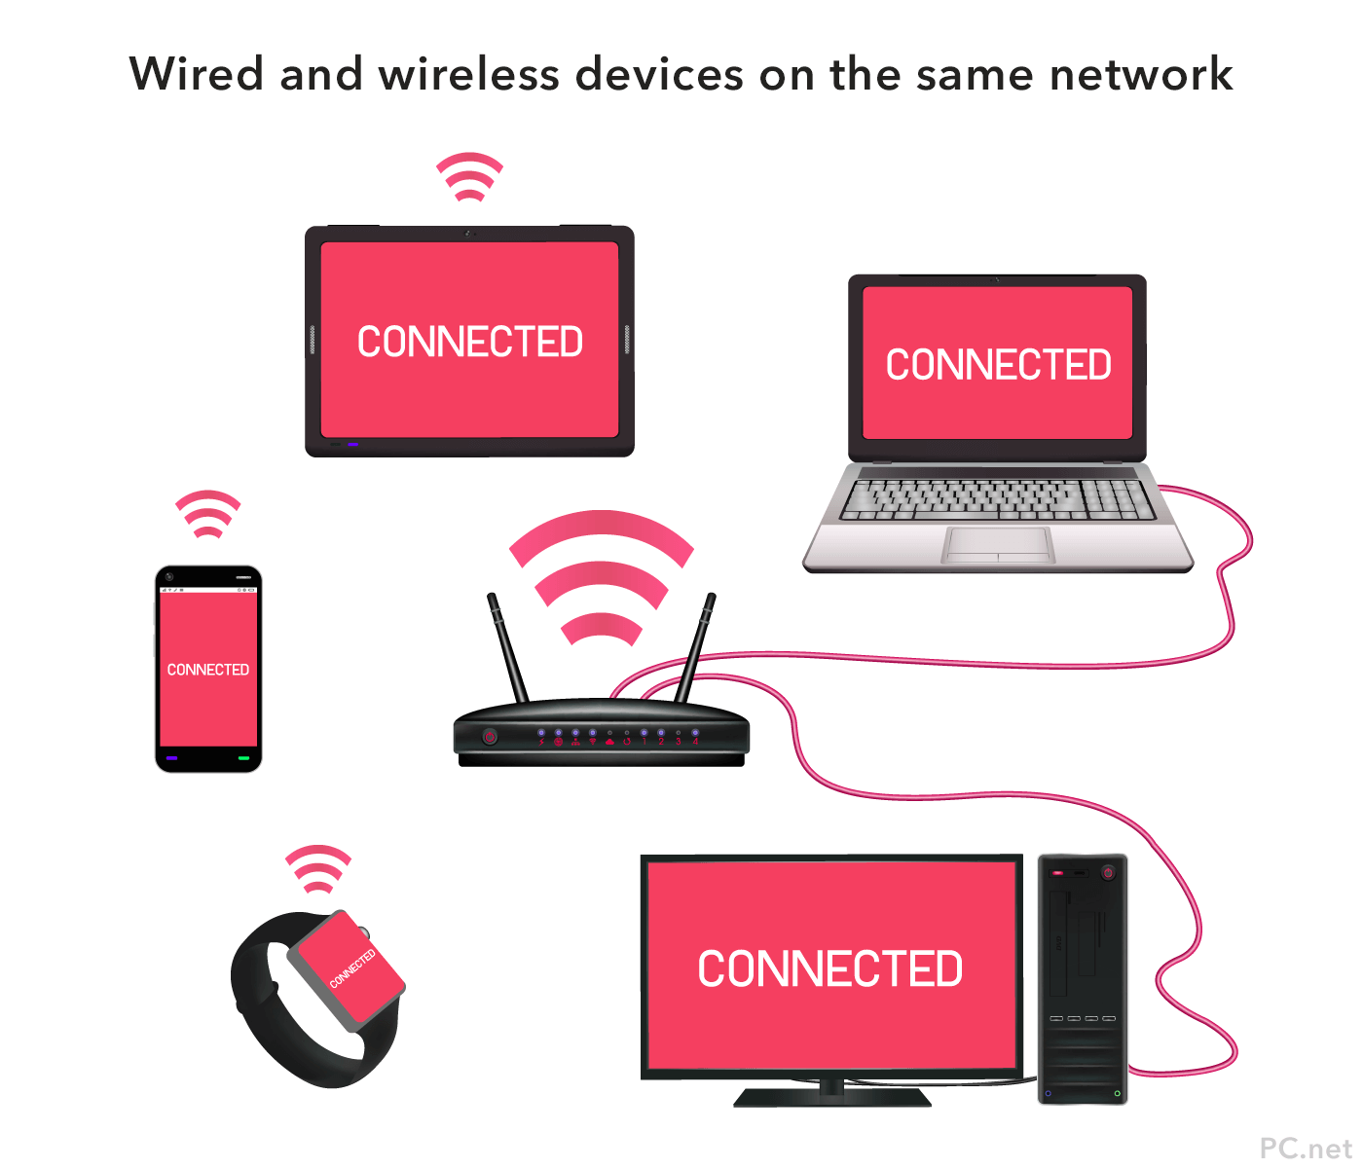
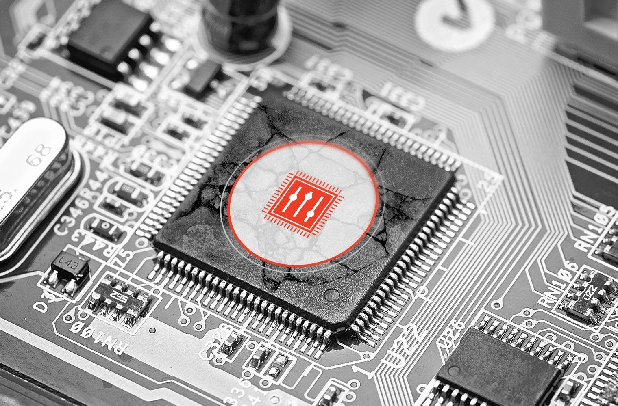
Security Issues in Smart Home Applications
Internet of Things, as important as it it, comes with its share of security and privacy problems.
Examples:
Devices being connected to a network without knowledge of network owners.
Vulnerable firmware
Overwhelming amount of data transferred in and out of IoT devices resulting in data oversight
Poor testing, unpatched vulnerabilities, and lack of updates
Image sources: www.hackread.com, www.upguard.com, www.eclypsium.com, www.pc.net

Slide 5
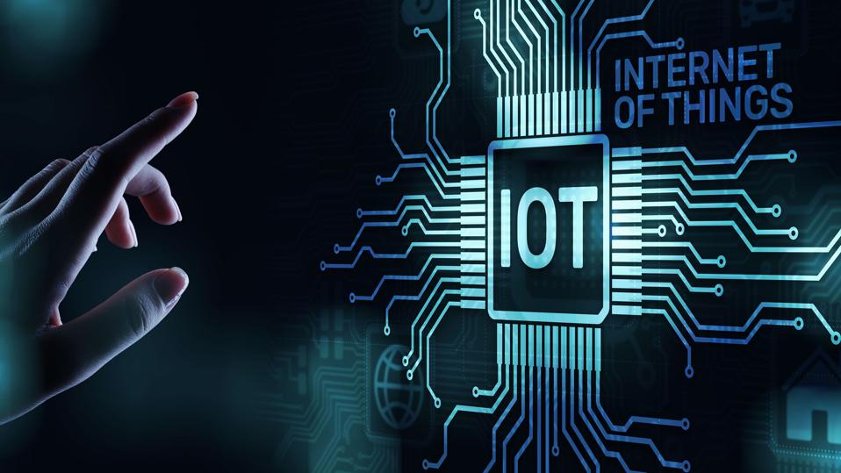
What is HOSS?
HOSS is a web application which provides two solutions to the issue of IoT device vulnerabilities.
The first solution is that HOSS provides users, (network managers who use HOSS) a list of all connected IoT devices in their network.
The second solution HOSS provides is a security and privacy assessment of these devices, which shall educate the user on the vulnerabilities of these devices and the steps that are recommended to take to prevent malicious attacks.
Image sources: www.forbes.com, www.necl-it.co.uk

Slide 6
Basic order of operations of HOSS
User logs in → Requests Scan → Scan returns with list of devices → HOSS provides score for security and privacy of these devices → HOSS then provides recommendations on what can be done to improve security and privacy scores
Image source: https://www.effortlessmath.com/math-topics/order-of-operations/

Slide 7
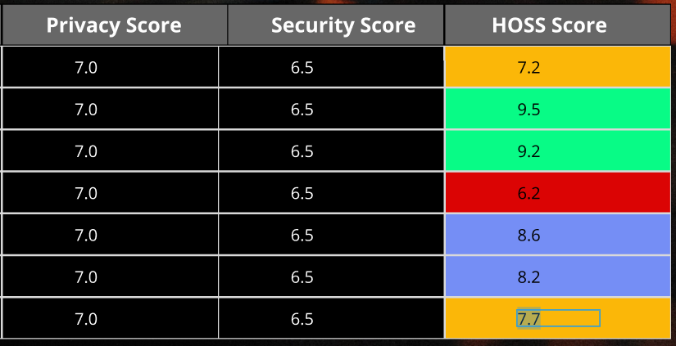
Scores (Security and Privacy)
Since IoT covers a broad spectrum of devices and device types, and each of those devices have different standards for security and privacy, an aggregate overall score of a device might not give the user the full picture of what security vulnerabilities may be present on their network. As a result of this, HOSS will provide two separate scores for device securities: Security and Privacy score, along with an aggregate score.

Slide 8
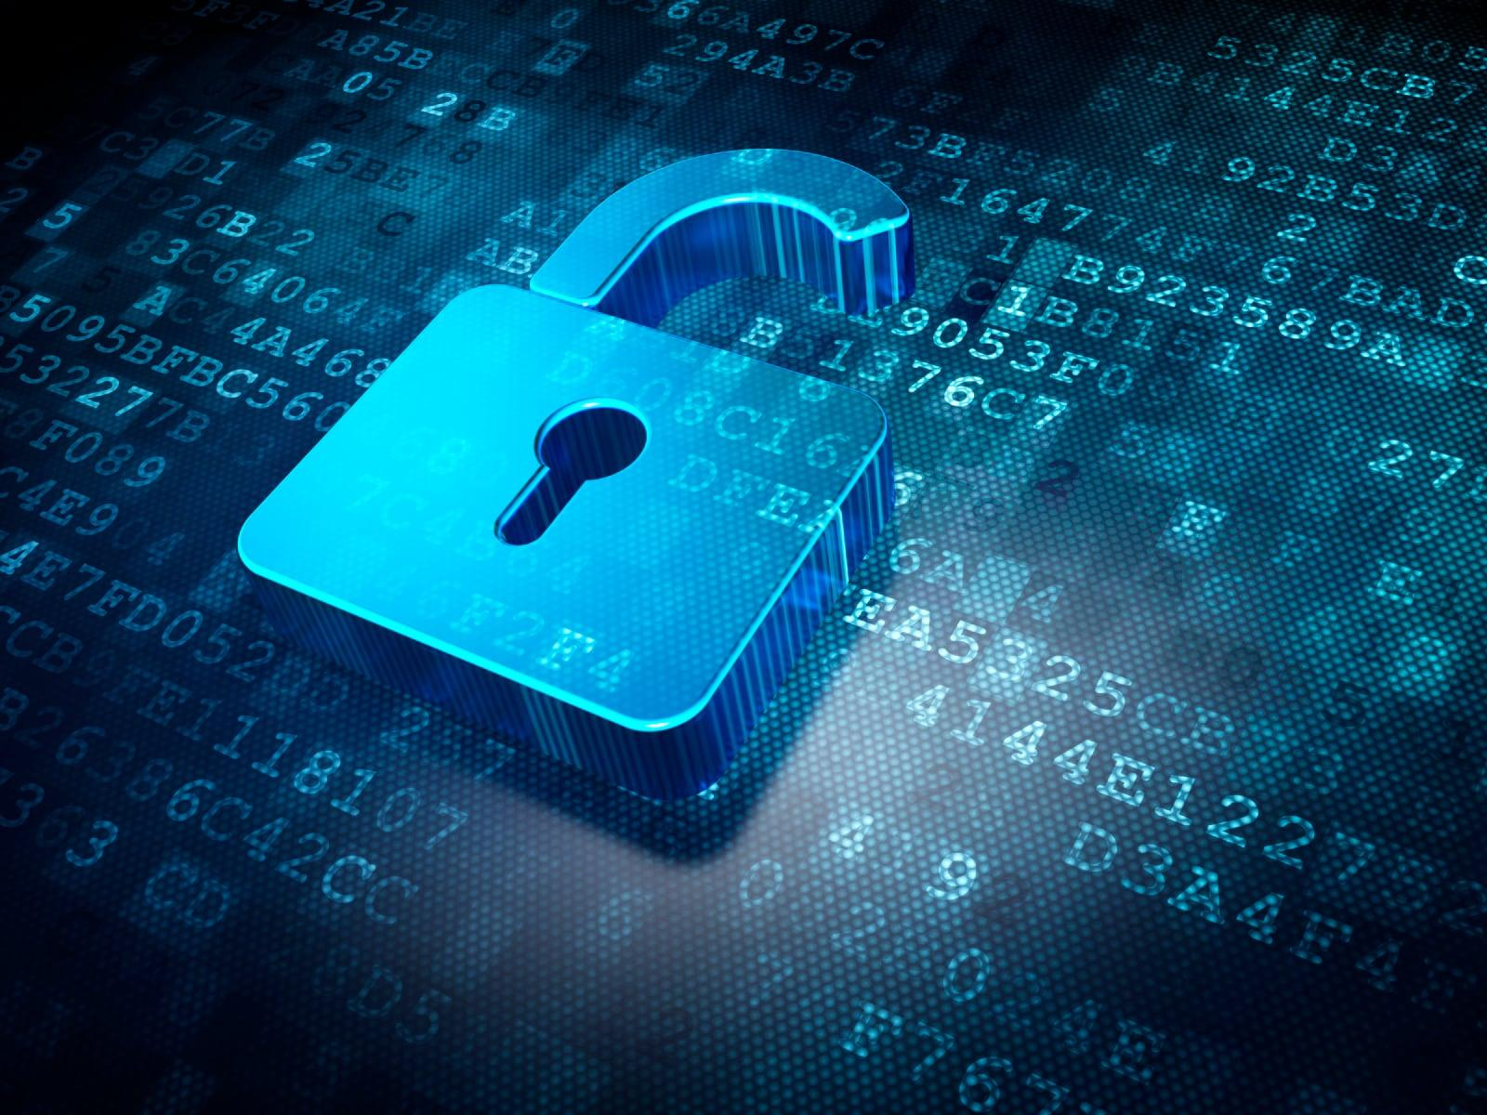
Security Score
Generating a security score
A security score is used to represent how secure the device is on a technical level, such as vulnerability to getting intercepted or otherwise manipulated on the network
The security score will be calculated by several factors, including but not limited to
What type of data encryption does the device use?
What method does the device use to connect to the network? ie bluetooth, wifi, etc
How does the device authenticate the user of the device?
Does the device automatically update?
What API(s) does the device use? Are the APIs themselves secure?
Does the device have a history of security vulnerabilities?
What Operating System does the device use?
Does the device maintain a connection to a separate web server?
Image source: https://www.nokia.com/networks/security-portfolio/

Slide 9
Privacy Score
While the security score will determine the technical level of security of a device, the privacy score will relate more to the protection of a users personal information of devices on the network.
Privacy score will be calculated by different factors, including but not limited to
Does the device record video?
Does the device record audio?
Does the device send analytics or other hardware/user information back to a web server?
How much data is being transmitted regularly by a device?
Does the device have screen sharing capabilities?
Does the device allow unauthenticated users access?
Does the device have a screen lock/passcode to access?
Image Source: https://www.bbc.com/worklife/article/20130625-your-private-data-is-showing

Slide 10
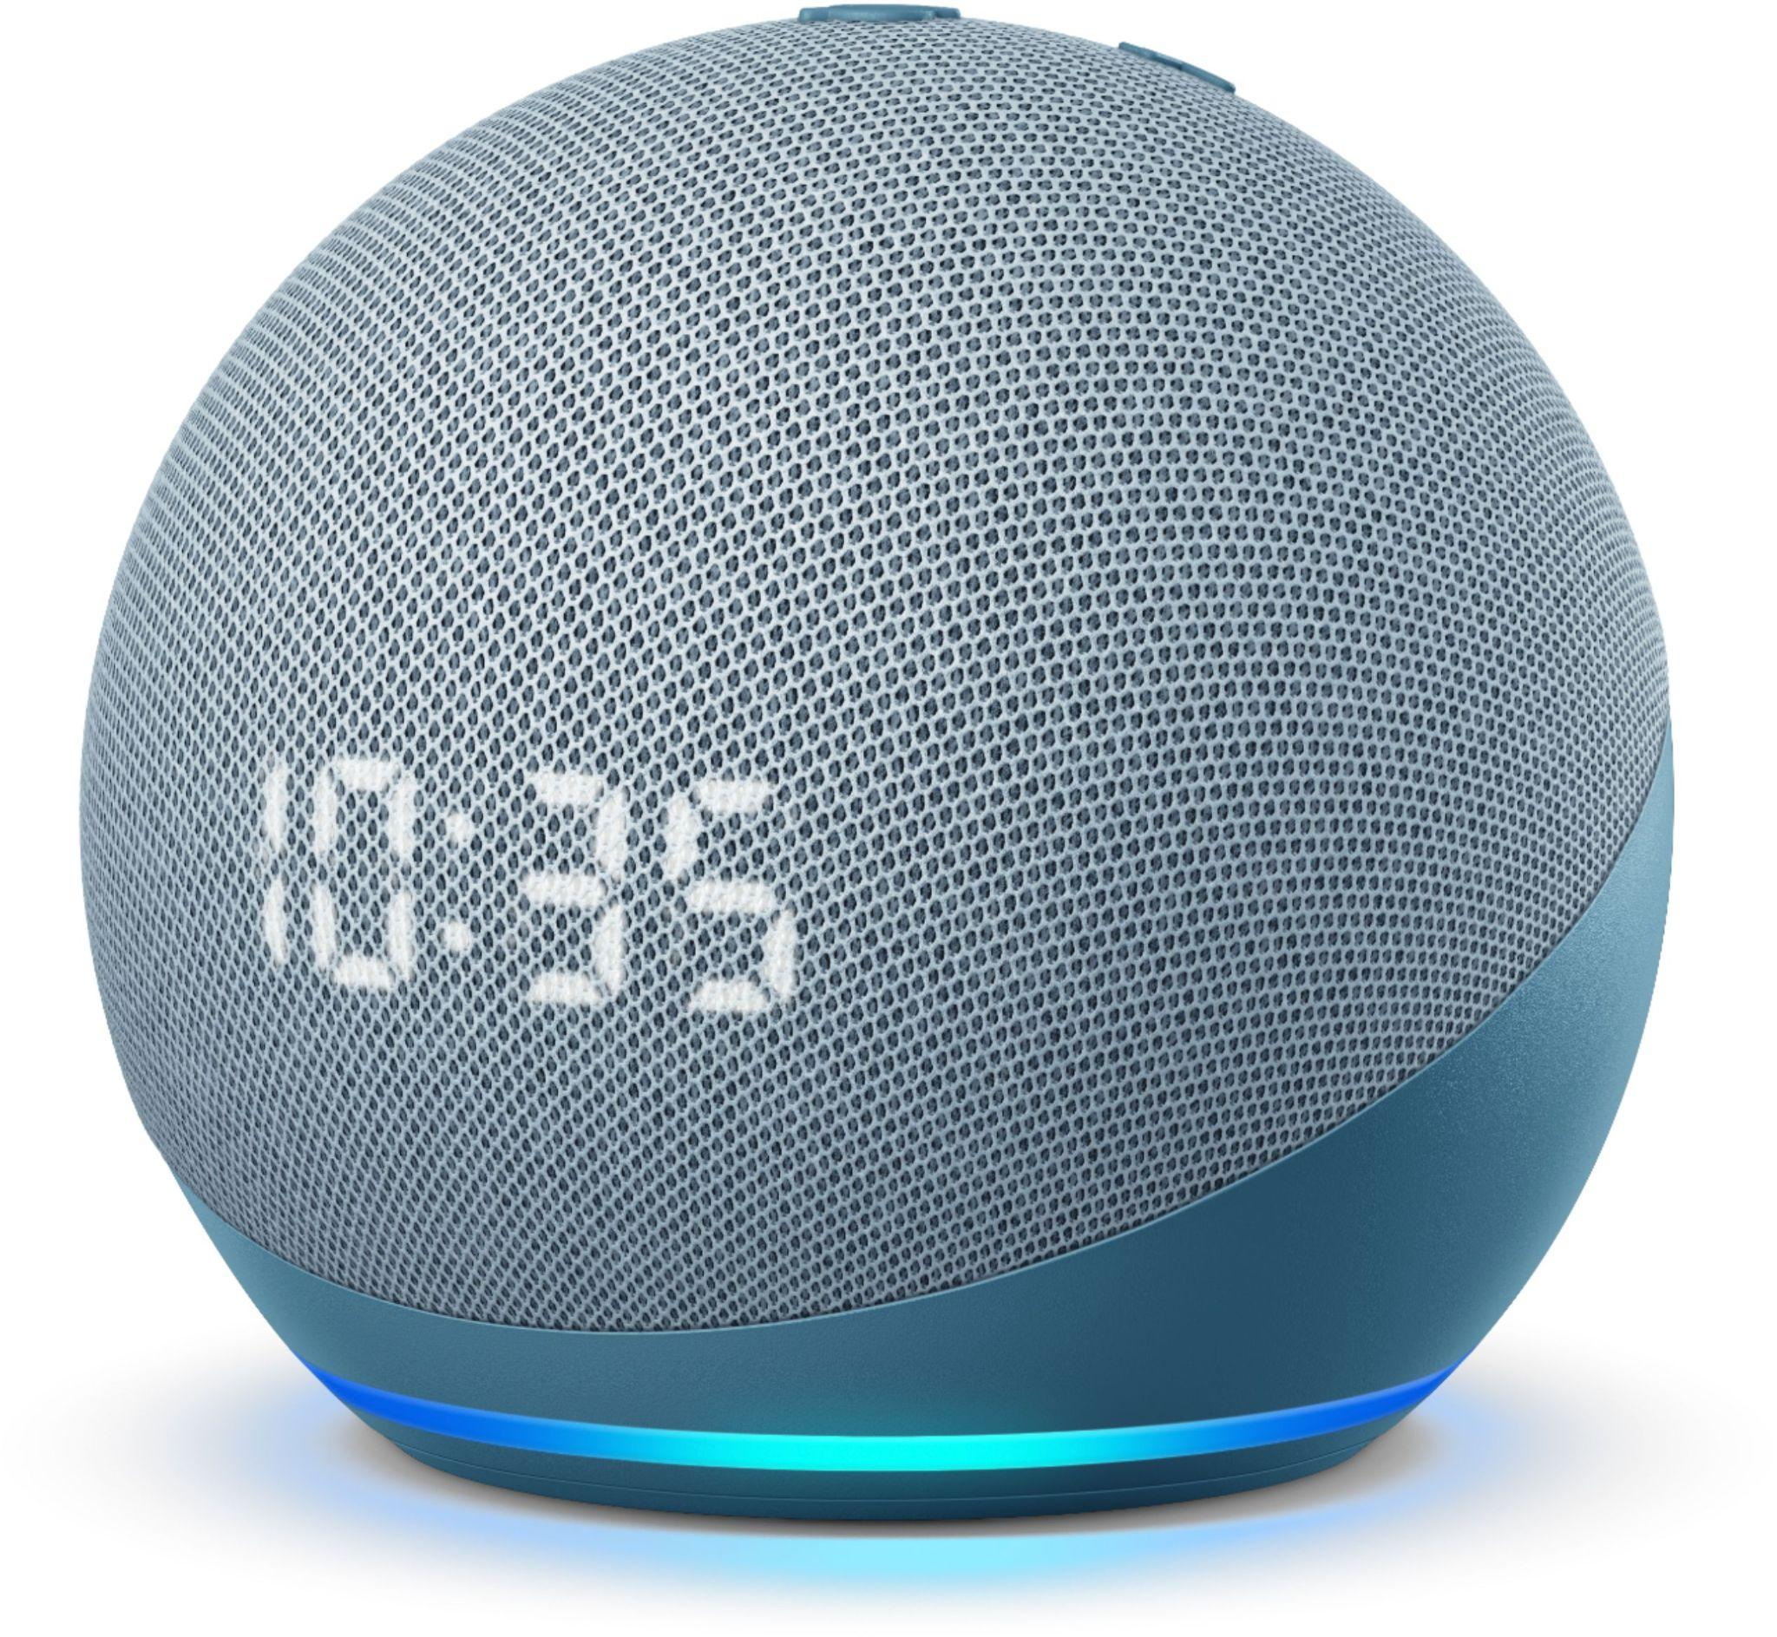
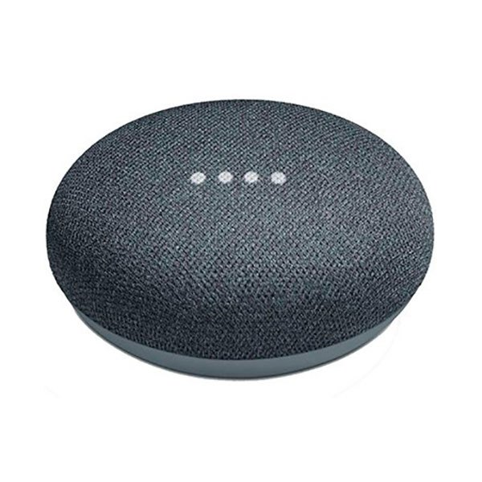
Examples of IoT Devices HOSS will evaluate
Amazon Alexa (Echo Dot, Echo Show)
Always listening for “Hey Alexa”
Amazon’s quality-control team reviews user recordings to ensure Alexa’s accuracy
Privacy - User data is encrypted between device, mobile app, and cloud
All customer-specific data is encrypted at rest and in transit
Uses customer master keys (CMK) provided by AWS Key Management Service (AWS KMS)
Google (Nest Mini, Home Mini)
Always listening for “Hey Google”
Records all interactions and stored on the cloud
Recordings can be shared with third-party apps and services
Has Transport Layer Security (TLS)
Encryption used WPA2/WPA3
Image Sources:
https://www.bestbuy.com/site/amazon-echo-dot-4th-gen-smart-speaker-with-clock-and-alexa-twilight-blue/6430063.p?skuId=6430063
https://www.tradeinn.com/techinn/en/google-home-mini-smart-speaker/137354402/p

Slide 11
IoT Devices (Cont’d)
Apple Siri (Watch/iPad/iPhone/Mac)
Always listening for “Hey Siri”
Siri collects a wide range of privacy and personal information
Apple Wallet
Calls/Messages
Fitness Data
Sleeping Data
Siri stores a user’s data for up to 2 years
End to end encryption when using iCloud
Tesla
Can collect data about the owner, the vehicle, energy product, or from third parties
Data is used to develop and define their self-driving assist
Has a 360-degree view that record activity from outside the car when parked, locked, and unattended
Image Sources:
https://1000logos.net/apple-logo/
https://pixels.com/featured/white-2017-tesla-model-x-luxury-suv-electric-car-isolated-oleksiy-maksymenko.html

Slide 12
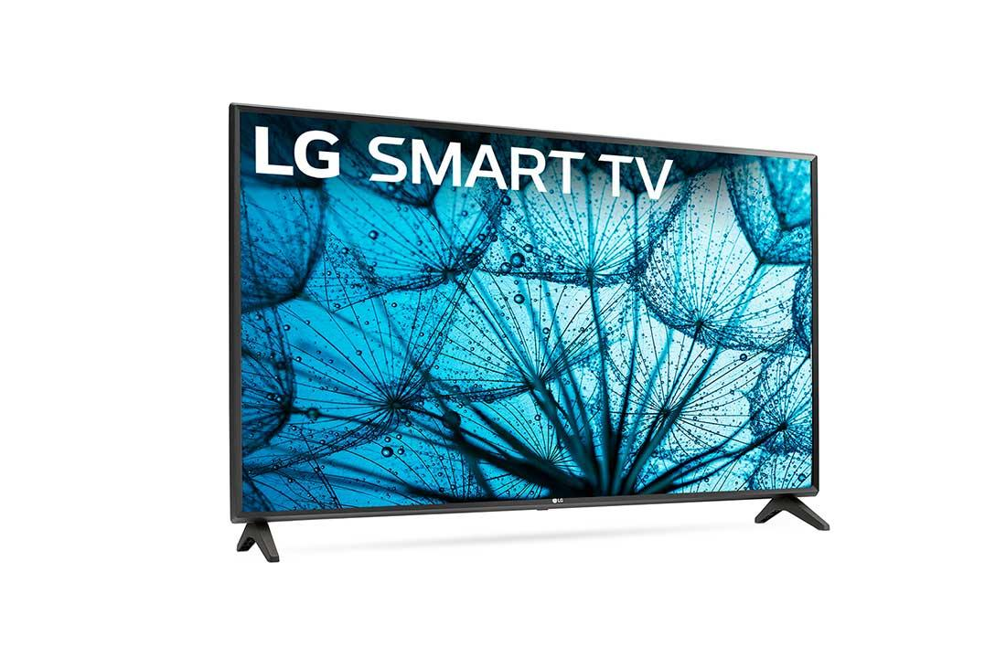
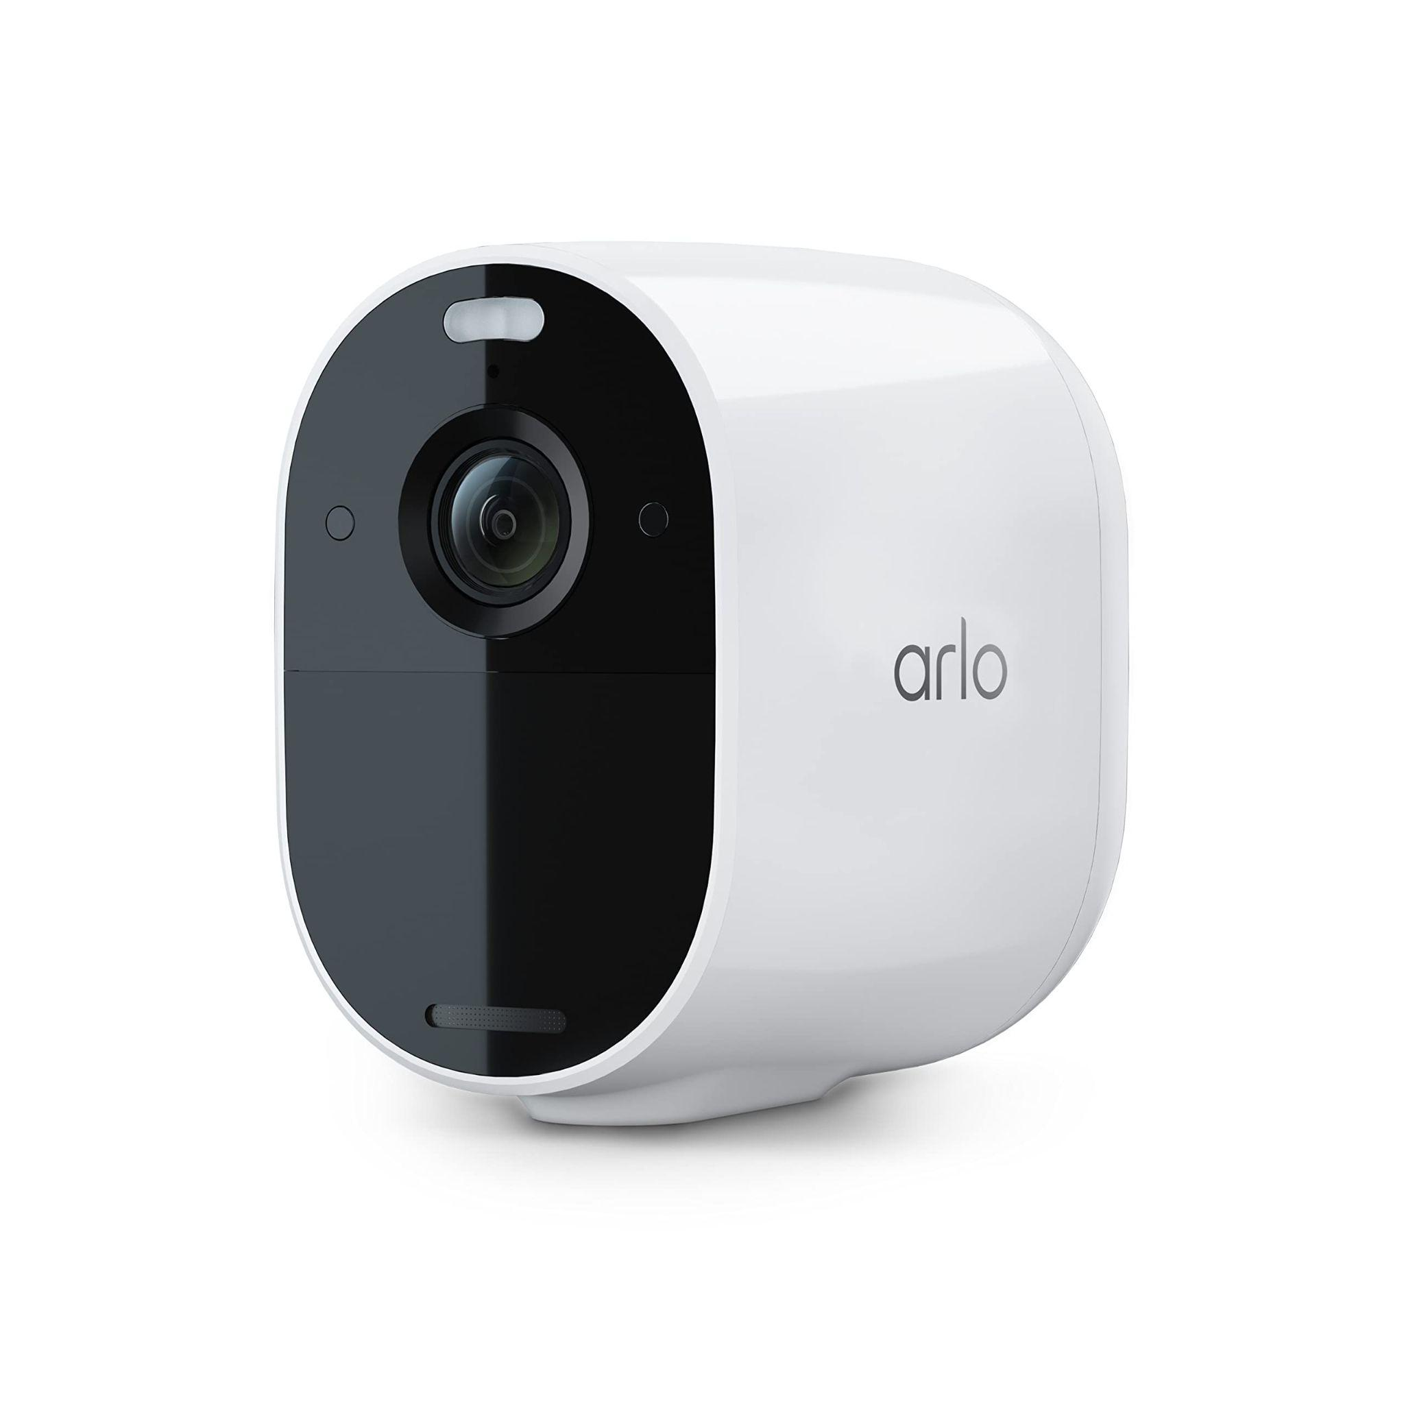
IoT Devices (Cont’d)
Smart TV (LG, Samsung, Sony, Vizio, Amazon Fire)
Sends data about user files and viewing habits to companies
May collect data about apps on tv
Provides data to third-party apps for advertisements
WPA/WPA2 Authentication
Arlo
Collect user data: name, email, and product usage data
Cameras can be hacked
Recordings are collected and stored in AWS
Use Advanced Encryption Standard (AES)
Game Consoles: Xbox, Playstation
Collect user data: name, email, address, phone number, username, password, and credit cards
Messages encrypted with Transport Layer Security (TLS)
Image Sources:
https://www.lg.com/us/tvs/lg-43LM5700PUA-led-tv
https://www.amazon.com/Arlo-Essential-Spotlight-Wire-Free-Activated/dp/B0875FRJPT

Slide 13
General Purpose of HOSS
To scan network to assess connected IoT devices. A scan will provide the following information:
Privacy, security and collective scores
Number of devices connected
Device name and version number
Image Source: https://pixabay.com/ , https://www.digitalnomadsoul.com/

Slide 14
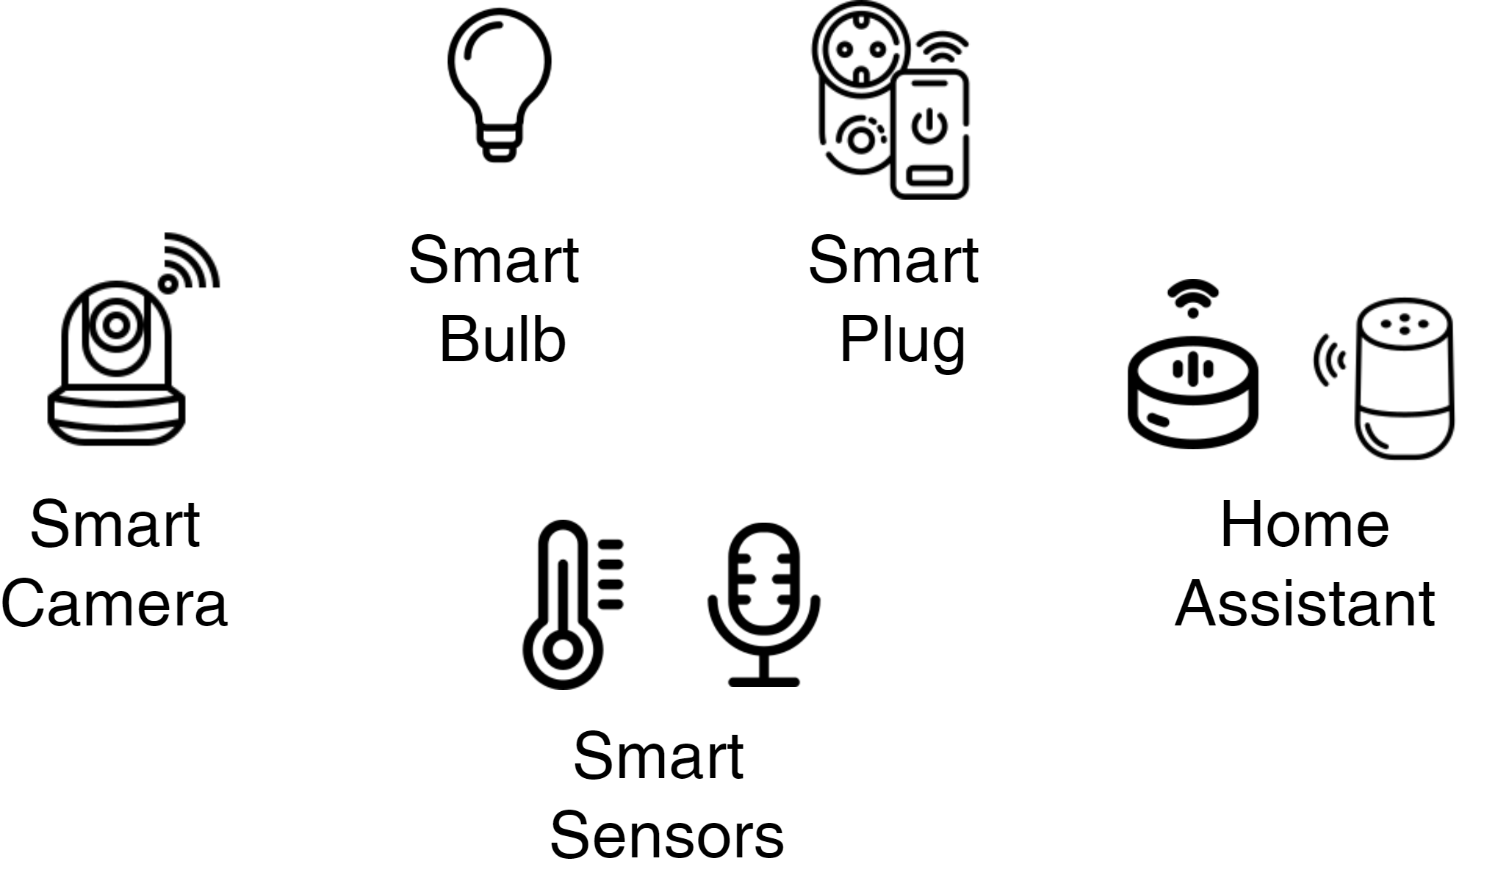
General Purpose of HOSS (Cont’d)
Additionally HOSS will provide privacy and security recommendations to the user and a glossary to inform and educate the user.
HOSS is here to make the user aware and act on detected vulnerabilities to make their network of IoT devices safer.
Image Source: Wikipedia.org

Slide 15
List of Modules
User Interface Module: Presents the user interface of HOSS
Main Module: The operating system of HOSS which handles the exchange and sharing of data between all other modules.
Scoring Module: Determines and aggregates the score of a device’s security and privacy, respectively.
Scanning: The module which utilizes NMAP scanning to scan the devices with the network manager’s proximity.
Source: Blogsnow.com

Slide 16
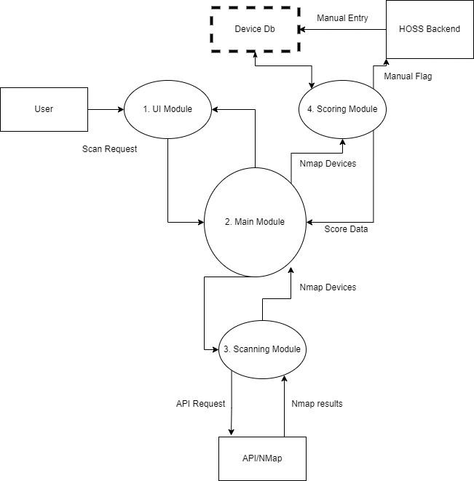

Slide 17
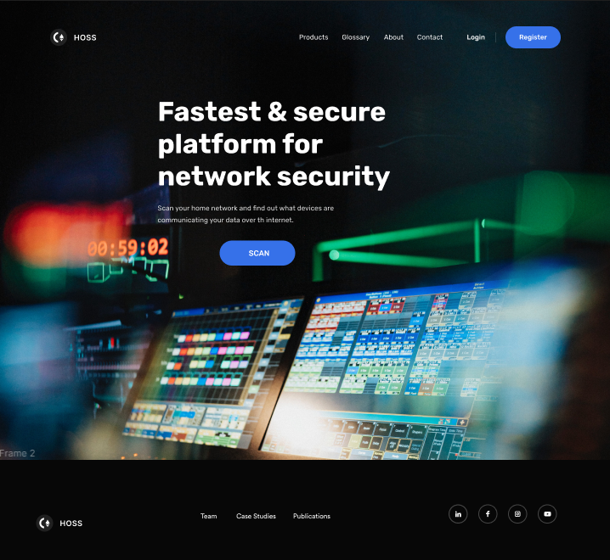
UI Mockup
SCAN button front and center
login/register
glossary for cybersecurity terminology
Notes:
Ricardo

Slide 18
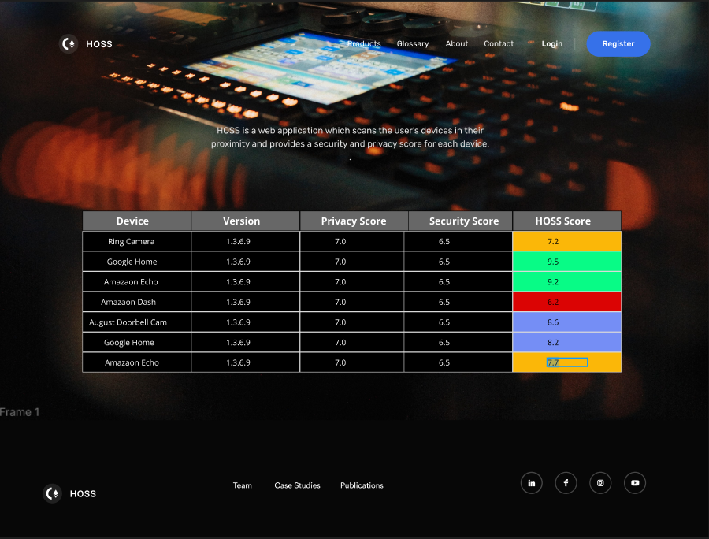
UI Mockup
Table with all devices connected to the user’s local network
Recommandations
Historical vulnerabilities about the device if any
Notes:
Diagram for user interface.

Slide 19
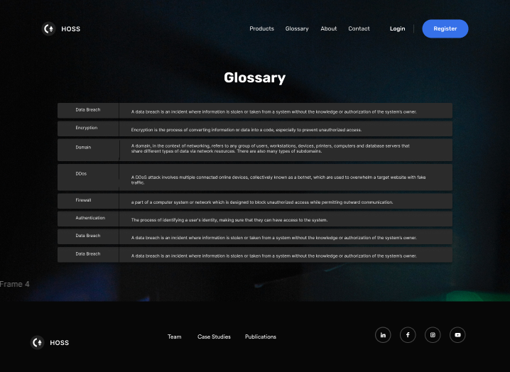
UI Mockup
glossary for cybersecurity terminology

Slide 20
NMAP
Network scanner
Discover hosts and services on a computer network
NMAP Python library
NMAP library allows us to create a network scanner
Create an API where a user makes a request and API returns list of devices
Command line flags: '-sn' and '-O'
'-sn' scans the network and returns list of devices
'-O' scans devices and returns operating system

Slide 22
API Response Example
"192.168.1.78": {
"hostnames": [
{
"name": "amazon-60a7abe10.attlocal.net",
"type": "PTR"
}
],
"addresses": {
"ipv4": "192.168.1.78",
"mac": "08:12:A5:92:CC:93"
},
"vendor": {
"08:12:A5:92:CC:93": "Amazon Technologies"
},
"status": {
"state": "up",
"reason": "arp-response"
}
}

Slide 23
Planned Software to Create HOSS
Image sources: https://en.wikipedia.org, https://commons.wikimedia.org, https://ubidreams.fr/, https://nmap.org/images/, https://www.mongodb.com,

Slide 24
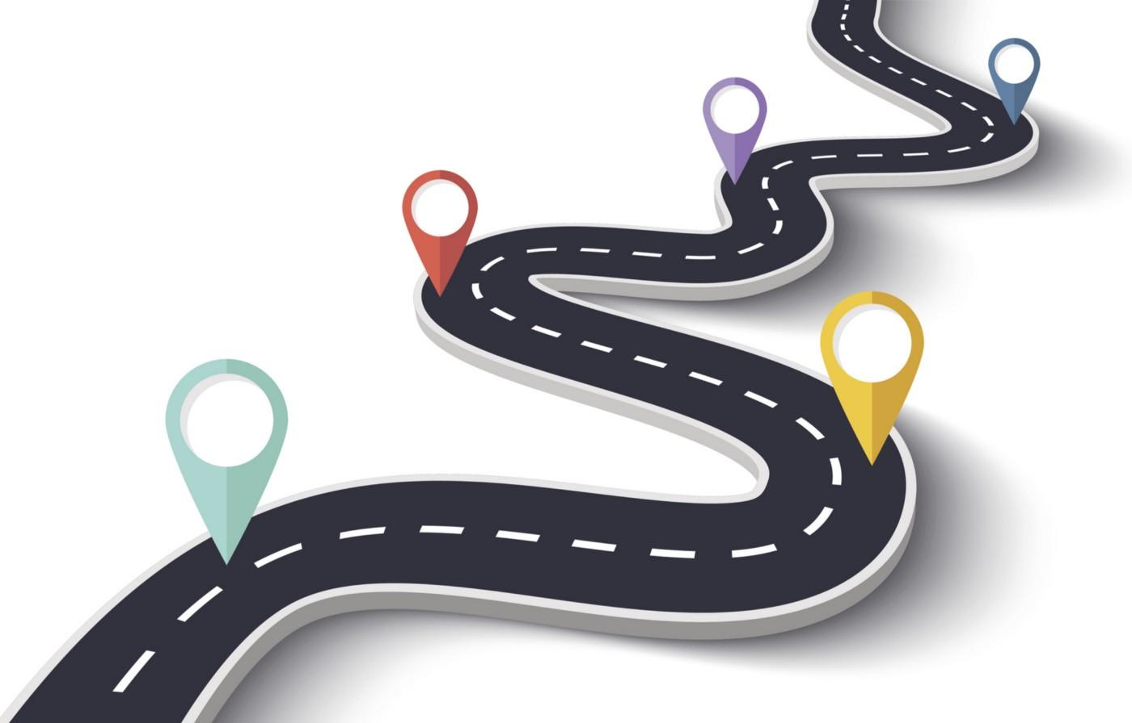
Future Plans
Create database for HOSS which includes all initial IoT devices as discussed earlier by end of Winter 2022.
Complete all coding/programming requirements for HOSS by Winter 2022.
Deploy HOSS on server by Spring 2023.
Image source: www.proandroiddev.com/our-engineering-roadmap

Slide 25
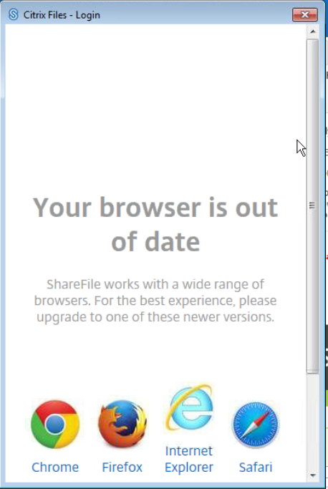
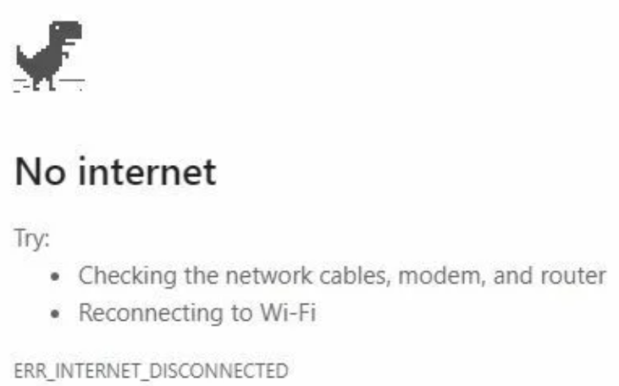
Requirements from our User
As our software is a web application, any modern browser will be compatible with the software, and thus, any hardware capable of running a browser and connecting to the internet will be compatible.
Any external hardware must have either Bluetooth or Wi-Fi connectivity to allow our NMAP API to detect it.
If a device does not have either of these connectivity capabilities, HOSS will not be able to detect it.
Image sources: www.support.citrix.com, www.google.com

Slide 26
Ethical Concerns
HOSS and its developers shall never disclose a device’s information to anyone besides the user requesting the scan.
We are not responsible for any damages or attacks resulting from a user’s action or inaction to address vulnerabilities. We do not address the vulnerability ourselves, we simply warn and advise the user to do so.
We shall, however, also advise users to consider warning device owners of identified vulnerabilities.
Image Source: www.josephhollander.com/legal-ethics-malpractice-reporter-vol-2-no-7/

Slide 27
Questions
Image source: www.freeiconspng.com/images/q-and-a-icon

