Slide 1
Sponsors
Cynthia Wang, Zachary Vernon
Current Developers
Cesar Ayala, Songtao Bu, Alejandro Ceballos, Bryan Chan, Erik Donovan-Blood, Kennard Lim, Jorge Mata, Kalvin Mateo, Misael Ortega, Jonathan Saldivar, Dustin Shin
Advisor
John Hurley
Notes:
Jorge -

Slide 2
Agenda
Jorge
What is The arqive?
Project Requirements
Project Challenges
Demonstration
Notes:
Jorge

Slide 3
What is The arqive?
Jorge
The arqive is a digital online storytelling map for LGBTQ+ stories that seeks to provide the full range of queer stories and then geolocates them and digitally preserves them.
Users have a safe platform where they can share personal, historical, and community stories, as well as have access to information about safe spaces.
“By sharing stories, we can give each other hope.”
-Cynthia Wang
Notes:
Jorge

Slide 4
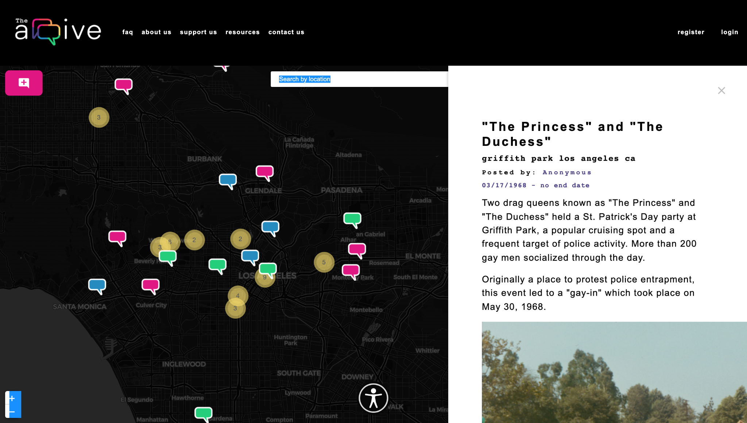
Overview of The arqive
Jorge
Users
Login
Add/Edit/Delete story
Bookmark/Unbookmark user
Flag posts
Manage profile
Anonymity
Admin
Login
Add/Edit/Delete story
Bookmark/Unbookmark user
Anonymity
Review/Remove flagged posts
Review/Remove flagged comments
Remove users
Notes:
Jorge

Slide 5
Project Goals
Kennard
Notes:
Kennard

Slide 6
Project Goals
Kennard
This year's project for The arqive will focus on expanding the website and mobile applications.
Upgrade the entire stack used by previous years
Gamification
Make a prototype AR/VR feature
Create an automated content moderation feature
Improve security of users
Miscellaneous Project Improvements
Notes:
Kennard
This year's project for The arqive will focus on expanding the website and mobile applications.
This includes:
Upgrading the stack to avoid security and compatibility issues
Introducing gamification and features that engage users
An AR prototype
Automated content Moderation
Improve the overall security of the app

Slide 7
Project Technologies
Kennard
Ubuntu 18.04 (Hosted on Digitalocean)
PostgreSQL
Django REST Framework
React
React Native/Expo
ReactJS
NodeJS
SciKit-learn
AR.js
Web APIs
OpenStreetMap
Notes:
Kennard
Our web application stack is comprised of:
An Ubuntu Server running on DigitalOcean
PostgresSQL for our database
Django REST for our API and web framework
React web and native for UI
NodeJS backend JS
SciKit-learn for Machine Learning
AR.js for AR/VR
And OpenStreetMap for our geolocation services

Slide 8
Proposed Technology Upgrade
Kennard
Software/Framework Current Version Proposed Version
Ubuntu 18.04 22.04 LTS
PostgreSQL 11.0 14.0
Django REST Framework 3.0.5 4.2 LTS
NodeJS 10.24.1 18.12.1
React Native/Expo 16.3.1 18.2.0
ReactJS 16.3 18.2
SciKit-learn 0.21.3 1.1.3
Product Support: End of Life <1 year >1 year N/A
Notes:
Kennard
This slide shows the current versions of software in our stack and our proposed versions
Once we upgrade.
As you can see from the legend, much of our stack is no longer
Supported for feature updates or security.
After updating the versions all critical software will have at least a year or more of support.

Slide 9
Node JS
Kalvin
NodeJS is a server-side scripting environment that allows JS running client-side to interact seamlessly with backend web applications.
The arqive relies on many deprecated and outdated packages
Updating Node and the packages will ensure the functionality of The arqive
Notes:
Kalvin
NodeJS handles the server-side logic
Talk about the changes of versions andt lts

Slide 10
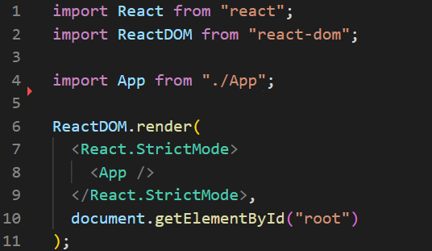
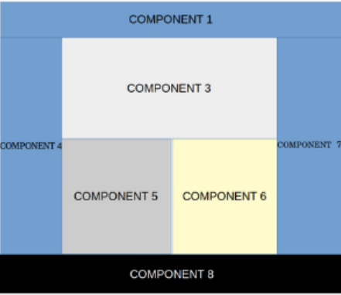
React JS
Kalvin
Declarative and dynamic framework for Javascript
Provides Graphic User Interface(GUI) for users of the app
Aides developers in building better user experiences
Must update code to reflect new versions
Notes:
Kalvin

Slide 11
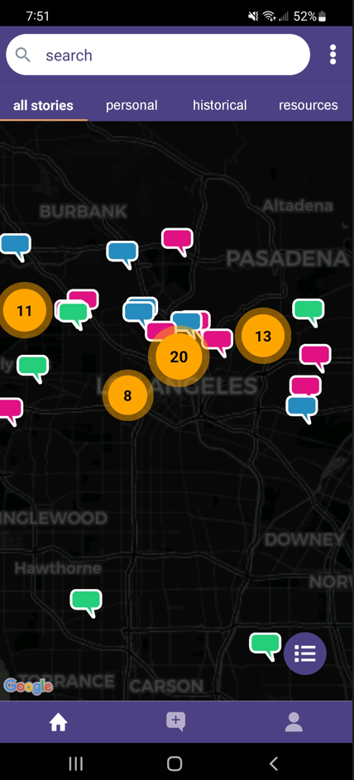
React Native
Kalvin
React Native is a framework for designing mobile apps
Used to provide GUI for mobile arqive user
Allows same backend logic used for React web app to be used for mobile app
Notes:
Kalvin

Slide 12
Django
Dustin
Python web framework for building secure and maintainable websites
Provides REST API for ReAct to access database
Integrates with other Python packages
Model-View-Controller design for organization
Notes:
Dustin
High-level web framework written PYTHON
This allows us to integrate Scikit-learn and other python packages into our web app
MVC design gives organization
Provides REST API for ReAct to access database

Slide 13
New Features
Dustin
👾 Gamification
🌏 OpenStreetMap Autocomplete
✏ Content Moderation
🕶 AR/VR
📲 Uploading Media
🔐 Security
Notes:
Bu

Slide 14
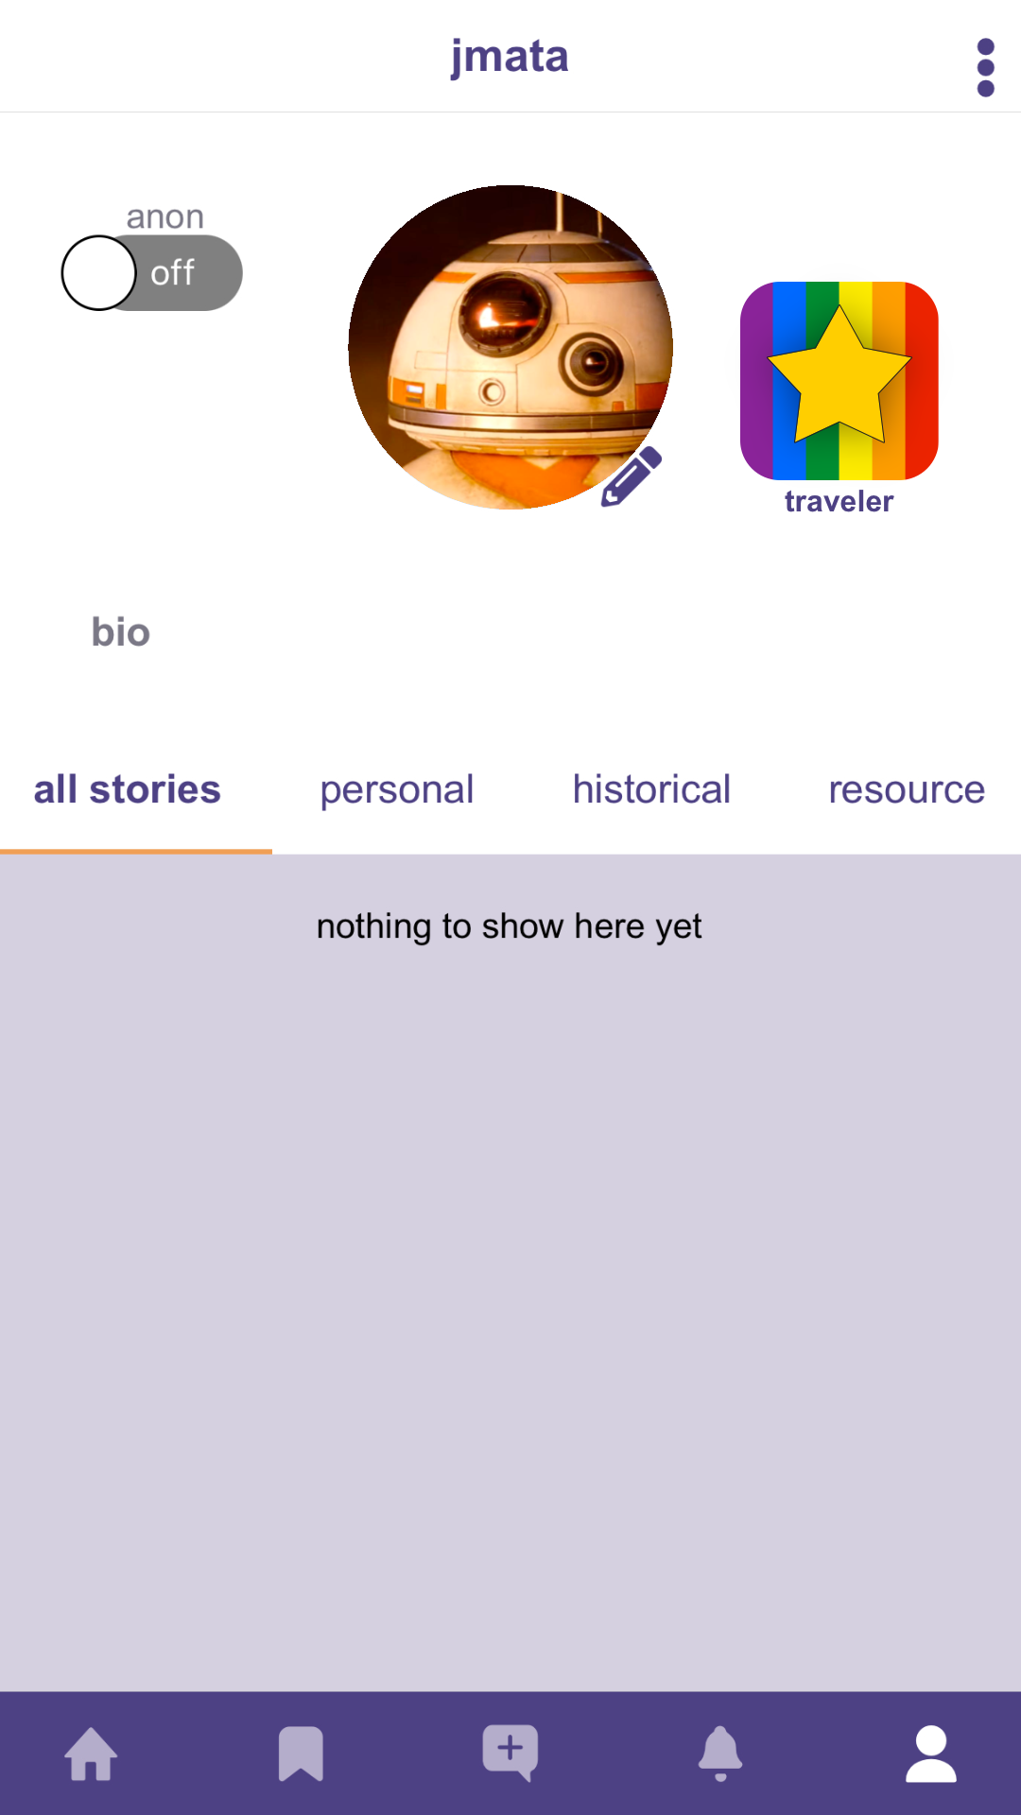
Gamification
Bu
Gamification Goal:
Make The arqive more engaging for users
Personalize profiles through badges
Help introduce a fun online environment
Notes:
Dustin
The sponsors of The arqive want users to be more engaged with the platform so we
Plan to implement badges for user’s profiles. Badges will denote achievements like
First person to post about a location. Hopefully this will make posting stories,
Resources and historical accounts a more captivating experience.

Slide 15
OpenStreetMap Autocomplete
Bu
Current State of Location Search Bar:
Presents one location at a time
Suggests locations far from the user
Not yet implemented in mobile application
Notes:
Bu

Slide 16
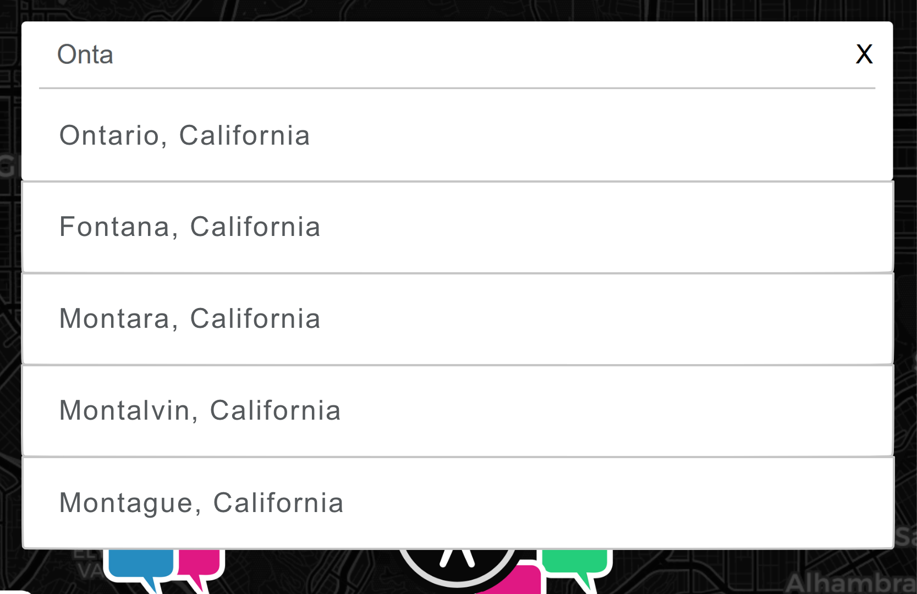
OpenStreetMap Autocomplete
Bu
Location Search Bar Goal:
Present up to 5 locations at a time
Suggests locations based on the user’s current location
Add location autocomplete functionality to mobile app
Notes:
Bu

Slide 17
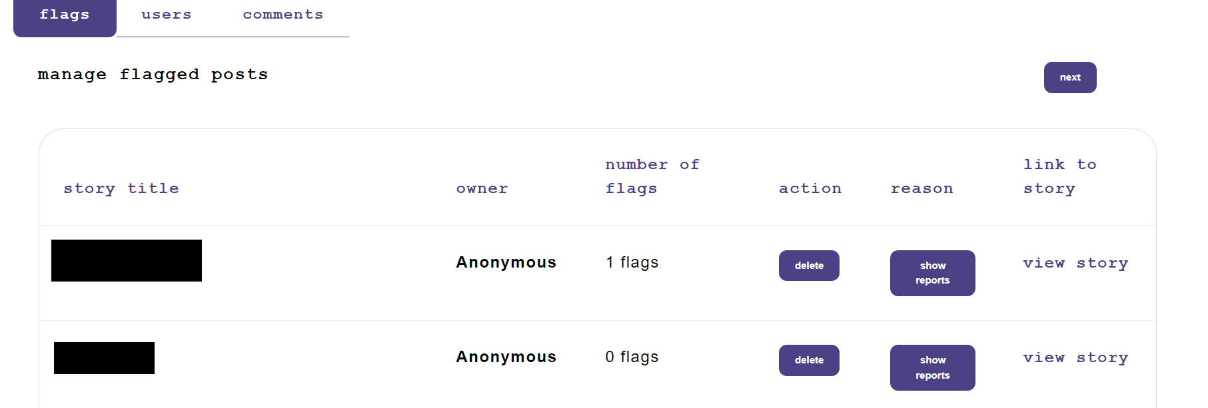
Content Moderation
Bryan
Users can flag posts by making a report.
Admins then check posts that have been flagged.
Admins review the report to decide whether post should be deleted.
Limited to human intervention
Comment moderation within posts also work similarly.
Notes:
Bryan

Slide 18
Requirements for Content Moderation
Bryan
Run moderation algorithms synchronously with both the frontend and backend
Flag stories and comments that contains:
spam
vulgar or offensive language
NSFW or explicit content
Quarantine stories and comments after a certain number of user flags have been detected until human moderator’s approval
Notes:
Bryan

Slide 19
Content Moderation
Cesar
What language is actually offensive, abusive, or considered hate speech by definition?
“Anything goes” platform vs reducing liability
Some phrases contain offensive words but are not offensive or hate speech.
They may be describing what happened to them, and that is okay!
Solution:
A “Netiquette Community Guidelines” and a combination of Machine Learning and Human intervention

Slide 20
Content Moderation
Cesar
SciKit-learn is a Python library for Machine Learning and Data Science.
Experimented with different machine learning algorithms
Naive Bayes classifier
Linear Support Vector Machine
Neural Networks
Naive Bayes classifier is possibly the most accurate
Run reclassification of the model periodically to improve model’s effectiveness
Notes:
Cesar

Slide 21
Augmented Reality(AR)/Virtual Reality(VR)
Jonathan
Create an AR experience where users can add 3D text messages to the real world
🌐 3D messages will be displayed at pin locations through mobile device camera
🌐 Pins will be geographically accurate
🌐 Depending on location historical venues will be displayed

Slide 22
Augmented Reality(AR)/Virtual Reality(VR)
Jonathan
AR.js is an open-source JavaScript library for implementing AR on mobile devices.
Features:
🖼 Image tracking
🗺 Location Based AR
📍 Marker Tracking
Works on any device with webRTC and webGL
Completely opened sourced
Notes:
Jonathan

Slide 23
Media Upload
Misael
Allow user to upload images to better share their stories.
Build in a way that is scalable, as the user base grows likewise the Arqive image base will grow.
From development perspective make image API as easy to use for quick development on the service.
Notes:
Misael

Slide 24
Security
Misael
Access to the database requires either
A specific ip address
Specific credentials (tokens)
Researched onion-only addresses to help user with privacy
Allow user to fully anonymize their data.
Notes:
Misael

Slide 25
Project Challenges
Alex
Notes:
Alex

Slide 26
Challenges Encountered So Far
Alex
Development:
Learning and implementing new frameworks and technologies
Issues with local development environments
Working with legacy code and documentation
Fixing bugs present from previous teams
Organization:
Redistributing workload through Jira, Discord, & Google Sheets
Database:
Accessing database without compromising security
Safeguarding the databasing from any possible mishap
Notes:
Alex

Slide 27
Miscellaneous Improvements
Alex
Implemented Docker for development
Migrated project tracking to JIRA
Created various tutorials for onboarding
The arQive Docker Documentation
Github playground
Created and automated a backup of the database to a different cloud
Made a development server for testing builds
Notes:
Jonathan

Slide 28
Development Environment
Erik
The application stack for The arqive is complex and requires a specific working environment.
Local Development: Create stack on local computer
Remote Development: Copy production server
Virtual Machines: Virtualize production server locally
Containerize: Create individual services for each component of the stack
Notes:
Erik
Greetings my name is Erik Blood, I'm part of the backend team and I've been tasked with Build/Deploy and AR/VR.
My colleague Jonathan will tell you more about the AR/VR.
The first order of business with Build/Deploy was creating a development environment for our team.
** The stack is a complex set of interdependent systems that require specific configuration and versioning **
The stack we are talking about here is the web stack or web application stack.
The set of software used to serve our site, store and manipulate data, display data to the user, handle input from users… you get the idea.
Due to this we need a development approach that accounts for how these systems interact with each other
While allowing us to switch in new versions of software.
Here are the options we had to choose from:
Local Development: Create stack on local computer
Remote Development: Copy production server
Virtual Machines: Virtualize production server locally (using something like VMware or Virtual Box)
Containerize: Create individual services for each component of the stack (Docker / Kubernetes)

Slide 29
Development Environment
Erik
Local Development:
Software conflicts, OS Issues, Knowledge overhead
Individual configuration and Troubleshooting
Remote Development:
One user at a time, One stack configuration at a time
Virtual Machine problems:
Individual configuration, Confusing network setup
Slow, Heavy on resources
Notes:
Erik
Local development is great if you’re writing in one language or a small aspect of a project and you can be
Sure your changes are affected by other changes and vice versa.
However this comes with issues:
Stack software conflicts
OS Issues: Mac, Windows, Linux
Required knowledge of how the stack interacts
Individual configuration and Troubleshooting
Remote development was another option, great if you have the money for an individual server for development
Or if you are not making changes to the software and frameworks that other services depend on.
However, this process came with its own problems:
One user at a time
Costly
One stack configuration at a time

Slide 30
Development Environment
Erik
🗒Provisioning is file defined:
Versioning, credentials, environmental variables, you name it
🏗Consistent builds:
No more build/configure instructions
👌Low entry requirements:
Hypervisor support, Docker and a Bash shell
🏃High Performance:
Initialization in seconds
💻Interface and IDE Integration:
VScode plugins, edit code on the fly
Notes:
Erik
Luckily with the help of a friend I was introduced to Docker and it was
The perfect solutions (Goldilocks joke here)
** Docker is platform as a service that uses OS-level virtualization to deliver software in packages called containers **
What does this mean? Docker uses a to that describe an environment, called a container, and many of these
Containers can be created and ran synchronously as a application.

Slide 31
Demonstration

Slide 32
