Slide 1
Capstone Senior Design
~ JPL VR Trek ~
Prepared By:
Lucca Andrade, Fabio Carrasco, Enrique Guardado, Ruben Heredia, Ari Jasko, Bryan Lopez, Ly Jacky Nhiayi, Ayush Singh, Rizwan Vazifdar, Justin Vuong

Slide 2
Agenda
Introduction
Summary of Previous Work
Project Overview
Project Management
Challenges
Future Plans
Presented By: Fabio Carrasco

Slide 3
Introduction
Presenter: Fabio Carrasco

Slide 4
Our Sponsors/ Advisors
Sponsor: Jet Propulsion Laboratory (JPL)
Liaisons: Eddie Arevalo, Richard Kim
Advisor: Dr. David Krum
Presented By: Fabio Carrasco

Slide 5
Students + Roles
Facilitators
Lucca Andrade
Fabio Carrasco
Communicators
Ayush Singh
Ruben Heredia
Notetakers
Ly Jacky Nhiayi
Bryan Lopez
Schedulers
Ari Jasko
Enrique Guardado
Compilers
Rizwan Vazifdar
Justin Vuong
Presented By: Fabio Carrasco

Slide 6
Summary of Previous Work
Presenter: Ayush Singh
Presented By: Ayush Singh

Slide 7
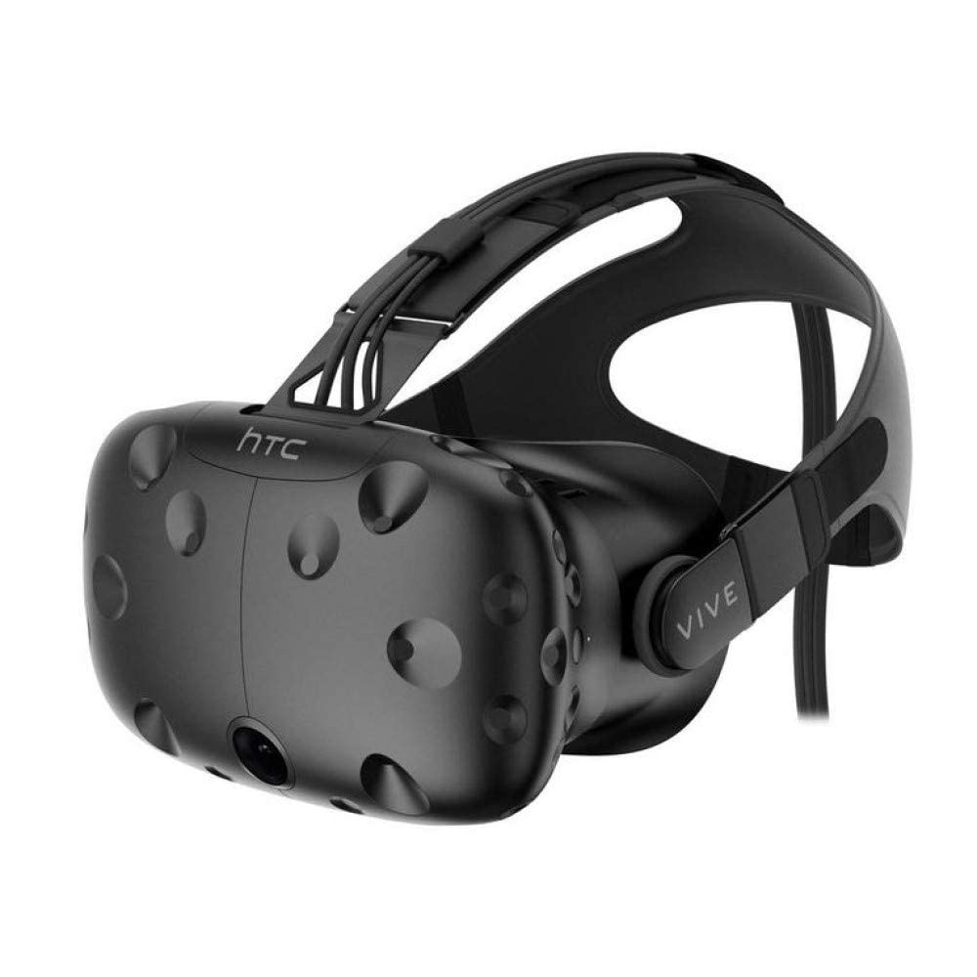
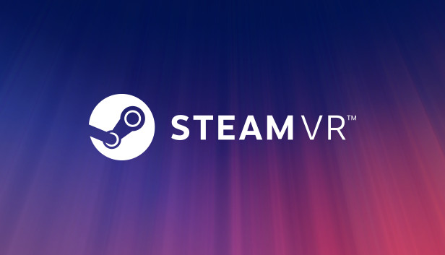
Summary of Previous Work
Initial Software Developer
Alvin Quach
https://github.com/alvinquach/jpl-trek-vr
Functions:
View the terrain of the Moon / Mars in a virtual reality space.
Supported Hardware
HTC Vive VR Headset
Supported Software
SteamVR
Windows Operating System
Presented By: Ayush Singh

Slide 8
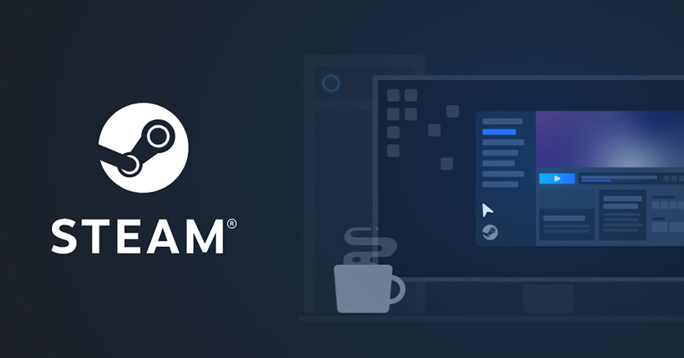
PC Requirements
Requirements
Operating System
Windows 7, 8.1, 10
Processor
Intel i5-4590 / AMD FX 8350 or Greater
Memory
4 GB RAM
Graphics
NVIDIA GeForce GTX 970 / AMD Radeon R9 290 or Greater
Reference
https://store.steampowered.com/app/323910/SteamVR_Performance_Test/
Presented By: Ayush Singh

Slide 9
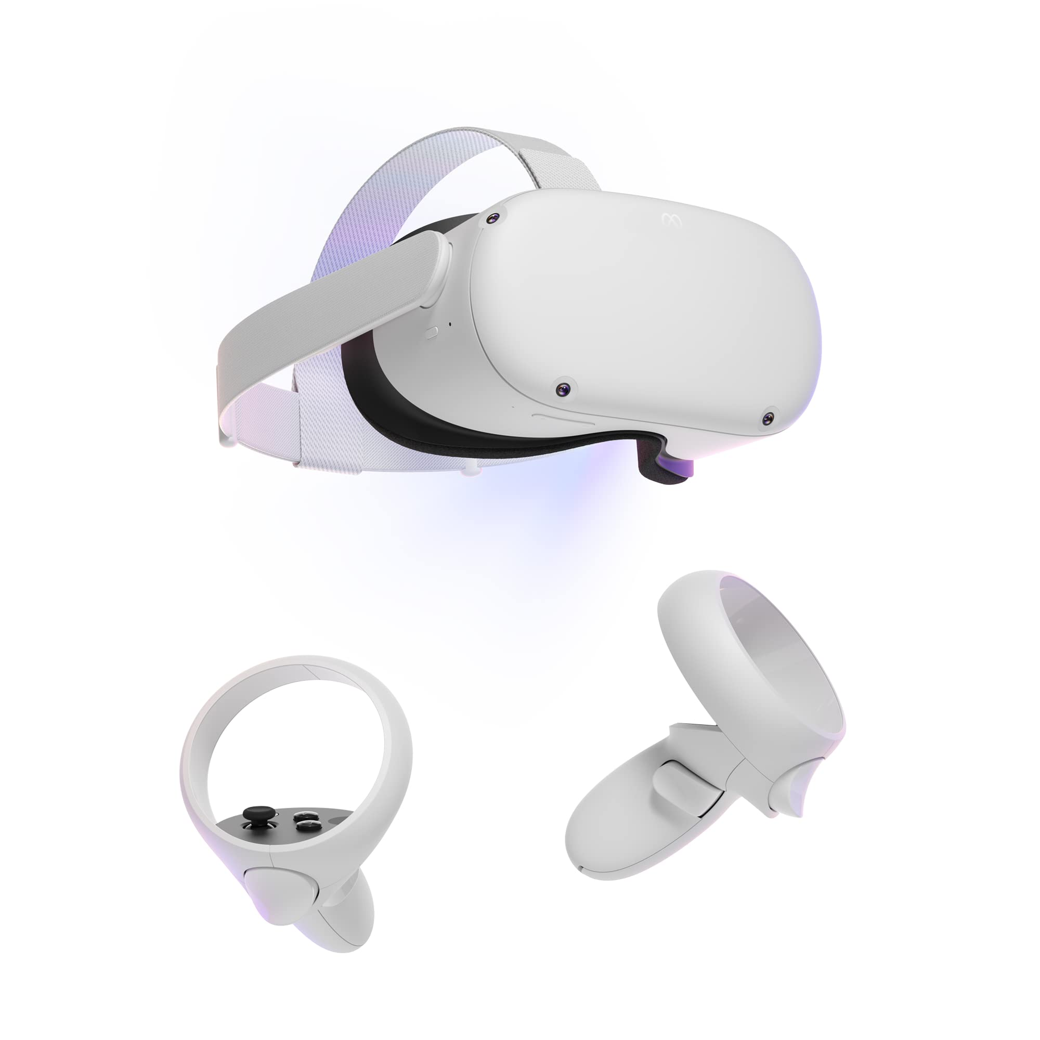
Upcoming Changes
Objective:
Run VR Trek on various VR Headsets.
OpenXR
C#
Unity Game Engine
Supported Hardware
Meta Quest 2
HTC Vive VR Headset
Supported Software
SteamVR
Windows Operating System
Presented By: Ayush Singh

Slide 10
Project Overview
Presenters: Rizwan Vazifdar, Bryan Lopez,
Lucca Andrade

Slide 11
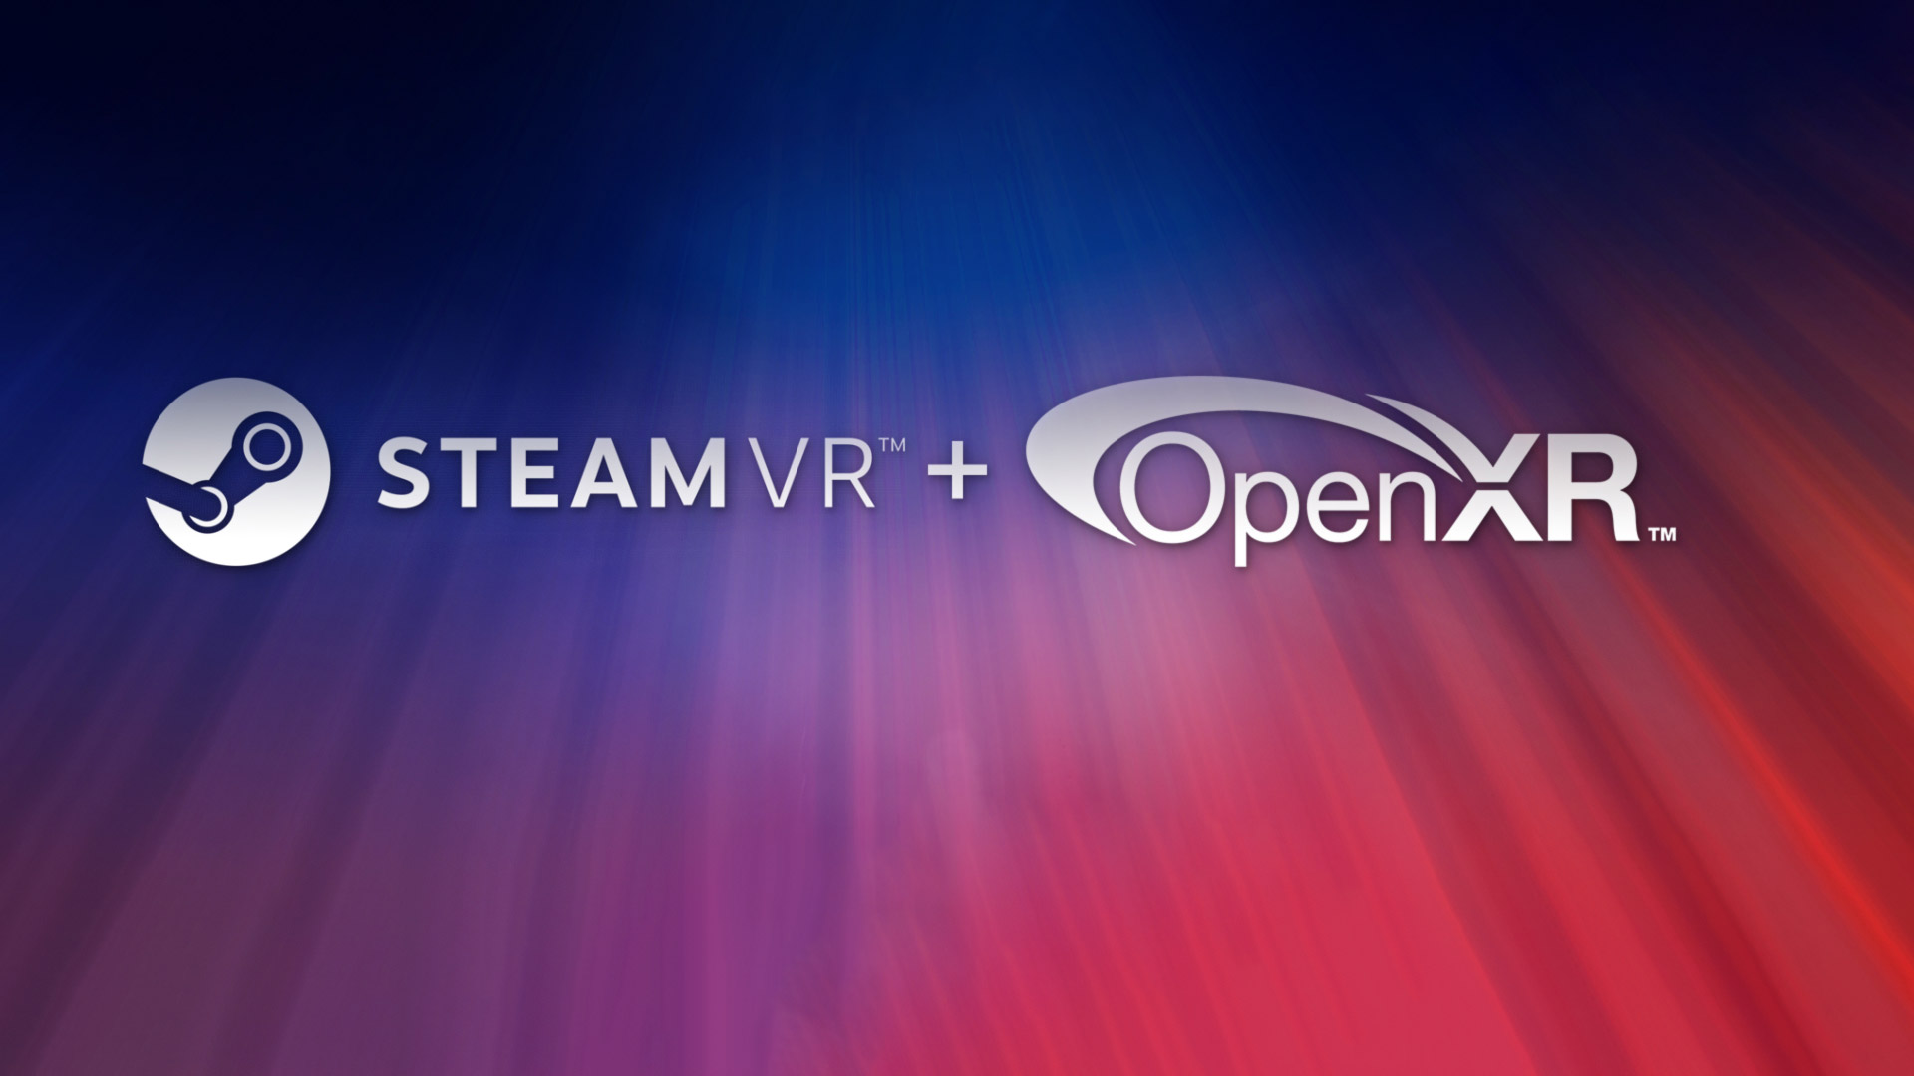
Our Main Objective
Create an application that visualizes the TrekVR database in virtual reality.
Update JPL Trek VR Room to open-standard.
OpenXR
SteamVR
Retrieve scientific data from TrekVR Database.
Presented By: Rizwan Vazifdar

Slide 12
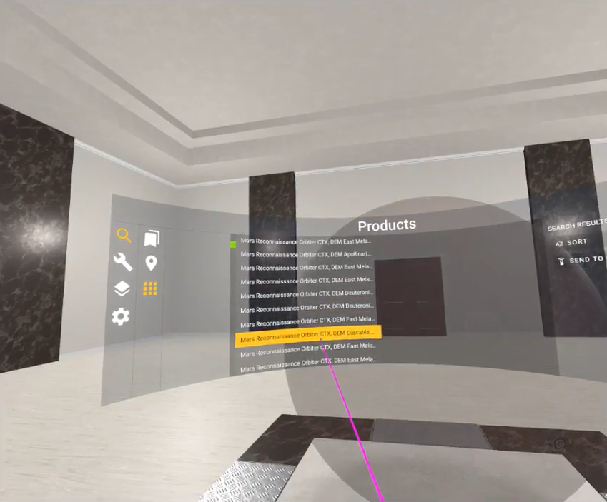
Utilities of JPL Trek VR
Room
Trek is meant to be used by the general public, with a focus on scientific and educational purposes
Interactive and easy to understand User Interface
Make notes and drawings on the application to be saved as custom annotations
Customizable display of the selected Moon or Mars terrain on a flat plane for ease of examination
Intuitive VR controls to select and manipulate data
Presented By: Rizwan Vazifdar

Slide 13
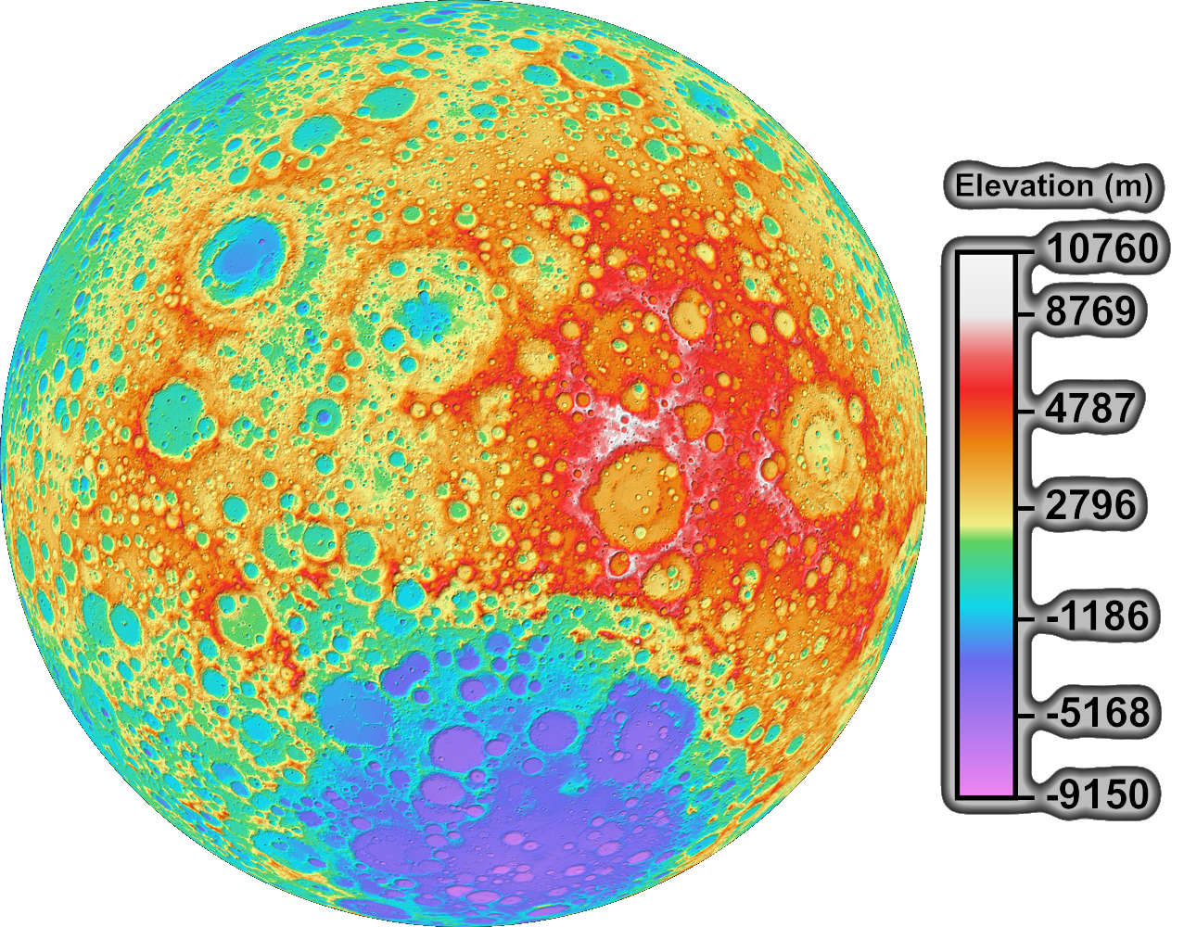
Utilities of JPL Trek VR
Room
Select and isolate specific data sets and sections of the available information
Display selected graphs, data and high definition images of the Moon and Mars
Calculate distance, area or elevation of terrain of the selected data set
Exaggerate elevation for easier interpretations and visualization of realistic terrain
Attribute a color map according to the desired parameters (heat, height, etc)
Presented By: Rizwan Vazifdar

Slide 14
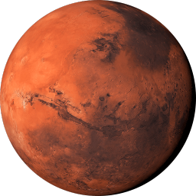
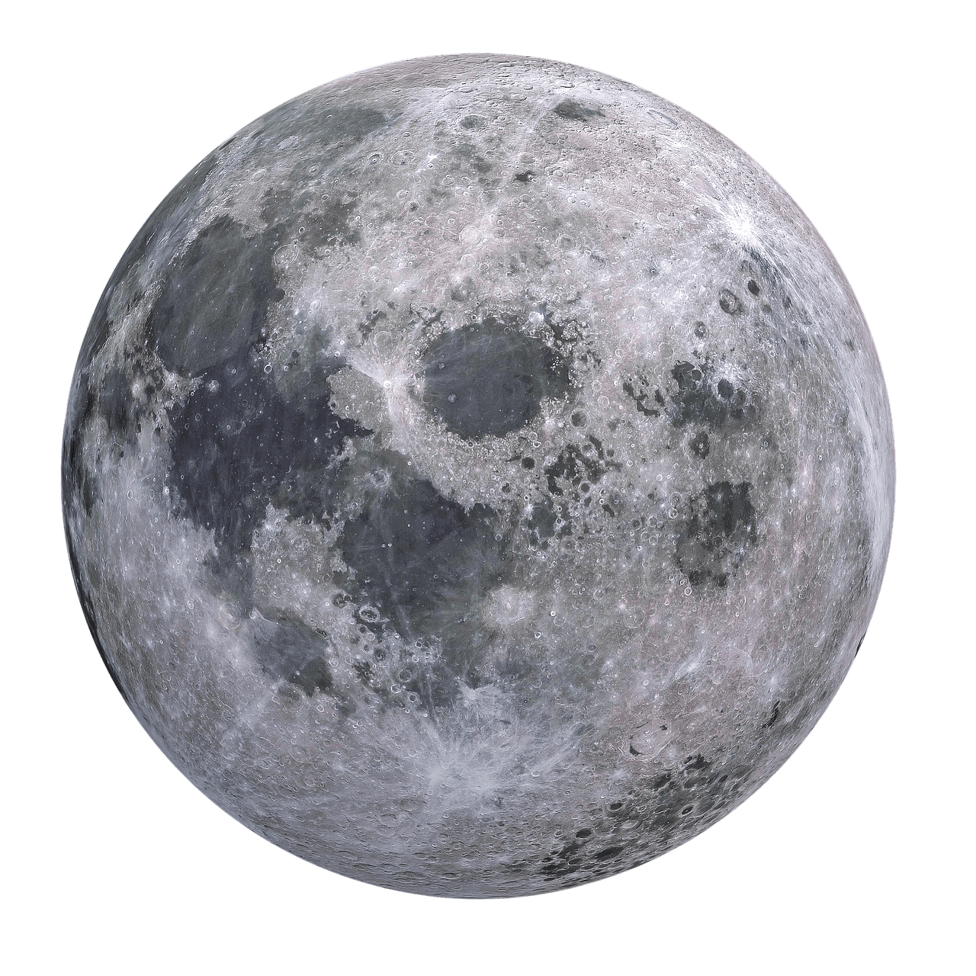
Project Goals
Deliver a software that allows users to fully visualize different planets/satellites in NASA's database.
Provide interactive navigation tools that may be employed to conduct research.
Develop an application that can be used with multiple VR headsets.
Deploy an application that may be utilized not only by scientists, but also by the general audience.
Presented By: Bryan Lopez

Slide 15
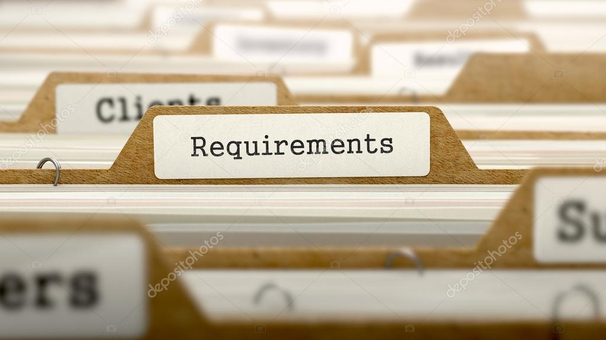
Requirements
Functional
User must be able to navigate through the planet/satellite 3D model.
Users must be able to create interactive navigation markers on 2D/3D surface using the application.
User must be able to save the current state.
Non-Functional
Performance
High-end computer hardware
Safety
Awareness of surroundings
Motion dizziness
Security
Data encryption
Software Quality Attributes
Accessible, stable, and testable
Business Rules
Available to any user
Presented By: Bryan Lopez

Slide 16
Deadlines
Software Requirements Document
Software Design Document
Final Product Ready
Presentation
Jan 23
2023
Apr 21
2023
Dec 12
2022
May
2023
First Day of Spring 2023
Implementation Phase
End of Implementation Phase
Debugging and Finalizing
Presented By: Lucca Andrade

Slide 17
Deadlines - Implementation Period
Basic Functionalities of a VR
Interactive Room Finished
Beta Product Ready
End of Implementation Phase
Jan 23
2023
Mar 24
2023
Feb 24
2023
Apr 21
2023
Implementation Phase Starts
Task Assignment Finished
Full JPL Database Accessibility
Integration and Manipulation of Data Through VR Controls Finished
Presented By: Lucca Andrade

Slide 18
Project Management
Presenter: Justin Vuong, Ly Jacky Nhiayi

Slide 19
Communication
Discord
Weekly virtual stand-up
General chat for open-forum like communication
Dedicated channels for important dates, files, and prior meeting recordings
Weekly In-Person
Meet on campus to discuss and demo
Everyone will be able to test limited physical hardware needed
Presented By: Ly Jacky Nhiayi, Justin Vuong

Slide 20
Communication
Weekly Meeting via Zoom
Advisor and liaison present
Discuss any questions the group has with advisor/liaison
Progression check
Note/taker
A notetaker will be present in every meeting
Notes follow Minutes template
Meeting Minutes
Note document that includes:
Agenda topics
Potential discussions
Actions & Deadlines
Presented By: Justin Vuong

Slide 21
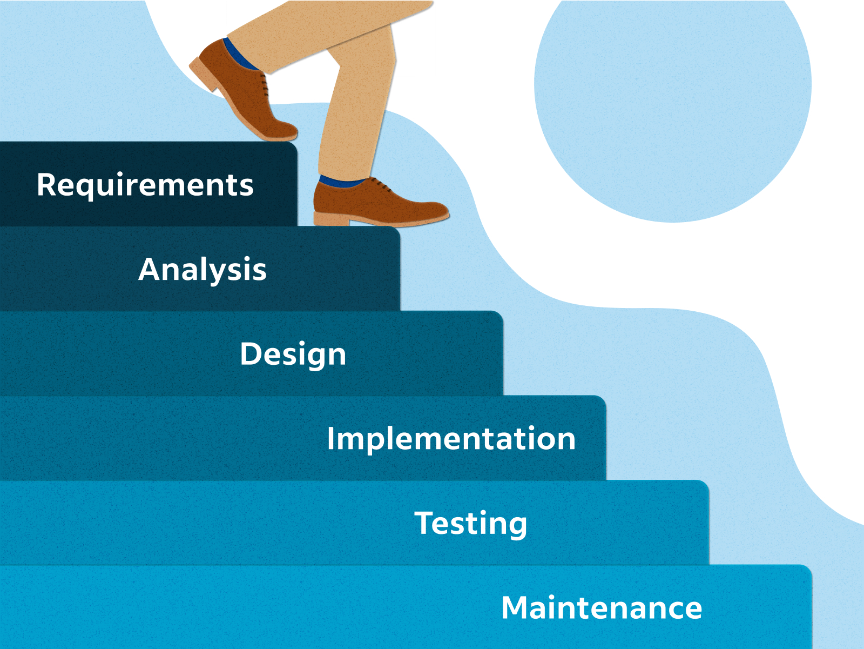
Initial Development Method
Waterfall Model
Created:
Software Requirements Specification (SRS)
Software Design Document (SDD)
Gave us a concrete goal
Structured Plan
Strengths :
Organized and well documented
Concise structure
Accessible information to all members
Presented By: Ly Jacky Nhiayi

Slide 22
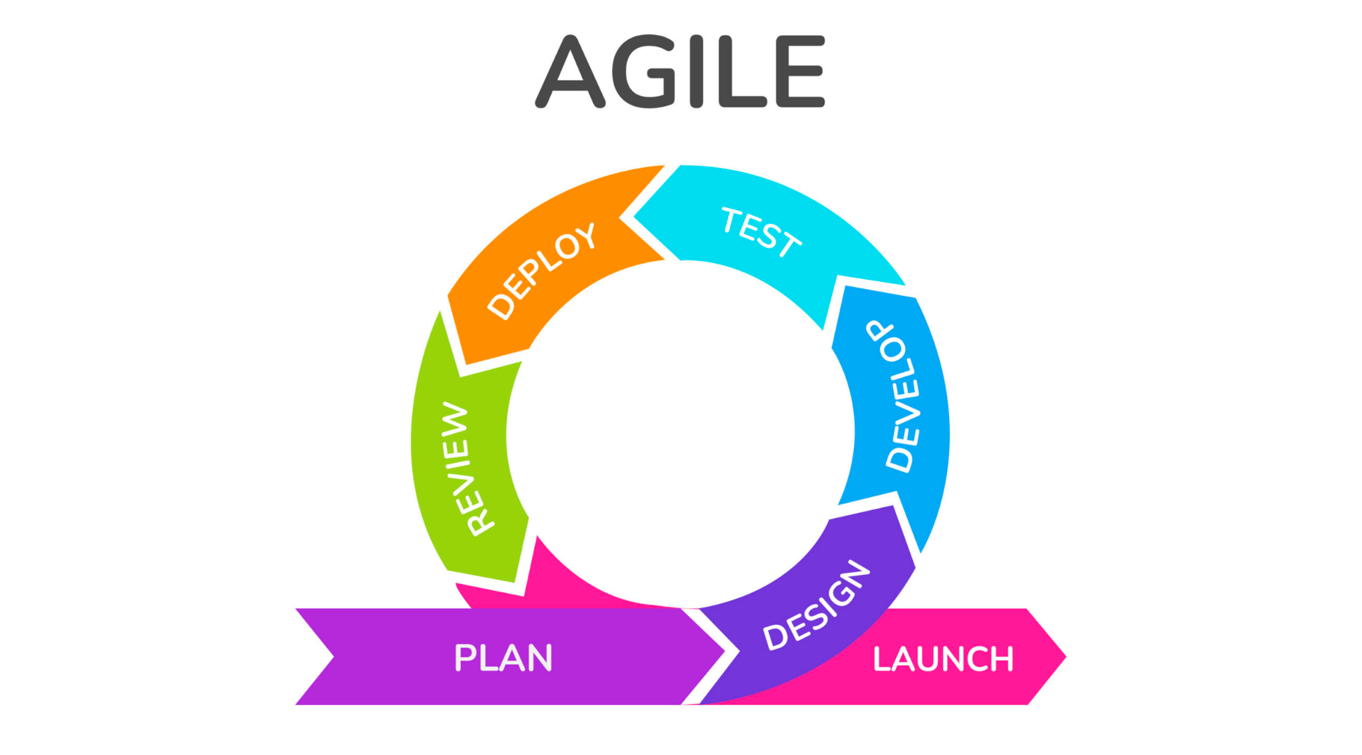
Subsequent Development Model
Weekly scrum meetings
Holding sprints
Split the entire projects into smaller parts and release feature sequentially
Collaborate with Liaisons for every new release to ensure it is what they want
Agile Model:
Strengths
Flexible
Adaptable to clients request
Better customer satisfaction
Presented By: Ly Jacky Nhiayi
Notes:
Waterfall Methods Cons
Inflexible
Liaisons may not be satisfied with previous requirements

Slide 23
Challenges
Presenter: Ruben Heredia, Ari Jasko

Slide 24
Challenge
Some of the challenges we faced were:
Obtaining VR Headsets
Expensive, not easily accessible
Needed in order to develop and test VR Trek application
Limited supply - not everyone was able to take home a headset
Logistics - Distribution / transferring among teammates
Learning New Technologies (OpenXR)
Very complex and difficult to incorporate
Limited resources available for obtaining more knowledge
Presented By: Ruben Heredia

Slide 25
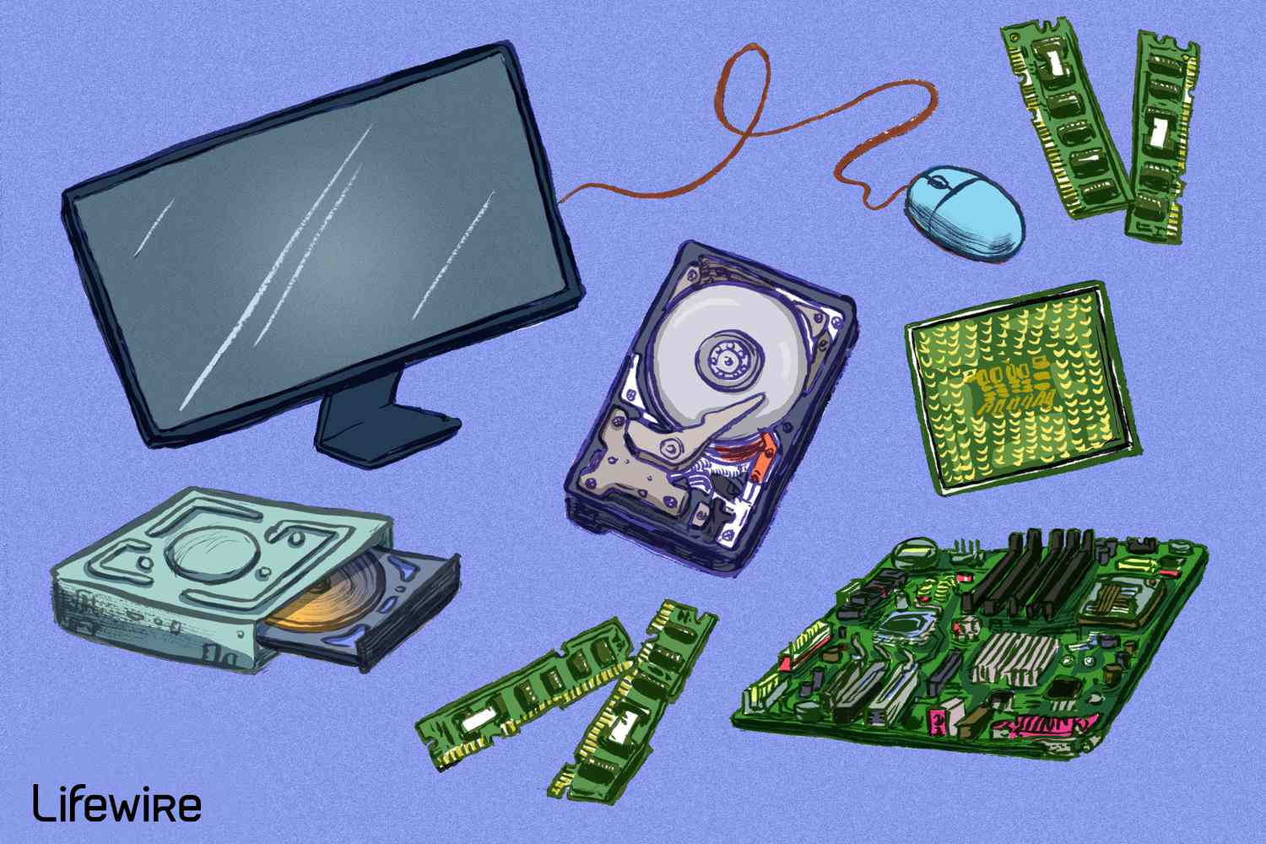
Challenge
Understanding Previous Project
Source code and Github Commands.
Github
Understanding utilization.
C#
Understanding Syntax and use.
Hardware
The programs have very high system requirements.
The programs were incompatible with mac.
Many of us had to borrow a high-end windows laptop from the school..
Presented by: Ruben Heredia

Slide 26
Future Plans
Presenter: Enrique Guardado

Slide 27
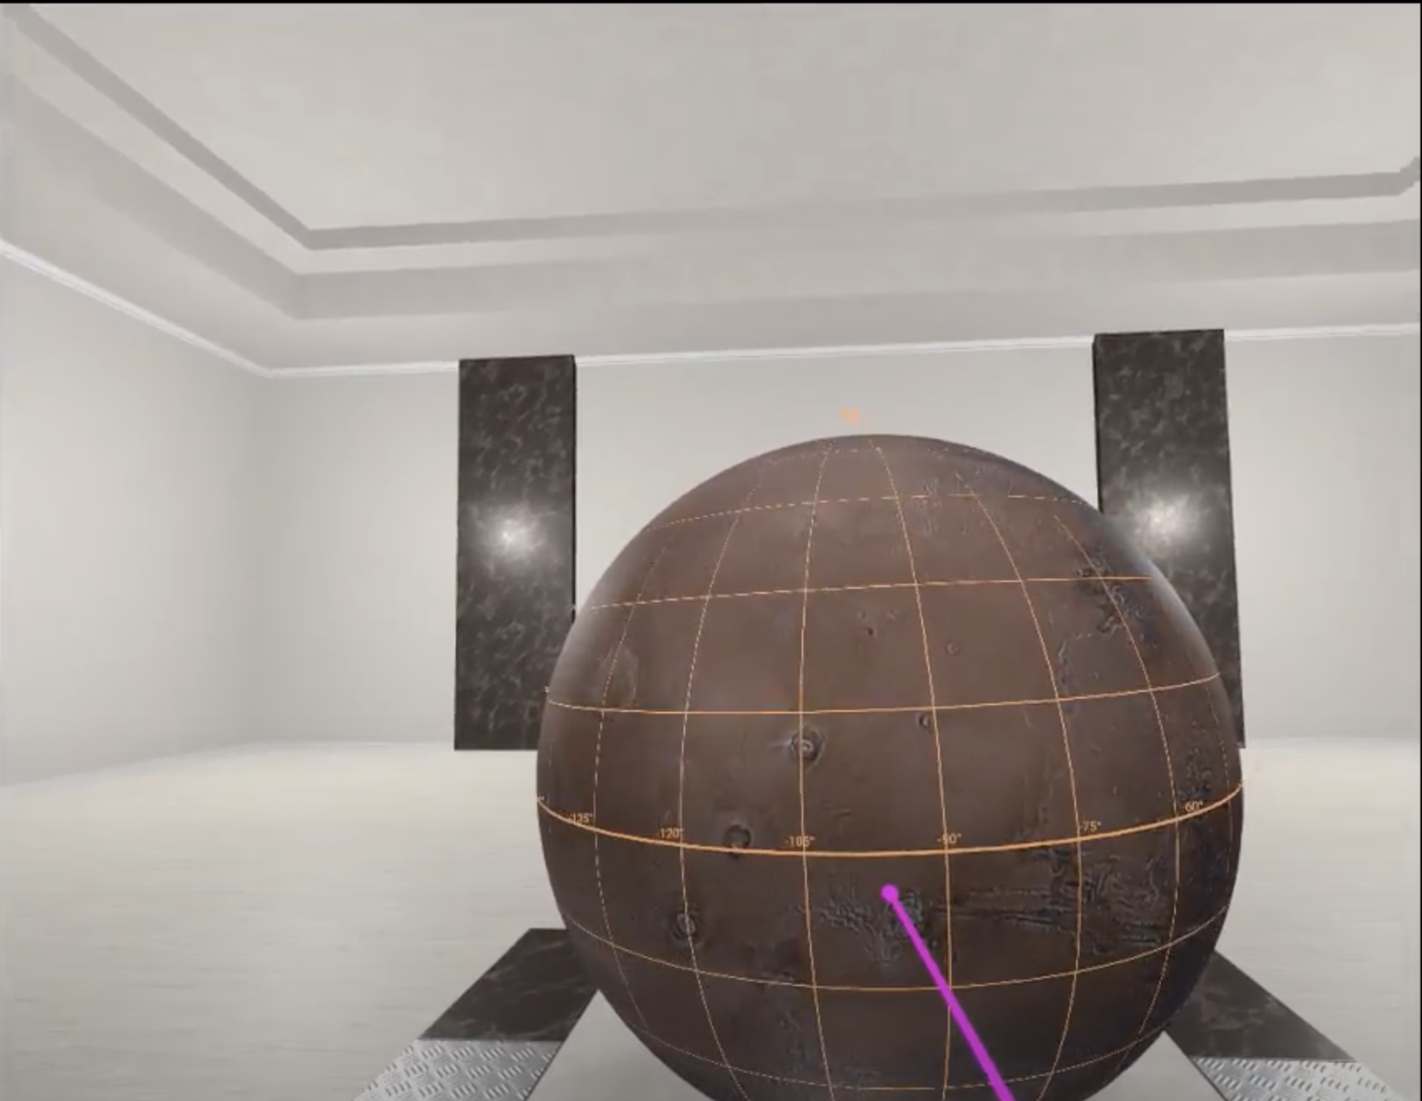
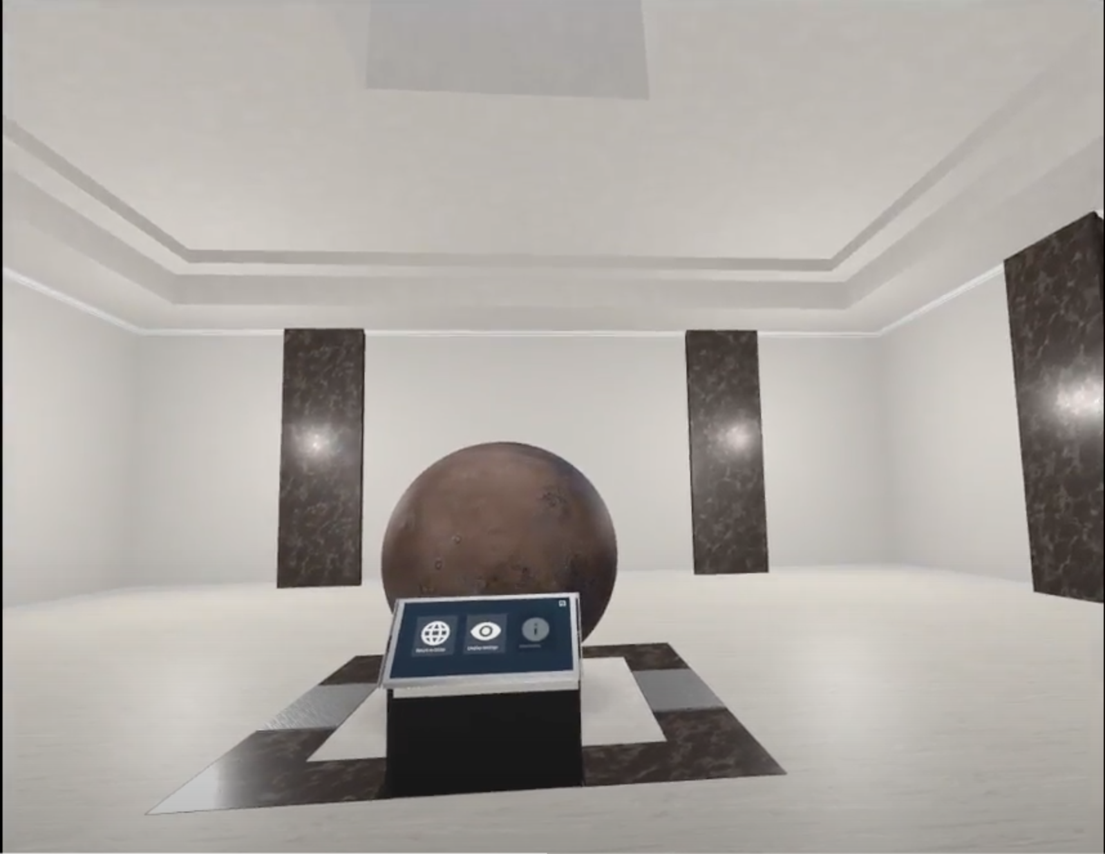
Future Goals
Allow different users to join the same room and collaborate in real time
Add an option for the user to change the theme of the virtual room
Presented By: Enrique Guardado

Slide 28
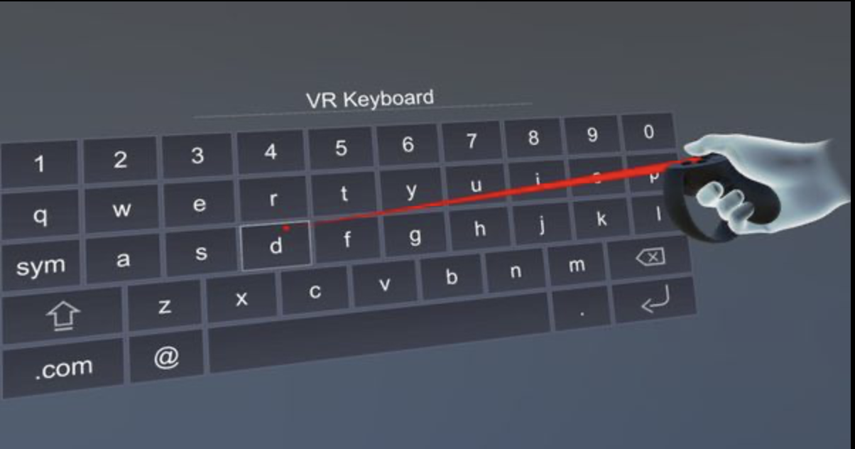
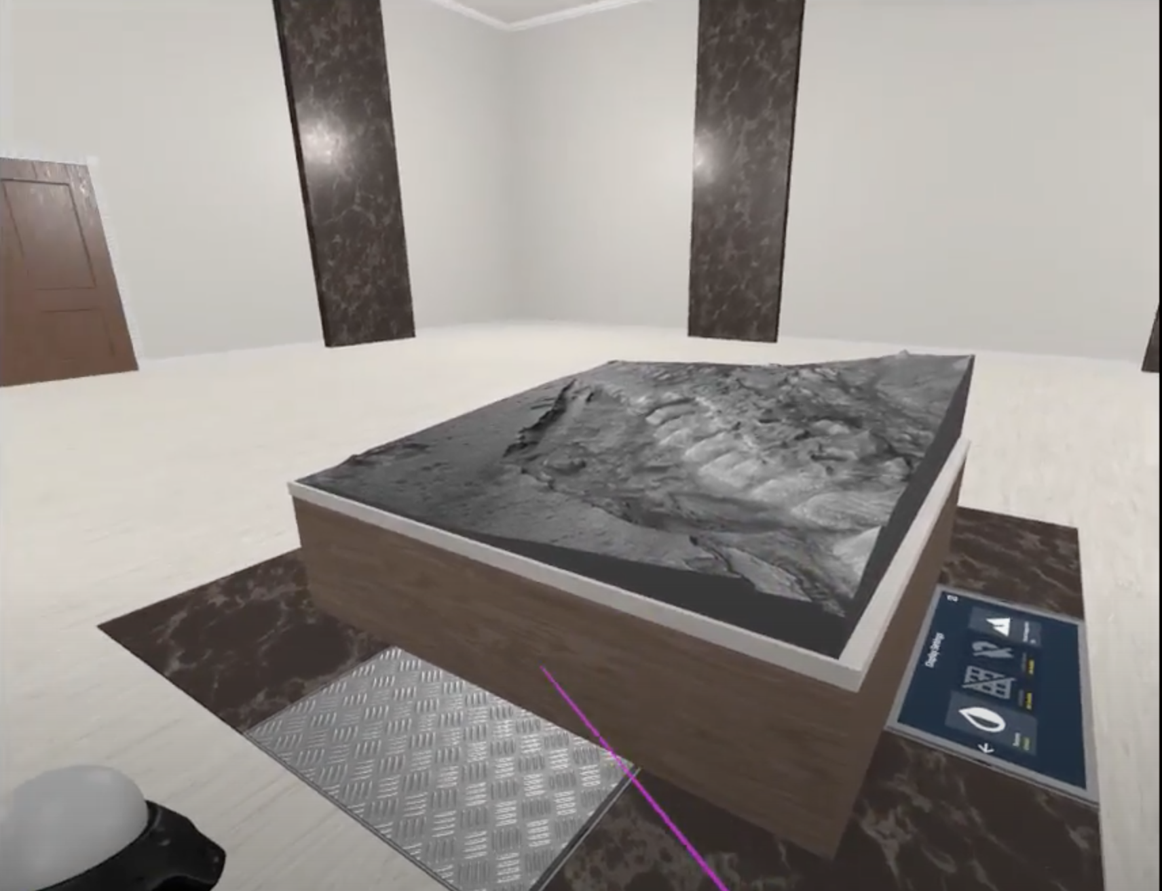
Future Goals (cont.)
Allow user to resize areas such as the table, information windows
Keyboard integration for search
Presented By: Enrique Guardado

Slide 29
Conclusion
Presenter: Ari Jasko

Slide 30
Conclusion
Goal: Complete a VR application allowing visualization of objects and terrain in the NASA database.
Purpose: provide a useful navigation tool for scientific research.
Accessible to the general public or educational purposes.
Available through Steam, and be usable with multiple VR headsets.
Utilize the agile model in the coming semester.
Learning C# and unity to understand and expand the source code is an ongoing challenge.
We’ve gained invaluable skills in organization and team work.
Presented by: Ari Jasko

Slide 31
Thank You!
Finally, we would like to thank once again our liaisons and advisor; Emily Law, Eddie Arevalo, Richard Kim, and Dr. Krum.

