Slide 1
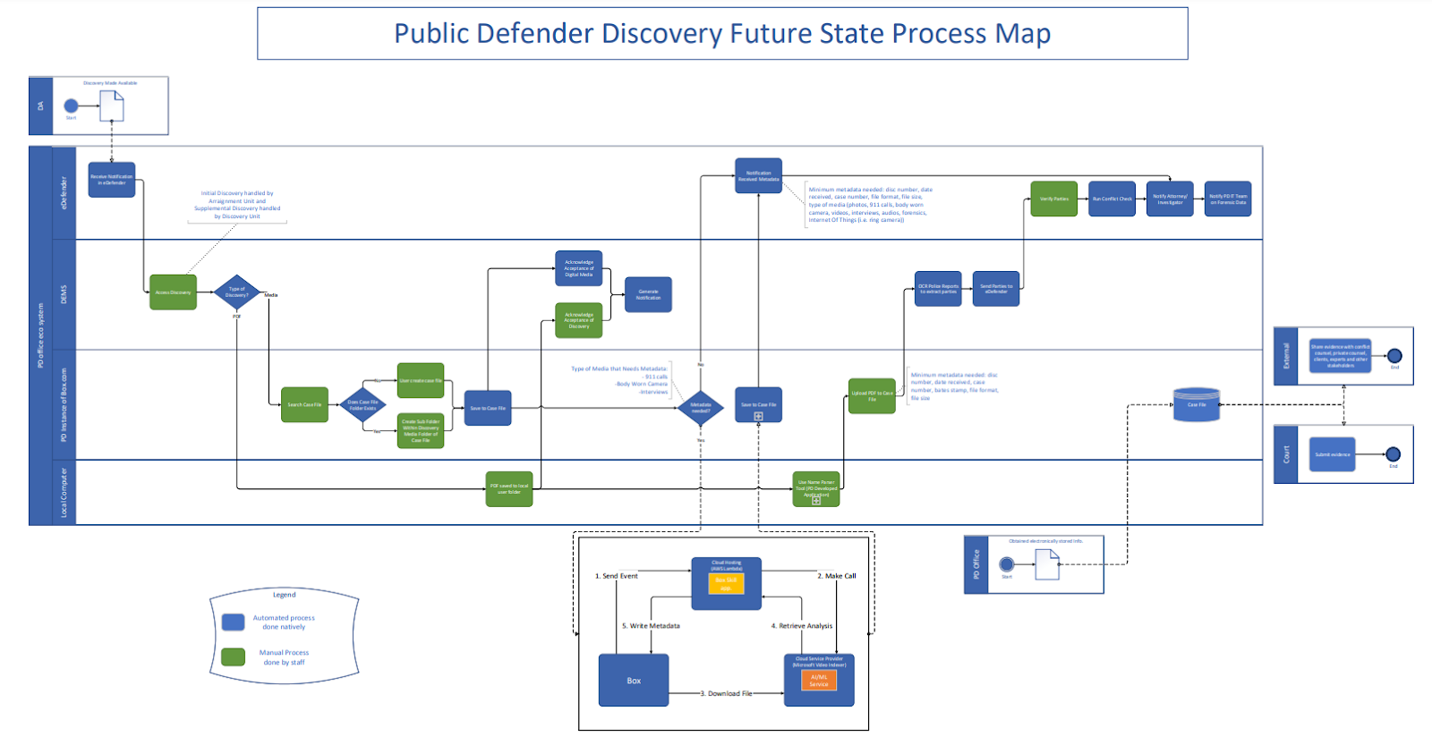
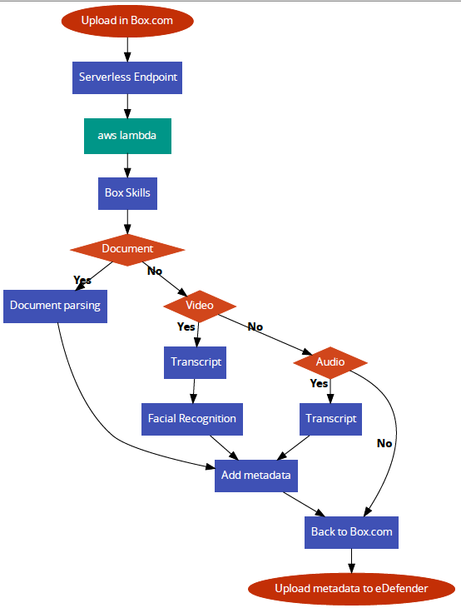
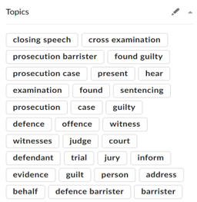
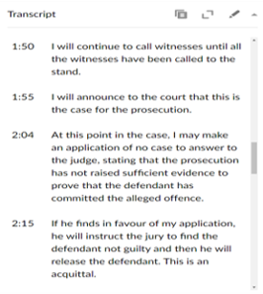
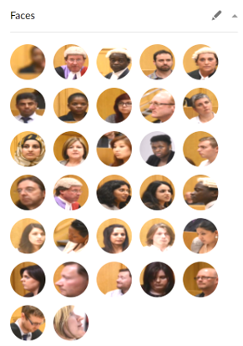
Box.com/eDefender
Team Members: Mario Avila, Jimmy Castillo, Joseph Comeaux, Sherina Marquez, Ethan Ngo, Alexis Ponce, Karen Quan, Rosa Robles, Alexander Voisan, James Yokley Faculty Advisor: Dr. Jung Soo Lim Santa Barbara Public Defender's Office Liaison: Deepak Budwani, Angella Stokke, Sarah Rothschild, Bryan Burzon, Luis Ramirez College of Engineering, Computer Science, and Technology California State University, Los Angeles
Background
The Santa Barbara Office of the Public Defender serves to protect and defend their clients’ rights through legal representation. They strive to provide a fair and unbiased system when advocating for their clients. Currently utilizes manual paper/electronic uploading, transcribing and notification system.
Objective
This project is intended to intake electronic/physical discovery and transfer and process them on Box.com. In addition, we will take advantage of other tools to enable a facial recognition function, keyword's function and generate a separate transcript file. The generated transcriptions will highlight key terms used throughout the video/audio files and the associated metadata will be signified for easy access.
Result/Conclusion
Our group was able to create a custom box app that adds facial recognition, keyword highlights, and generates a separate transcript document in accordance with the liaison’s specification.
Future Plans
Some suggestions for the next group to work on:
Transcribe and translate for video and audio files in foreign languages, especially Spanish.
Increase the accuracy for the transcript, tune the app to process professional jargon for different professions.
Objective
This project is intended to intake electronic/physical discovery and transfer them to Box.com. Through Box.com and the tools we will utilize, the discovery files will be ‘processed’.
In addition, we will take advantage of other tools to enable a facial recognition function, keyword's function and generate a separate transcript file. With these processed files, the generated transcriptions will highlight key terms used throughout the video/audio files and the associated metadata will be signified for easy access.
Result/Conclusion
Our group was able to create a custom box app that generates a separate transcript document in accordance with the liaison’s specification.

