Slide 1
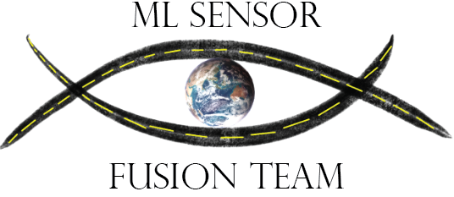
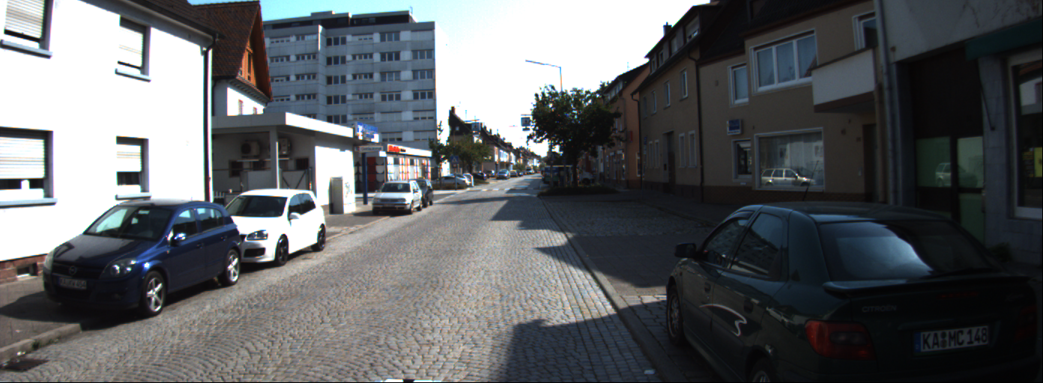
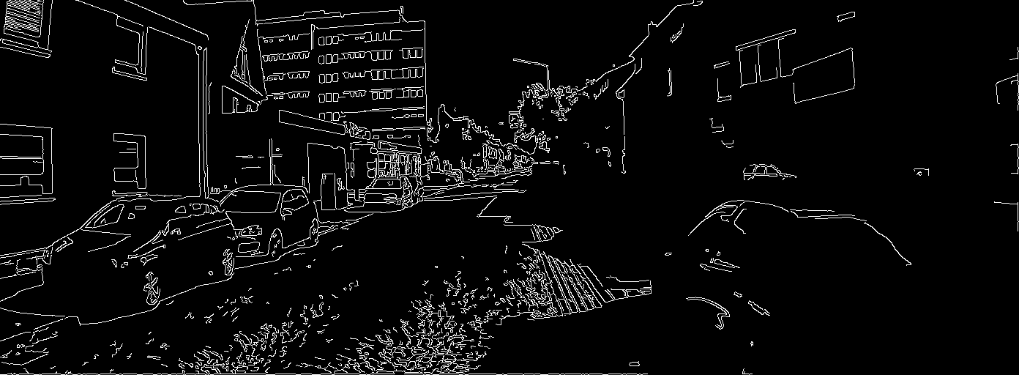
Lane-change assistance using
on-vehicle sensor data fusion Team Members: Hagop Arabian, Daniel Gallegos, Roberto Garcia,
Gerardo Ibarra, David Neilsen, Patrick Emmanuel Sangalang,
Jonathan Santos, Deepanker Seth, Angel Tinajero, Xiao Hang Wang
Faculty Advisor: Dr. Manveen Kaur MathWorks Liaison: Sumit Tandon
Department of Computer Science College of Engineering, Computer Science, and Technology California State University, Los Angeles
[Background]
[ Objectives ]
Sensor fusion is the merging of data, from a combination of sensors, which provides a better understanding of the surrounding area.
Types of sensors may include a camera, LiDAR, and Sonar.
Compared to classic filtering techniques, previously used, machine learning allows the system to learn from patterns to make predictions based on training data.
Vehicular technology can integrate sensor fusion to assist in creating safer driving conditions by improving situational awareness.
A vehicle operator must be aware of its position and surroundings, which may include path markings, pedestrians, and other vehicles.
The purpose of this project is to develop a sensor fusion algorithm to assist in determining whether it is safe to change lanes. The objective is to create an algorithm which fuses data captured from sensors to guide the future actions of the vehicle and increasing lane change safety.
[Datasets and Tools]
These are the sources of Data that were used:
The KITTI Vision Benchmark Suite
Frame images from a mounted camera
png images
Velodyne point cloud from Velodyne HDL-64E lidar.
txt text files
Matlab
Data simulation
The Following Algorithms were used to preprocess data:
Canny edge detection: Edge detection
Cascade classifier: Car detection
MPL classifier: Algorithm fusion
Tools and Libraries
Flask: Back-end web framework
React: Front-end framework
Sklearn: Machine learning algorithm training and testing
Numpy: Data normalization and high-level mathematical functions
Pandas: Data normalization
Opencv: Object detection
Python: Programing Language
[Algorithm]
Algorithm YoMo (You Only Merge Once) Algorithm
Initialize variable video_frame
Initialize data structure variable edge to store modified frame
video_frames gets the individual video frame from the dataset
for frame in video_frames:
Apply ‘Canny edge detection’ algorithm to the frame
Append the resulting frame into edge
end for
for frame in edge:
Store third quadrant of image in third_quad variable
Store fourth quadrant of image in fourth_quad variable
Initialize num_of_cars variable
Use “Cascade classifier” to count the number of cars detected in third_quad and add count in num_of_cars variable
Use “Cascade classifier” to count the number of cars detected in fourth_quad and add it to the count in num_of_cars variables
end for
for vec in lidar_vectors:
vec_mag gets the magnitude (Math.sqrt(vec.x**2 + vec.y**2 + vec.z**2) of vec
Append values of vec_mag to the magnitude data structure
end for
result = Algorithm MLPClassifier is applied with parameters: [edge, num_ of_ cars, magnitude]
[Methods]
The YoMo (You Only Merge Once) algorithm uses video frames along with LiDAR data as inputs from the KITTI Vision Benchmark Suite.
“Canny edge detection” is used to identify edges in the frames.
Each video frame is divided into four quadrants and the algorithm focuses on the third and fourth quadrants.
Cascade classifier is used to identify the number of cars present in each of the selected quadrants.
Lidar sensor data is processed to compare the distances to all objects and calculate their proximity to the vehicle.
The resulting data are fused by the Multi-layer Perceptron Classifier, a machine learning algorithm, to determine if it is safe for the vehicle to change lanes.
Sample of the conversion from video frame to an edge detection frame.
Application flowchart
Notes:
1
Have students check that the logo is the appropriate one to use.

