Slide 1
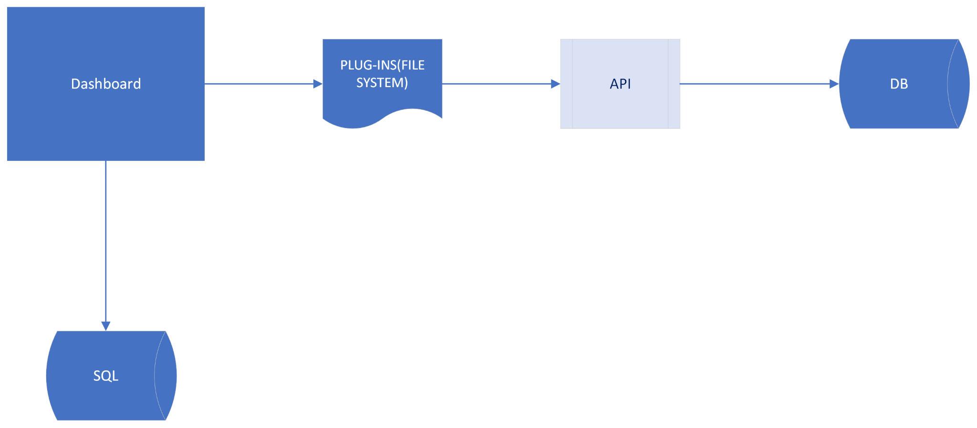
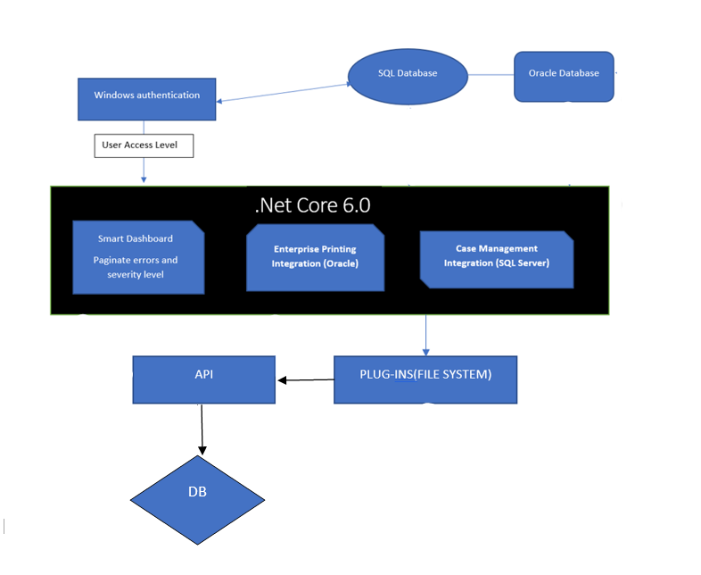
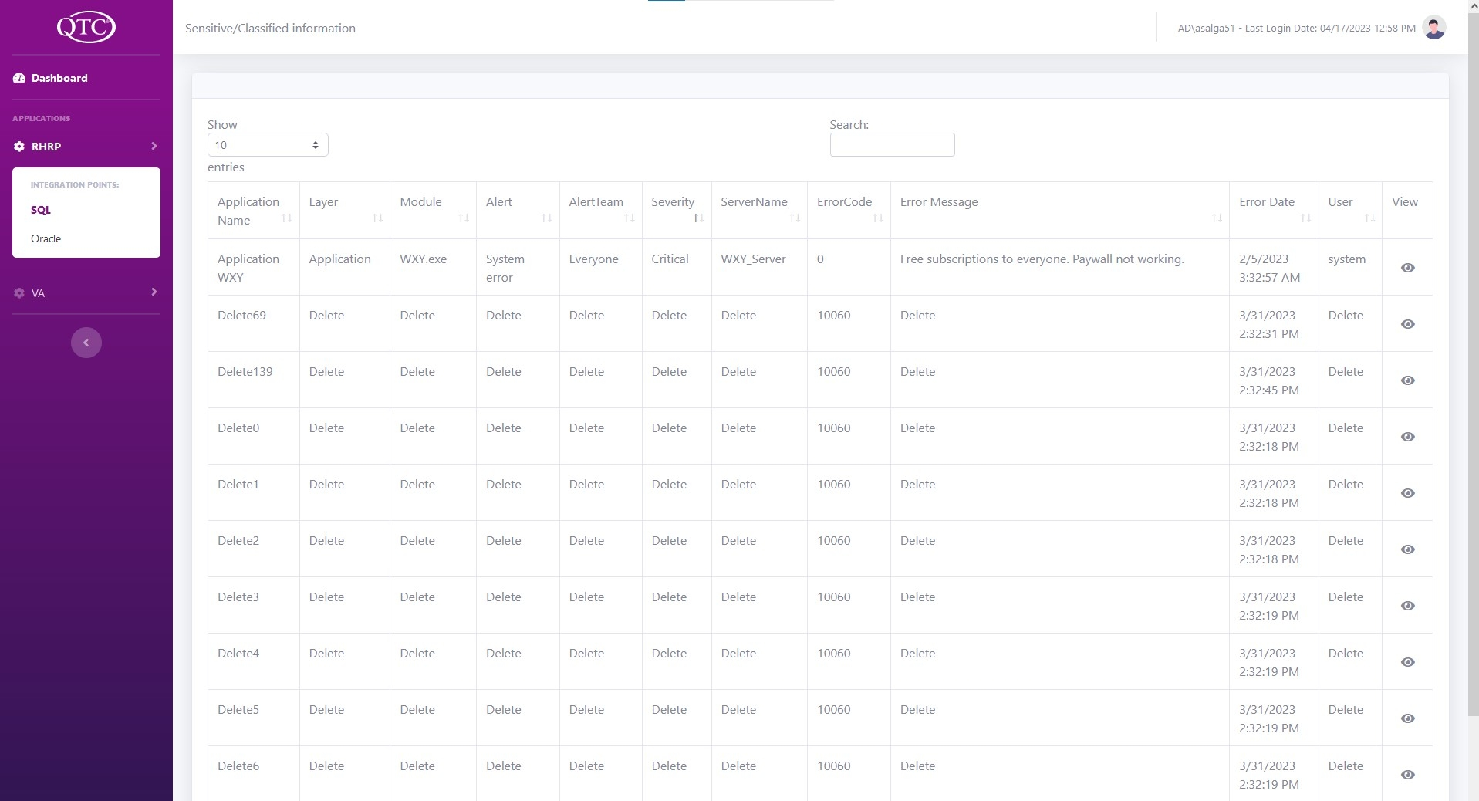
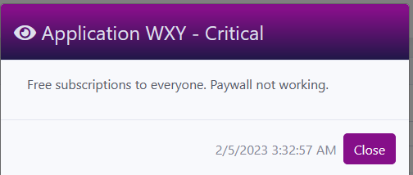
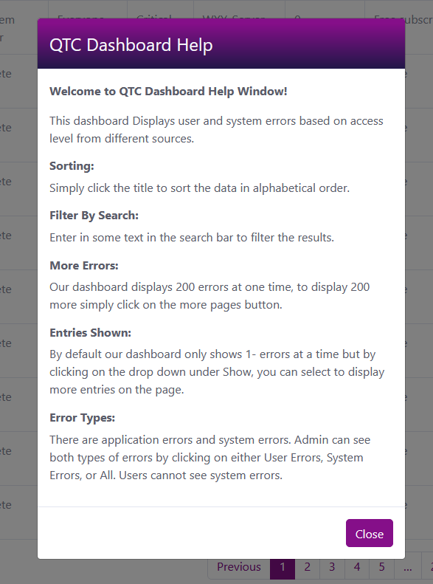
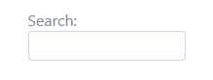
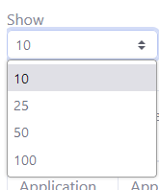
Smart Dashboard
Team Members: Alvent Chang, Bryan Gonzalez, Ashley Manese, Karina Pascual, Adrian Salgado Faculty Advisor: Dr. Huiping Guo QTC Liaisons: Francisco Guzman, Julian Gutierrez College of Engineering, Computer Science, and Technology California State University, Los Angeles
Background
Objective
QTC (Quality, Timeliness, Customer Service) handles all medical, disabilities, or occupational health services through a medical focused examination and diagnostics test. Need a centralized location to investigate errors from different sources.
Create a smart dashboard:
Display errors from different sources
Table features:
Sort
Search
Paginate
Error window
Help window
Architecture
Our dashboard can convert data from an API or a Database that will then be displayed to the User Interface.
Our Dashboard gives the user the ability to filter, paginate, and search through the error data converted.
Result
Some dashboard functionalities includes displaying error messages in full length after clicking on view icon as well as a descriptive help button with a question mark icon.
Dashboard:
Features:
Tools and Technologies

Slide 2
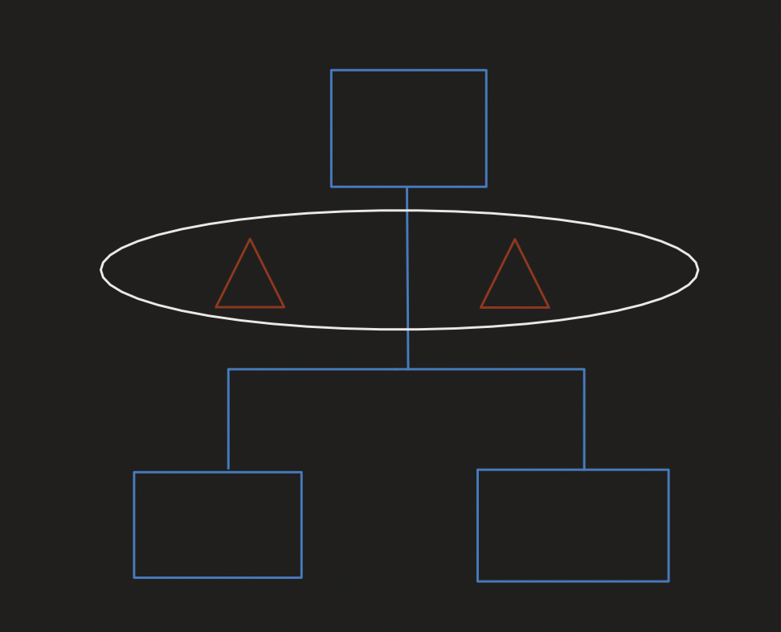
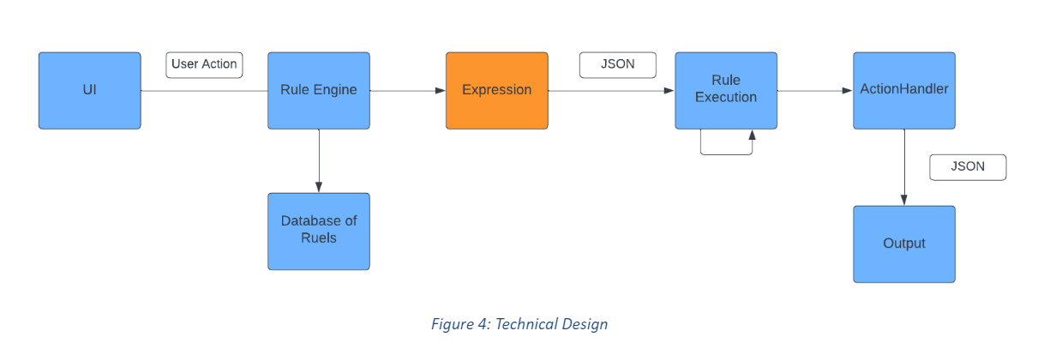
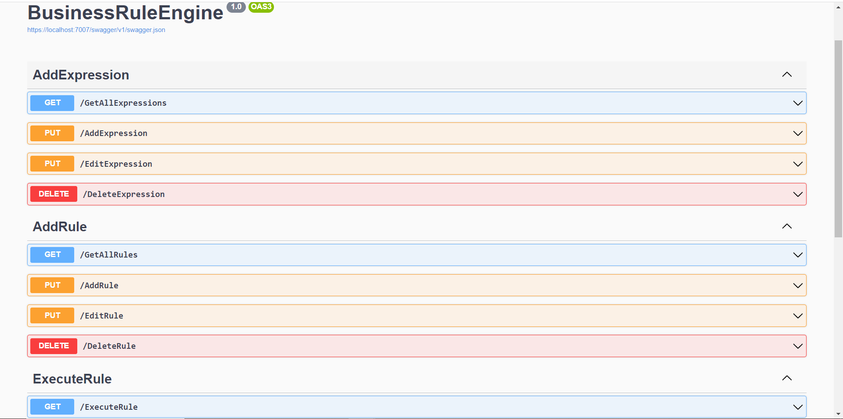
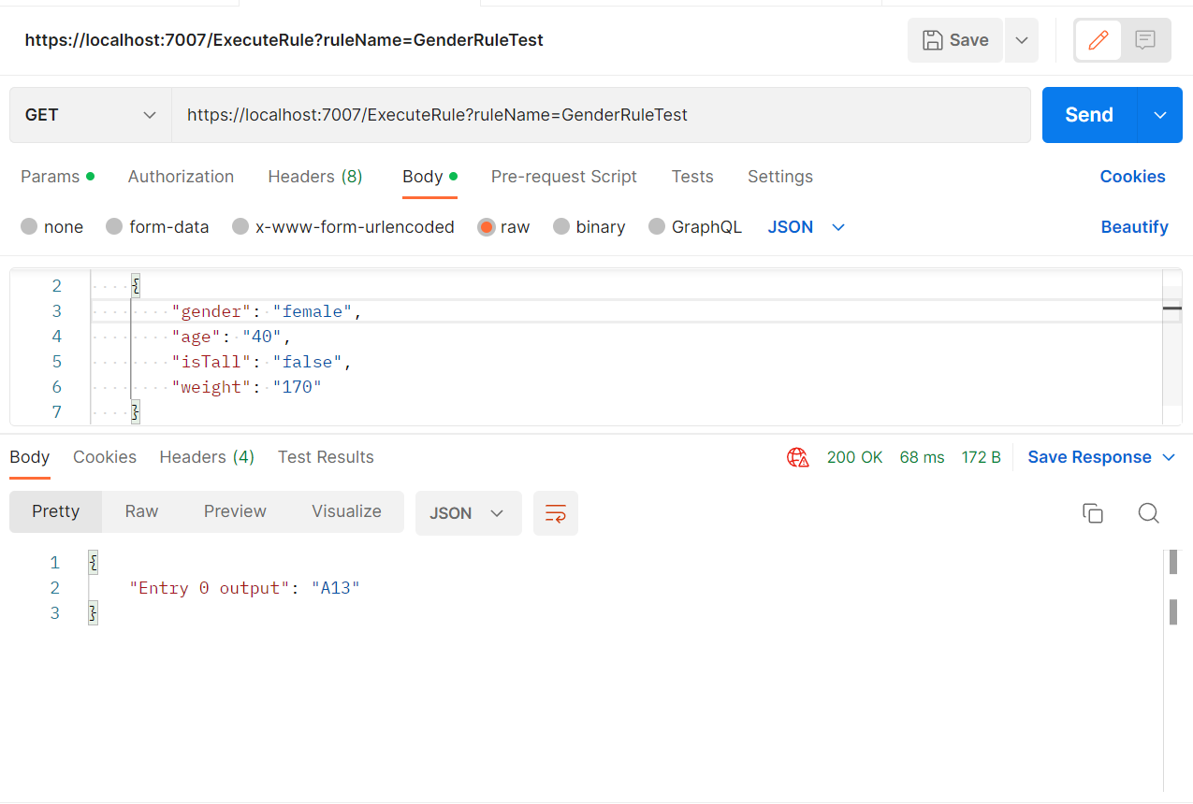
Business Rule Engine
Team Members: Jonathan Diaz, James Eddins, Razin Khan, Pokuong Lao, Anthony Tsui Faculty Advisor: Dr. Huiping Guo QTC Liaisons: Francisco Guzman, Julian Gutierrez College of Engineering, Computer Science, and Technology California State University, Los Angeles
Background
Objective
QTC (Quality, Timeliness, Customer Service) handles all medical, disabilities, or occupational health services through a medical focused examination and diagnostics test. They needed a dashboard in order to investigate errors from different data sources and they needed a rule engine to quickly classify information.
The system will be receiving the
“ExecuteRules” request which will contain
the name of the rules that are to be executed. The Engine will then execute the rule accordingly and determine the appropriate outcome with the processes it goes through. After which, either the result will be returned to the user or another rule will be executed recursively depending on the outcome.
Data
This diagram depicts the structure of a rule and expression, the rule (blue) starts with a rule at the top and can evaluate to rule/output. An expression (white) handles the logic of each rule.
This diagram depict a technical diagram of the Business Rule Engine.
Result
The rule engine is designed to be able to add/remove rules and expressions as well as execute rules by using the following commands.
This is an example of an output of the rule engine given one item.
Tools and Technologies

