Slide 1
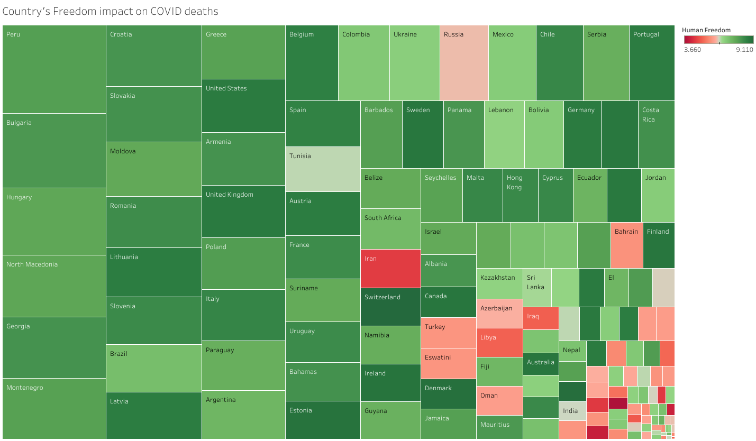
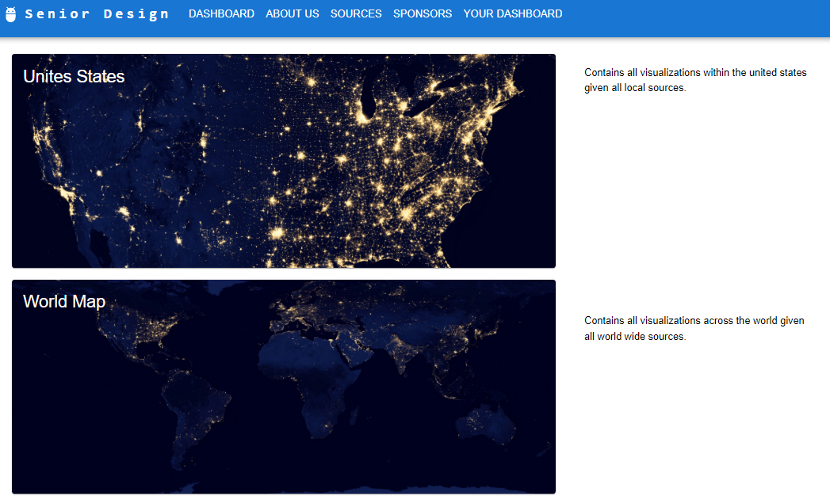
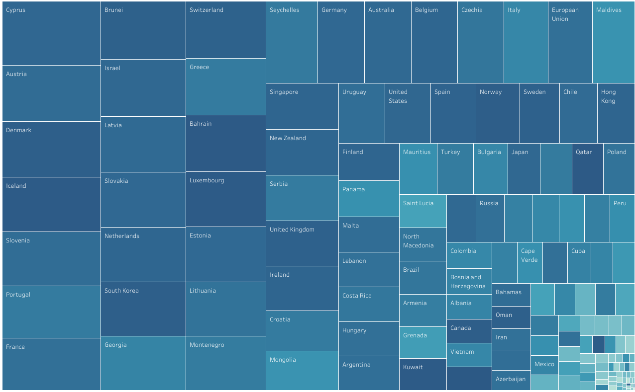
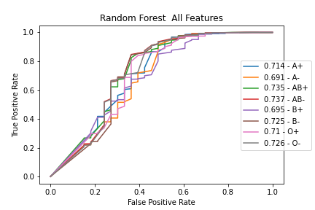
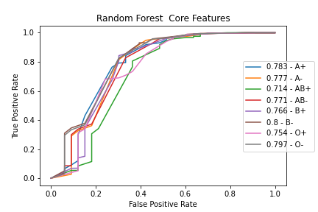
Comorbidity and Genetic Factors and their Impacts on Patients with COVID-19
Team Members: Rohan Chatterjee, Francisco Contreras, Jimuel Julaton, Luis Gonzalez, Riese Atianzar, Emily Gonzalez, Chen-Ching Lin,
Juan Hernandez, Carlos Hernandez, Ting Fung Ha Faculty Advisor: Dr. Navid Amini
Project Liaison: Haley Kirk Department of Computer Science College of Engineering, Computer Science, and Technology California State University, Los Angeles
Background
Objective
COVID-19, a highly infectious disease caused by the SARS-CoV-2 virus, has had a profound impact on the world, affecting health, economies, and daily life. Despite extensive research, there are still several overlooked aspects related to the disease that have been considered controversial and therefore, have not been thoroughly studied. It is important to consider these areas to gain a complete understanding of the virus and its impact on human health.
The objective of this project is to study overlooked or unconsidered aspects related to COVID-19 to gain a better understanding of the disease. This is being done by studying various areas, including clinical factors such as blood type and its association with disease severity and mortality, as well as the impact of geographical, economical, and social factors on COVID-19 cases, vaccinations, and mortality. Our approach involves segmenting the deliverables into three separate branches.
Tableau Portal
Visualization Application
Blood Type Analysis
Country's Freedoms Score and impact on COVID deaths
Comorbidities and Traits Investigated
Libraries Used
Blood Group
Fever
Chills
Cough
Dyspnea
Anosmia Ageusia
Loss of Appetite
Asthenia
Cyanosis
Rhinorrhea
Sore Throat
Diarrhea
Muscle Ache
Nausea Vomiting
Headache
Gender.
After preprocessing the data the Boruta Algorithm was used to identify core features.
A comparison of freedom score of different countries and COVID-19 deaths in those countries, with the countries having more freedom also having more deaths.
The application is created to display the visualizations
Boruta Core Selected Features for Mortality (All Blood Types)
Chills
Cyanosis
Diarrhea
Cough
Sore Throat
Features were further supported by high rank order stability in Fisher’s Exact and Chi Squared tests.
Internet Access vs Covid Cases
Main Page
Toolbar
About Us
Select
Region
Resources
Sponsors
Dashboard
Next multiple models were created for each, each varying a single feature informing if the sample matches the corresponding blood type.
Visuals
A comparison using percentage of internet access of different countries and COVID-19 cases in those countries, with the countries having more access also having more cases.
Filter
Active Visualization
Note:
Features:
Results:
You can use the following QR codes to access the project’s online versions.
Realtime data
Easy interaction
Intuitive Design
Custom Dashboard
Identified Core Comorbidities associated with COVID-19
Core Comorbidities helped reduce noise in the models
No significant changes were found when examining blood type
Blood type likely has no effect on COVID-19 mortality
similar were found for results severity
Notes:
‹#›
Have students check that the logo is the appropriate one to use.

