Slide 1
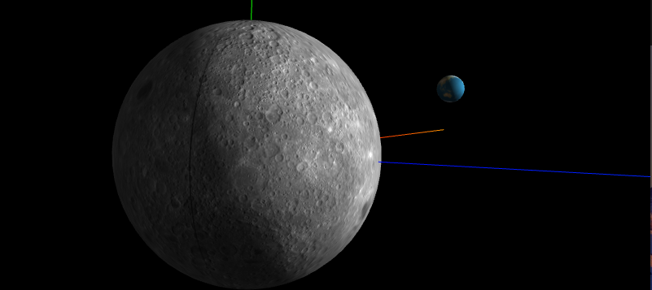
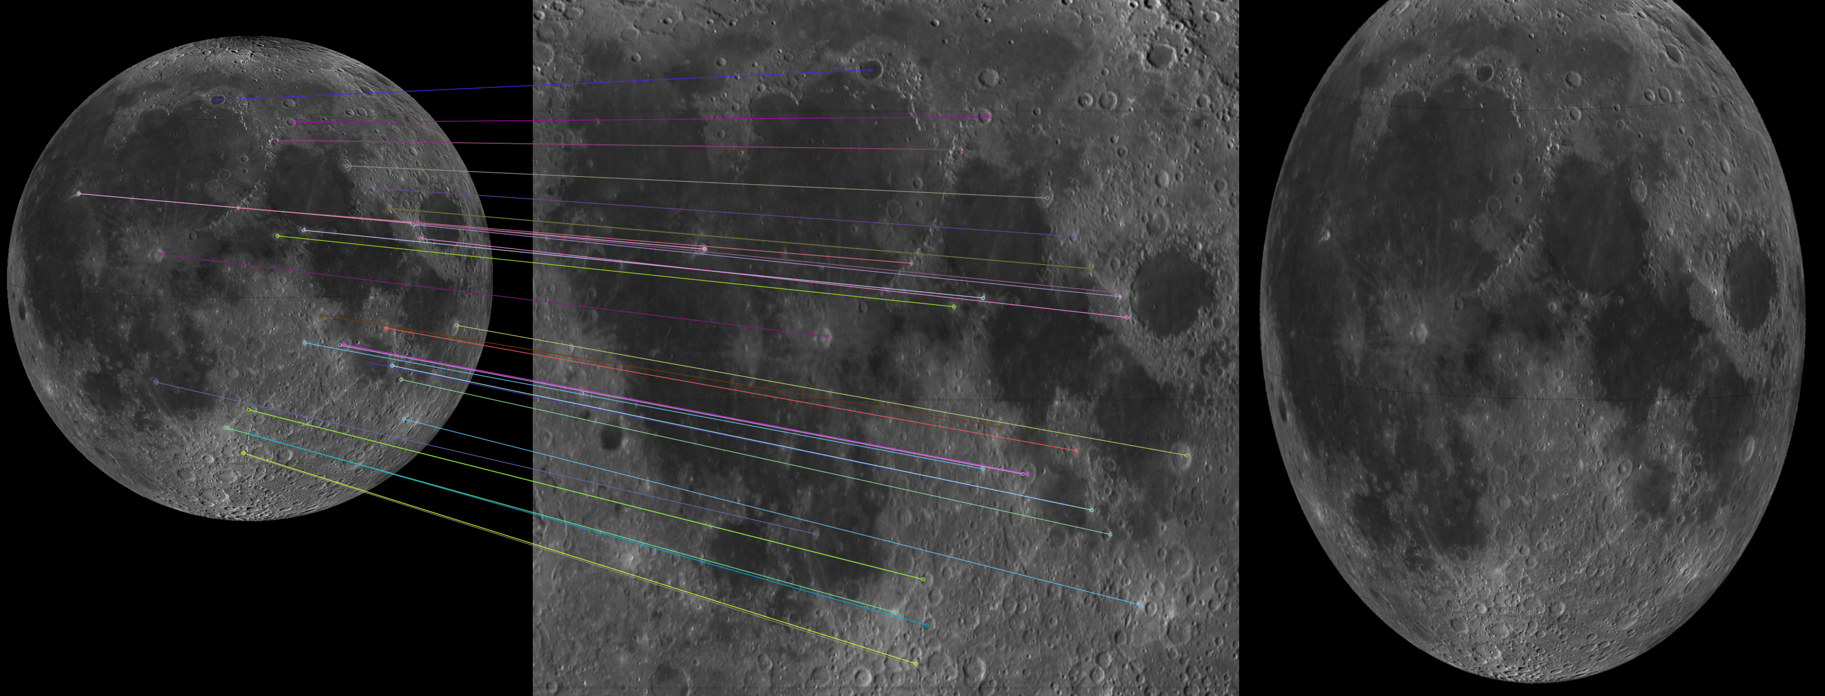
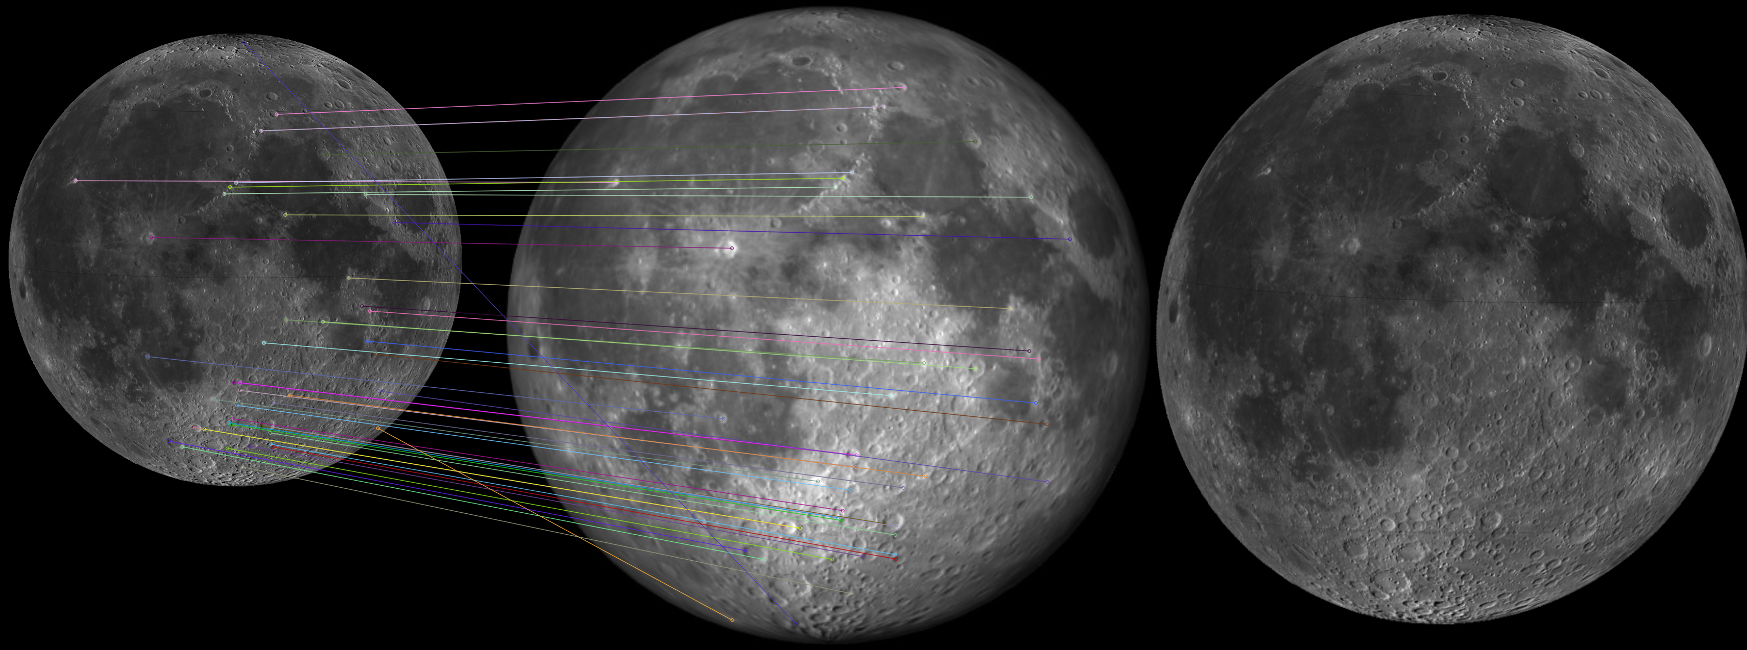
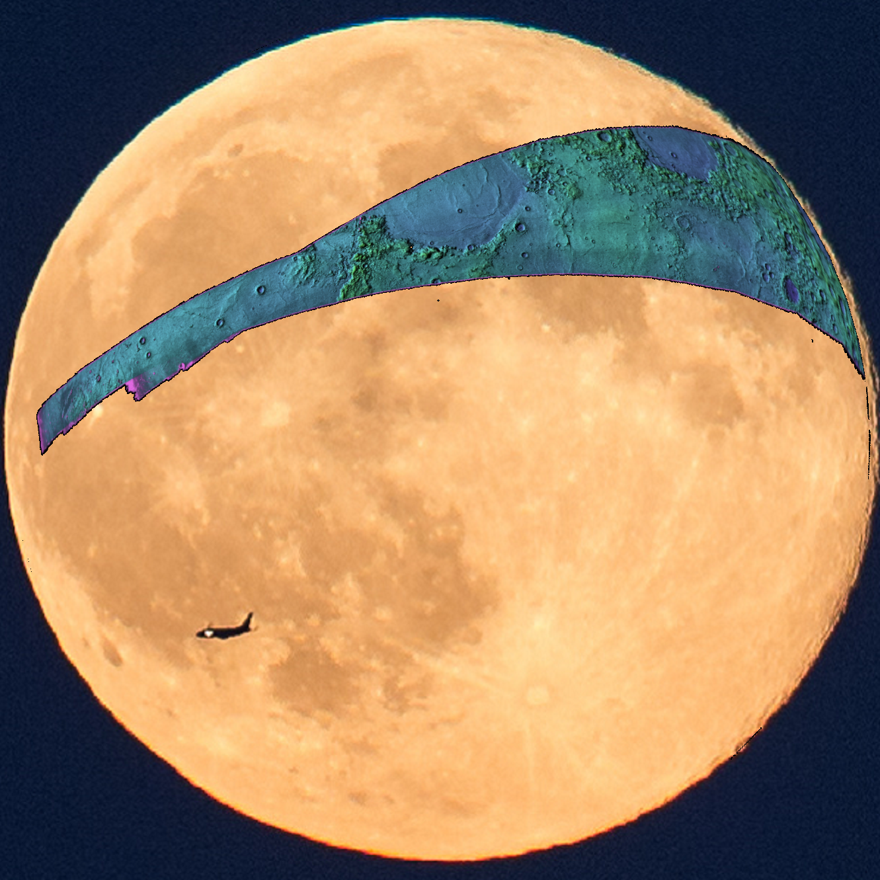
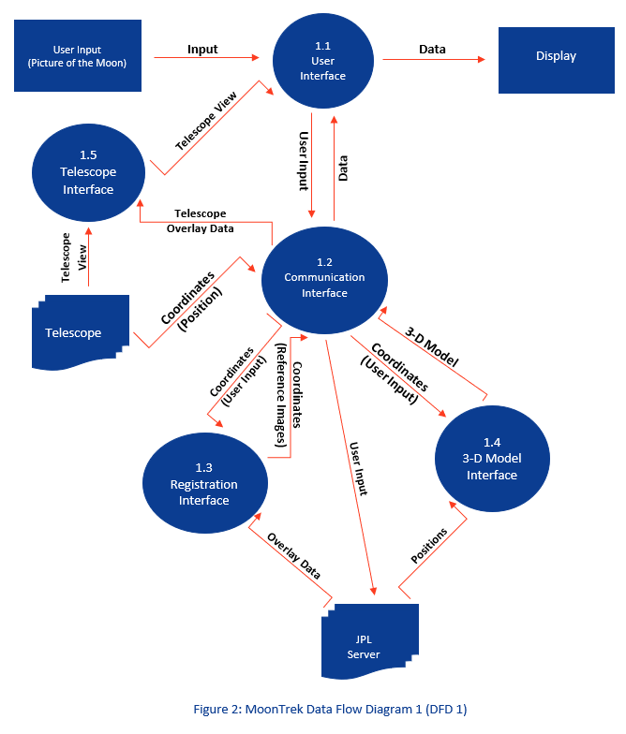
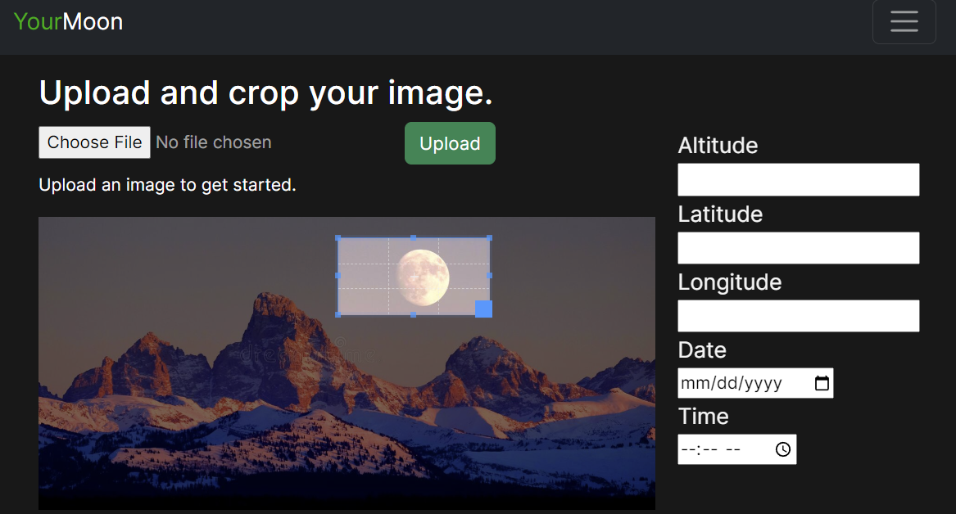
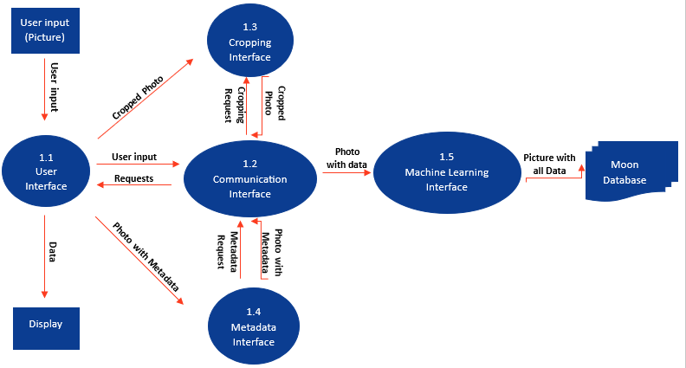
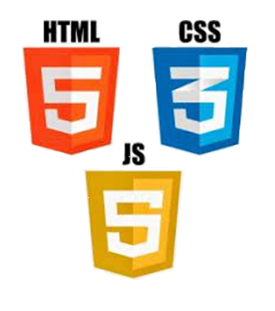
JPL - MoonTrek Augmented Reality Team Members: Nadir Abdusemed, Jackson Bentley, Jesus Cruz, Youssef Elzein, Derek Guevara, Joe Hineno, Rich Ho, Owen Ramirez, Salman Sheikh, Alex Sherzai. Faculty Advisor: Weronika Cwir JPL Liaison: Natalie Gallegos, Shan Malhotra College of Engineering, Computer Science, and Technology California State University, Los Angeles
BACKGROUND
3D Model
Jet Propulsion Laboratory is partnering with California State University - Los Angeles, College of Engineering, Computer Science, and Technology to build an interface between Moon Trek and telescopes amateur astronomers use to look at the Moon. When images from the telescope are routed to a laptop or a smartphone they will be annotated with names of lunar features and landmarks, local temperature, chemical makeup of the soil or any available information the astronomer chooses.
OBJECTIVE
Without context
With context
Using the location on Earth and timestamp, via metadata, of the user's image we will create a 3D model the mimics the Earth, Moon, and Sun relationship. From the model we will create reference image with the correct positioning and lighting, which will then be used for context aware image registration. The generated transformation matrix will be used to correctly position the overlays onto the user’s image. We will also build a database of images to test the accuracy of registration.
User Image Generated Image Rotated Image Overlaid Image
ARCHITECTURE
YourMoon: Database of test images
GOALS
3D model of the Earth, Moon, and Sun
Context aware registration
Correct overlay positioning
Create database of images to test registration model
TECHNOLOGIES
MATH
Notes:
Have students check that the logo is the appropriate one to use.

