Slide 1
QTC Team
Smart Dashboard & Business Rule Engine
Team Members:
Bryan Gonzalez
Ashley Manese
Karina Pascual Z.
Alvent Chang
Adrian Salgado Lopez
Pokuong Lao
Anthony Tsui
Jonathan Diaz
James Eddins
Razin Khan
QTC: Liaisons
Francisco Guzman
Julian Gutierrez
Faculty Advisor
Huiping Guo
May 5, 2023

Slide 2
Agenda
QTC’s Company/Business Needs for Business Rule Engine.
Rule Engine Project Requirements
Challenges
Retrospective
Achievements
Technologies Used
Demo
QTC Overview
What is a Smart Dashboard?
QTC’s Company/Business Needs for Dashboard
Dashboard Project Requirements
High level Overview
What is the Business Rule Engine?

Slide 3
QTC Overview
A Leidos Company
QTC is the nation’s leading provider of medical, disability, and occupational health examination services.
Works closely with clients to help identify program needs, provide diagnostic testing services and provide medical examination.
The technology provides clients with real-time access to reporting, tracking, and case information.

Slide 4
What is the Smart Dashboard?
Web Application
helps consolidate user and system errors that have occurred in different systems
Users can fix integration issues related to data by knowing the errors.
Developers can fix integration issues related to bugs in the system by knowing the errors.

Slide 5
QTC’s Business Needs
Multitenant
serves multiple tenants where their data is logically separated from other tenants but they all share the software
Low Maintenance
easy to maintain and update overtime
Decoupled Code
allows for more flexibility because it reduces the dependencies between different components
Reusability
efficient, cost-effective, and scalable

Slide 6
Why QTC Needs a Smart Dashboard
Many Errors in Different Systems
multiple files or systems to find and retrieve that data
Easy Access to Errors in a Centralized Location
General purpose application to view user and/or system errors
User Friendly Interface
Easy to use interface with options for filtering data

Slide 7
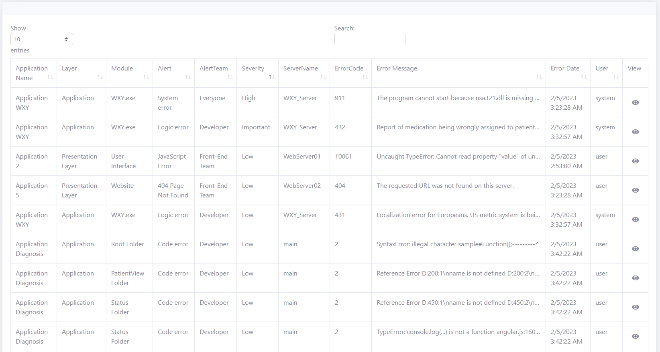
Project Requirements Error Table
Displays Errors Only From a Particular Client (Tenant)
Supports Pagination and Filtering
Displays Errors Based On the Integration Point selected
Errors Can Be Sorted Based On Severity
Long Errors Are Truncated And Can Be Seen By Clicking a Button
Adheres to QTC’s UI/UX Standards

Slide 8
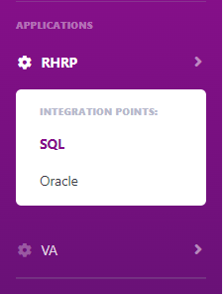
Project Requirements Scalable and Extensible
New Organizations Can Be Added As Tenants
Each Tenant Has Their Own Line Of Business
Using A Reusable Class Library To Make Our Code Easier To Maintain
Supports Multiple Integration Points
Uses Dependency Injection, N-tier Architecture, and a Modular Design

Slide 9
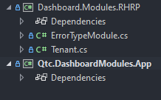
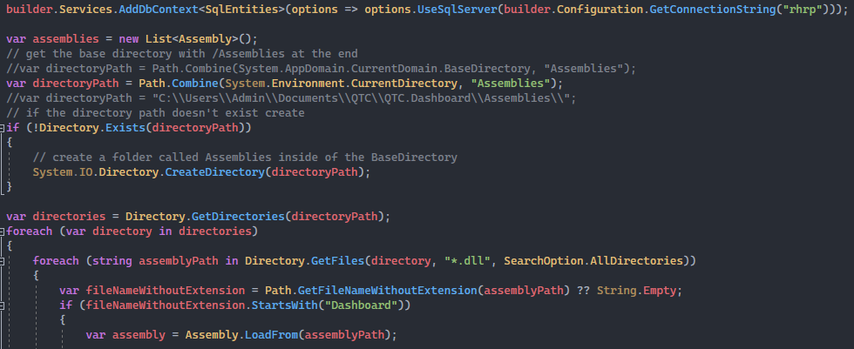
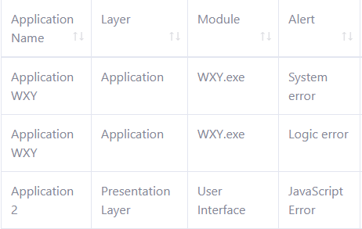
Smart Dashboard High Level Overview

Slide 10
Business Rule Engine

Slide 11
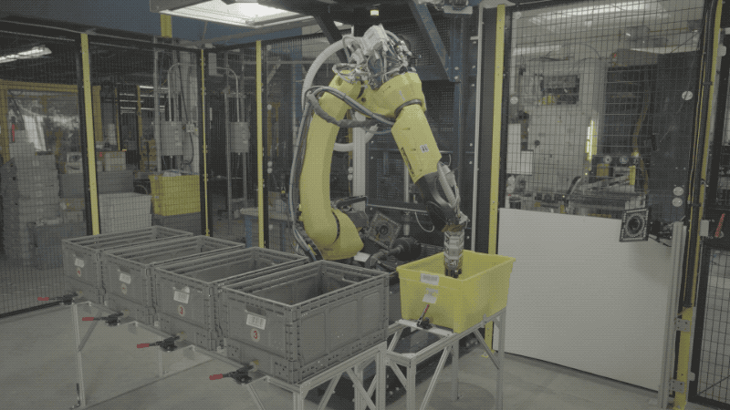
What is that?
A program which takes information and outputs a group to which the information pertains to.
Provides a way to classify/group lots of information without requiring to manually look for information.
This is useful in several different situations.
The ultimate goal is to be able to take in any piece of information and be able to organize it.

Slide 12
Wait…There Are More !
Ensure compliance
data protection etc
centralized platform managing & enforcing rules
reduces risk of non-compliance & legal penalties
Improve customer experience
Fast response time
provide customers more personalized & efficient services
Increased agility
modified without changing the application code
easier & faster to adapt
Enhanced collaboration
create & modify business rules without the IT
faster iteration & adaptation to changes in the business environment
Improved auditability
changes and decisions can be recorded
troubleshooting and identifying issues

Slide 13
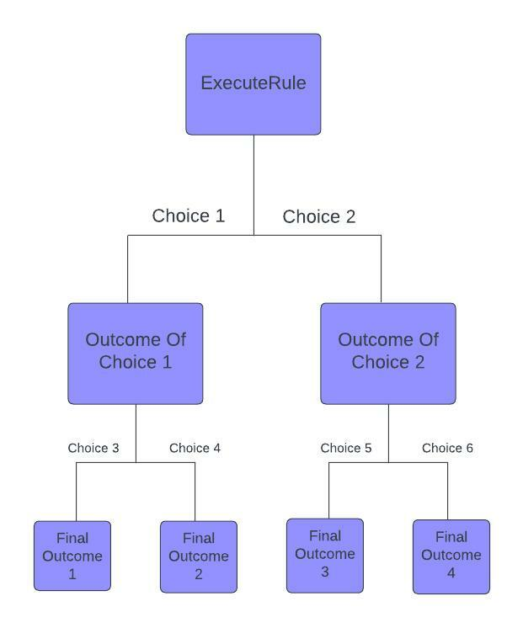
Requirements
Create a Rule Engine that takes in a JSON Object.
Based on information within JSON object, execute appropriate logic.
Based on expression tied to each rule we determine what action to take (left or right).
Recursively execute rules until we reach a final output.

Slide 14
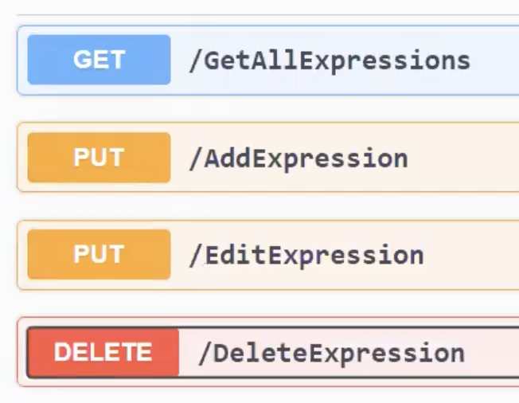
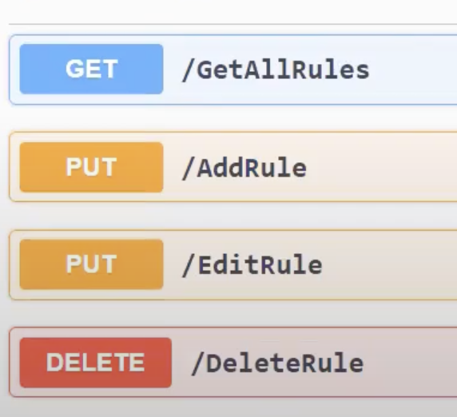
Rule Engine helper functions
A user/company can do the following to a rule and expression
Get (all)
Add
Edit
Delete

Slide 15
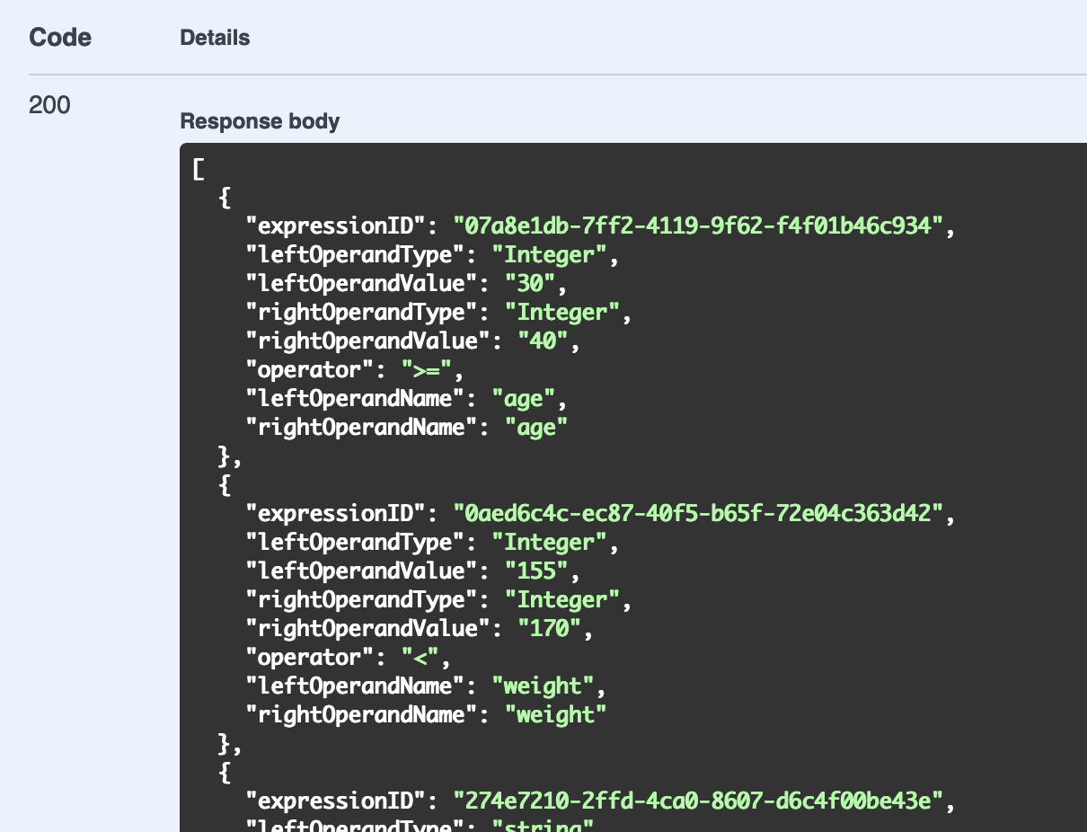
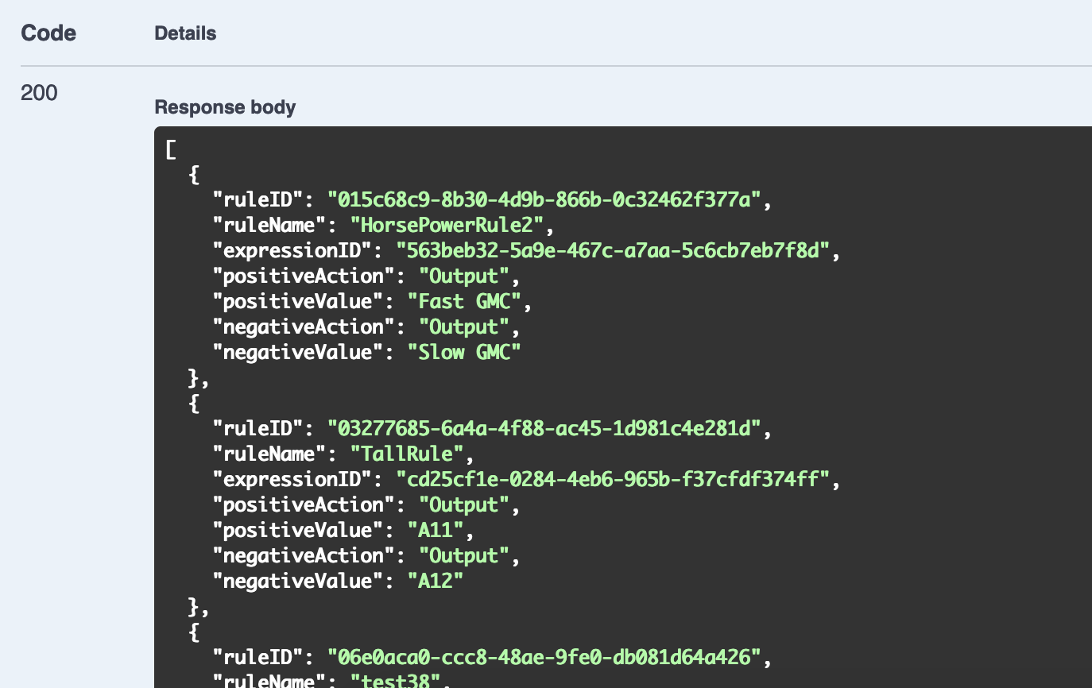
GetAll Function

Slide 16
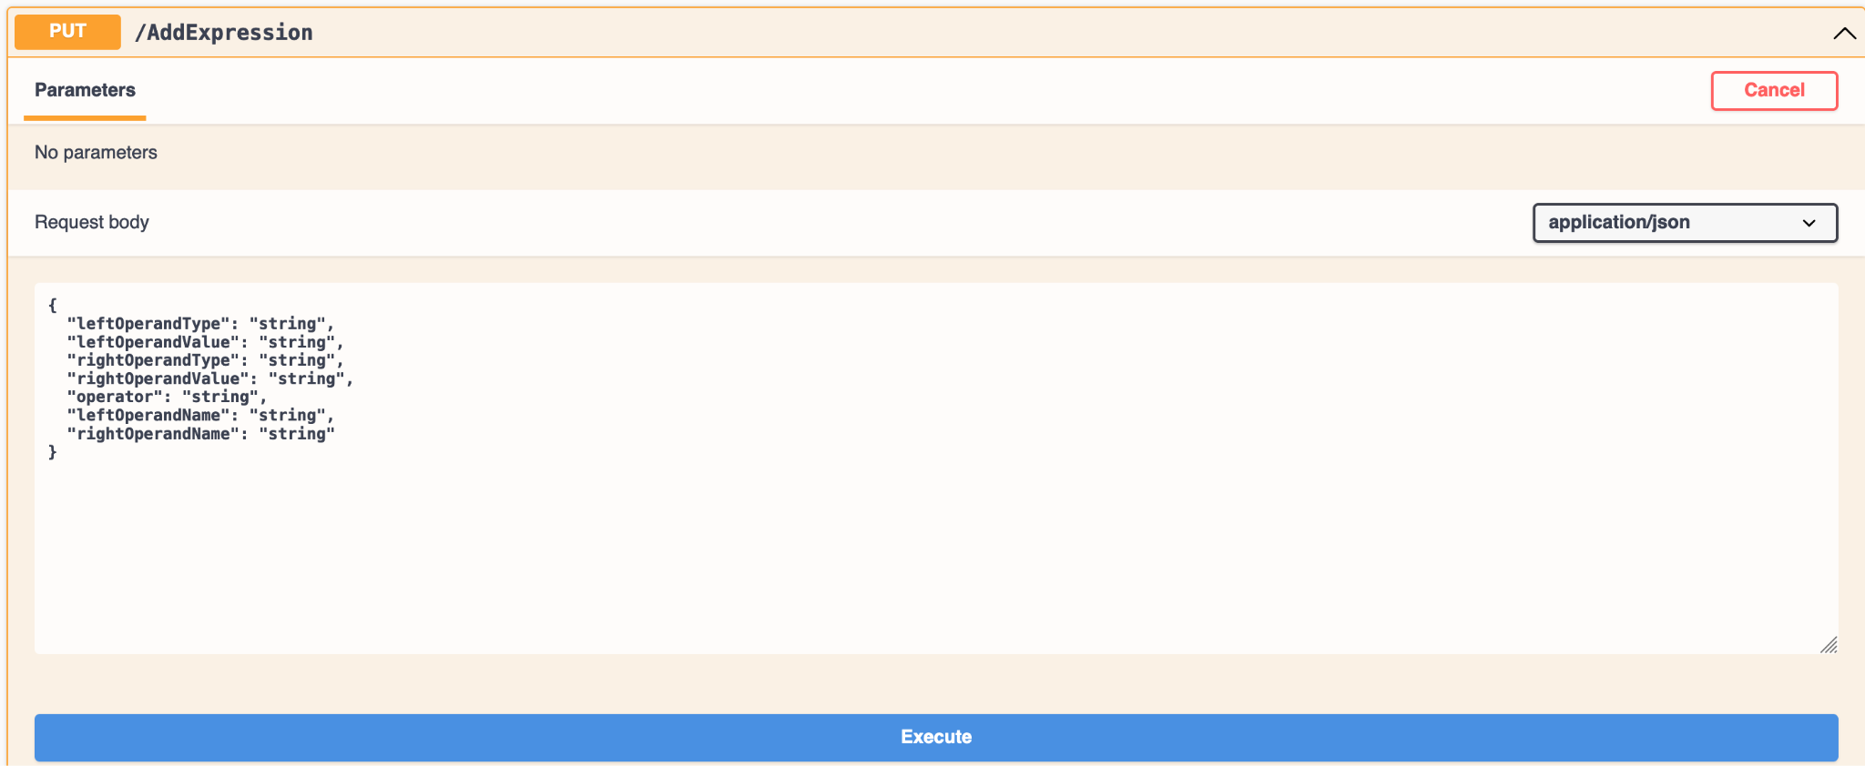
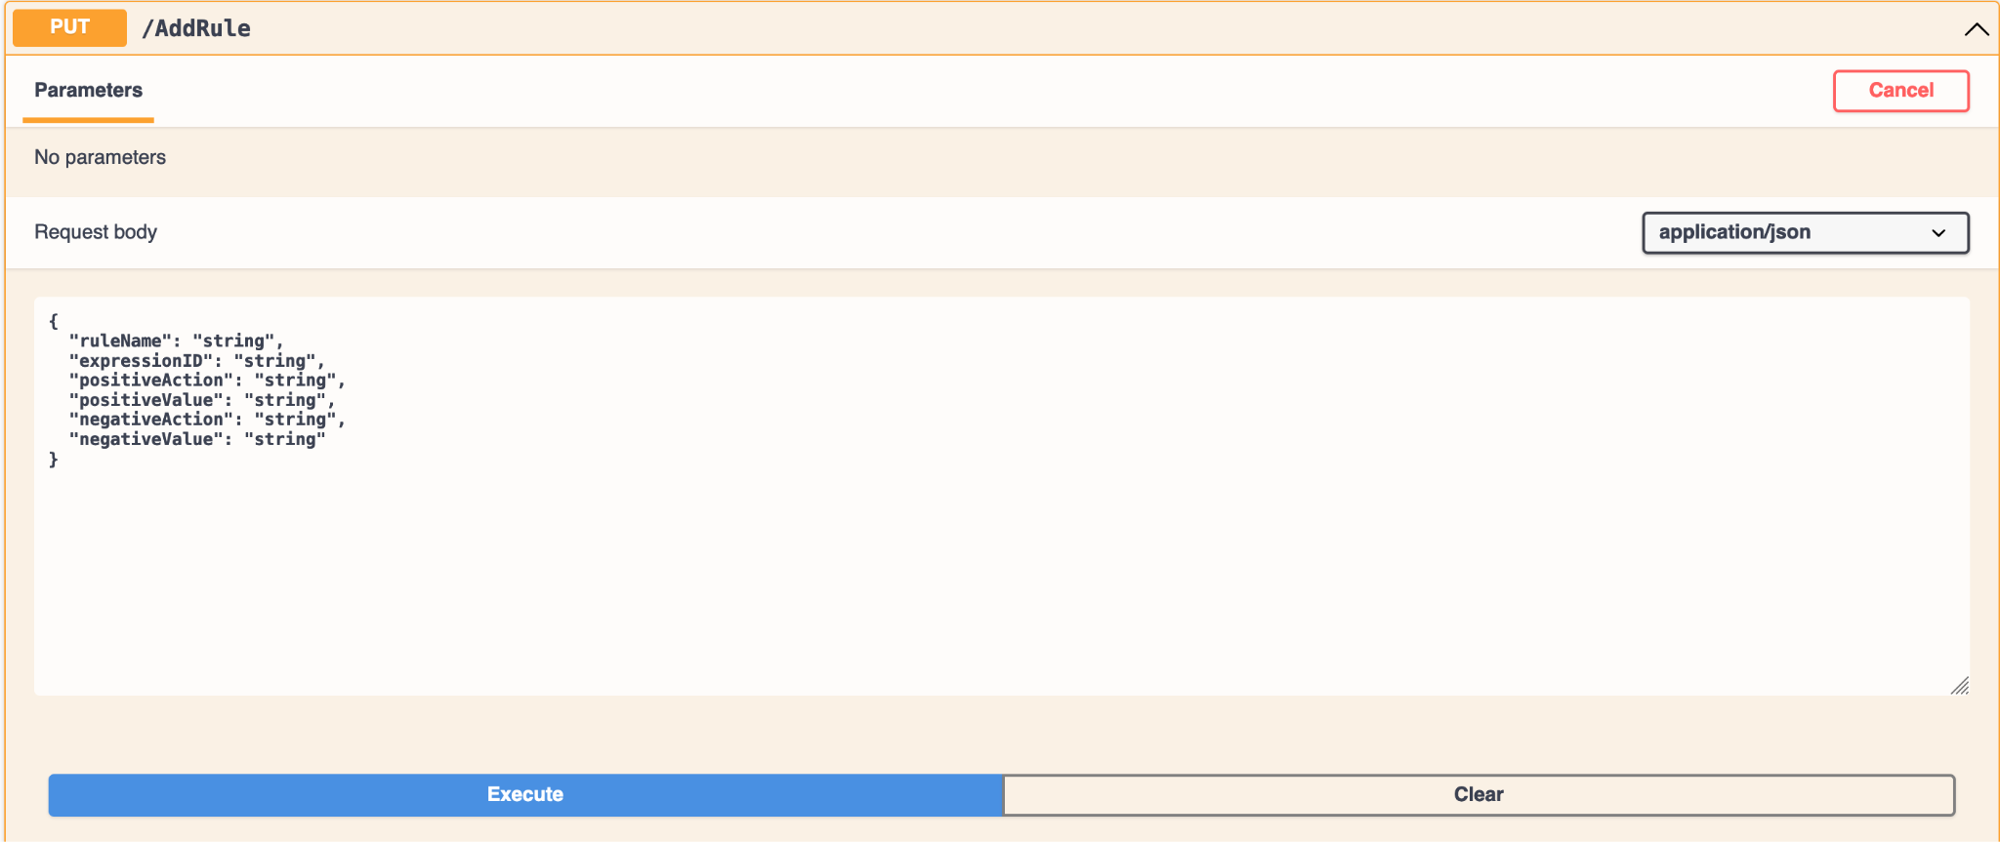
Add Function

Slide 17
Edit Function

Slide 18
Delete Function

Slide 19
Challenges/Solutions
Working with version control applications that not everyone was accustomed to
Not a lot of online resources to implementing something similar
Many of us were new to C# and ASP.NET
Finding time to meet on our own in between busy schedules

Slide 20
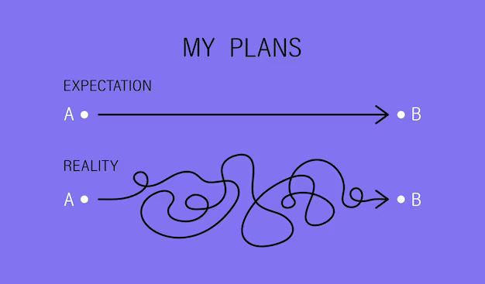
Retrospective - Dashboard
Development
Implemented many features
Solved many bugs
Grown as developers
Not everything goes as planned
Important for any future team to keep in mind when inheriting this project

Slide 21
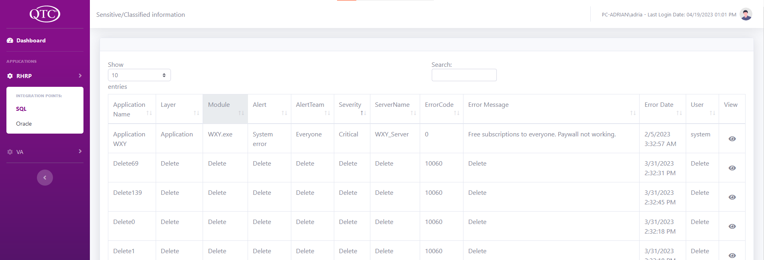
Retrospective - Dashboard
Current:
Future:
Welcome Page:
For us developers
Note taking page
Welcome Page:
No Dashboard home button
No Welcome page
Redirect to the first table of the first application

Slide 22
Retrospective - Rule Engine
Use of the Postman API tool made it easier to pass JSON objects
Few difficulties
Could not implement Nested Expressions
Getting access to database on campus due to IP address issues
Lots of trials and errors involved

Slide 23
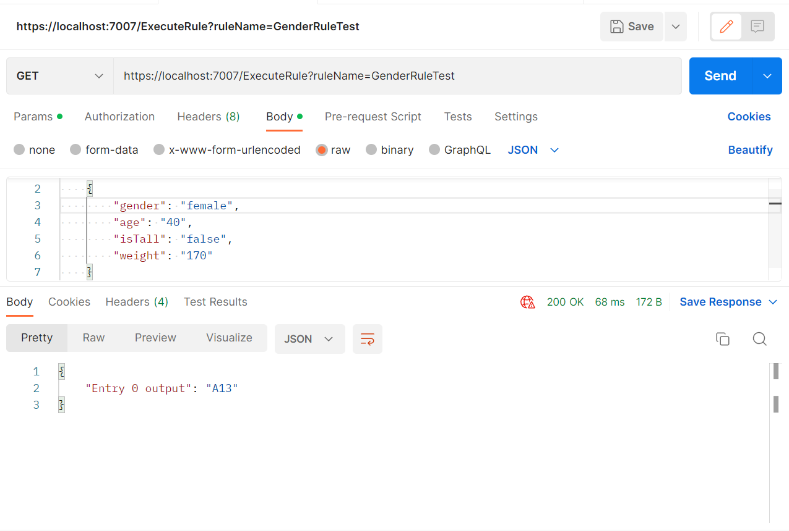
Retrospective - Rule Engine

Slide 24
Achievements
DashBoard
Load and inject the code from the assembly
Display errors based on integration point selected
Users can sort errors based on column headers
Notify users if data is still loading or if there’s no data
Keyword Search filtering
Rule Engine
Create, delete, and edit rules and expressions
Verify if rules or expressions are already in the database
Users may use the rule engine’s functionality with their own databases via Azure
Can notify the user of any exceptions found or any missing information needed

Slide 25
Communication Tech
Github
Discord
Jira
Google Drive
Figma/Photoshop

Slide 26
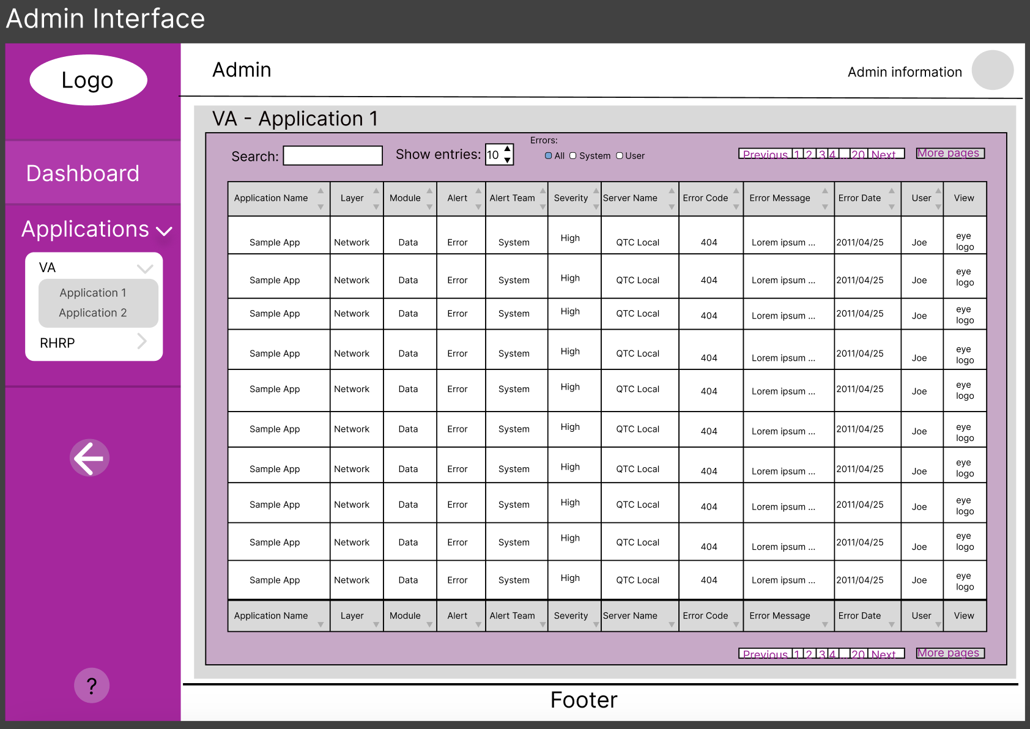
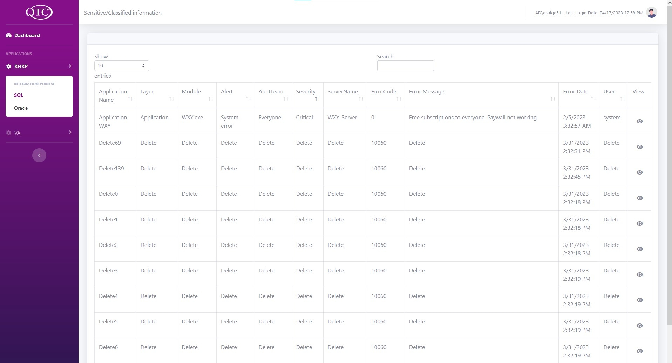
Before
After

Slide 27
Technologies
C# (C Sharp)
HTML, CSS, Javascript
CSHTML
Bootstrap 5
ASP.NET
Azure Database/SQL Server Management Studio
Swagger/Postman API

Slide 28
Smart Dashboard Demo

Slide 29
Business Rule Engine Demo

Slide 30
Thanks!
Do you have any questions?

