Slide 1
Comorbidity and Genetic Factors and their impact on Patients with COVID-19
Francisco Contreras, Jimuel Julaton, Emily Gonzalez, Chen-Ching Lin, Riese Atianzar, Luis Gonzalez, Juan Hernandez, Carlos Hernandez, Ting Fung Ha, Rohan Chatterjee
Advisor - Dr. Navid Amini
Project Liaison - Haley Kirk
Francisco Contreras

Slide 2
Outline
Introduction Full project + branches - Francisco
Blood Type ML
Intro and explanation - Juan
In Depth + conclusion - Rohan
Tableau Portal+Process and Design of the Visualizations - Jimuel
Application
Overview - Carlos
Tools and Technologies - Ting Fung
Front End Design - Riese
Back End Design - Luis
Demo Visualizations - Chen Ching
Demo Features - Emily
Conclusion - Rohan
Francisco Contreras

Slide 3
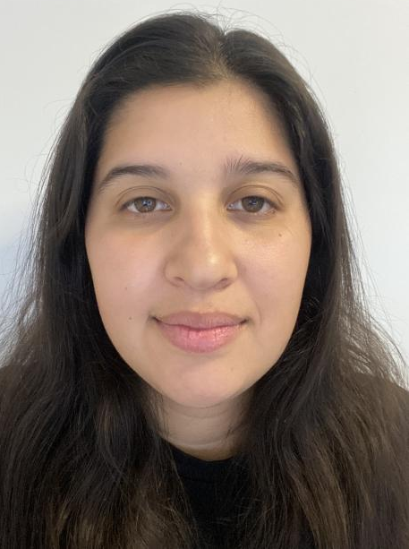
Rohan Chatterjee
Project Lead
Francisco Contreras
User Experience (UX)
Engineer
Jimuel Julaton
Data Visualization Engineer
Juan Hernandez
Data Analyst
Chen-Ching Lin
Data Visualization Engineer
Carlos Hernandez
Data Gatherer/
Developer
Riese Atianzar
User Interface Designer
Emily Gonzalez
Data Visualization Engineer
Ting Fung Ha
Technical Writer
Luis Gonzalez
User Experience (UX)

Slide 4
What is Our Goal?
Gain a better understanding of COVID-19
Study aspects which are frequently overlooked
Blood type, happiness score, etc
How do we accomplish this?
Deliverables is segmented into 3 branches
Francisco Contreras
Notes:
End of intro section

Slide 5
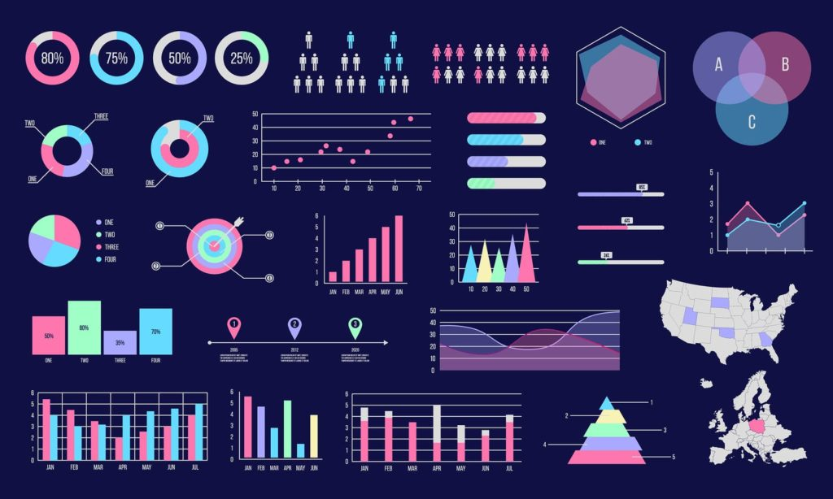
Project Branches
Machine Learning Analysis
Studying comorbidity and genetic factors
Boruta Algorithm, Pearson Correlation, etc
Tableau Portal
Contains Visualizations
Used to design and experiment
JavaScript Application
Remade visualizations from Tableau Portal
Easy navigation and interactive visualizations
More efficient than Tableau Portal
Francisco Contreras

Slide 6
Data
Proprietary/Confidential Data
Francisco Contreras

Slide 7
Machine Learning Analysis
Objective: To determine clinical factors of a poor prognosis in patients with COVID-19 infection
Juan Hernandez

Slide 8
Overview:
Examine medical records of patients with COVID-19 infections to design and construct logistic multivariate regression models adjusted for age and gender
Analyze this data and results to independent predictive factors associated with death, ICU admission and hospitalization of these patients
Focus on genetic factors primary blood groups, and their association with COVID-19
Juan Hernandez

Slide 9
Prior work in COVID-19 related to blood type
Blood type has been linked to a number of health outcomes, including susceptibility to certain diseases and response to treatment
Previous studies have shown that blood type B and AB are more likely to test positive for COVID-19
COVID-19 severity and mortality still remains unclear for the most part
Juan Hernandez

Slide 10
Data
Dataset of anonymous COVID-19 provided by Vodafone
All Patients living in the same region of the world
The dataset consists of:
Basic clinical and demographic information
Infection severity
Symptoms
Outcome
All of the infections have been confirmed by polymerase chain reaction (PCR) tests
Juan Hernandez

Slide 11
Core Features Investigated
Already Known Risk factor for COVID-19:
Age of the patient.
Acute pancreatitis.
Acute rheumatic fever.
Asthma.
Cancer.
Chronic kidney disease.
Chronic liver disease.
Chronic obstructive pulmonary disease.
Diabetes mellitus.
Hypertension
Infection type: Symptomatic or Asymptomatic:
Fever
Chills
Cough
Dyspnea
Anosmia Ageusia
Loss of Appetite
Asthenia
Headache
Cyanosis
Rhinorrhea
Sore Throat
Diarrhea
Muscle Ache
Nausea Vomiting
Gender.
Blood Group
Time between exposure to the virus and the onset of symptoms. (dropped due to bias)
Juan Hernandez

Slide 12
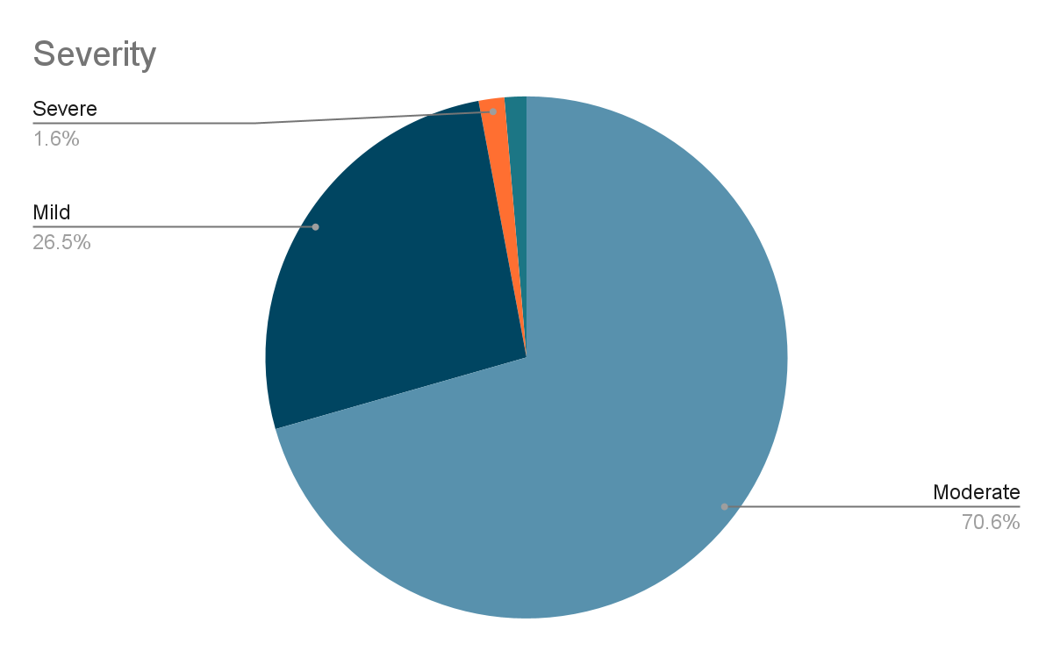
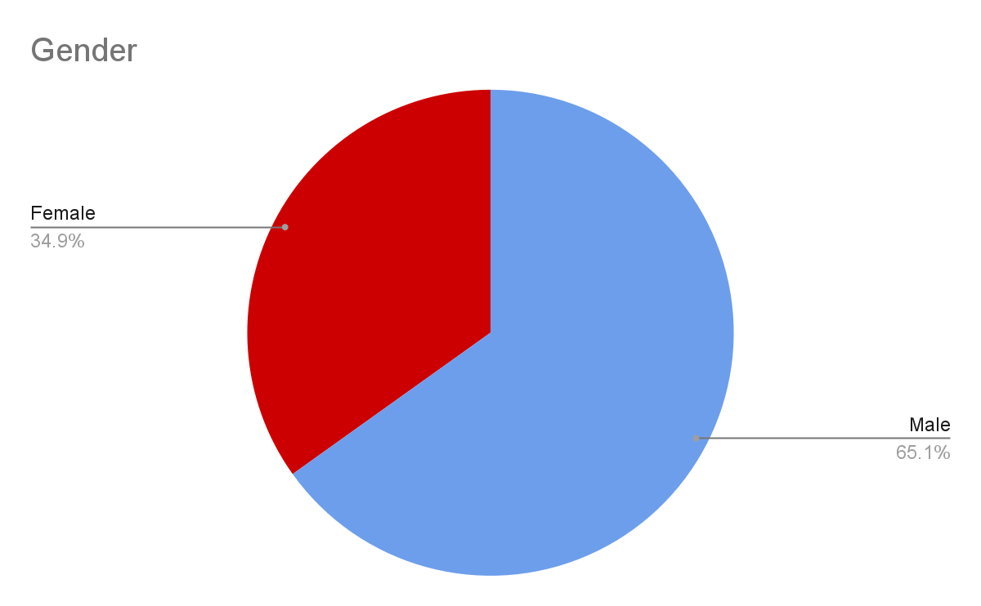
Details
Outcome counter:
Recovered: 5492, Died:176
Severity counter:
Moderate: 4000,Mild: 1501,Severe:90,Critical: 77
Samples For Blood Type
A+ | 1493
A- | 79
AB+ | 511
AB- | 134
B+ | 1653
B- | 227
O+ | 1495
O- | 76
Total | 5668
Juan Hernandez

Slide 13
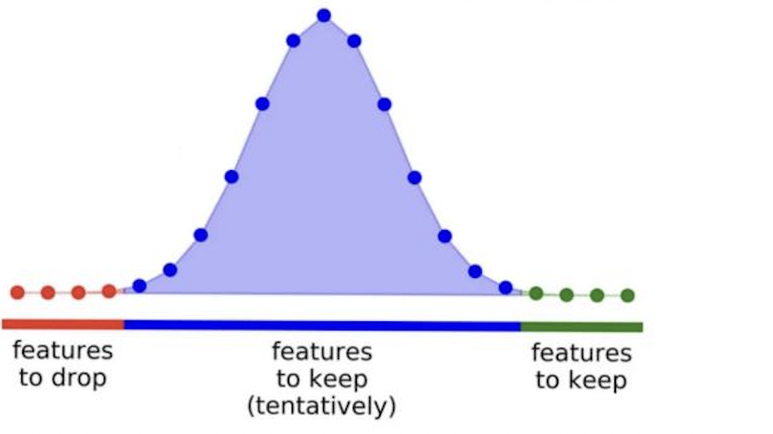
The Boruta Algorithm
Boruta is a feature selection algorithm
Steps of The Boruta Algorithm:
Create new dataset with doubled number of columns which contain shadow features.
Train a random forest model on the new dataset.
For every feature, we determine it is important if the level of importance of the original feature is greater then the max level of importance of the shadow feature, or a “hit”.
We iterate the above 3 steps n times and determine the important features.
Juan Hernandez

Slide 14
Methods and Results
Rohan Chatterjee

Slide 15
Boruta Identified Core Features
Boruta (A+)
Chills
Cyanosis
Diarrhea
Cough
Sore Throat
Boruta (B+)
Chills
Cyanosis
Diarrhea
Cough
Sore Throat
Boruta (AB+)
Chills
Cyanosis
Diarrhea
Cough
Sore Throat
Boruta (O+)
Chills
Cyanosis
Diarrhea
Cough
Sore Throat
Boruta Outcome (All Blood Types)
Chills
Cyanosis
Diarrhea
Cough
Sore Throat
Boruta (A-)
Chills
Cyanosis
Boruta (B-)
Chills
Cyanosis
Diarrhea
Cough
Sore Throat
Boruta (AB-)
Chills
Cyanosis
Diarrhea
Boruta (O-)
Chills
Cyanosis
Diarrhea
Rohan Chatterjee

Slide 16
Core Features Statistical Tests (All Blood Types)
(Top 5 In order) Chi-Square Test
Cyanosis
Diarrhea
Sore Throat
Cough
Chills
(Top 5 In order) Fisher's Exact Correlation (P Value)
Cyanosis
Diarrhea
Cough
Sore Throat
Chills
Boruta
Chills
Cyanosis
Diarrhea
Cough
Sore Throat
Chi-Square is used to test the independence between categorical variables.
Fisher's exact test is used to determine if there is a significant association between two categorical variables.
(works well with small samples)
Rohan Chatterjee

Slide 17
Next Steps
For Each Blood Type
{
Machine Learning Algorithm
All samples with a single varying feature related to blood type.
Boruta Selection
Ada Boost
Logistic Regression
Random Forest
…
Rohan Chatterjee

Slide 18
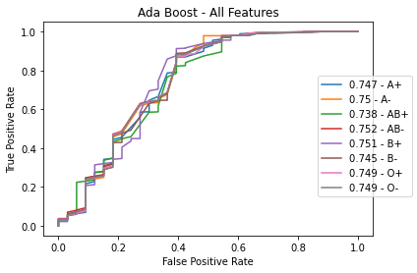
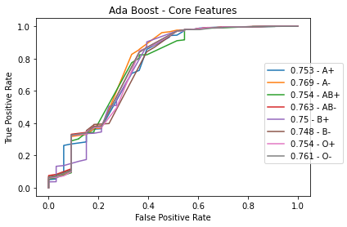
AdaBoost Mortality (Mortality)
Rohan Chatterjee

Slide 19
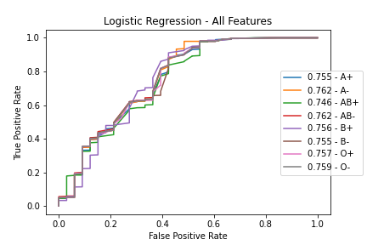
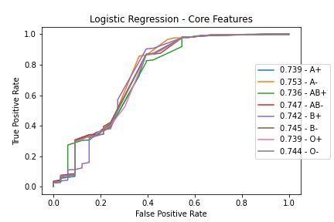
Logistic Regression (Mortality)
Rohan Chatterjee

Slide 20
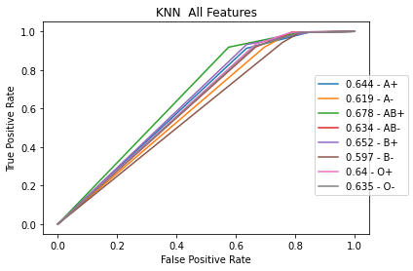
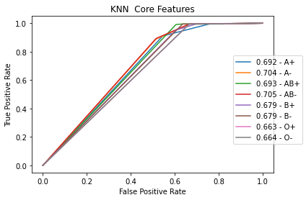
K-Nearest Neighbors (Mortality)
Rohan Chatterjee

Slide 21
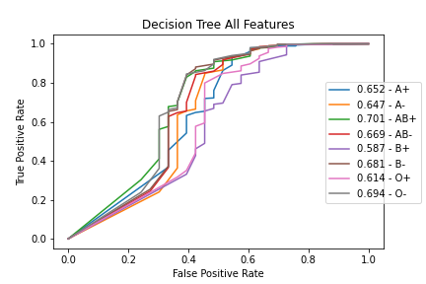
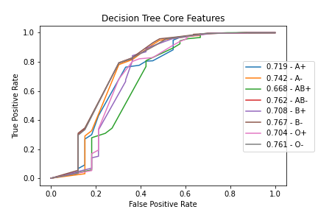
Decision Tree Mortality (Mortality)
Rohan Chatterjee

Slide 22
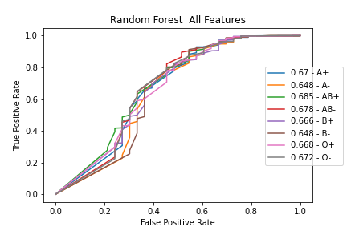
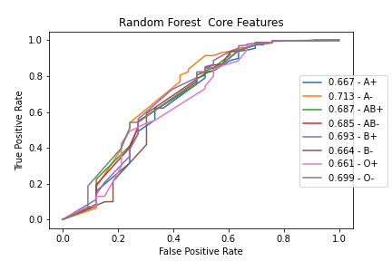
Random Forest Mortality (Mortality)
Rohan Chatterjee

Slide 23
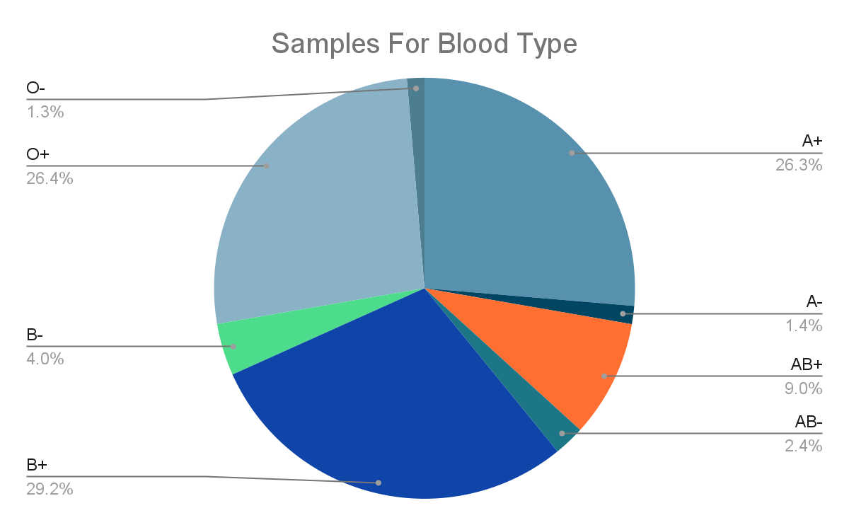
Results
All Features
Core Features
Rohan Chatterjee

Slide 24
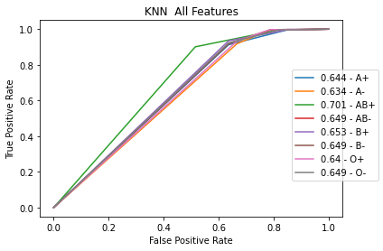
Severity (All Blood Types)
Boruta Severity (All Blood Types)
Chills
Cyanosis
Diarrhea
Cough
Sore Throat
Rohan Chatterjee

Slide 25
Tableau Branch Overview
Tableau
A professional visual analytics application
Used to create and experiment with data visualizations
Tableau Public
A browser version of Tableau
Allows us to share our data visualizations
Jimuel Julaton

Slide 26
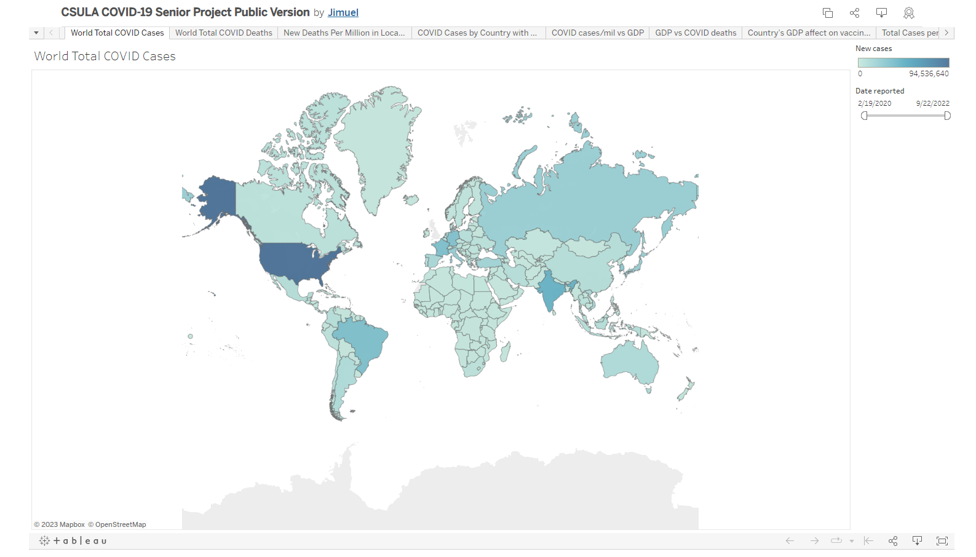
Tableau Public Portal
Link
Jimuel Julaton

Slide 27
Research Process
The Tableau branch mainly focused on the research of possible external factors that could’ve impact COVID-19
Brainstorm
Research
Visualize
Analyze
Jimuel Julaton

Slide 28
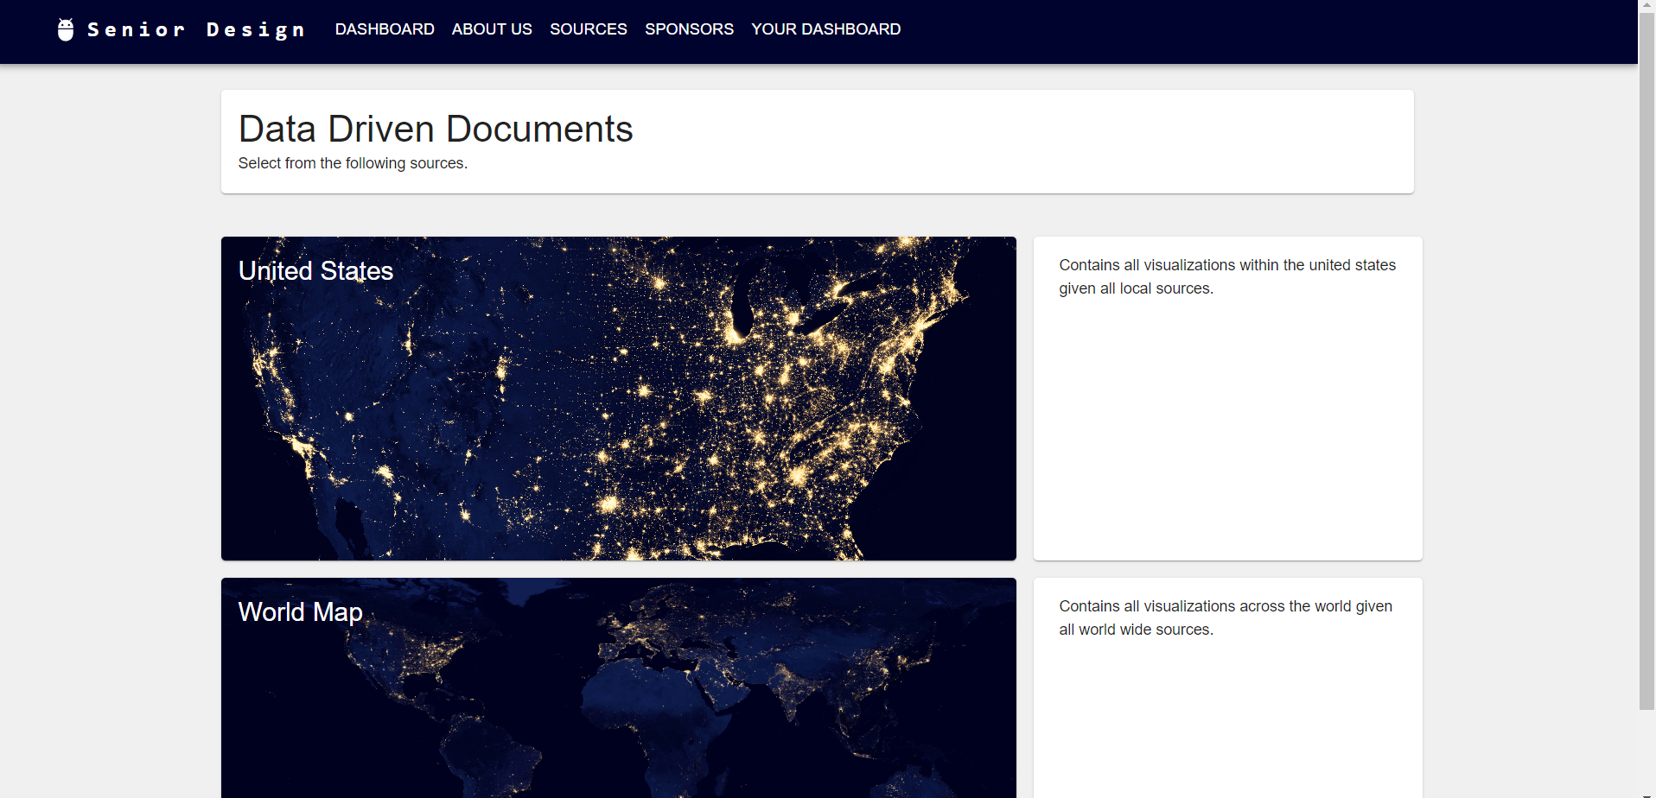
Javascript Application Overview
What is the purpose of the JavaScript Application?
Simplistic portal reaches a wider audience
Dynamic coding allows for longevity
Faster loading times and advanced filtering options
Carlos Hernandez

Slide 29
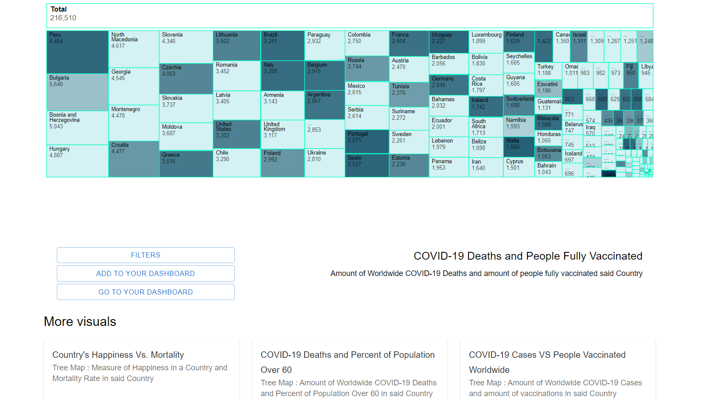
Navigation
UI is separated into 3 parts:
Data and Visualization
Options to apply filters or add to dashboard
More Visualizations to explore
Carlos Hernandez

Slide 30
Navigation (Continued)
Main Page
Intuitive navigation is one of the most important elements of any successful application.
Efficiently designed applications help users traverse through different pages, enabling them to find useful information quickly.
A simple hierarchy helps users develop an easy mental map for using the application.
Toolbar
About Us
Resources
Select
Region
Sponsors
Dashboard
Visuals
Active Visualization
Filter
Carlos Hernandez

Slide 31
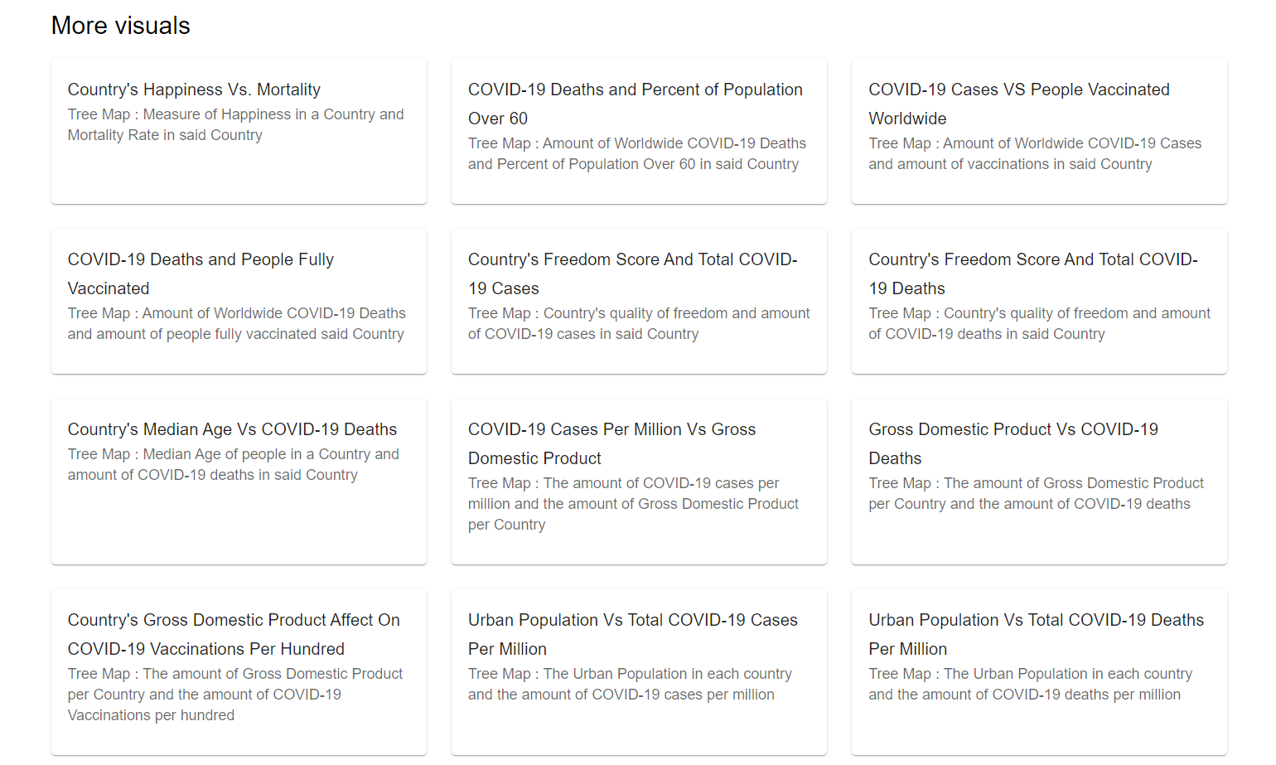
Quality of Life
Modular design allows for easy insertion of new data
Maintenance is also easy for existing data structures
Carlos Hernandez

Slide 32
Tools and Technologies – Goals
Provide pleasant user experience while maintain a professional layout
Have full control of the application
Applied contemporary technologies used in the industry
Ting Fung Ha

Slide 33
Tools and Technologies - Main JavaScript Libraries
React
Easy to learn and implement
Provide the framework for interactive applications
Excellent compatibilities with other JS libraries
Material UI
Offer a variety of customizable components and styles for better aesthetics
D3
A powerful tool for creating interactive and dynamic visualizations
DOM manipulations
Ting Fung Ha

Slide 34
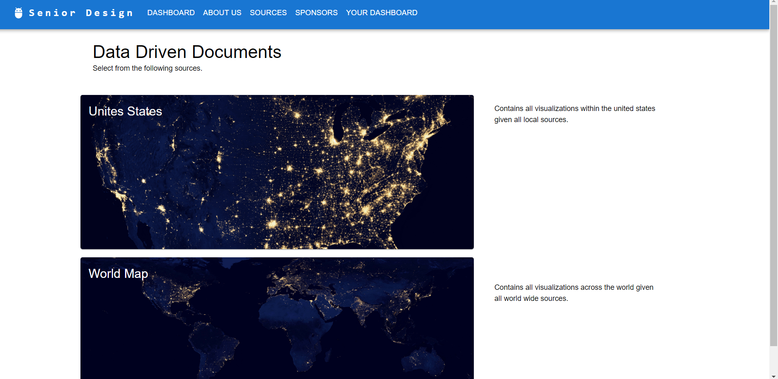
Front End Of Application
Utilizes cards in order to allow the user to select from two different sources for data visualization.
Riese Atianzar

Slide 35
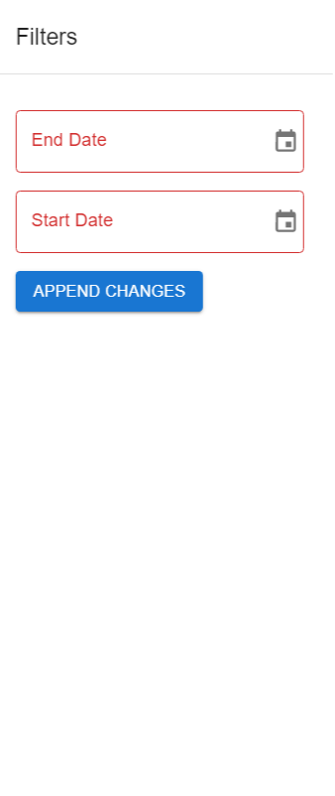
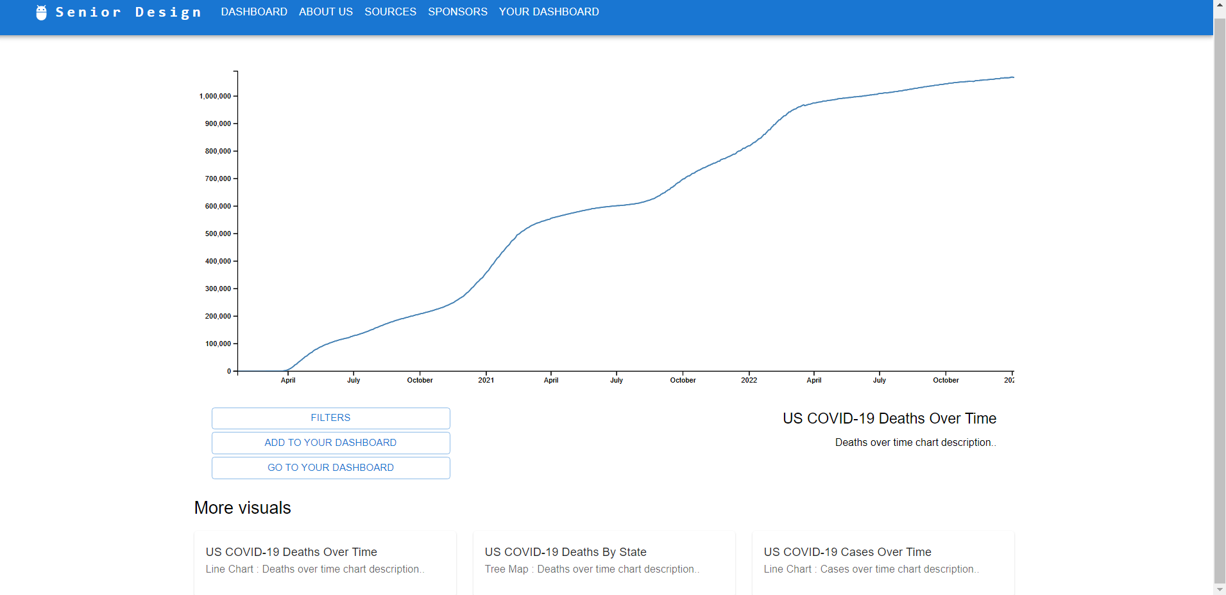
Expanding Visualizations & Filters
Riese Atianzar

Slide 36
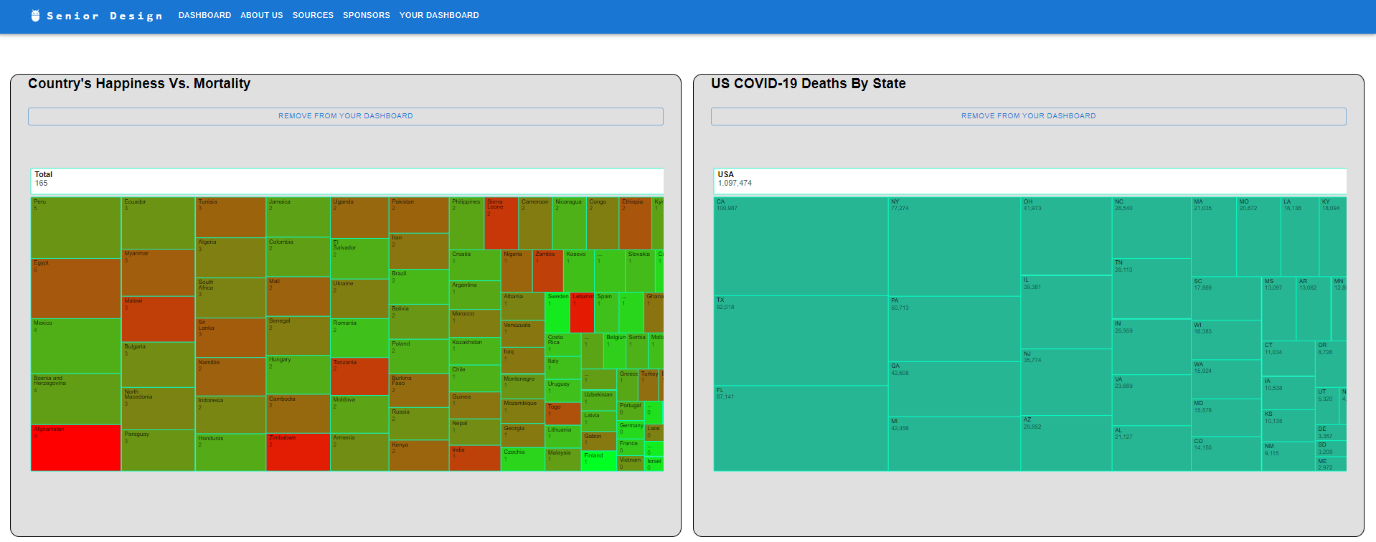
User’s Custom Dashboard Function
Riese Atianzar

Slide 37
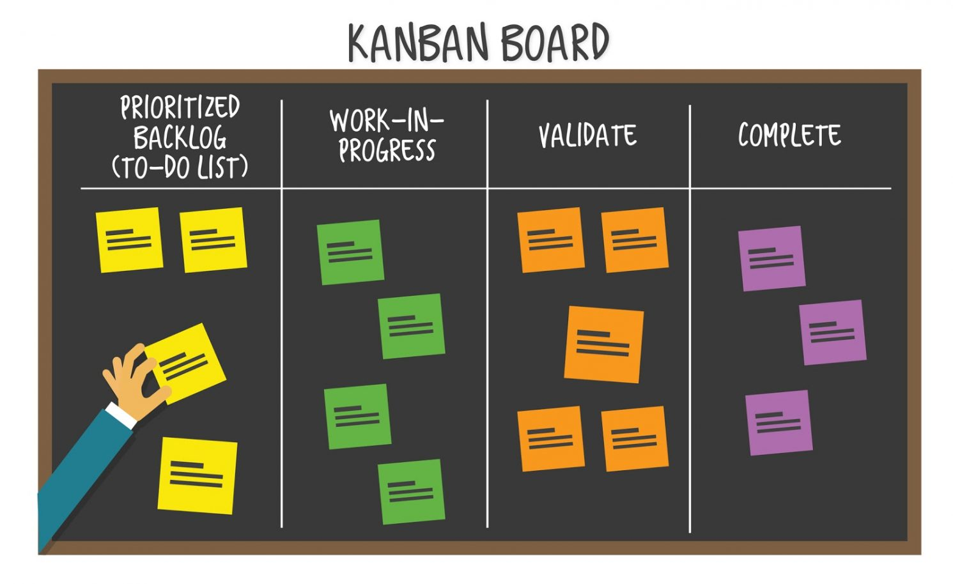
Development
Kanban is a popular framework used to implement agile and DevOps software development.
Collaboration: Kanban was created to improve the way people work together.
Understanding: Individual and organizational self-knowledge of the starting point is necessary to move forward and improve.
Luis Gonzalez

Slide 38
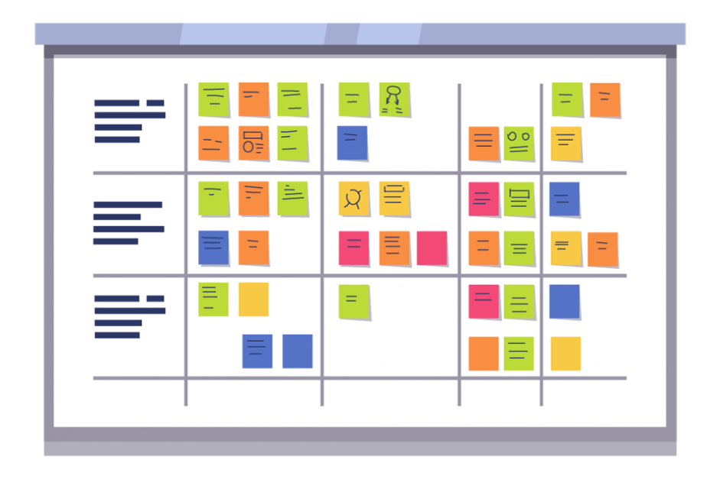
Our Development Cycle
Backlog
To do
Validation
Complete
Luis Gonzalez

Slide 39
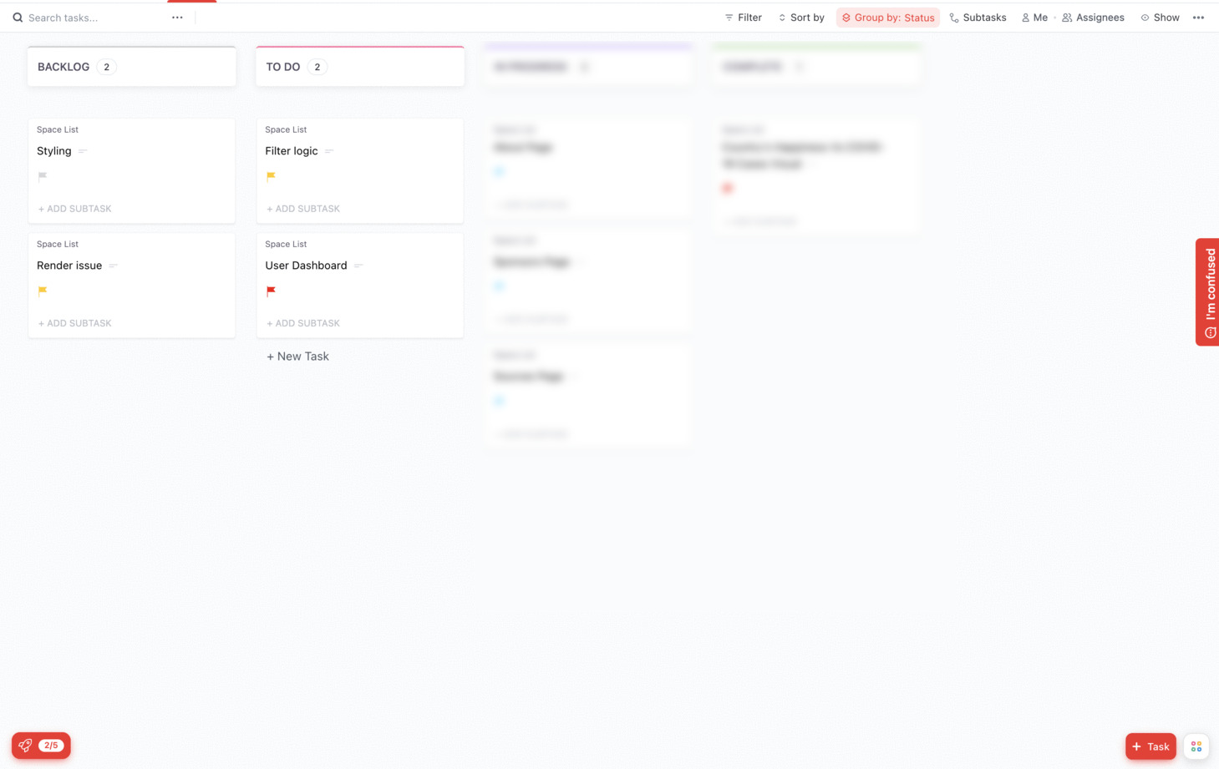
Backlog and To do Columns
- Our backlog consists of multiple tasks which have been reviewed by the team beforehand during our weekly meetings.
- 2 week sprints
- We want to approach each task based on importance. Each member is then assigned a task to complete.
Luis Gonzalez

Slide 40
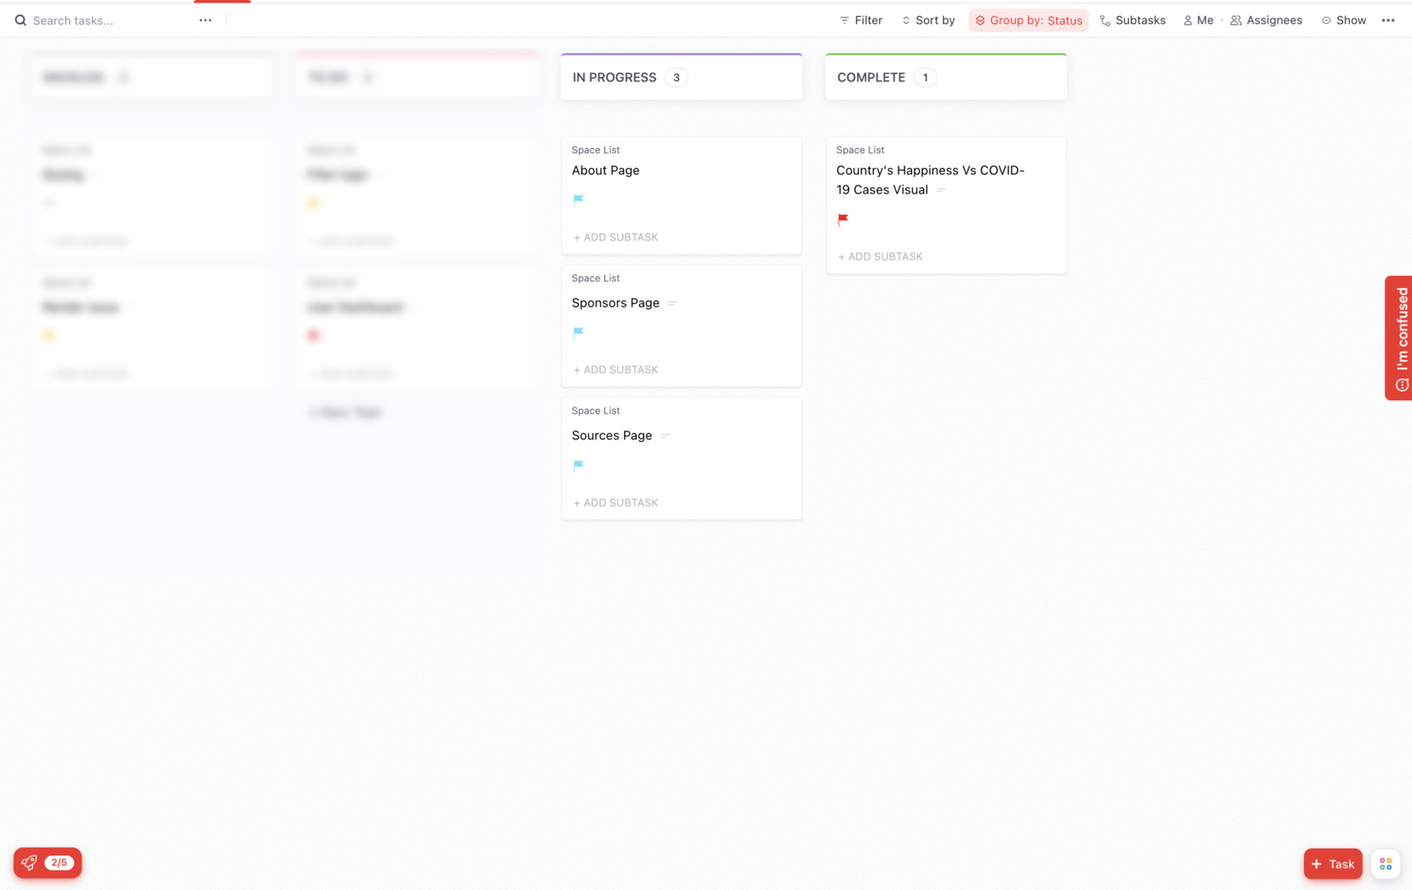
Validate and complete columns
In progress: Tasks are attempted to be completed.
In complete: share information with work that has been done, has not been done, work that has been added, and work removed from the sprint.
Luis Gonzalez

Slide 41
Demo
Chen-Ching Lin and Emily Gonzalez

Slide 42
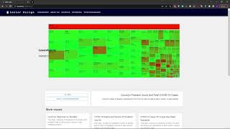
Chen-Ching Lin

Slide 43
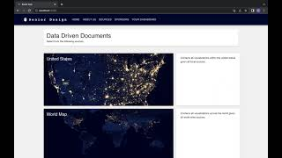
Emily Gonzalez

Slide 44
Conclusion
Rohan Chatterjee

Slide 45
Machine Learning Analysis
Identified Core Comorbidities associated with COVID-19
Core Comorbidities helped reduce noise in the models
No significant changes were found when examining blood type
Blood type likely has no effect on COVID-19 mortality
Machine Learning
Rohan Chatterjee

Slide 46
Tableau
Designed Visualizations to show the association between various factors and COVID-19 cases, vaccination, and mortality
Available on Tableau Portal
Limitations:
Inability to easily access Realtime data
Limited interactions with the visualizations
Difficult navigation
Tableau
Portal
Rohan Chatterjee

Slide 47
Application
Circumvents Tableau portal limitations
Advantages of the application:
All visualizations available publicly
Easily share results with a wider audience
Dynamic real-time visualizations
Faster loading times
Easy navigation
Custom features
Javascript
Application
Rohan Chatterjee

Slide 48
Thank You
Rohan Chatterjee

