Slide 1
Digitization and Modernization of PDHelpdesk Ticketing System
Presented by: Nshan Kazaryan, Gilbert Hopkins, Marie Karibyan, Geovanny Huerta, Mark Perez, Kevin Trochez, Brandon Estrada, Biruk Mengeste, Hoai Nam Cao
Project Advisor: Dr. Chengyu Sun
Sponsored By: Santa Barbara Public Defender Office

Slide 2
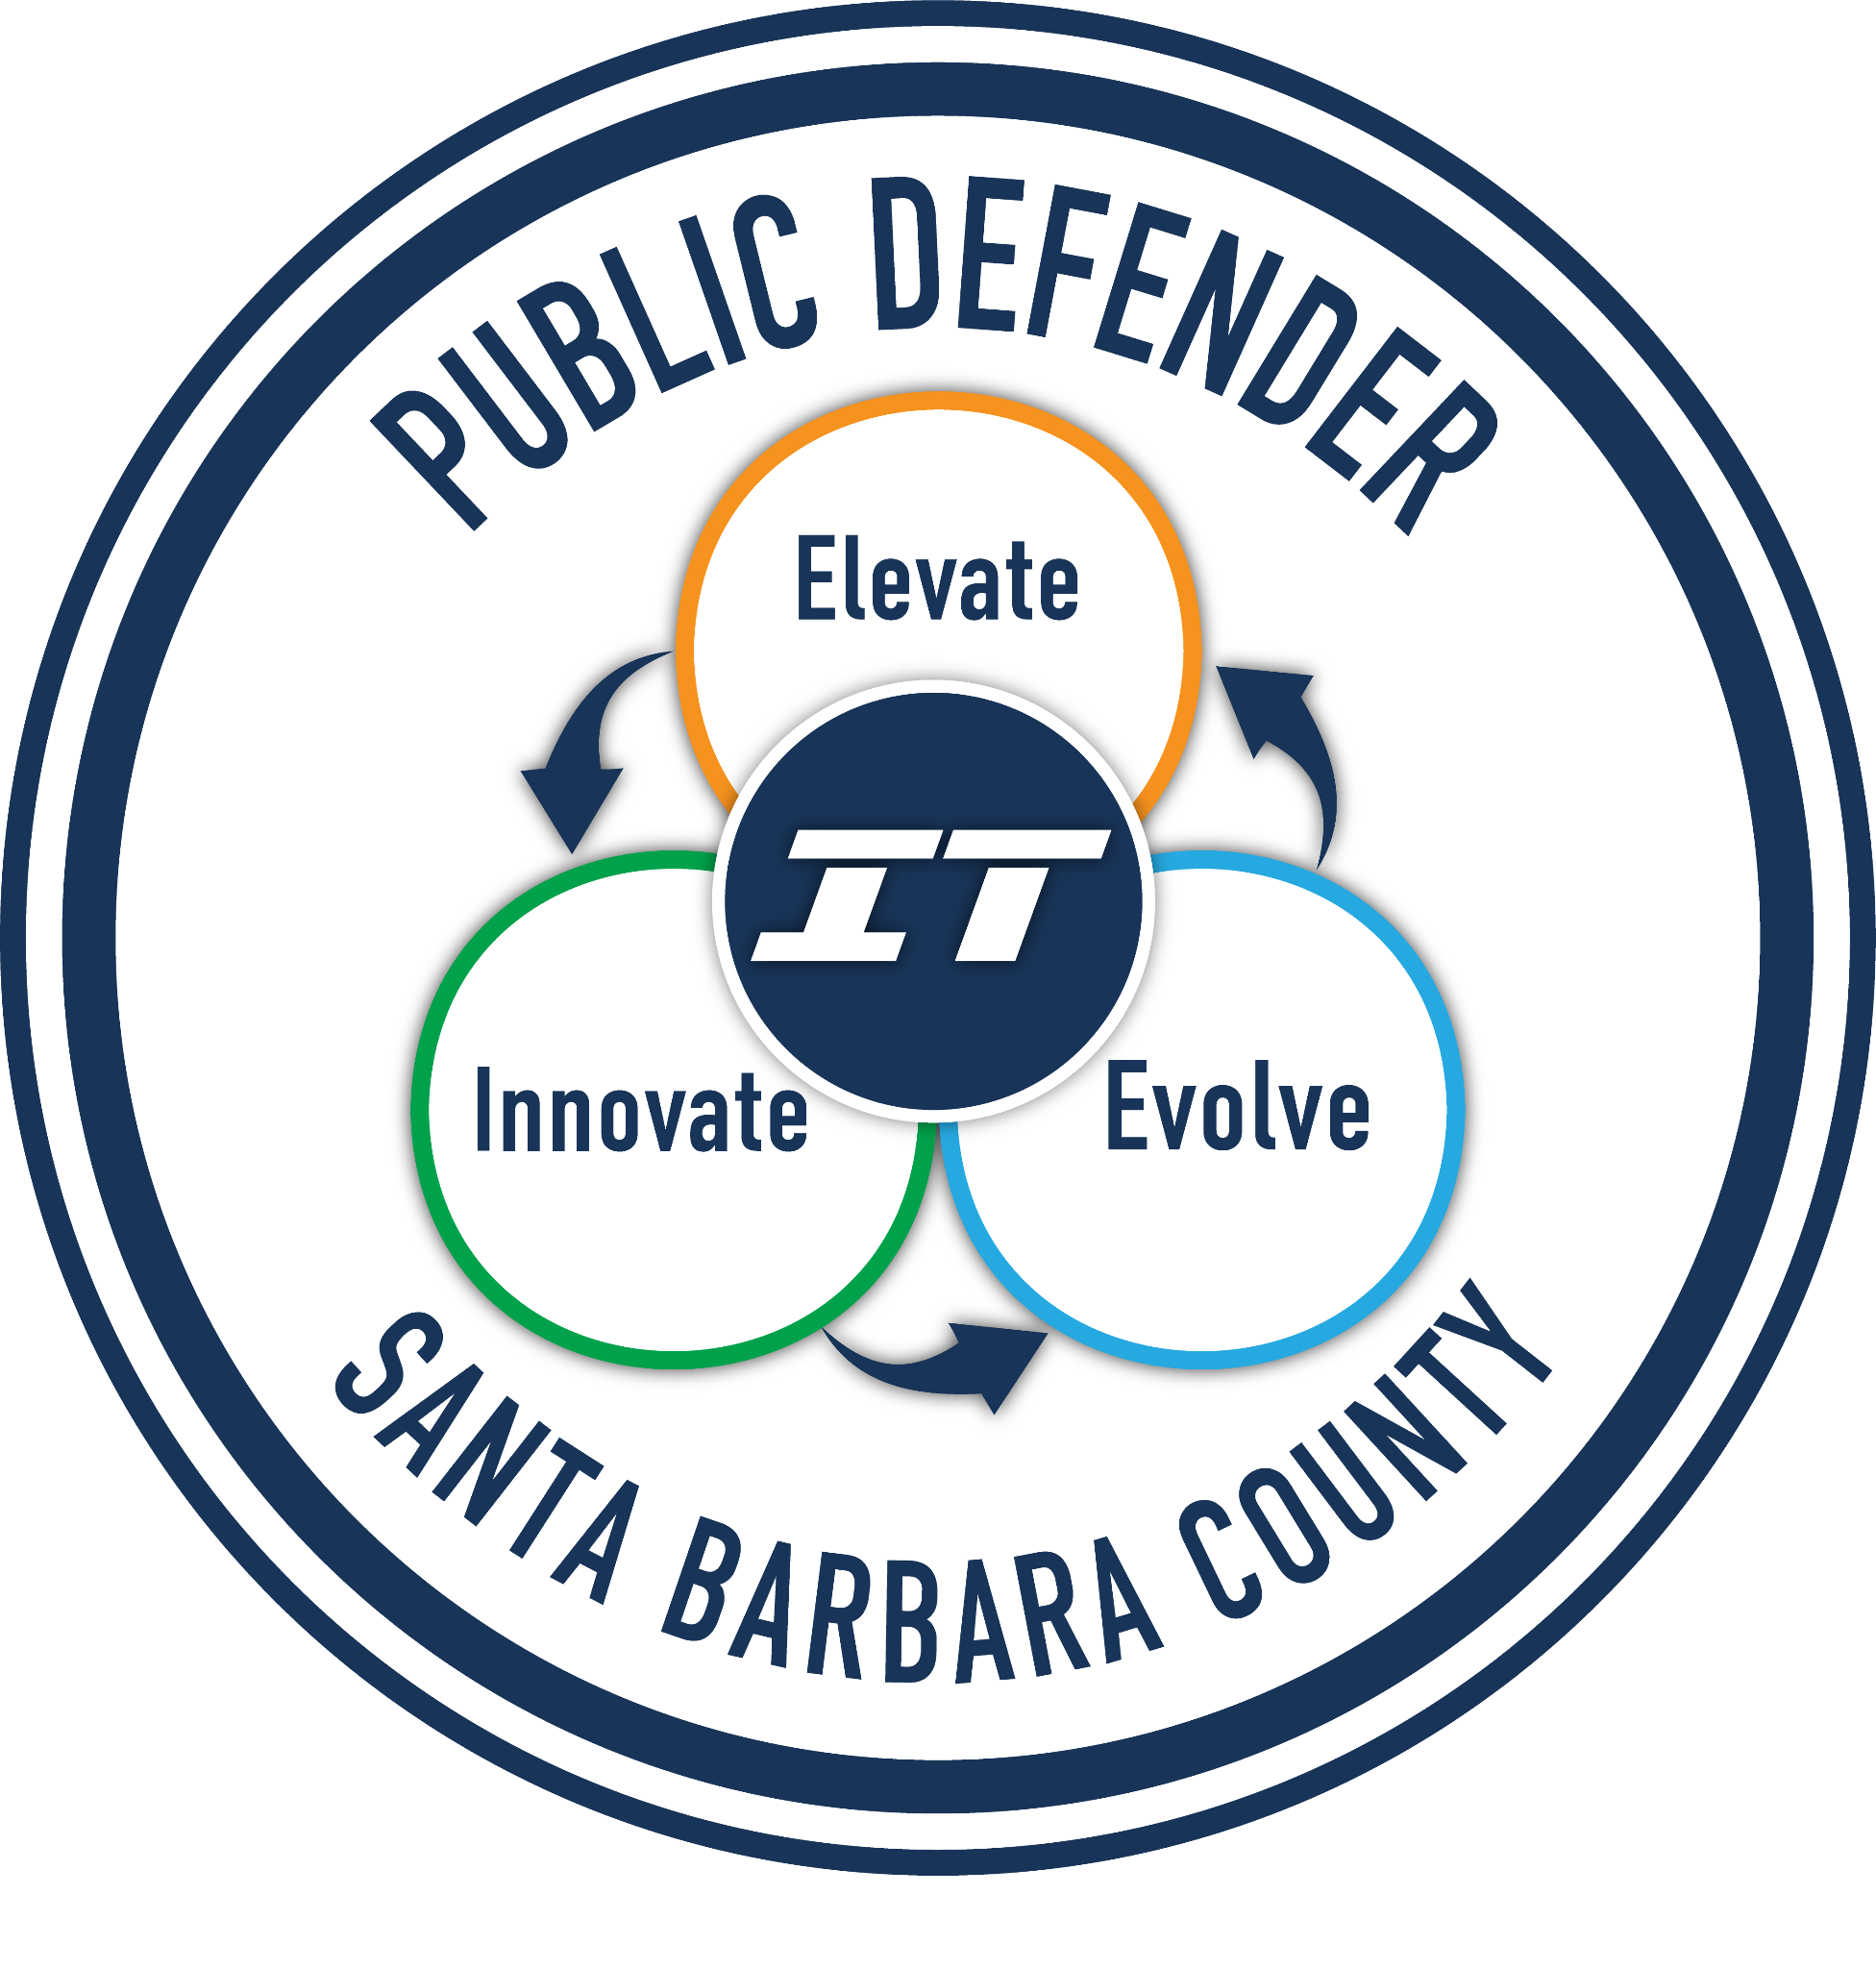
Teams
UI
Database
Santa Barbara
Marie Karibyan
Mark Perez
Kevin Trochez
Brandon Estrada
Biruk Mengeste
Nshan Kazaryan
Gilbert Hopkins
Geovanny Huerta
Hoai Nam Cao
Deepak Budwani
Brent Modell
Luis Ramirez
Angella Stokke

Slide 3
Presentation Overview
Project Intro
Purpose/Goals
System Design
Project Background
Why this project?
System Components
Limitations
Conclusion
Application Constraints
Final Thoughts

Slide 4
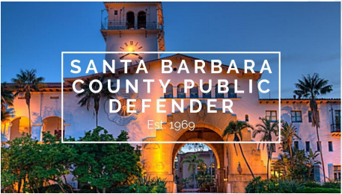
Who is Santa Barbara Public defender?
Provide legal services across cities of Santa Maria, Santa Barbara, and Lompoc
Mission: Protect and defend the rights of their clients through legal representation of the highest quality

Slide 5
Project Introduction
Santa Barbara Public Defender PDHelpDesk Ticketing System
Ticketing System
CURRENT SYSTEM
Proposed
Solution
What is a Ticketing System?
How is the current system utilized?
PowerApps Application

Slide 6
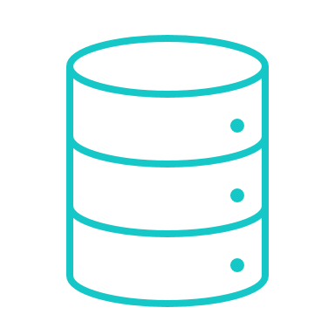
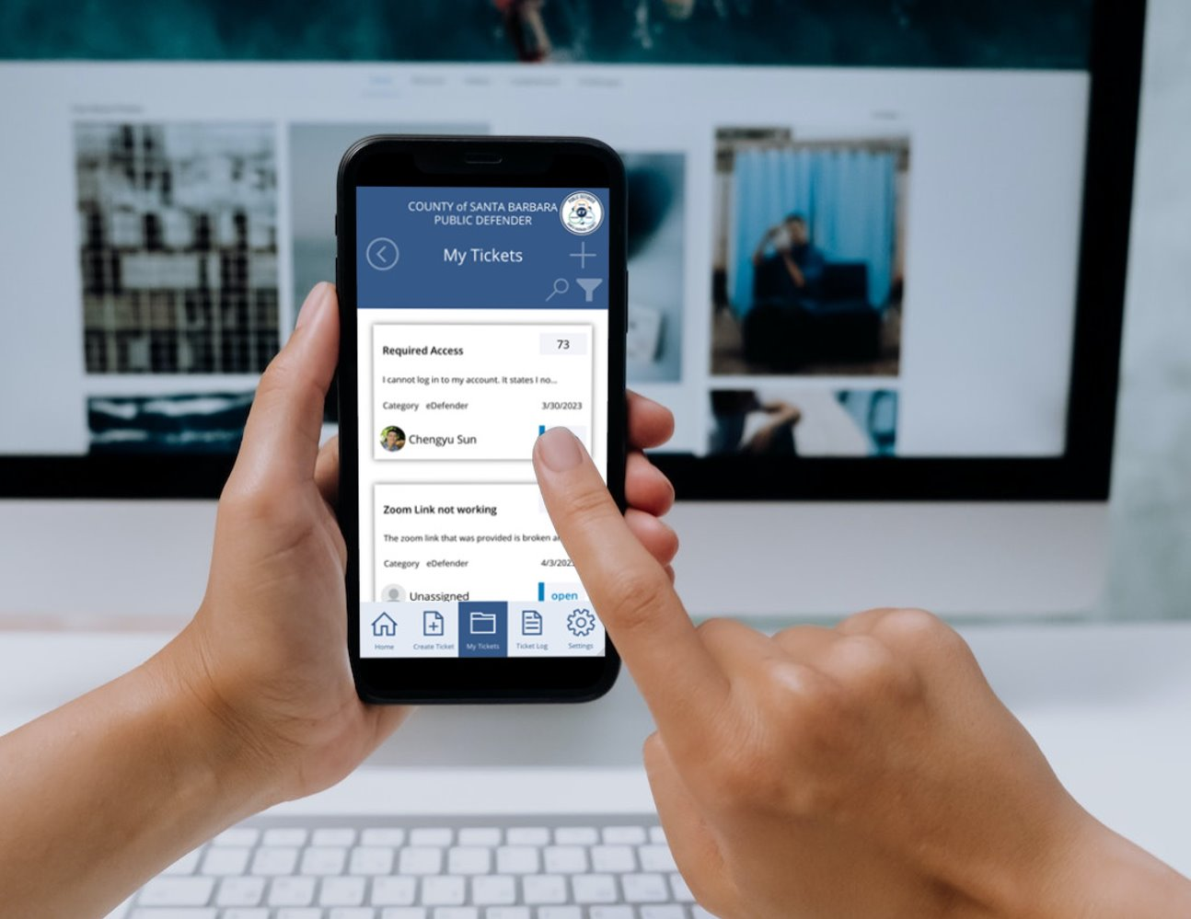
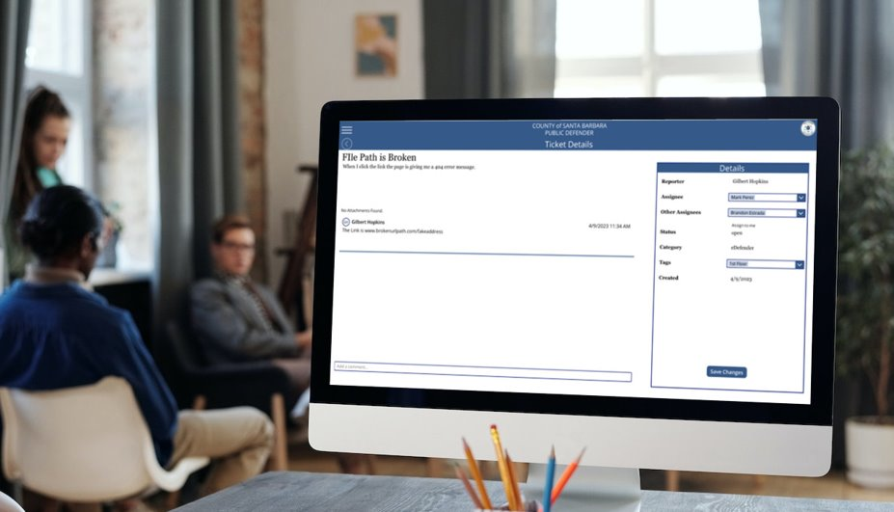
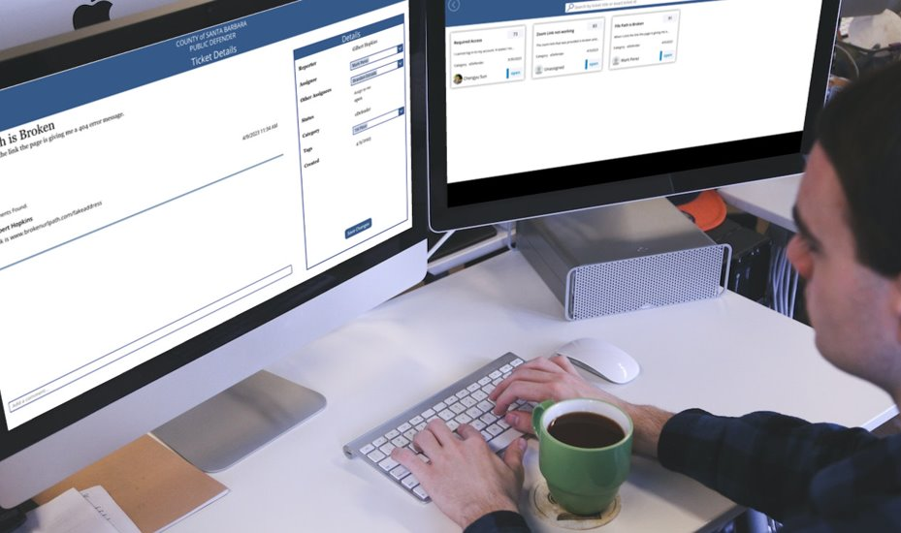
Purpose/goals
Product
Ticket Hub
Data
Notes:
SBPD, is in need of a new ticketing system. They have a home built email based solution that gets the job done but is not completely scalable.
First, we took a mobile centered focus, when designing and building the application. The expectation was that most of the userbase would be out of the office during the day and have their mobile devices on hand, such as their smartphones. Needless to say, is that we also have a traditional desktop experience as well.
Our second goal was to create a centralized hub for all support tickets. This would make the process of creating, managing, and tracking tickets much easier to manage and automate. Automation would take the form of configuring a set of rules for the system to allow for auto-assignment of tickets to technicians.
Finally, data insight and the ability for data analysis was a big goal for us. Gathering data insights and identifying trends will allow SBPD to make data-driven decisions and continuously improve their support services.

Slide 7
TECHNologies used
Share point
Power Apps
Power Automate
GitHub
Notes:
Stuff we used:
Power apps
Sharepoint
Power Automate
Github
Microsoft 365

Slide 8
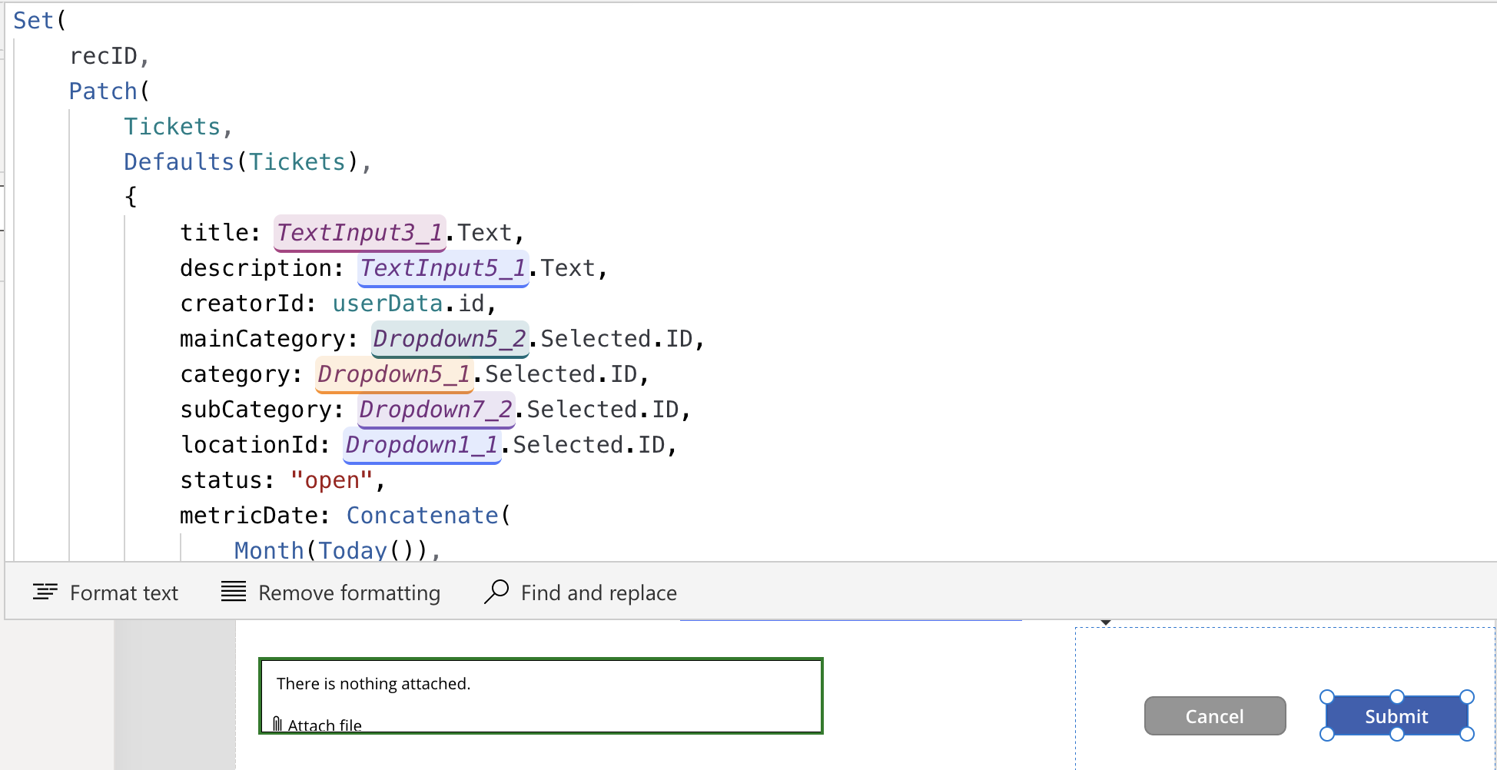
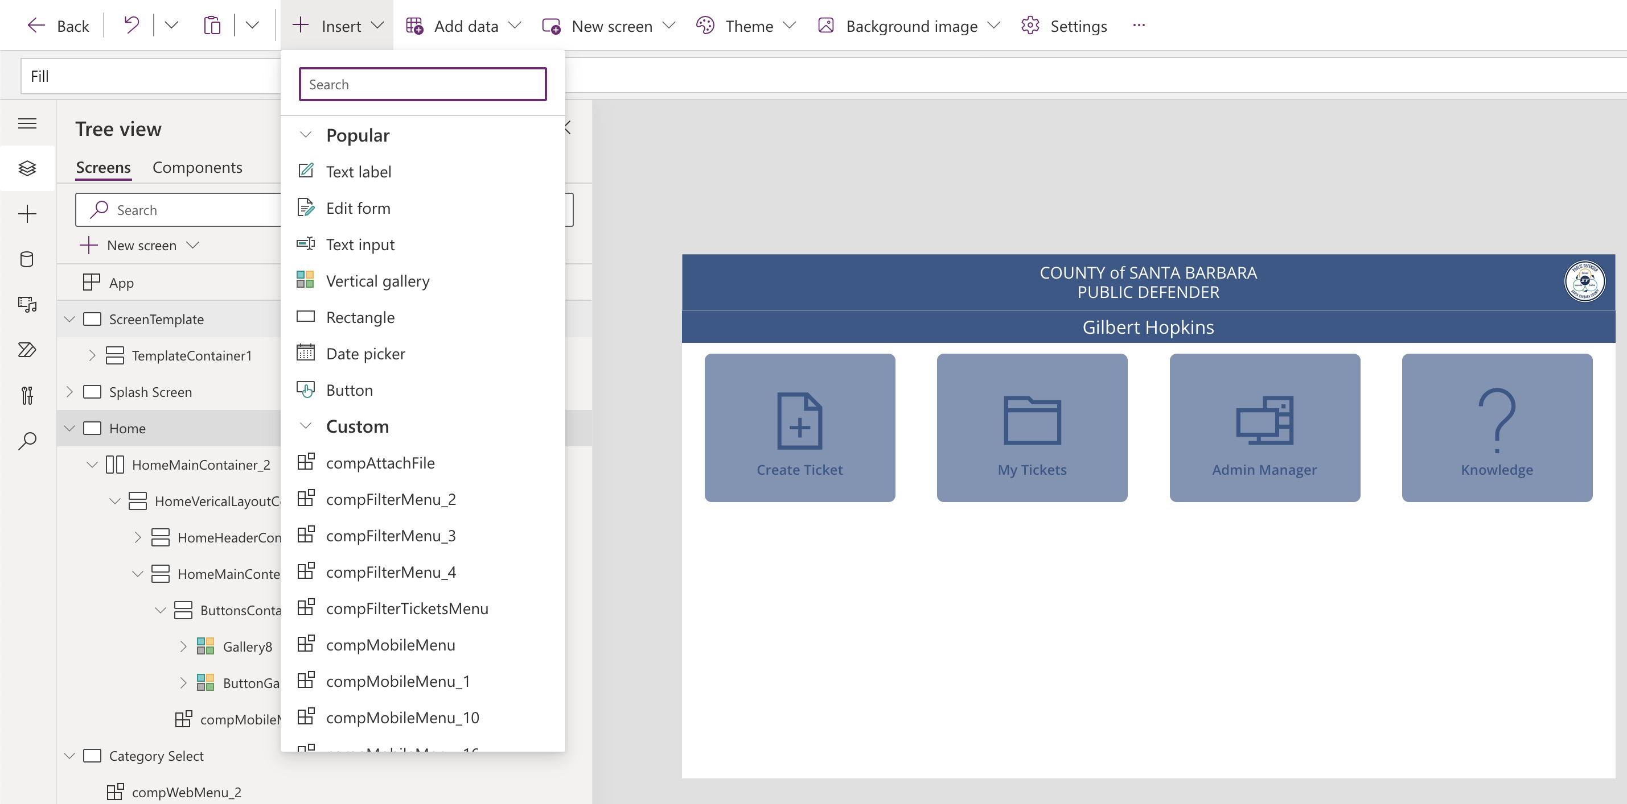
Background
Microsoft PowerApps
Low Code Environment
Notes:
What is Microsoft PowerApps?
It is one of the other 2 services on Microsoft’s Power Platform. Microsoft PowerApps is a low-code development platform that enables users to create custom apps for business purposes. It simplifies the app development process by offering pre-built templates, drag-and-drop interface design, and integration with various data sources. This means those who are not technically inclined, can create applications.
PowerApps offers pre-built functions that eliminate the need for users to create them from scratch. Think of the functions used in PowerApps as similar to those in Excel. Just as you can use functions in Excel to manipulate data, you can use functions in PowerApps to create powerful custom applications without needing extensive programming knowledge.
On the right side of the screen, you can see an image that demonstrates the process of inserting pre-built elements onto your current page. By clicking the insert icon, you can choose from a variety of elements to add to your app. Once you have selected an element, you can easily position it anywhere on the page according to your preferences.
While it is low-code, that does not mean that it is low in code.
The left portion of the screen is an example of some coding that a developer may need to do for a particular action. In our case, we are submitting some data, and this code is connected to the submit button on the bottom right. As we continue this presentation you will see more of these snippets for particular events.
“PowerApps is one of many commonly used no-code development platforms on the software market.” To maximize the utilization of SBPD's existing ecosystem with Microsoft 365, we made the strategic decision to implement the new Help Desk Ticketing system using PowerApps.

Slide 9
System Overview

Slide 10
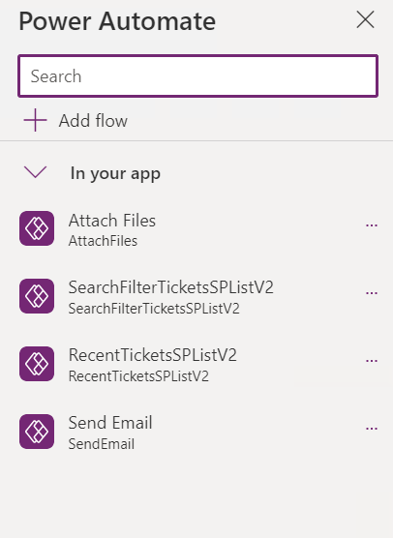
Power Automate
Core features of Ticketing System
Automates workflow
Bypass limitations of Power Apps and SharePoint List

Slide 11
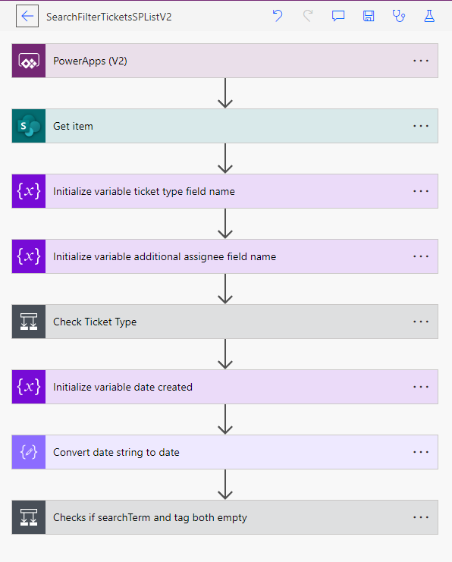
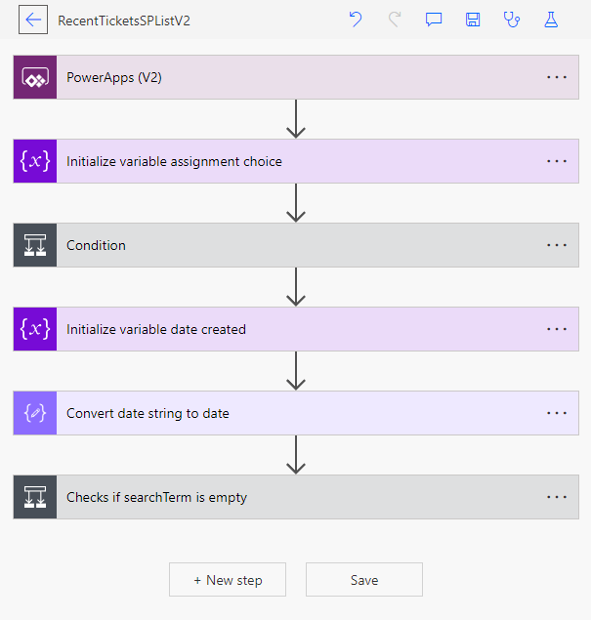
Power Automate
Search & Filter Flows

Slide 12
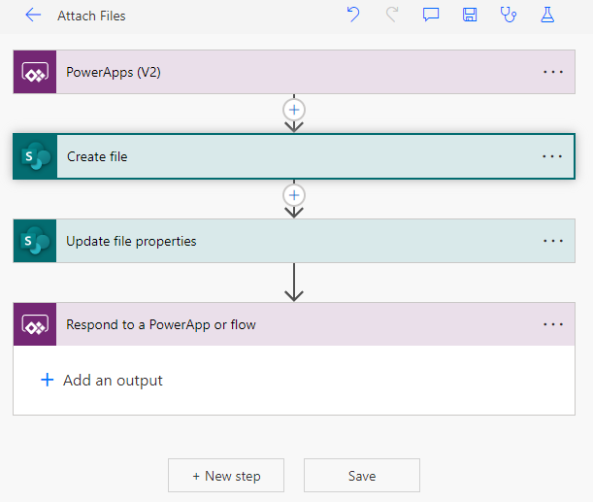
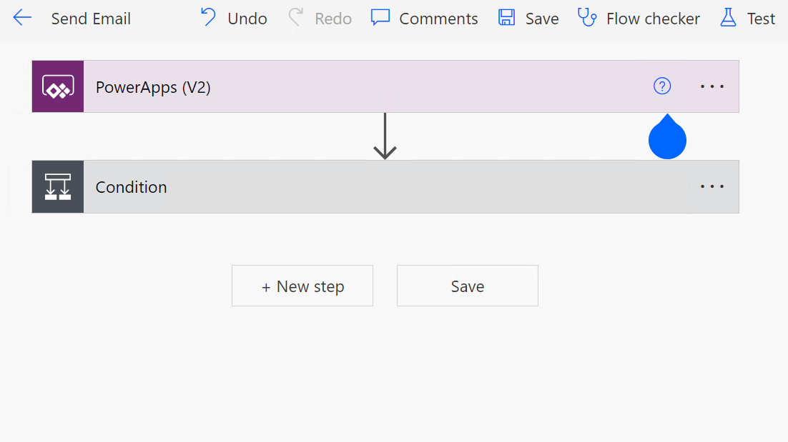
Power Automate
Attach Files & Send Email Flows

Slide 13
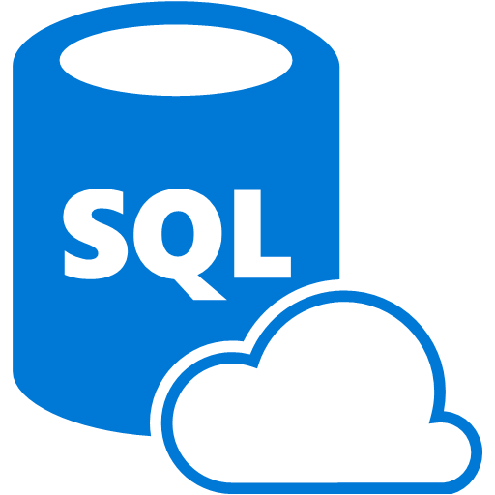
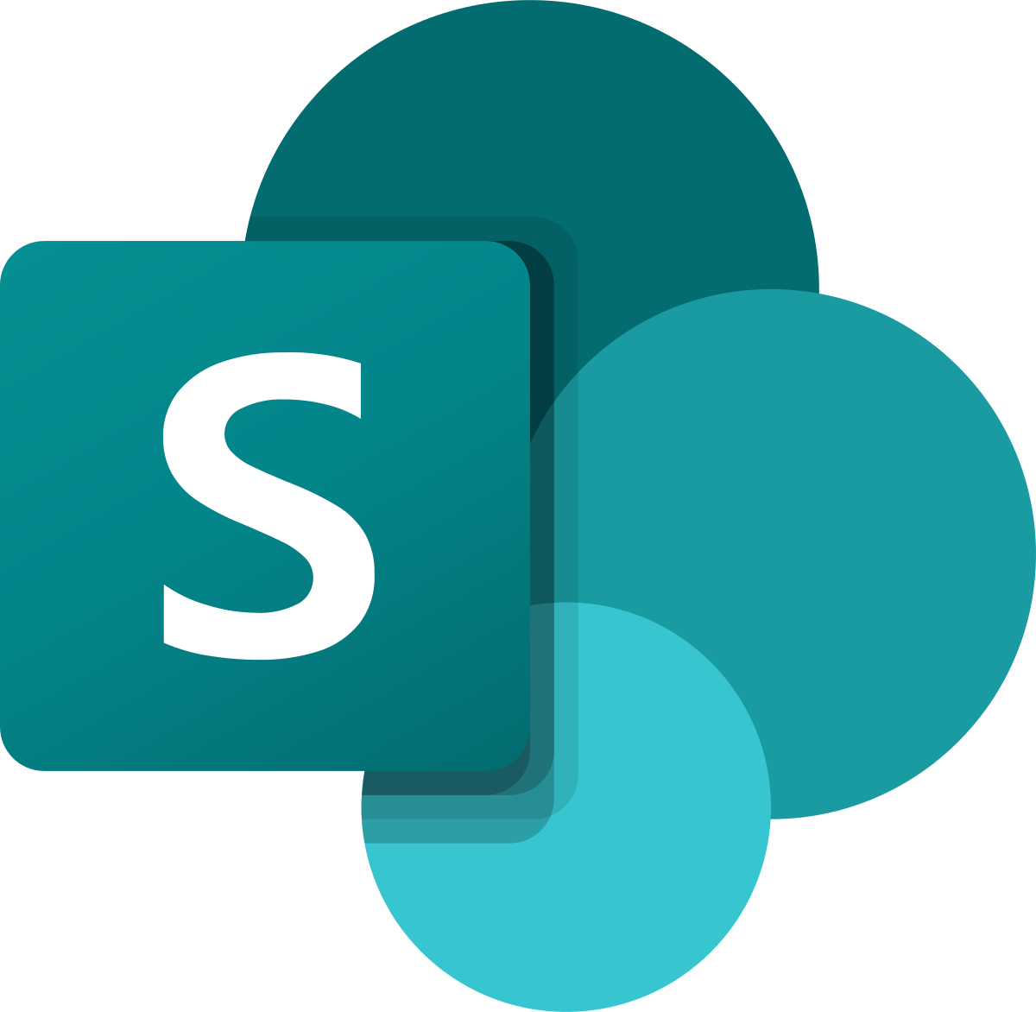
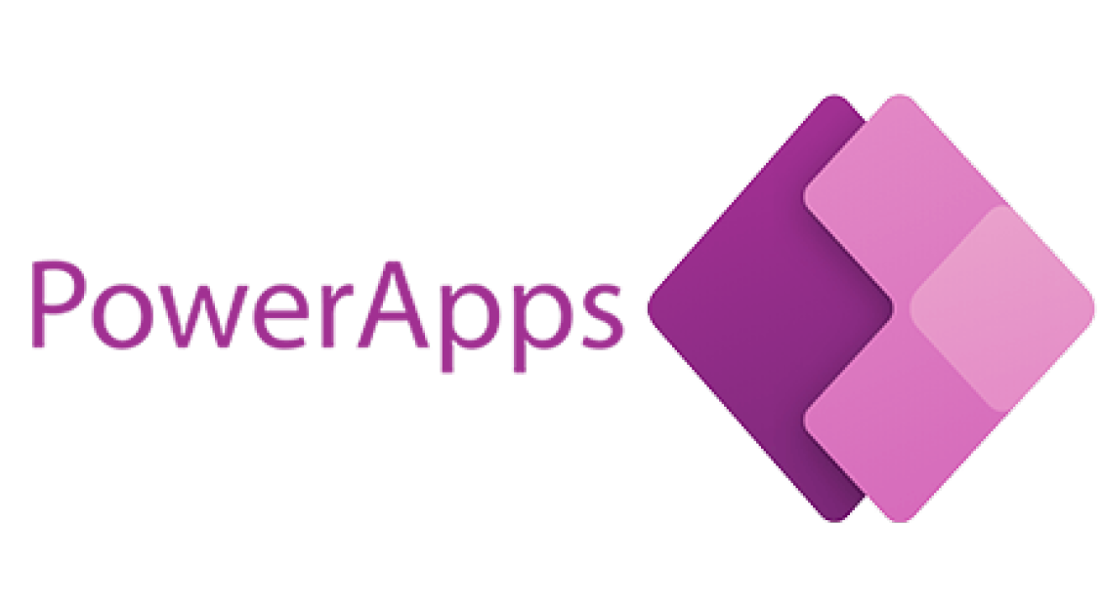
Database + Migration
SQL
Share Point List

Slide 14
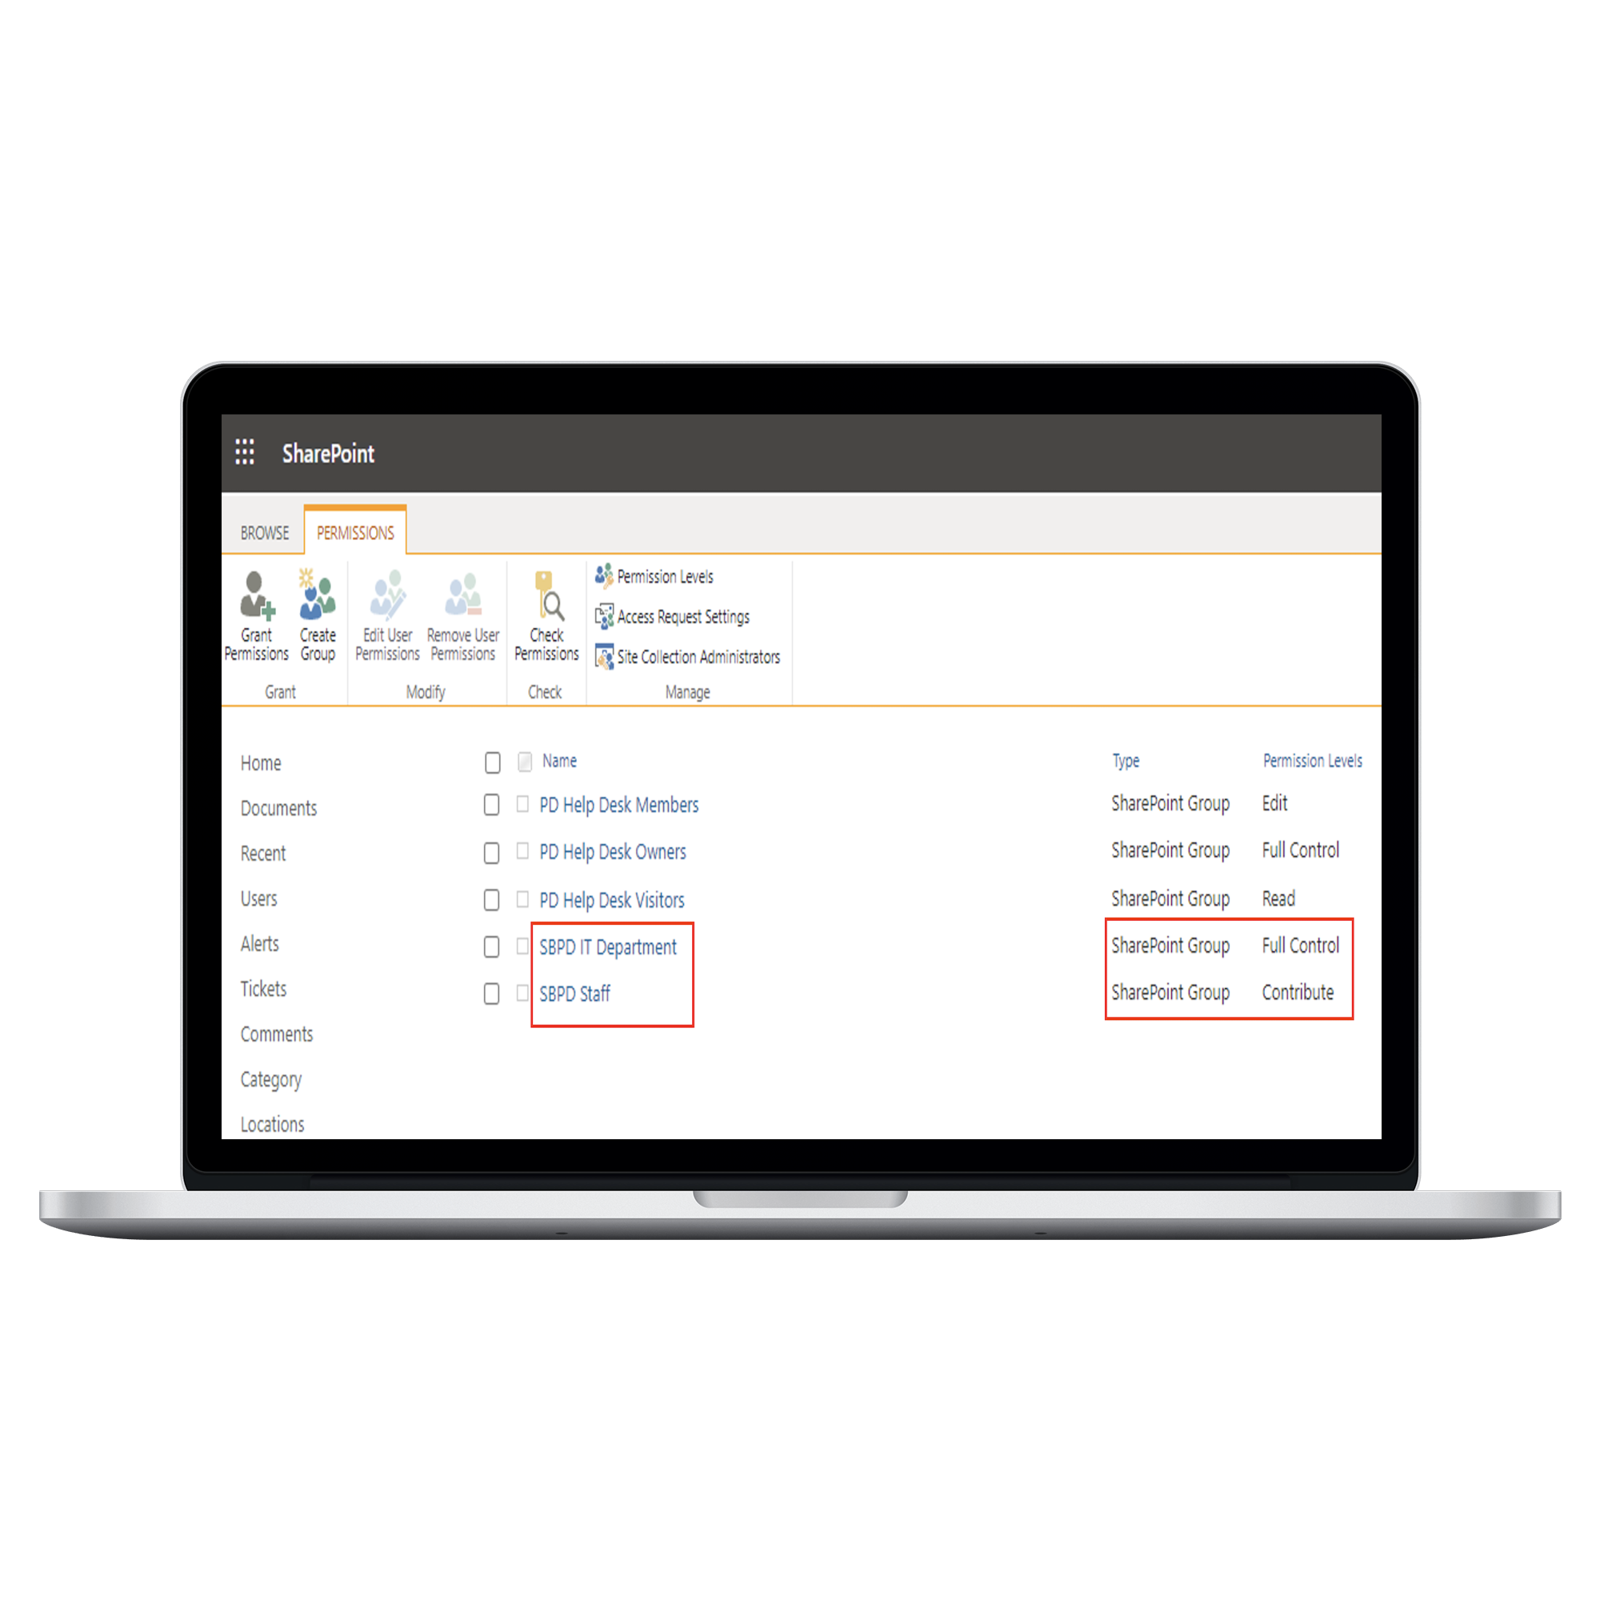
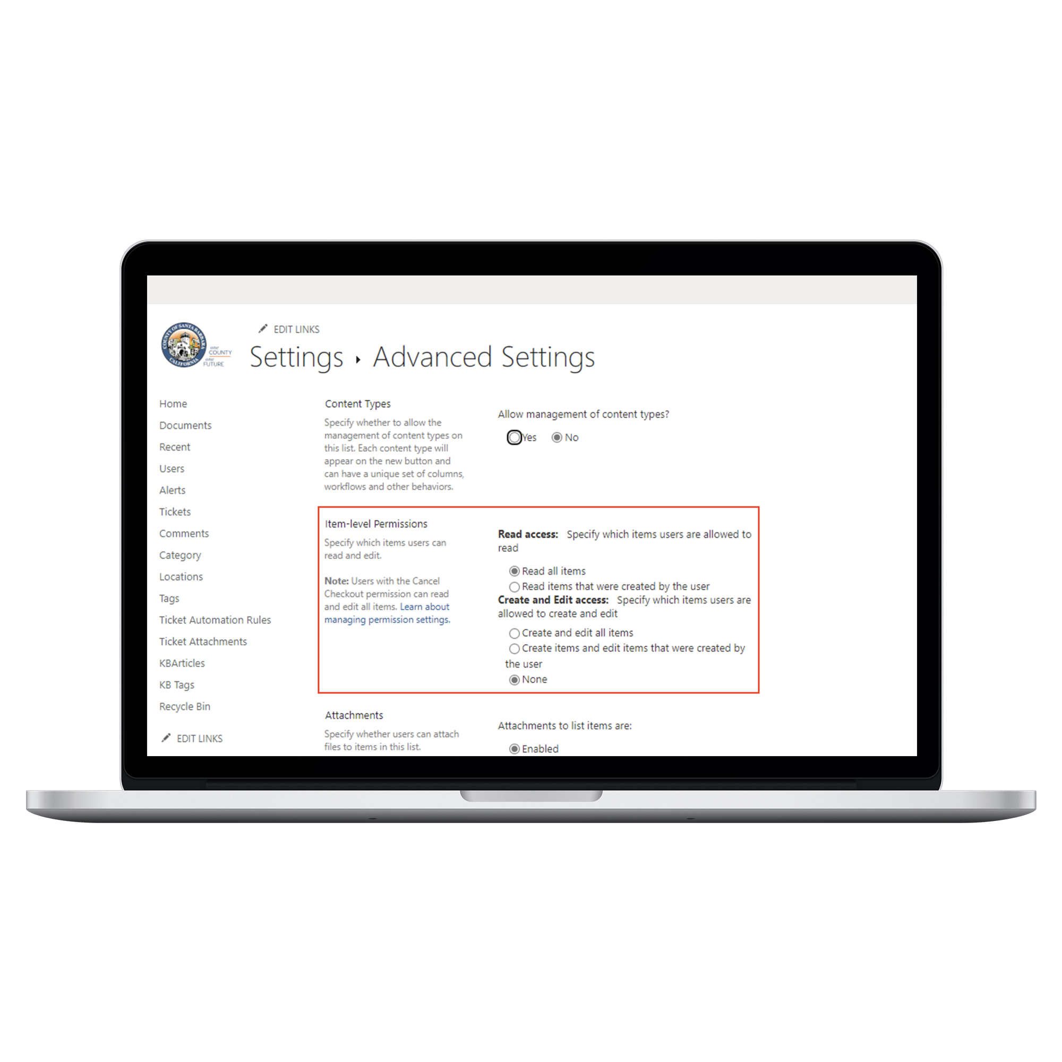
SharePoint List Security
SharePoint Site Permissions
List Item Permissions

Slide 15
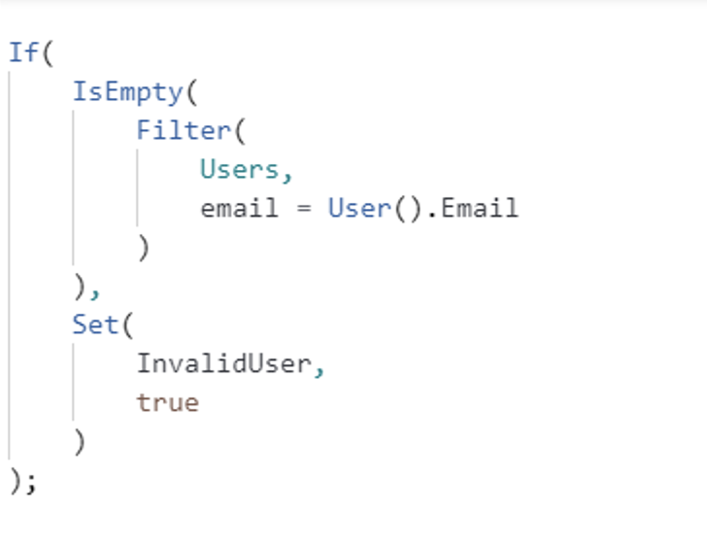
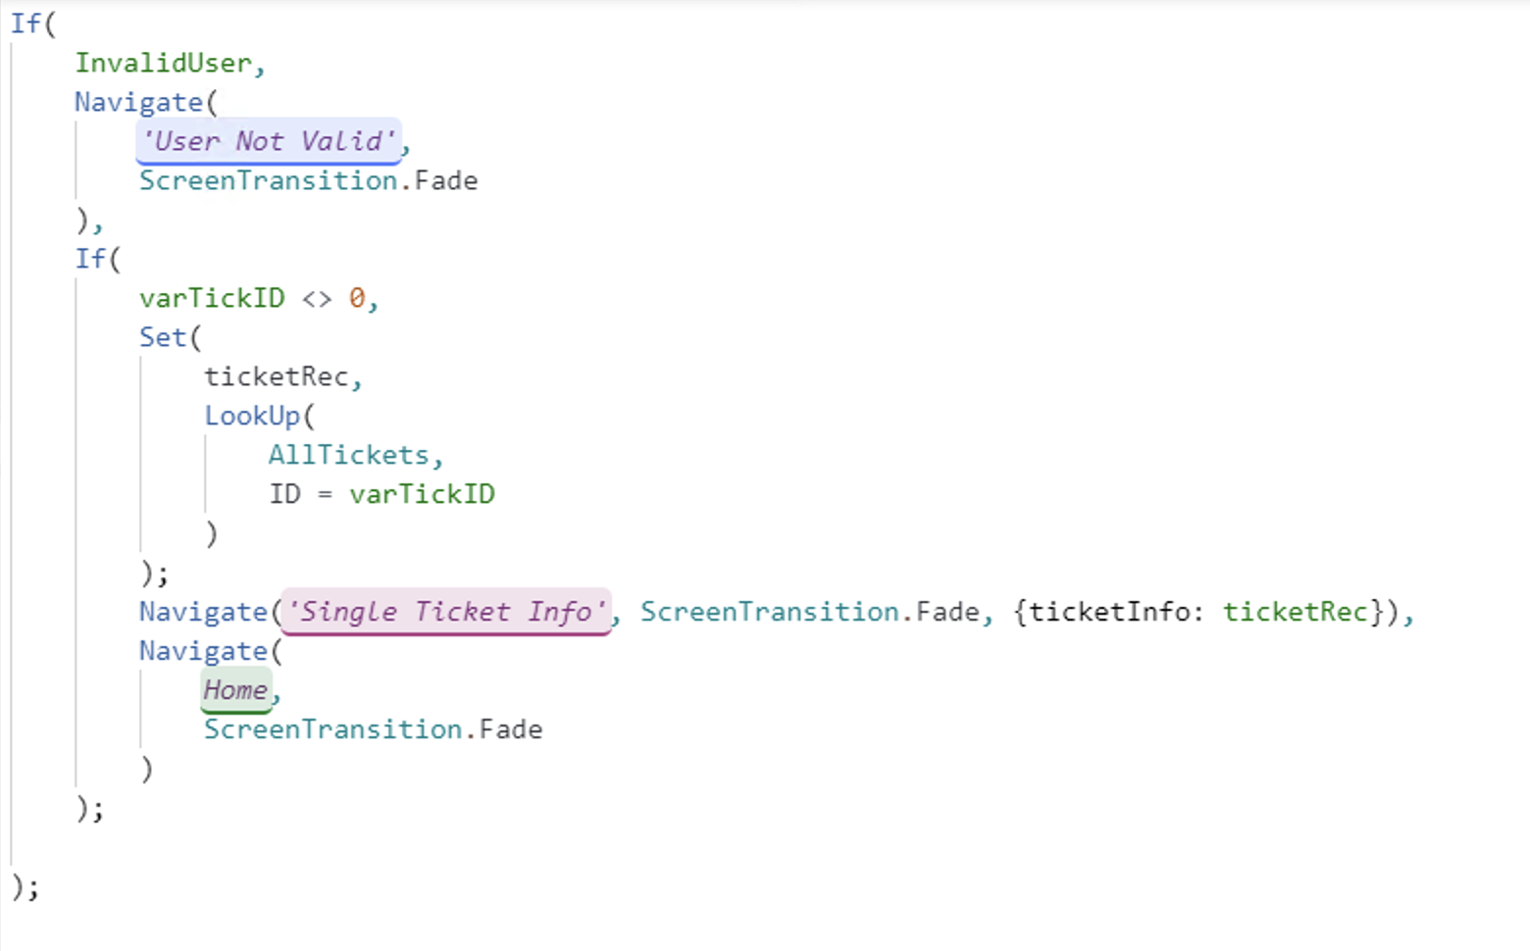
user Authentication
User Roles
Auth
Staff
Tech
Admin

Slide 16
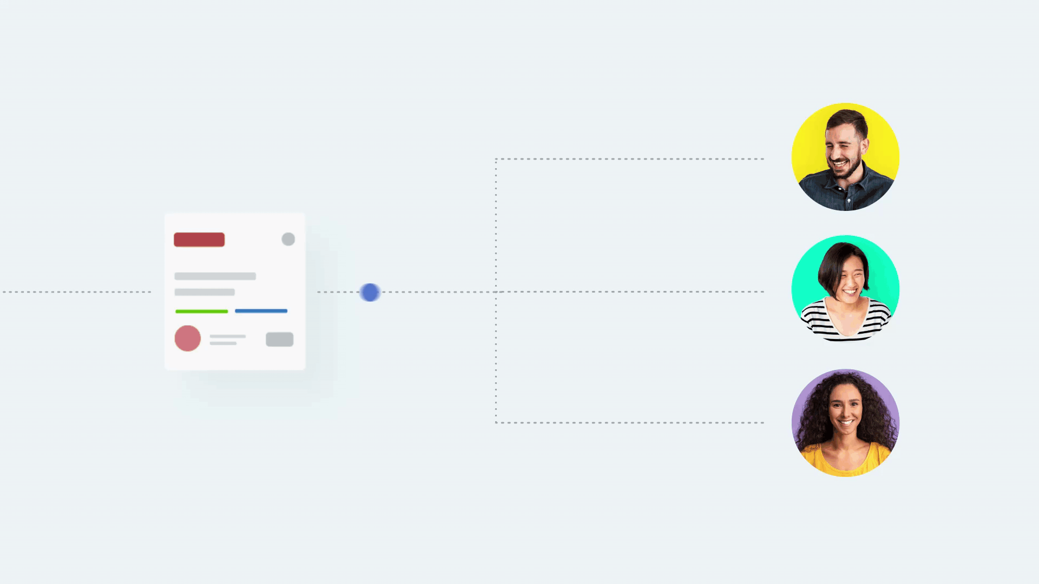
Ticket Assignment Automation
Past solution didn't have any automation workflow
Tickets get assigned based on:
Category
Location
Streamlines ticket handling process
Increased Productivity & Scalability
Automation Rules

Slide 17
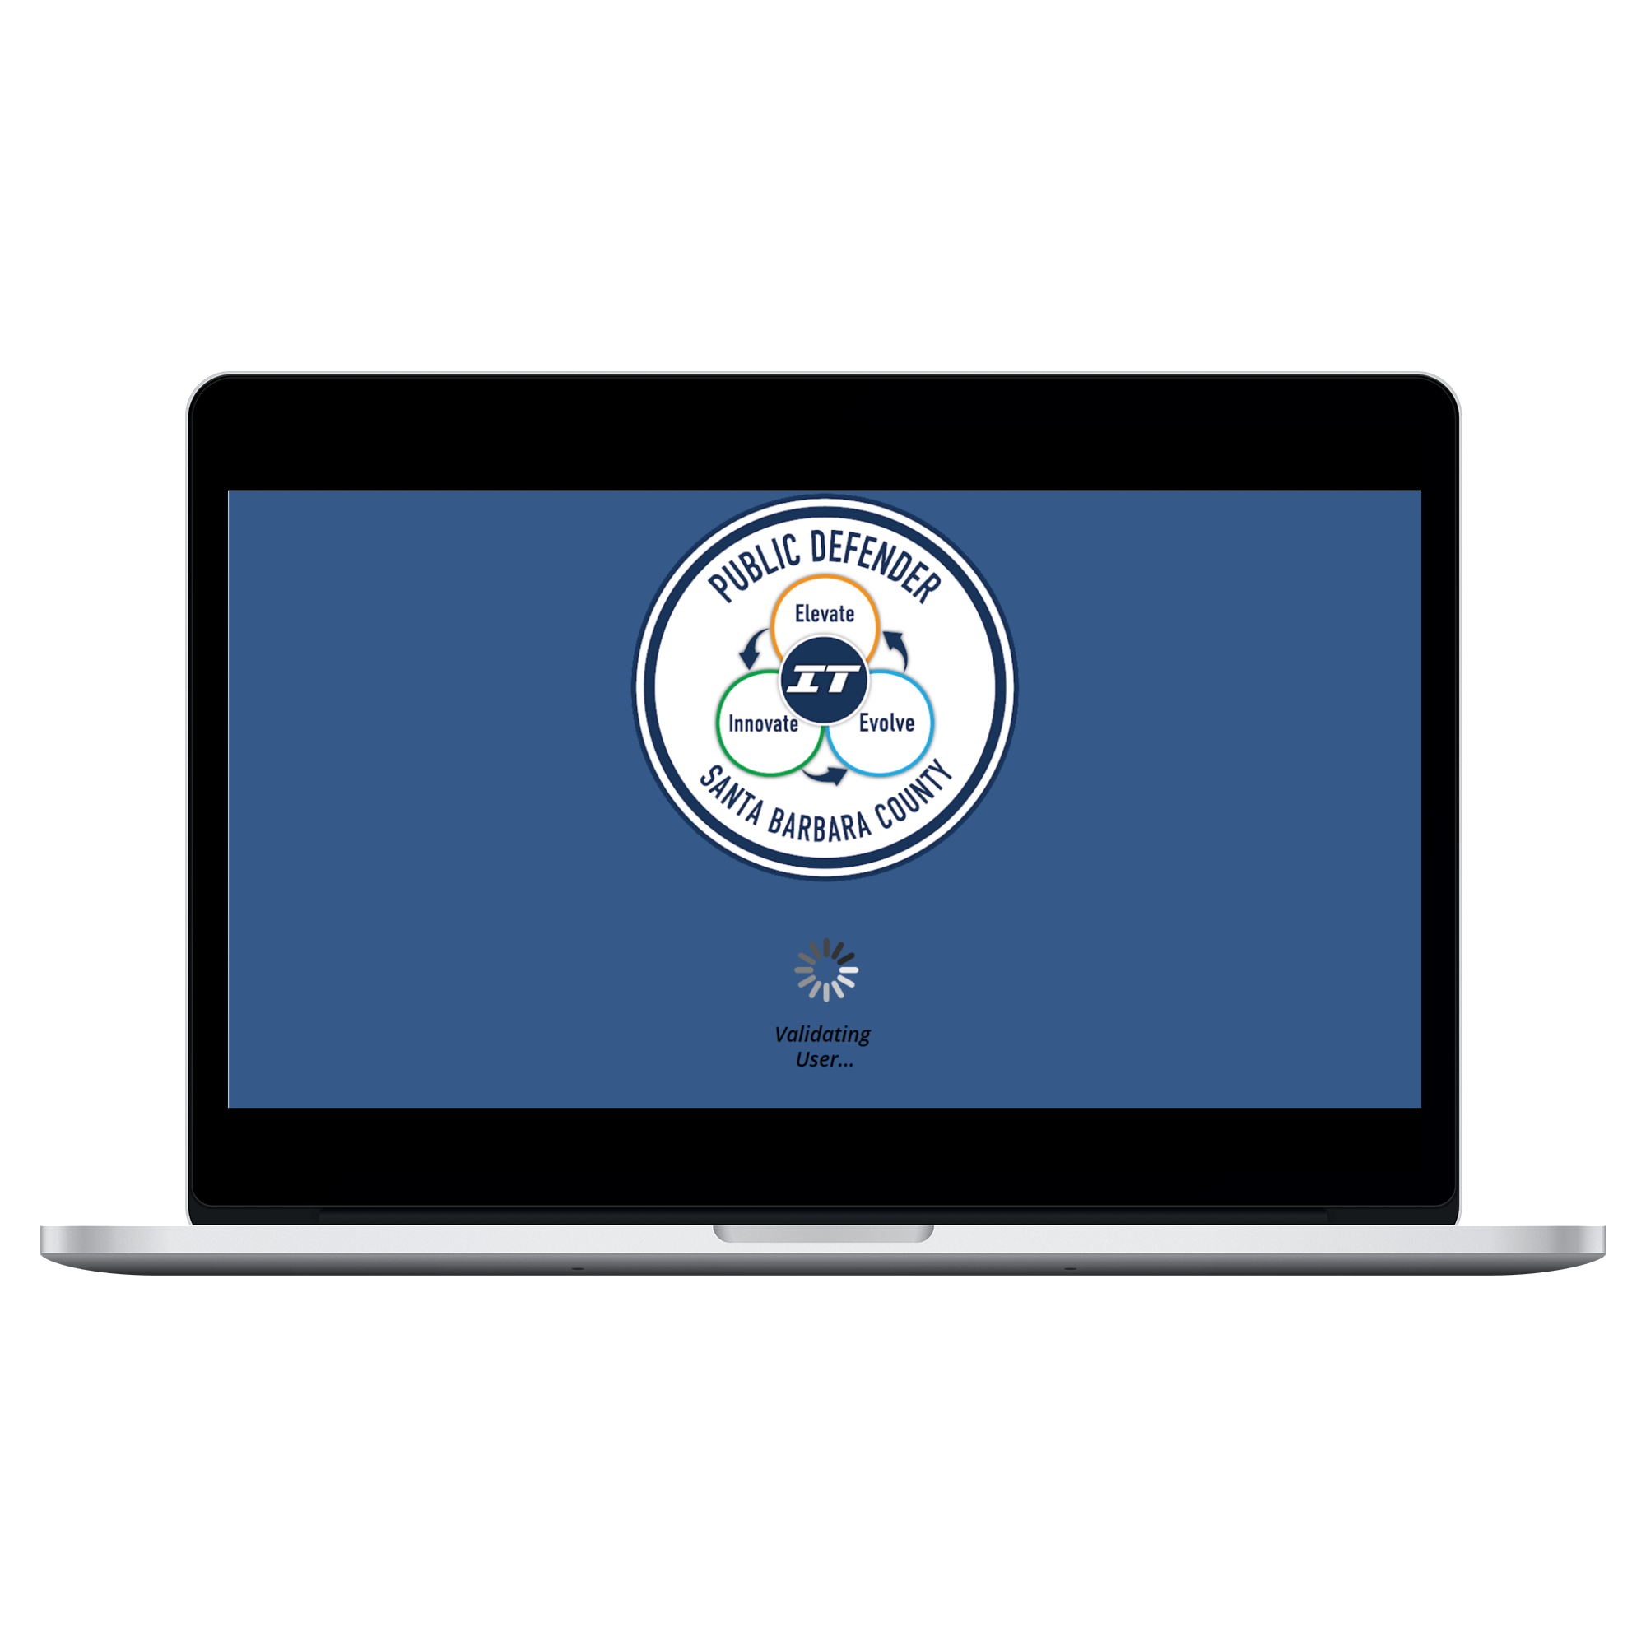
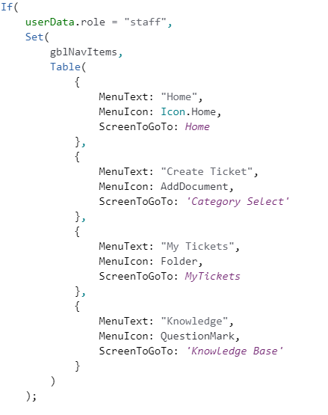
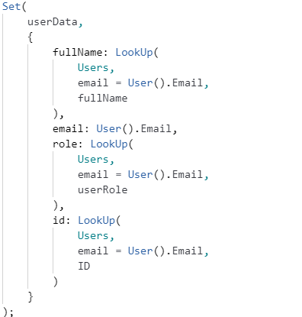
Splash screen
Onvisible code

Slide 18
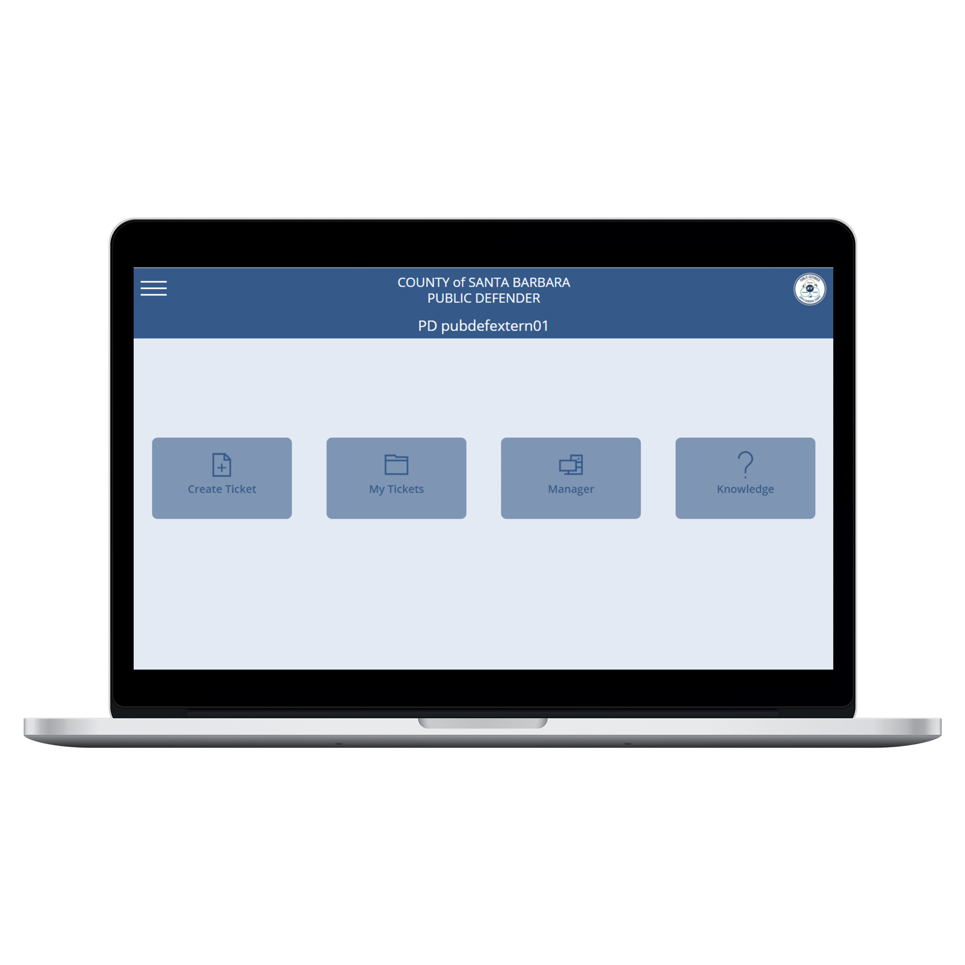
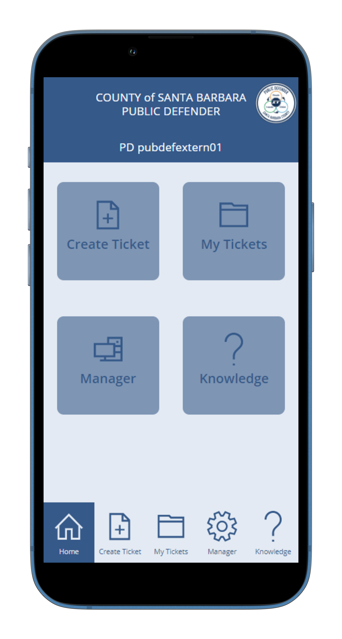
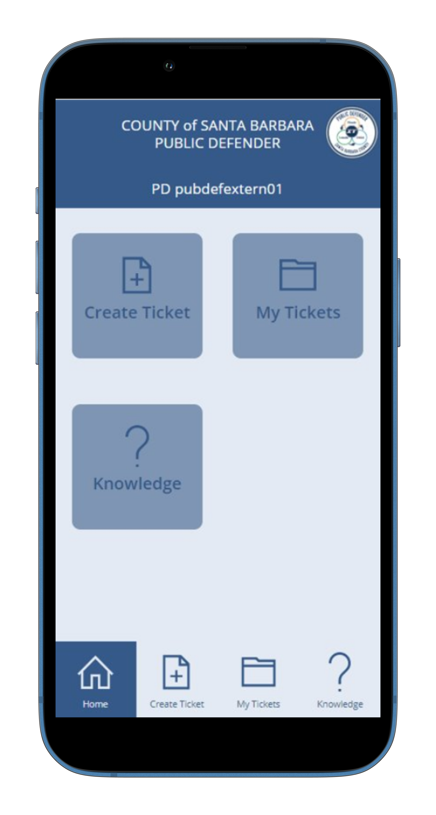
Home

Slide 19
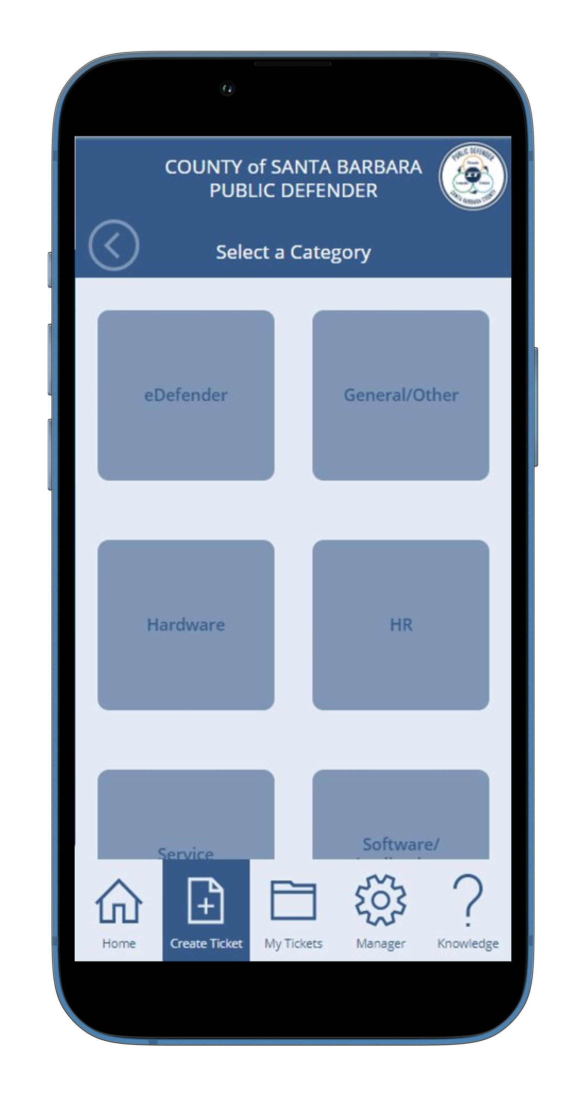
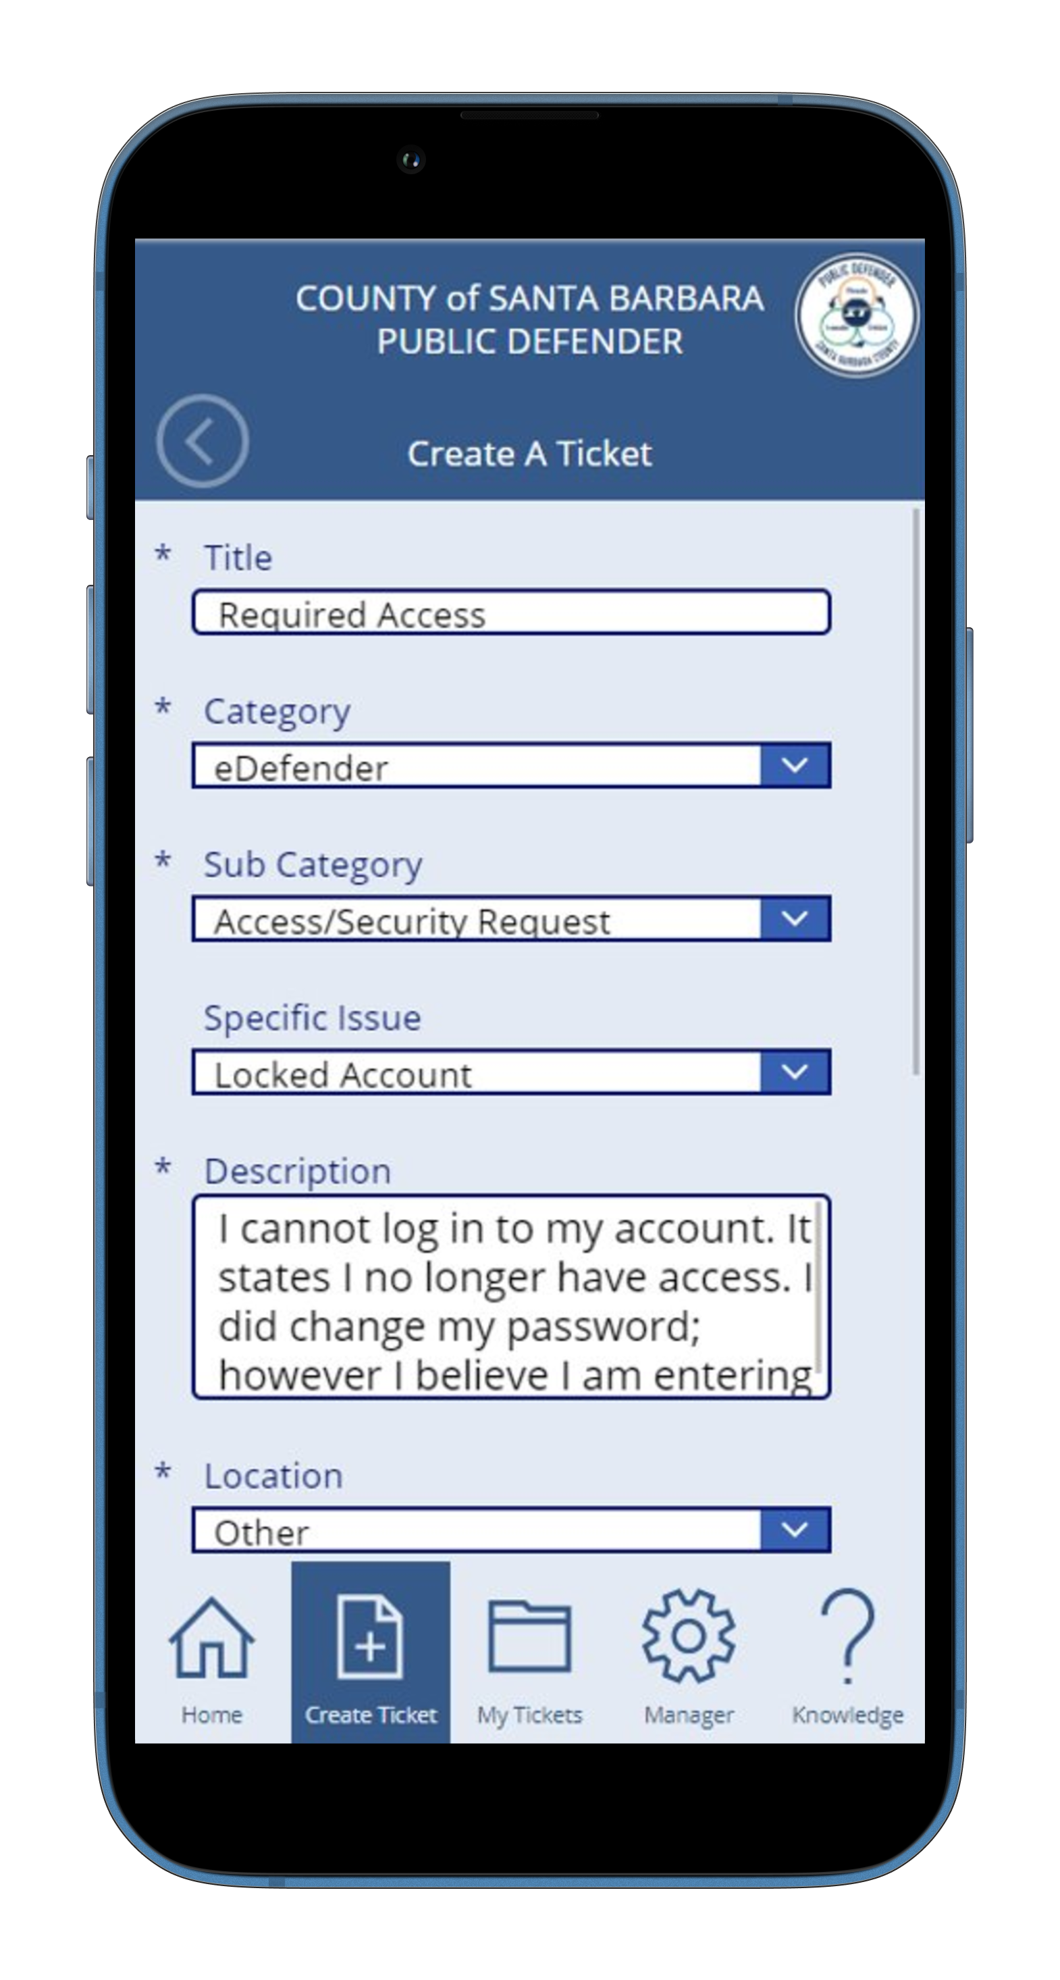
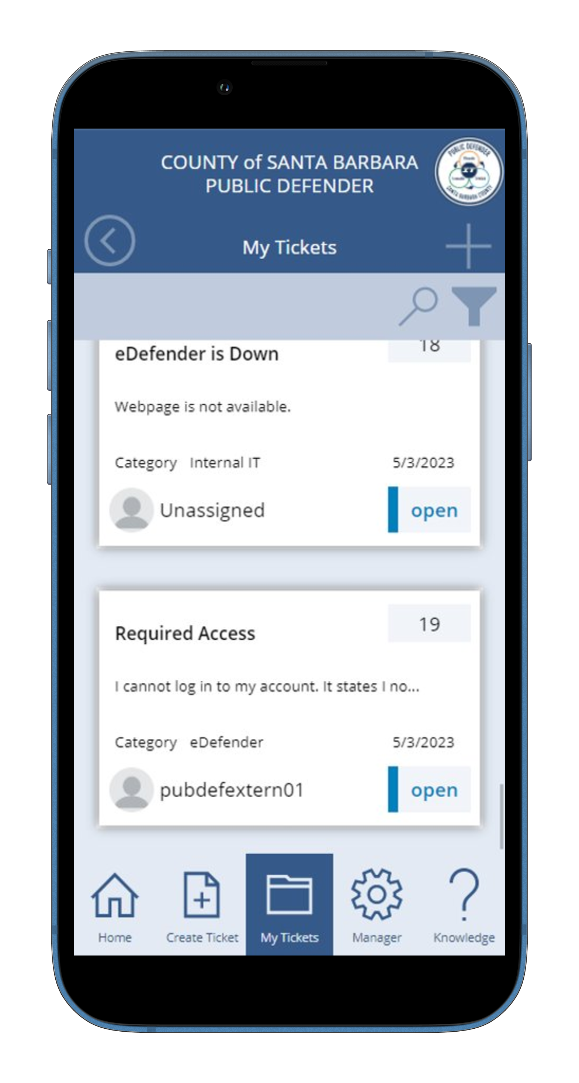
Create A Ticket

Slide 20
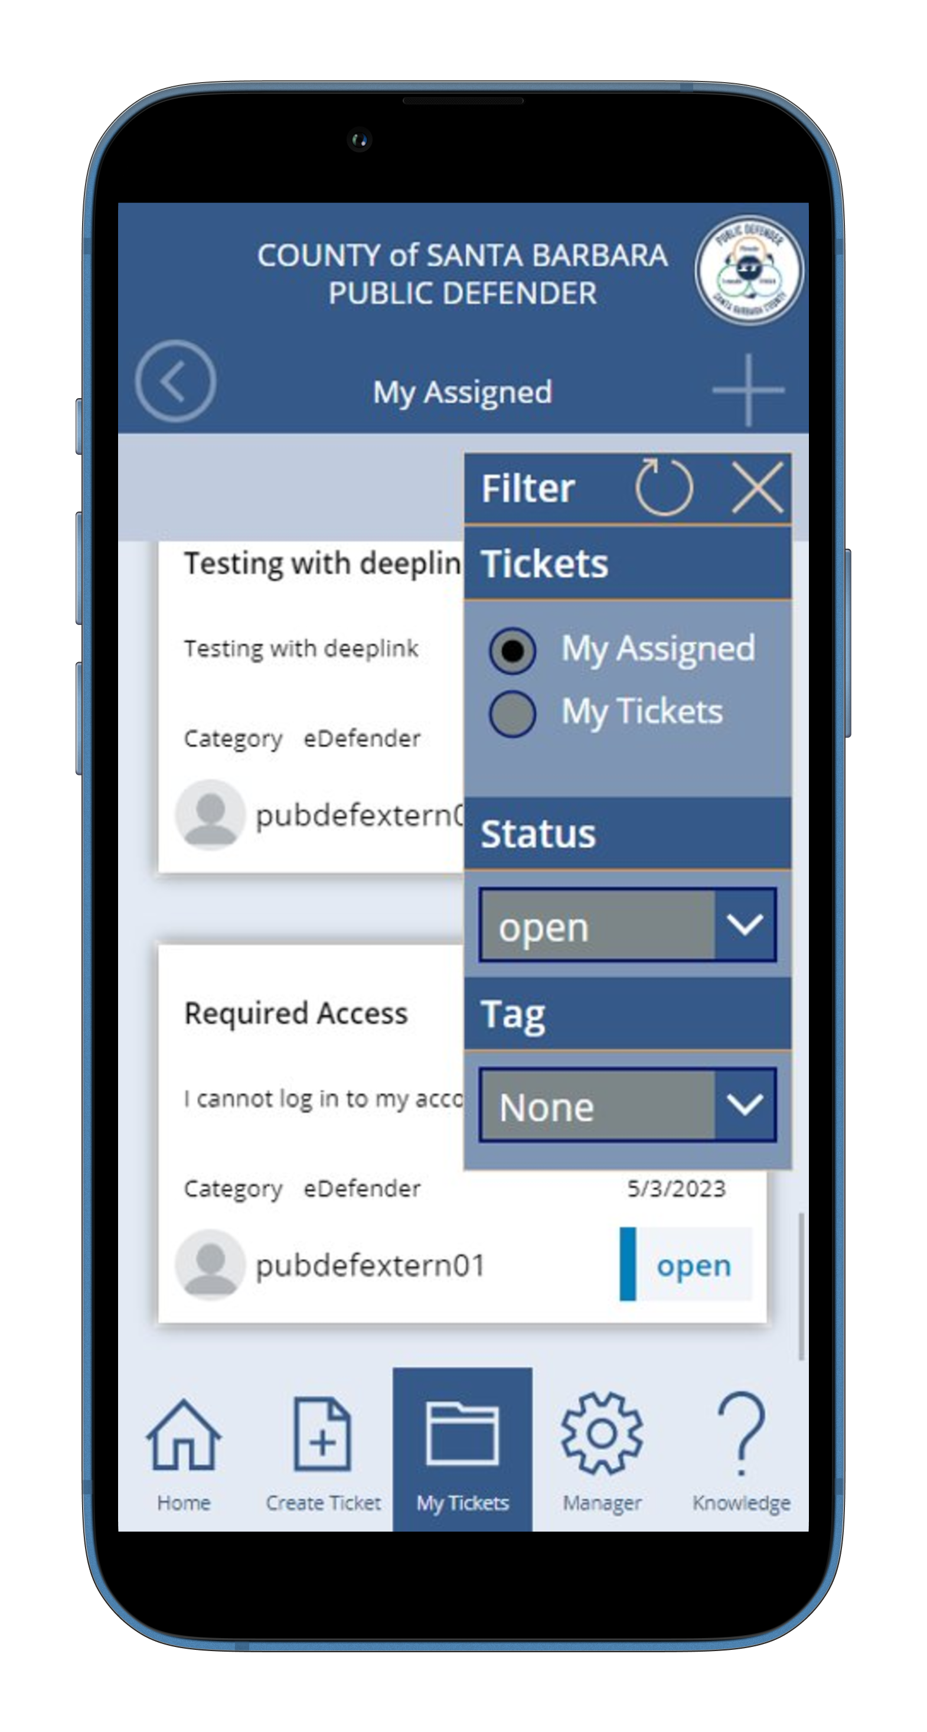
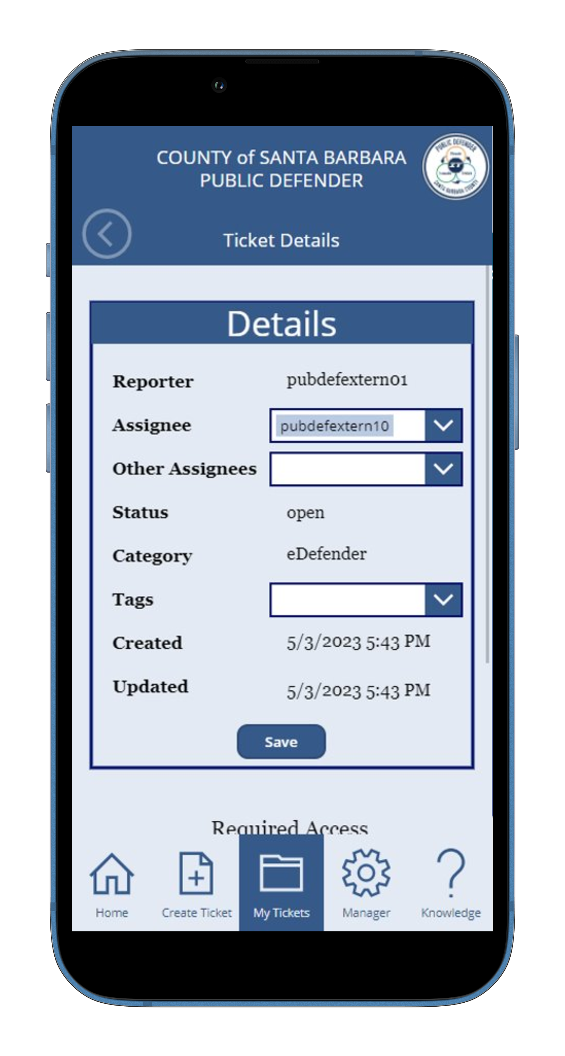
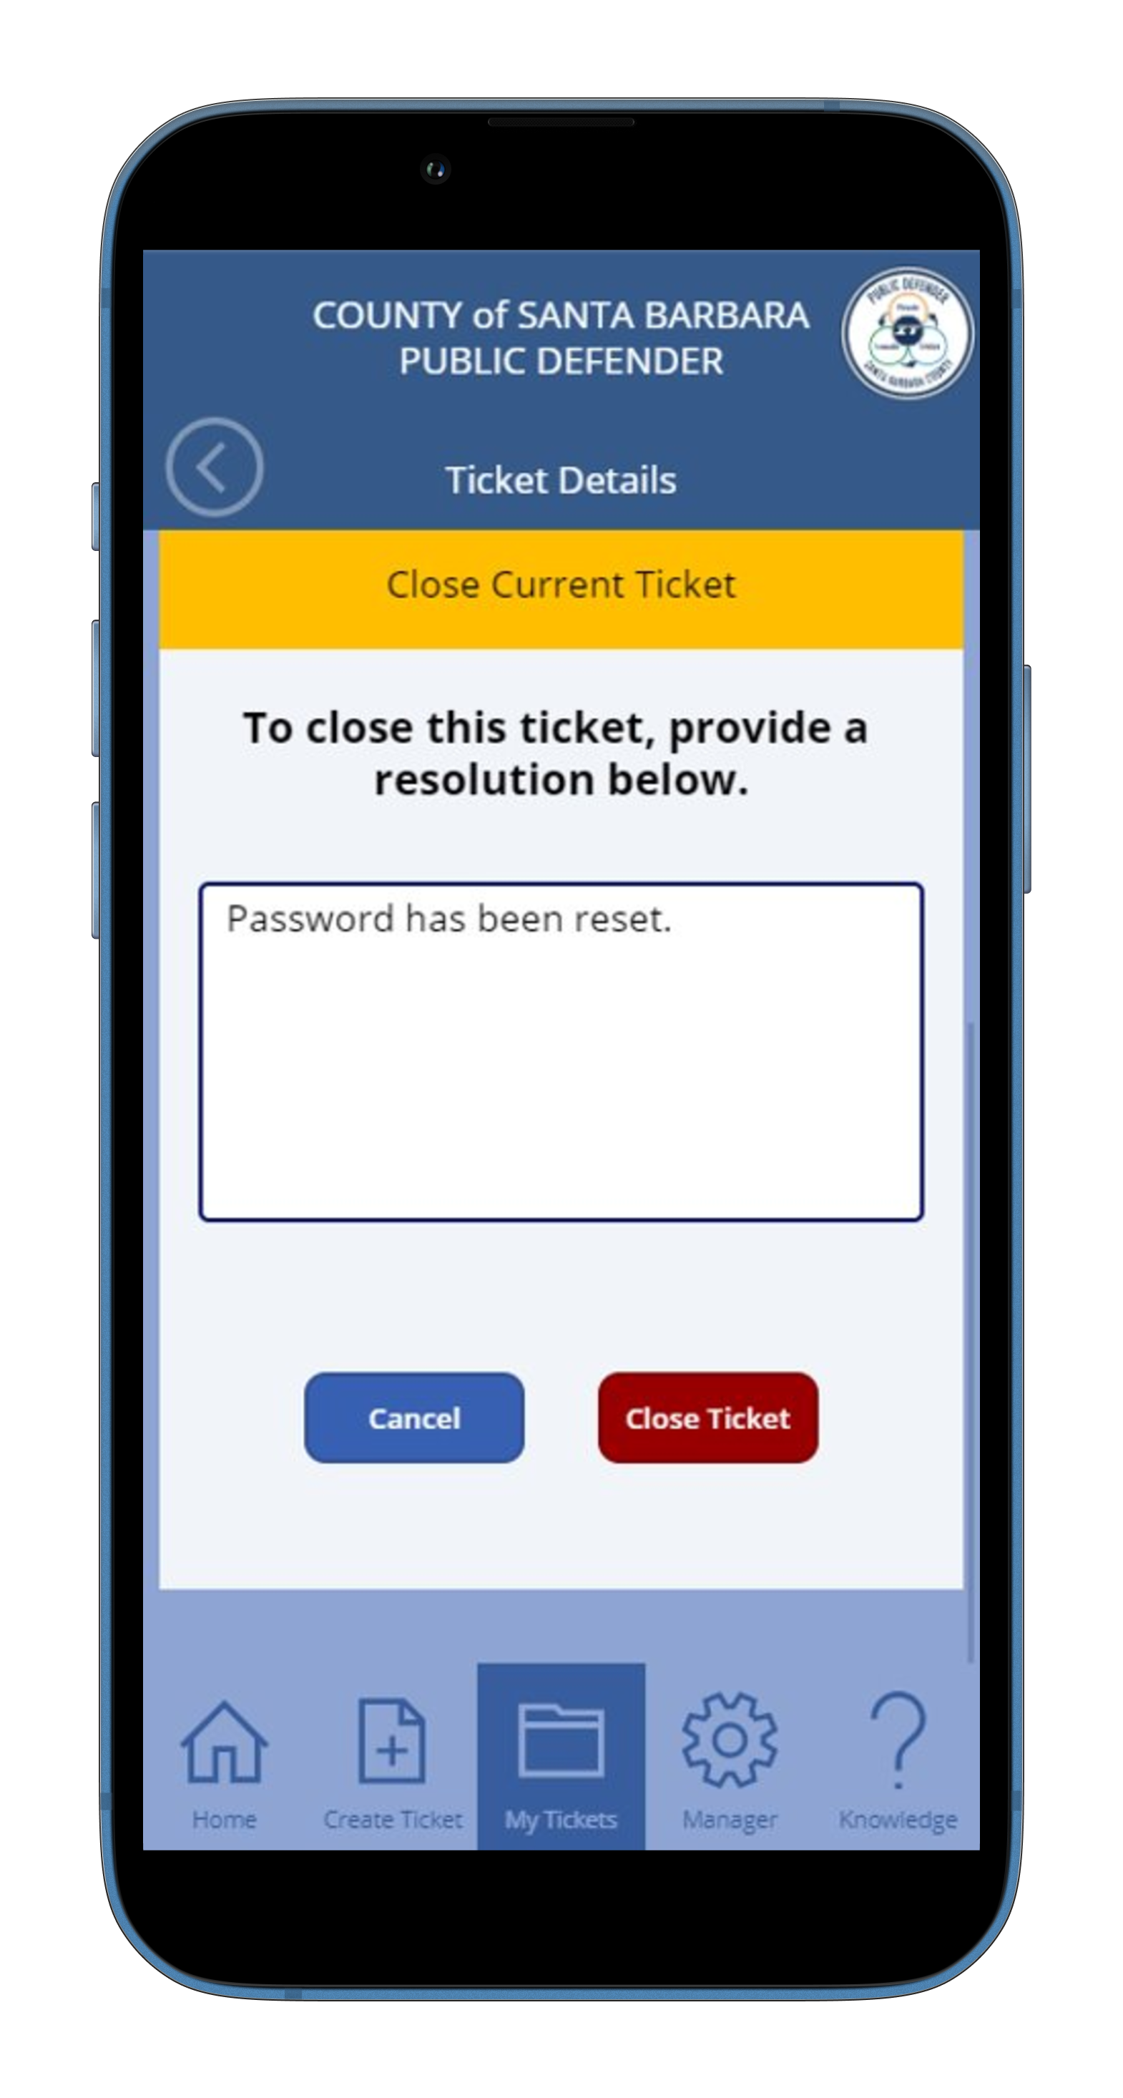
Resolve a ticket

Slide 21
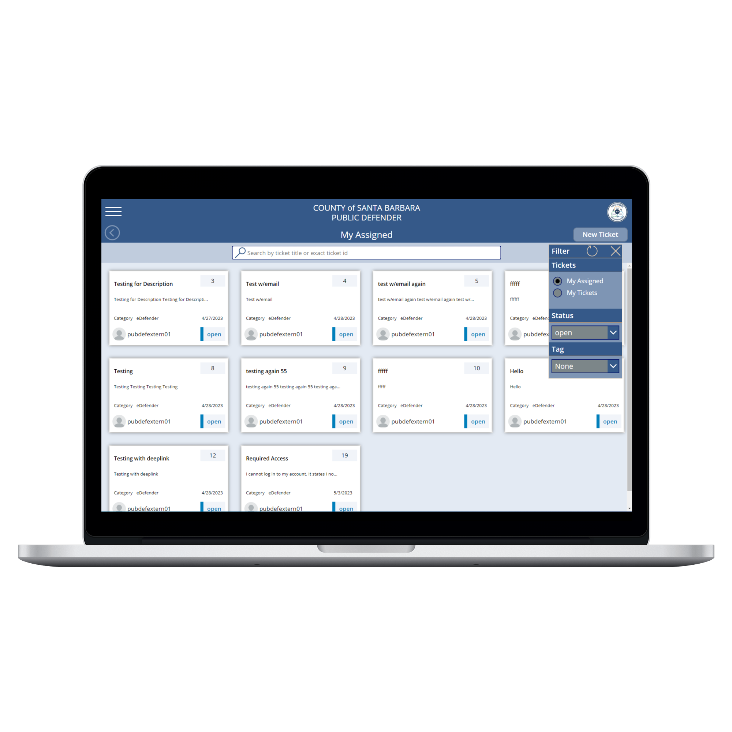
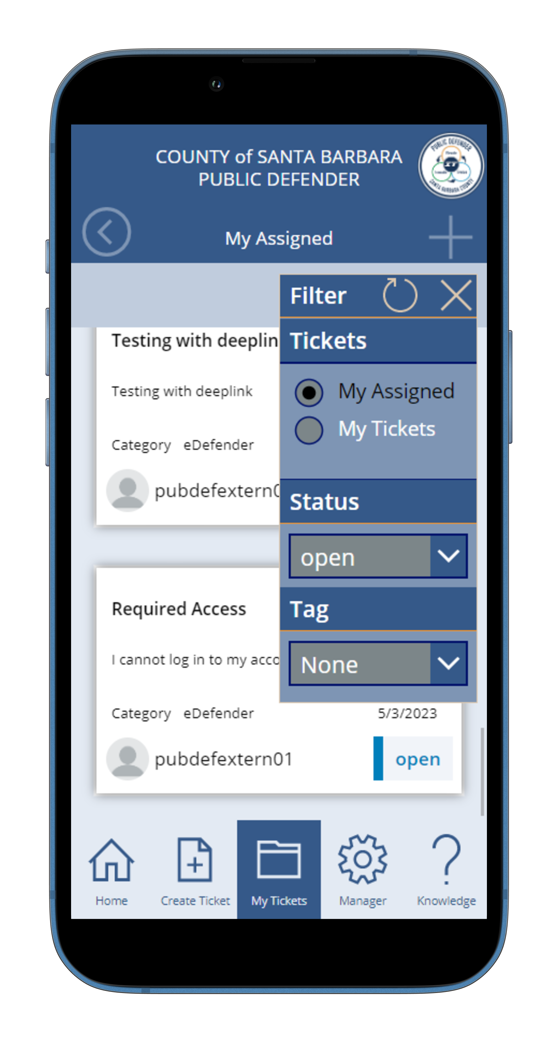
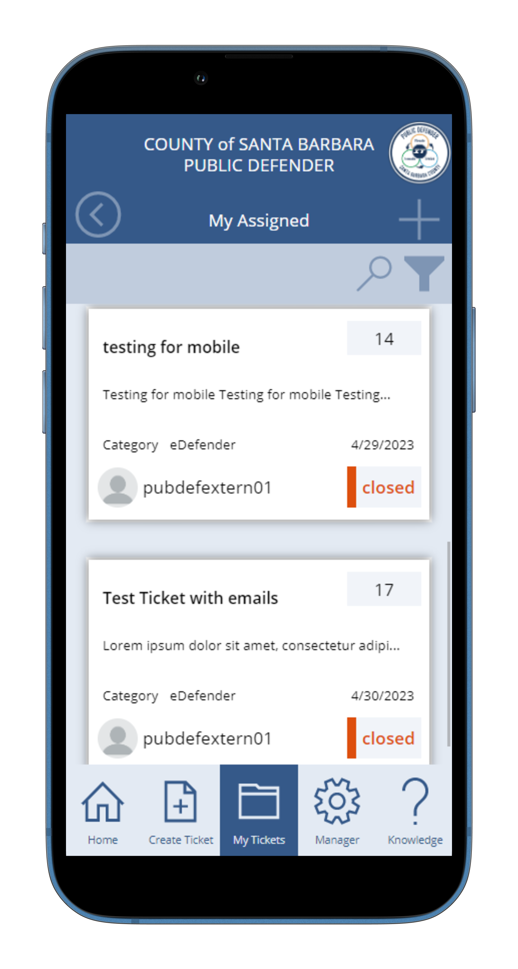
My Tickets

Slide 22
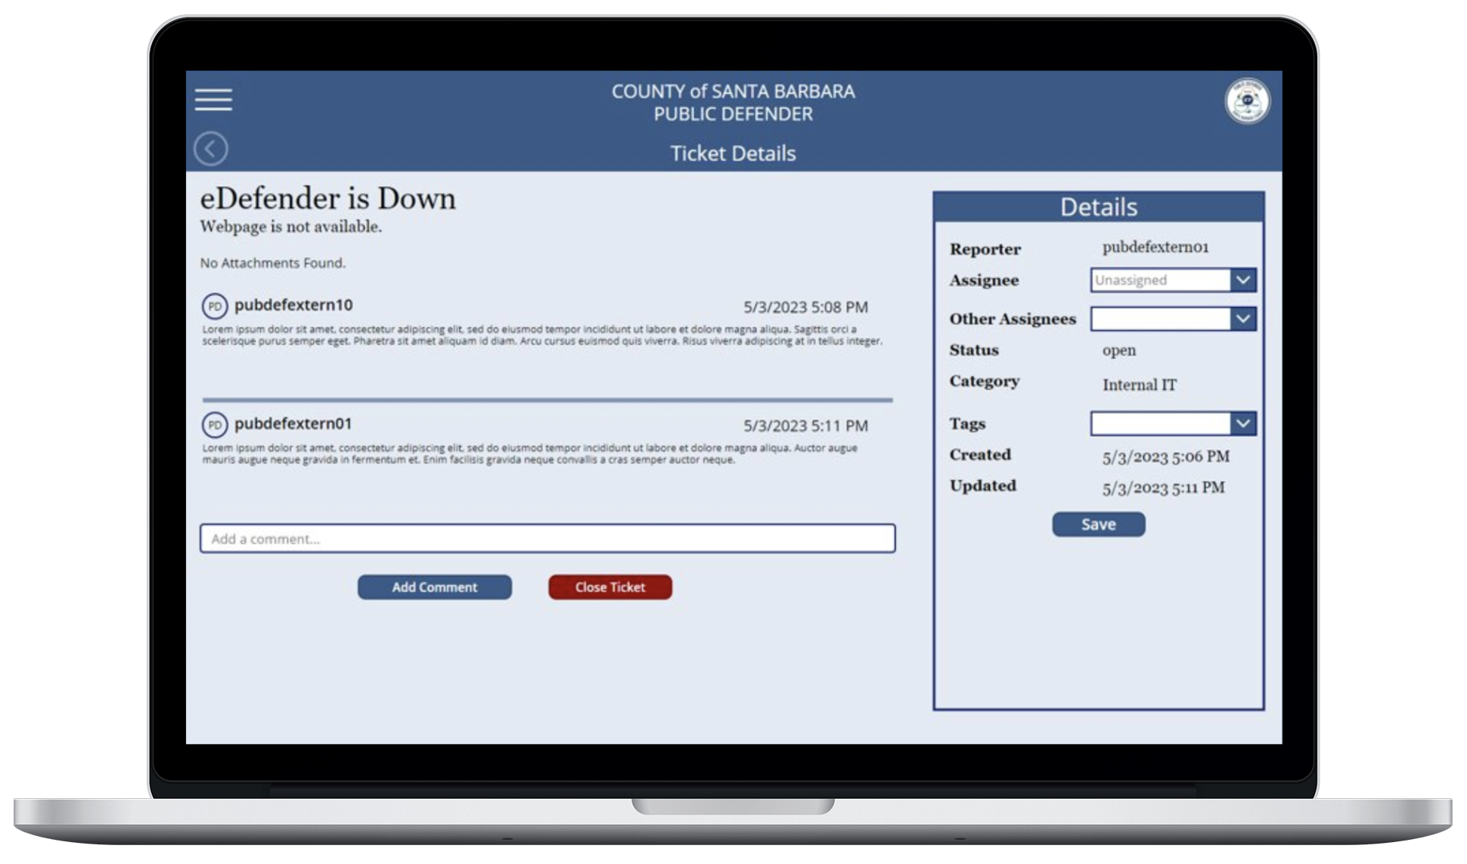
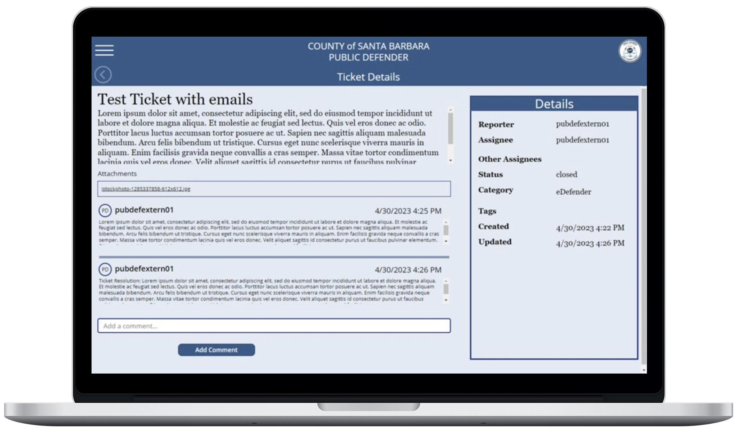
Single Ticket Info

Slide 23
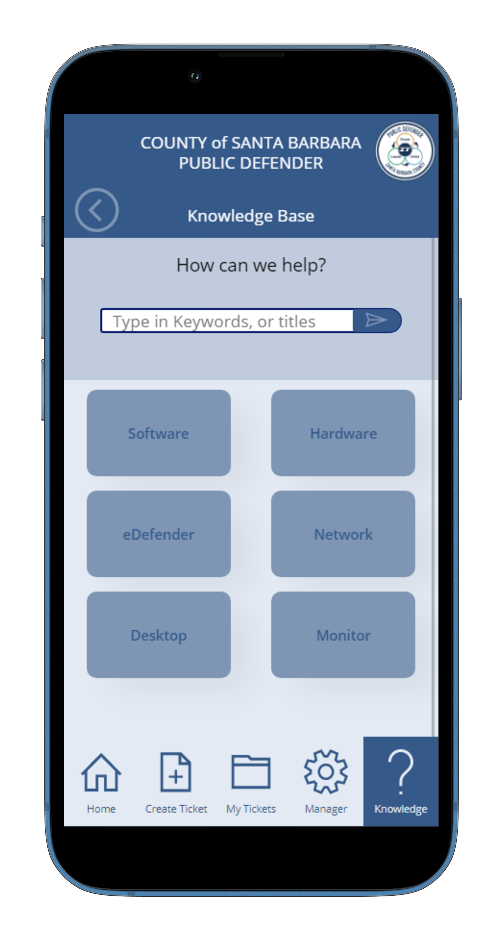
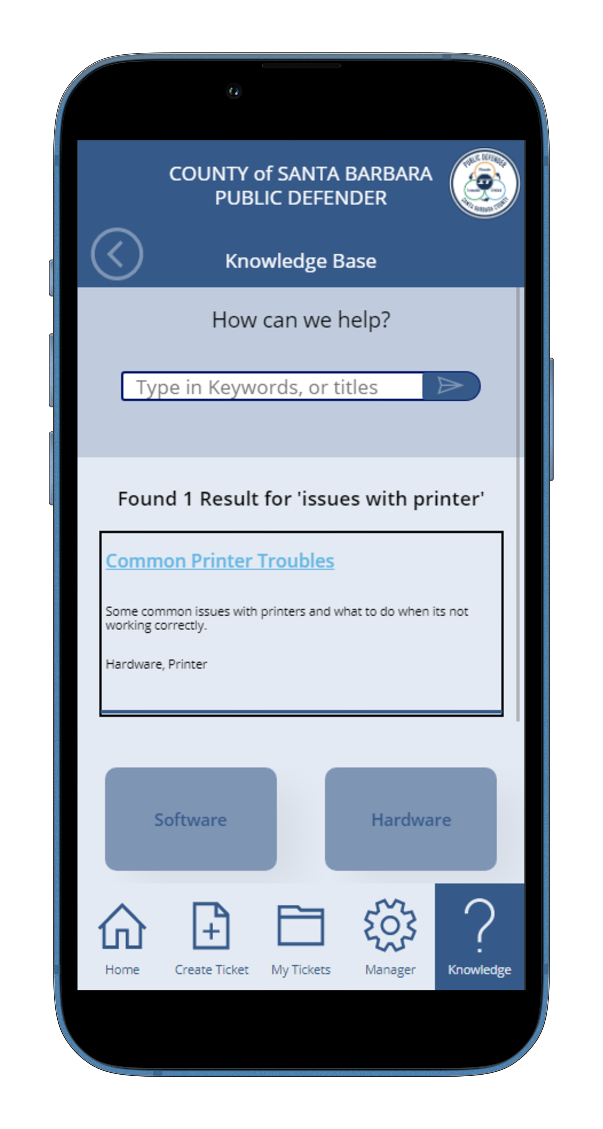
KNOWLEDGE bASE

Slide 24
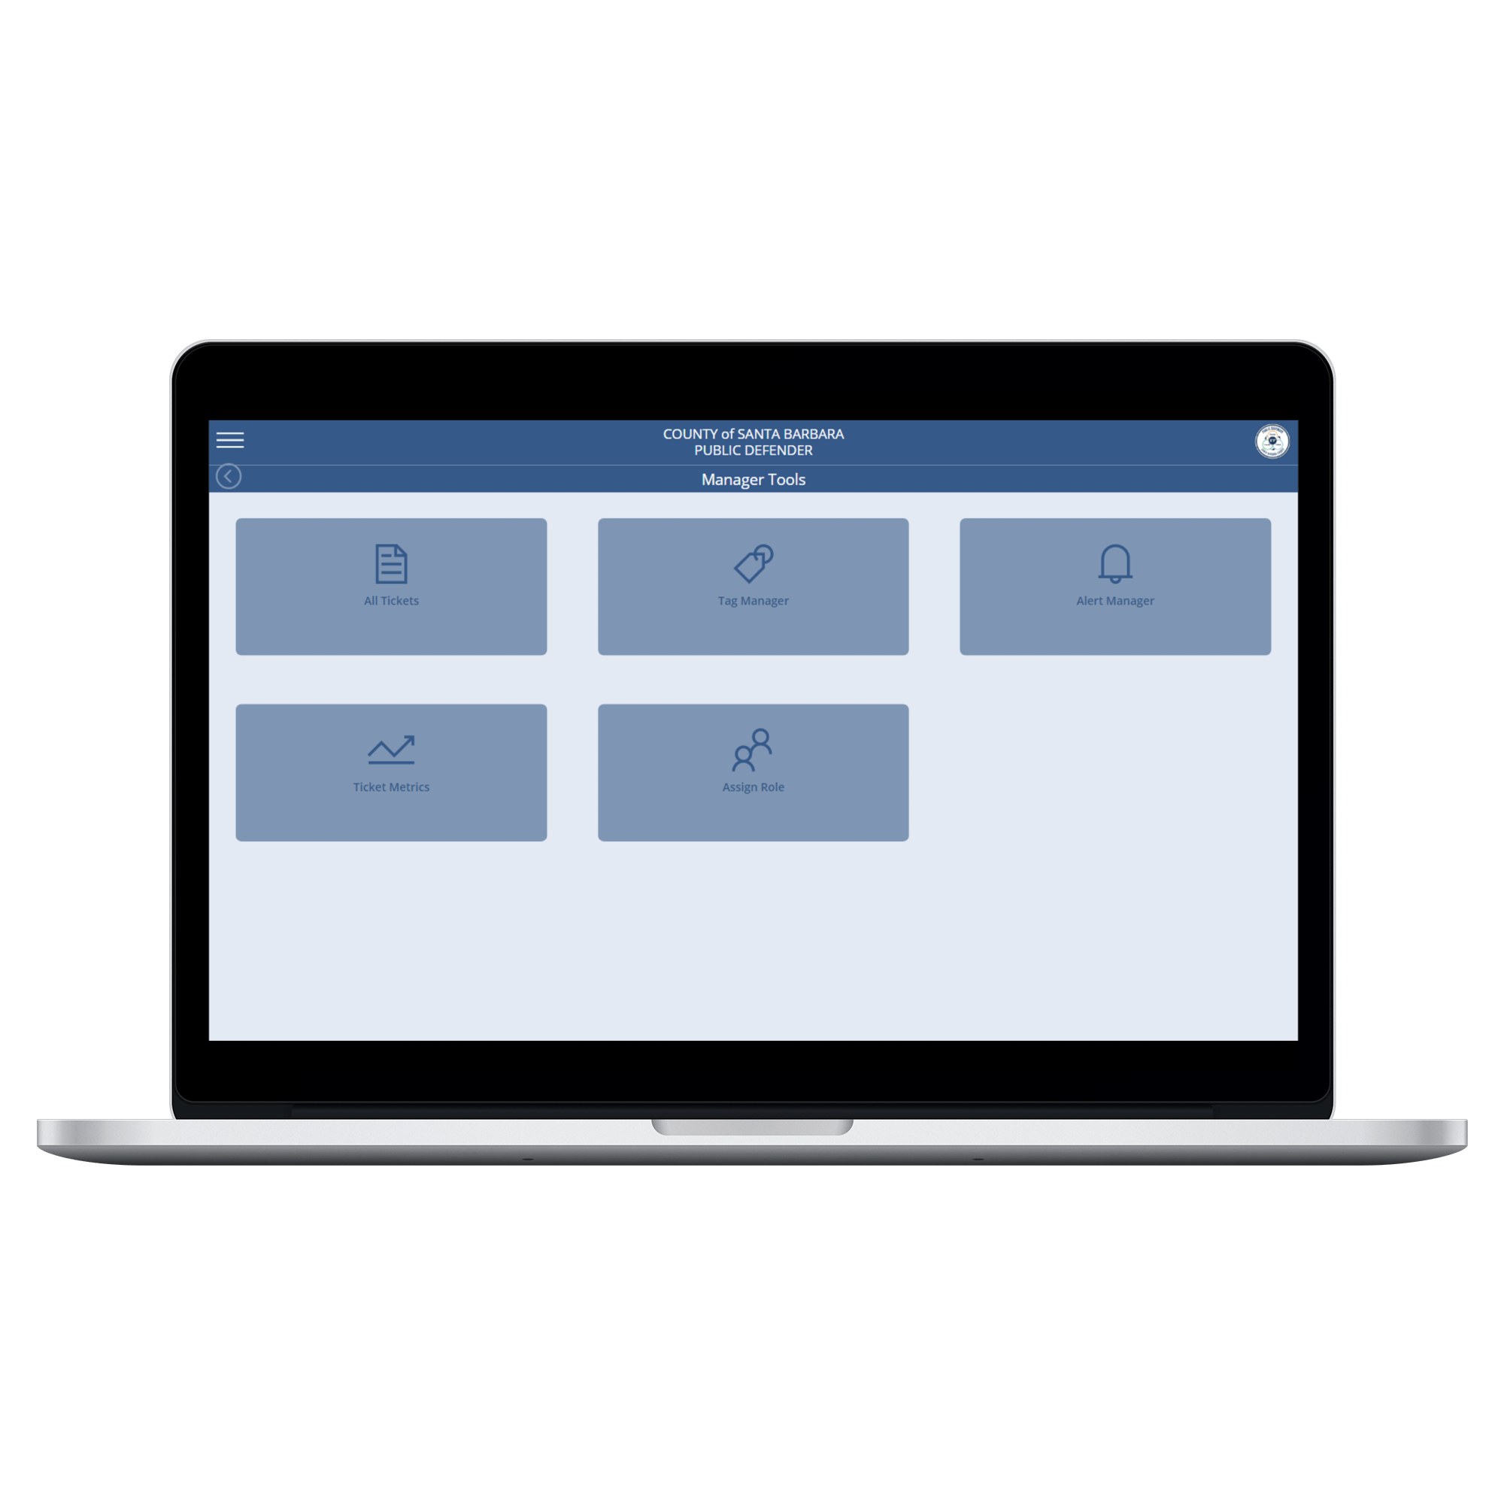
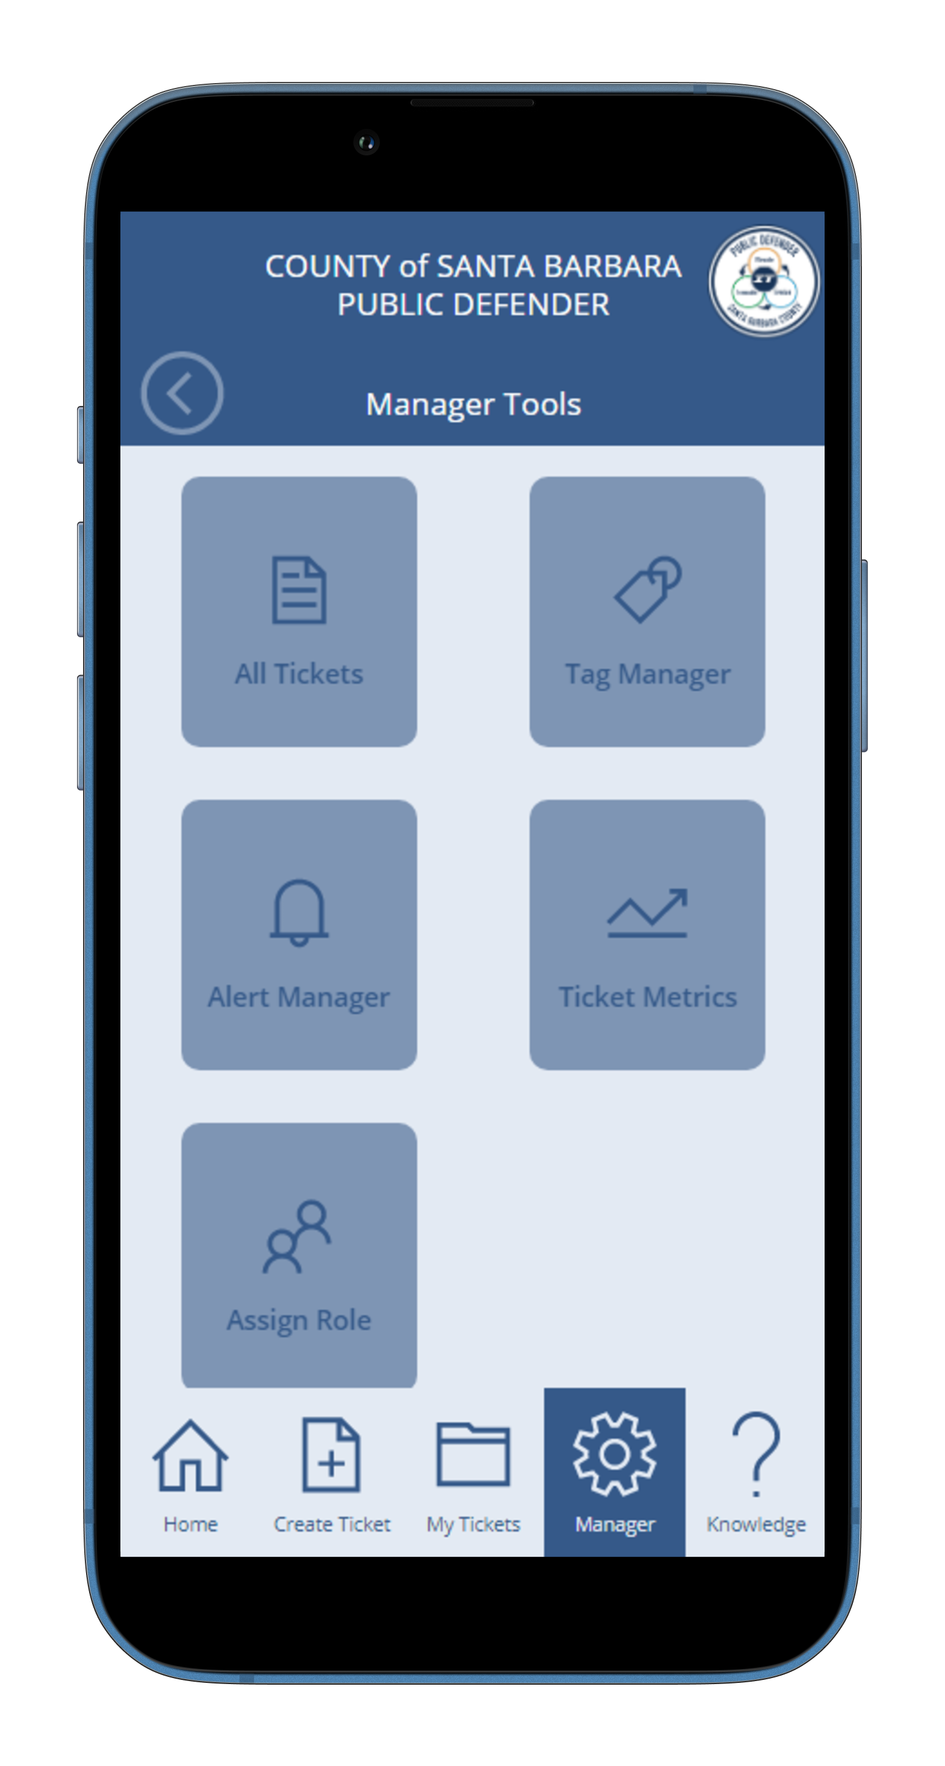
ManAger Tools

Slide 25
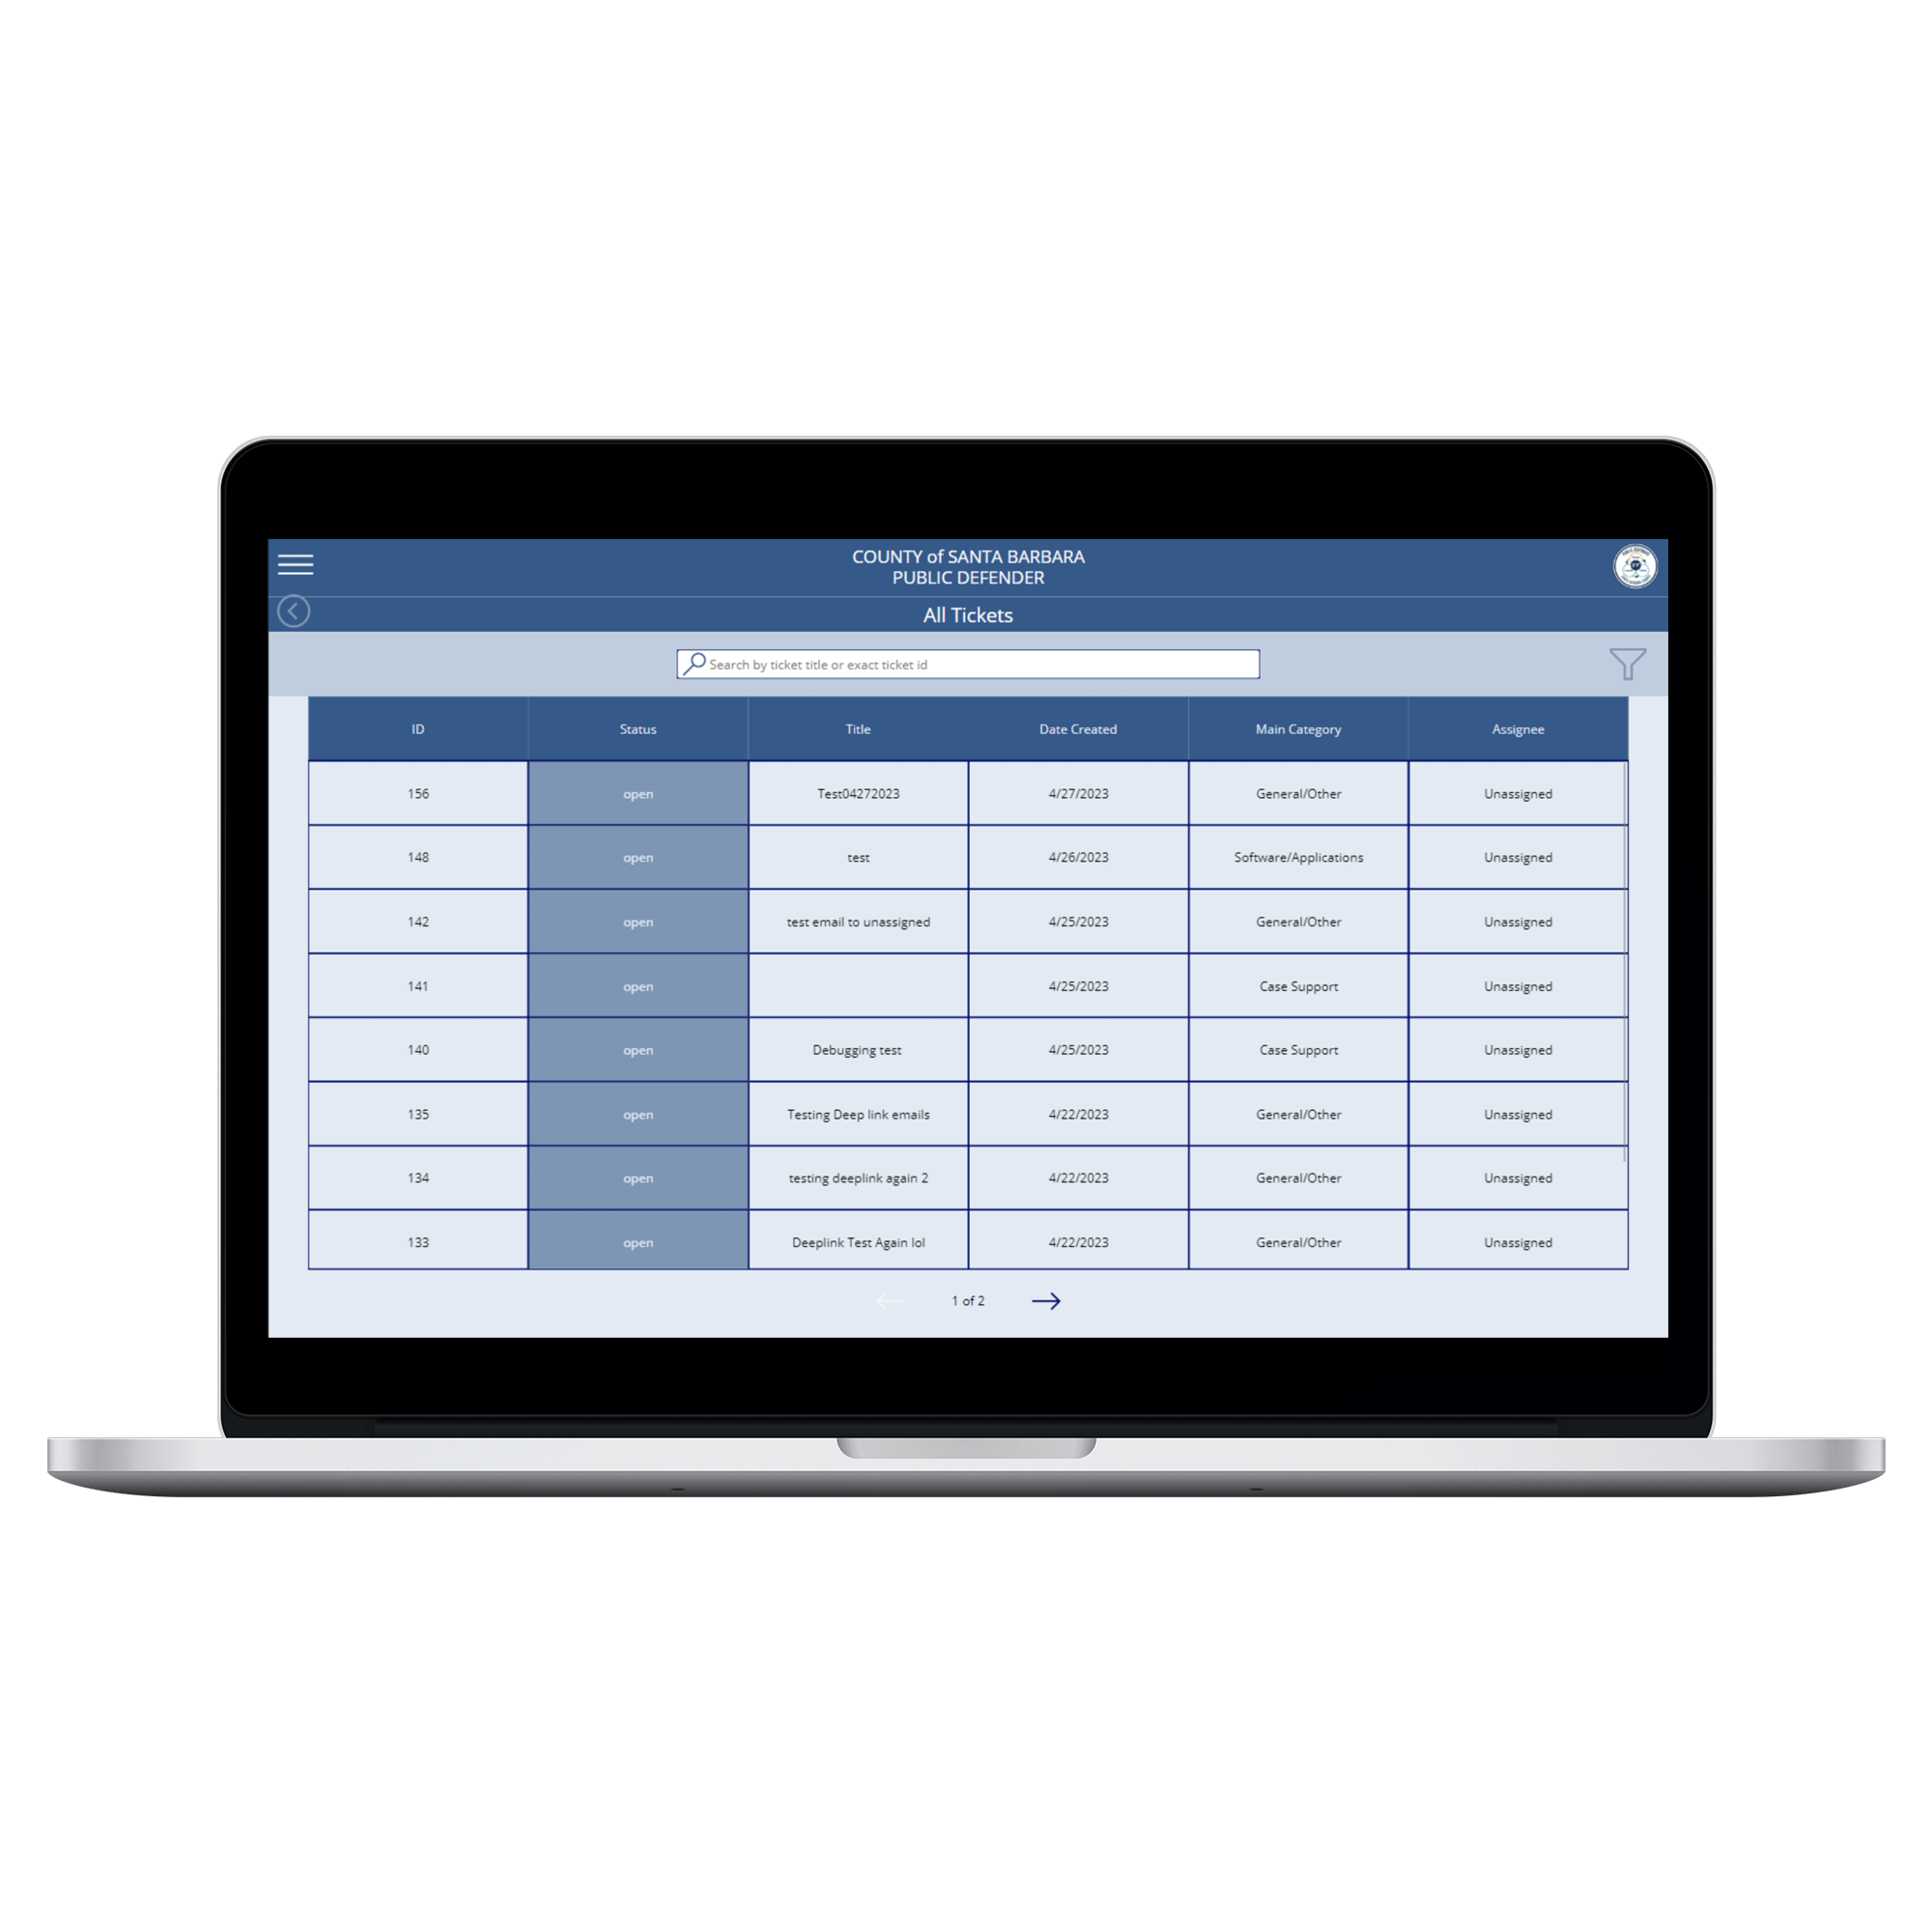
All tICKETS

Slide 26
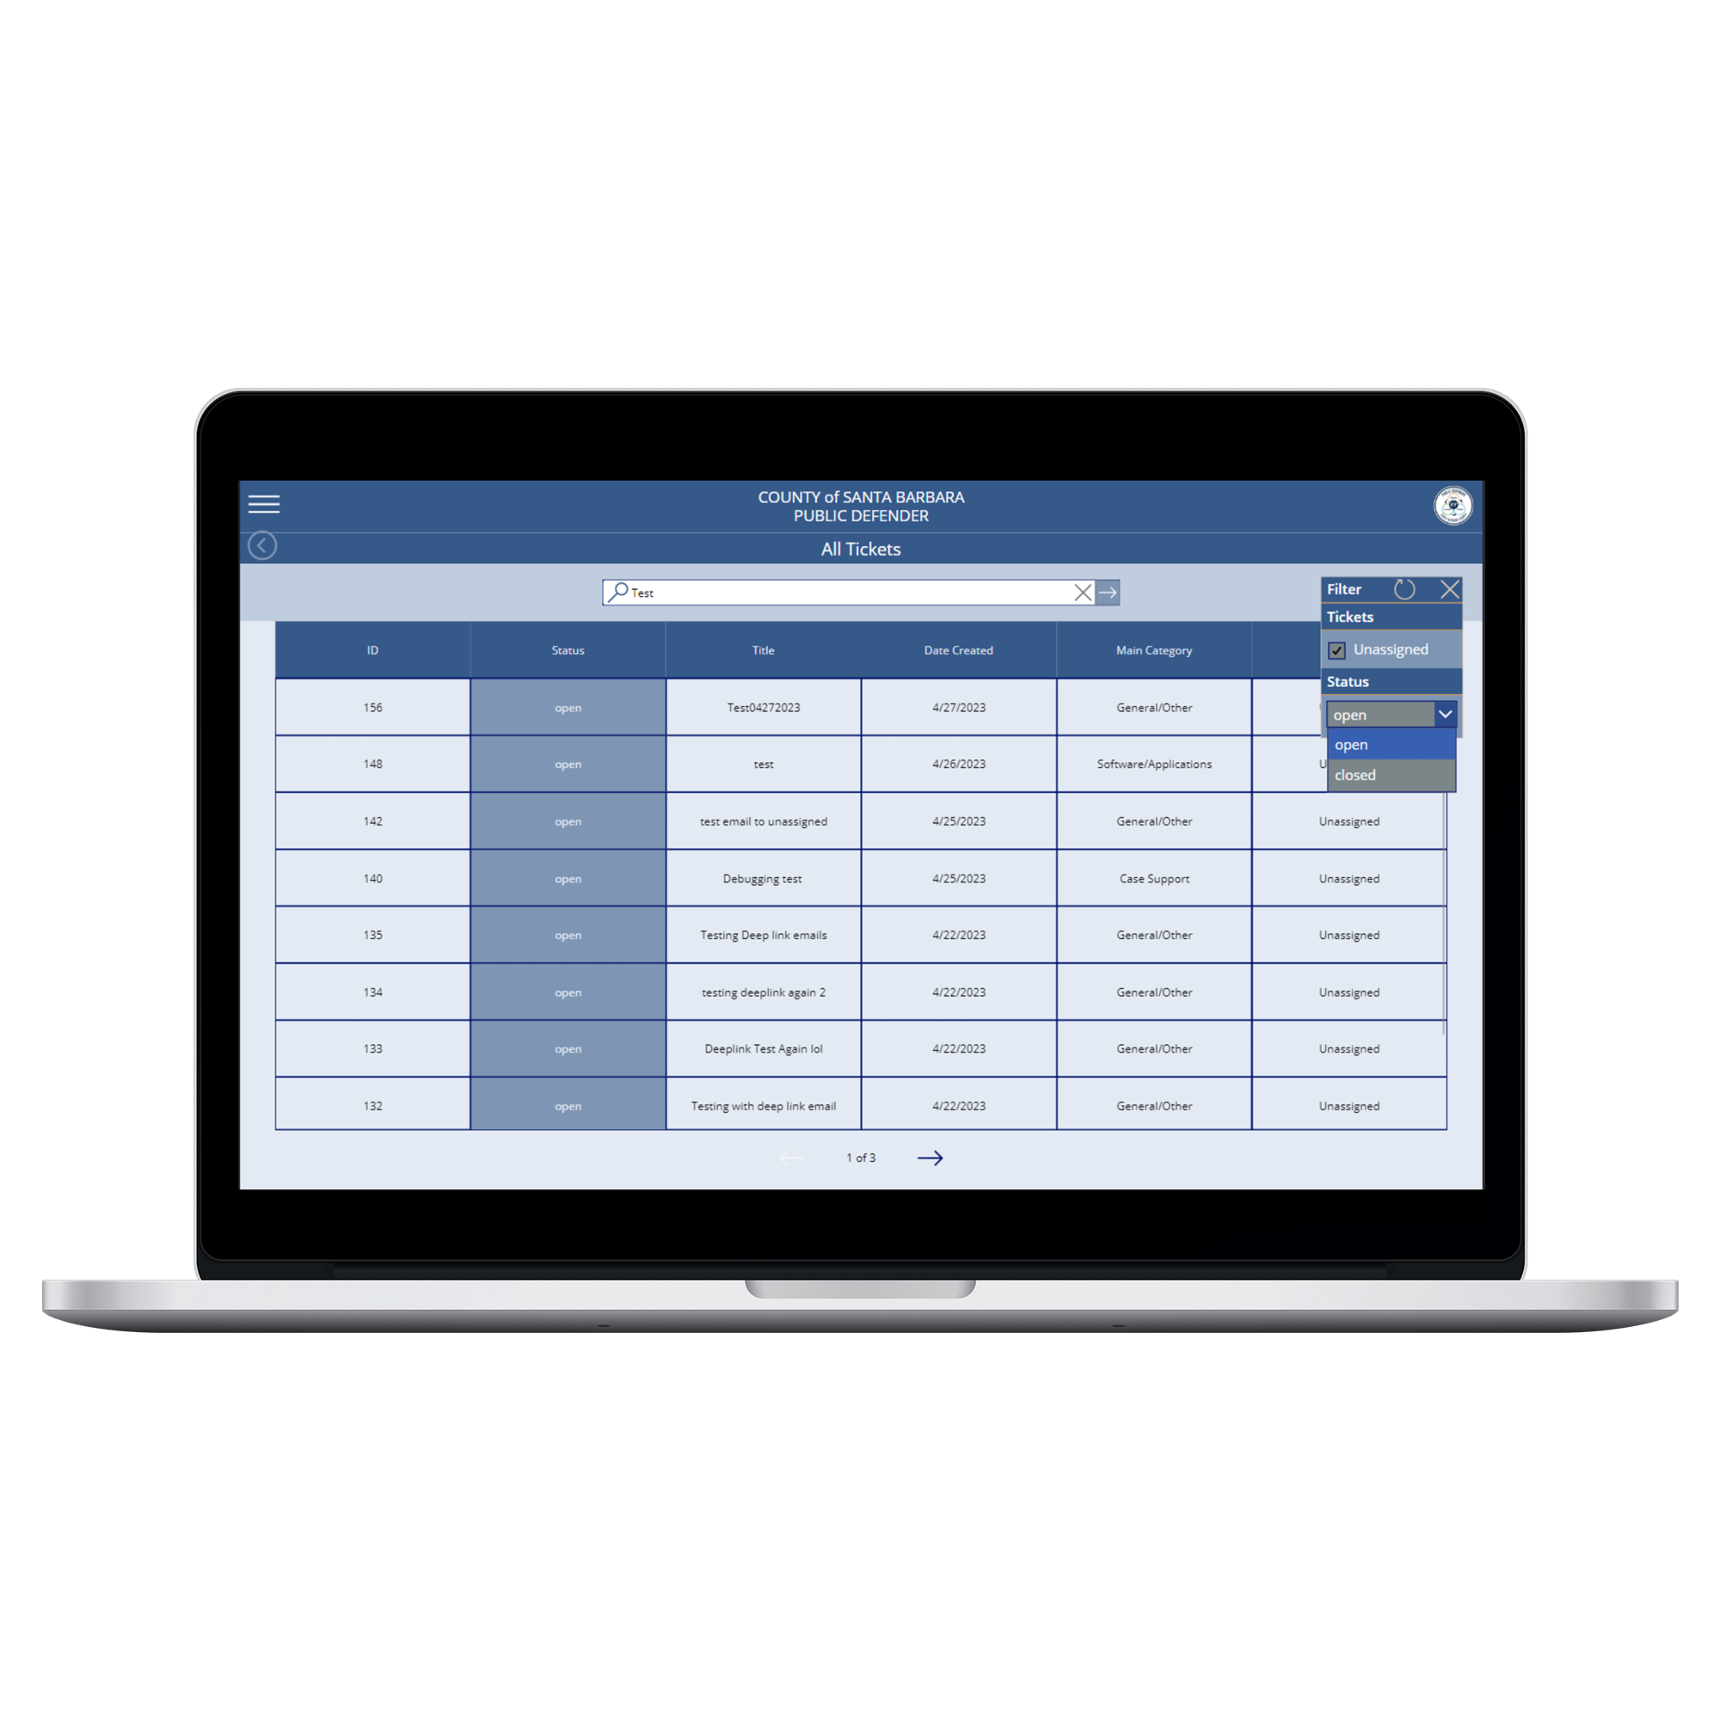
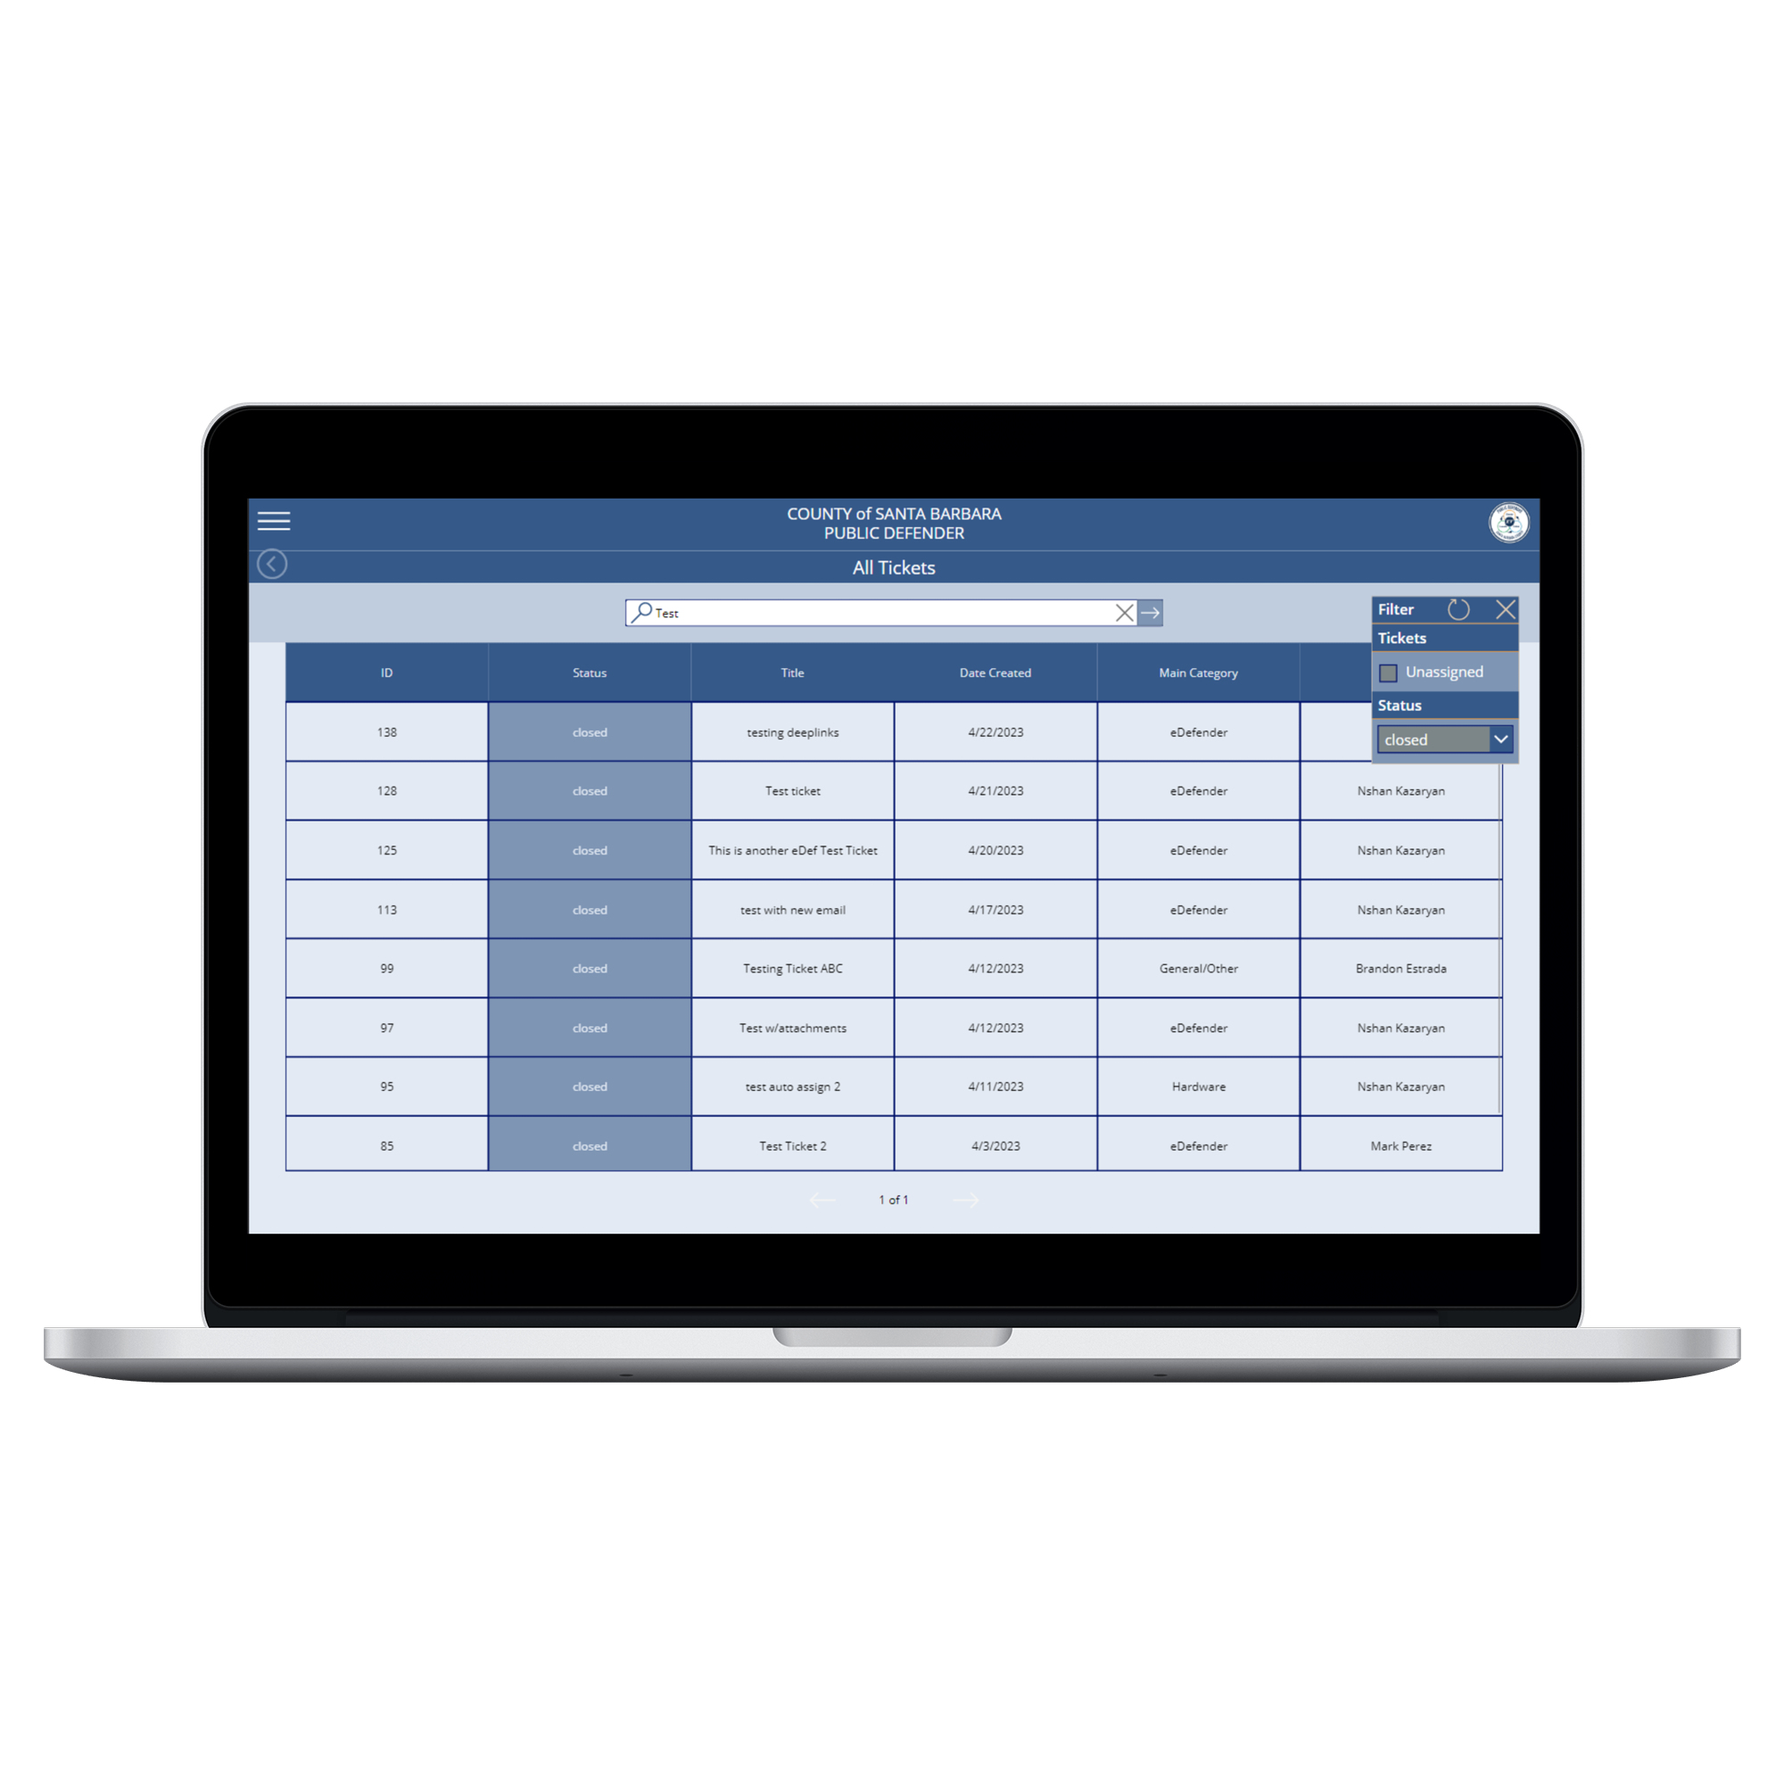
All tICKETS
Unassigned
Assigned

Slide 27
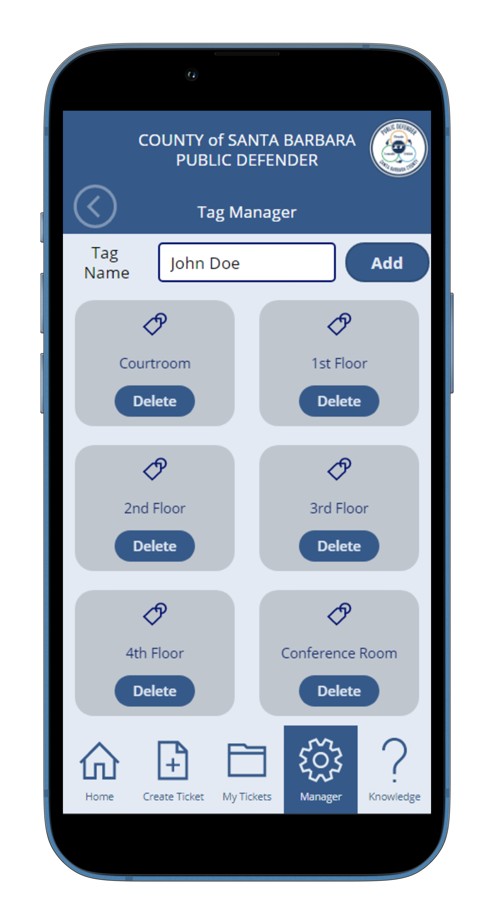
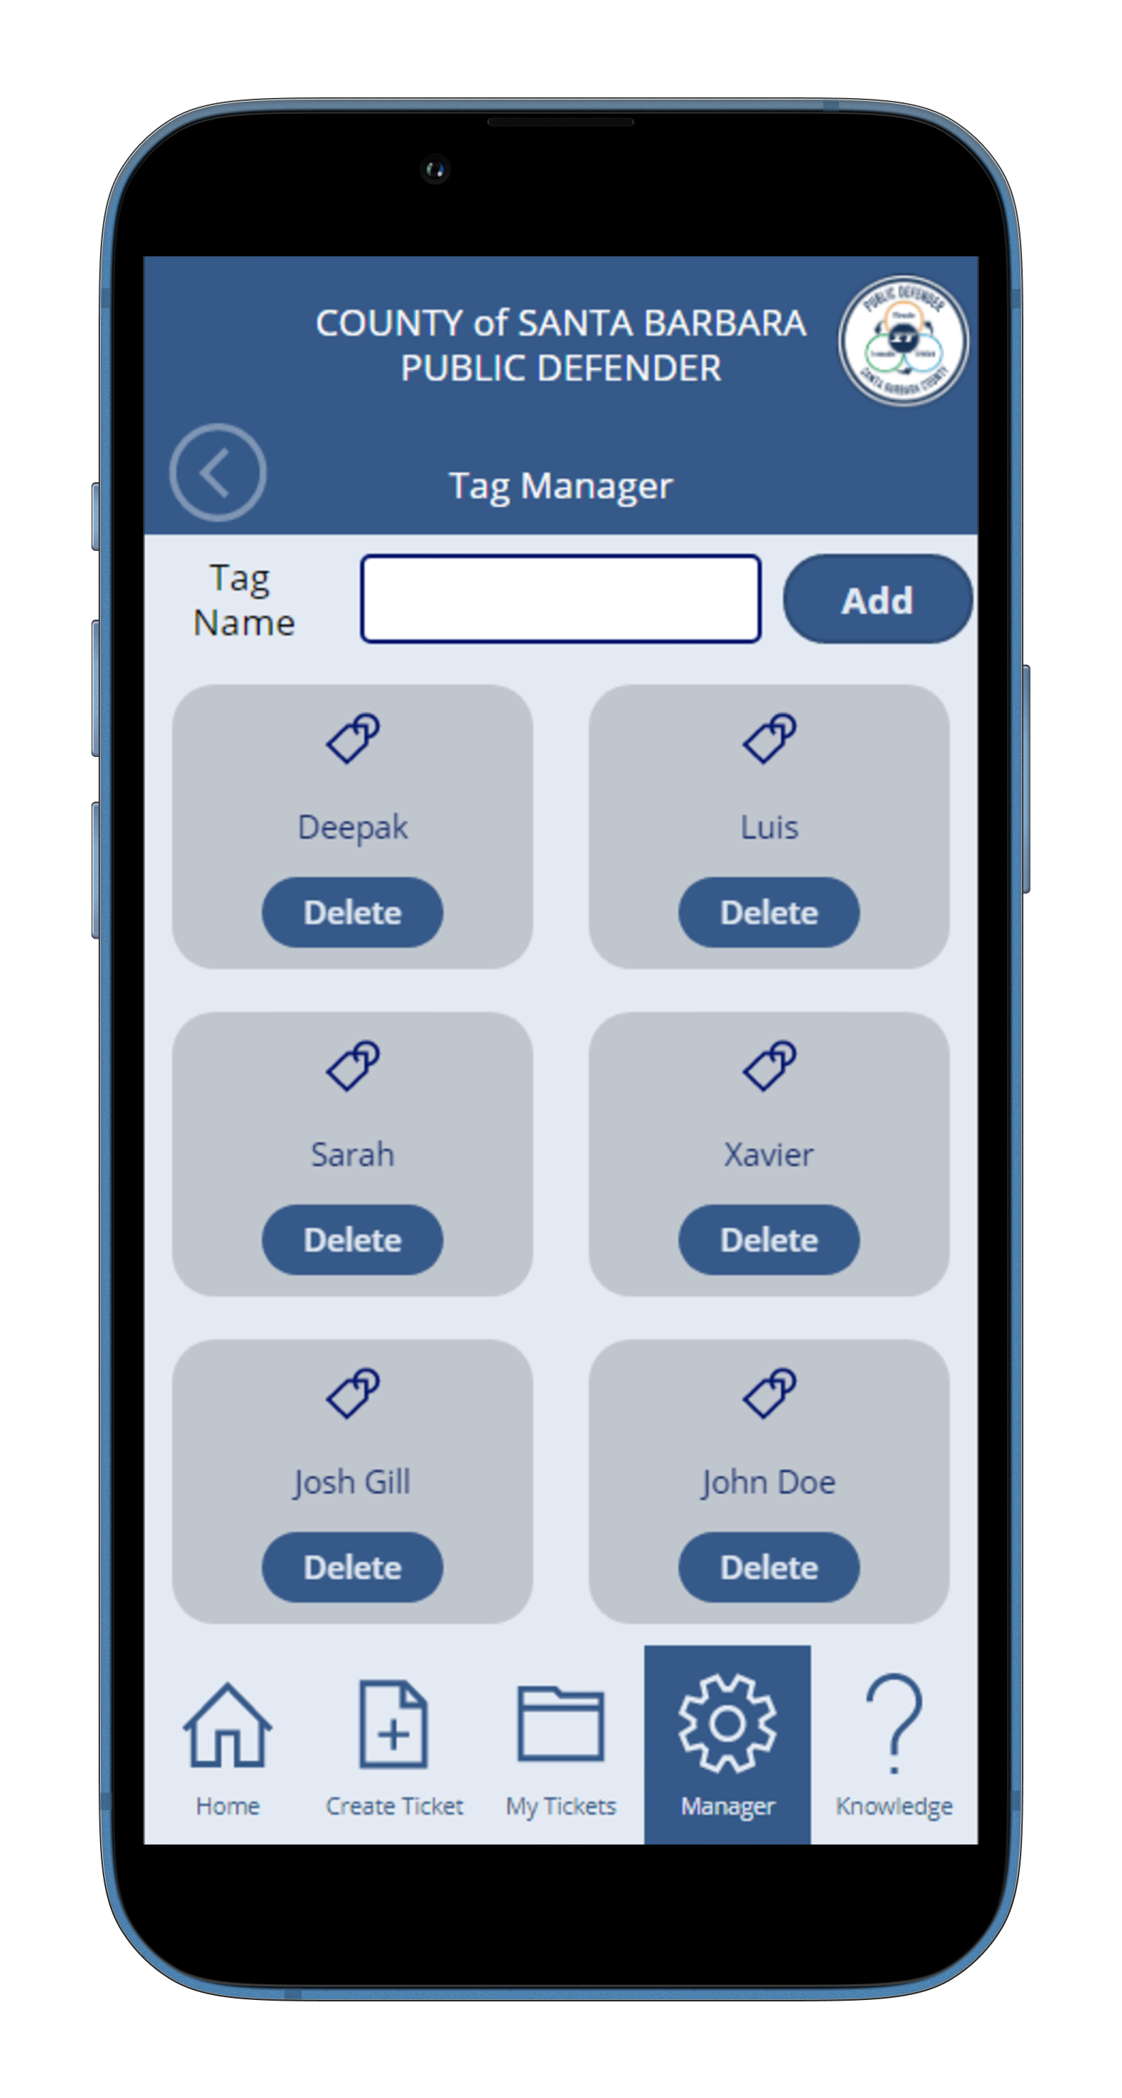
Tag Manager

Slide 28
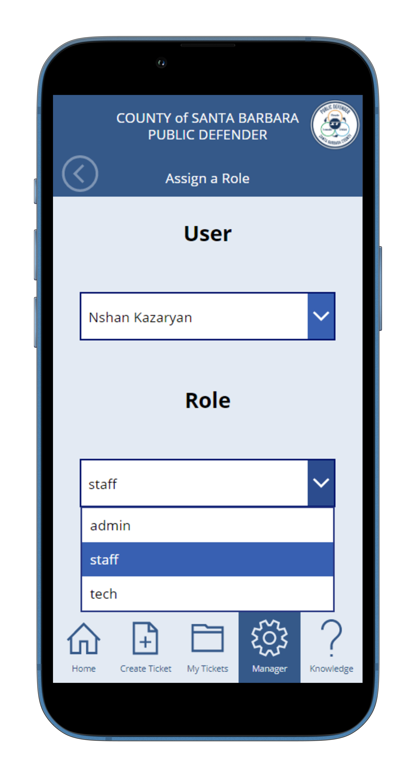
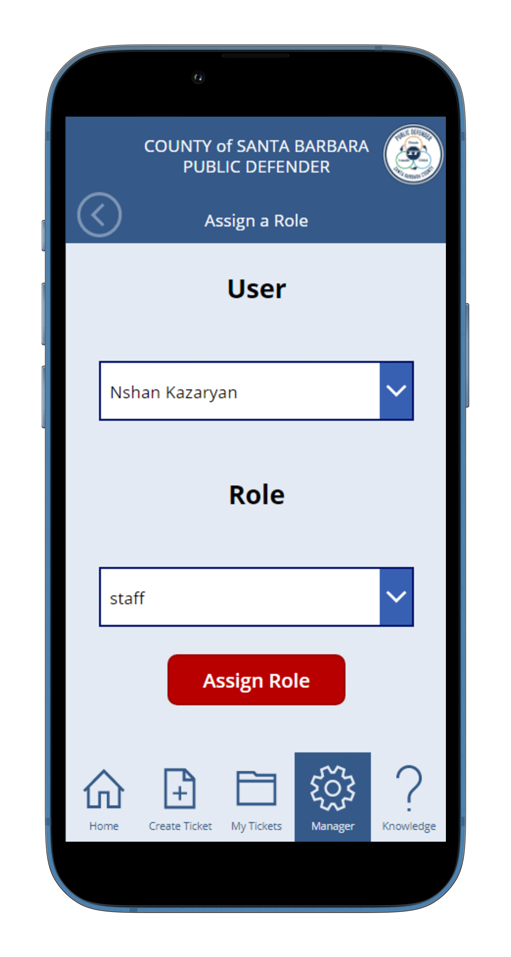
ASSIGN ROLE

Slide 29
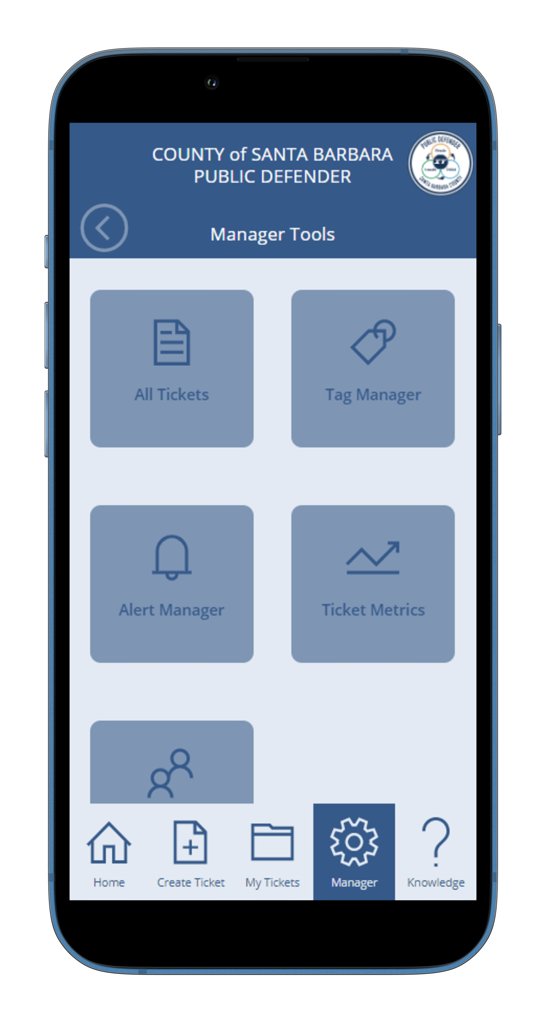
Alerts

Slide 30
All Alerts/Info

Slide 31
Email notifications
Interface
Backend
Email

Slide 32
Interface To Database Interaction
Interface
Backend
Database

Slide 33
Responsive Design

Slide 34
Mobile design
Mobile View
Desktop View

Slide 35
Limitations
PowerApps
Limited Collaboration
Limited Data Source
Licensing limitations
Performance issue
GitHub
Hard to branch, hashed codes
SQL
Premium access
Migrating to Share point

Slide 36
Future Recommendations
Power BI Integration
Advanced Analytics
Reporting
Chat Bot
Self Service Portal
Escalation Management

Slide 37
Conclusion
1
Significance of the project
2
Reflecting on our work
3
Potential Impact

Slide 38
THANK YOU
Questions?

