Slide 1
Home and Office Security Scanner (HOSS)
Created By:
Ricardo Castellanos, Luis Cortez, Diego Flores, Adrian Holloway, Jivan Karapetian,
Minsu Lee, Asahel Monroy, Ashley Pablo - Ramirez, Garrett Stewart, Guang Wu
Liaison: Dr. Anson Fong
Faculty Advisor: Dr. Huiping Guo

Slide 2
Agenda
What is The Internet of Things
What is HOSS and its Design Principles
Achievements
Data flow diagram
In-Depth look at functions
Video Demo
Future Plans and Opportunities
Q&A

Slide 3
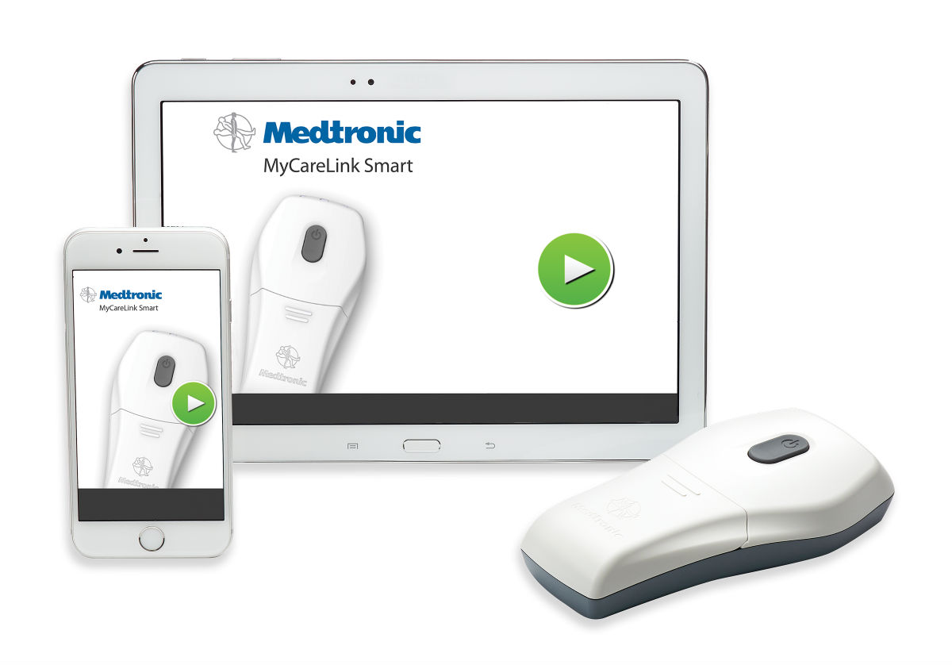
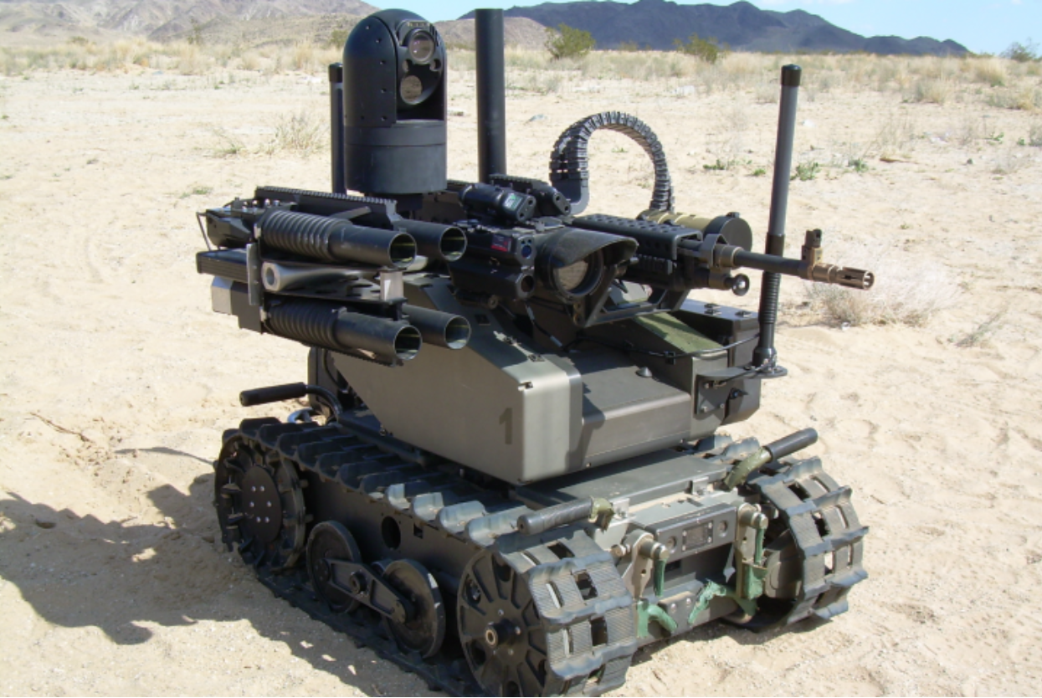
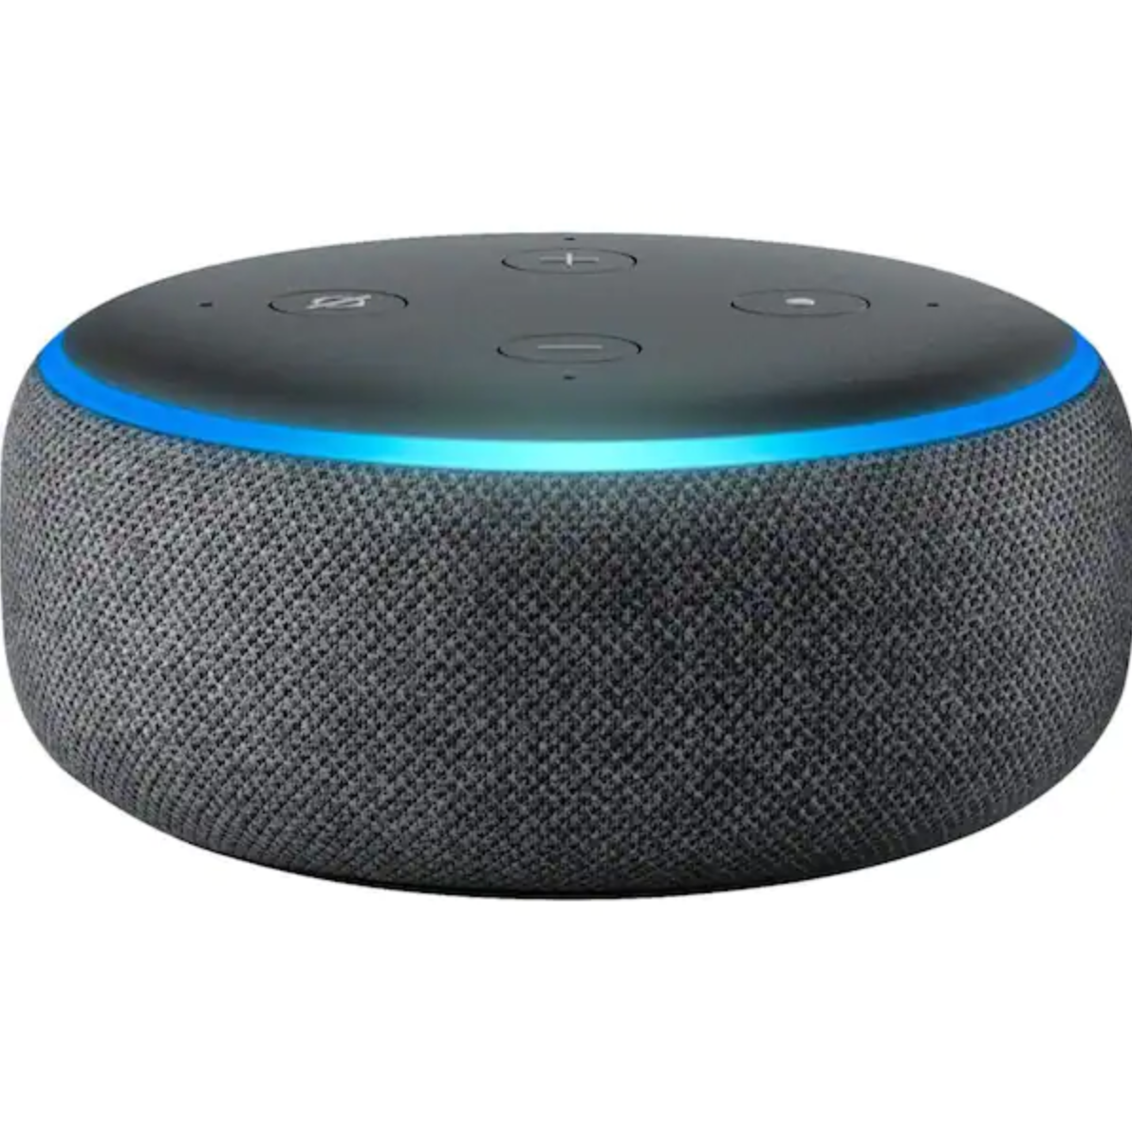
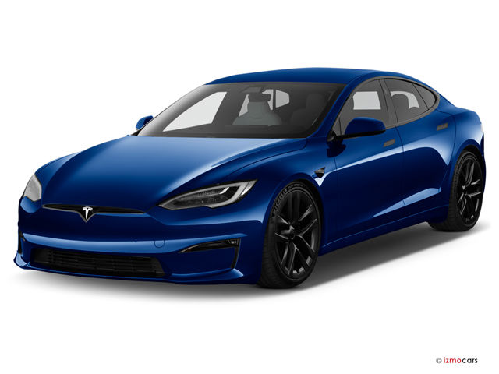
The Internet of Things
Merriam-Webster on IoT: “the networking capability that allows information to be sent to and received from objects and devices…using the Internet “
Capabilities such as sensors, video and voice recording, processing abilities
Applications: Smart Vehicles, Smart Home, Health Care
Image sources: www.qinetiq.com, www.medicaldesignandoutsourcing.com/,
www.tesla.com www.amazon.com
Notes:
Add some pictures/diagrams. (picture source/link).

Slide 4
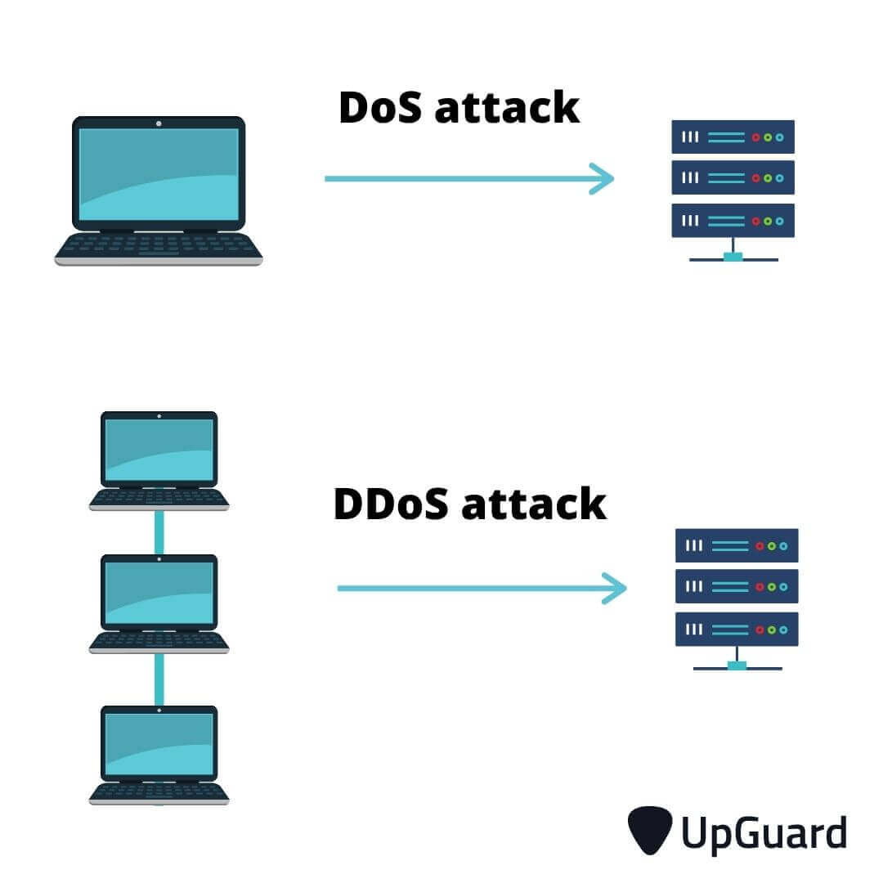
Security Issues in Smart Devices
IoT devices come with their share of security and privacy issues.
Examples:
Unknown devices connected to network
Vulnerable firmware
Poor testing, unpatched vulnerabilities, and lack of updates
Device vendor selling user data
Image sources: www.hackread.com, www.upguard.com, www.eclypsium.com, www.pc.net

Slide 5
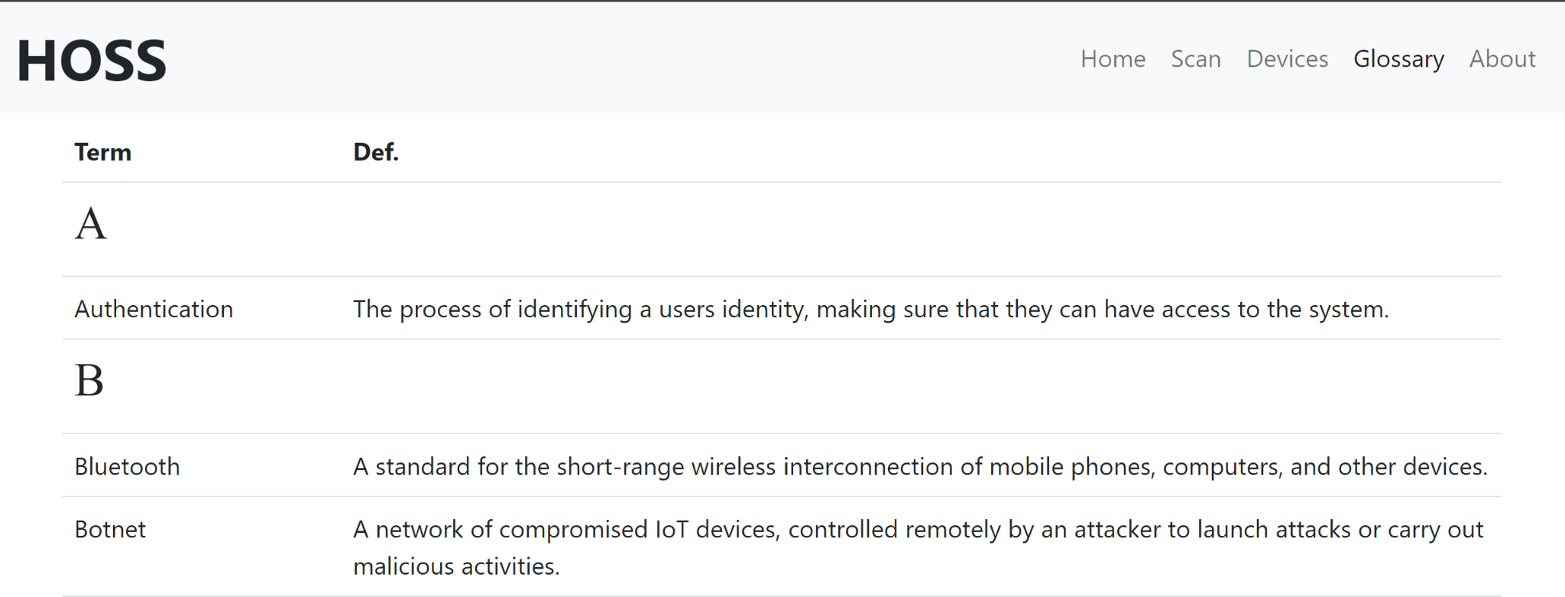
What is HOSS?
HOSS is a software application which provides two solutions for the issue of IoT device vulnerabilities.
First Solution: HOSS provides users a list of all connected IoT devices in their network.
Second Solution: HOSS provides a security and privacy assessment of these devices and their brands
HOSS shall also provide a glossary to the user regarding cybersecurity terminology.

Slide 6
Design Benefits
HOSS provides an intuitive framework both programmatically and visually
API Implementations for device scanning:
Network Mapper (NMAP) as first layer
Fing API as a second layer of device detection
Our database is written in MongoDB
MongoDB complements the versatility and simplicity of HOSS
MongoDB stores all information regarding different devices and their security & privacy scores
Saved in JavaScript Object Notation
Image sources: nmap.org, fing.com, mongodb.com
Notes:
Due to NMAP by itself being insufficient for returning expansive information about a device, we then incorporated Fing API as a second layer of device detection.
Saved in JavaScript Object Notation → known for particularly human-readable

Slide 7
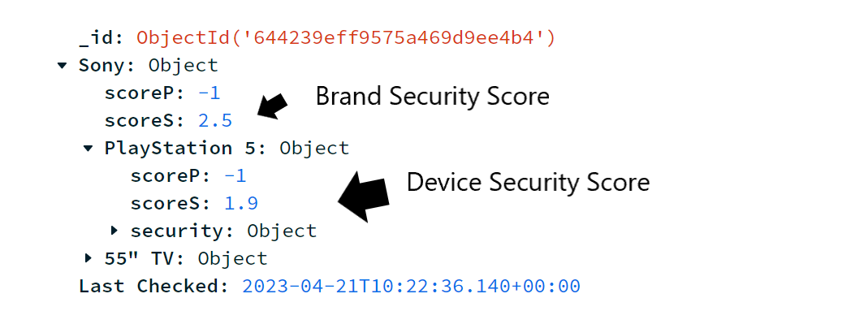
Automated Achievements
HOSS allows us to:
Conduct scans of any user’s network and return a full list of their IoT devices
Store all device information into MongoDB server managed by our back-end team
HOSS automatically captured:
Brand, model, MAC address, and total number of vulnerabilities
CVE NVD API (Common Vulnerabilities and Exposures)
Allows us to automatically capture the total number of vulnerabilities a device’s brand has disclosed
Image source: https://nvd.nist.gov/
Notes:
Scored most device’s security and privacy (with independent scores for both the Brand and Device itself)
Launched a user-interface to present this information.

Slide 8
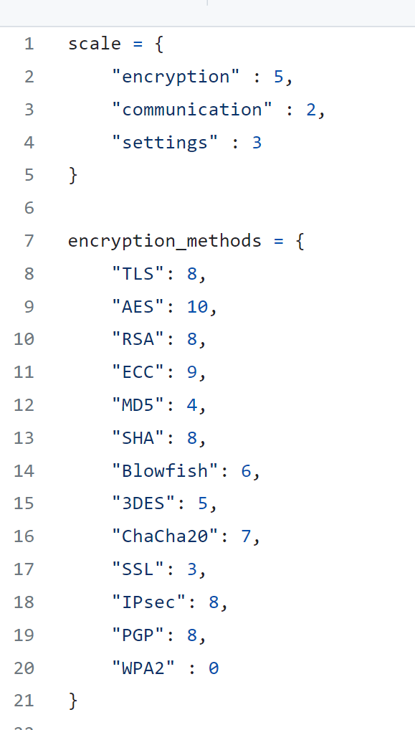
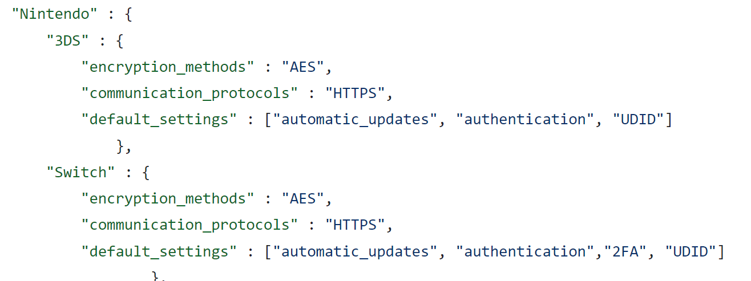
Manual Achievements
Attributes that we can automatically get for our scoring criteria include:
Device name
Brand/Model
Mac Address
Total number of vulnerabilities
Attributes that we couldn’t automatically get and required manual research include:
Encryption method
Communication Protocols
Default Settings for Authentication

Slide 9
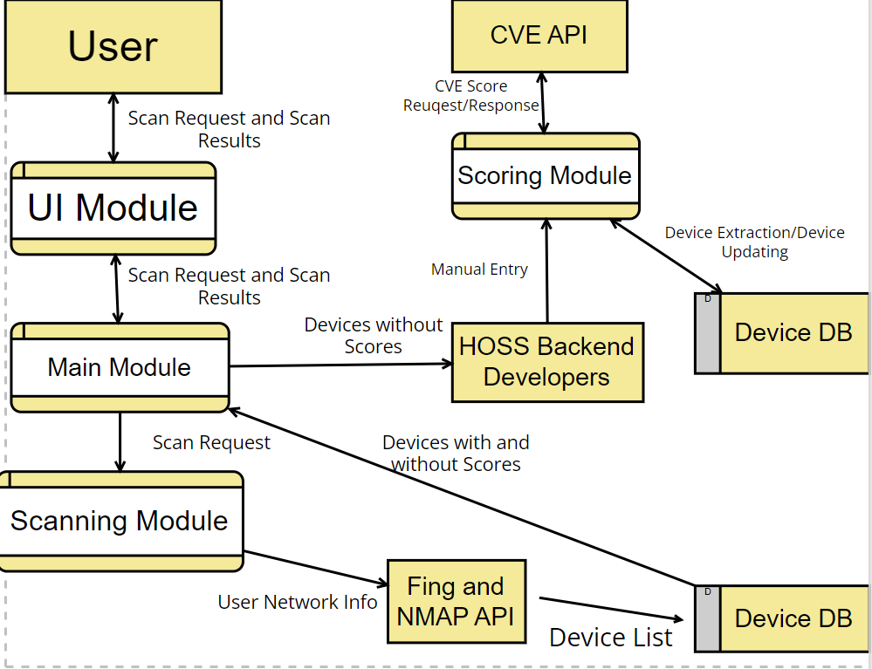
Data Flow Diagram

Slide 10
Scanning and Identifying Devices
NMAP and Fing
NMAP - Network Scanner
List of devices
IP Address
MAC address
Hostname
Open Ports
Fing - Device Recognition API
Brand
Model
Type

Slide 11
Fetching Scores
Security and Privacy Scores
By Brand or Model
Brand has generic score
Model has specific score based on features
Brand score for no specific device
New entries
Insert brand and model
Score -1
Scores are then inserted into scan results and scan table is displayed

Slide 12
Device Security Score Implementation
Encryption Method
Weight of 50%
Ex: AES (10)
Communication Protocol
Weight of 30 %
Ex: SNMP (8)
Default Security Settings
Weight of 20%
Authentication + 2FA
Automatic Updates
UDID

Slide 13
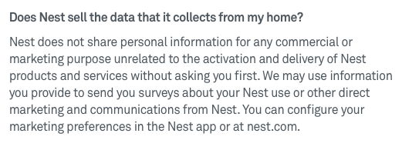
Privacy Score
A 5 point rating
Research & manually enter data into database
Two separate criterias for privacy score:
Brand
Do they sell their data?
If they do, then results in a lower score.
If they don’t, then results in a higher score.
Device
What type of information is stored?
Payment info
Address
DOB
Social Security
Notes:
For the Brand: The back-end manually researches if the device’s Brand sells the user’s information or not, and then inputs this into our database. If they sell the user’s information, this results in a lower privacy score. If they do not, it increases the privacy score.
For the Device: The back-end manually researches and inputs into our database what type of privacy information a device stores (Payment information, social security, address, date of birth, etc).
These are all criteria which we are not able to automatically capture via an API, and thus would have to be manually inputted per-device.

Slide 14
Implementation of CVE API
Common Vulnerabilities and Exposures (CVE)
list of publicity vulnerabilities for a brand

Slide 15
Implementation of CVE API Cont’d
A separate utility for getting CVE scores
Retrieve and sum all scores for a given brand
Use a weighted average to output a final score
We use the result of this calculation to update our database, rounding to the nearest tenth
Provides a baseline score for unscored brands

Slide 16
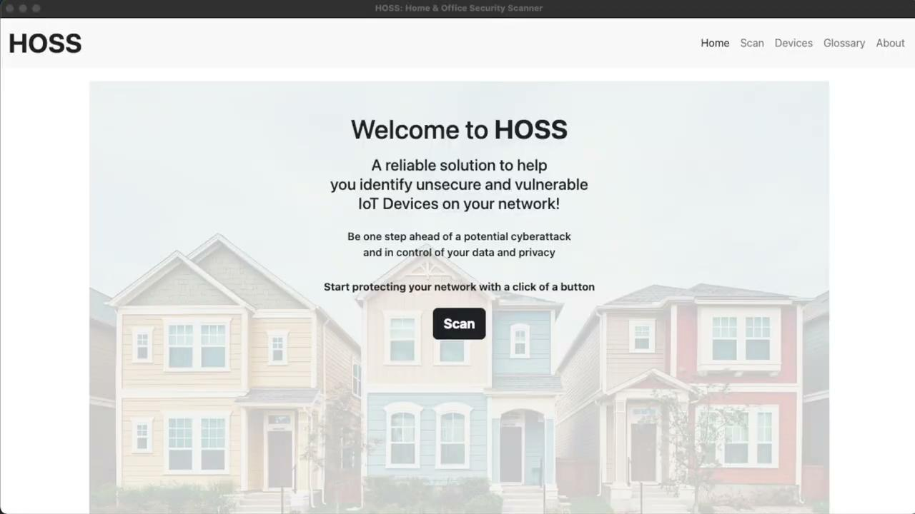
Demo video

Slide 17
Unfulfilled Goals
Track how much server-traffic is going into a device’s MAC address and use that as part of the criteria for the device’s security score.
Fully automate finding a device’s
Encryption method
brand data-sharing policies
Communication protocols
two-factor authentication
Image Sources: skillcast.com, onlinebusiness.umd.edu

Slide 18
Future Plans
Accomplish our unfulfilled goals
Incorporate a way for the user to manually enter their device’s information.
Provide users with recommendations as to how to improve their security and privacy
Image Source: Salesforce.com

Slide 19
Questions
Image source: www.freeiconspng.com/images/q-and-a-icon

Slide 20
THANK YOU!

