Slide 1
Box.com/eDefender Integration
Sponsored by the Santa Barbara Public Defender’s Office
Liaisons: Deepak Budwani, Angella Stokke,​
Sarah Rothschild, Bryan Burzon, Luis Ramirez​
Advisor: Jungsoo Lim
Notes:
James - Intro

Slide 2
Meet the Team
Alexis Ponce
Backend Lead
James Yokley
Project Lead
Mario Avila
Demo Lead
Sherina Marquez
Presentation Lead
Joseph Comeaux
Document Lead
Alexander Voisan
Architecture/Design Lead
Ethan Ngo
Customer Liaison Lead
Rosa Robles
QA/QC Lead
Jimmy Castillo
UI Lead
Karen Quan
Database Schema Lead
Notes:
James

Slide 3
Santa Barbara Public Defender’s Office
Who They Are and What They Do
The Santa Barbara Office of the Public Defender serves to protect and defend their clients’ rights through legal representation.
Notes:
James
represents people living in poverty and who have been traditionally marginalized from a holistic and client-centered perspective. We stand with our clients every day in many courtrooms and now Zoom rooms across Santa Maria, Santa Barbara, and Lompoc.

Slide 4
Santa Barbara Public Defender’s Office
Their Current Process
Currently utilizes eDefender and Box.com.
Manual paper/electronic uploading and notifying.
Hands-on human input required.
Notes:
James - pass to Sherina

Slide 5
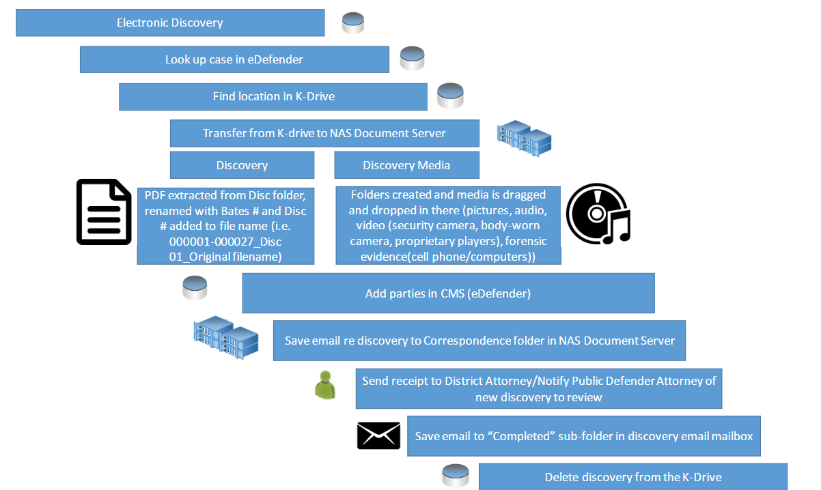
Their Current Process - Electronic Discovery Only
Notes:
Sherina

Slide 6
Project Description
Importance of the Project
The significance of this project is to reduce the time and workload the attorneys spend organizing/analyzing the case discovery
This will make their process more efficient and effective
Notes:
Sherina - pass to Ethan

Slide 7
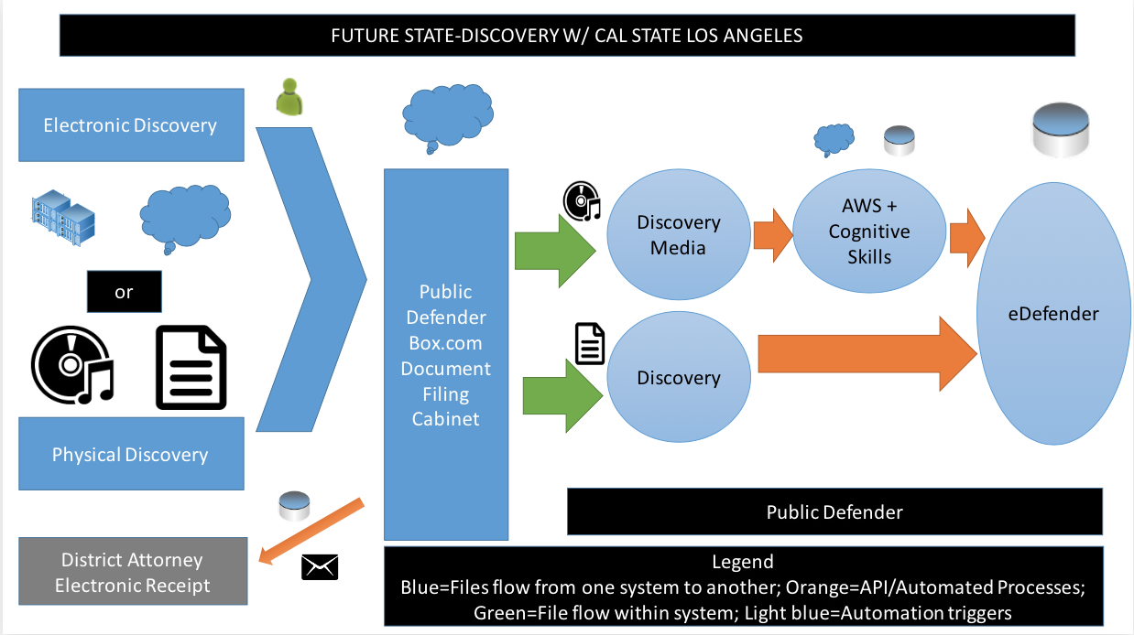
Project Description
Project Requirements
Notes:
Ethan

Slide 8
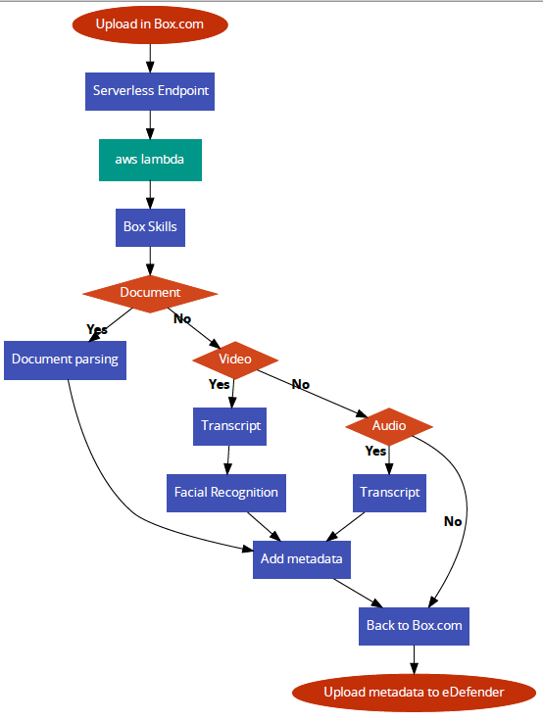
Implementation
From the Box Skill, the next steps are determined depending on the file type
Notes:
Ethan

Slide 9
Implementation
Continued
Documents
Images
Audio
Video
Notes:
Rosa

Slide 10
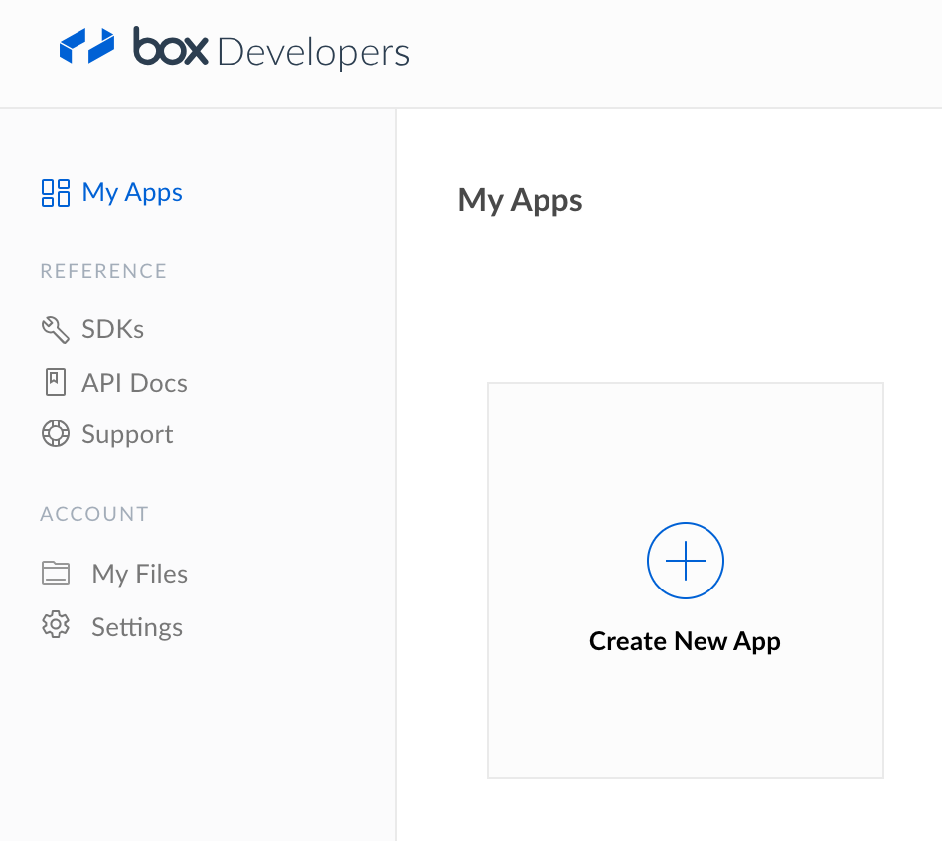
Box Skills
What is it?
Box Skills is a framework
File information sent through an automated process
The process of setting up a Box Skill Application
Notes:
Alexis

Slide 11
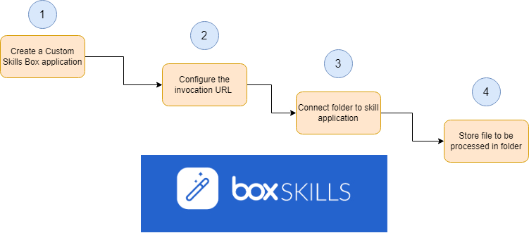
Box Skills
How We Use it
Created and configured our own custom Box Skills application using our invocation URL.
After creating a designated folder in Box.com, we followed the proper steps to link that folder to our custom skill.
Notes:
Alexis

Slide 12
Box Skills
Role in Overall Implementation
Sends event to skill once file is previewed/uploaded, makes call to API
Retrieves analysis and converts into metadata cards to be displayed
Notes:
Karen

Slide 13
Box Skills
Once a file is uploaded to Box.com, an event will be triggered and the file information will be sent for processing.
When the file is finished processing, our Box Skill will retrieve the analysis and create metadata cards to be stored in the Box file. It will then be displayed in the file preview.
Metadata : transcript, keywords, faces, timeline.
Notes:
Karen

Slide 14
Serverless
Implementation Process
What is Serverless?
To explain Serverless, you should think of a chain. It’s a way to connect the cloud to AWS.
Here’s how to set it up
Notes:
Jimmy

Slide 15
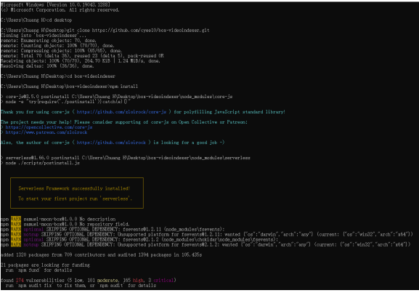
Serverless
Command Prompt
Notes:
Jimmy Here we use a package manager NPM in conjunction with serverless to package up our dependencies and function, and then deploy it onto AWS lambda

Slide 16
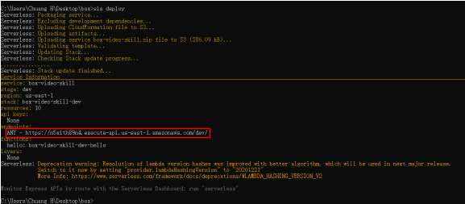
Serverless
Notes:
Jimmy

Slide 17
Serverless
We use Serverless in order to install the required packages using NPM. We’ll then be able to set up AWS credentials within Serverless.
We connect Serverless to AWS Lambda using the keys provided by AWS. We use the command: “serverless config credentials -o --provider aws --key 'YOUR_AWS_KEY' --secret 'YOUR_AWS_SECRET'”.
Finally, it can be deployed to AWS Lambda using the command: “sls deploy”
Notes:
Jimmy

Slide 18
AWS Lambda
What It Does
AWS Lambda is scalable serverless technology (Function-as-a-Service)
AWS Lambda functions are triggered by events
Invoke functions using AWS resources or other services
Img src: https://aws.amazon.com/lambda/
Notes:
AJ

Slide 19
AWS Lambda
How We Utilize It
Discovery media file uploaded to Box.com folder
Box Skills invokes lambda function
Lambda function will connect to Azure Video Indexer to create transcription / facial recognition
AWS Lambda will send response back to Box.com and attach it as metadata to the file
Notes:
AJ

Slide 20
AWS Lambda
Transcript File Service
As the Azure Transcript is returned to AWS, our transcript parser will create a new document
New document will be formatted automatically using speaker IDs and file name
Uploads to same folder where
original files were uploaded and allows for
duplicate file names
Notes:
AJ

Slide 21
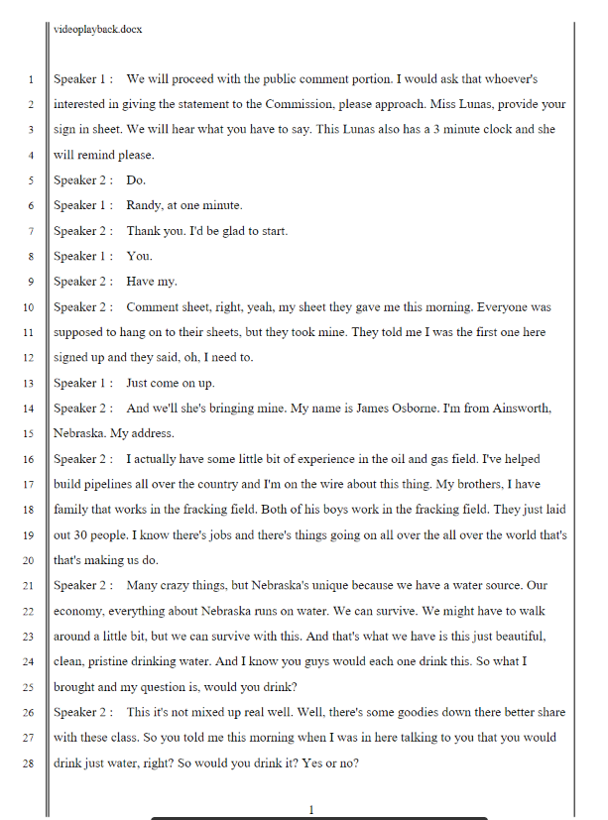
AWS Lambda
Transcript File Format Requirements
Speaker ID instead of timestamp.
Letter Size: 8.5” x 11”
Times New Roman 12 point font
Left Border with Double Lines
Right Border with a Single Line
Line numbers with 28 lines per page
Header with the filename
Footer with page numbers in decimal format
Notes:
AJ

Slide 22
Microsoft Azure
What Is It?
Cloud platform with tools and frameworks used to build, run, and manage applications
Healthcare, Financial Services, Government, Retail, Manufacturing
Several services
Azure Video Indexer API
Notes:
Mario

Slide 23
Microsoft Azure
How We Utilize It
Video Indexer for Box
Azure Video Indexer Account
Video Indexer Account ID
Video Indexer Account Keys
Create skill using the API
Notes:
Mario

Slide 24
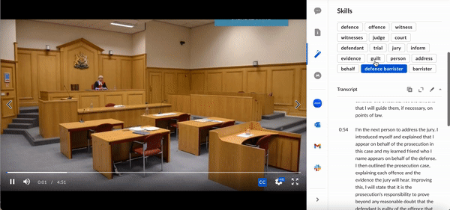
Microsoft Azure
In Action
Notes:
Mario

Slide 25
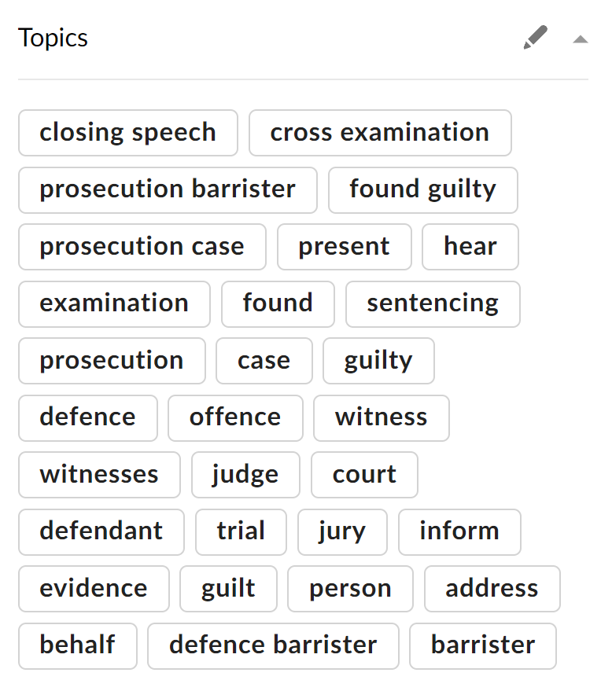
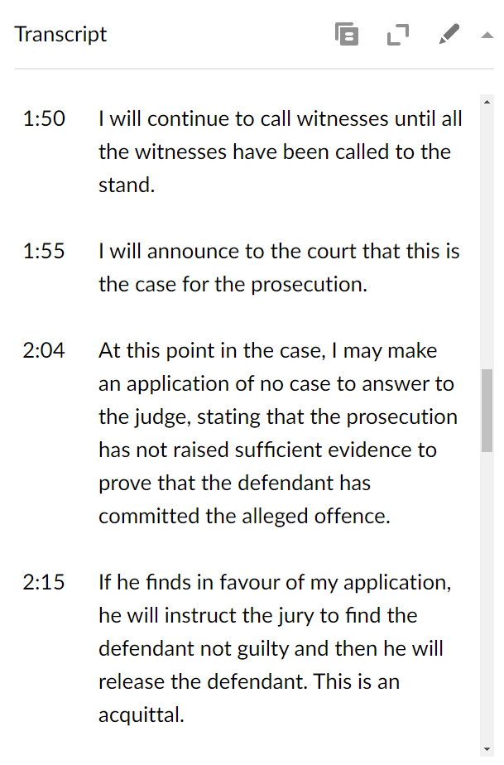
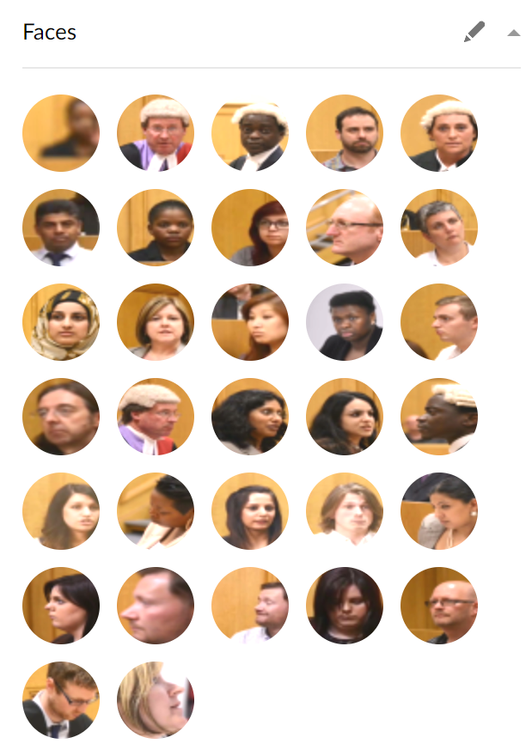
Microsoft Azure
Transcription/Facial Recognition
Notes:
Mario

Slide 26
Accomplishments
Getting AWS Lambda, Microsoft Video Indexer, and Box.com to interact properly
Delegated tasks efficiently among a 10 person team
Communicated our setbacks to the whole team
Improved documentation from previous groups
Deployed serverless to new regions
Solved unexpected errors during testing and deployment
Notes:
Joseph

Slide 27
Future Goals for the Next Group
Add capability for Spanish translation
Improve the formatting of the transcript document
Leverage MS Azure’s customization capabilities to cater to legal terminology
Notes:
Joseph

Slide 28
Recorded Demo
Notes:
AJ - show results of file upload

Slide 29
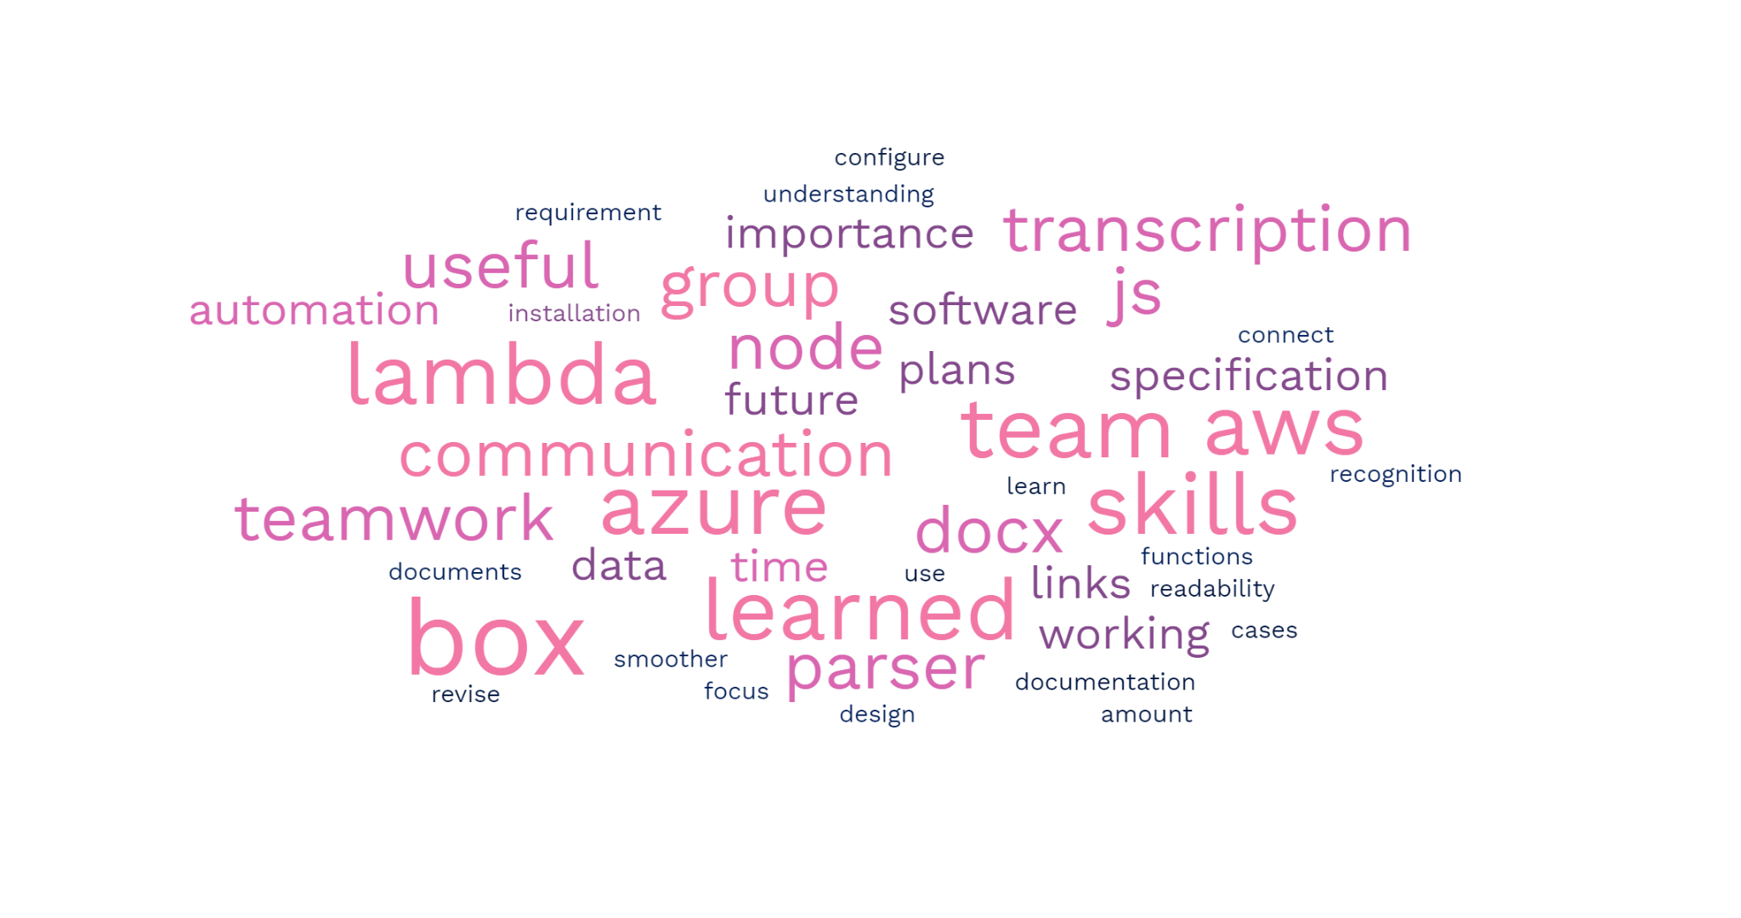
What We’ve Learned
Notes:
Word Cloud.

Slide 30
Thank you!
Questions? Comments?
Notes:
James - Conclude Presentation

Slide 31
Google Slide copy
https://docs.google.com/presentation/d/1dNeSu8H1ECHaxBx68UjHkw9qDuS5YSlnWmcYajb4t5U/edit#slide=id.g1a35e475184_0_0

