Slide 1
Mathworks
(Sensor Fusion for Autonomous Systems)
1
Daniel Gallegos
Notes:
YOMO

Slide 2
Team Members
Daniel Gallegos
Gerardo Ibarra
Deepanker Seth
Angel Tinajero
David Neilsen
Hagop Arabian
Xiao Hang Wang
Roberto Garcia
Patrick Emmanuel Sangalang
Jonathan Santos
2
Daniel Gallegos
Notes:
Introduce in listed order

Slide 3
Sponsor information
MathWorks
Company focused on computing software for many disciplines and purposes:
Scientists, Researchers, Mathematicians, Engineers
Provide simulation based environment to model and test solutions to vehicular problems, such as our lane-changing problem
Main Products are:
MATLAB and SIMULINK
3
Daniel Gallegos
Notes:
Address the link between Matlab and our project.

Slide 4
Agenda
1) Introductions (Daniel Gallegos)
2) Problem statement (Gerardo Ibarra)
3) History of project (Deepanker Seth)
4) Approach to Lane Changing Problem (Angel Tinajero)
5) Demo
6) Technical breakdown
7) Results (Roberto Garcia)
8) Next steps goals (Patrick Sangalang)
9) Conclusion (Jonathan Santos)
10) Q & A
4
Daniel Gallegos

Slide 5
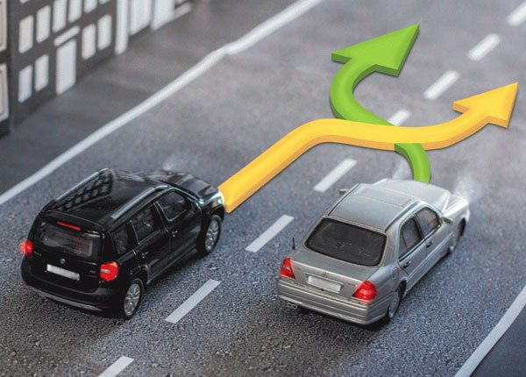
Motivation
According the National Highway Traffic Safety Administration (NHTSA):
10% of car accidents due to improper lane changes
Resulting 35,000 injuries
6,000 death per year in the US alone.
5
Daniel Gallegos

Slide 6
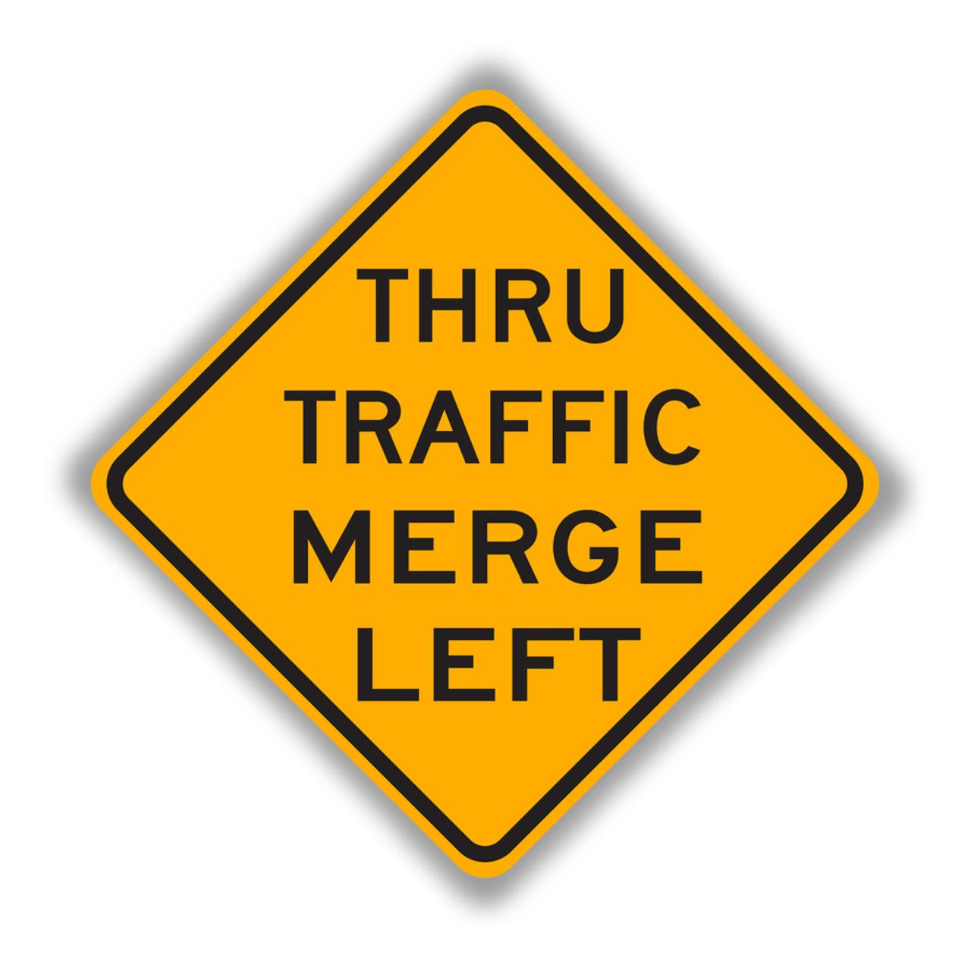
Y.O.M.O.
(You Only Merge Once)
Algorithm
6
Daniel Gallegos

Slide 7
Problem Statement
Create sophisticated Machine Learning Algorithm and complimentary web application to help a driver safely change lanes in a moving vehicle
We will use data collected through sensors on the vehicle, and data analysis through sensor fusion
Sensor used:
LIDAR
Cameras used too
Complements with Auto Braking
7
Gerardo Ibarra
Notes:
-Sophisticated machine learning algorithm and complimentary web application to help a drive safely change lanes in a moving vehicle
-We will use data collected through sensors on the vehicle, and data analysis through sensor fusion
-Sensors used:
-Algorithm we have devised is YOMO
-Allows a driver to be aware of position and surroundings
-Complements auto braking

Slide 8
Fall Semester Recap
We spent the fall semester developing the foundation of the project and exploring what tools would be necessary to create a statistically accurate algorithm.
We determined the basic components of the project.
We used Matlab, various ML algorithms and data collection strategies.
Tested various algorithms with data simulated using Matlab and limited sensor data to see which fits our needs better.
We understood the limitations of a standalone algorithm.
We experimented with different sensors such as GPS, LIDAR and visual odometry and data they provide.
By the end of Fall, we had our YOMO version 1 ready and it was going through testing. Our main goal for the spring included working on improving the structure and accuracy of the algorithm.
8
Deepanker Seth
Notes:
Which tools we explored and which

Slide 9
Spring Semester
Our focus this semester became creating a sophisticated algorithm and a complimentary web application to show how it works, so it could take in data and use output from the algorithm to inform the user to make lane change.
9
Deepanker Seth

Slide 10
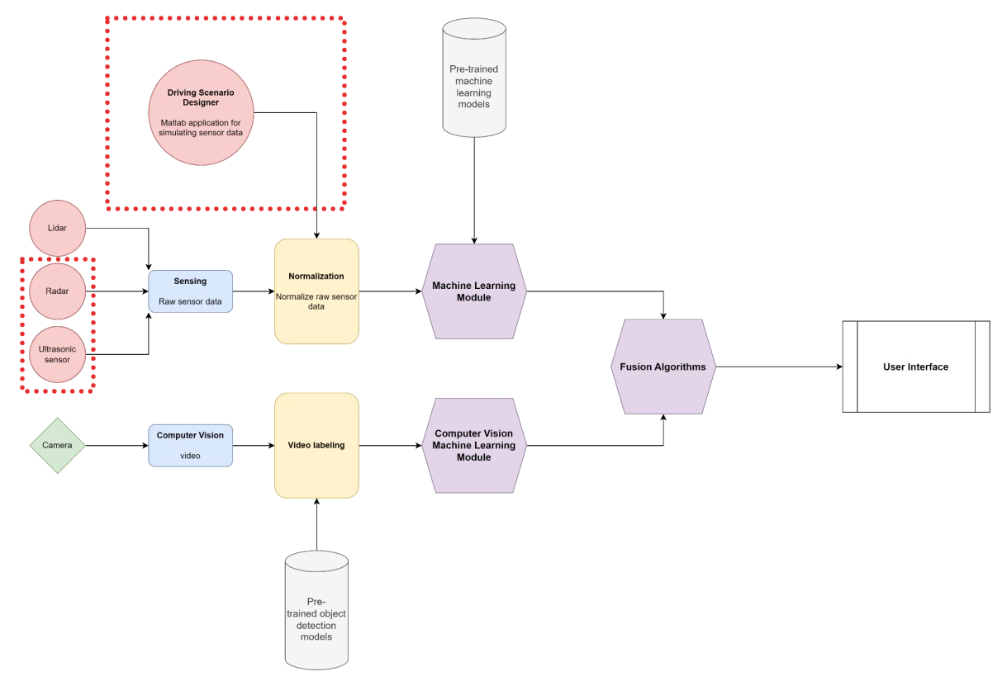
Flowchart
of intended System
Architecture
for Fall:
10
Deepanker Seth
Notes:
The flowchart above shows the intended system framework of our project in Fall ‘22. The project consisted of a total of 8 parts, where the blue rectangles show raw data acquisition and pre-processing. The yellow rectangles are normalizations of the raw data. And the purple hexagons are the machine-learning algorithms. The final white rectangle with edges is the User Interface. We ended up not needing the red-dotted parts parts in our final algorithm.

Slide 11
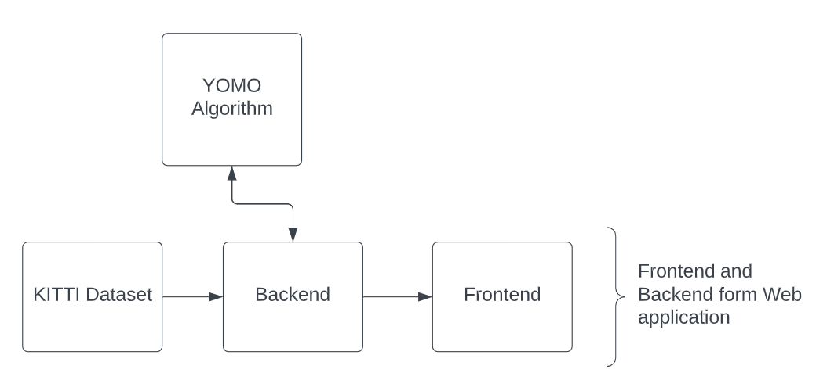
Approach to Lane Changing Problem
Using datasets from the Karlsruhe Institute of Technology (KIT) we developed the YOMO algorithm for safe lane changing.
The KITTI dataset used is provided through MATLAB
For the Lane Changing problem, we separated the work into several parts:
Algorithm
Backend
Frontend
11
Angel Tinajero
Notes:
Devloped the yomo algorithm for safe lane changing
Talk about flow of the diagram in more detail
Backend and frontend form teh web app which provides a visual presentation

Slide 12
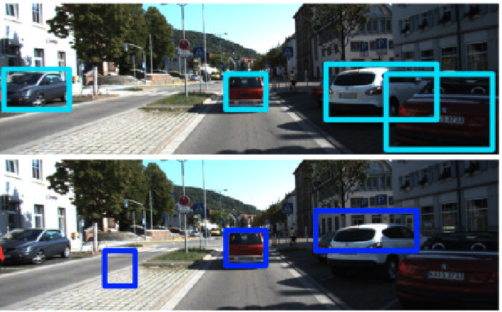
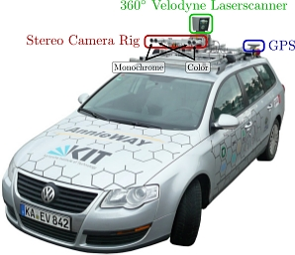
KITTI Dataset
The KITTI dataset is a collection of datasets primarily used for computer vision tasks
Provides Camera and LiDAR sensor data from a vehicle being driven in real-world conditions
Contains over 50 GB of captured data
We utilized 8 datasets for our YOMO algorithm(each roughly 1GB each)
12
Angel Tinajero
Notes:
The KITTI dataset provides camera and LIDAR sensor data from a vehicle being driven in real-world conditions
Add what else is useful about the dataset
bench mark is not useful info
Mention dataset consist of short video clips
We use 8 datasets, each ~1 GBs, from this dataset.

Slide 13
Break down of Sections
For our approach we split up the process into multiple sections:
Algorithm: Takes in processed data via the provided dataset (KITTI Dataset)
Backend: Uploads/converts data into a usable format as well as creates a web server for generating frames and syncing video streams. Data collected and converted is then sent to the Frontend
Front-end: Visually displays relevant data to user on a local web page application
13
Angel Tinajero

Slide 14
Demo
Notes:
Talk by piece: What the vehicle sees, what the vehicle senses. Explain how the safe/danger alert is the output of the algorithm given the input of the other components.
Explain how it would be implemented in a car. How the output result would only be communicated to a driver when the turn signal was used.

Slide 15
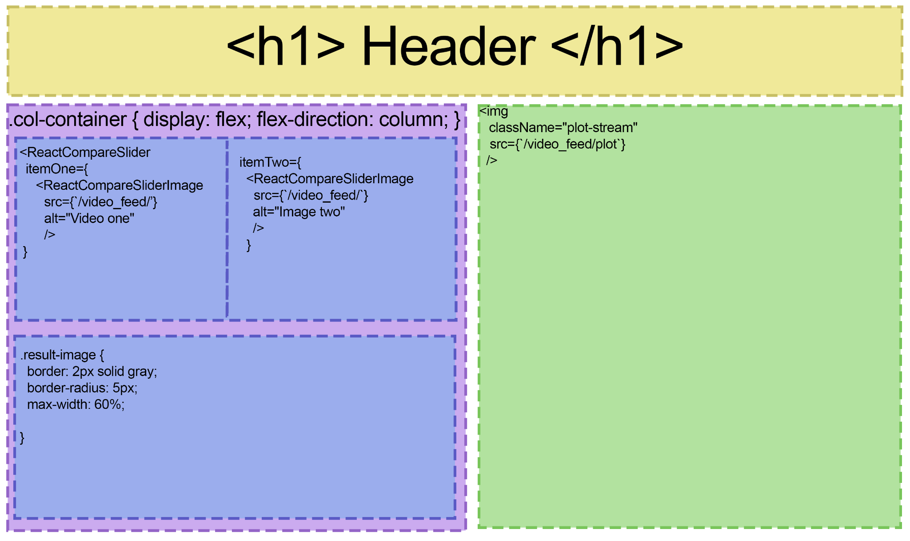
Front-End
Provides a visualization of what the car is seeing
Compiles and displays several components of the project in a Web App:
Raw Video
Processed Video
2D Lidar Minimap
Algorithm Output
Technologies used
Javascript
React
HTML
CSS
Flexbox
Matplotlib
Video Comparison
2D Lidar
Minimap
Algorithm
Output
15
David Neilsen
Notes:
Point out that some of this is to illustrate what the vehicle is seeing. Could be abstracted into its own mobile app at a later point

Slide 16
Front-End
Purpose :
Display data and outputs in a visually appealing and easy to comprehend way
Assist the further research and development of autonomous systems
Assist in safety analysis for vehicles, both manned and unmanned
Provide accurate record and visualization of kinetic events for insurance claims
Output can be abstracted into a standalone mobile application
16
David Neilsen

Slide 17
Backend - What is Flask?
Flask Microframework:
Relatively easy to learn and apply
Easy to use; especially when creating smaller web applications
Python
Microframework
Simple and scalable
Supports multiple extensions
Increases readability
17
Hagop Arabian
Notes:
Backend sanitizes the sensor data, and serves as an intermediary between the Algorithm and the Front-end.

Slide 18
Backend
Ability to upload files and convert them into usable formats (JSON for our application)
Create web server to generate frames and stream video feed
Syncs video streams and serves them simultaneously
Input video
Computer vision edge detection
Lidar Plot
Safety Warning
Data collected from the server will then be sent to the front end for the user to visualize the safety warning
18
Hagop Arabian

Slide 19
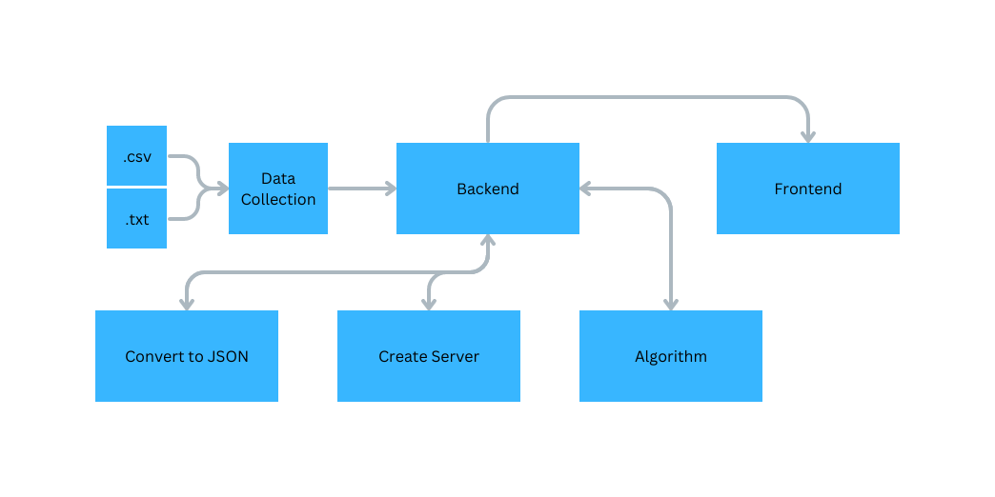
Solution Flowchart
19

Slide 20
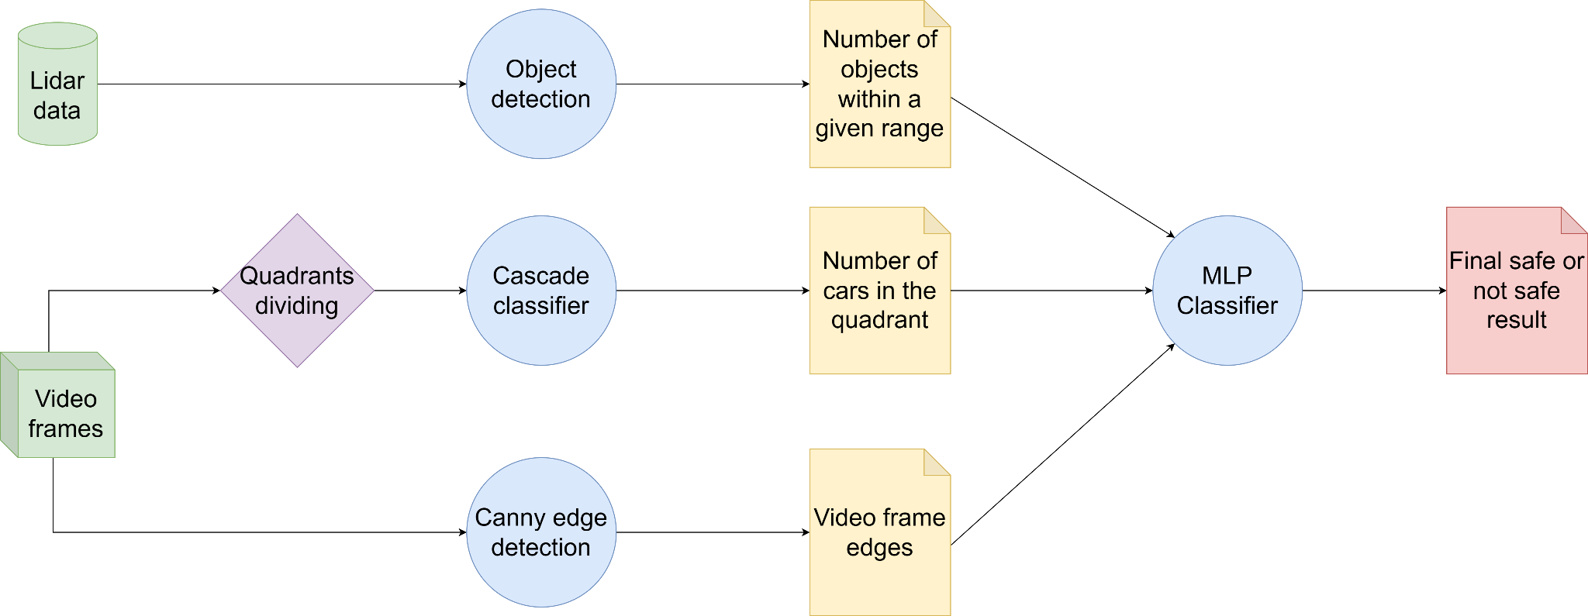
Algorithm Overview
20
Xiao Hang Wang

Slide 21
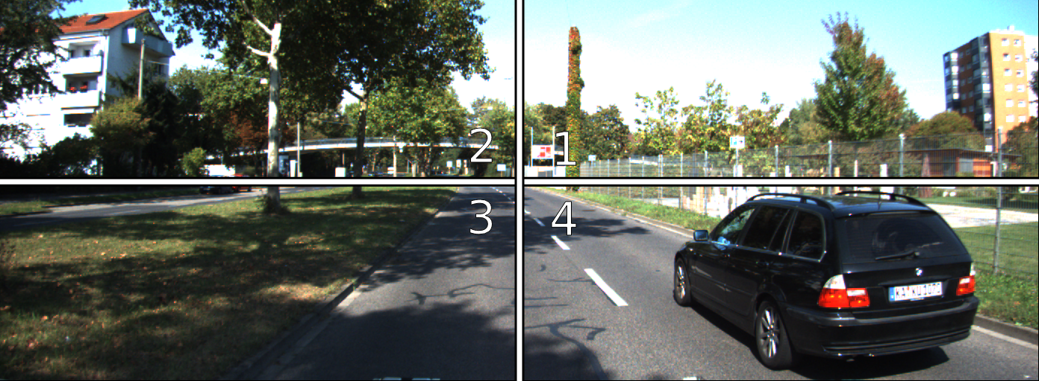
Cascade Classifier
Apply it only to the third and fourth quadrants to reduce the calculations
Integral the image to further reduce the calculations
Apply classifiers from OpenCV library to each quadrant
Get the number of cars
21
Xiao Hang Wang

Slide 22
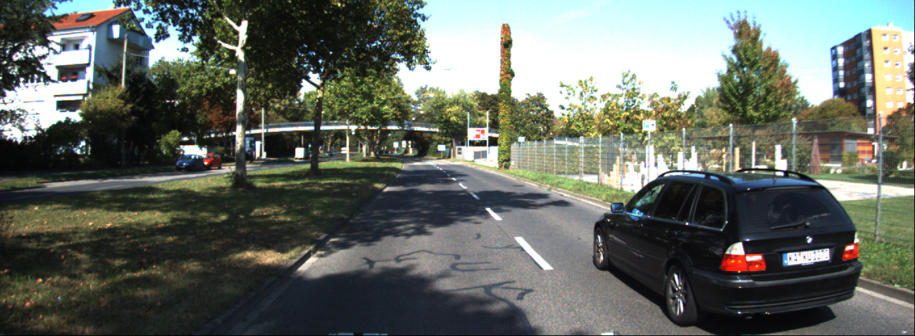
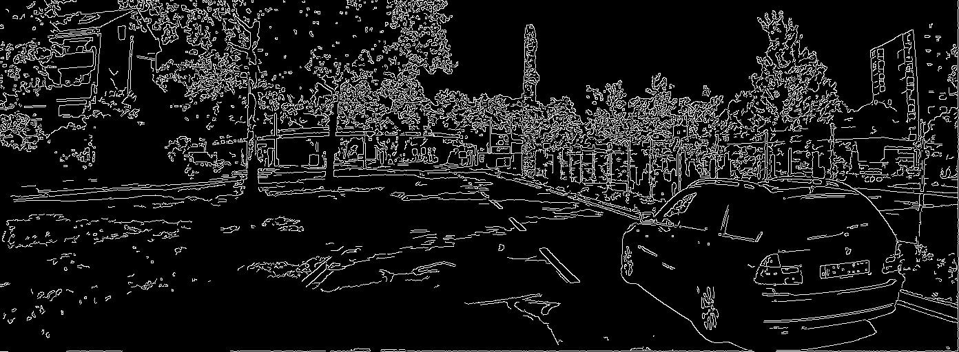
Canny Edge Detection
Make the image less noisy by blurring it out with Gaussian filter
Remove the color of the image and keep only the brightness information
Find areas where there are big changes in brightness.
Get rid of any areas that aren’t really edges by setting a threshold for how big the change in brightness has to be.
Connect all the strong edges together and get rid of any weak edges that aren’t connected to strong ones.
22
Xiao Hang Wang

Slide 23
Object Detection
The lidar data from the The KITTI Vision Benchmark Suite is in Velodyne point cloud. For each point, it contains 4 numerical values, where the first 3 values correspond to x, y and z, and the last value is the reflectance information.
The magnitude gives us the information that there is an object at a distance of the value of the magnitude.
23
Xiao Hang Wang

Slide 24
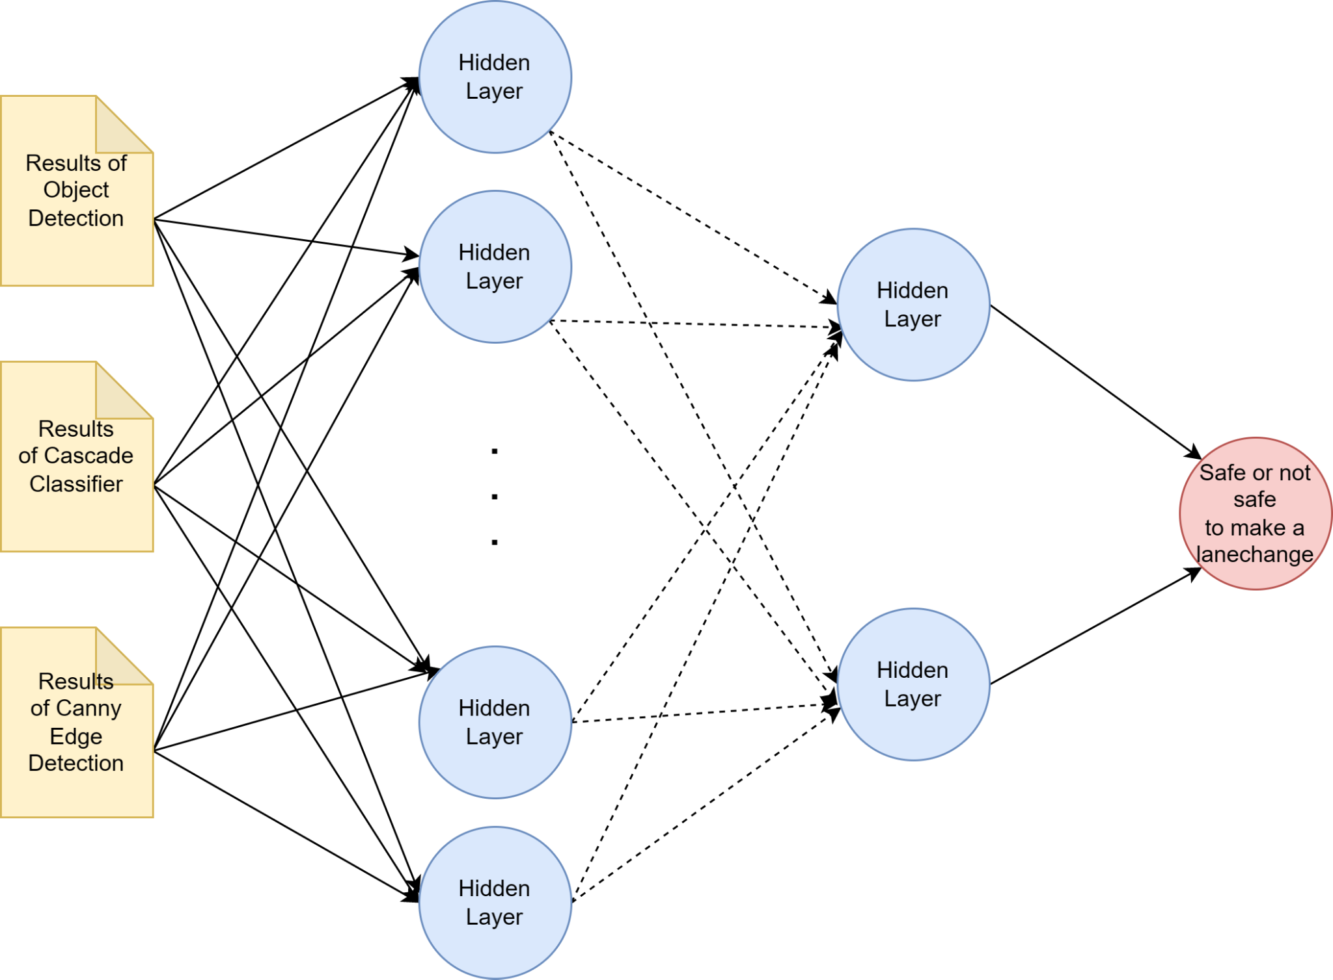
Multi-layer Perceptron Classifier
Input layers are the results from the previous algorithms
Output layer is the final result of whether it’s safe to make a lane change
24
Xiao Hang Wang

Slide 25
Tests conducted
We manually labeled datasets to be used for training the model and testing the accuracy
Compared the results from the algorithm to the human-labeled results to get the accuracy and false positive and negative rates
We tried three ways of fusing results, Linear weight,3 datasets and 8 datasets used
Accuracy is determined by how the results from the algorithm compare to the result from the human-labeled.
FP represents when the algorithm shows its safe when its not
FN represents when the algorithm shows its not safe when it is.
25

Slide 26
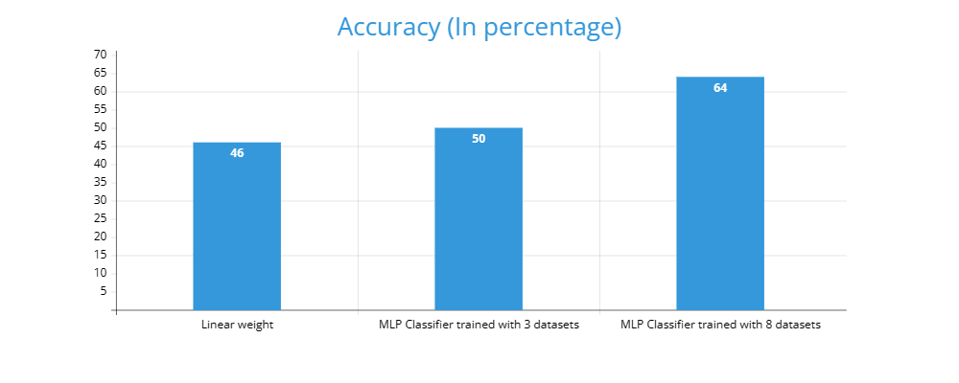
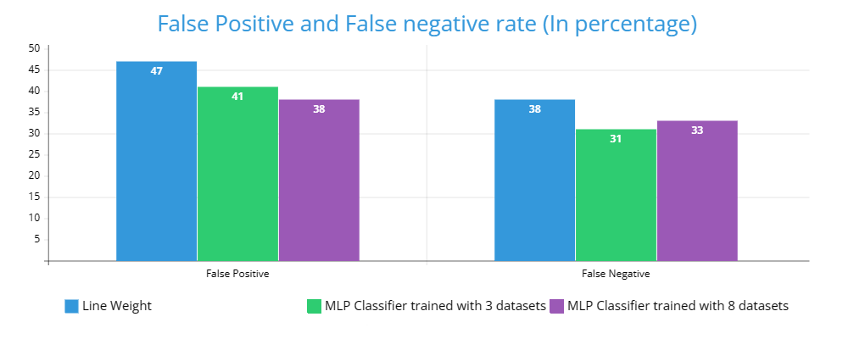
Results
26
Roberto Garcia
Notes:
How we got the results
Slide before

Slide 27
Analysis of Algorithm
Accuracy
46% lowest using linear weight
64% highest achieved using 8 dataset
Achieved approximately a 40% increase
False positive/negative
Highest FP and FN 47% and 38%
Achieved 38% FP and 33% FN using 8 datasets
Decreased rates by approximately 20%
Trends
Curve trend
Clear relationship between amount of datasets used
More datasets used lead to better results
27
Roberto Garcia

Slide 28
Next Steps/Goals
Use our algorithm in real world application
Improve safety for road users
Avoid collisions
Minimize accidents
Minimize fatalities
Demonstrate algorithms efficiency
Smooth lane change
Accurate lane change
28
Patrick Sangalang

Slide 29
Next Steps/Goals cont.
Ensuring that algorithm is adaptable
Traffic volume
Weather
Real time decisions
Make sure algorithm abides by the law
Traffic laws
Driving norms
29
Patrick Sangalang

Slide 30
Recap
Problem Statement
Create a machine learning algorithm that uses sensor fusion to help a driver safely change lanes in a moving vehicle
General Solution
Web Application
YOMO Algorithm
Tested using the KITTI dataset
Final Results
Found more datasets = better accuracy
Relationship
Hypothesis: If we add more datasets into our algorithm, then we will receive better accuracy.
Limited by time and datasets
30
Jonathan Santos
Notes:
Maybe the real sensor fusion were the friends we made along the way..

Slide 31
Q & A
Any Questions ?
31

