Slide 1
Firefox: Improving Import Usability for Users
Sponsor: Mozilla Foundation
Faculty Advisor: Dr. Chengyu Sun
5/5/2023 Expo
Notes:
Alvin

Slide 2
Meet the Dream Team
Team: Alvin Lew, Angel Villalobos, Ani Movsesian, Brian Pham, Bryan Macoy, Evan Liang, Nolan Ishii, Portia Wu, Steven Wang, Zachariah Harris
Liaisons: Mike Conley, Katherine Patenio, Niklas Baumgardner, Neil Deakin, Gijs Kruitsbosch
Advisor: Dr. Chengyu Sun
Notes:
Alvin

Slide 3
Introduction
Firefox is a popular web browser
Browsers import data from each other
“Migration”
User experience matters
Data
Firefox
Other browsers
Notes:
Alvin

Slide 4
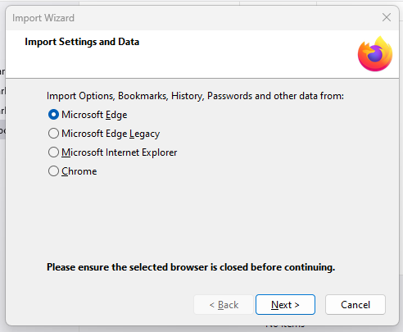
The Old Migrator
Bugs from 15+ years ago
Dated appearance
Limited browser compatibility
Inconsistent import capabilities
System modal
No favicons
Notes:
Steven

Slide 5
Project Goals
Modernize UI
Improve the import experience
Expand browser support
Easy for users to switch to Firefox
Notes:
Steven

Slide 6
Development Challenges
Firefox: massive project
Need good software engineering practices
Effective collaboration is key
Learning curve for Mozilla workflow
200M+ Active Users (2023)
20M+ Lines of Code
10,000+ Contributors
Firefox Statistics (2023)
Notes:
Evan

Slide 7
Tools & Technologies:
Phabricator VS Code Bugzilla Searchfox Matrix
Code Review IDE Bug-Tracking Code Indexing Tool Communication
Zoom Google Drive JS Mercurial
Weekly Meetings Status Updates Language Version Control
Notes:
evan

Slide 8
ESMification
“ESMification”
“ESM”
“JSM”
Converting existing modules
Mainly for learning
Old module system
New module system
Notes:
Angel
Our first job was ESMIFICATION.

Slide 9
Development Cycle
✘
✔
Bug Assignment
Coding
Submission and Review
Push to Nightly
Bugs/Tasks are assigned to group members through Bugzilla.
Pull code from the central repository.
Ask for guidance from mentors
Code is submitted to Phabricator and reviewed
After Q/A the code is pushed to Nightly
Notes:
Nolan
-Bugs/Tasks are assigned to group members through Bugzilla.
-The team works on the bug in Mercurial while asking for guidance from the mentors in Matrix.
-Code is submitted to Phabricator and reviewed.
-After Q/A the code is pushed to Nightly, an experimental version of Firefox.

Slide 10
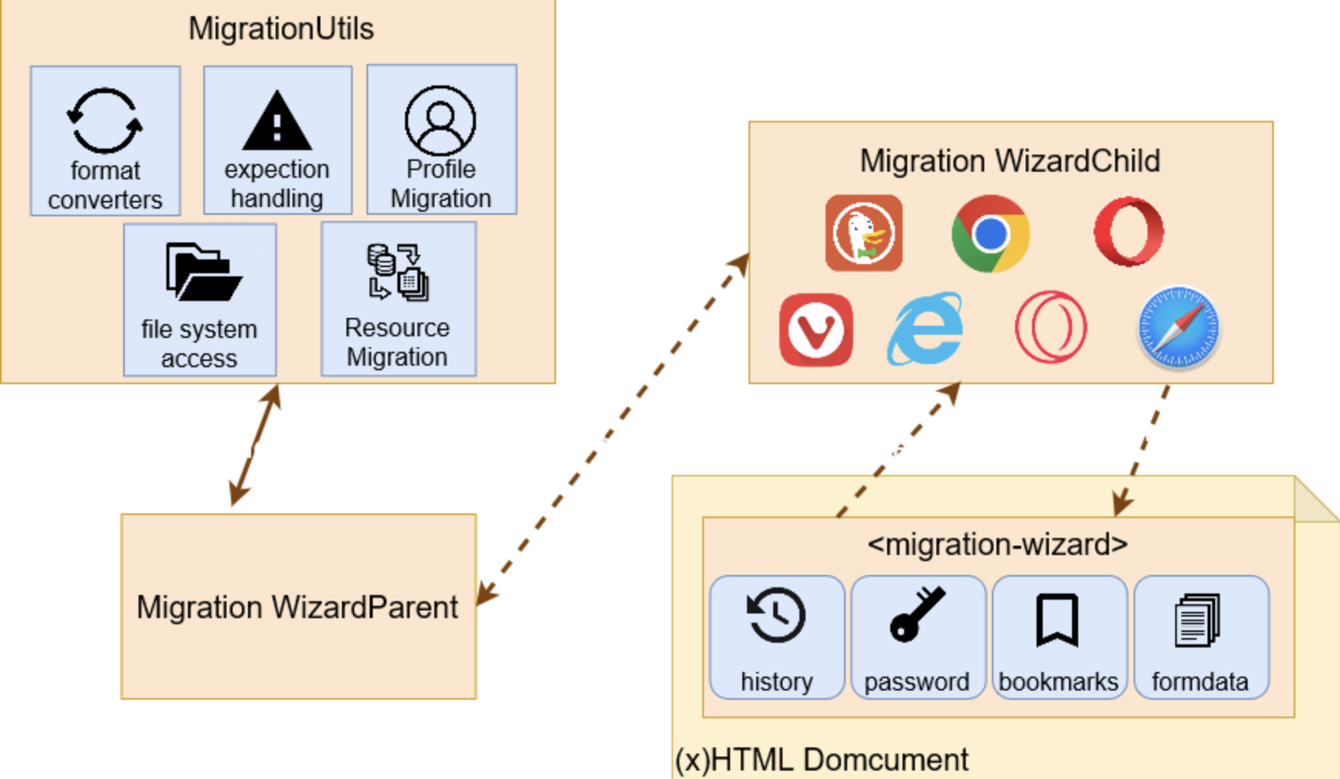
Migration Architecture
Browser-specific migrators get called, extending a shared class
Helper functions for import logic
Maintains UI state
On events
User interface
Top level,
facilitates communication
(x)HTML Document
Notes:
Nolan

Slide 11
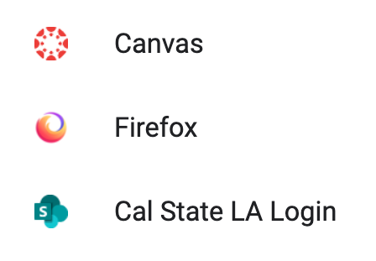
New Data Imports
Favicons
Credit Card Data
Favicons
Default
Notes:
Bryan Macoy - The challenge we faced was figuring out where a user profile’s data was stored. How to locate, extract, map, and include the favicons to the bookmark navigation bar.

Slide 12
Chrome Import of Favicons
SQLite DB Table
Favicons
Map Function
Website URL
Notes:
Bryan Macoy

Slide 13
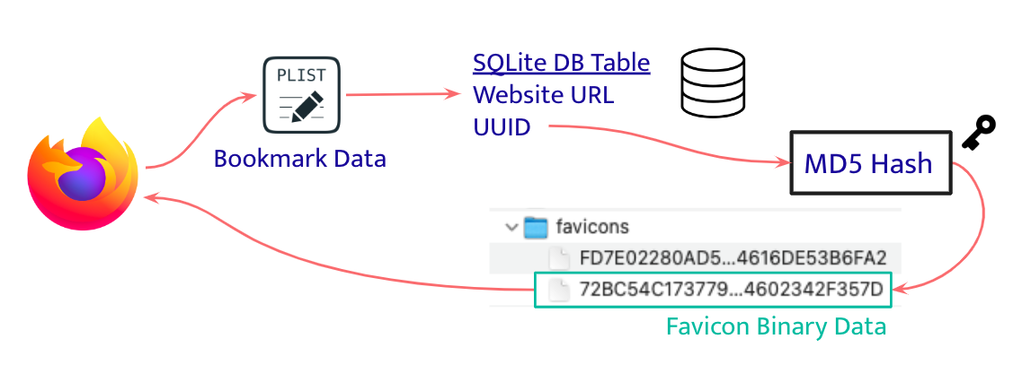
Safari Import of Favicons
Notes:
Bryan Macoy
Dr. Sun’s comment:
I tried this and it didn’t work, I looked at certain folders and it didn’t work, we finally found the stuff …
Tell more stories

Slide 14
Import of Payment Methods
The process
SQLite database stored locally
Decryption
Insert into Firefox Database
The significance
Opens pathway to new AutoForm import
Expansion of import options
Notes:
Zach

Slide 15
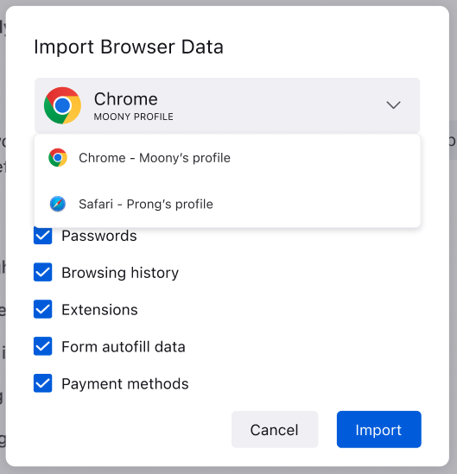
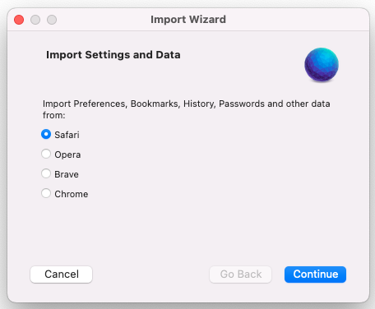
UI Results
Developed 7 new modal windows
Translation for 100+ languages in mind
Fewer steps, better theme
Old
New
Notes:
Alvin

Slide 16
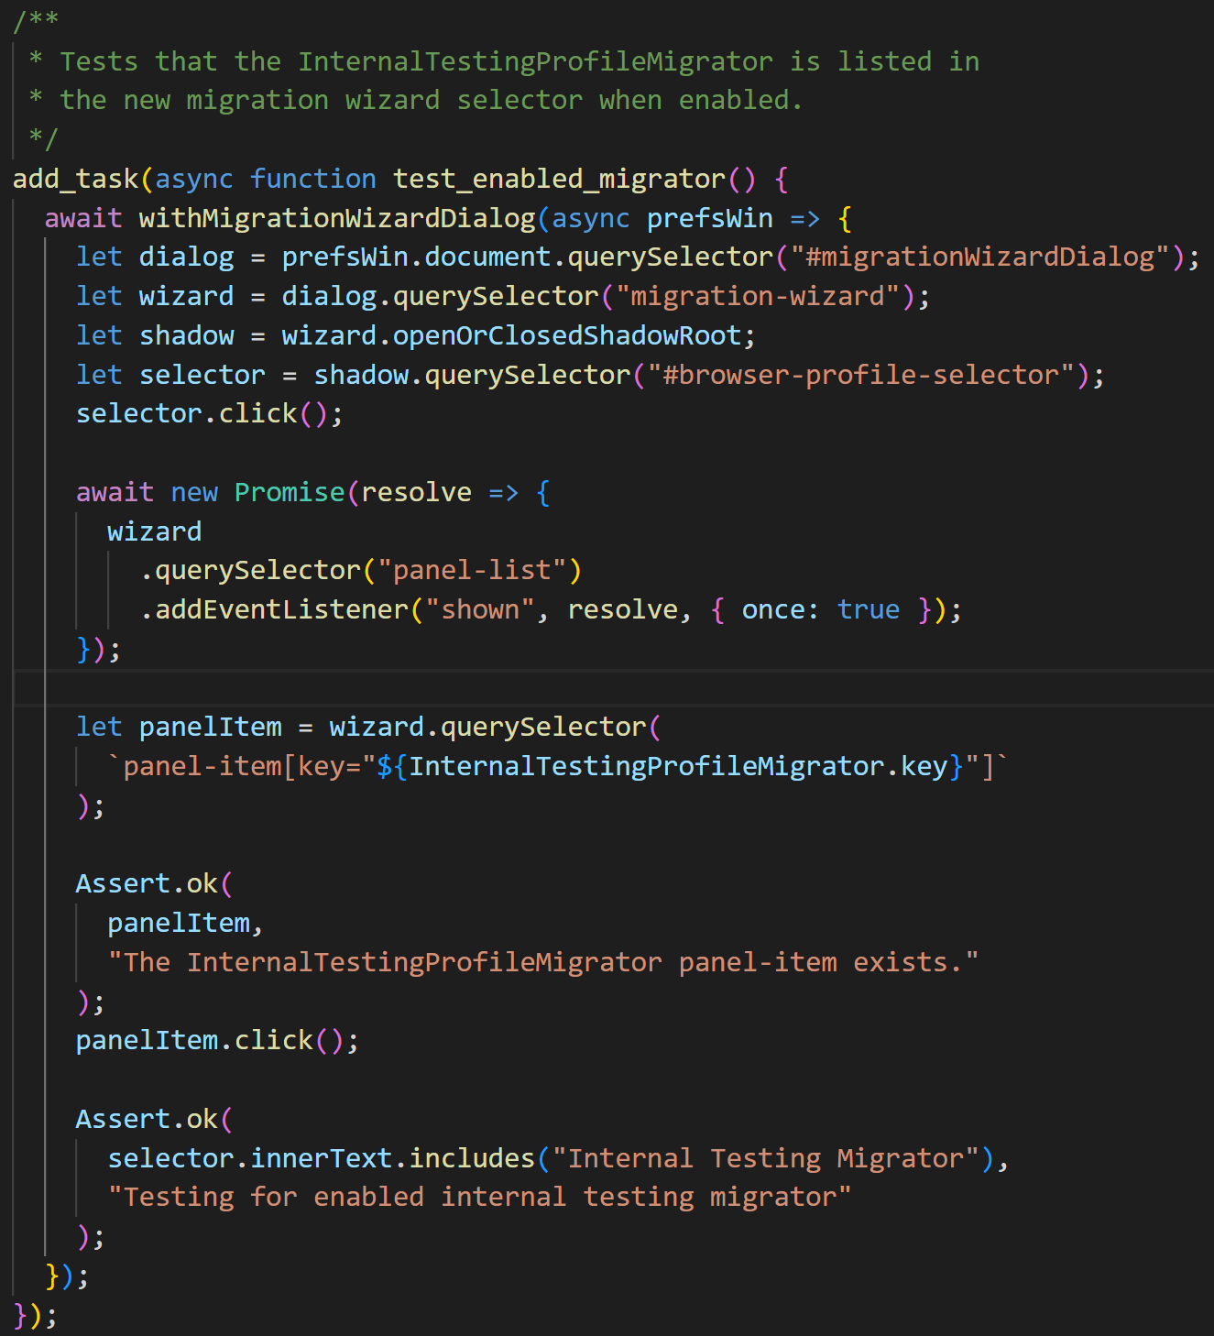
Other Bugs Completed
Filter out disabled migrators
Update modules that are used/referenced from various platforms (ex: login module from Chrome, Edge, etc)
Modified/added unit and integration tests
Notes:
Brian P: more graphics on slide

Slide 17
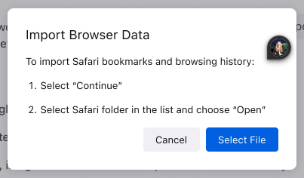
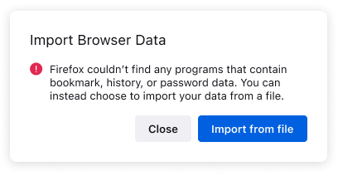
Other New Features
Import “Other Bookmarks” content from user profile
Create permission dialog page for wizard import
Display an error message when no importable resources are found
Notes:
Brian P: more graphics on slide

Slide 18
Migration Variants
Variant 2
Variant 1
Notes:
Brian P

Slide 19
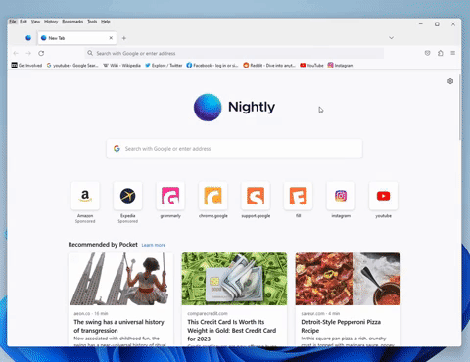
Migration Video (Continued)
Notes:
Brian P

Slide 20
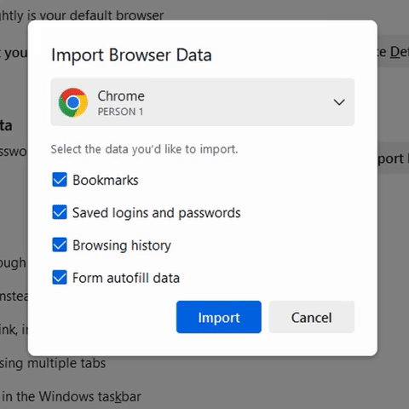
The Impact We Made
Favicon
User-friendly Migration experience
Effortless browser transitions
Expanded browser support
More options for users switching to Firefox
Favicons for better recognition
Enhanced visual cues for bookmarks
Consistent, modern UI design
Unified look across different platforms
Notes:
Portia

Slide 21
Future Work
Expand migration support
more data types/browsers
Focus on AutoForm enhancements
Some team members continue contributing
Notes:
Portia

Slide 22
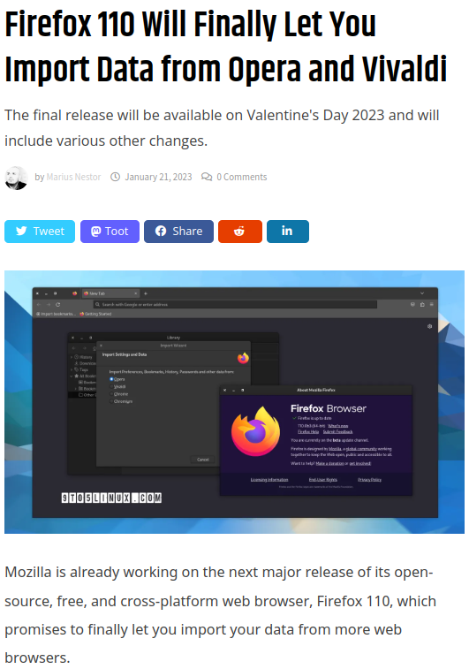
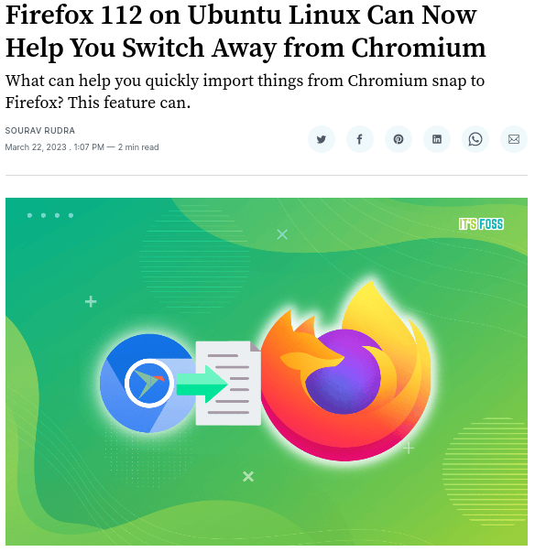
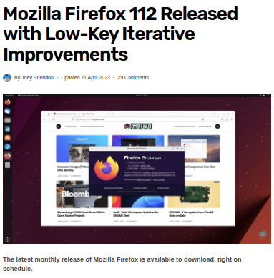
Recognition from Open Source Community

Slide 23
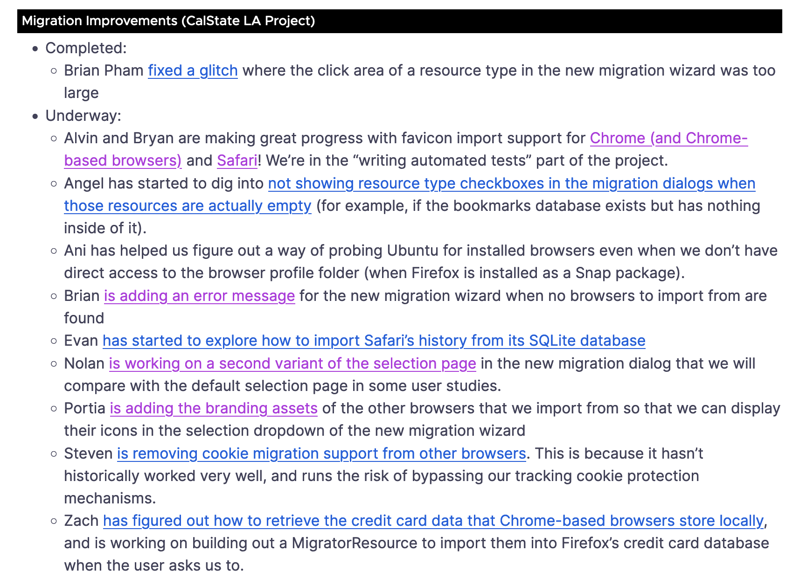
Team was mentioned on weekly Firefox blogs multiple times!
Notes:
Ani Link to mentioned blog —- https://blog.nightly.mozilla.org/2023/04/14/jam-packed-with-updates-these-weeks-in-firefox-issue-135/

Slide 24
Thank You !
Questions?
Notes:
Bryan Macoy

