Slide 1
S.U.D.O
Small-Unit Drone Optimization
Project Sponsor / Liaison: Army Research Lab (ARL)
Dr. Peter Khooshabeh - Regional Lead
Dr. Paul Fedele - Physical Scientist
Dr. Eric Holder - Research Psychologist
Advisor: Dr. David Krum
Jean Paul Espinosa
Notes:
Hello everyone, thank you for taking the time to come out today. My name is ________ and I would like to introduce you to our Senior Design project, S.U.D.O, which stands for Small-Unit Drone Optimization. We would like to give a thanks to our project’s liaisons: Dr. Peter Khooshabeh, Dr. Paul Fedele, and Dr. Eric Holder from the Army Research Lab, as well as our advisor Dr. David Krum for their awesome communication and guidance.

Slide 2
Meet our Team
Jonathan Aguirre Unity Team | Raymond Martinez Unity Team | Bruck Negash Data Team | Peter Han Data Team | Hugo Izquierdo Data Team
Jay Perez Data Team | Jean Paul Espinosa Data Team | Lloyd Castro Documentation Team | George Hernandez Documentation Team
Jean Paul Espinosa
Notes:
Our team is composed of 9 members, and for this research portion of the project, we have divided ourselves into 3 sub-teams:
Jonathan and Raymond in the Unity Engine Team
Bruck, Peter, Jay, and Myself, in the Data Team
Jean Paul, Lloyd, and George in the Documentation Team

Slide 3
Agenda
Project Overview
Significance
Technologies
Source Data
Challenges
Python Detection Program
Detection Model
Factors
User Interface
3D Visualization with Unity
Results
What we learned
Model Limitations
Future Goals
Jean Paul Espinosa

Slide 4
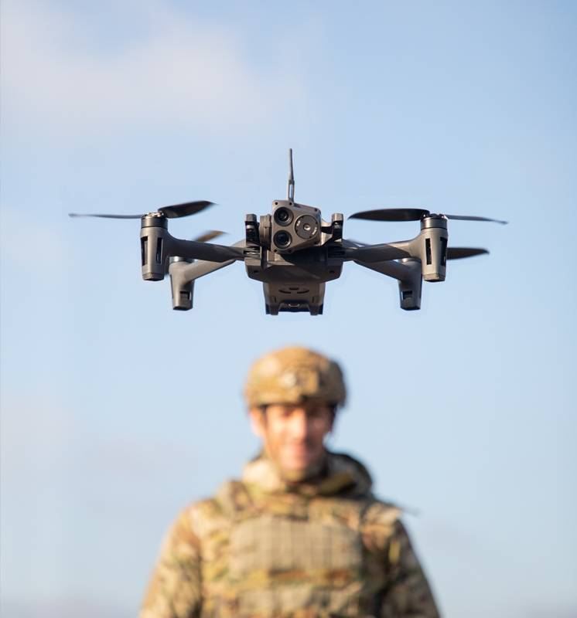
Project Overview
ARL tasked us with proof of concept project:
Is is possible to apply human perception models to a detection program to increase the stealth of a small unit drone?
Detection program with Python, 3D visualization with Unity
Displays environment with detection probability bubbles
Allows user(soldier) to navigate area and gather intelligence before an operation
Jean Paul Espinosa

Slide 5
Importance / Significance
Reconnaissance missions for the military
Support soldiers in small units who lack resources
Military can practice and test detection models for efficiency
Minimize casualties/injuries
Lloyd Castro
Notes:
Why is this project important? With this project, the military can effectively use drones in their reconnaissance missions. To be more specific, it will allow soldiers in small units to utilize the drone in a more safer and discreet way. Since small units can’t access all the resources of the US army at any given moment, we were tasked with developing a human perception model that would help them perform reconnaissance with a drone while staying undetected. The military can also test the model to determine its impact on detectability and how information of the surroundings is collected so they can optimally deploy it into their drones. Because our scope is set in an urban environment, it is essential that the drone can effectively calculate risks of detection to keep casualties and injuries to a minimum.

Slide 6
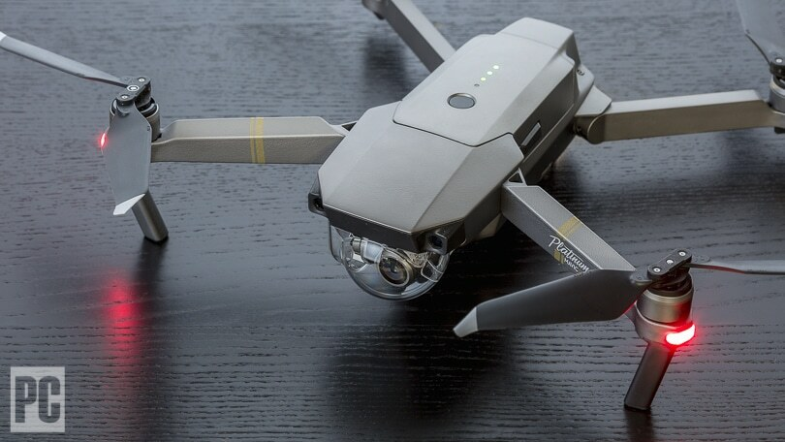
Technology and Equipment
Used
Unity - 3D simulation/visualization
ODM (Open Drone Mapping) - generate maps/3D environments
Python - auditory detection model, testing input parameters
Didn’t Use
Drone
Camera
YoloV5 - object detection model
Lloyd Castro
Notes:
For this project, we used Unity Engine to create simulations for our 3D environments and our detection model. We also used ODM, which is a drone mapping software that allows us generate maps and 3D models from images. With ODM, we can take images from a drone to create our 3D environments which would be visualized in Unity. To code our detection model, we translated Army Research Lab’s auditory detection model from VBA (Visual Basic) to Python so we could compartmentalize various functions in the model for better code readability. With our Python detection program, we can test different input parameters such as environmental or listener conditions to see how they affect a drone’s probability of being detected. However, we weren’t able to incorporate the needed hardware such as a camera or a drone to test our models. In terms of software, we initially had the idea to use YoloV5 to detect objects in real time with our own models. But we realized that with the limitations of our detection model, we couldn’t integrate our model and YoloV5 into an actual drone with the timeframe we had.

Slide 7
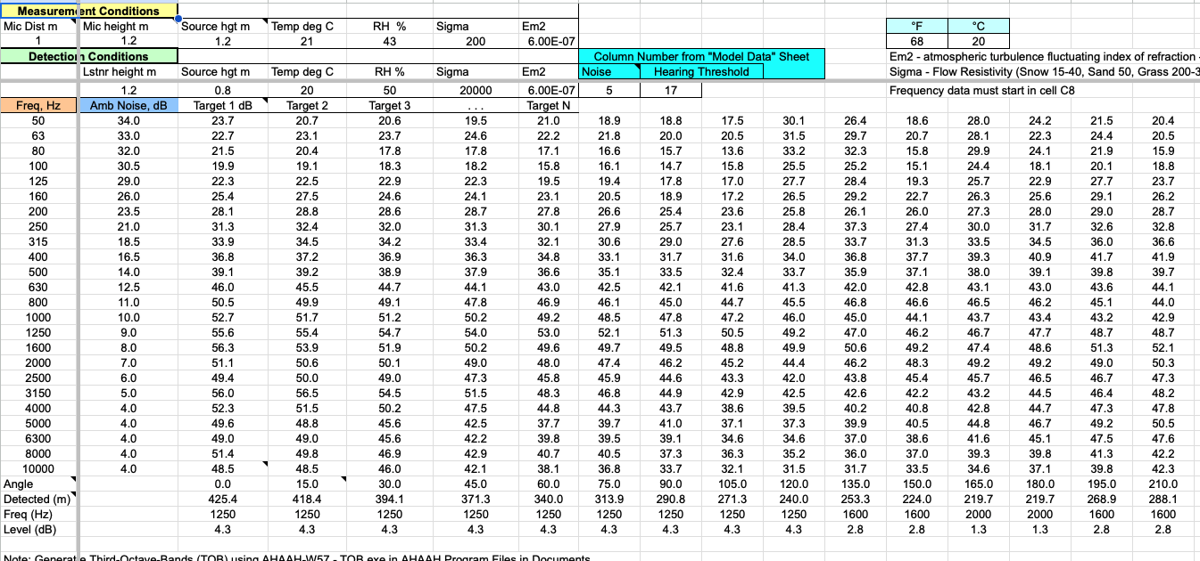
Source Data
Our model was based on data from the Army Research Lab, which had been aggregated over many decades.
Our principal duty was to interpret all of this data and filter the most relevant information for which to base our model on.
Once we identified the critical data, the next hurdle was to convert it into a modern Python program which could scale dynamically and be used in various context, such as in a 3D visualization environment.
Hugo Izquierdo
Notes:
Our source data came from the Army Research Lab in the form of various research documents on acoustic and visual perception, which included Department of Defense findings on live experiments, academic research papers, and models of auditory detection conditions in Microsoft Excel format.
The most relevant data for us came in the form of the Auditory Detection Model, since it contained background macros running through the use of Visual Basic code, which we were able to extract and translate for use in our program. The auditory model also seemed like the most logical place to begin creating our complex Detection Model, because of the large number of variables that affect human perception of an auditory target, which we could incorporate into our algorithm. This would be much more beneficial to the accuracy of our model, especially in our given urban environment, than visual perception during this particular phase of the project.

Slide 8
Interpreting the Data / Challenges
One of the greatest challenges was interpreting the data and building something from it.
The doctorate-level physics behind many of our models became a major obstacle.
We tackled this problem by relying on the skills we do have: understanding programming and algorithms.
By converting the data to a familiar format, we were able to manipulate and test it with greater ease.
Hugo Izquierdo
Notes:
One of the greatest challenges for our project was to interpret the data given to us, and convert it into something meaningful. We were given models for auditory and visual perception that had been put together by physics research scientists over the course of decades. To even begin to comprehend the formulae needed to grasp the big picture of what was going on took almost the entirety of last semester, and a lot of our sanity. And we were still simply scratching the surface of what all of this meant. The auditory model alone was affected by factors such as relative humidity, atmospheric refraction, environmental sound dampening, temperature, ground effect, barrier attenuation, scalar diffraction, and weighted octave-bands, where the propagation loss contributed by each of these factors across a frequency band of 50-10k hertz affected the overall detection output.
So we analyzed the problem at a high-level, switched gears, and made use of the skills we do have: understanding the programming process and employing algorithms to properly utilize any type of data. We didn’t necessarily need to understand all the math behind this, but we could still piece together enough information to create a modern Python program that could be tested against the provided data, then visually represent that within the Unity 3D environment.

Slide 9
Python Detection Program
Auditory Detection Model (ADM) was in VBA
extremely limiting to work with
forced to work through the excel sheet
Translated the VBA macros into python
Redesigned the pipeline to allow modularity and scalability
Compartmentalized the framework - 3 python modules
ADM.py - main module to execute desired detection model
ADM_functions.py - functions that are used to calculate various detection parameters within each model
data_dict.py - dictionary that stores all parameters - listener, source, and environmental conditions
Peter Han

Slide 10
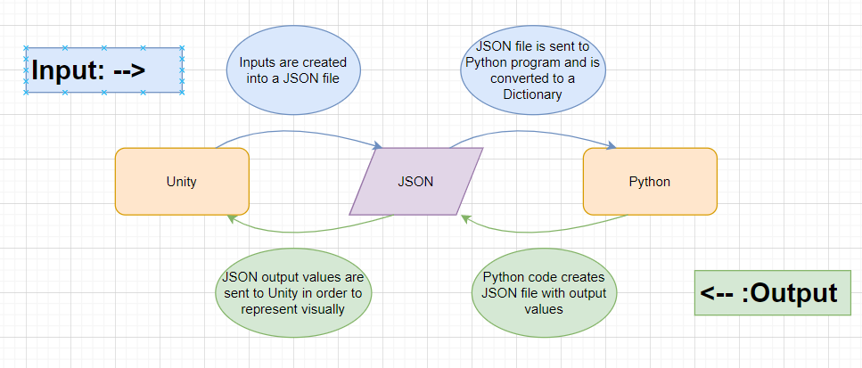
Python Detection Program (cont..)
Peter Han

Slide 11
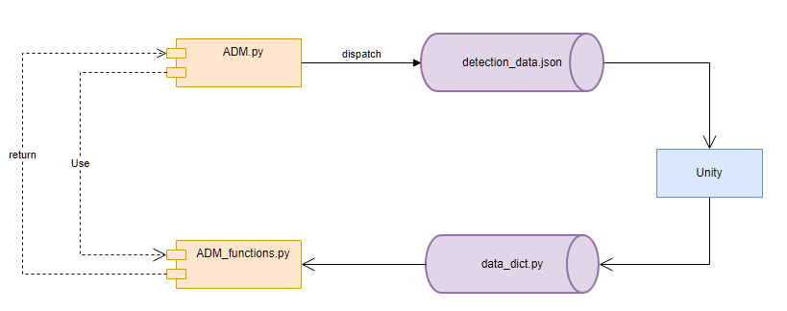
Python Detection Program (cont..)
Peter Han

Slide 12
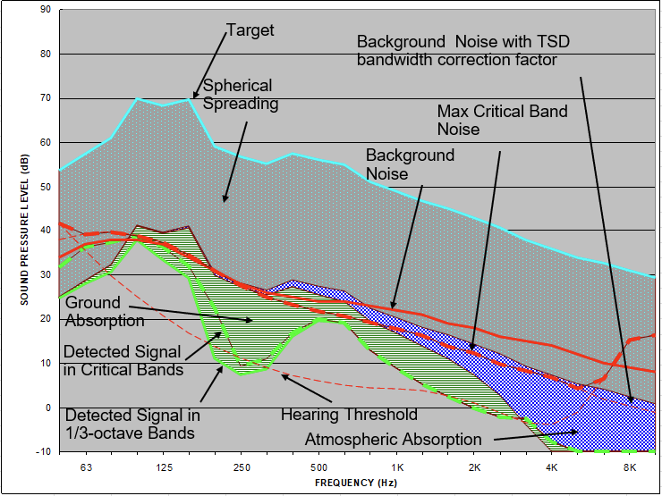
Detection Model
Bruck Negash
Notes:
Detection distance is determined by comparing the target sound level at the listener's location to the listener's hearing threshold and background noise level.
Detection is then confirmed when the target sound is louder than the hearing threshold and background noise.

Slide 13
Detection Model
01
Detection Parameters
Sound Source Height
Height of the Listener
Temperature
Relative Humidity
Atmospheric Condition
02
Listener Parameters
Critical Bandwidth of human hearing
Hit Probability
False Alarm Rate
Listener Efficiency
03
Measurement Parameters
Distance of the Sound Source
Height of the Sound Source Above Ground
Height of the Microphone Above Ground
04
Computation Parameters
Target Spectrum
Background Spectrum
Detection Range Precision
Bruck Negash
Notes:
To accurately calculate the detection distance in our detection model, 4 parameters needed to be taken into account.
Detection parameters significantly affect the detection distance calculation.
Listener parameters will affect the listener's ability to detect the target sound.
Measurement parameters will affect the sound propagation and interaction with the environment.
Computation parameters will influence the accuracy of the calculation.

Slide 14
Detection Model
1
2
3
4
5
6
Ground Effect
Refraction Due to Wind and Temperature Gradients
Barriers
Foliage
Geometric Spreading
Atmospheric Absorption
As the sound moves away from the source, the area that the sound energy covers becomes larger
When sound waves encounter the ground and produce a complex pattern of reflection and absorption
An obstacle that limits the transmission of sound waves.
Refers to the leaves and branches of plants or trees.
Is dependent upon distance, frequency, relative humidity, temperature and, to a very small degree, atmospheric pressure
Wind and temperature gradients produce refraction which affect the propagation of sound.
Bruck Negash
Notes:
A crucial element and first step in developing an effective detection model was to understand the various factors that affect sound propagation such as
Each of these factors affect propagation of sound and a person's ability to detect sound.
These factors produce different rates of attenuation versus distance for each frequency, ultimately affecting the ability of a listener to detect a sound event.
Refraction due to wind and temperature gradients may cause excess attenuation of low frequencies and reduce detectability during the day.
At night, lower temperatures near the ground and reduced wind velocities can decrease attenuation provided by the ground effect, lower background noise levels,
and allow sound to be heard at significantly greater distances than during the day.

Slide 15
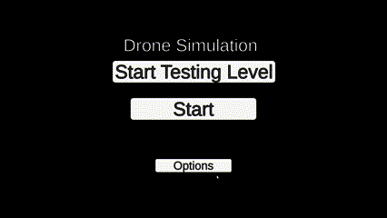
User Interface
Simple interface for the fastest menu traversal
Multiple input fields for each variable that will be used in the script both present and future
Calculations and scripts will be run with simple button clicks
Jonathan Aguirre
Notes:
The UI in Unity is made to be as simple as possible compared to the Excel model that was sent to us initially. We wanted to make the user experience as easy as possible .

Slide 16
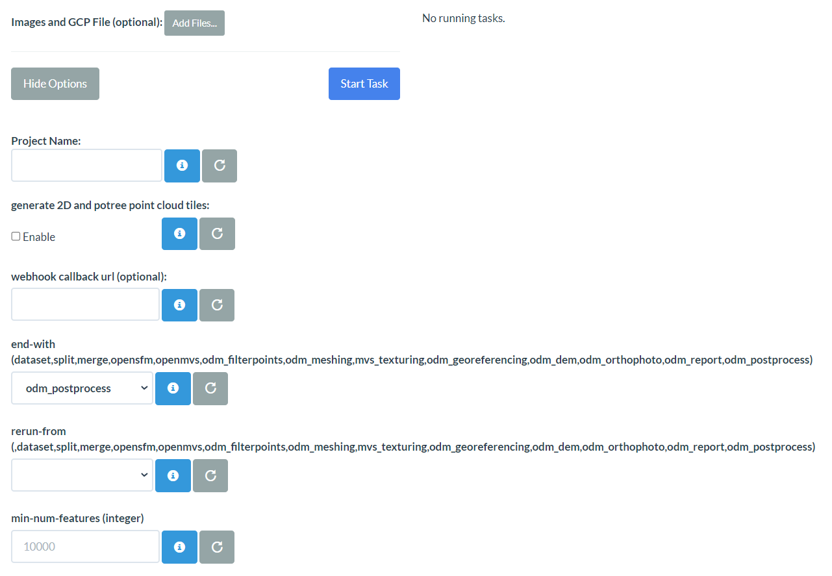
3D Environment Creation
Tasked with creating a visual representation of the detection model using Unity
Creating a 3D environment sandbox will help create visuals while using the data needed for near-realistic results
OpenDroneMap(ODM) will let user create 3D environments via Docker container from images collected
Jonathan Aguirre
Notes:
We were also tasked with creating a visual model using the data from the auditory detection model specifically using Unity, a 3D game engine and software that will let us create these simulations. For the specific task of 3D model creation we will be using a Docker container that will let the user connect to the OpenDroneMap model creation site or ODM for short. ODM will let us take the images a drone has taken, change the quality of said model with several settings made available, and generate a 3D environment based off of them. Within a reasonable amount of time, the images will be converted into an object file that will be necessary for the Unity visualization process. This will help us get accurate environmental data for a simulation and give the user a more realistic and combined representation of the information that was given. After the 3D environments are generated, we can then transfer them over to Unity where the user will have more control of the environment in question.
—-------------------------------------------------
Here we can give an overview of how/why we created a simulated 3D environment , and how it works in conjunction with the Python Detection program to create our 3D Detection Simulation. Why did we choose unity / ODM, and how will the end user interact with this technology. (Maybe if there is time: how we use simulated objects to add to the detection algorithm by binary decisions…like is there a wall? Is the there a tree obstructing view)

Slide 17
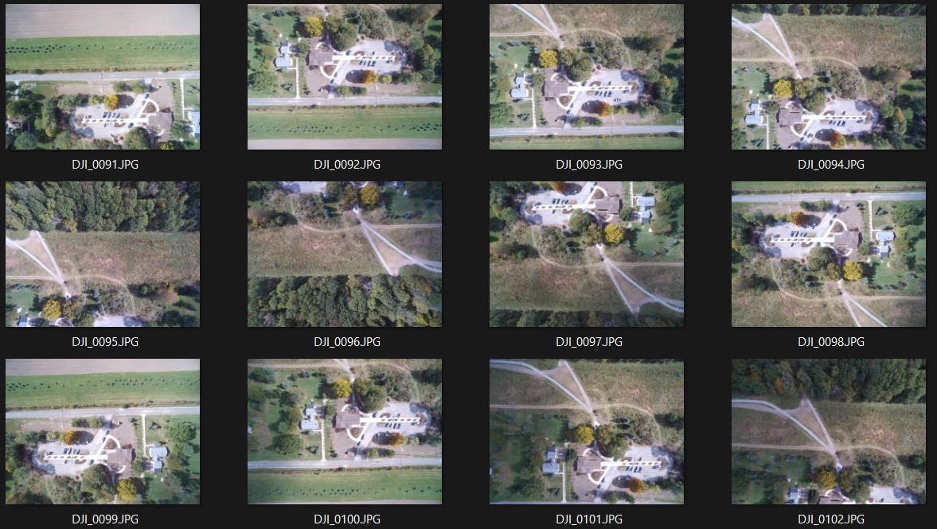
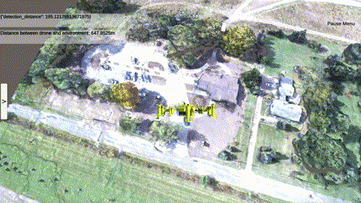
Object Importation with Unity
3D environments can be created and imported within the program made
Explorable as a drone simulation along with the detection models
Adjustments to the model can be made as needed in regards to position and scale
Jonathan Aguirre
Notes:
As mentioned before, Unity is a game engine/software that will let us simulate those environments we have created before and essentially serve as a testing ground for future recon. Using the tools from the ODM site, we can create these accurate 3D environments from a set of a couple of images and easily import them within the same program. When the model is imported, the sandbox environment can be explored in a drones’ point of view where the user can move around and explore freely. The environment created has a detailed textured recreation of the environment using the images as a major reference and it only takes a few seconds to load in. We also made it easy for the user to take control of the drone in the simulation using the standard WASD keys to move and arrow keys to rotate the drone. There is also a sidebar that will let the user edit any changes on the spot relating to the detection distance script values and also be able to change the position and scale of the 3D environment to fit the users needs.
—--------------------------------------------------------------
I think the best way to do this would be to pre-record a screen-grab video of the program working in the optimal way, embed the video, and then explain what parameters were put, etc. This way we avoid any technical difficulties or rendering problems. Or we can make it look like we running the program, but it is actually pre-recorded. What you think?

Slide 18
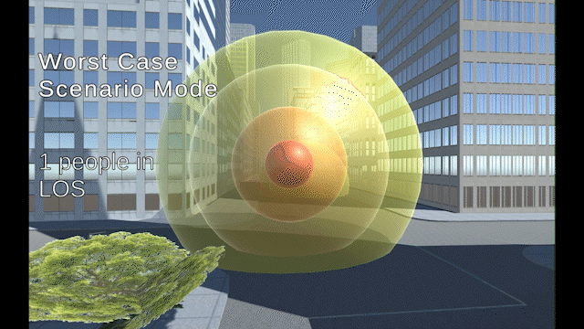
Premade Level
Some of the Parameters Used (9 out of 38):
false alarm rate
isExpert
isBinaural
Wind Direction
Temperature Degree Celsius
Wind Speed
drone type
location/background noise
hearing threshold
Raymond Martinez
Notes:
Hello, I'm Raymond and this the premade level using a free New York City block asset that was slightly modified. As well having our drone prefab and human prefab. On the right you can see our simulation running. And on the left you can see some of the parameters that are influencing our model. There are many more parameters but they are more complex and harder to explain in a short amount of time.
Note: Feel like the gif doesn’t match slide, this slide feels like it’s trying to explain too much.

Slide 19
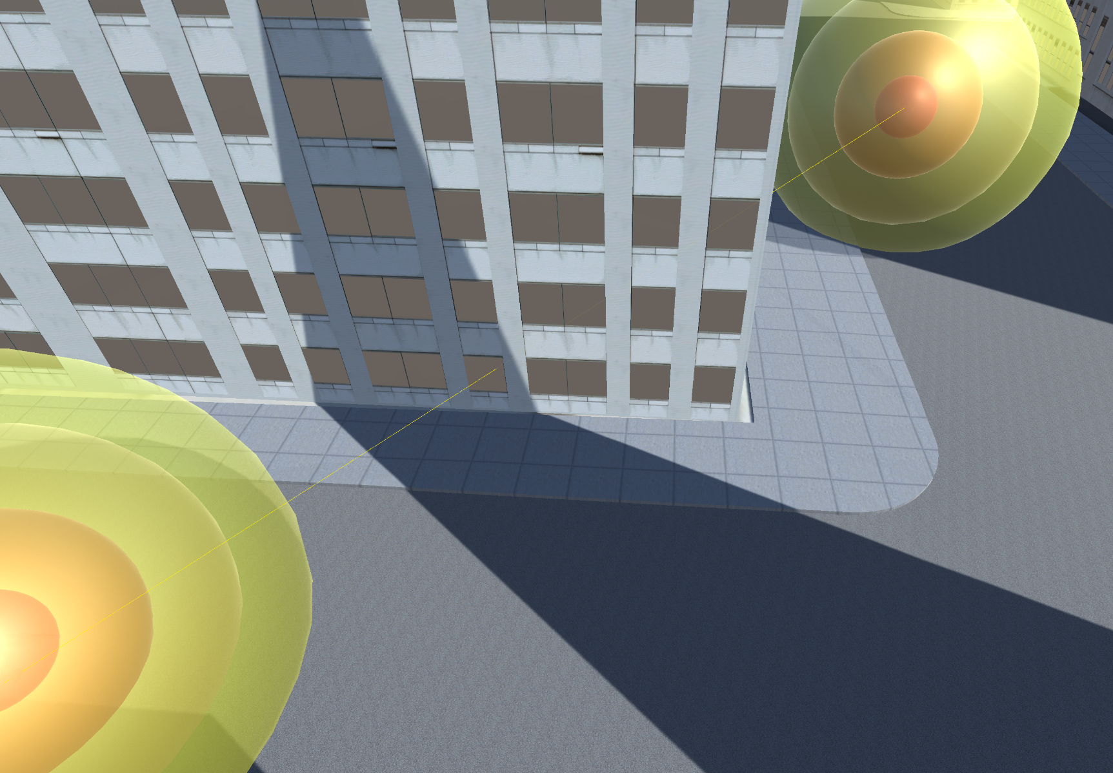
What Unity is Doing
Raycasting
Object Count
Barrier vs Foliage
Human Count
Running physics auditory model
Raymond Martinez
Notes:
What Unity is doing here is using raycasting between the drone and every human in the simulation. Raycasting is essentially a laser, this laser will then return information about what is between the drone and the human. Such as if there are any objects blocking the path and if there are objects blocking the path how many objects are blocking the path as well information of the objects that are blocking the path. We then pass this information to physics auditory model which will then return us a chance of detection that will be shown by the size of the sphere around the drone.

Slide 20
Different Detection Modes
Worst Case Mode
Average Case Mode
Raymond Martinez
Notes:
We will then show this chance of detection in two different ways. Worst case mode and Average case mode.

Slide 21
Worst Case Mode
Drone
Drone
Raymond Martinez
Notes:
Here in Worst case mode after iterating through every human in the simulation and finding their chance of detection the person that provides the highest chance of detection will be shown on the drone's detection sphere.

Slide 22
Average Case Mode
Drone
Drone
Raymond Martinez
Notes:
Average case mode works by finding the chance of detection for every person and then taking the average of that next we apply that average to the drone's detection sphere. You can see here the drone's detection are slightly smaller than in worst case mode. Let me go back slide so you can see the difference between the two. Now I will pass it off to George

Slide 23
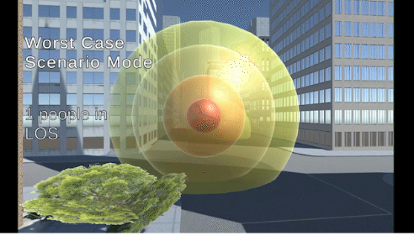
Results of our Project
Created modern version of human perception module. From Excel demonstration to Unity simulation
Create a python program that can calculate detection distance with various input values
Interactive and versatile Unity simulation that allow parameters to be changed for detection output
George Hernandez

Slide 24
What we learned as a Team
Communication / Cooperation
Spending a year working on a project with each other as given us the valuable skills of communications and creativity
Time Efficiency / Management
Working on a project as a student has brought the problem of managing other classes while being consistent on progress. We gained the skills to prioritize task and set effective goals
George Hernandez

Slide 25
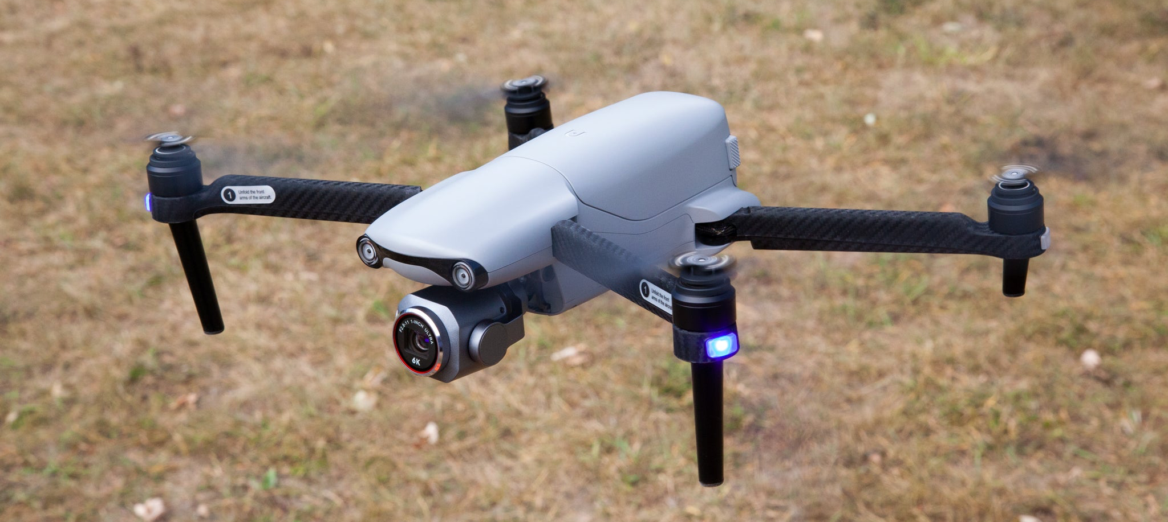
Model Limitations
Doesn’t integrate model to hardware such as cameras, onboard sensors, spotting targets
Program lacks dynamically targeting objects in the field
Only using specific distance specification, not able to dynamically change
Using only auditory model within the software
Reliability still needs to be tested with more use cases
Jay Perez Arias
Notes:
Our program does not dynamically detect targets in the field for which to adjust the drone’s range because we would need to actually work with the physical hardware and the capabilities of cameras, rangefinders, and other sensors such as these. A situational example: “Suppose a drone is flying towards an enemy village. The program directs the drone to stay 800 meters from the target, otherwise it will be detected. With its advanced cameras, it accurately spots a target at 1000 meters, and so hovers around the 800 meter mark to get photos of the situation. But then an unspotted enemy appears from behind a tree right below the drone. Does the drone continue taking pictures, since it is already compromised? Or does it quickly turn around an accelerate out of the detection zone of this newly-found target, even though it has already been detected?

Slide 26
Future Goals
Integrating model to hardware such as cameras, onboard sensors, spotting targets
Using other various other models such as psychological, visual, etc
Making the model scalable for different hardware
Integrating software with other hardware
Create an algorithm to find the “sweet distance” to avoid enemy soldiers
Jay Perez Arias

Slide 27
Thank You!
The floor is open for any questions you may have.

