Slide 1
sponsors
Cynthia Wang, Zachary Vernon
advisor
John Hurley
current developers
Cesar Ayala, Songtao Bu, Alejandro Ceballos, Bryan Chan, Erik Donovan-Blood, Kennard Lim, Jorge Mata, Kalvin Mateo, Misael Ortega, Jonathan Saldivar, Dustin Shin
Notes:
Introduce the whole team
(each member waves when their name is said)
-Hello everyone we are the arqive
- sponsors (pronounce wang -> wong)
-advisors
- myself entire team

Slide 2
agenda
introduction
project goals
final outcomes
challenges
conclusion
demonstration
Notes:
- The sentence that introduces everything
-Explain arqive
-What we set out to do this semester (explain)
- An we will then present what we learned along the way

Slide 3
what is the arqive?
The arqive is a digital online storytelling map for LGBTQ+ stories that seeks to provide the full range of queer stories and then geolocates them and digitally preserves them.
Users have a safe platform where they can share personal, historical, and community stories, as well as have access to information about safe spaces.
“By sharing stories, we can give each other hope.”
-Cynthia Wang
Notes:
Jorge
Main purpose of arqive.
DON'T say "What is the arqive"
Say "the arqive is"
The arqive is an online story telling map for the LGBTQ+ stories that represent (community events, personal experiences and historical events).

Slide 4
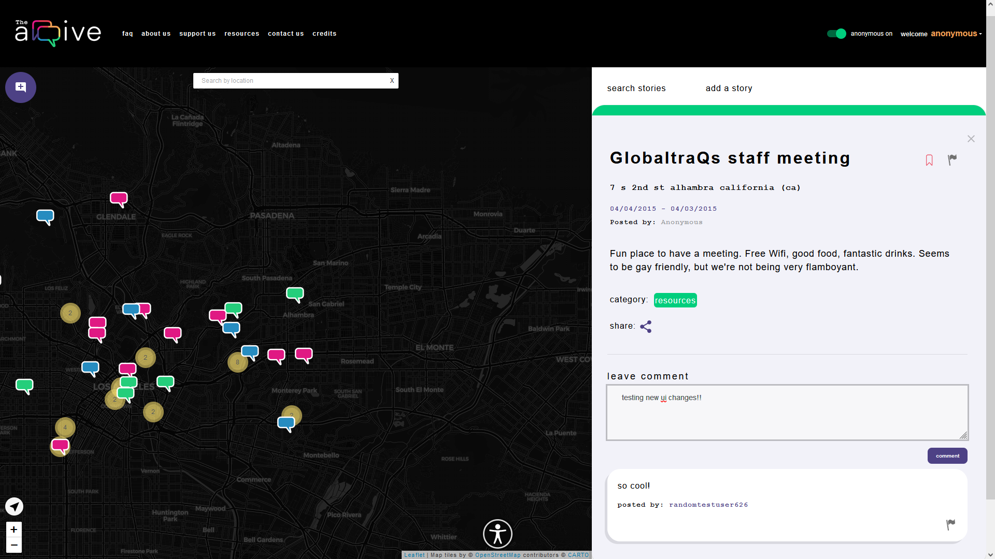
overview of the arqive
users
Login
Add/Edit/Delete story
Bookmark/Unbookmark user
Flag posts
Manage profile
Anonymity
admin
Login
Add/Edit/Delete story
Bookmark/Unbookmark user
Anonymity
Review/Remove flagged posts
Review/Remove flagged comments
Remove users
Notes:
Describe the arqive’s main functionality.
-Explain the website briefly

Slide 5
project technologies
Ubuntu
PostgreSQL
Django REST framework
Node.js
React
React Native/Expo
scikit-learn
AR.js
Web APIs
OpenStreetMap
Notes:
Bu
Our web application stack is comprised of:
An Ubuntu Server running on DigitalOcean
PostgresSQL for our database
Django REST for our API and web framework
React web and native for UI
NodeJS backend JS
SciKit-learn for Machine Learning
AR.js for AR/VR
And OpenStreetMap for our geolocation services

Slide 6
project goals
Notes:
Bu

Slide 7
project goals
This year's project for The arqive focused on expanding the website and mobile applications.
Automated Content Moderation
Location Autofill​
Media Upload​
UX/UI Improvements​
Update Software Stack
AR/VR Prototype​​
Notes:
Bu
Introduce the feature and WHY it is wanted / needed in one sentence.
This year's project for The arqive will focus on expanding the website and mobile applications.
This includes:
Automated Content Moderation using machine learning
Location Autofill​ - To replace autofill provided by open street maps
Media Upload​ - To allow users to upload pictures along with their posts
UX/UI Improvements​ - To conform to the design provided by the design team
Update Software Stack - Upgrading the stack to avoid security and compatibility issues
AR/VR Prototype​​

Slide 8
final outcomes
Notes:
Alex

Slide 9
new features
📱 UX/UI improvements​
🌏 Location Autofill​
📸 Media Upload
📝 Delete and disown posts
⚙️ Update Software Stack​
Notes:
Alex
To showcase the features that we developed my teammates will explain what we have accomplished

Slide 10
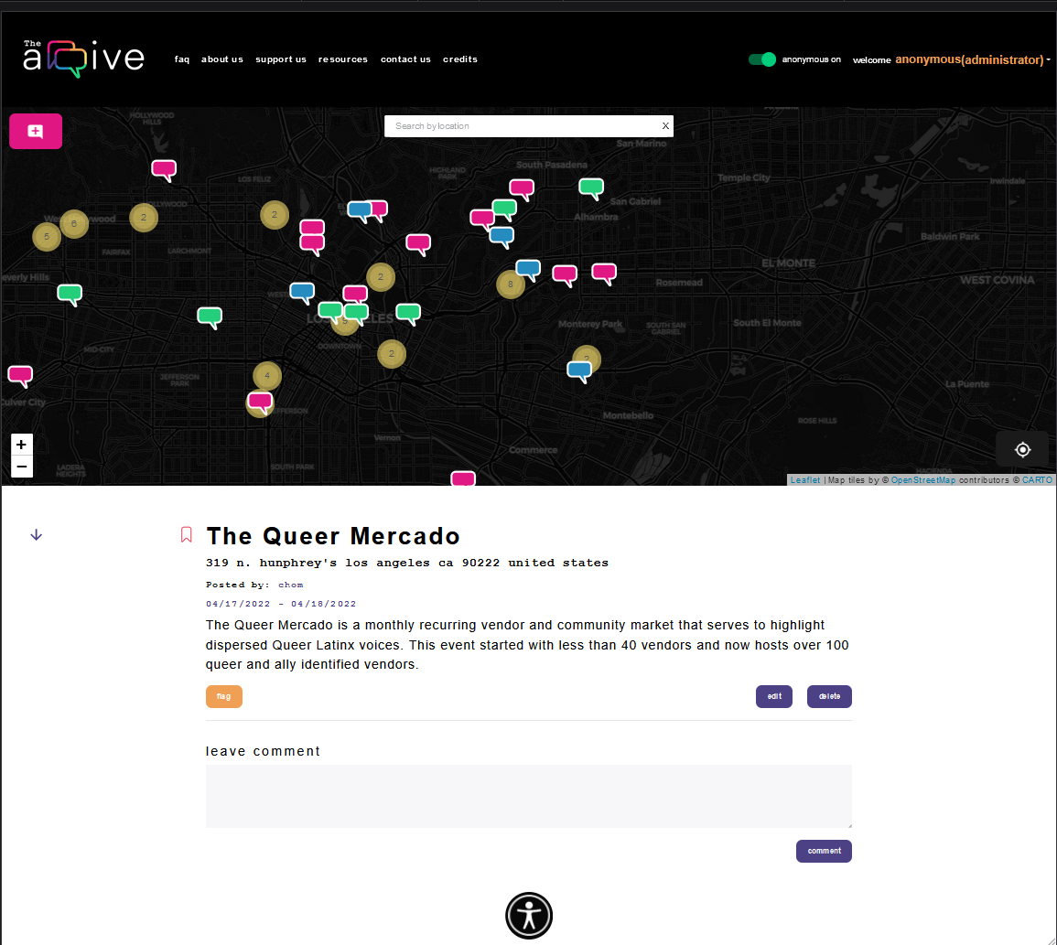
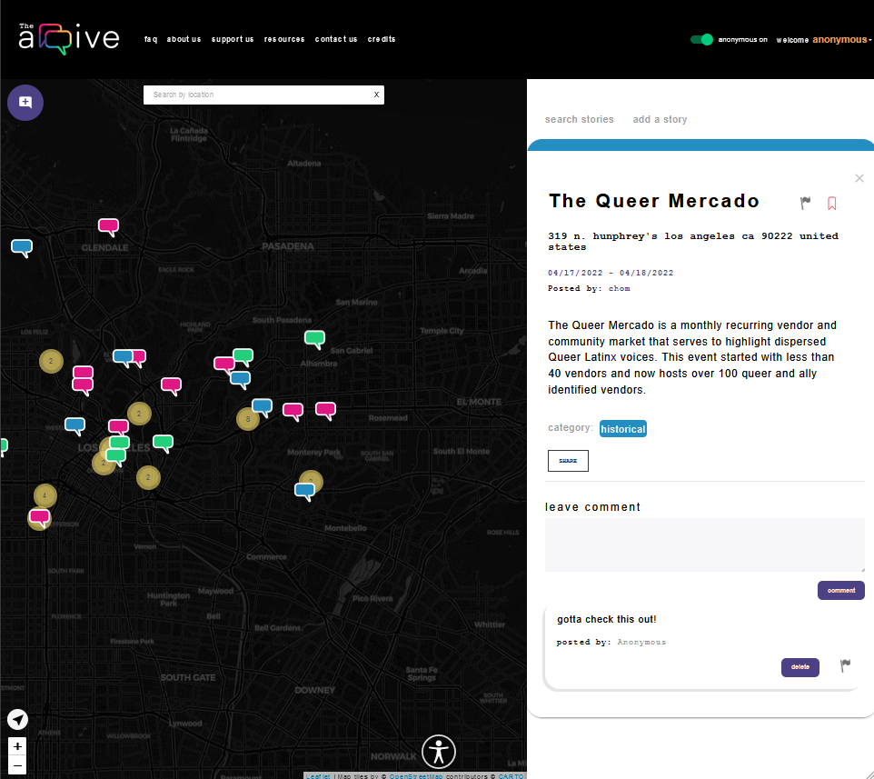
ui/ux improvements - web
Imported new icons
Formatted text and structuring for readability
Cleaned up CSS and styling for story components
Created color labeling for current story
Notes:
Updated site while maintaining original functionality
Imported new icons
Formatted text and structuring for readability
Cleaned up CSS and styling for story components
Created color labeling for current story

Slide 11
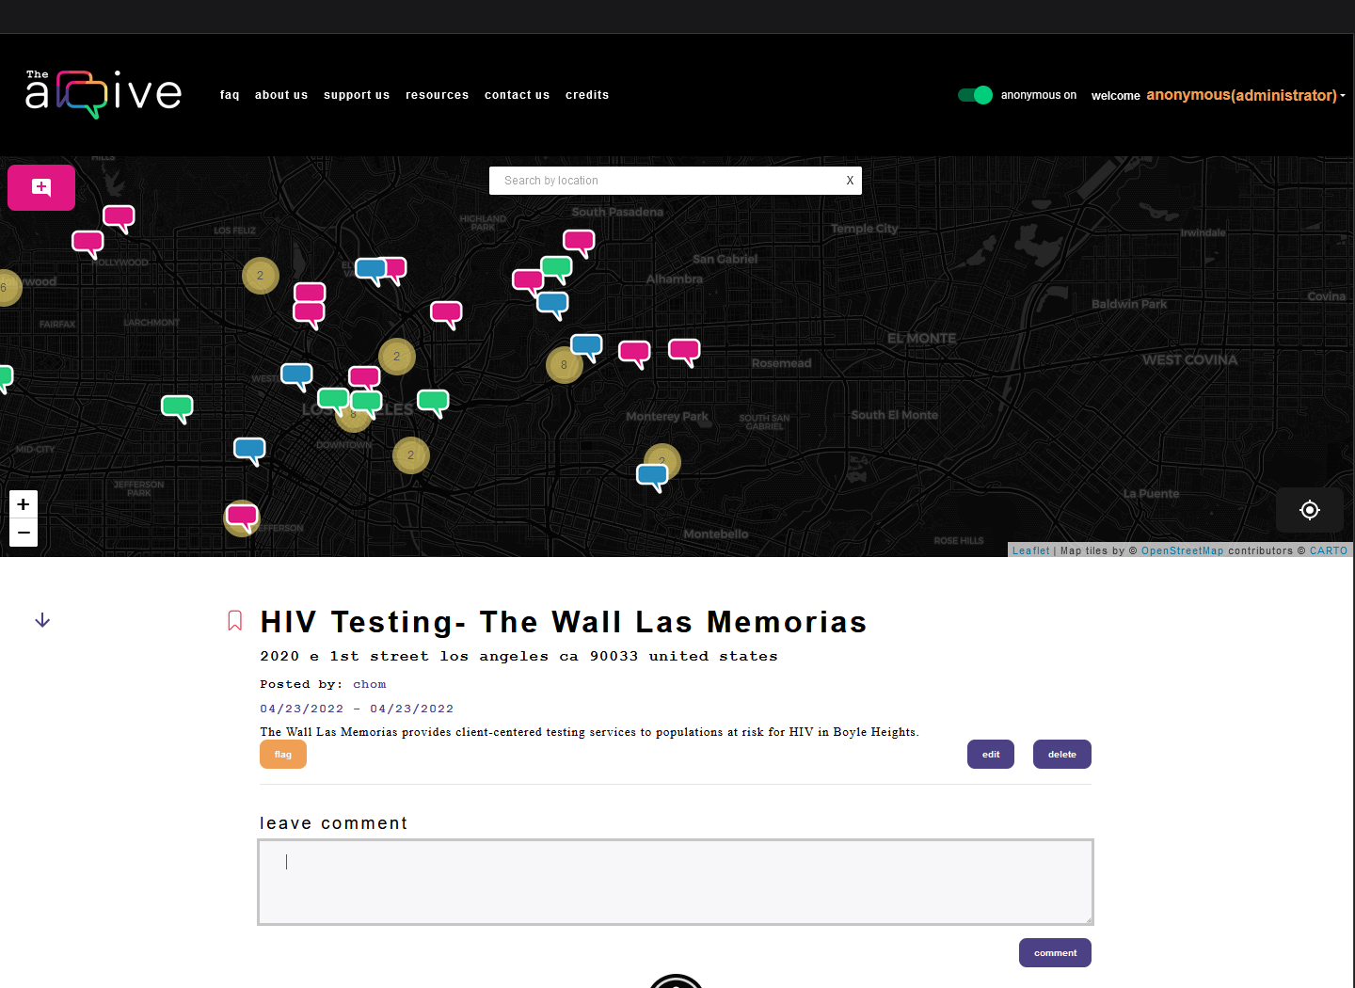
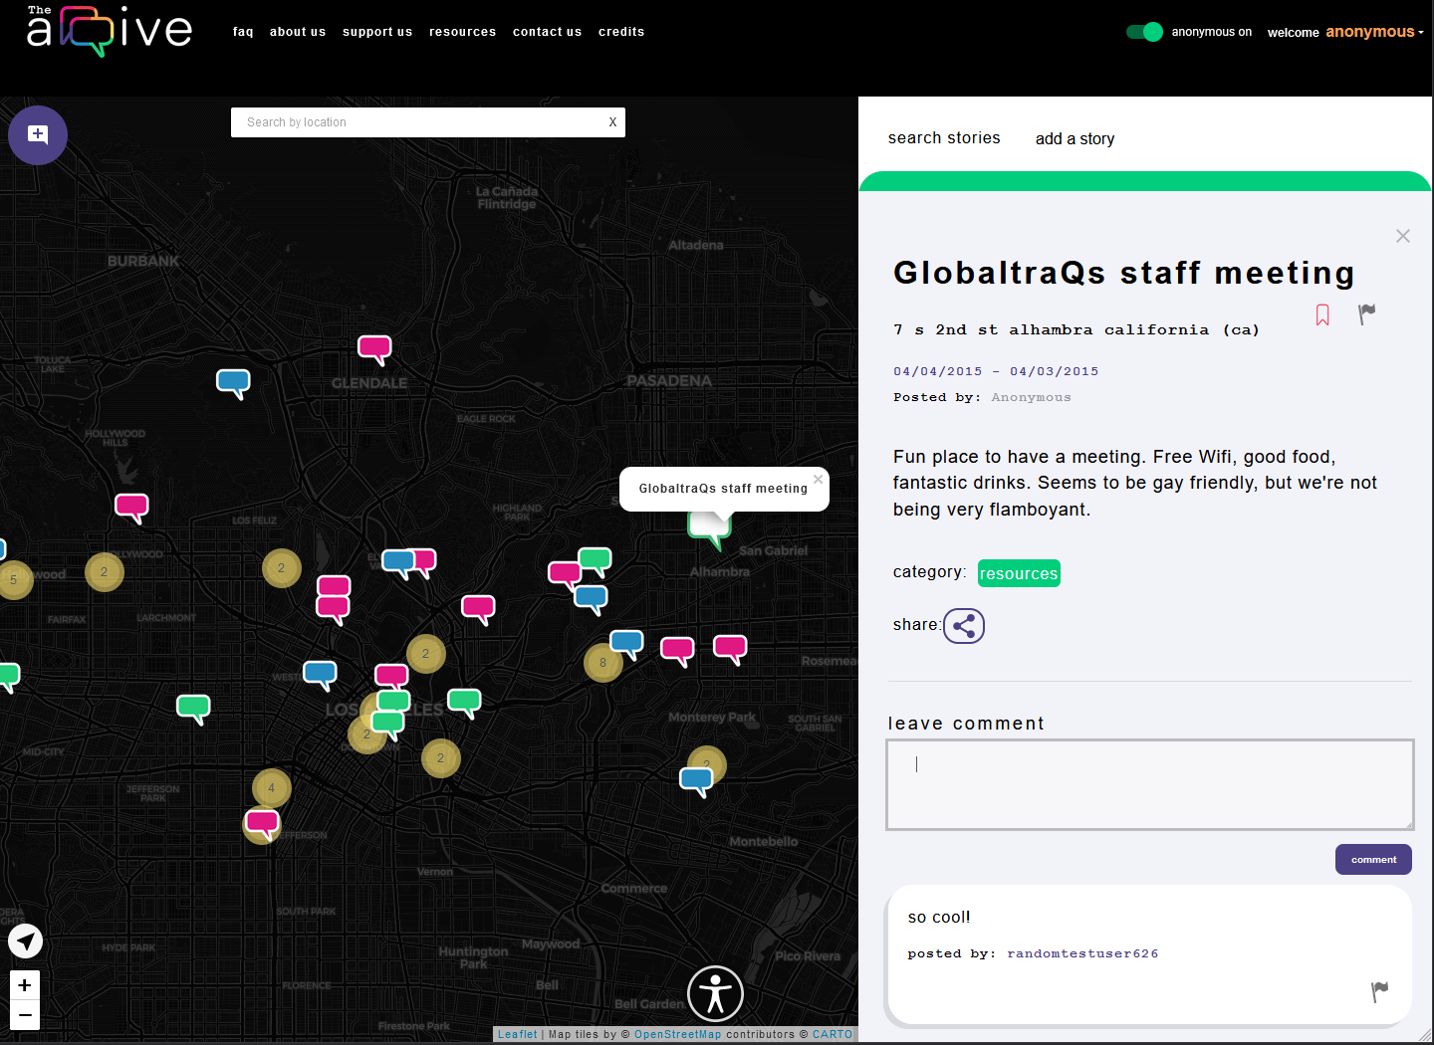
ui/ux improvements - web cont
Notes:
Updated site while maintaining original functionality
Imported new icons
Formatted text and structuring for readability
Cleaned up CSS and styling for story components
Created color labeling for current story

Slide 12
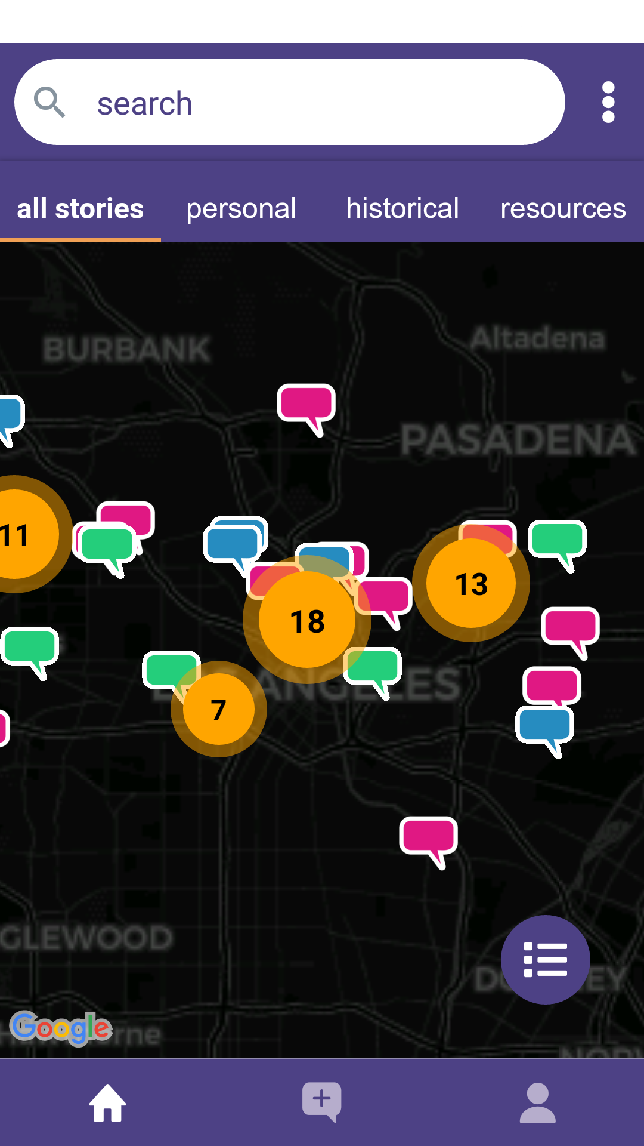
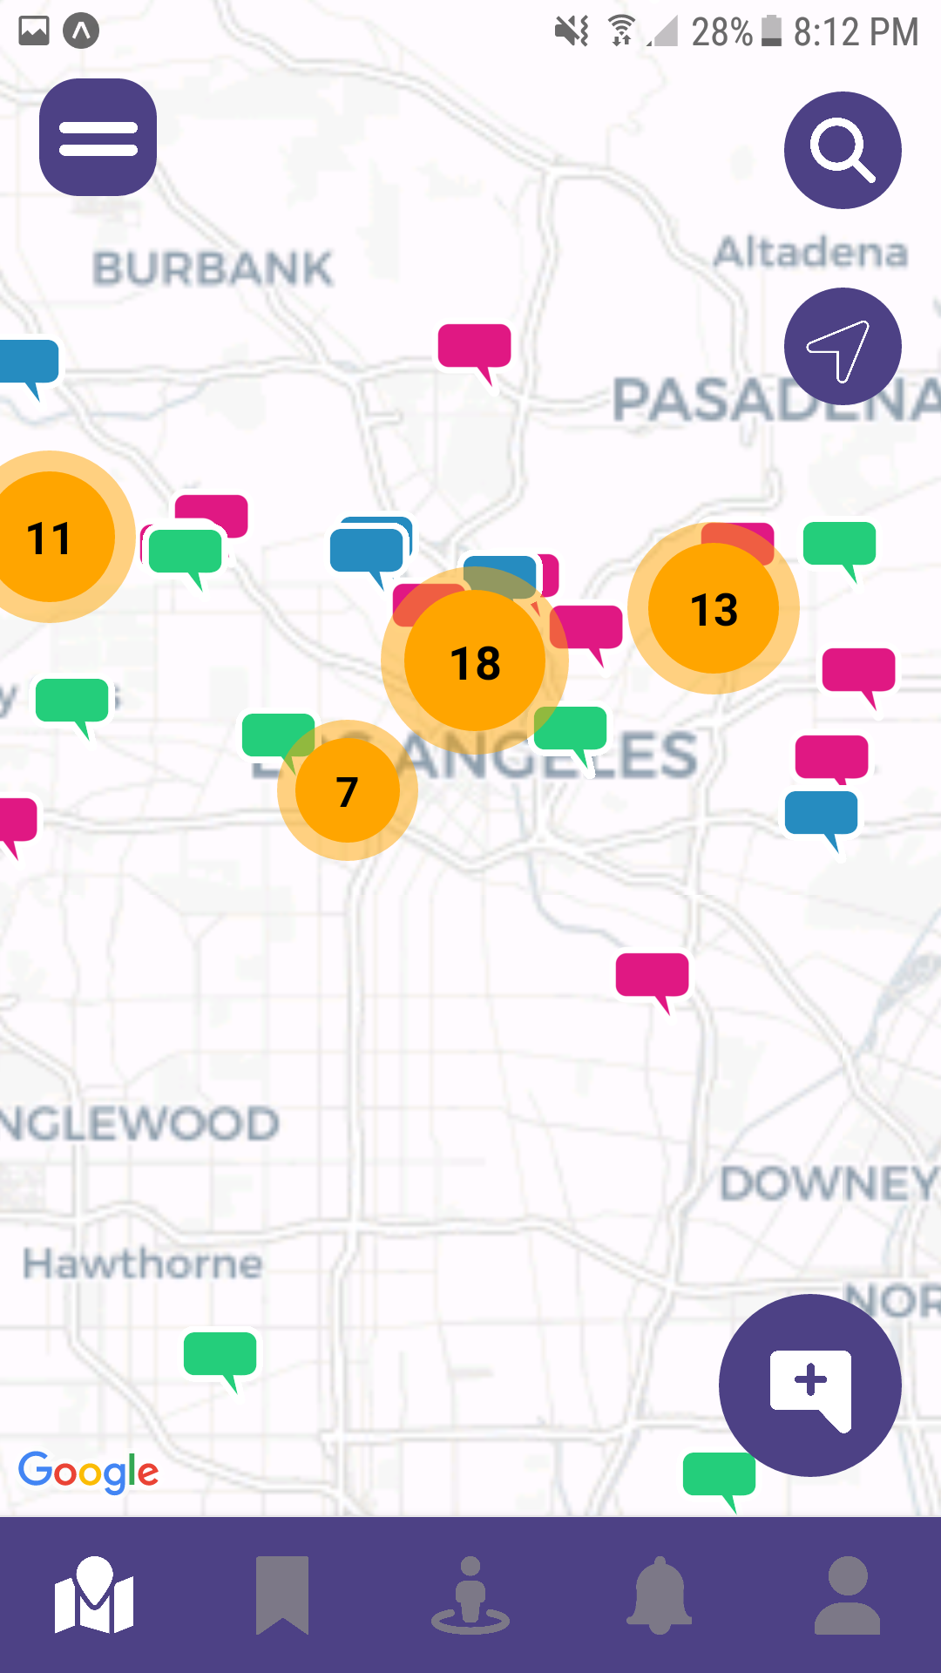
ui/ux improvements - mobile
Map Screen
From sandwiched interface to more open design
Overlaid buttons on top of map
Bottom tab has access to map, bookmark, nearby, notification, and profile
Notes:
Bryan
changed icons and overlaid buttons on top of map instead of them sandwiching the map
the bottom tab has access to map, bookmark, nearby, notification, and profile
the top right dots menu button moved to the hamburger menu button on the top left

Slide 13
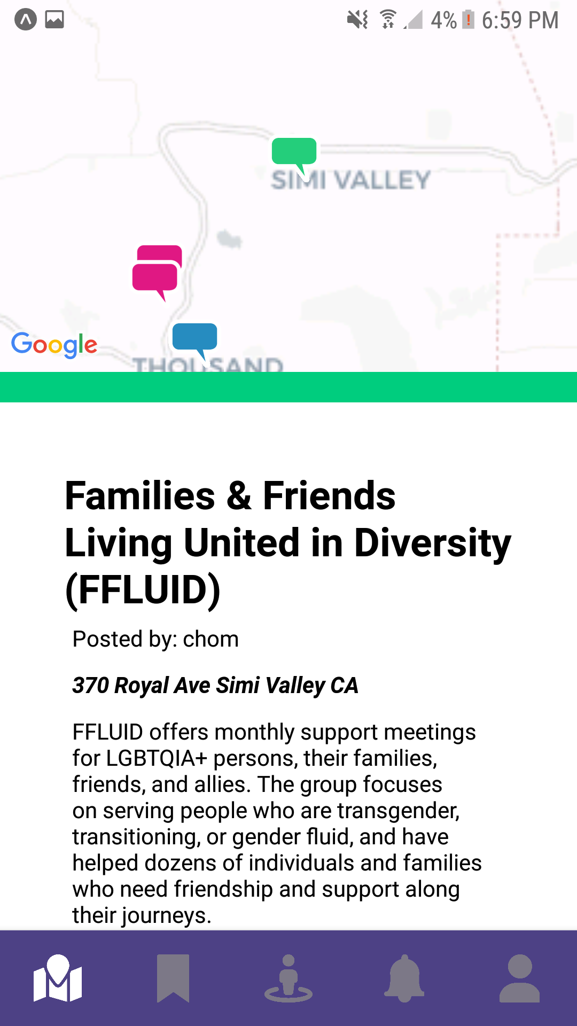
ui/ux improvements - mobile
Story Screen
Formatting adjustments
Shows the map and centers on the location of story opened
Login and Register
Improved cluttered layout for ease of use
Notes:
Bryan

Slide 14
location autocomplete
Previous State:
Presents one location at a time
Suggests locations far from the user
Not yet implemented in mobile application
Notes:
Jorge

Slide 15
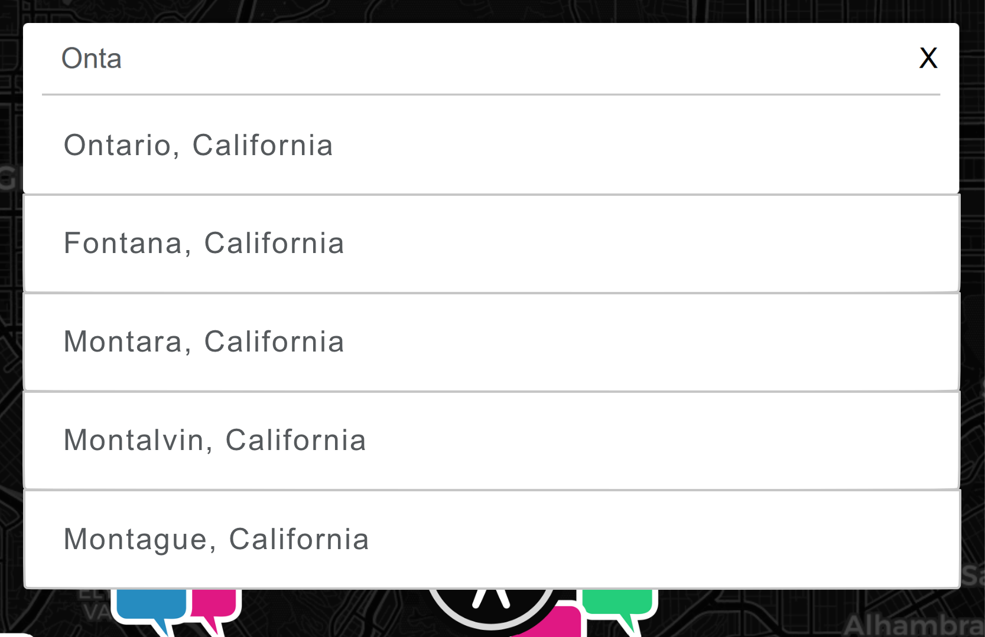
location autocomplete
Goal:
Present up to 5 locations at a time
Suggestions based on the user’s current location
Add location autocomplete functionality to mobile app
Notes:
Jorge

Slide 16
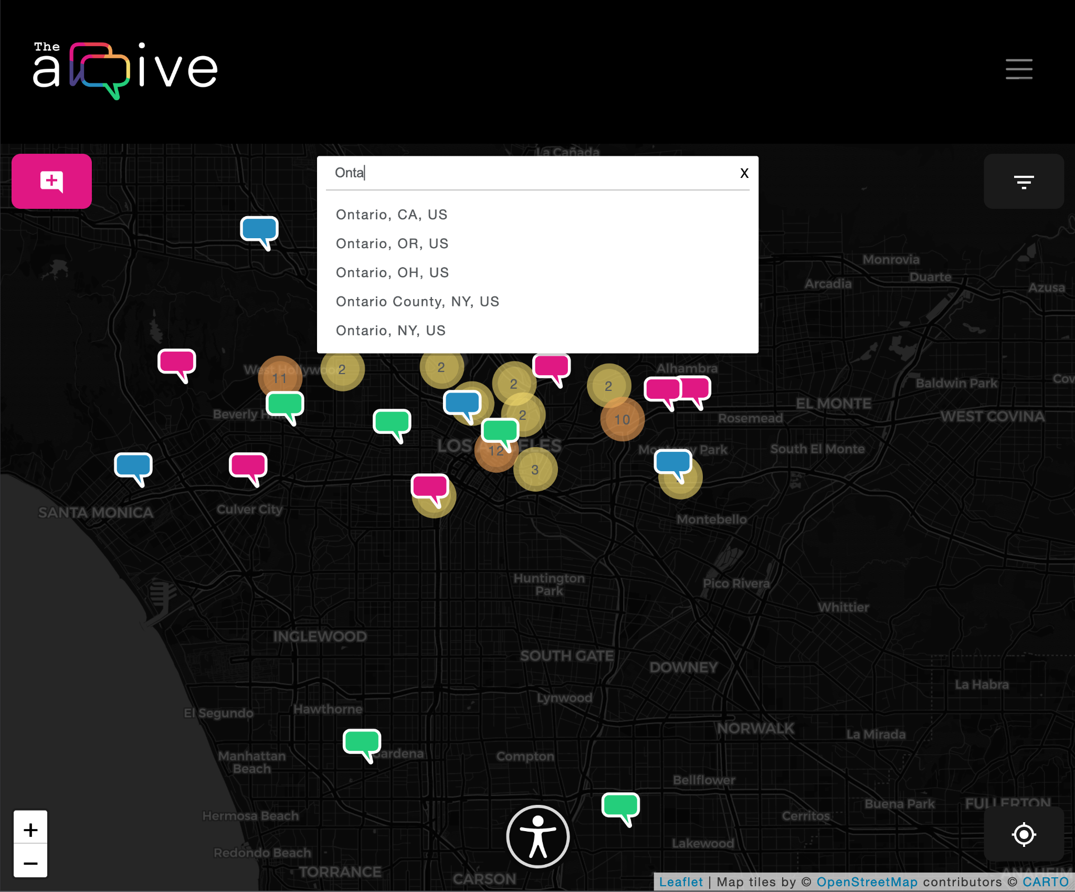
location autocomplete
Current State:
Presents a custom amount of location results at a time
Suggests locations close to the user
Suggestions change depending on previous search
All in-house, no 3rd party dependencies
Notes:
Jorge

Slide 17
location autocomplete - data flow diagram
user coordinates,
search box input
database query
User
Django REST
DigitalOcean storage
array of results containing:
latitude, longitude, unique ID, city name etc
query set return
Notes:
COntent is served with URL that have header/tokens attached to so user has access to storage

Slide 18
media upload
Goal: Allow users to upload images to the arqive
👀 Maintains user’s privacy
🔐 Storage of images secured behind access keys
💰 Cheap and easily scalable
🎥 Extensible for other formats
Status:
🛠️ Still working on Frontend implementation
Notes:
Misael
📸 Remote storage is handled by serializers and tracked by the Django database
📸 Unique names enforced during storage
📸 Storage of images secured behind access keys
no identifying information about users
opens up other media possibilities for Arqive

Slide 19
media upload - data flow diagram
URL accesses image
User
media with post ID
Django REST
media
DigitalOcean storage
URLs encoded with access tokens
Notes:
COntent is served with URL that have header/tokens attached to so user has access to storage

Slide 20
media upload - storing images
User
media with post ID
Django REST
media
DigitalOcean storage
Notes:
COntent is served with URL that have header/tokens attached to so user has access to storage

Slide 21
media upload - serving images
URL accesses Image
User
user requests page
Django REST
DigitalOcean storage
URLs encoded with access tokens
Notes:
COntent is served with URL that have header/tokens attached to so user has access to storage

Slide 22
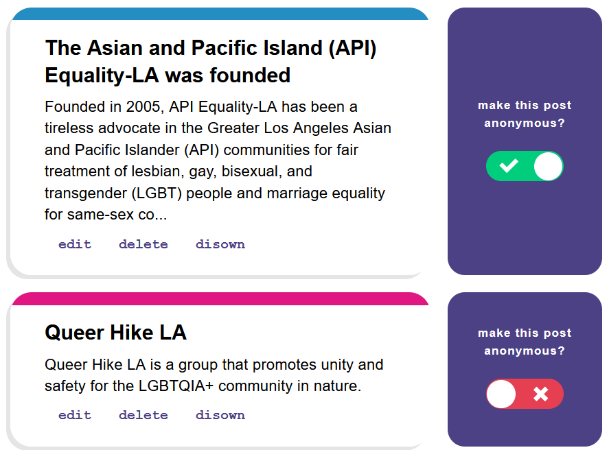
delete and disown post
In order to preserve history users can now:
delete their account while keeping their posts on the site.
dissociate posts from their accounts without deleting their account
delete posts after deleting their account
have sufficient warning to prevent accidental deletion of their account or posts

Slide 23
updated software stack
Product Support: End of Life <1 year >1 year N/A
Software/Framework Previous Version Current Version
Ubuntu 18.04 22.04 LTS
PostgreSQL 11.0 14.7
Python 3.7 3.10
Django 3.0.5 4.1.7
React Native 0.64.3 0.71.7
Expo 43 48
Node.js 10.24.1 10.24.1
React 16.3 16.3
Notes:
Kennard
This slide shows the current versions of software in our stack and our previous versions
As you can see from the legend, much of our stack is no longer
Supported for feature updates or security.
After updating the versions all critical software will have at least a year or more of support.
Mentions the dependency hell + a lot of tech debt from around 3 years
Ubuntu update was mostly safe
Postgresql had a little trouble with backward compatibility
Django depends on Python, and python tends to make breaking changes and dependency issues + change import names and api calls
React Native was an entire 10 version behind
Expo had to be updated
Node is close to being updated to around 16 (updated node branch)

Slide 24
miscellaneous improvements
Implemented Docker development environment
Created various tutorials for onboarding
The arqive Docker Documentation
Github playground
Created and automated a backup of the database to a different cloud
Fixed server’s email routing
Notes:
Implemented Docker development environment
This will help future teams get started working on the project
Created various tutorials for onboarding
The arqive Docker Documentation
Github playground
Deployment Documentation
Next years team will likely not have experience working with these frameworks so this will provide a roadmap of how the project works
Created and automated a backup of the database to a different cloud
Fixed server’s email routing
Google changed their protocol for sending email so the service was broken temporarily. Email allows the server to report errors and handles contact from its users and this is operational again.

Slide 25
project challenges
Notes:
Erik

Slide 26
project challenges
Node.js End of Life Timeline
Working with an existing code base had its challenges
Dependencies and EOL issues
Best practices change between versions
Documentation
Communication and merges
https://endoflife.date/nodejs
Notes:
Working with an existing code base mean you have a full functioning system or the blueprints already drawn up for you
It can be a daunting to figure out where to start and what is too large of a project to take on
We were not able to rebase our code to a newer version of react or node
And although security patches are available for older versions of react the core functionality of newer versions changes
We had a hard time figuring out what versions of packages were causing errors
base has its challenges

Slide 27
maintenance
The arqive is a live site so changes to production code and its underlying server required tact
Configuration issues
Apache, SSL Certificates, Domain Register
Python versions
Memory Issues with Mod WSGI
Digital Ocean Droplet hijack attempt
Notes:
Bryan

Slide 28
integration of features
We were not able to integrate and deploy all the features we developed
Media Upload
Frontend still needs to be built out
Backend API is live
Automated Content Moderation
API hosted on a separate Digital Ocean droplet
AR/VR Prototype
Still in its infancy
Notes:
Bryan

Slide 29
conclusion
Notes:
Summary of key points
What we want the audience to walk away knowing

Slide 30
conclusion
Web development exposes the complexity of computer science that we interact with daily.
What we accomplished:
Location Autofill
Media Upload Backend
UI/UX improvements
Upgraded Stack
TODO:
Rewrite Web Frontend
Implement Media Upload
Implement Automated Content Moderation
Notes:
Web development exposes the complexity of computer science that we interact with daily.
Although we could not implement everything we set out to with our project we all learned a great deal.
We developed real world skills for working on large codebases and with web frameworks.
Rest APIs Django, Linux, Docker ,Git version control React, React Native
What we accomplished:
Autocomplete - A more intuitive and professional site
Media Upload - Allows users to share in more than just text, a picture says a thousand words
UI/UX improvements - Improves site’s usability and user retention
Updated Stack - GIves the next developers a stronger start
TODO:
Rewrite Web Frontend -Our projects web frontend needs rewrite due to rapidly advancing React Versions and package dependencies
Media Upload and ACM - The implementations of the features we created this semester should seamlessly integrate into the new version
Summary of key point of presentation Results, Difficulties
Overview what should we know walking away from this presentation

Slide 31
demonstration
Notes:
Alex

Slide 32
Notes:
Point out how the search are choosing locations close to what was previously put in.
Misael: Show the use of the links generated. Preferably, show the link when you create the image (in browser), show the link after you update the image (in browser, just refresh the page), and show the link after you delete the image (refresh). Send video to Jorge (Before 11:00pm)

Slide 33
questions
Notes:
Alex

Slide 34
end of presentation

Slide 35
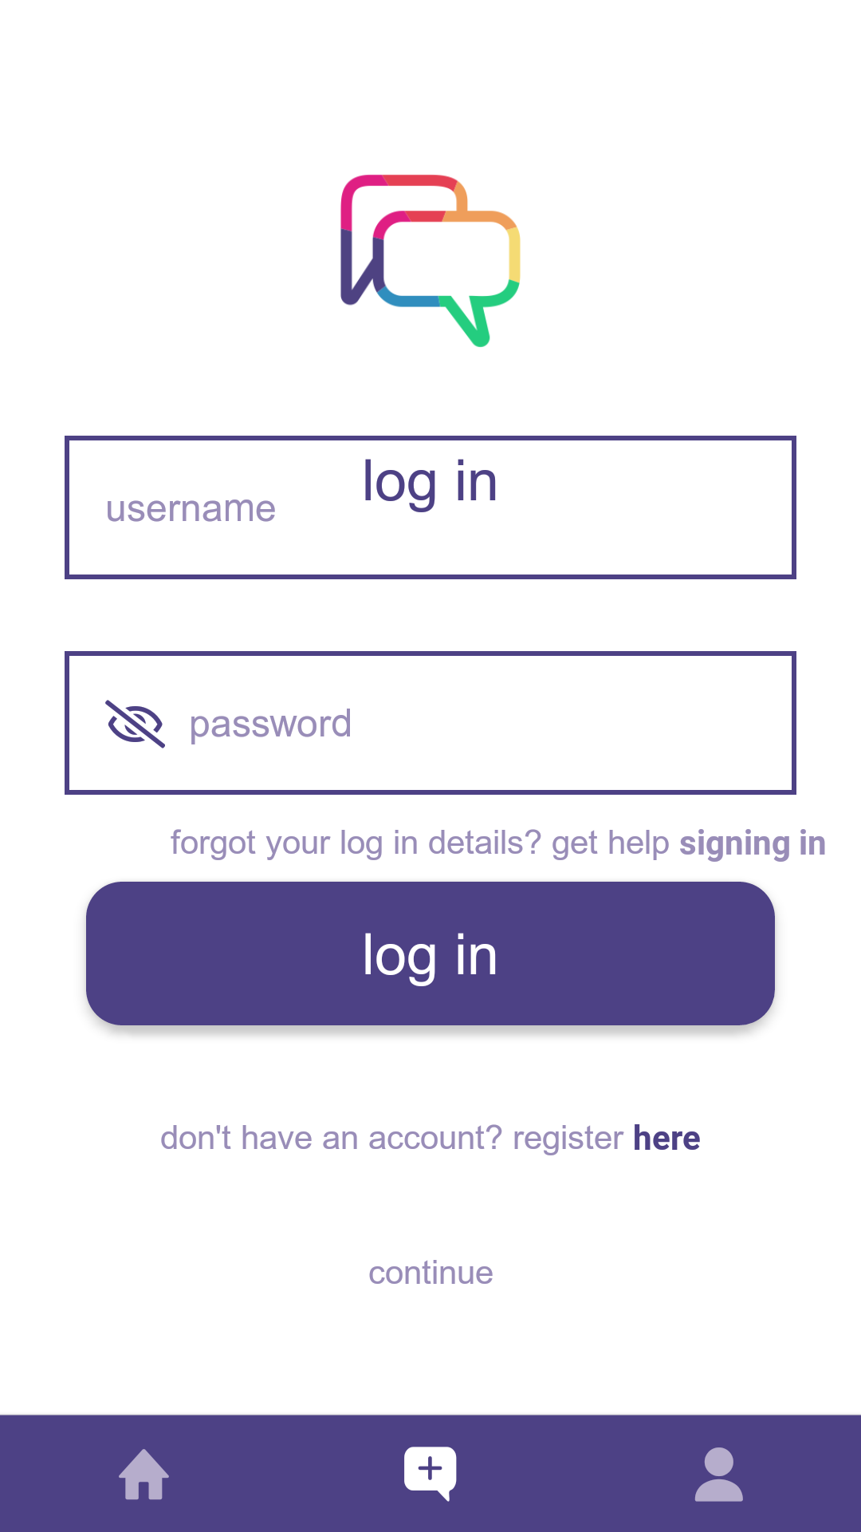
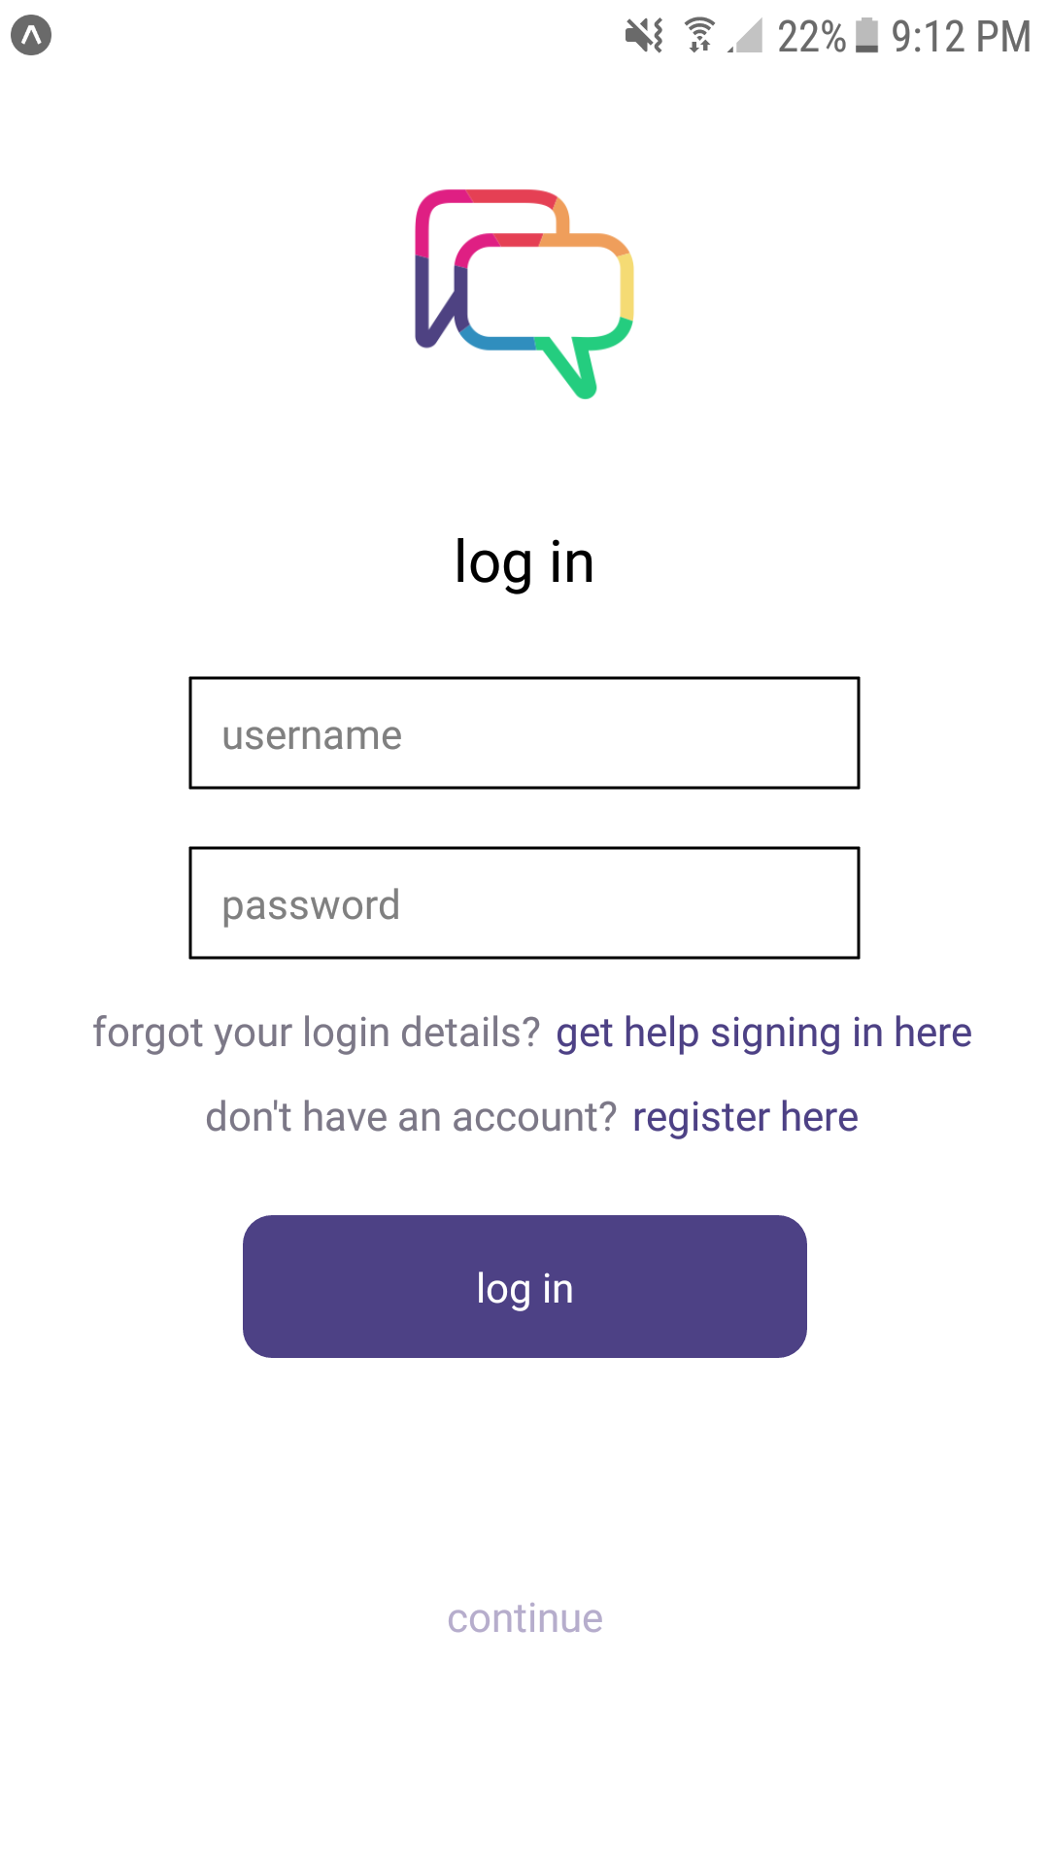
ui/ux improvements - mobile
Login and Register
Improved cluttered layout for ease of use
Notes:
Bryan

Slide 36
Content Moderation
Integration of a new API hosted on a separate Digital Ocean droplet dedicated to managing the machine learning models and processing content moderation requests.
Allows for improved scalability and independent maintenance of our web application, ensuring a smooth user experience.
Notes:
Cesar

Slide 37
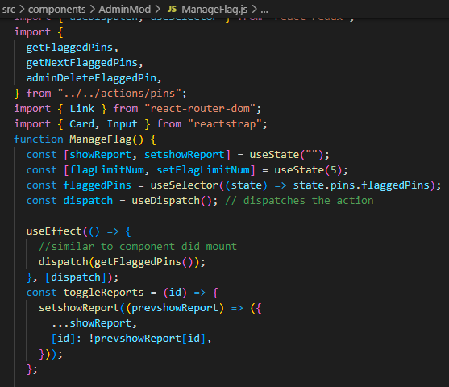
Content Moderation (Cont.)
Machine learning models now feature an ensemble approach, combining Random Forest, Naive Bayes, and Logistic Regression algorithms, trained on a comprehensive dataset to better understand and classify user-generated content. With th
Content moderation API will process the text and return a moderation decision. The web application then stores the decision in our database and handles the content accordingly improving on current human moderation.

Slide 39
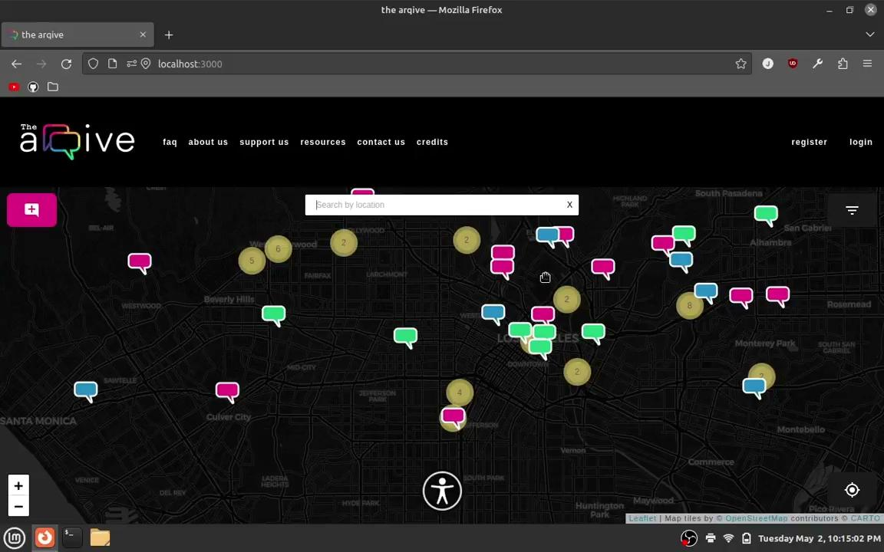

Slide 40
node and react
Erik
Dependency issues:
Dependencies are managed by NPM (Node Package Manager)
Packages in Node are open source and maintained individually
Packages that depend on each other may introduce breaking changes
Major React versions (that have breaking changes) are released every year to six months
The project uses: "react": "^16.13.1"
Circular Dependencies occur when one package depends on different version used in the project
Notes:
Bryan

Slide 41
Security
Bryan
Fixed leak APIs
Insert example showing exposing User Data
Notes:
Bryan

Slide 42
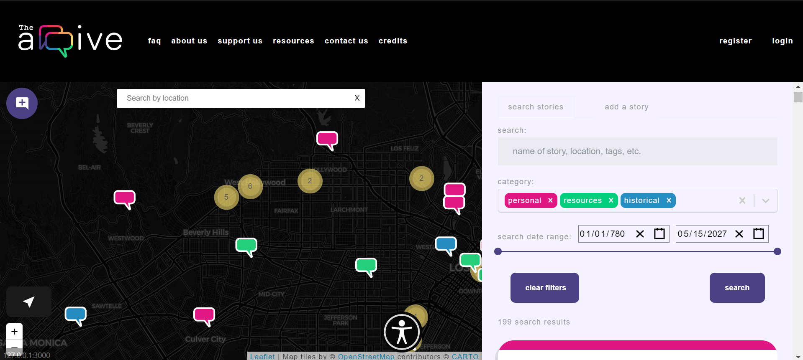
UI changes
Dustin
Notes:
Dustin
Change the text to black (more contrast)
Change the purple (#f2f2f9 hexcode)
Wait for hexcode from
Updated site while maintaining original functionality
Imported new icons
Formatted text and structuring for readability
Cleaned up CSS and styling for story components
Created color labeling for current story

Slide 43
Augmented Reality(AR)/Virtual Reality(VR)
Jonathan
create an ar experience where users can add 3d text messages to the real world
🌐 3d messages will be displayed at pin locations through mobile device camera
🌐 pins will be geographically accurate
🌐 depending on location historical venues will be displayed
Notes:
Our Ar/VR prototype has successfully demonstrated an immersive and interactive user experience, made possible through the use of Ar.js and the A-frame framework. Our research has shown that these technologies have the potential to engage users with content throughout our site, allowing for unprecedented interaction with digital content.
~Ar/VR prototype provides an immersive and interactive user experience.
~Ar.js and the A-frame framework enable user engagement with content throughout the site.
~Successful demo of Ar.js showcases the capabilities of generating and manipulating scenes.

Slide 44
Augmented Reality(AR)/Virtual Reality(VR)
Jonathan
Marker tracking allows for the presentation of specific 3D objects by developers.
360 imaging technology provides a realistic experience for users as if they were physically present at the location.
Location-based system implementation was not successful, but progress was made towards achieving this goal.
Future works may include further research on location-based AR/VR systems to enhance the user experience.
Notes:
Although we were not able to successfully implement a location-based system, we were able to create a demo showcasing the capabilities of Ar.js and how scenes can be generated and manipulated. Through our demo, we were able to generate marker tracking, enabling developers to present specific 3D objects. Additionally, our 360 imaging technology provides users with a realistic experience, as if they were physically present at the location. Ultimately, for future works within the AR/VR prototype a user may want to continue research in order to incorporate a location-based ar/vr system.

Slide 45
Node JS
Kalvin
NodeJS is a server-side scripting environment that allows JS running client-side to interact seamlessly with backend web applications.
The arqive relies on many deprecated and outdated packages
Updating Node and the packages will ensure the functionality of The arqive
Notes:
Kalvin
NodeJS handles the server-side logic
Talk about the changes of versions andt lts

Slide 46
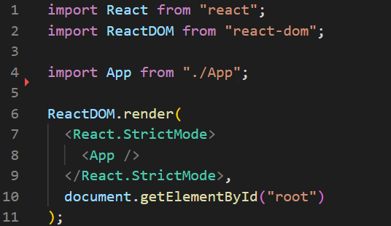
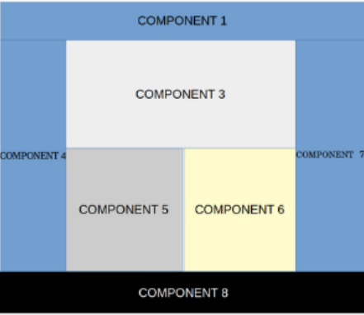
React JS
Kalvin
Declarative and dynamic framework for Javascript
Provides Graphic User Interface(GUI) for users of the app
Aides developers in building better user experiences
Must update code to reflect new versions
Notes:
Kalvin

Slide 47
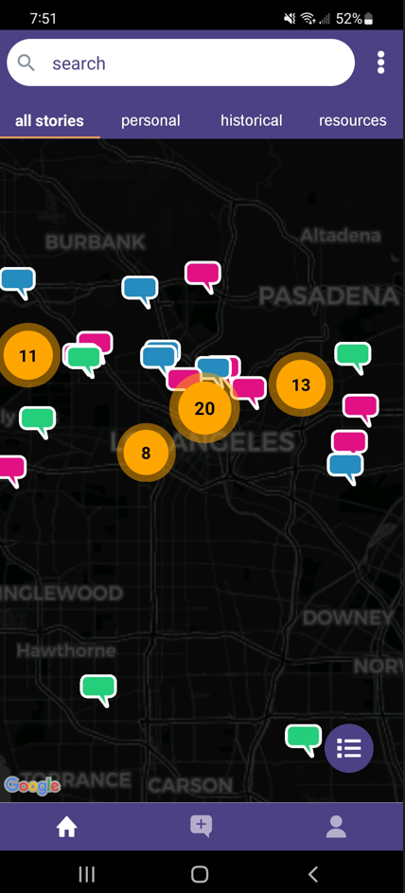
React Native
Kalvin
React Native is a framework for designing mobile apps
Used to provide GUI for mobile arqive user
Allows same backend logic used for React web app to be used for mobile app
Notes:
Kalvin

Slide 48
Django
Dustin
Python web framework for building secure and maintainable websites
Provides REST API for ReAct to access database
Integrates with other Python packages
Model-View-Controller design for organization
Notes:
Dustin
High-level web framework written PYTHON
This allows us to integrate Scikit-learn and other python packages into our web app
MVC design gives organization
Provides REST API for ReAct to access database

Slide 49
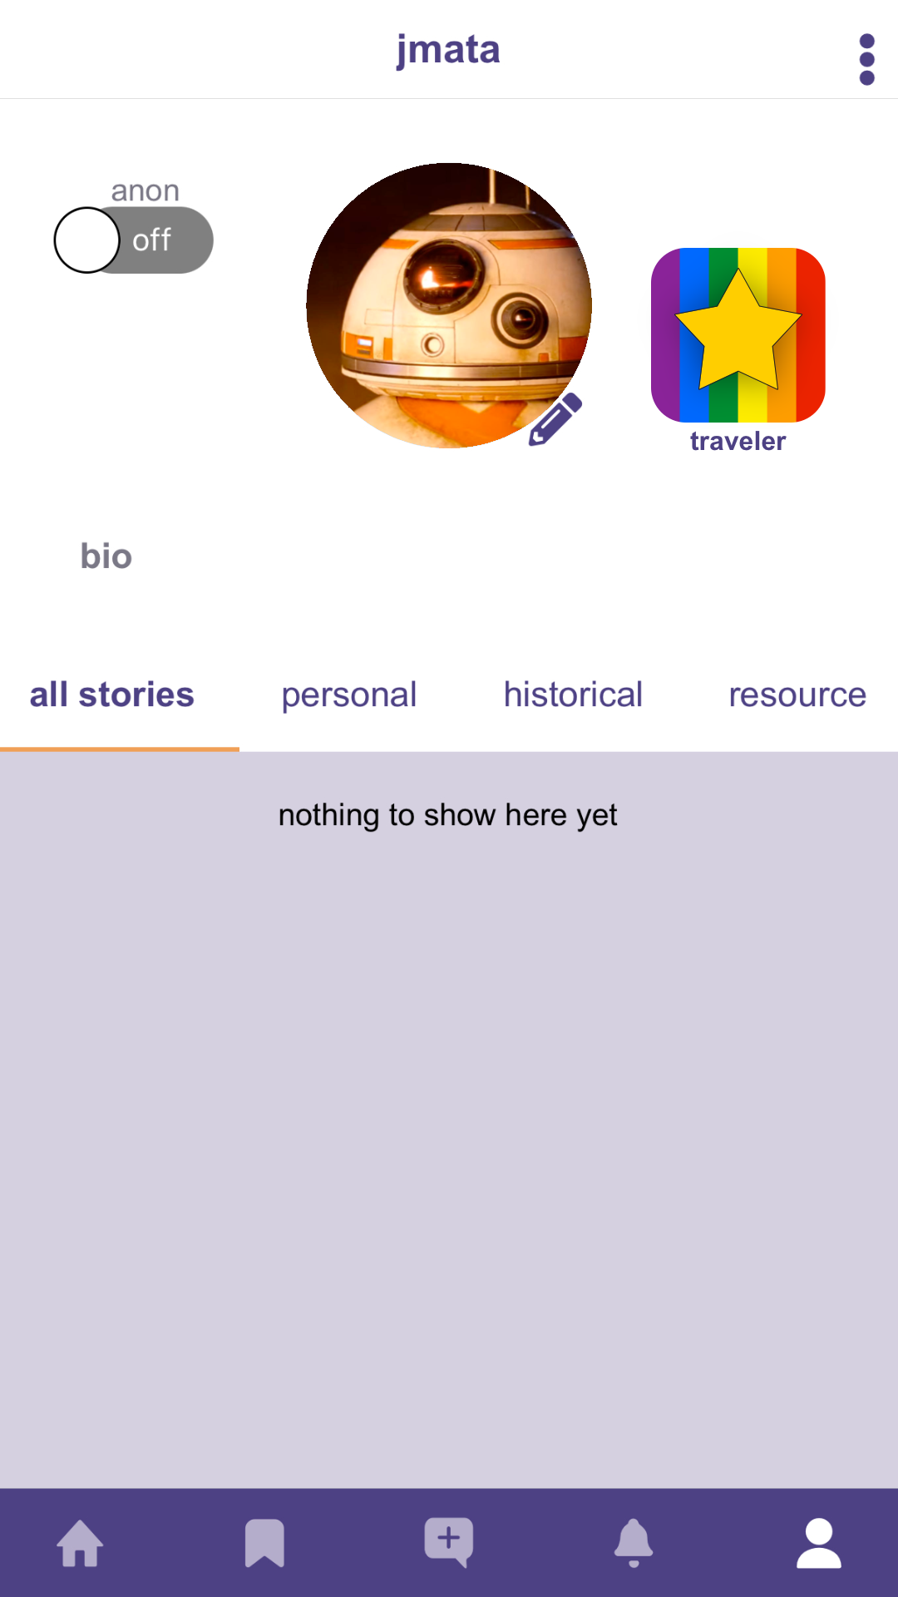
Gamification
Bu
Gamification Goal:
Make The arqive more engaging for users
Personalize profiles through badges
Help introduce a fun online environment
Notes:
Dustin
The sponsors of The arqive want users to be more engaged with the platform so we
Plan to implement badges for user’s profiles. Badges will denote achievements like
First person to post about a location. Hopefully this will make posting stories,
Resources and historical accounts a more captivating experience.

Slide 50
Media Upload
Misael
Allow user to upload images to better share their stories.
Build in a way that is scalable, as the user base grows likewise the Arqive image base will grow.
From development perspective make image API as easy to use for quick development on the service.
Notes:
Misael

Slide 51
Security
Misael
Access to the database requires either
A specific ip address
Specific credentials (tokens)
Researched onion-only addresses to help user with privacy
Allow user to fully anonymize their data.
Notes:
Misael

Slide 52
Challenges Encountered So Far
Alex
Development:
Learning and implementing new frameworks and technologies
Issues with local development environments
Working with legacy code and documentation
Fixing bugs present from previous teams
Organization:
Redistributing workload through Jira, Discord, & Google Sheets
Database:
Accessing database without compromising security
Safeguarding the databasing from any possible mishap
Notes:
Alex

Slide 53
Development Environment
Erik
The application stack for The arqive is complex and requires a specific working environment.
Local Development: Create stack on local computer
Remote Development: Copy production server
Virtual Machines: Virtualize production server locally
Containerize: Create individual services for each component of the stack
Notes:
Erik
Greetings my name is Erik Blood, I'm part of the backend team and I've been tasked with Build/Deploy and AR/VR.
My colleague Jonathan will tell you more about the AR/VR.
The first order of business with Build/Deploy was creating a development environment for our team.
** The stack is a complex set of interdependent systems that require specific configuration and versioning **
The stack we are talking about here is the web stack or web application stack.
The set of software used to serve our site, store and manipulate data, display data to the user, handle input from users… you get the idea.
Due to this we need a development approach that accounts for how these systems interact with each other
While allowing us to switch in new versions of software.
Here are the options we had to choose from:
Local Development: Create stack on local computer
Remote Development: Copy production server
Virtual Machines: Virtualize production server locally (using something like VMware or Virtual Box)
Containerize: Create individual services for each component of the stack (Docker / Kubernetes)

Slide 54
Development Environment
Erik
Local Development:
Software conflicts, OS Issues, Knowledge overhead
Individual configuration and Troubleshooting
Remote Development:
One user at a time, One stack configuration at a time
Virtual Machine problems:
Individual configuration, Confusing network setup
Slow, Heavy on resources
Notes:
Erik
Local development is great if you’re writing in one language or a small aspect of a project and you can be
Sure your changes are affected by other changes and vice versa.
However this comes with issues:
Stack software conflicts
OS Issues: Mac, Windows, Linux
Required knowledge of how the stack interacts
Individual configuration and Troubleshooting
Remote development was another option, great if you have the money for an individual server for development
Or if you are not making changes to the software and frameworks that other services depend on.
However, this process came with its own problems:
One user at a time
Costly
One stack configuration at a time

Slide 55
Development Environment
Erik
🗒Provisioning is file defined:
Versioning, credentials, environmental variables, you name it
🏗Consistent builds:
No more build/configure instructions
👌Low entry requirements:
Hypervisor support, Docker and a Bash shell
🏃High Performance:
Initialization in seconds
💻Interface and IDE Integration:
VScode plugins, edit code on the fly
Notes:
Erik
Luckily with the help of a friend I was introduced to Docker and it was
The perfect solutions (Goldilocks joke here)
** Docker is platform as a service that uses OS-level virtualization to deliver software in packages called containers **
What does this mean? Docker uses a to that describe an environment, called a container, and many of these
Containers can be created and ran synchronously as a application.

Slide 56
Requirements for Content Moderation
Bryan
Run moderation algorithms synchronously with both the frontend and backend
Flag stories and comments that contains:
spam
vulgar or offensive language
NSFW or explicit content
Quarantine stories and comments after a certain number of user flags have been detected until human moderator’s approval
Notes:
Bryan

Slide 57
Content Moderation
Cesar
What language is actually offensive, abusive, or considered hate speech by definition?
“Anything goes” platform vs reducing liability
Some phrases contain offensive words but are not offensive or hate speech.
They may be describing what happened to them, and that is okay!
Solution:
A “Netiquette Community Guidelines” and a combination of Machine Learning and Human intervention

Slide 58
Content Moderation
Cesar
SciKit-learn is a Python library for Machine Learning and Data Science.
Experimented with different machine learning algorithms
Naive Bayes classifier
Linear Support Vector Machine
Neural Networks
Naive Bayes classifier is possibly the most accurate
Run reclassification of the model periodically to improve model’s effectiveness
Notes:
Cesar

Slide 59
Augmented Reality(AR)/Virtual Reality(VR)
Jonathan
AR.js is an open-source JavaScript library for implementing AR on mobile devices.
Features:
🖼 Image tracking
🗺 Location Based AR
📍 Marker Tracking
Works on any device with webRTC and webGL
Completely opened sourced
Notes:
Jonathan

Slide 60
Demonstration

Slide 61
