Slide 1
FINAL PROJECT REPORT
Want 2 Remember App®
powered by We2Link ®

Slide 2
Jesse Gonzalez David Pablo | - - | Project Co-Lead Project Co-Lead
Harshil Kotamreddy Jonah Kim | - - | Note Taker / Software Developer Software Developer
Ryan Mckean Marco Gonzalez | - - | Software Developer Software Developer
Salvador Cornejo Victor Flores | - - | Software Developer Software Developer
Roger Ramirez Angelo Esmeralda | - - | Note Taker / Software Developer Software Developer
OUR TEAM
Michael Malone
Dr. Zilong Ye
Ricardo Marroquin
-
-
-
Sponsor / CEO
Advisor
We2LinkⓇ Liaison

Slide 3
PURPOSE
➤ Build an App to help people with memory problems and their caregivers
➤ Colonel(ret) Michael Malone served 32 years in the Army and suffered multiple Traumatic Brain Injuries(TBI)
➤ Treated at Walter Reed Military Hospital along with hundreds of other Military Personnel with TBI
➤ Could not find a workable solution so decided to build Want2Remember App®

Slide 4
PRESENTATION OUTLINE
Scope Of Work
Our Stack
Task Overview
Application Map
Application Screens
Spring 2023 Updates & Features
Video Demo
Future Goals
Conclusion

Slide 5
Scope of Work
(1 of 2)
Convert functionality from mobile app to web app
Edit/View/Delete memories
Implement additional Caregiver Support
Edit/view access

Slide 6
Scope of Work
(2 of 2)
Increase Access to People with Disabilities
Create customization tools
Tie data into Google Firebase cloud infrastructure

Slide 7
Our Stack

Slide 8
Languages
(1 of 2)
JavaScript: Programming language that is one of the core technologies of the world wide web.
HTML: HyperText Markup Language is the standard markup language for documents designed to be displayed in a web browser.
CSS: Cascading Style Sheets is a style sheet language used for describing the presentation of a document written in HTML.
Tailwind CSS: Scans all of the HTML files, JavaScript components, and other templates.
TypeScript: Programming language that adds static typing with optional type annotations to JavaScript.

Slide 9
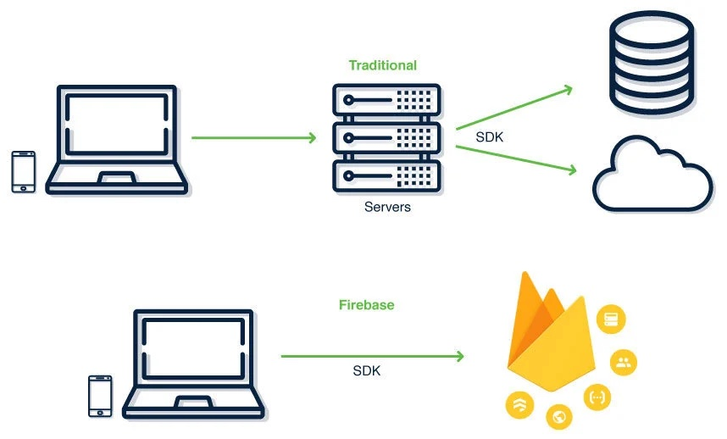
Languages (2 of 2)
Where our work is being done
React:
JavaScript framework that is open-source.
Re-use components that have been written already.
Uses virtual DOM
Firebase:
Collaborative applications.
Secure access to a database.
Provides variety of tools and services to help developers develop applications.
Google Cloud:
Provides tools for building deploying, managing applications and services in the cloud.

Slide 10
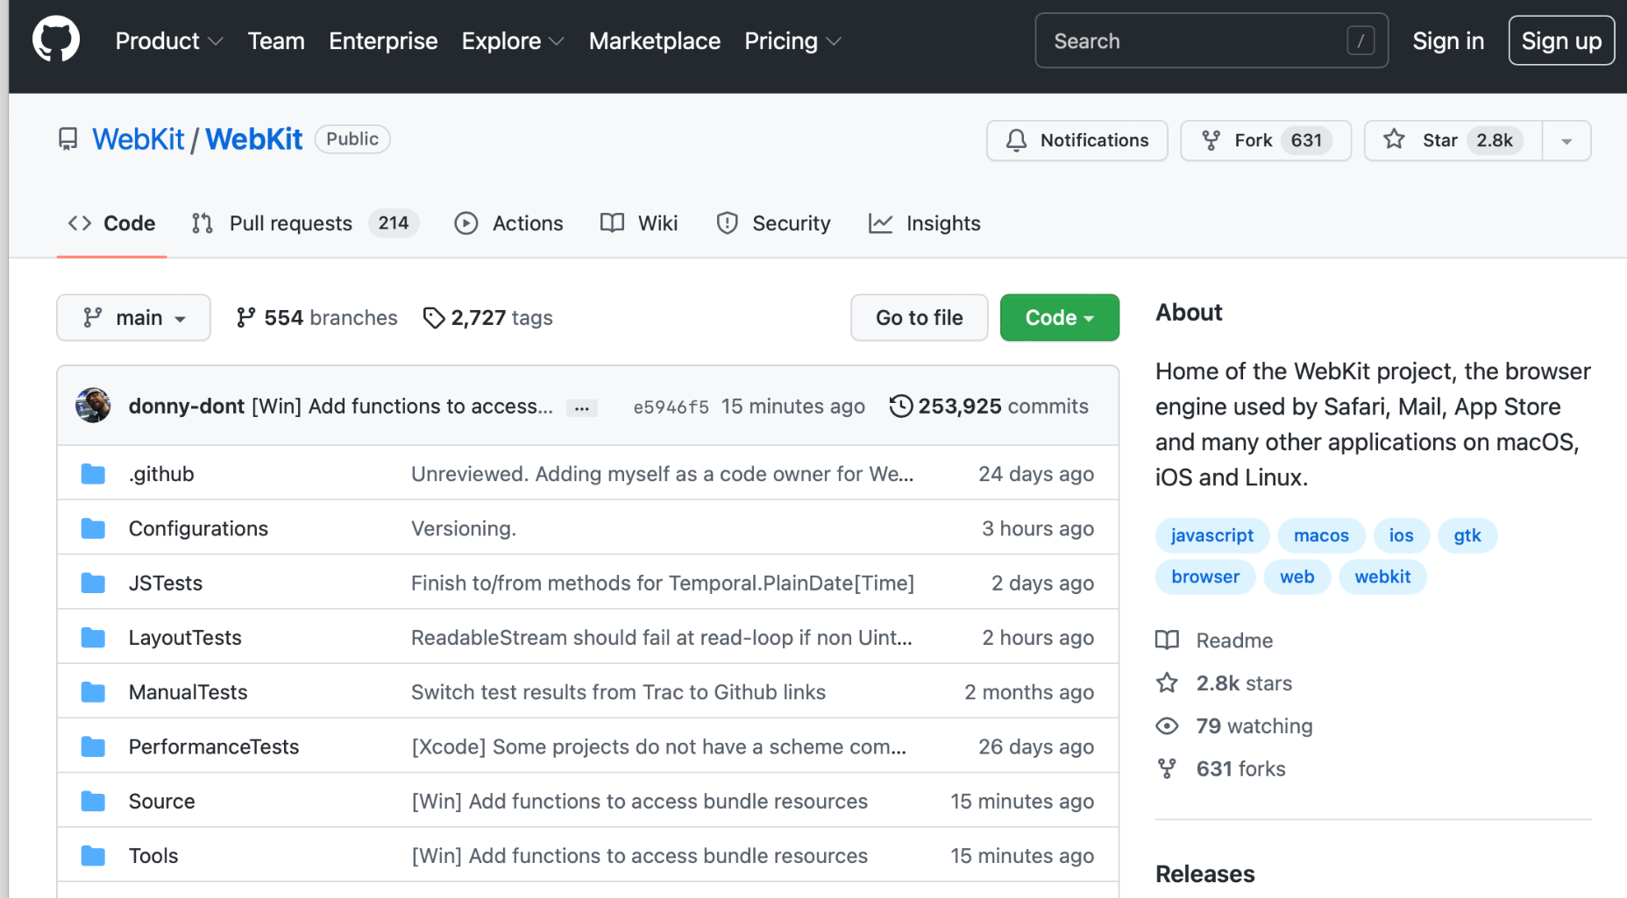
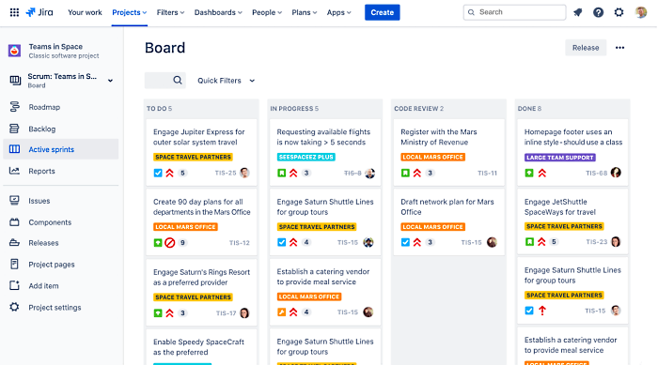
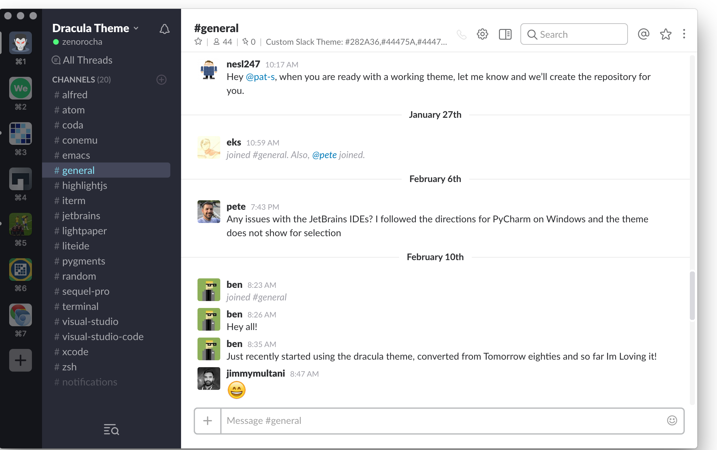
Communication
GitHub:
Code hosting platform.
Stores, tracks, and collaborating on software projects.
Jira:
Used for Agile project management.
Slack:
Instant messaging application.

Slide 11
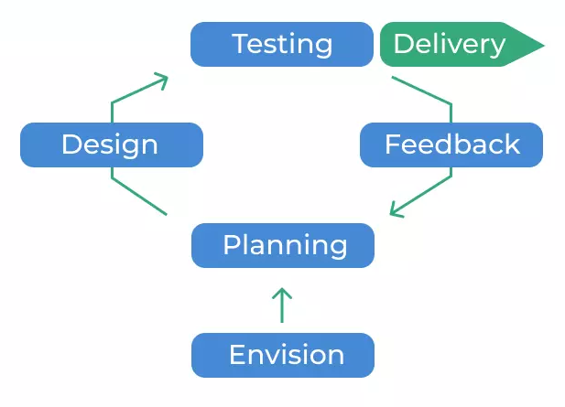
Task Overview (1 of 3)
Agile Workflow
Sprints
Starts on Fridays
Runs for two weeks
Check-ins on Wednesdays and Fridays
Retrospectives on last Friday
Tasks
Assigned to programming pairs
Begins in To-Do
Tasks moved by current team to next team
Jira
Roadmap
Sprints
To Do
In Progress
Dev Complete
PR Review
PR Review Complete
We2Link ® Staff Testing
Done
Tasks

Slide 12
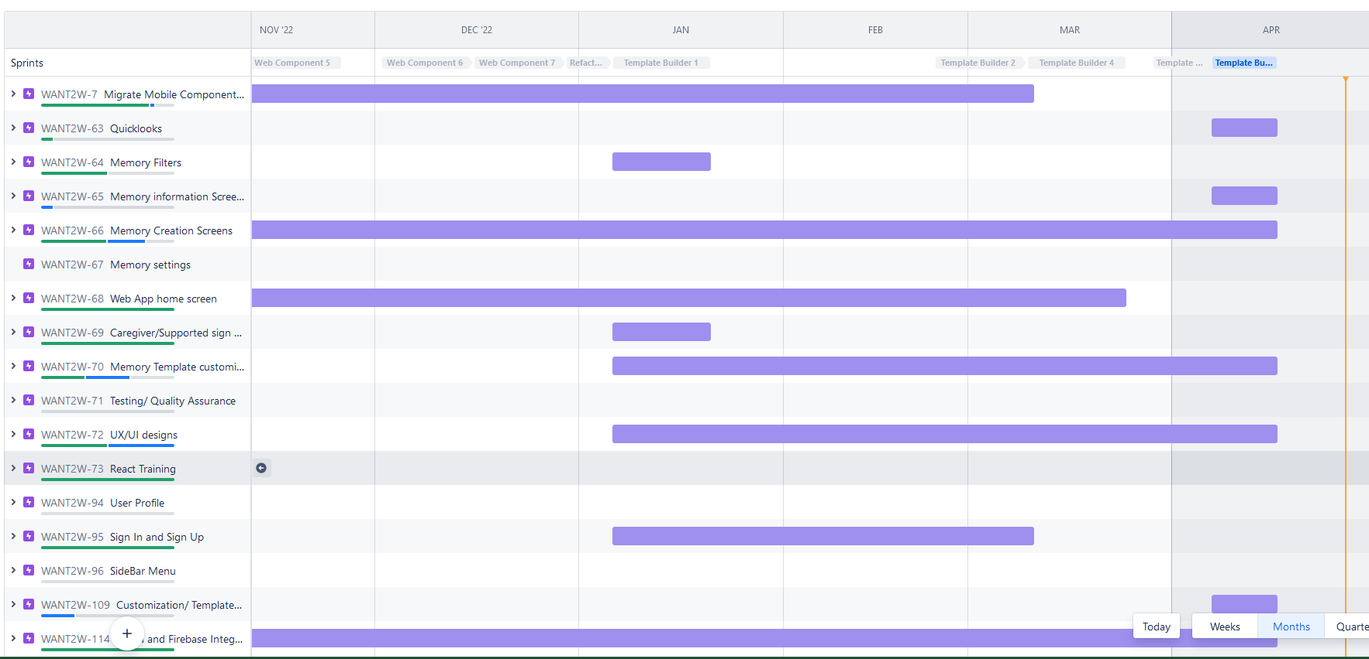
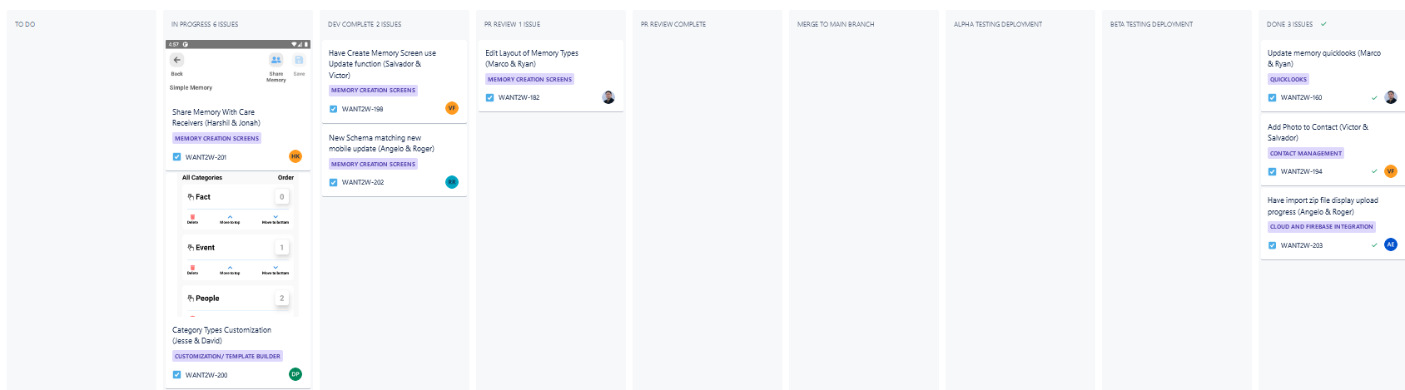
Task Overview (2 of 3)
Jira Software
Project Roadmap
Task Progress Columns per Sprint

Slide 13
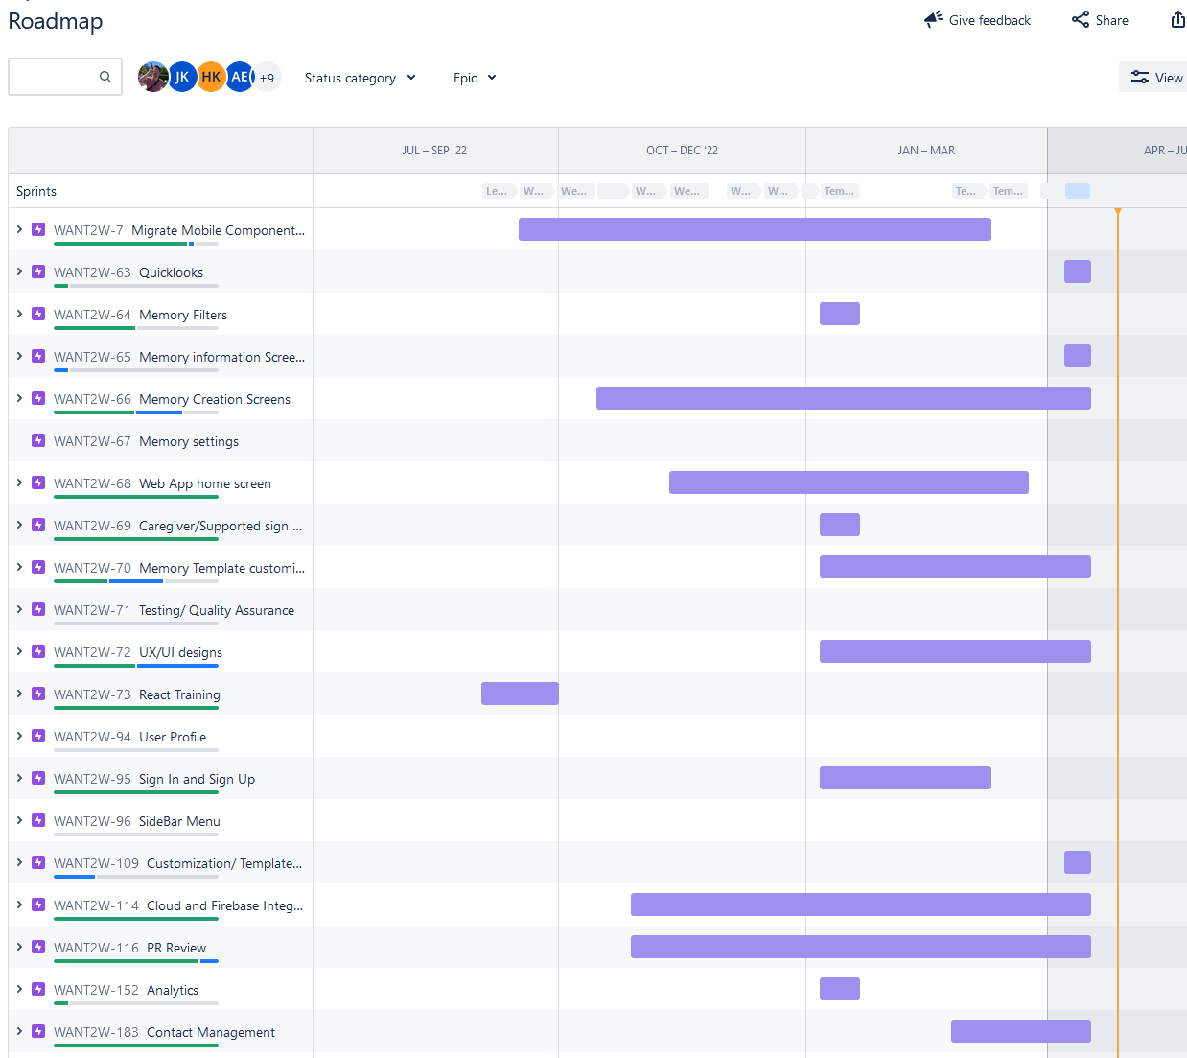
Task Overview (3 of 3)
Work Overview
React Training
48 hours per student
Sprints
Number of sprints & retrospectives: 18
Coding
Code reviews: 237
Total hours programming: ~3,600
Total paired programming tasks: 120
In Progress Reviews
54

Slide 14
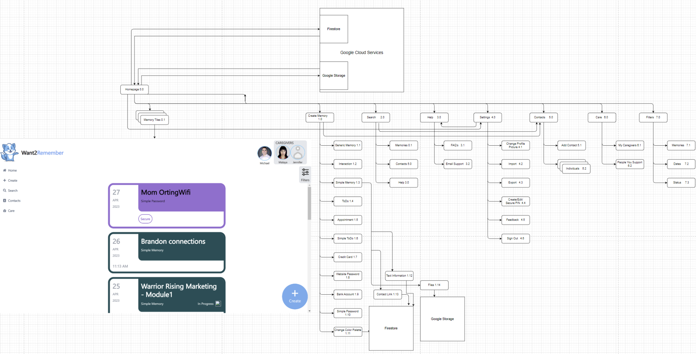
Application Map
(1 of 3)

Slide 15
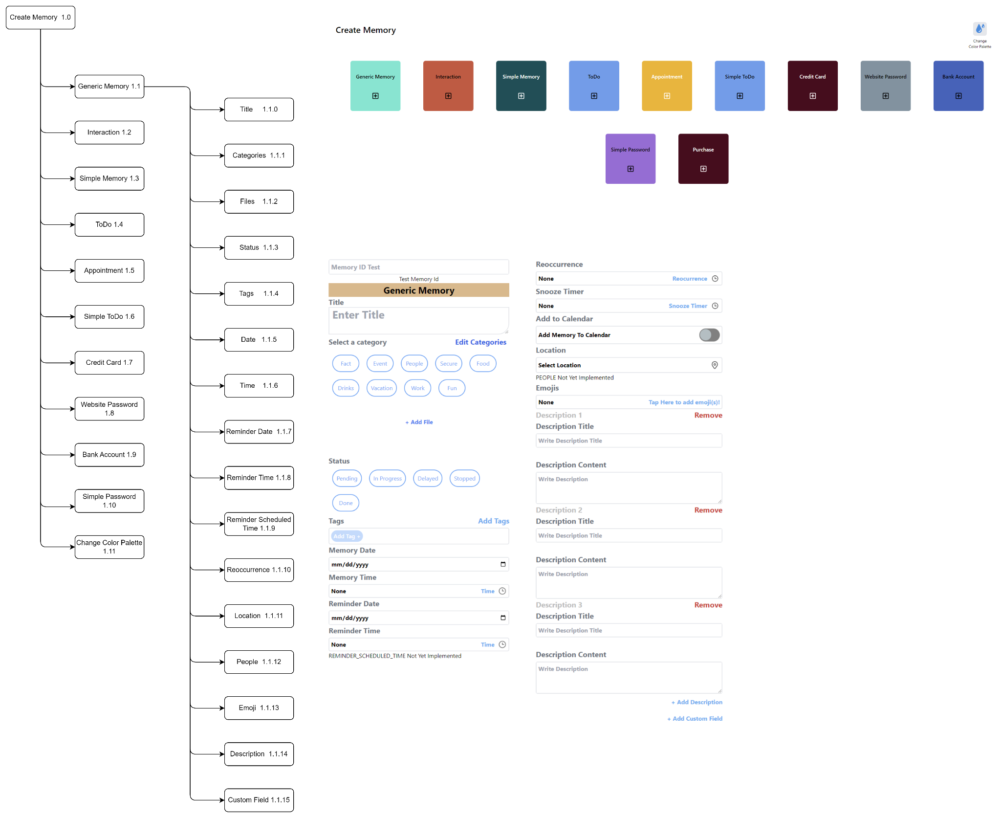
Application Map
(2 of 3)

Slide 16
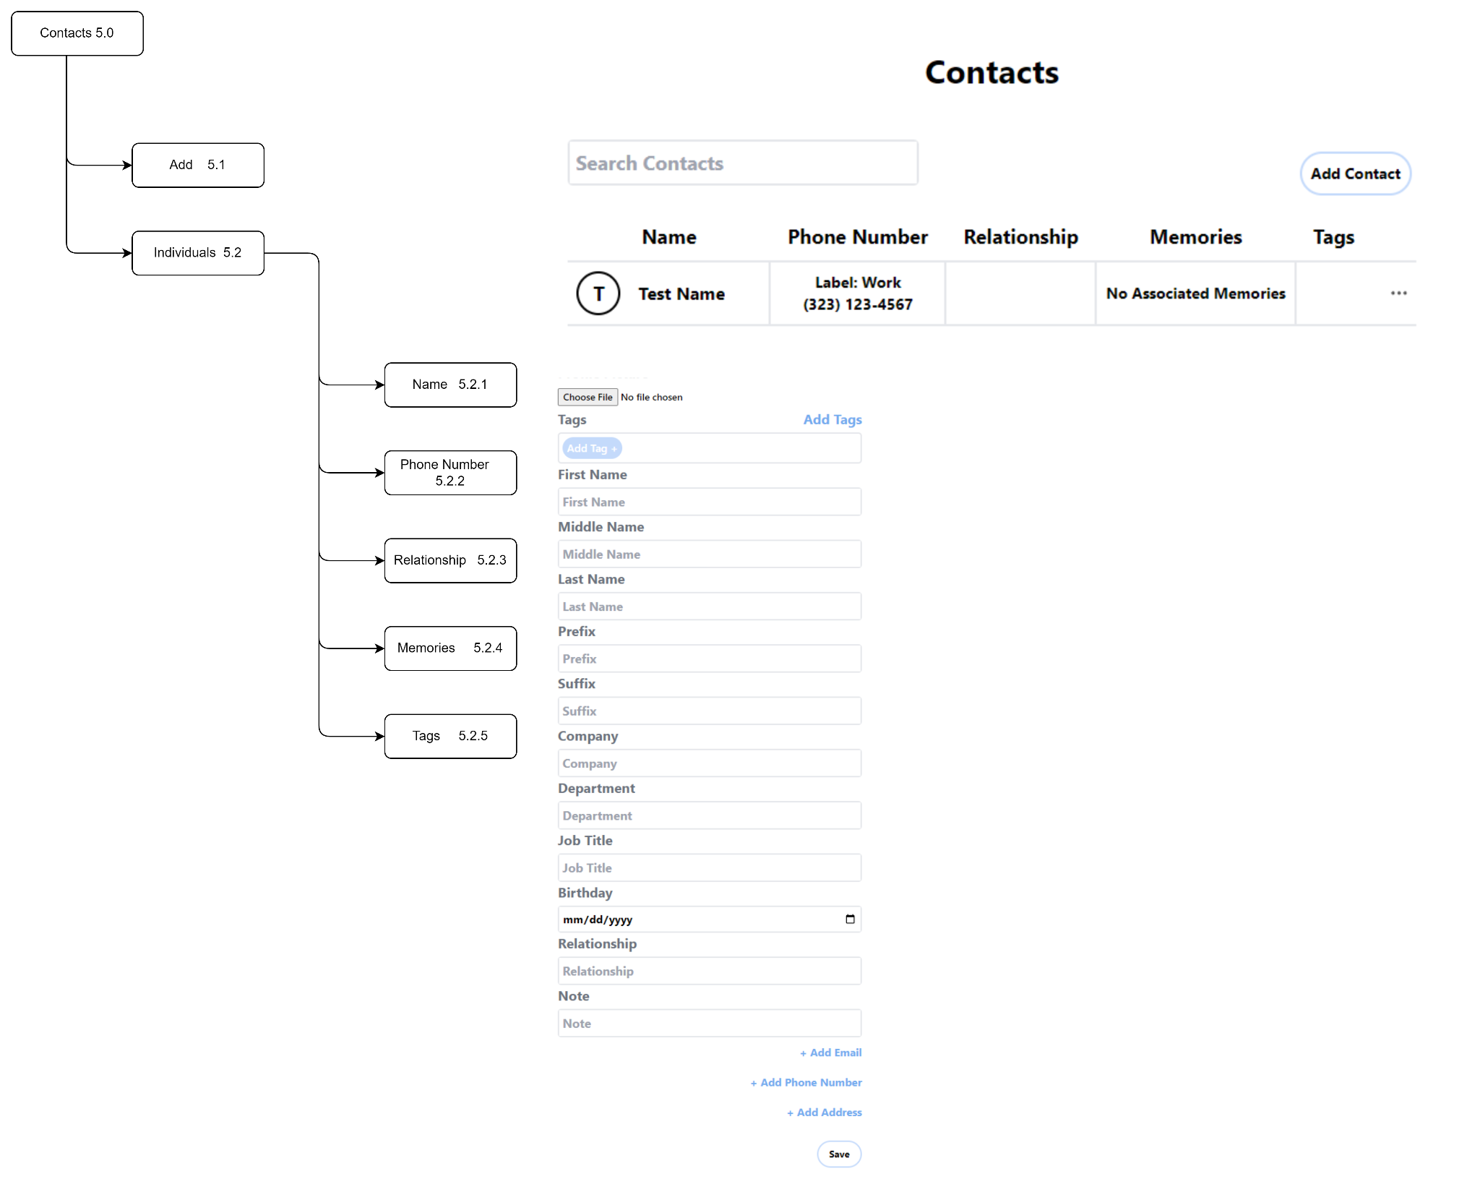
Application Map
(3 of 3)

Slide 17
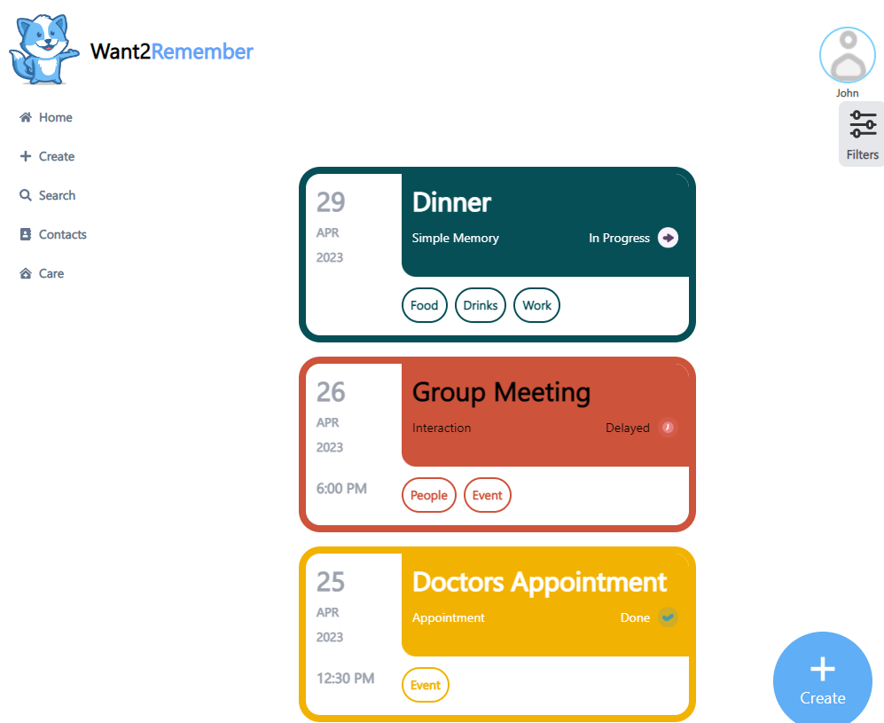
Application Screens (1 of 4)
Home Screen
Features/Functionalities
Brief overview of all existing memories
Filter memory categories
Navigation to other sub screens
Sub screens
Details
Help, Settings, Filters
Create, Search, Contacts, Care

Slide 18
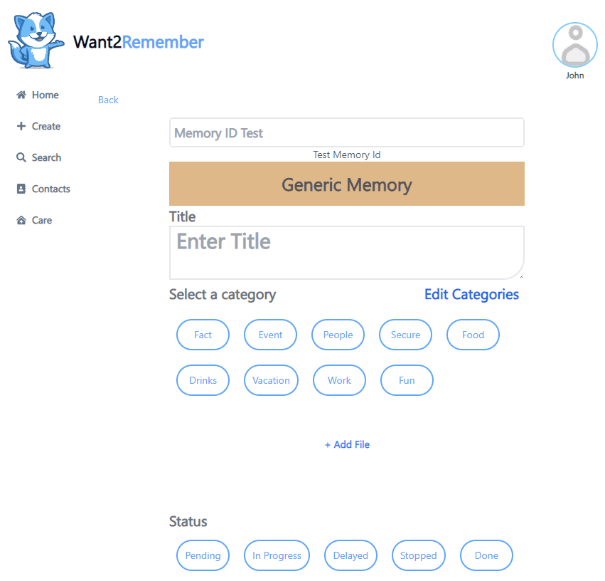
Application Screens (2 of 4)
Create Screen
Used both for editing memories and creating them
Layout unique for each different premade memory template
Capable of keeping track of
Title
Categories
Files
Status
Tags
Date and Time
Location
Reminder Time
Recurring Event
Description
Emoji
Notes:
The create screen is used for both creating and editing memories. The layout of the screen’s contents differ depending on the type of memory template that was selected. It is able to keep track of a variety of things entered by the user such as the given title; any categories that the memory belongs too; files; status of the memory such as pending, in progress, done; tags which are similar to hashtags where you can use them later to help find a group of memories; and date and time of when the memory was made as well as the date and time the user gives the memory like for example, if the user needed to remember an upcoming birthday and wrote it down in the app, the day and time of when they entered the birthday will be saved along with the actual birthday date. One other notable thing that can be saved is an emoji which can be used to associate a feeling or emotion to the memory. How often a memory should reoccur can also be saved which is especially useful if the memory is related to an event or a daily task like taking medications. Most memory templates have their own custom fields as well like the credit card template has some fields to enter in your credit/debit card information and the ToDo template lets you add in multiple tasks that you need to do along with a date for each task. Some of the more complicated fields that require the user to do more than just enter text have a sub screen that can pop out. For example, when entering a date, a calendar will pop up for selecting the date and for time, a clock will pop up.

Slide 19
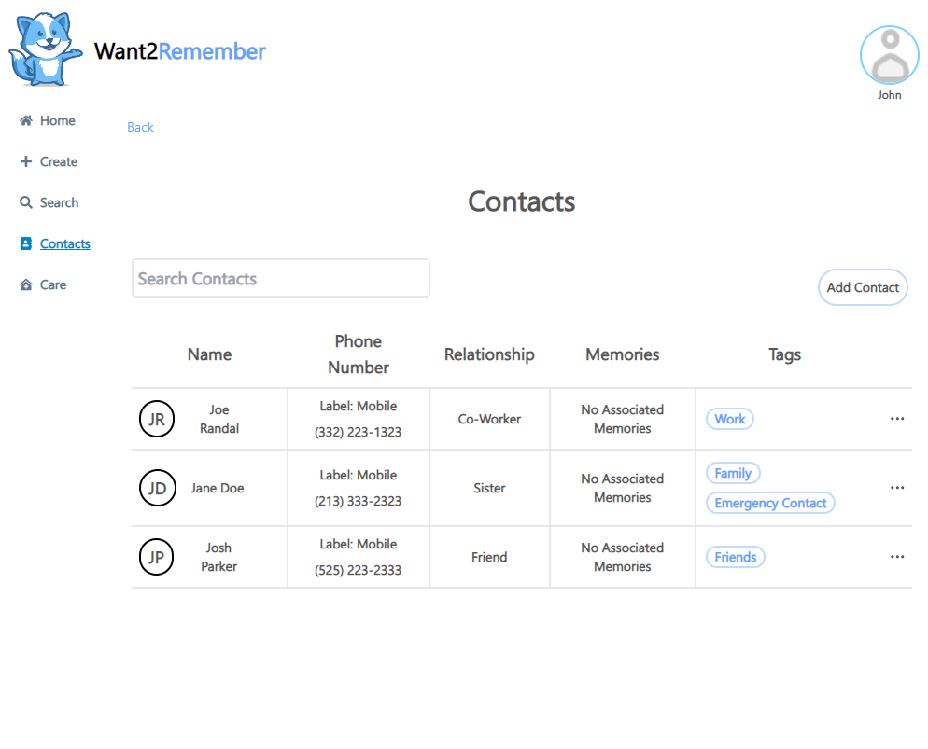
Application Screens (3 of 4)
Contacts Screen
Create and edit existing contacts to the application
Shows the following contact information:
Contact Photo
First name, Last name, and Company
Phone Number
Email
Address
Dates
Displays memories associated with the Contact

Slide 20
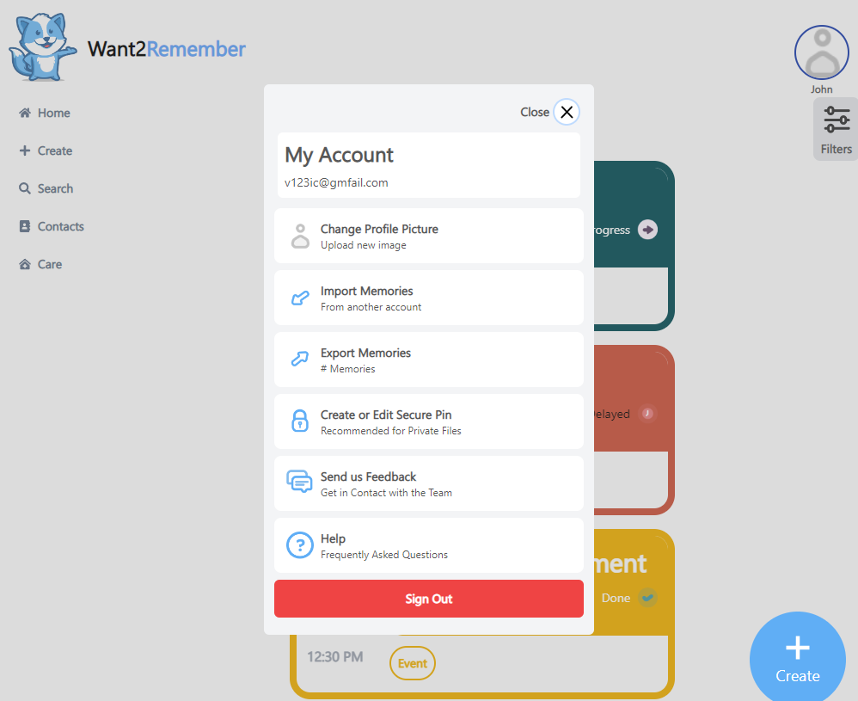
Application Screens (4 of 4)
Settings Screen
Changing Profile Picture
Importing Memories
Exporting Memories
Creating a Secure Pin
Feedback
Help Screen

Slide 21
Spring 2023 Update
Full Cloud Support for User Data
Screen Reordering
Refactoring & Bug Fixes

Slide 22
Refactoring & Bug Fixes
Over 100 Total Bug Fixes & 50 Code Tasks completed
Adding multi-line to input field to help users track their input easily
Fixed a sign in bug where there was a problem when users signed out and logged back in

Slide 23
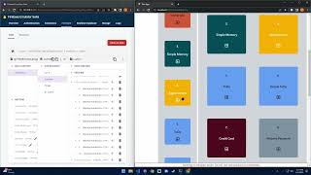
Video Demo

Slide 24
Future Goals
Customization
Change the font, color palette, categories, and custom templates all in one customization screen.
Caregiver support
Save to contacts, gps tracking, automatic role assignments.
Medication Tracker template
Medicine administration reminder and image proof prompt.
Proximity Support
Bluetooth for knowing if a connections/memories are nearby.
Smart Reminders
Use machine learning/AI to support user reminder.
Machine Learning/AI Implementation
Develop real time interactivity with the app.

Slide 25
Conclusion
Purpose:
Improve daily lives of those with cognitive impairments
What We Accomplished In Total
Migrated Mobile Components to Web App Components
Installed Google Analytics into Website
Allow Users to Import/Export User Data
Added Caregiver Support
Customize Memory Colors
Filter Memory Categories
Cloud and Firebase Integration
Sorting and Filter functionality
User Sign In and Sign Up
Contact Management

Slide 26
Demo Link
https://want2remembercloud.web.app/

