Slide 1
BOE Sidewalk Assessment System

Slide 2
Team Members and Roles:
Team Members:
Amy Torres
Bryan Nguyen
Christopher Chau
Gerardo Bracamontes
Jorge Sanchez
Joshua Chang
Ricardo Miranda
Robert Cueto
Salvador Gomez
Zach Justus
Advisor: Jungsoo Lim, Ph. D.
Liaison(s): Irvin Nguyen, Jonathan De Leon, Alisa Blake, Chris Tsangaris, Miguel Grajeda, and Ted Allen

Slide 3
Team Roles:
Project Lead: Joshua Chang
Customer Liaison/ Requirements Lead: Zach Justus
Architecture/Design Lead: Ricardo Miranda
Component Lead: Robert Cueto
QA/QC Lead: Amy Torres
Demo/Presentation Lead: Salvador Gomez
Documentation Lead: Bryan Nguyen

Slide 4
Project Overview
The Bureau of Engineering (BOE) Sidewalk assessment system is a multi-year ongoing senior design project to develop a rover that will assess a sidewalk to inspect for any damage needing repair
We are teaming up with the City of Los Angeles’ BOE, sharing our designs, plans, and regularly meeting
Our current rover base was manufactured by Ubiquity Robotics
This semester, the team was split into 4 separate tasks focusing on different deliverables
Courtesy of Ubiquity Robotics
Notes:
Over 10,000 miles of sidewalk Pass to amy

Slide 5
Task 1: Sidewalk Verification / Rover Calibration
Team Members:
Gerardo Bracamontes
Amy Torres

Slide 6
Task 1: Measurement Verification
Survey data of a select few sidewalks
Using rover and survey team
Testing and Calibration of the rover
Using makeshift ramp
Comparison of slope data gathered from the rover and survey data gathered from survey team

Slide 7
Task 1: Problems Encountered and Solutions
Survey data was gathered through ELAC Civil Engineering Team.
Dr. Humberto Gallegos, ELAC Faculty
Along with his two Geospatial Engineers:
Juan Rodas
Brandon Roiz
Level experienced some vibrational interference
Of little to no consequence
Notes:
(can you add the results of the survey)

Slide 8
Task 1: Sidewalks and ADA Compliance
Measure slope degree with a margin of error of 0.5-1 degrees.
Sidewalk slopes must be less than 1:20 (20 units horizontal by 1 vertical unit).
Ramps must be less than 1:12 (12 horizontal units by 1 vertical unit).
Measure vertical changes of at least ¼ inches over any joint or crack.
The rover was able to correctly gauge and collect data from the electronic level–accurate to 0.5 degrees. Meaning we are able to gauge ADA compliance

Slide 9
Task 1: Future Goal
Ensure the accuracy of bed-mounted level to account for changes in the rover itself
Currently, cannot automate this process
Idea for future teams:
Measure the slope of the floor beneath the rover
Measure the slope from the bed itself
Account for the difference between the two when polling measurements

Slide 10
Task 2: Updating Movement Software
Team Members:
Bryan Nguyen
Ricardo Miranda
Amy Torres
Notes:
Pass it off to Ricardo

Slide 11
Task 2: Summary
BoE provided a new rover platform for this year’s project.
We held a couple of meetings discussing whether to use the old or the new platform
Port the previous platform’s software to the new rover
Modify data collection code to work with new sensors
Update controller website UI and functions
Notes:
From point 2 to 3: Both were built in ROS and ubiquity training

Slide 12
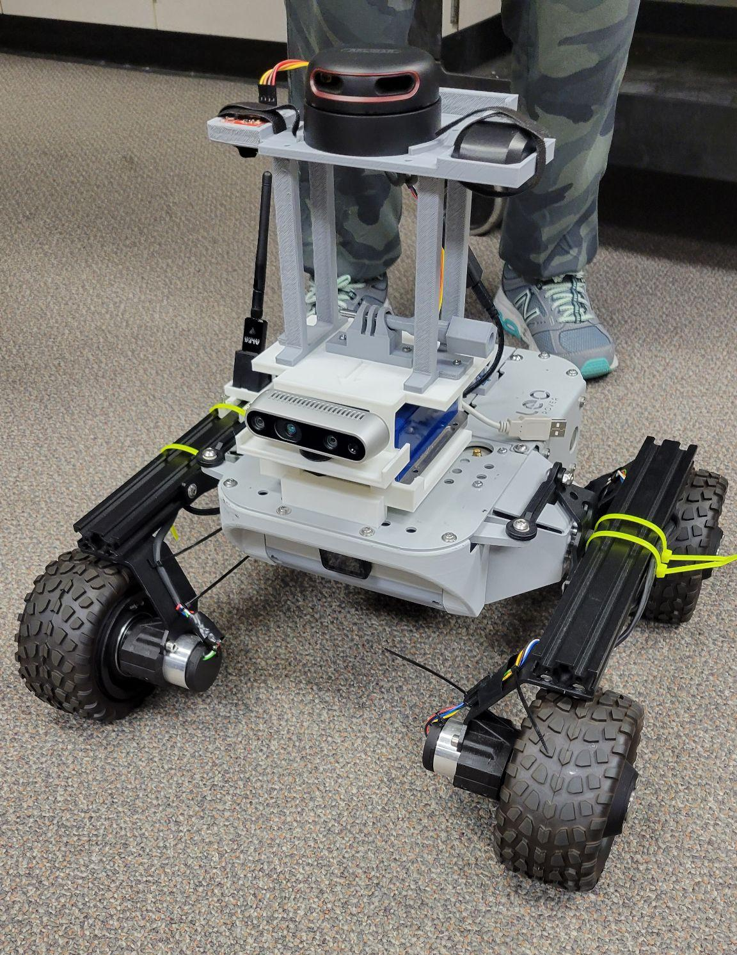
Task 2: Why Make the Change?
The Leo Rover was the previous platform
Leo had many design constraints for our purpose
Magni Silver by Ubiquity replaced the Leo Rover
Notes:
We bought a new robot
The old software was never finished

Slide 13
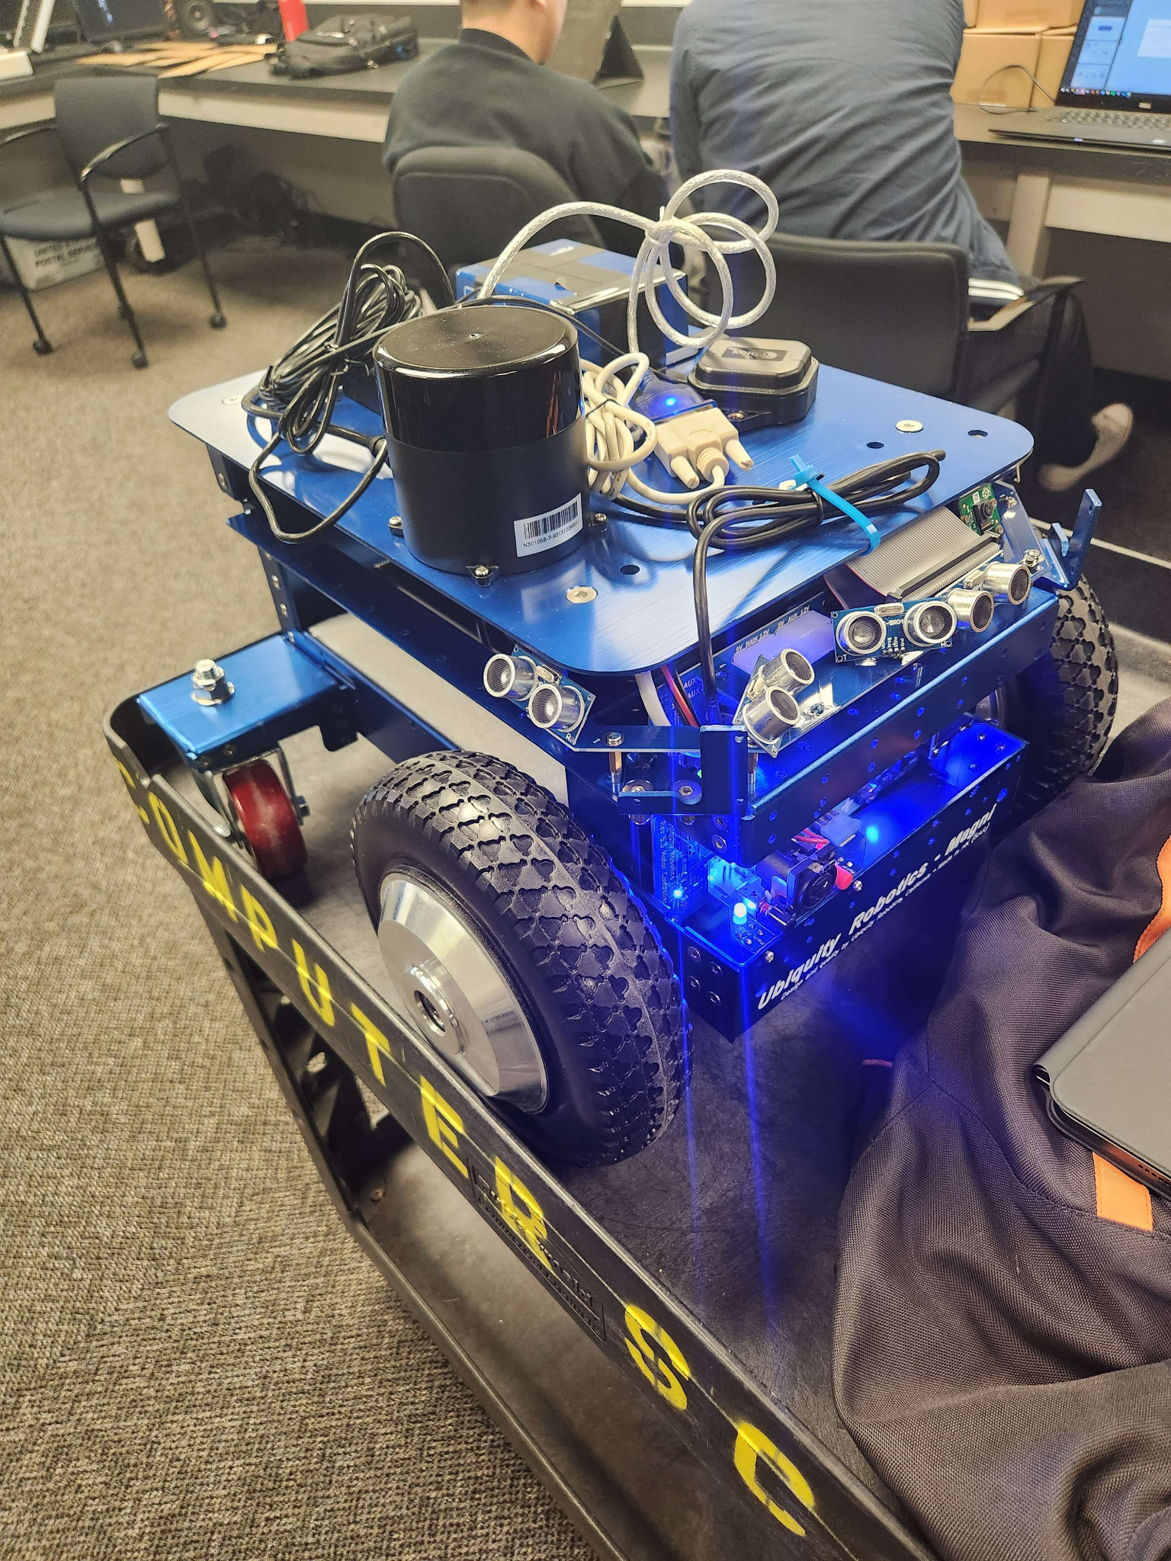
Task 2: The Benefits of the Magni Silver
Better suited towards our needs for sidewalk assessment
Higher weight capacity
Larger area for components
Larger interior space
Solid wheels
Notes:
Transition to Bryan

Slide 14
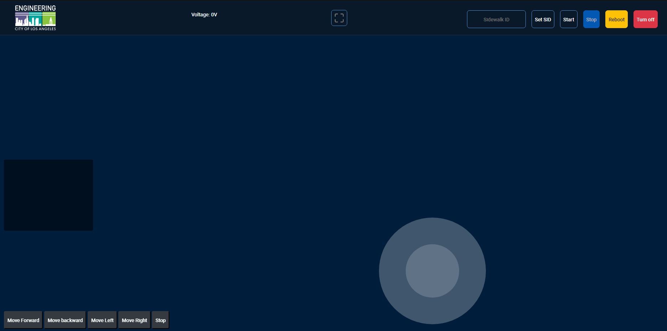
Task 2: Old Controller UI

Slide 15
Task 2: New Controller UI
Notes:
Pass it on to Roberto

Slide 16
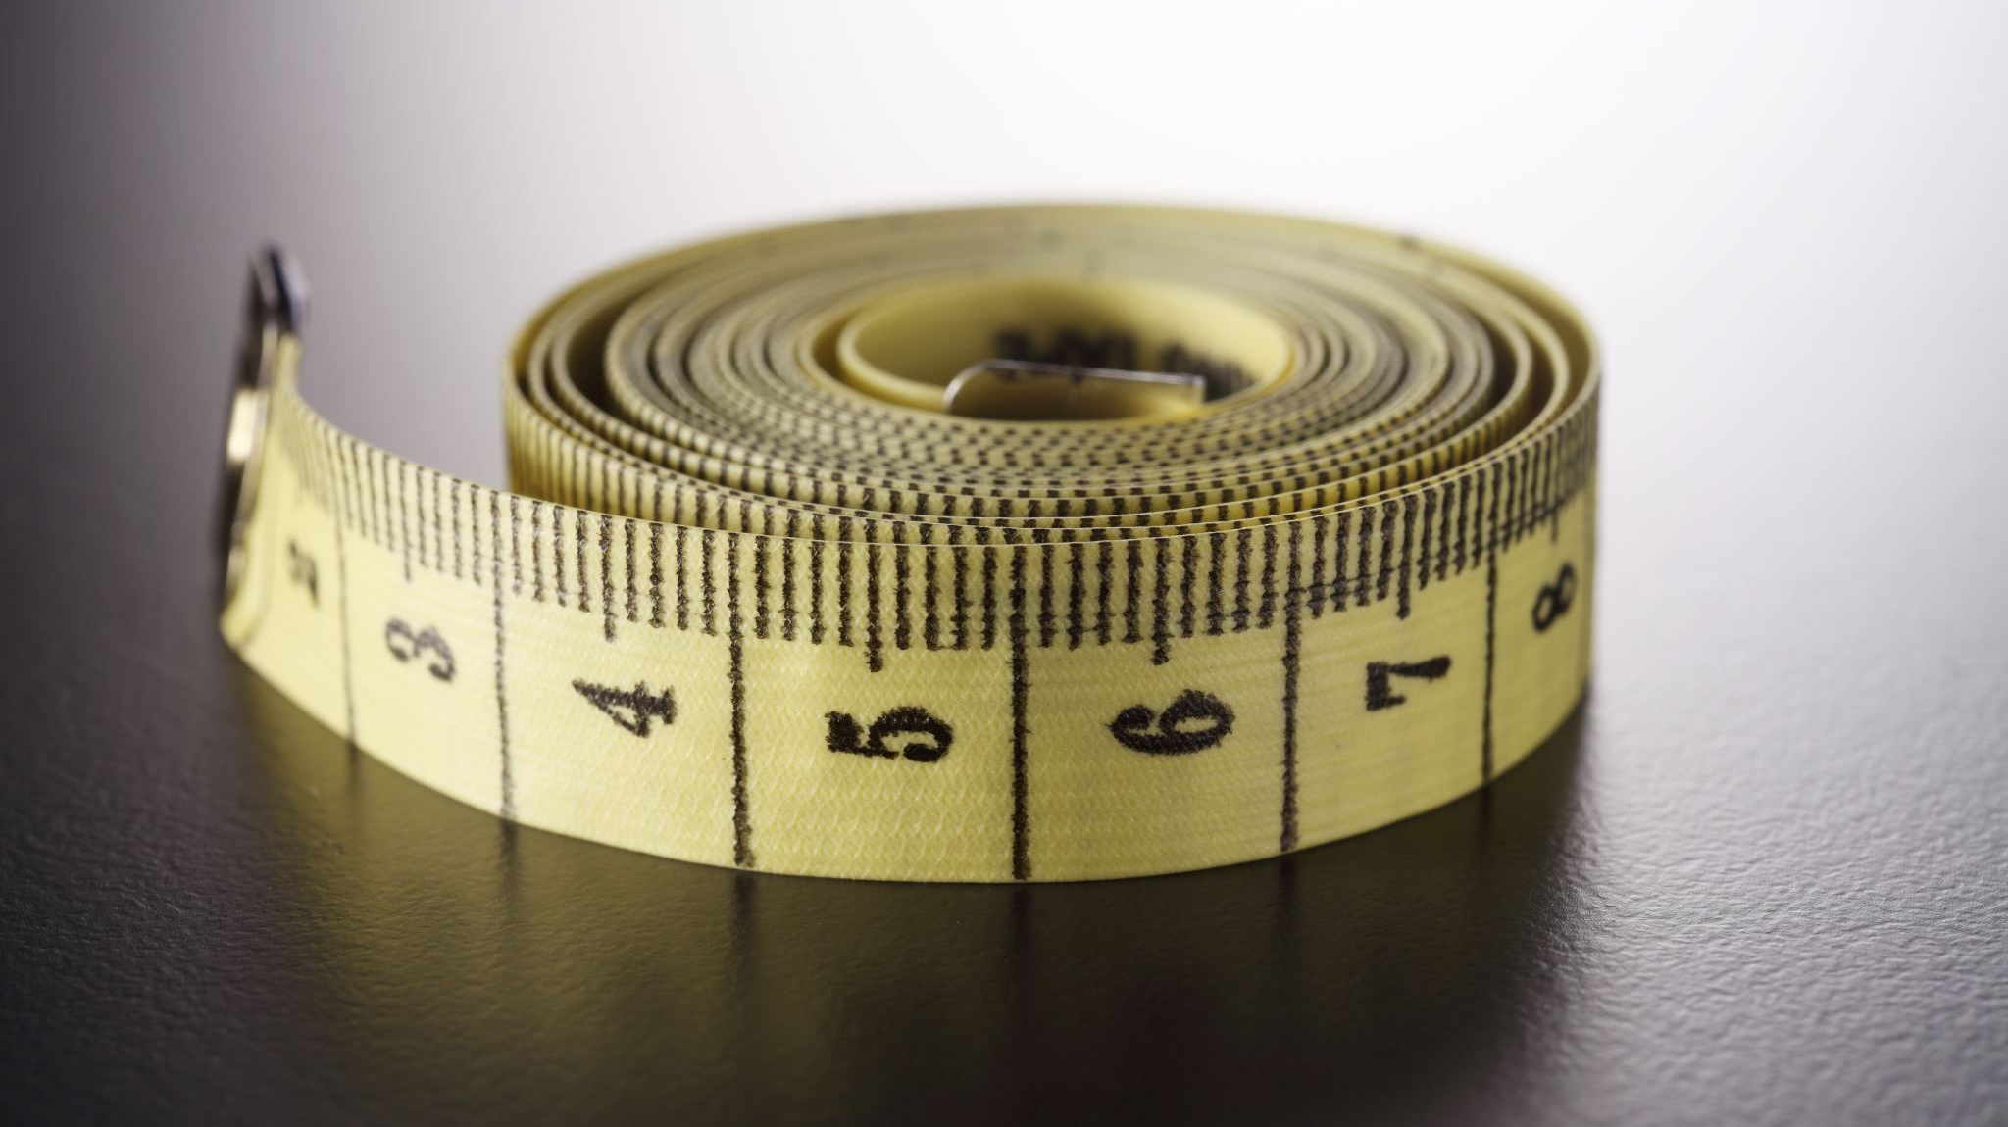
Task 3: Horizontal & Vertical Displacement Measurement
Team Members:
Amy Torres
Christopher Chau
Gerardo Bracamontes
Joshua Chang
Robert Cueto

Slide 17
Task 3: Task Description and Requirements
Task Description:
Develop a method to measure vertical and horizontal displacement (cracks) on sidewalk
Main Requirements:
Must detect changes within 6.35mm (¼ inch) for ADA compliance
Record and store measurements in a file
Design must accommodate for rover platform and other modules

Slide 18
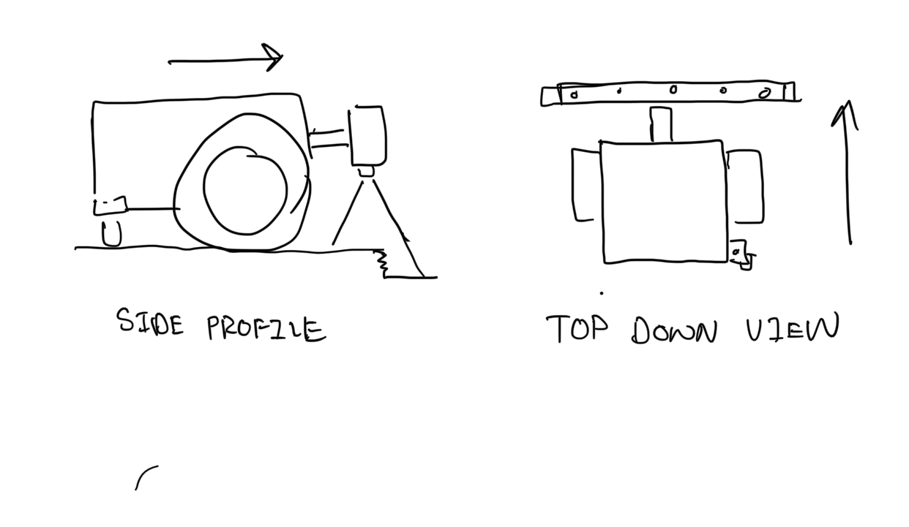
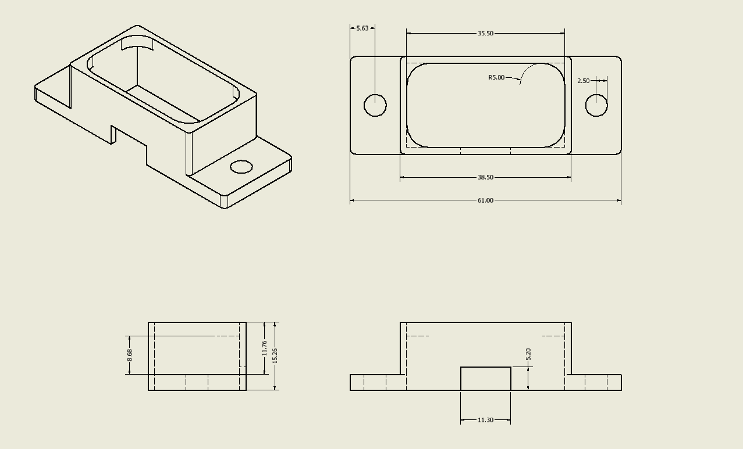
Task 3: Design/Approach
Lidar Bar Design Draft
Our approach was to have the lidars mounted in front of the rover
The lidars would be mounted to a bar one after another with a little bit of gap to capture a section of sidewalk
3-D printed lidars holders to mount from the T Bar
Our design will scan for horizontal and vertical cracks to detect cracks that go across the sidewalk.
Lidar Mount Design

Slide 19
Task 3: Code/Environment and Considerations
Goal: Read and collect data from Lidars
We ran into a few roadblocks that we had to consider:
Hardware Limitations
Rover runs off a Raspberry Pi
Software Limitations
Python 2.7 vs Python 3.7
The software cycle through all the lidars being used
Developed a class with methods that would store data accurately into a CSV file
Notes:
Code/Environment and Considerations

Slide 20
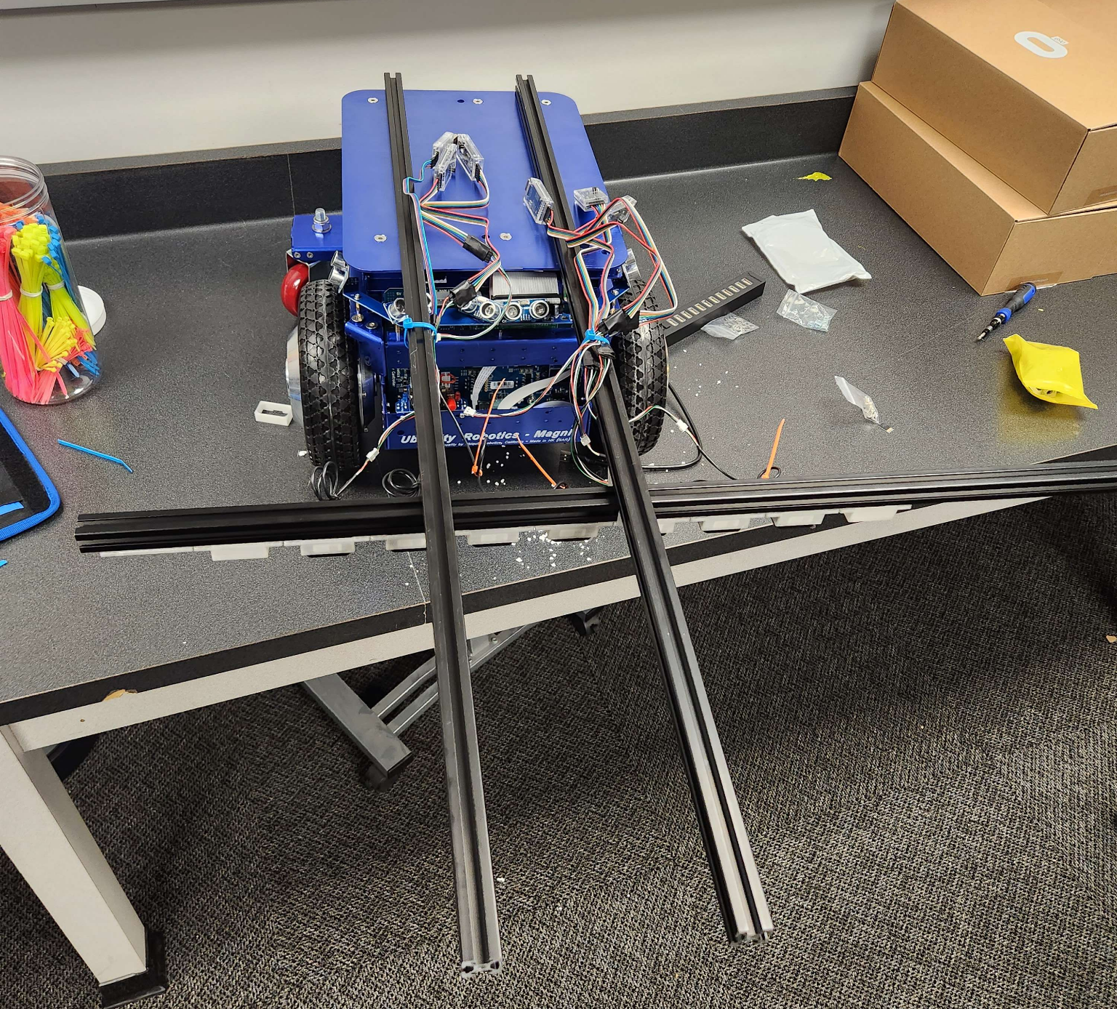
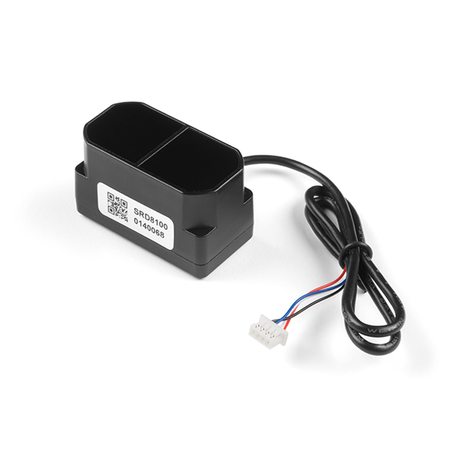
Task 3: Results
We built the rover based off the draft
Lidars attached to two bars for stability
Lidars are all connected to a multi-usb hub
Lidars
Our lidars have an accuracy of 0.1 to 0.5mm from close range
Model: TF Mini Plus
The rover can collect data and export it into a CSV file

Slide 21
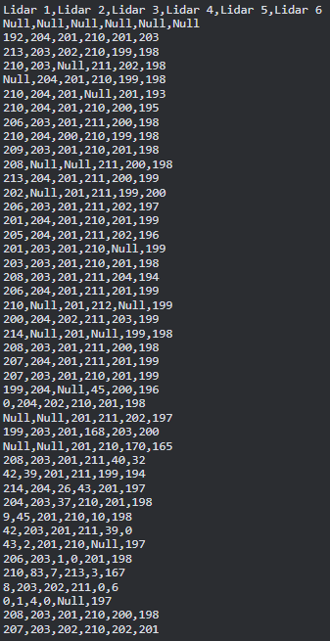
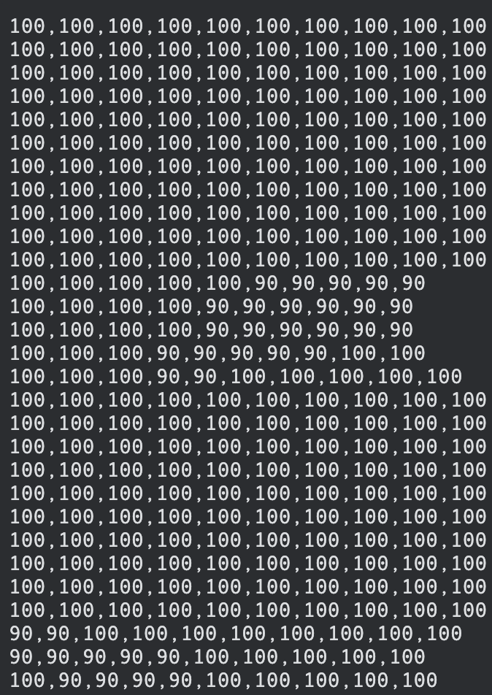
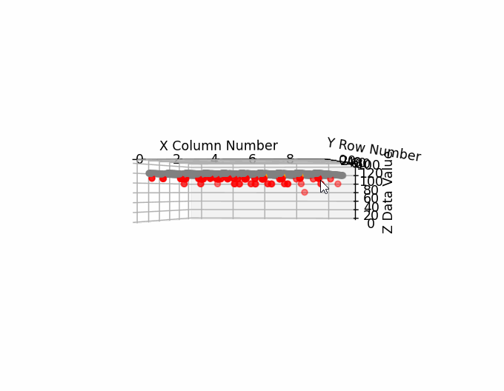
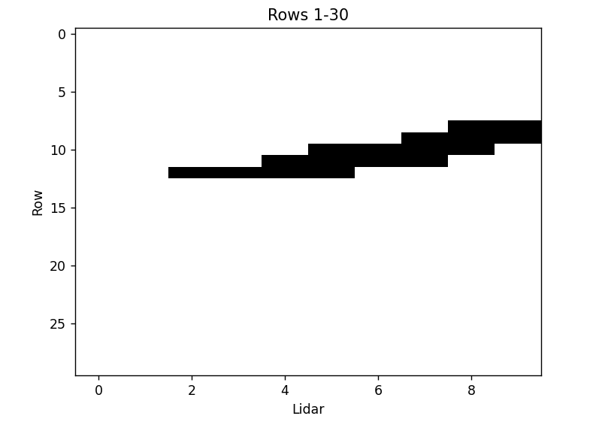
Task 3: Graphing
Real Lidar Data
Generated Data
Here are the example results from the lidars
The results are collected by the rover, then saved onto a csv file
Data is available in 2-D and 3-D graphs
Uses pandas and matplotlib
The graph shows how the crack is formed from the sidewalk from the top down
The 3D Graph would show a series of slabs and different cracks
3D Graph Example
Generated Data Graph

Slide 22
Task 4: Hillside Prioritization Application
Team Members:
Jorge Sanchez
Salvador Gomez
Zach Justus

Slide 23
Task 4: Task Overview
Tasks:
Create Dynamic Analytics API Server
Create graphs and charts using D3
Create interactive street view with Leaflet

Slide 24
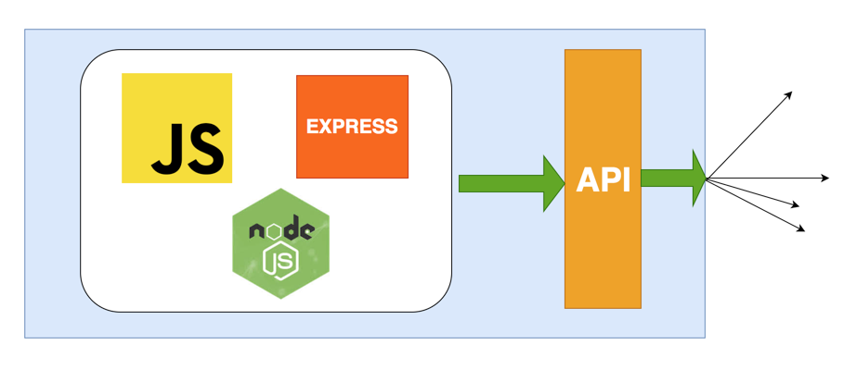
Task 4: Dynamic Analytics API
Must be Modular and Extendable
Must be Scalable to large data workloads
Must be User friendly and easy to work with

Slide 25
Task 4: Graphs and Charts
Data-driven documents (D3)
Graphs drawn with SVG
D3 SVG Graphs
Notes:
Transition to Salvador

Slide 26
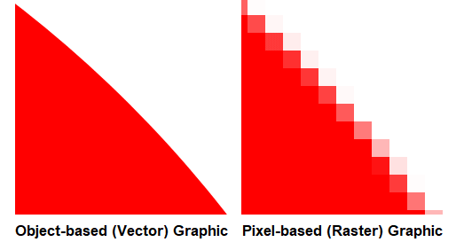
Task 4 - D3 SVG Vs D3 Canvas
SVG
Better precision
Displays better graphs
Shape-based
Canvas
More efficient at rendering larger data sets
Better at updating data in real-time
Pixel-based

Slide 27
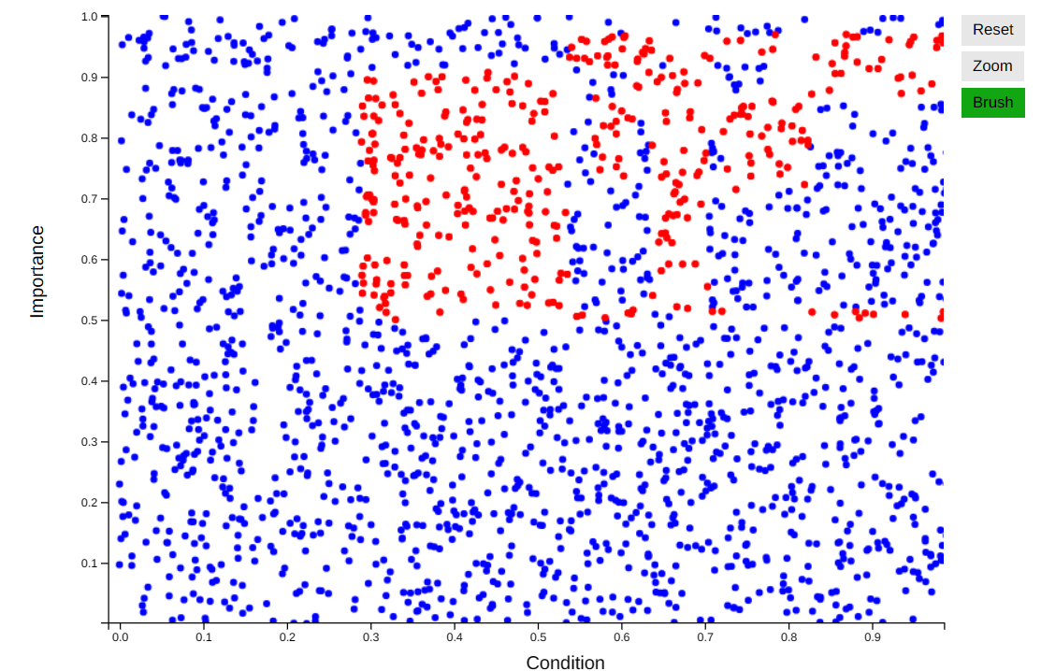
Task 4 - Scatterplot Functionality
Zoom
Brush
Reset
Selected data affects other components of the website
Drawn in SVG Canvas

Slide 28
Task 4: Leaflet Streetview Map
Leaflet provides an overhead street view
The user will select a location that will be showcased in first person view by the Mapillary map.
Can use markers to highlight points of interest
Has similar features to Google Maps

Slide 29
Task 4 - Frontend Development Technologies:
React.JS
React-Leaflet-Bootstrap
Leaflet.JS
Mapillary.JS

Slide 30
Extensions and Considerations
Field Testing
Working concurrently with all modules
Stress testing for the battery life and continuous usage
Collected Lidar data post processing and cleanup
Remove noise and/or debris
Implementation of Nexar API or any applicable geographical/map API

