Slide 1
Dilution of Precision Automation (DOPA)
Sponsor: The Aerospace Corporation
CSULA - Spring Semester 2023

Slide 2
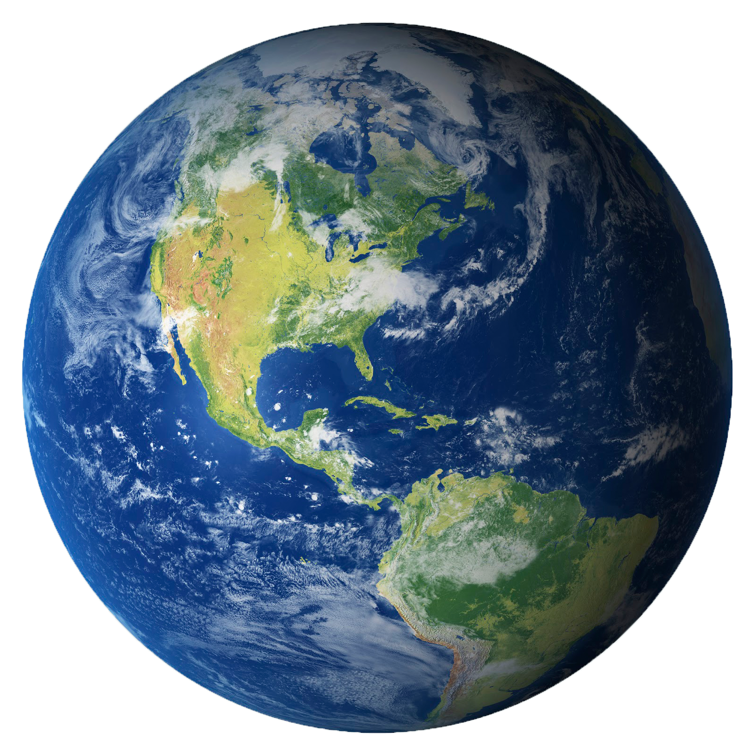
Agenda
1
Introduction
2
DOPA Integration
3
Conclusion
Ramirez

Slide 3
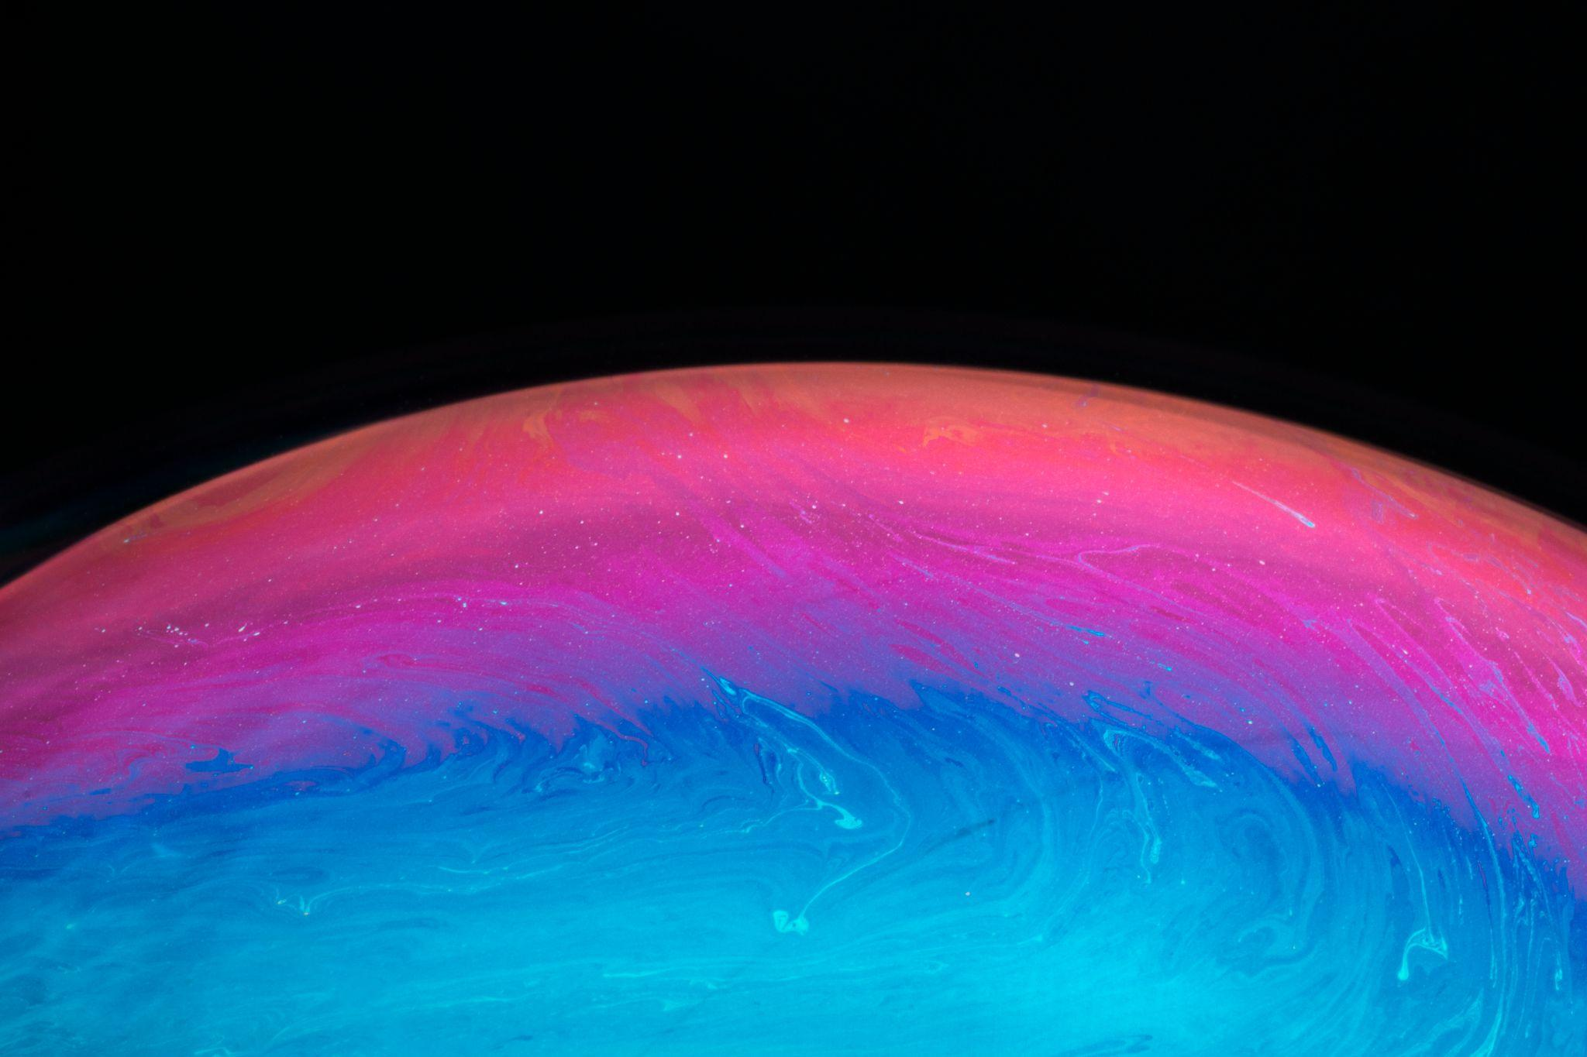
01
Introduction
Notes:
Introduce better,clear,why WOW factor

Slide 4
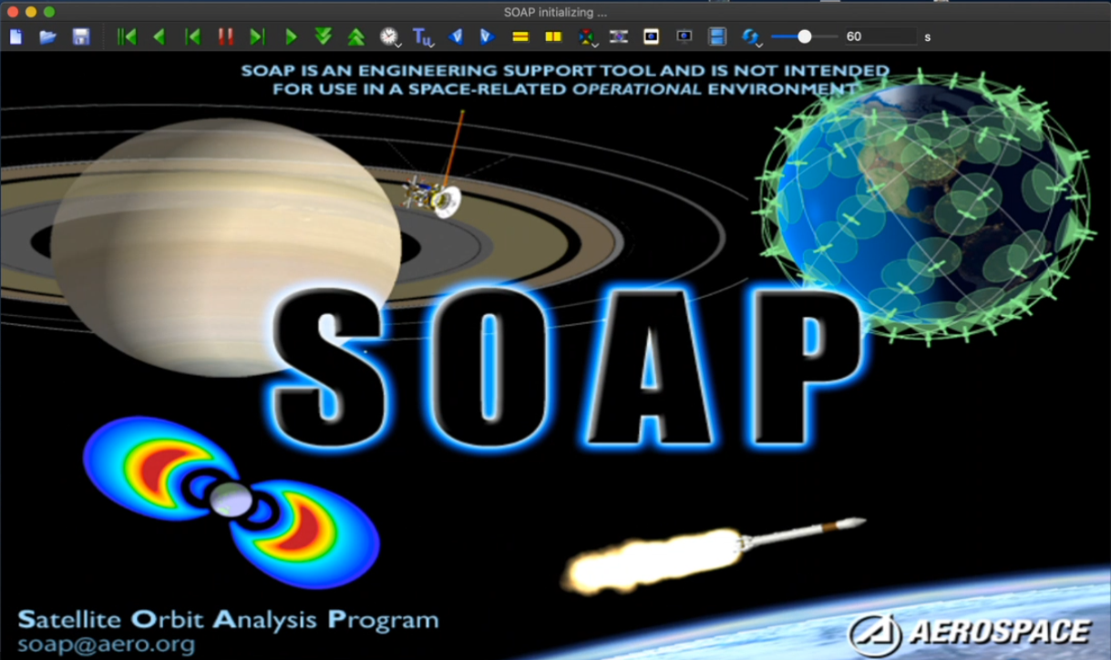
Do you need longer text?
What is SOAP
Satellite Orbit Analysis Program (SOAP)
Graphical user interface (GUI) developed by Aerospace since 1980
Used heavily within Aerospace to manually build and analyze satellite scenarios
Capable of performing more than 150 different analysis types
We will leverage SOAP to do the heavy lifting calculations
Gonzales
Notes:
notes:
soap is “Satellite Orbit Analysis Program” an interactive three-dimensional orbit visualization and analysis software made by aerospace (manually build satellite scenarios)
*capable of simulating and predicting relative motion with satellites, groundstations, vehicles, aircrafts, and other objects that propagate around earth
capable of producing up to 150+ different analysis types
two ways to use SOAP (the GUI way & automated way)

Slide 5
Do you need longer text?
SOAP Demonstration
Notes:
2min video of SOAP running a demo orb file and visualizing PDOP
includes objects - satellites
4 view senarios - all showing the same thing (2 being a data table)
middle one showing pdop color scale, the colors in relation to the analysis data output 0 being green and precise, to high numbers being red and not precise
LAAFB (los angeles air force base) sensor
pdop analysis
color scale view grid contour
DESCRIBE WHAT IS GOIN ON

Slide 6
Frequently Used Terms
Dilution of Precision (DOP)
A measure of the quality of a Global Positioning System (GPS) signal.
Two-Line Elements (TLE)
A TLE is a data format encoding a list of orbital elements of an Earth-orbiting object for a given point in time
Epoch
A moment in time used as a reference point
Gonzales
Notes:
Spell out first time

Slide 7
Do you need longer text?
What is Docker?
An essential tool and industry standard used in large companies
A platform used to develop and run applications in containers which are lightweight and portable environments
Docker containers packages code and dependencies making them manageable and deployable between systems
Used to containerize our code and applications
Leung
Notes:
**Industry Standard**

Slide 8
Do you need longer text?
Background
Aerospace and many of their stakeholders want to monitor the DOP of satellite constellations
An internal Aerospace project has the capability for some these performance metrics, but the analysis has to be manually generated
Time consuming
Tedious
This project aims to leverage container technology to automate the DOP analysis of a constellation.
Ramirez

Slide 9
Proposed Solution
Split into 4 sub-groups:
Data Gathering
Data Processing
Data Storing
Data Visualization
Once every team completes their task we can combine all the scripts into one working system
Ramirez

Slide 10
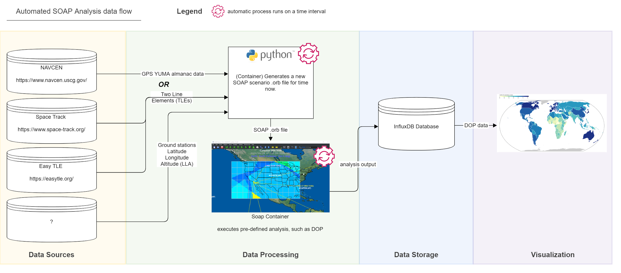
Data Pipeline

Slide 11
02
DOPA Integration

Slide 12
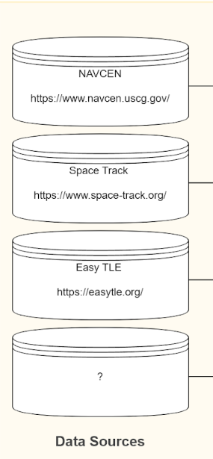
Backend Engineers
Tasked with getting TLE’s from Space-track.org
Leveraged python Requests library
With the python library and API calls we were able to access satellite data
Satellite data was processed and parsed only keeping the needed TLEs
30KB pre-processing
5KB post-processing
After the data was cleaned it was passed to the Data Formatting Team
Ramirez

Slide 13
Backend Engineers
Major Achievement
Noticed there were 5 other GPS constellations
Researched to find which satellites were part of each constellation
After finding the data needed we created a way to store each constellation set
Ramirez

Slide 14
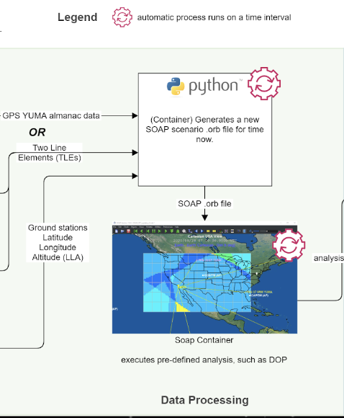
Data Engineers
Problem - How do we go from raw two-line element(TLE) data to DOP data and how do we use docker to containerize both this process and SOAP for automation?
Accomplished - a containerized python script to format TLE data into a .orb file then run .orb files in the SOAP container to output dop data.
Jarmin
Notes:
intro :
andrew jarmin
richard bailon
what we had to do as data engineers on this project
The main problem we are facing

Slide 15
Data Engineers
Main goal
SOAP Research
How to make functional .orb file
Produce the data that we’re looking for
Analysis output
Predefined objects and values in the orb file needed to produce the dop data
epoch, grid contours, color plots, sensor, satellite data, and more
.orb file -> a file format that runs through SOAP
Two-Line Element satellite data
DOP data (.dtt file)
Jarmin
Notes:
talk about the main goal / main objective as data engineers on this project -
figure out how to go from the raw TLE formatted data ( backend team ) to a fully functional .orb file
and then containerize this process (for automation)
the first steps we took was to do SOAP research, to basically go inside this program itself and to figure out what makes a functional .orb file and how to produce the data that we’re looking for (like we said earlier, soap has many analysis’s but we specifically want the DOP analysis.
after a some research we found a lot of important predefined objects within the .orb file that we took note of.
epoch - value of time
grid color plot - main analysis output
sensors -
color scale (for values)
satellite data -

Slide 16
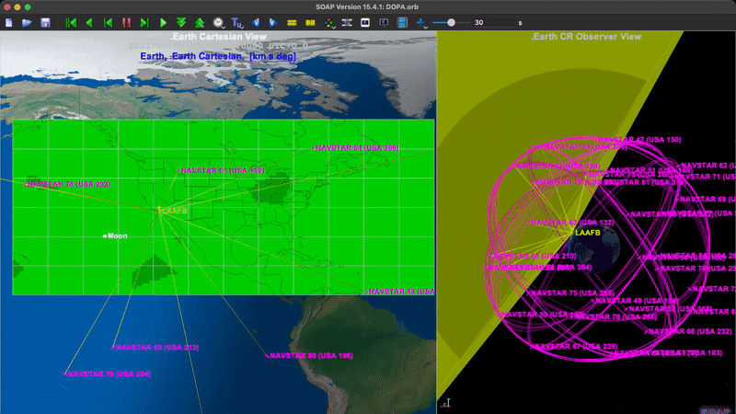
Legend:
NAVSTAR
LAAFB SENSOR
COLOR GRID
Jarmin
Notes:
on this screen you can see a
grid color plot , (Add legend)
a colors scale for the grid,
navstars (satellite data)
and a sensor (LAAFB),
analysis being used
as you can see the amount of satellites in view of the sensor reflect on the dop values on the grid
create legend
DO VIDEO INSTEAD
Here’s a demo of us using SOAP to visualize one of our .orb files that produces dop data. There are a couple of important objects to keep track of here, first the pink object propagating around earth (navstar), these navtars are satellites that we inputted from our TLE data. The next object is the yellow sensor, which is labeled LAAFB (los angeles air force base) this object acts as a gps sensor and when navstars are within view of this sensor it uses its analysis and produces the dop values across our grid. The color grid is the next important object in this scenario because when we export this grid contour we get our dop data values, as you can see on the right we have a color scale that matches the values of our dop, the higher value of dop will result in a red color, while the more precise our satellites are, the lower the dop value resulting in a light green color contour. now i also want you to keep in mind the amount of satellites currently in view of that sensor. there are currently about 30 satellites in this scenario, but lets say we have a sensor that only targets 10 satellites? *next slide*
navstar definition : The NAVSTAR Global Positioning System (GPS) is a constellation of 24 satellites developed, launched, and maintained by the United States Air Force that provides positioning, timing, and navigation signals free of charge to both military and civilian users worldwide.

Slide 17
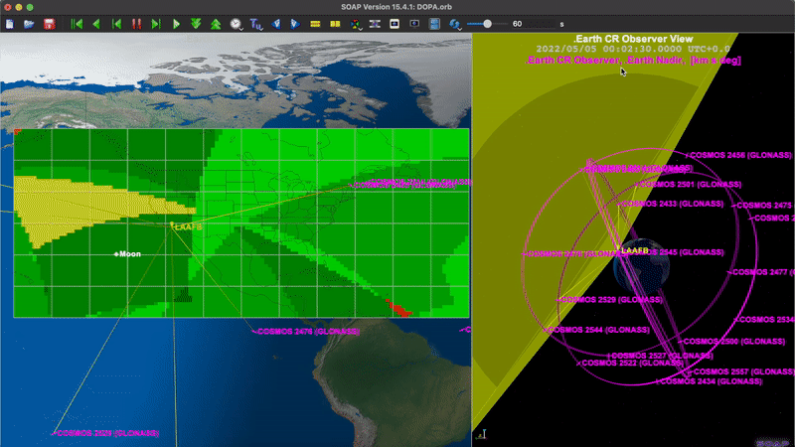
Legend:
COSMOS
LAAFB SENSOR
COLOR GRID
*note: the process of getting an analysis output file is very tedious in SOAP; it requires you to manually set up Analysis/Defined Objects/Satellite Data/etc.
Jarmin
Notes:
same analysis but different dop data, this is using a different constellation called COSMOS (RUSSIAN) this video means the amount of satellites in view of our sensor correlates to the dop values on the grid, as you can barely see the sensor is only targeting close to 3 satellites at a time resulting in very interesting contour analysis from SOAP.
i want you to note that the process…
it is too difficult to produce the values at an effective pace. which is why containerizing this process is very important
that being said we figured out these were the most important objects that were defined in the .orb files
so what we did next was to look at the specific orb files to figure out how to manipulate the data
*we then basically gutted very specific areas within the orb file and then created scripts to manipulate the data

Slide 18
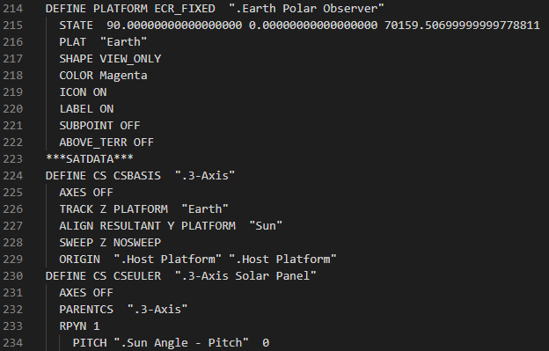
Data Engineers
Objective
Reverse Engineer the already complete orb file
Find out what data made the orb file unique
Found that there was a lot of redundant data
Solution
Engineered a template
Filling in only what is necessary
Bailon
Notes:
Talk about template by comparing it to madlib, word bank is the TLES from API team. (Put the TEMPLATE.orb)

Slide 19
Template Part 2
Bailon
Notes:
FIne Details (template within a template, template for object)
Where sat data actually gets plugged into to create object

Slide 20
Data Engineers
Final Result
Filled in with appropriate data
Satellite Number, Mean Anomaly, …
Settings in original file changed
echo2dtt
DTT Produced
Contains DOP values of specified area
DOP plotted using latitude and longitude
DOP may be better based on constellation
DTT is handed over to Database Engineers
Eccentricity
Bailon
Notes:
Mention How we went about creating the ORB files for the other constellations. Using a for loop to create new files with different names so they do not overwrite. N times

Slide 21
Data Engineers
TLE Data for 31
Satellites
Bailon
Notes:
example of tle data being pulled from the api calls
(Zoom in, call out)
the box highlights one satellite

Slide 22
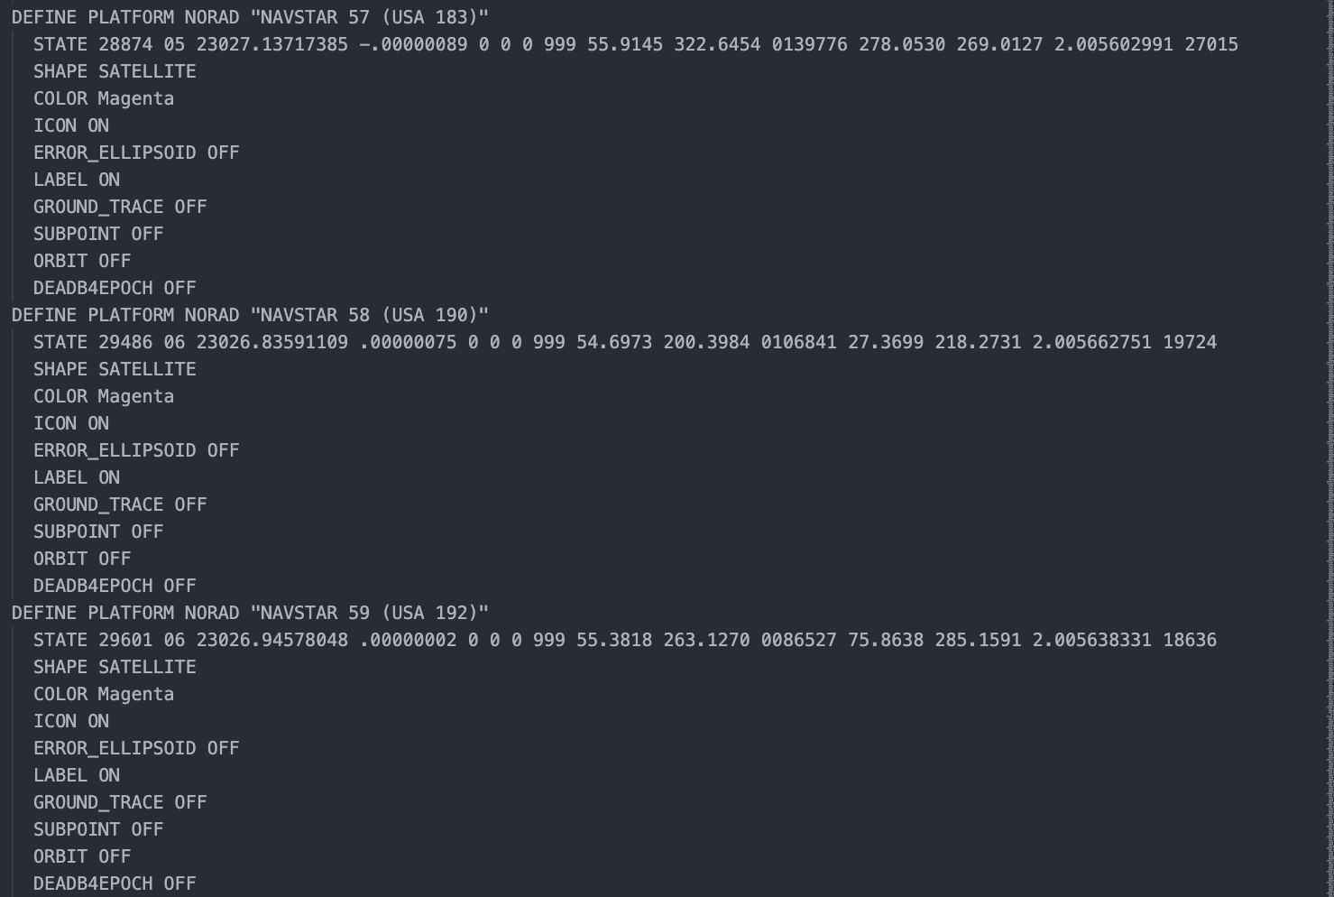
Data Engineers
a defined satellite object ->
.ORB file
Bailon
Notes:
example of what that transformation into the .orb files would look like…
going from TLE -> .orb file
How template looks after being filled in (chunks of data)
the box highlights one satellite after it has been formatted for SOAP to use

Slide 23
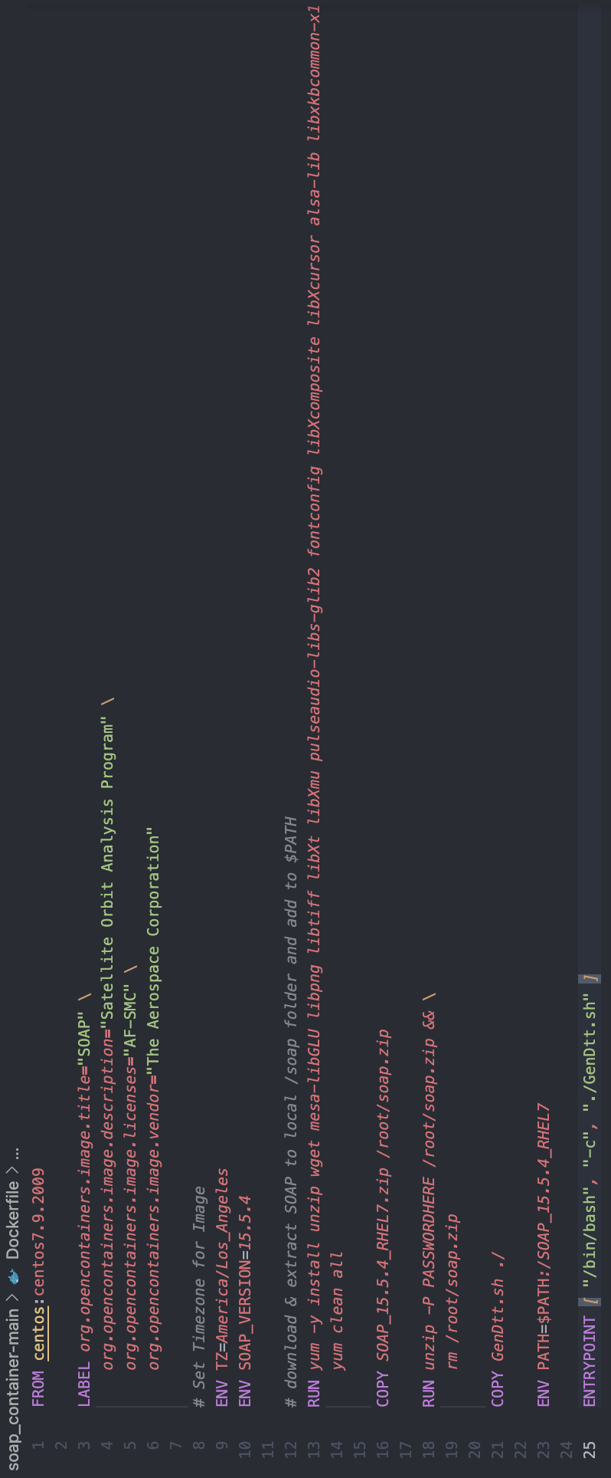
Data Engineers
Containerize the process
OrbGen Container -> Soap Container
Accomplished Deliverables :
working script to create orb file
containerized the process
containerized SOAP
Improved our skills in python, docker, github, and documentation.
Jarmin
Notes:
the last step we wanted to accomplish was to dockerize this whole process
*soap is a complex and confidential program, we needed to download the binaries of the application

Slide 24
Database Engineers
InfluxDB + Docker
A database platform that allows to store and manage large volumes of time series data
Most popular and best time series database available
Efficient, Fast, Easy to use
Write, Query, Process, and Visualize Data
Ginez
Notes:
Ginez

Slide 25
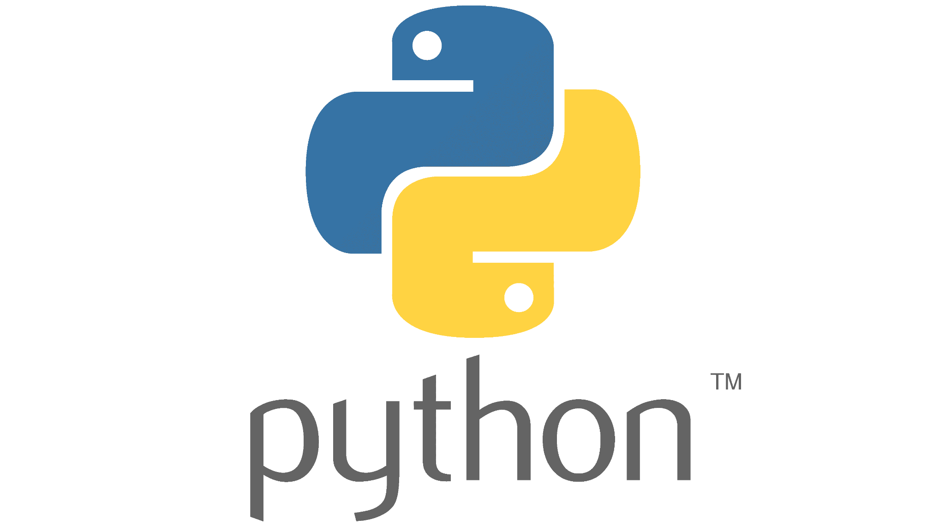
Database Engineers
Goal
Store data into a database
Approach
Format data into readable data for InfluxDB
Writing data by using Python scripts
Utilized InfluxDB User Interface to verify data storage
Ginez
Notes:
Ginez

Slide 26
Database Engineers
Difficulties
Correctly writing the epoch as a timestamp
Reading table of data into a database
Long execution time for importing data
Solutions
Learned how to manipulate the epoch into a timestamp
Transform table of dop values into lists of points
Optimized writes using batch writing
Leung
Notes:
Add solutions

Slide 27
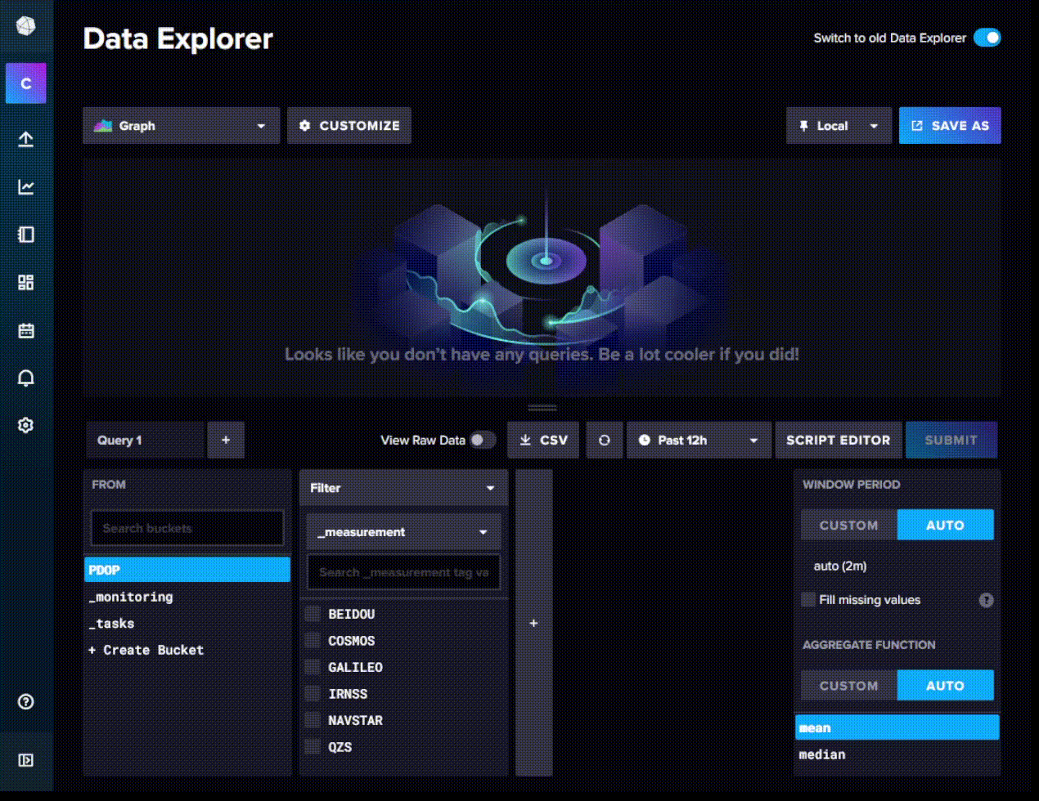
InfluxDB Demo
Leung
Notes:
Show influx potentially

Slide 28
Full Backend Demo
Notes:
Added recording of the backend. Merge with front end recording when front end is available.

Slide 29
Front End Engineer
Notes:
Spend some time here and explain it well
Some notes
• Looking back at the full pipeline of our project, the final section of the pipeline is the front end visualization that will tie everything together
• Review full pipeline to tie people back in, and those who are confused
• With this visualization complete, we essentially have created an automatic (containerized) SOAP application
• We will go into what we were tasked to do for this web application, and what we were able to accomplish

Slide 30
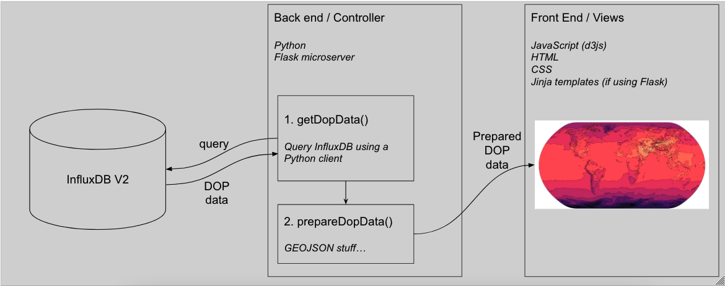
Front End Engineers
Query
Using a python client
Data Type
A list of Epoch, longitude latitude and DOP value
Sun
Notes:
Some notes
•

Slide 31
Front End Engineers
D3.js
Using HTML, SVG, CSS
Manipulating documents based on data
Build a world map using GEOJSON data
Open standard format for simple geographical features
Point, LineString, Polygon
Sun
Notes:
What we used to create web application
Flask
D3.js

Slide 32
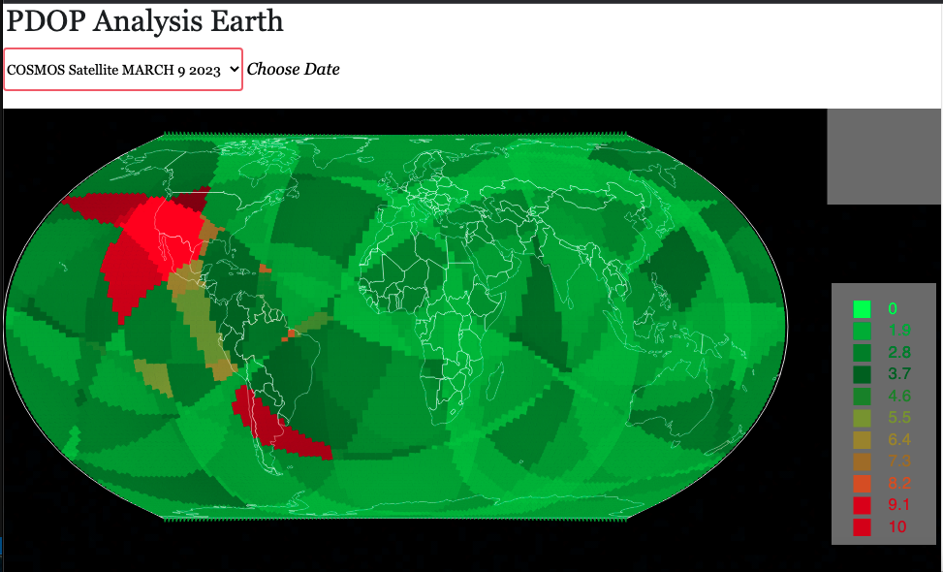
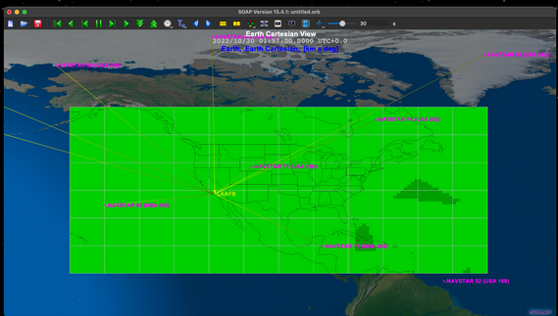
Front End Engineers
Simental
Notes:
Will be removed once live demo is ready
Maybe this can be kept? Quick comparison between our web application and SOAP. (Or include in live demo)

Slide 33
Live Demo
5 Satellite Constellations
BEIDOU (CHINA)
COSMOS (RUSSIA)
IRNSS (INDIA)
QZS (JAPAN)
NAVSTAR (UNITED STATES)
Epoch: March 9 2023 1:05 PM

Slide 34
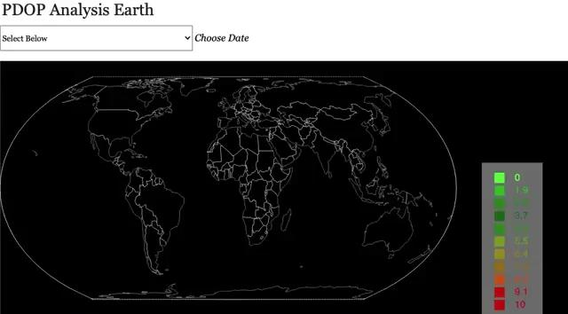
Video of Live Demo
Simental

Slide 35
Challenges and Lessons Learned
D3.js
How to make a map with GeoJson file
Learning Javascript
How to build a function to define map
Working with longitude and latitude data
• InfluxDB connection
Simental
Notes:
I will pass it on to Cesar, to talk about how we plan to finish up the project in our future work.

Slide 36
Future Work
Salazar
Notes:
For Future Work we want to able query data from influxDB for any given day or time
As well for our web application to be able to use more of the data that is in influxdb. For example, if we can retrieve the individual satellite names and locations, we can display where each satellite is in orbit at any given time and its coverage.
This will allow us to improve efficiency by seeing which corresponding satellites are orbiting in a red area (high dop area)

Slide 37
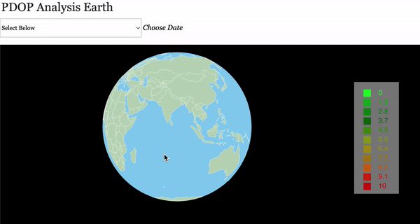
Future Work
Notes:
Another improvement to our web application is that we want to
Visualize the data on a globe instead of on a flat map
Doing this will be much more visually appealing
Make it easier to analyze the data

Slide 38
04
Conclusion

Slide 39
Challenges
Each team talked about team specific challenges here are a few team wide:
Learning Aerospace terms and theories
Understanding SOAP
Docker
Software architecture
Developing multiple programs that communicate work together
Gonzales
Notes:
Follow up with the solution (Same slide) we found the solution!

Slide 40
Achievements
The work conducted over the last 8 months showed a proof of concept that the DOP analysis pipeline can be automated using docker technology.
Our work can inform SOAP developers on how they can improve their interfaces to adapt for container technologies as well as implementing a smoother user experience.
Initially our goal was to automatically generate DOP for the United States NAVSTAR GPS constellation, we went a step further and automated analysis for 5 other constellations.
Ramirez
Notes:
Focus more on this!! -Pedro

Slide 41
Future Work
Deployment to a production server:
Centralize data
Better user experience
No need to run any code
Develop a DOP compression algorithm:
One world view has 15,000 points (14MB)
With an algorithm we can plot a fraction of those points
Store less data
Display less data
Better UX flow
Lower latency
Ramirez

Slide 42
Thank You!

