Slide 1
We2Link®
®
Notes:
Kevin

Slide 2
01
Introduction
®
Notes:
Kevin

Slide 3
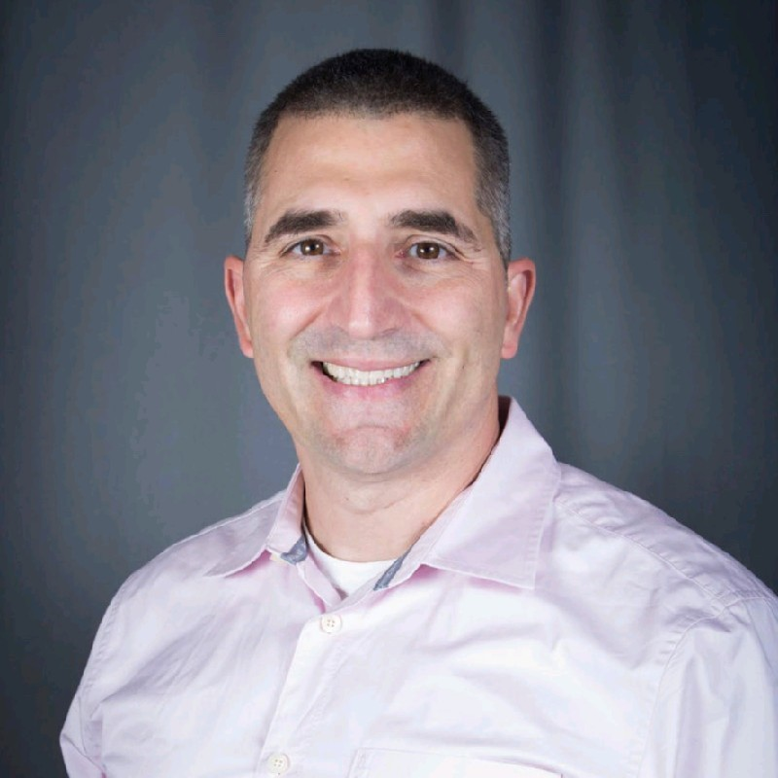
Sponsor, CEO, Michael C. Malone
Founder of We2Link, Inc®.
A Disabled Army Veteran
Developed Traumatic Brain Injury [TBI] while serving in the military
Works with TBI
Interviewed people who had TBI
Designated that this has impacted the Quality of Life [QoL] of people
Notes:
Kevin

Slide 4
Team Members
Advisor:
Huiping Guo
Senior Developer:
Ricardo Marroquin
Project Manager:
Jesus Rodriguez (Jay)
Web Team:
Hein Htet, Ivan Wang
Zain Syed (Scribe), Jennifer Lizarraga
Mobile Team:
Davy Chi (Co-Lead), Joanne Wu (Scribe)
Adrian Soria (Co-Lead), Kevin Fong
Carlos Ramirez, Nicholas Barger
®
Notes:
Start: Davy after teams: All together

Slide 5
Presentation Outline
About Want2Remember®
Purpose
Goal
Want2Remember® Project
Software
Project Requirements
Firebase
React/React Native
Completed Tasks
Workflow
Communication
Work Environment
Q&A
®
Notes:
Davy

Slide 6
02
About Want2Remember®
Notes:
Davy

Slide 7
About Want2Remember® / Purpose
Quality of life app to assist those who suffer from cognitive difficulties
Examples:
Traumatic Brain Injuries [TBI]
Alzheimer's Disease
Dementia
The main purpose:
Help those with cognitive impairments and daily living challenges
The overall goal:
Reduce Isolation
Ease the burden on caregivers
Reduce Suicide Rate
Achieve Greater Independence
Notes:
Hein

Slide 8
The Current Want2Remember® Team Goals
Learn React/ReactNative
Fixing current issues and bugs as well as adding new components to both the mobile app and the website
®
Notes:
Davy

Slide 9
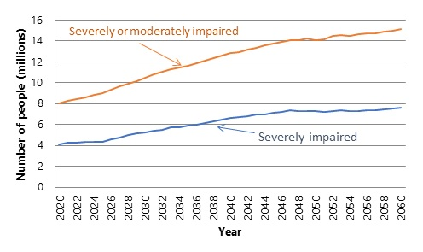
Why the Project is Important
Stats
16+ million people in the US are living with cognitive impairment.
2.5 million people annually sustain a Traumatic Brain Injury (TBI).
6+ million people with alzheimer's in US.
About 40% of the people that are of ages 65+ have age associated memory impairment in the US.
About 1% of them will progress to dementia each year.
55+ million people have dementia worldwide
Improved support for caregivers.
53+ million unpaid caregivers in US (family members).
Providing features for virtual caregiving.
Notes:
Kevin
Resources: https://www.cdc.gov/aging/pdf/cognitive_impairment/cogimp_poilicy_final.pdf, https://braintrauma.org/info/faq#:~:text=Each%20year%20about%202.5%20million,Motor%20vehicle%20crashes%20(20%25), https://alzheimer.ca/en/about-dementia/do-i-have-dementia/differences-between-normal-aging-dementia, https://www.ncbi.nlm.nih.gov/pmc/articles/PMC1123445/#:~:text=Only%20about%201%25%20of%20them,memory%20deficits%20without%20functional%20impairments., https://www.who.int/news-room/fact-sheets/detail/dementia, https://www.aarp.org/caregiving/basics/info-2020/unpaid-family-caregivers-report.html, https://aspe.hhs.gov/reports/risk-costs-severe-cognitive-impairment-older-ages-key-findings-our-literature-review-projection-0

Slide 10
03
Software
Notes:
Kevin

Slide 11
Project Requirements/Tech Stack
Programming/Development:
Firebase
HTML
Tailwind CSS
Visual Studio Code
Javascript/React
React Native
Android Studio/Xcode
Source Control:
GitHub
Jira (Agile Tracking)
Communication:
Slack
Notes:
Hein

Slide 12
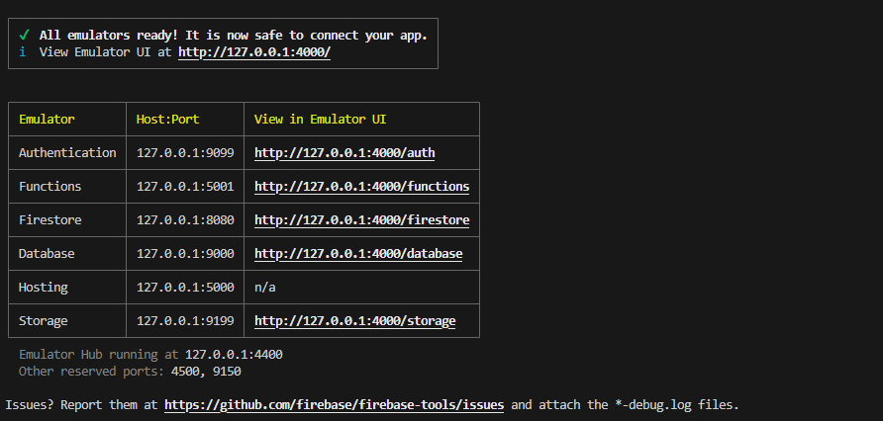
Why Firebase for Want2Remember®️?
Was documented very well and was an easy option
Affordable and offered many advantages, such as web hosting, firebase storage, cloud functions
The database emulator on firestore allows devs to edit and view the web application in real time.
Notes:
Zain will do this

Slide 13
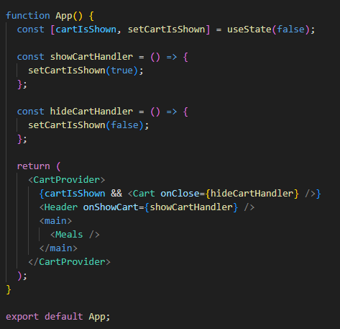
Why React for Want2Remember®️?
We can utilize React components like building blocks.
React native allows for flexibility between ios and android development at the same time since its the same syntax
React works through both jsx and javascript so you can implement front end as well as events and other features at the same time
We can manage the state and effects of each component
Notes:
Zain will do this

Slide 14
04
Completed Tasks
Notes:
Zain

Slide 15
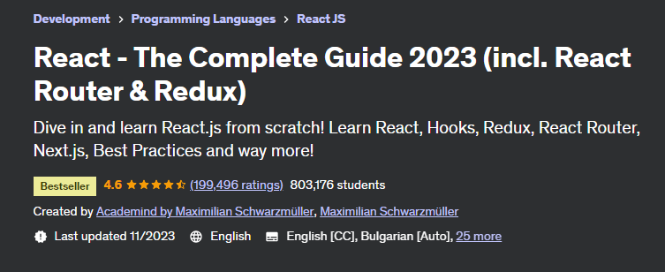
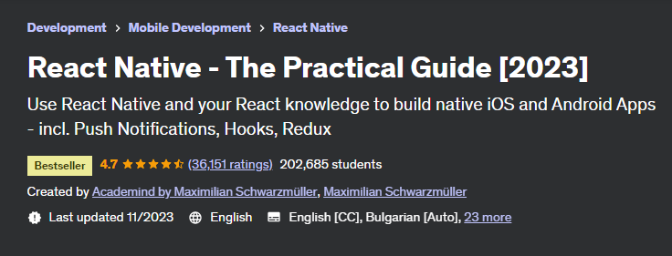
What We Have Done So Far
28+ Hour Online React/React Native Course on Udemy
8 Completed Web Tasks
6 Completed Mobile Tasks
®
Notes:
Adrian

Slide 16
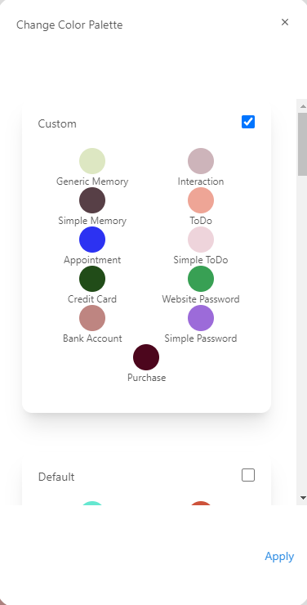
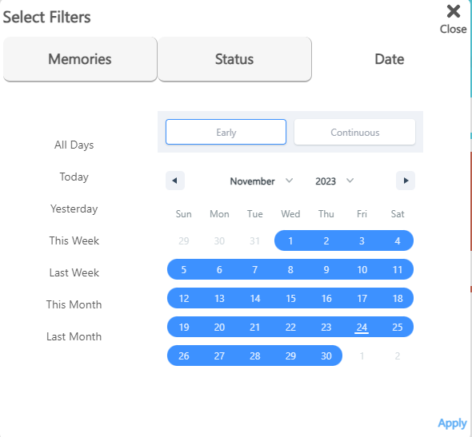
Web Team: Jennifer & Zain
Completed Tasks:
Fixing the custom color palette
Contact Quicklook UI updates
Fixing the Date section on the memory filter
Current Task
Refactor memory detail screen
Notes:
Both of us
Talk about reasons why custom color palette was crashing (color pallete was not made to recognize anything other than the default palette in the userDefaults.json)

Slide 17
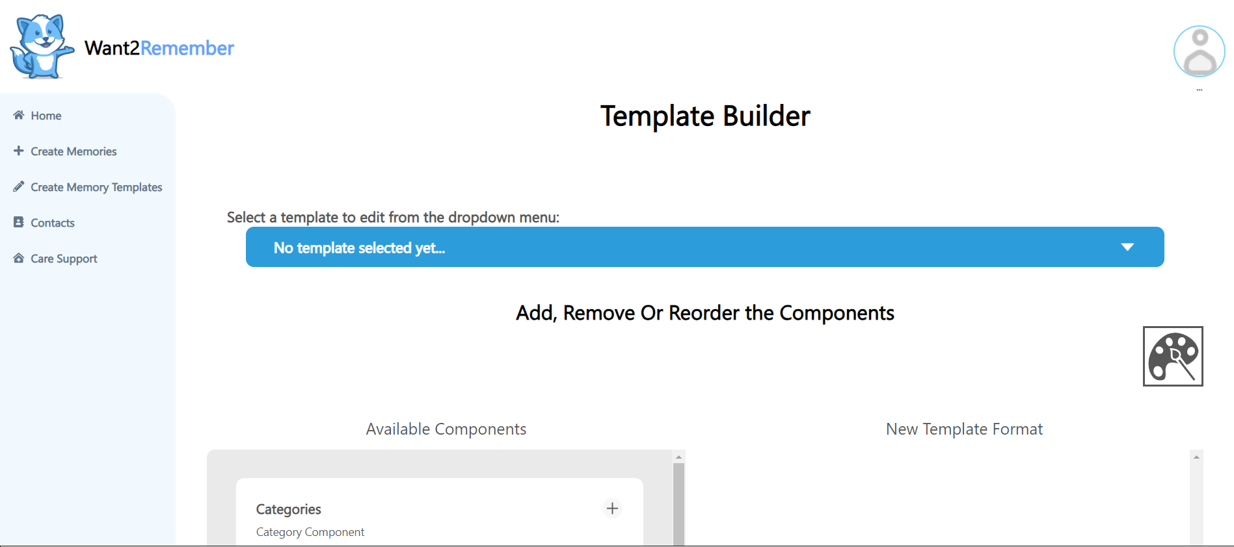
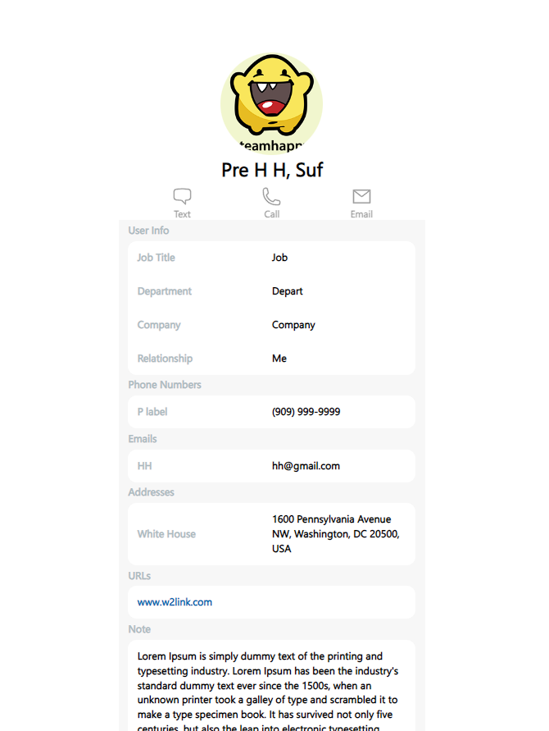
Web Team: Hein & Ivan
Completed Tasks:
Memory Template Creation Screen
File count in memory quicklook
Contact Details Screen
Have contact details shown in Contact Detail Screen
Eslint (Fixed almost the entire web directory)
Current Task
Single Source for Select Palette
Notes:
Ivan

Slide 18
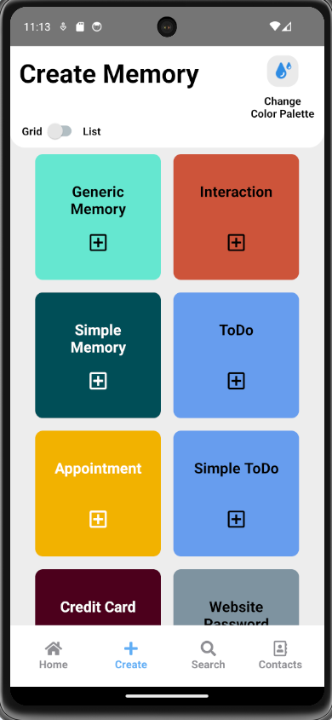
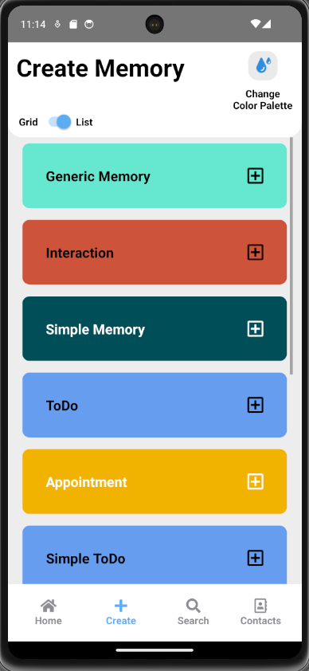
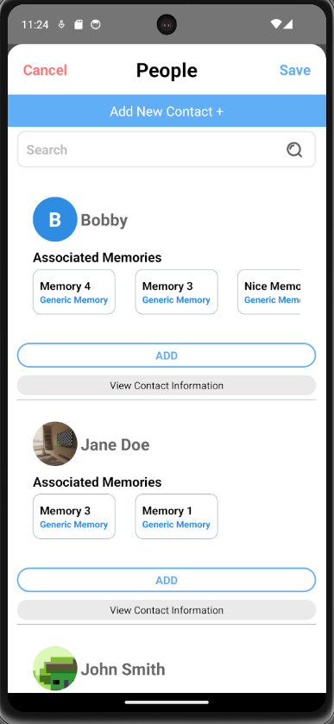
Mobile Team: Davy & Joanne
Completed Tasks:
Fixed Grid / List view for Memories Screen
Added Associated Memories for People Picker in Create Memories Screen
Current Tasks:
Implementing a Location Picker in Create Memories Screen
Notes:
Joanne

Slide 19
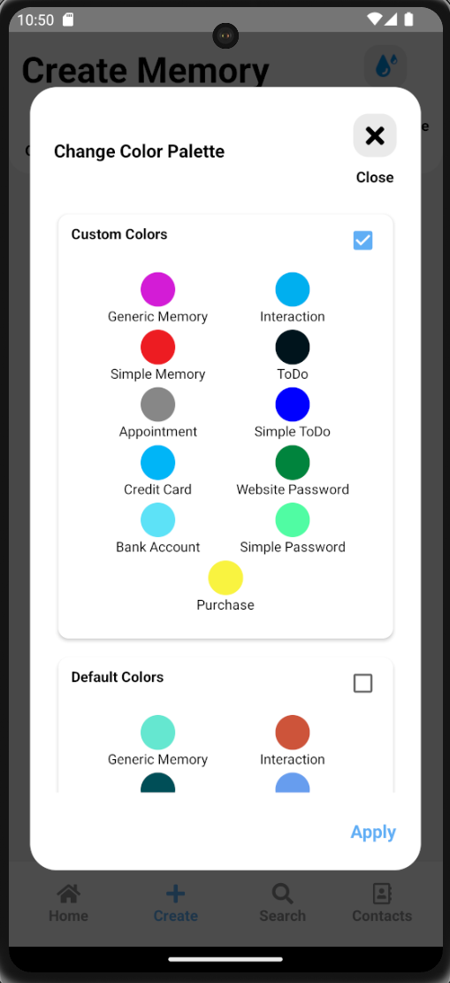
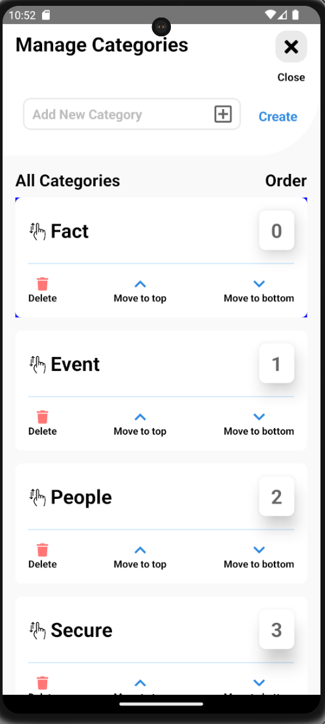
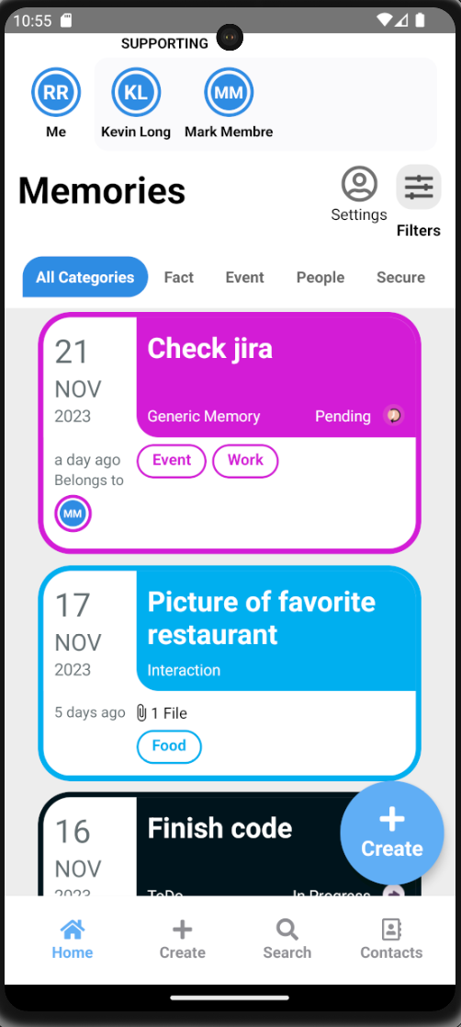
Mobile Team: Adrian & Kevin
Completed Task
Retrieve color palette data from Firestore
Fix the draggable flat list for Android
Current Task
Create a care support header component
Notes:
Adrian

Slide 20
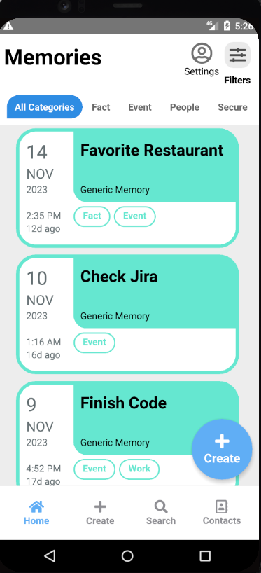
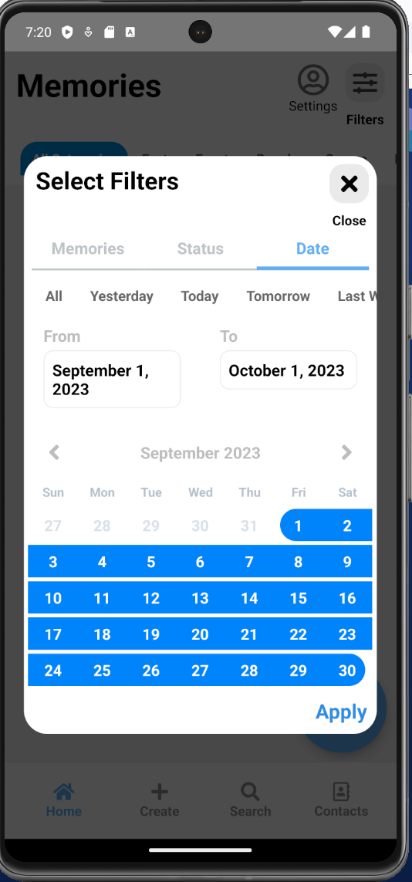
Mobile Team : Carlos & Nicholas
Completed Tasks:
Show time correctly on older versions of android
Fix date selection in filters
Current Task:
Save files locally to android device
Notes:
Carlos

Slide 21
05
Workflow
Notes:
Carlos

Slide 22
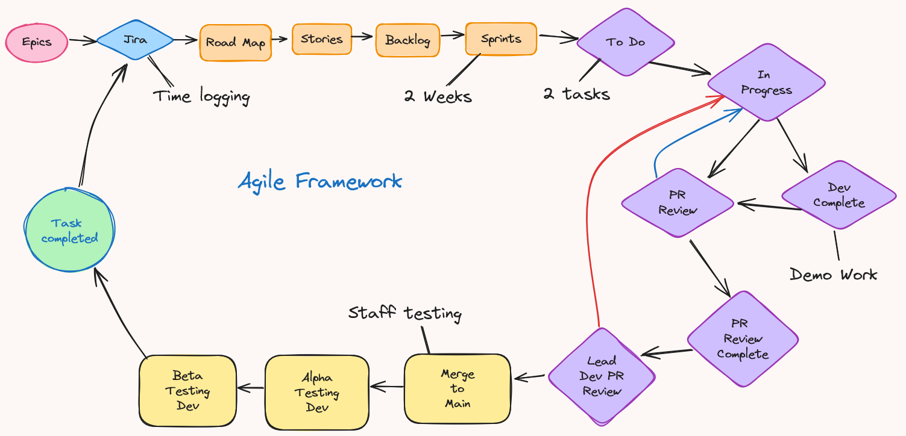
Workflow
Notes:
Jennifer

Slide 23
06
Communication
Notes:
Jennifer

Slide 24
Our Communication
Slack
Communicate with Stakeholders
Discord
Communication among Team Members
Zoom
Project meetings with Stakeholders and Team Members
Github
Code updates for current tasks
Notes:
Ivan

Slide 25
07
Work Environment
Notes:
Ivan

Slide 26
Work Environment
Virtual Work Environment
Visual Studio Code offers Live Share
Github Desktop
2 Zoom meetings weekly
Progress updates
What works
Report issues
Next steps
Sprint Retrospectives
Demo completed tasks
Briefed on new tasks
Notes:
Nicholas

Slide 27
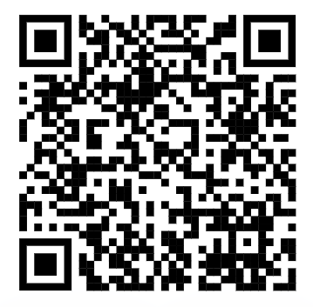
Demo Link: https://want2remembercloud.web.app/
Q & A
®
Notes:
Nicholas

Slide 28
THANK YOU
®
®

