Slide 1
Saya Life
Notes:
Gabriel

Slide 2
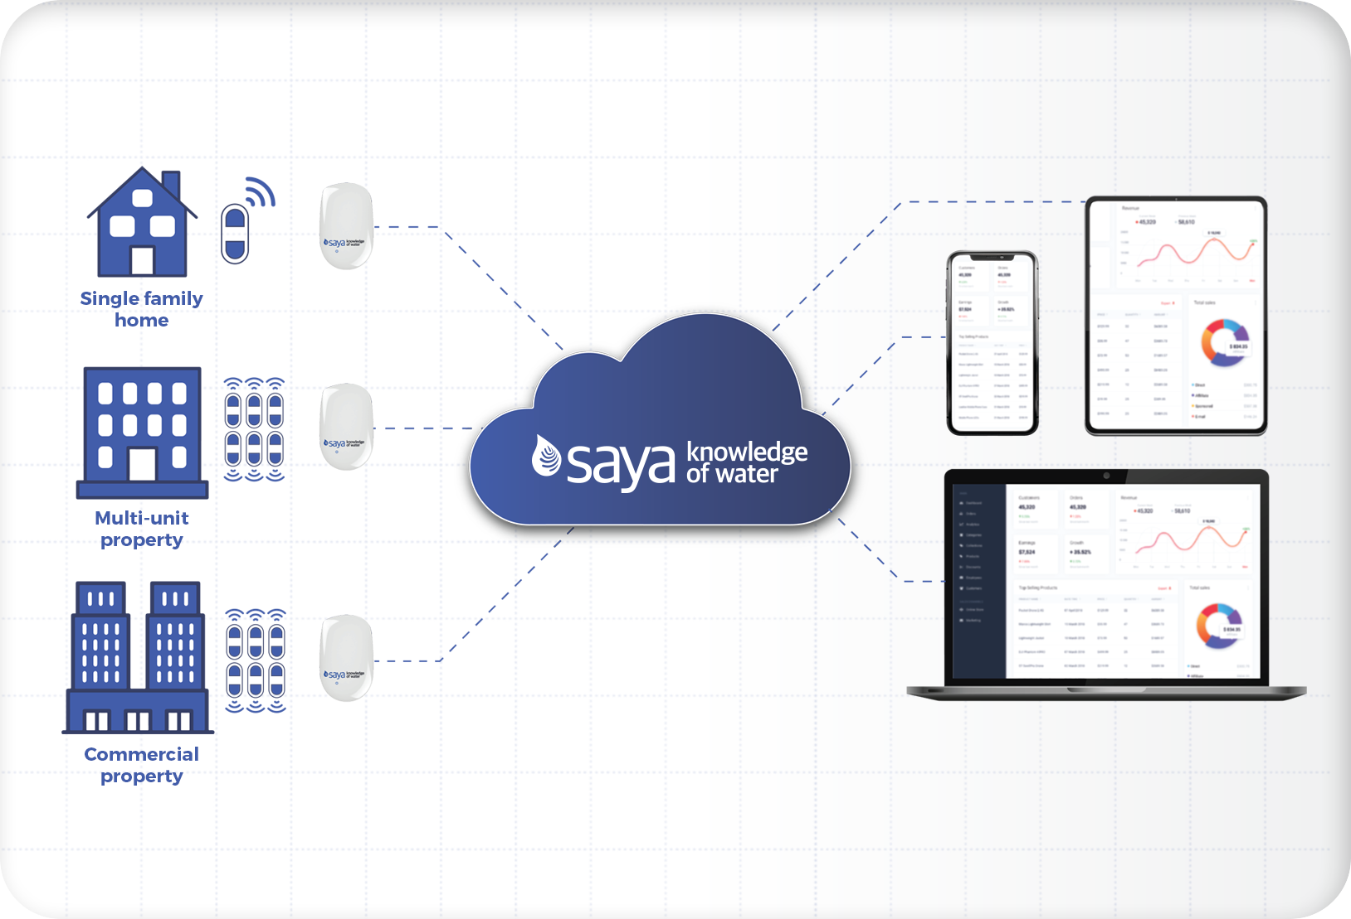
Saya.Life
Company that provides water management solutions
Attaches meters on pipes track the flow of water.
Detection of leaks
Water remote shut off
Notes:
Gabriel

Slide 3
Problem Scope
Goal:
Create a risk detection machine learning model
Tells insurance companies how cost effective a building
Desired scale: 1-10
1: Unsafe
10: investing in the building ()
Identify relevant metrics to train a suitable machine learning model
Identify an algorithm suited for the machine learning model
Create a nice dashboard that insurance companies can use
Notes:
Andres

Slide 4
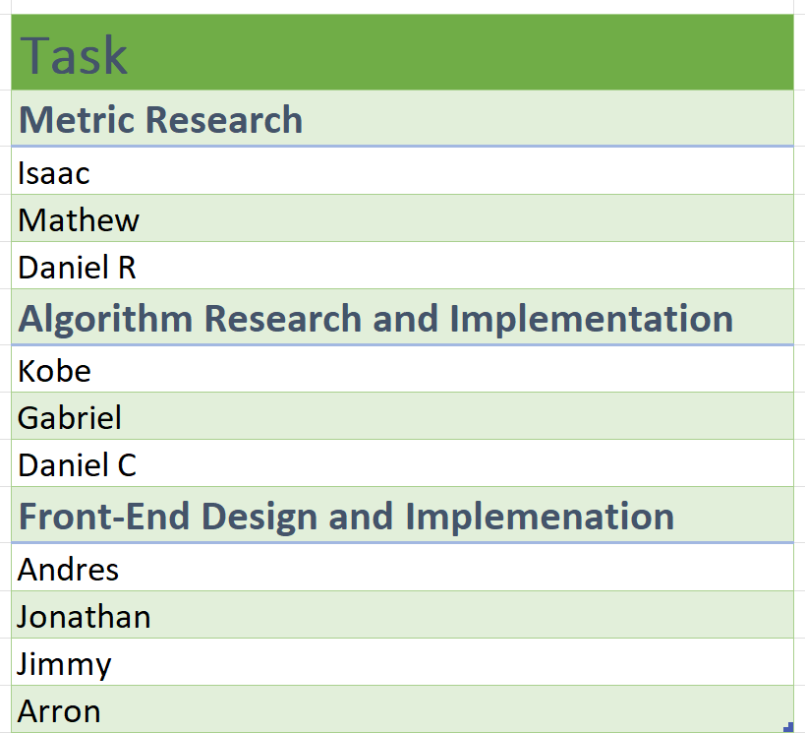
Team distribution
Notes:
Andres

Slide 5
Ethics
All data we used was given directly from Saya.life
Consent was given
Keeping data private
Being responsible
Other data used was publicly available
Machine learning Algorithm will avoid harmful biases
Example: Zip code could penalize a user
Notes:
Andres

Slide 6
Metrics Research

Slide 7
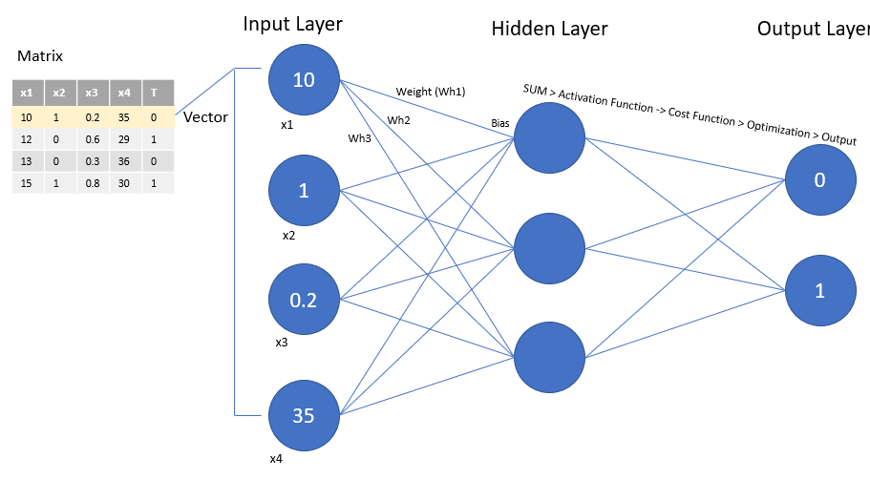
Motivation/Goal
Goal
Determine which metrics affect cost effectiveness
Metrics that change the weight and bias

Slide 8
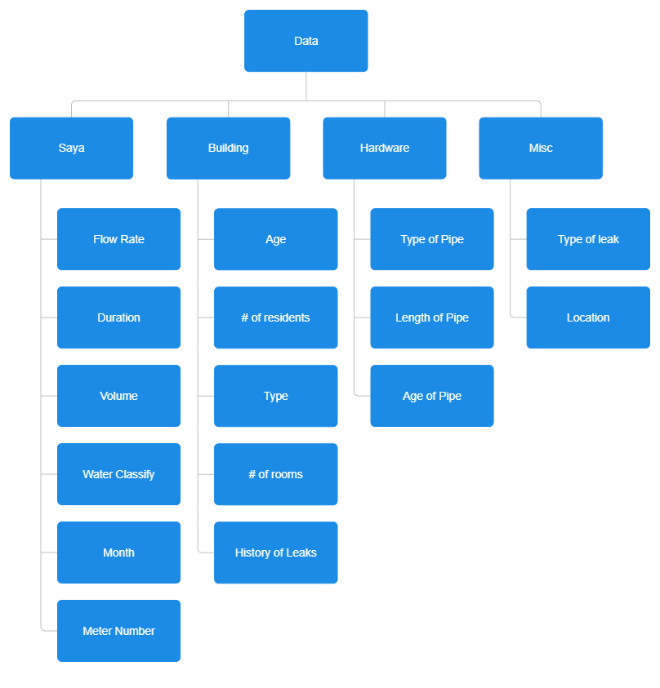
Comprehensive list of metrics
Notes:
Isaac

Slide 9
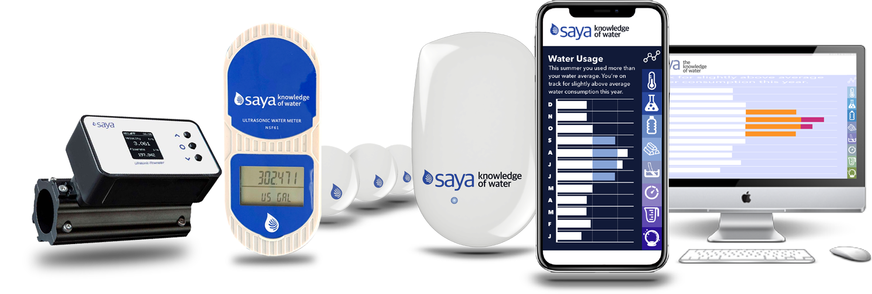
Saya Data
Data taken from Saya sensors
Spans over exactly one year
Water Classify
Data has a condition to classify water type
Ranges from low,medium,high, and unclassified
Meter Number
Each sensor is attached to a specific pipe
Meter number determines pipe and location

Slide 10
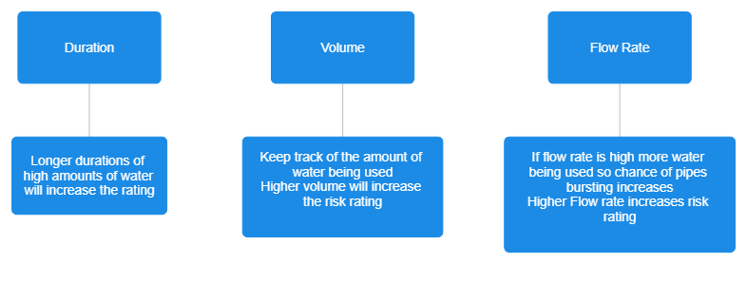
Saya Sensors

Slide 11
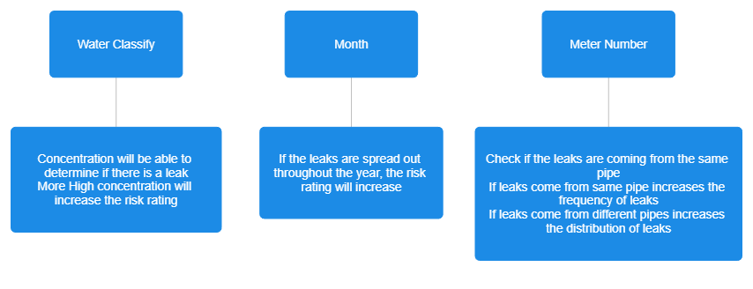
Saya Sensors
Notes:
Isaac

Slide 12
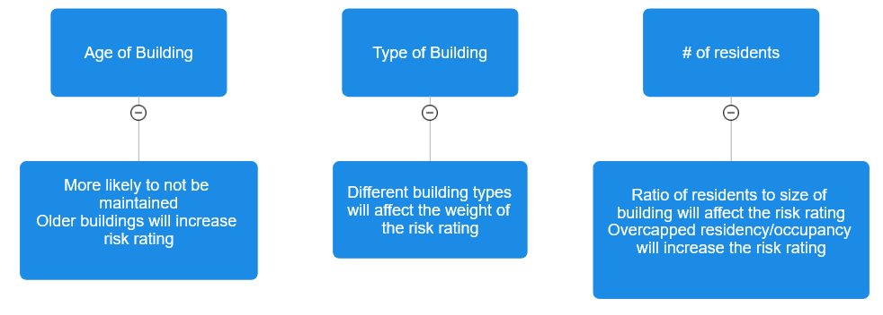
Building Data
Notes:
Matthew Kim

Slide 13
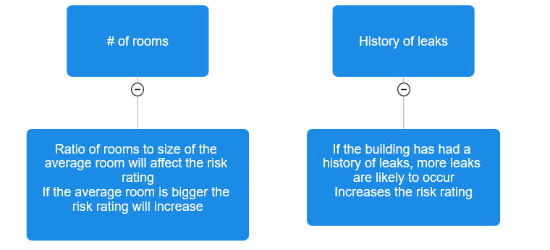
Building Data
Notes:
Matthew Kim

Slide 14
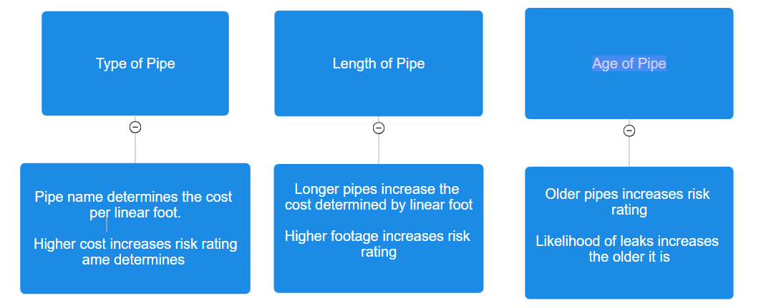
Plumbing Hardware Data
Notes:
Daniel R

Slide 15
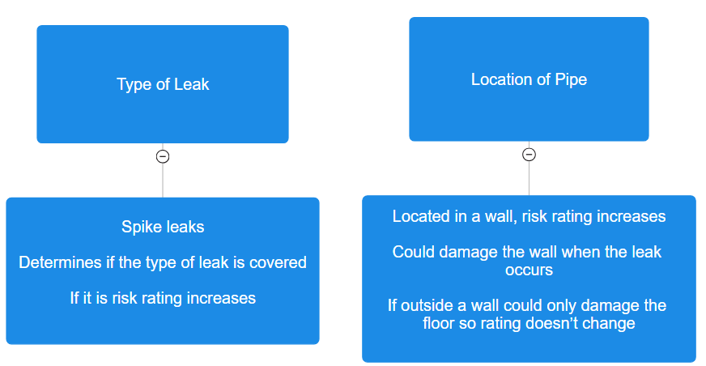
Misc Data
Notes:
Daniel R

Slide 16
Algorithms-Research
Notes:
Daniel Castillo

Slide 17
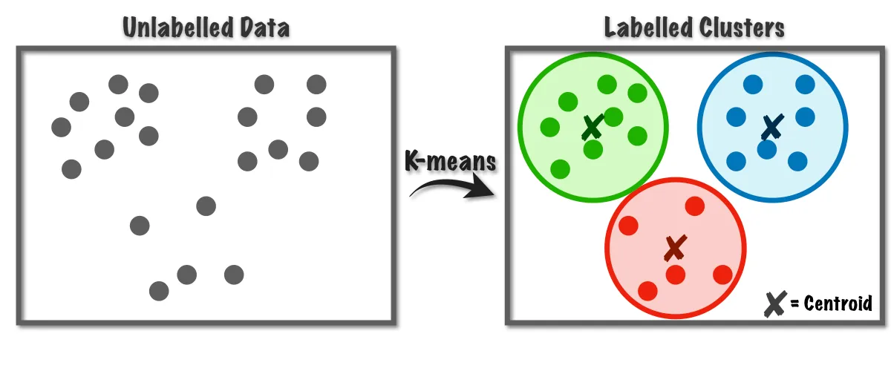
Our Original Approach
Dataset
No obvious patterns
Unsupervised Learning model: K-Means
Finds hidden patterns in the dataset
Organizes data into clusters
Results:
New perspective(s)
Led us to ask a different question

Slide 18
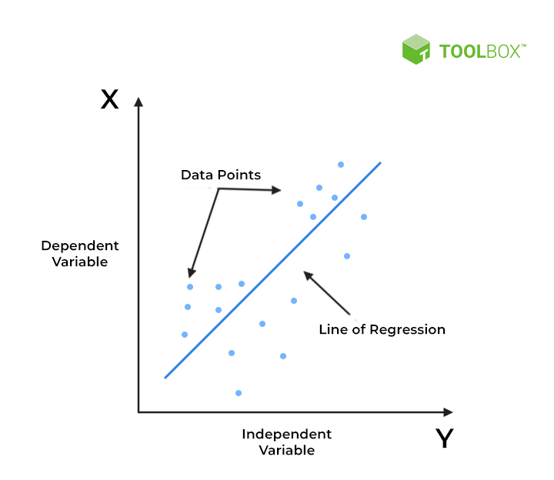
Algorithms Used - Linear Regression Why?
Efficient - less power usage because of gradient descent
Adaptive - with using categorical or numerical data
Numerical label
Simple -features and the target is approximately linear

Slide 19
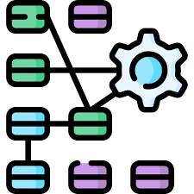
Feed Forward Neural Network - Why?
Fast - GPU Parallel Processing
Complexity - handling various of data types audio, images, text, and numerical data
Wide range of libraries to use (TensorFlow, PyTorch, Keras, and scikit-learn for Python)

Slide 20
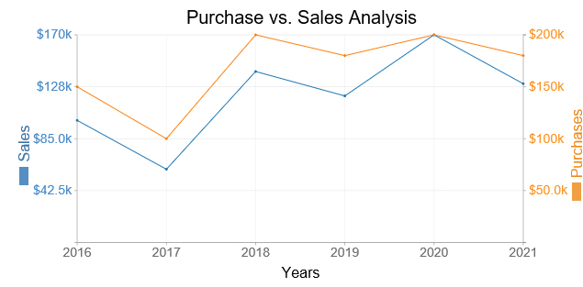
Purpose for using these 2 algorithms
Illustrate the effectiveness of the two algorithms(accuracy and speed)
Provide an illustration of the results from different perspectives for the user
Make sure the user receives as much data for a better understanding
Notes:
KOBE
The main purpose for having these two algorithms is for their fast and effective usages within their respective algorithms structures.

Slide 21
How the algorithm works
The algorithm uses inputs that we have for the the model to learn from.
y is what the model is trying to predict or classify.
We are trying to understand the relationship between the(X values) and the occurrence of (Y value).
Training data
input(X values)
Machine algorithm
Predictions (y value)

Slide 22
Creating our own Y Test
Inputs
Building types:
Houses
Apartments
Offices
# of people
Use inputs from the insurance company
Notes:
GABRIEL
Building type 1 for a house 2 for apartments 3 for offices style
By trying to combine these information type should show what the average usage of water is
AvgGal =TF/#people
Enum one=300
If AvgGal < one Low
High
AVG
After creating usage category we will try to compile the risk factor
With leakage TF and type
(equation hasn't been made) but with it We can return a numerical value or categorical.

Slide 23
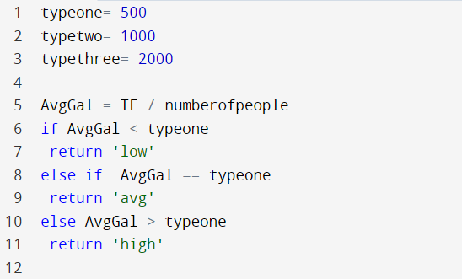
Data created with Saya data
Data given by Saya
User input
User input
Returns a consumption category called usage

Slide 24
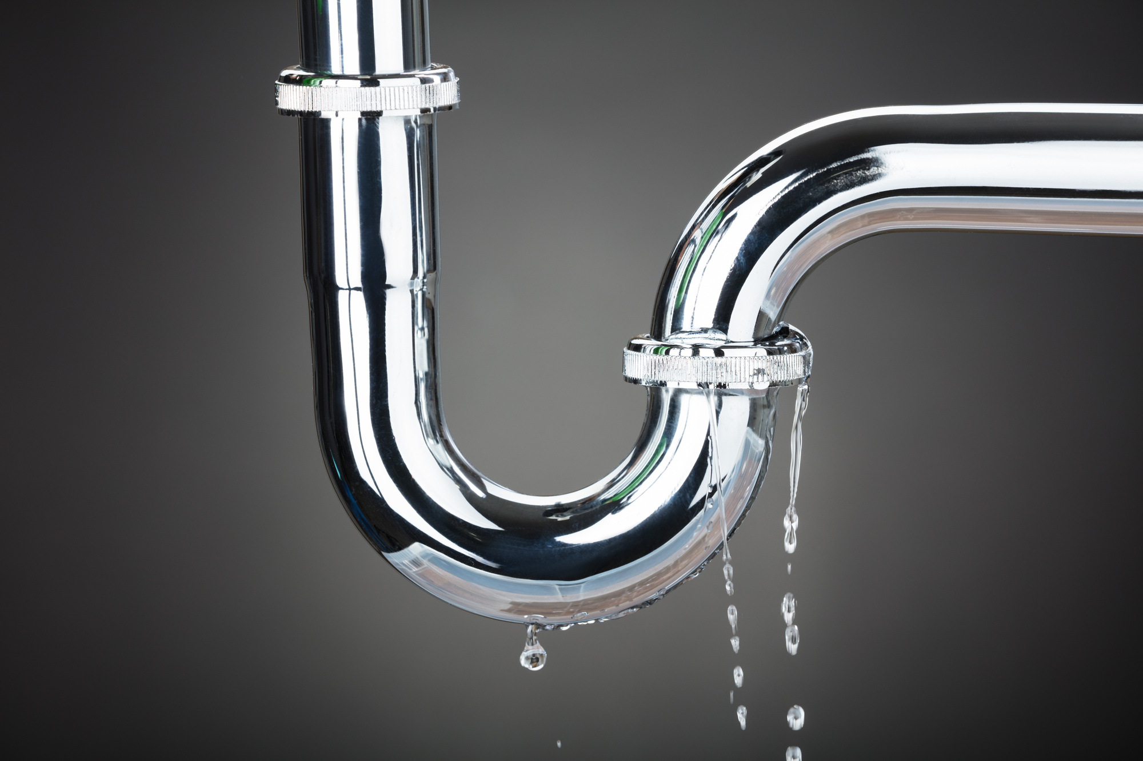
Then compile the risk factor
With leakage TF and usage
Can return a numerical value or categorical.
Will return if it has a good standing risk factor 1-10 or potential loss.

Slide 25
Front End
Notes:
johnathan

Slide 26
Tableau
Tableau is a data visualization tool
Allows users to connect different data sources
Spreadsheets
databases
User can create dashboard
Currently working with tableau to create graphs using mock data
Notes:
Jonathan

Slide 27
Goal
Create a user interface
UI to be integrated in saya website
Will allow user to input data metrics to see risk rating of property
Dashboard will show graphs and visuals so the user can see a representation of information

Slide 28
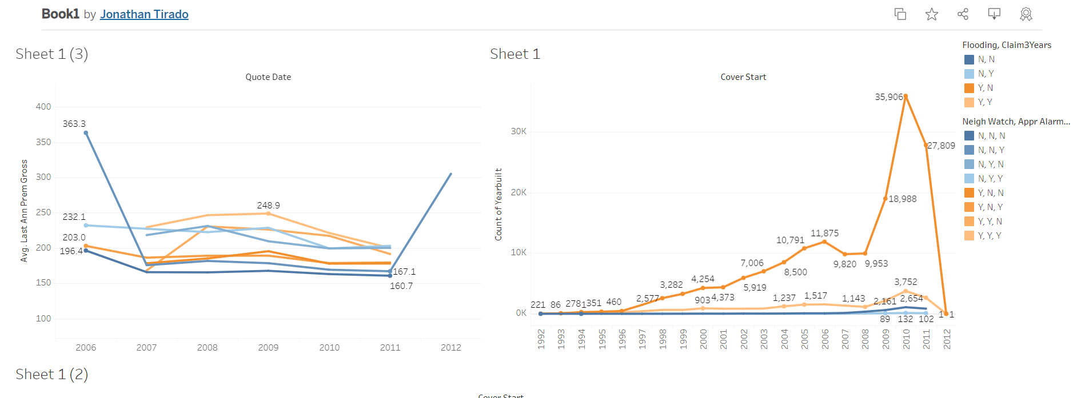
Notes:
Jonathan

Slide 29
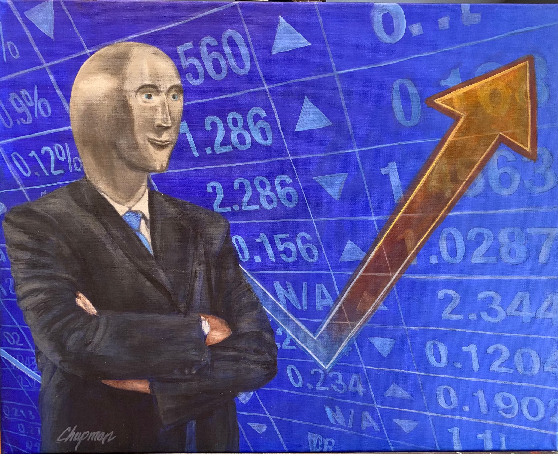
Conclusion
Goal
Create a Dashboard that insurances can use
Create an appropriate model
Metrics
Researched what features are relevant for our model
Algorithms
Tested regression algorithms
Linear regression, Neural Network
Front End
Learned Tableau
Created a mock dashboard
Notes:
Arron

Slide 30
Next Steps
Metrics
Create an API to hold and access the data
Algorithms
Finish calculations for scale and apply it to the provided data
Use Saya data to create a model
Front End
Continue learning Tableau
Use the Saya data to create an appropriate graph
Notes:
Jimmy Nguyen

Slide 31
Thank you!
Any questions?
Notes:
Jimmy Nguyen

