Slide 1
Machine Learning For Network-Denied Environments

Slide 2
Team Members
Server Team
Johnson Tan
Alvin Yu
Sanjog Baniya
Jonathan M Dooley
Xavier Lara
Mobile Team
Justin To
Wilson Gan
Enrico Efendi
Kevin Maravillas
Web Team
Howard Nguyen
Nisapat Poolkwan
Team Leader: Johnson Tan
Advisor: Dr. Chengyu Sun
Liaisons: Dr. Ben Nye and Dr. Mark Core
Johnson Tan

Slide 3
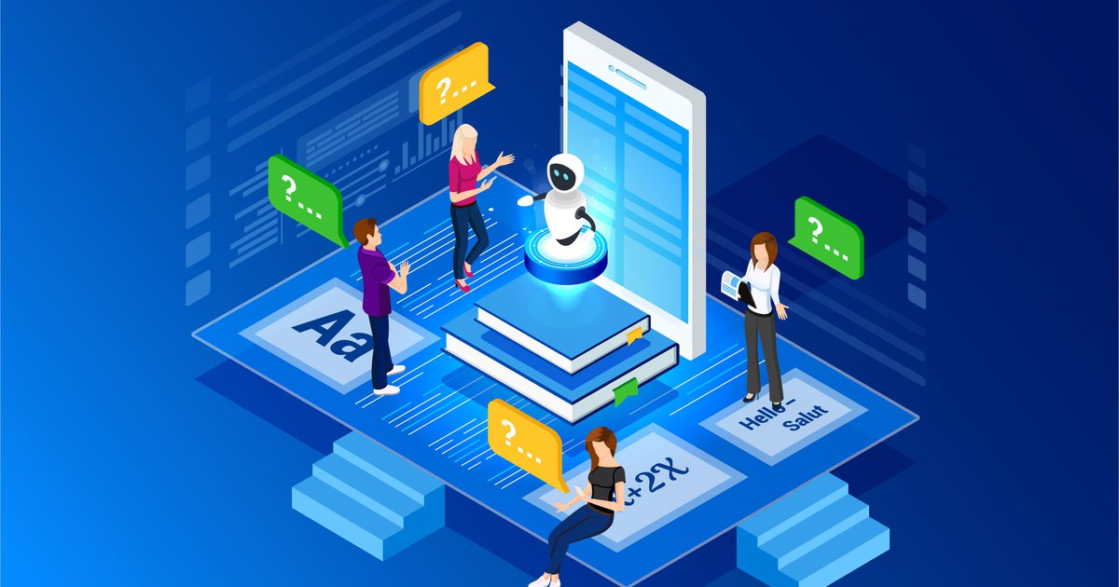
Project Description:
Image Classification prototype has been proposed for an offline environment
Download and update the model in online environment
Share the updated model while connecting to other mobile client
Collects unlabeled data during tutoring and send back data when online
Sanjog Baniya

Slide 4
Problem Statement
Unavailability of networks is common in areas where needs are most urgent, such as in conflict zones, major disaster areas, and under-developed regions
AI and Machine Learning have become increasingly reliant on cloud processing, which is brittle even against brief interruptions in connectivity
Sanjog Baniya

Slide 5
Significance
Service members or learners will need periods to educate or train under little to no internet reception
Solution focus on Offline AI model usage, and offline content sharing among local devices.
The main purpose is to have an AI system be able to properly work without any network connection and update itself once a network is available
Enrico

Slide 6
Requirements
Offline Client Capabilities
Use the machine-learning model
Gather new training data, and evaluations
Server Capabilities
Train on new data provided by the clients
Share model updates to the client through small packages
Layers, fine-tuning, etc.
Peer-to-peer Data Relays: Client devices should be able to share data between others locally. Ideally sharing data with online devices
Kevin

Slide 7
Goals of the project
Offline Mobile Client: ​
User takes a picture or upload image for classification
Image not in model, chance to add it, if it is it'll classifies it
Evaluates most recent ML models offline​
Collect & manage both new labeled and new unlabeled data reliable​
Share information via Bluetooth
​
Server/Cloud Training: ​
Provides endpoints to the Web API and Mobile client
Allows it to retrieve latest model, upload, etc.
Trains most recent ML model layers or tunes it​
Web UI to do manual training for bad/new classifications​
Kevin

Slide 8
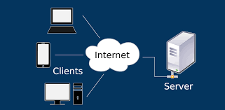
Our Approach
The team is divided into sub teams to handle different components of the project
Server team provides training data, new data and a model to classify images with relatively high accuracy
Web client team provide user interface to manage the server
Mobile client works on the mobile app to allow taking pictures through the camera or gallery and uploading to the server for training
Wilson

Slide 9
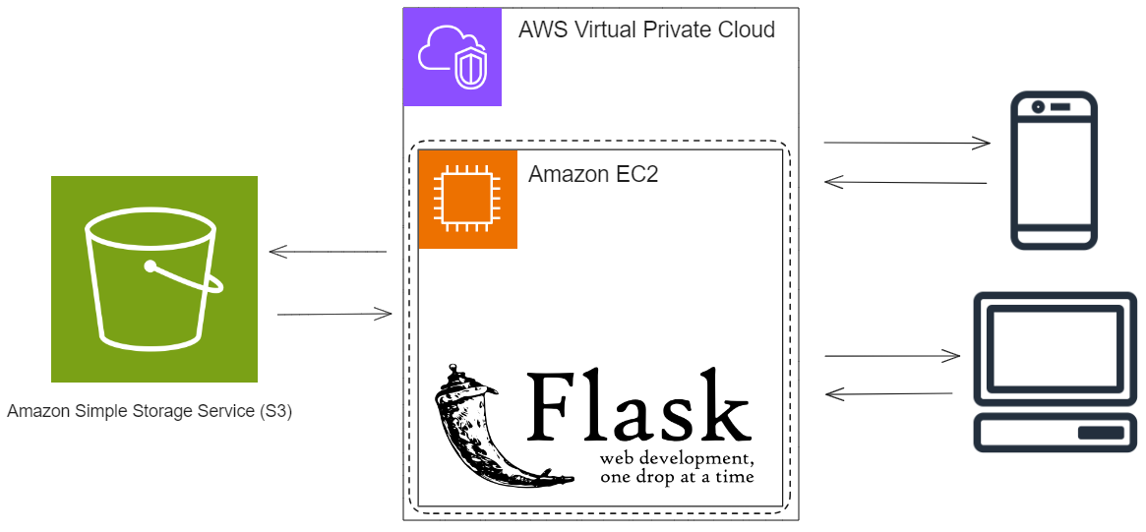
System Architecture
Jonathan

Slide 10
Server - Web API
AWS EC2 server for model training and hosting HTTP endpoints
Image objects and metadata stored in AWS S3 bucket
Flask Server Environment
Allows for native interaction with ML libraries
Integrate server functions for client access via developer defined endpoints
Jonathan

Slide 11
Server - Web API
Server Web API will have these capabilities:
Receive data from mobile devices (new images and their labels) and incorporate into the training set
Retrain the model at certain increments
Send over updated versions of the model (ideally new layers) to the mobile client
Jonathan

Slide 12
Server - Model
Model Requirements
Lightweight enough to deploy on mobile devices
Not surpass a certain file size to store
Be able to be incrementally updated
Have relatively good accuracy for image classification
A good model candidate matching these criteria has been found in MobileNet
Alvin

Slide 13
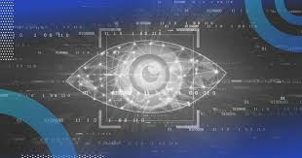
Server - Model
MobileNet
Good base model to be used in transfer learning
Open-source model developed by Google for training classifiers
Chosen due to its emphasis on deployment on mobile and embedded devices
Very lightweight, meaning less storage requirement for mobile devices
Balances computational needs and accuracy
Alvin

Slide 14
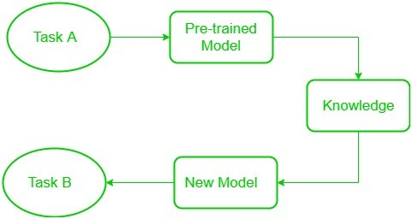
Server - Model
Transfer learning
Project approach to tackling image classification
A machine learning technique in which knowledge learned from a task is re-used to boost performance on a related task
i.e. For image classification, using a pre-trained model able to recognize a general selection of objects as the basis to train a more specific classification model
Johnson Tan

Slide 15
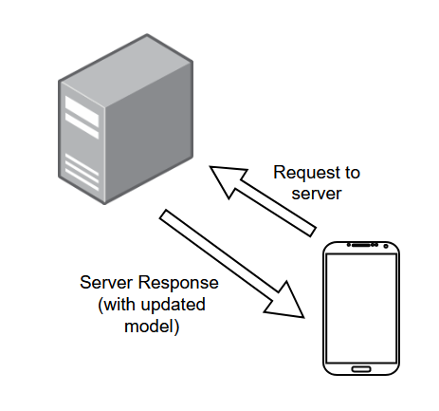
Server - Model
Transfer learning
This leads to greater customizability of classification without the burden of retraining an entire model from scratch
For this project, it would be a mobile device sending a request to the server with its own information and receiving an updated model
Johnson Tan

Slide 16
Server - Tools
TensorFlow
V2.0+ is the main basis for our project
Open-source framework developed by Google for the purposes of machine learning, artificial intelligence, and other statistical tasks.
Keras
Keras is the API interface for interacting with TensorFlow
Xavier Lara

Slide 17
Future Goals for Server
Optimize server AI training while improving accuracy
Integrate to uWSGI production ready server
Provide authentication for protected endpoints with AWS Cognito
Move training data to AWS EFS
Introduce EC2 spot instance in VPC with hardware optimized for training actions
Make server endpoints and function code bullet proof
Xavier Lara
Notes:
Someone from server team can say this

Slide 18
Mobile Client
User-friendly interface
Ability to take/send images from camera or photo gallery
Classification through a Machine-Learning Model of any general objects. Some examples may include but are not limited to:
Animals such as Dogs/Cats
Computer Accessories
User input of Label and Confidence Numbers
Trains the Machine-Learning Model when new data made by user is sent to the server
Technologies used
React Native
Expo Go (ImagePicker)
Enrico Efendi

Slide 19
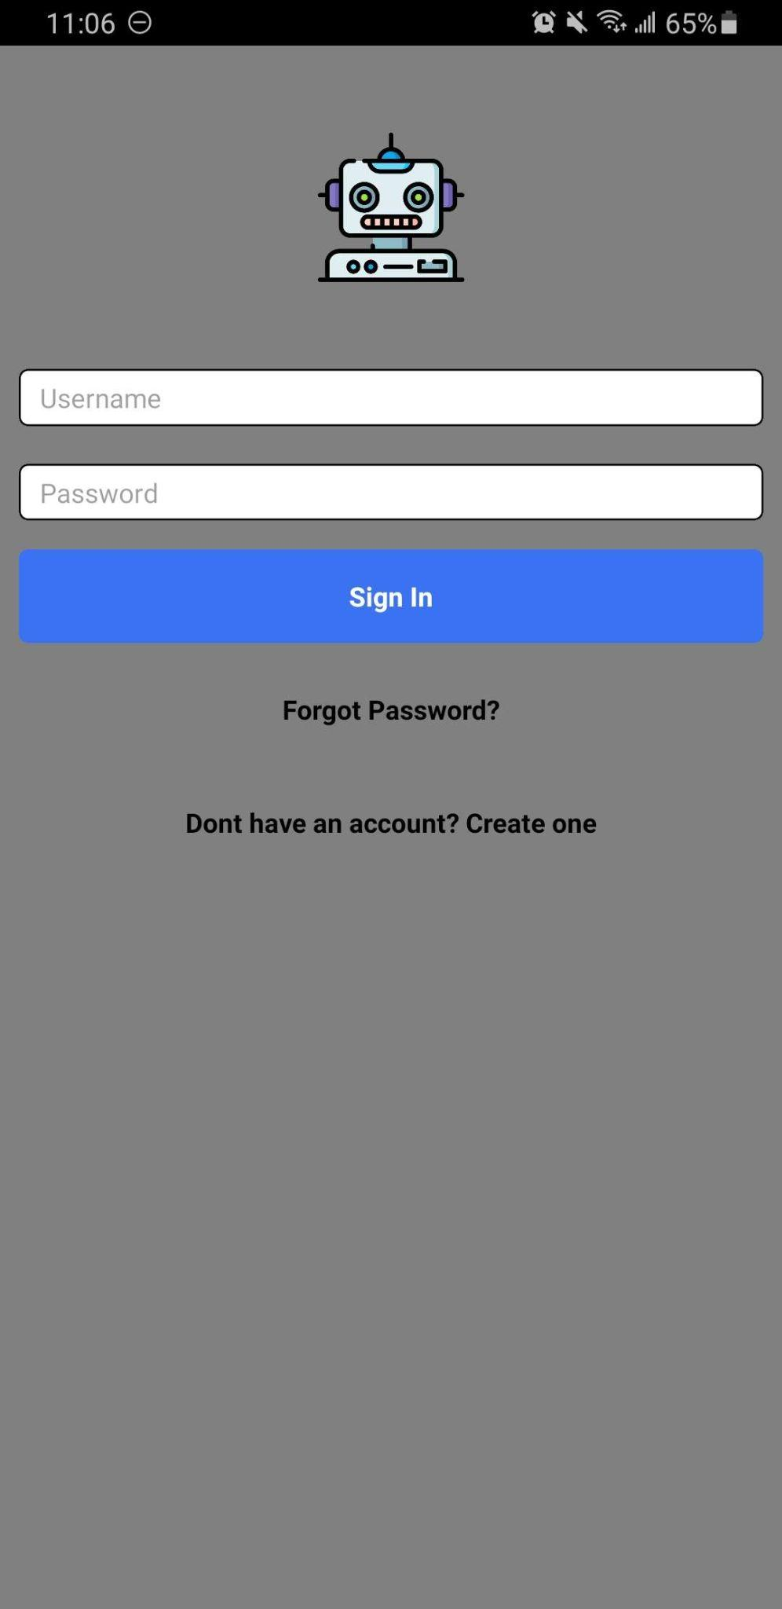
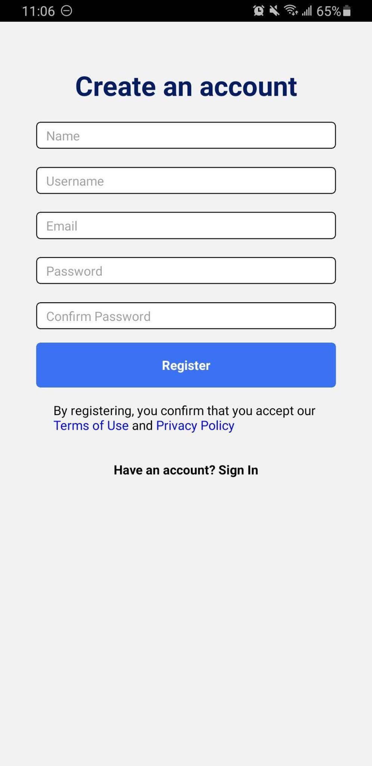
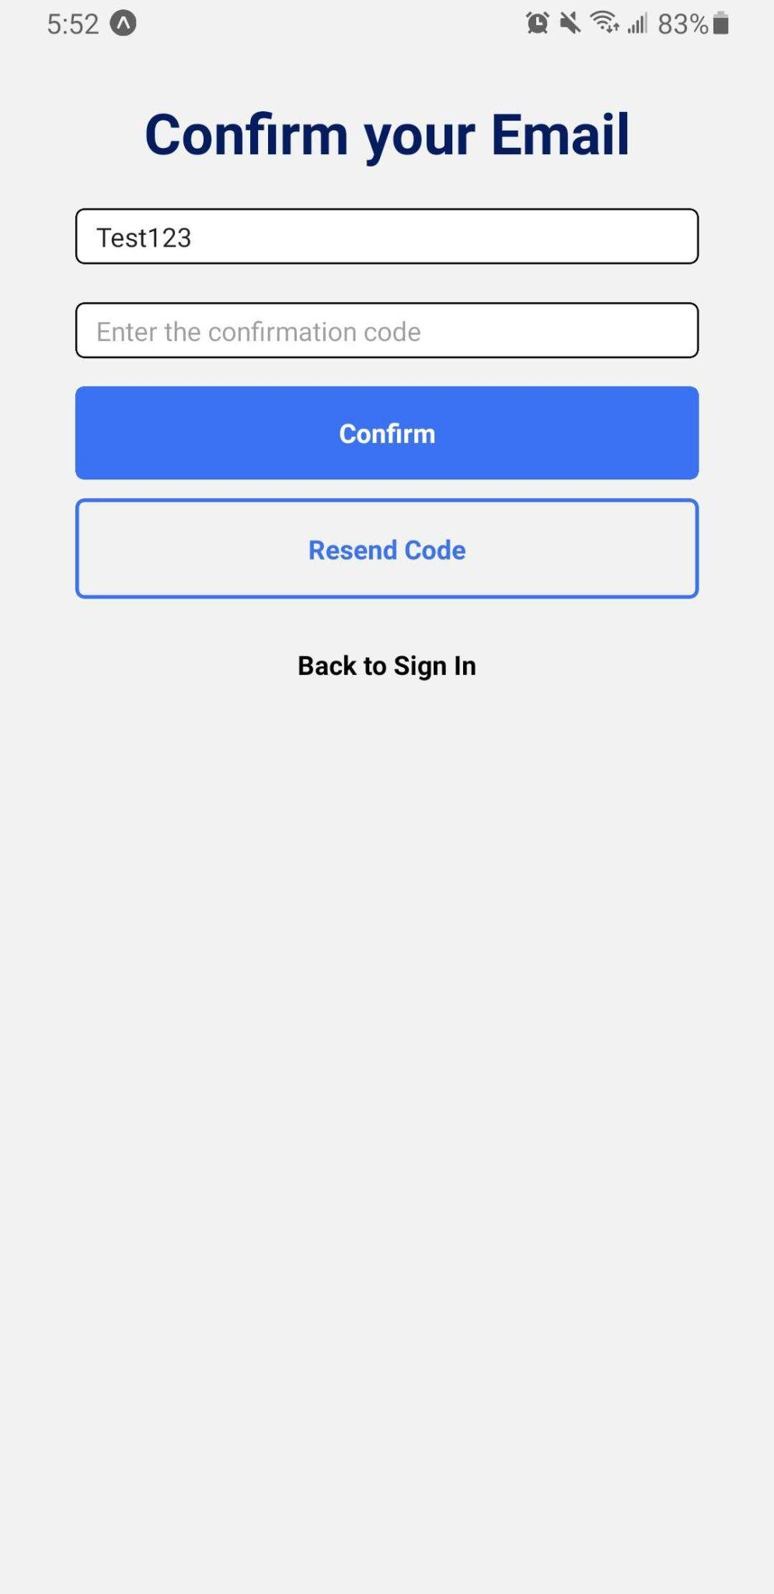
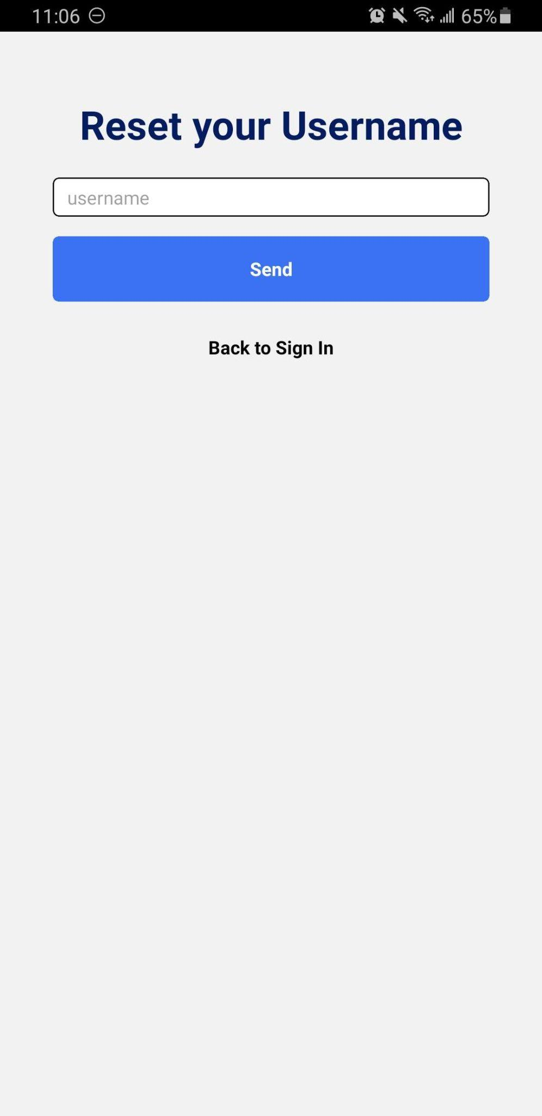
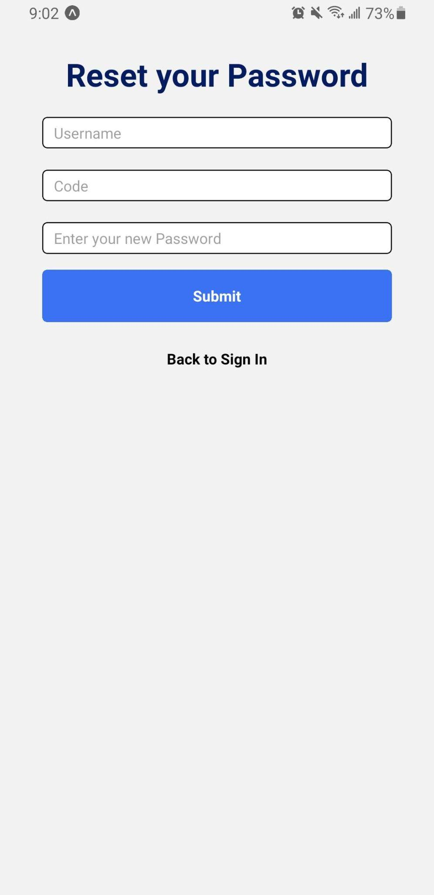
Mobile Client
Create Account
Reset Account
Justin To

Slide 20
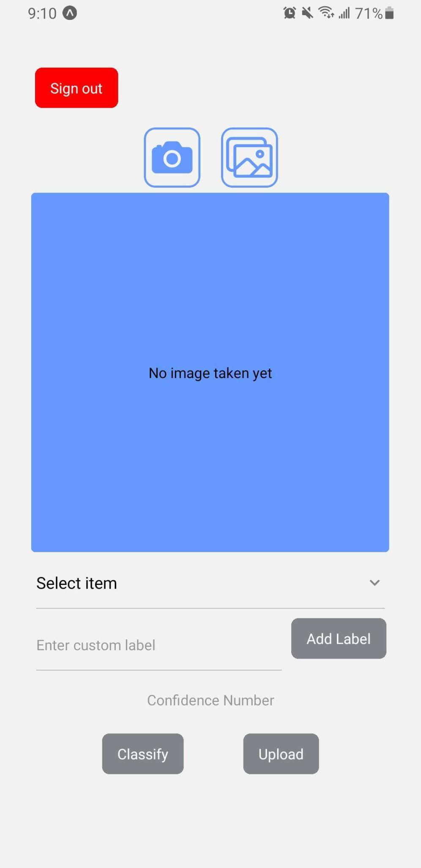
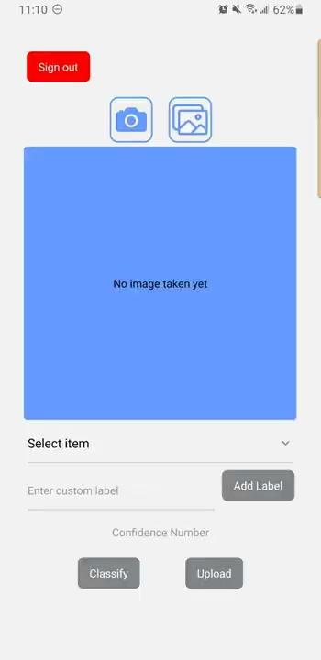
Mobile Client
Justin To

Slide 21
Future Goals for Mobile
Implementing image predictions user uploads (outcome & accuracy)
APPs between different users can update each other’s data and upload corresponding data
Button to update model version
Wilson Gan

Slide 22
Web Client
Goal: create admin client to serve as a main interface to the server
Verification for new incoming images
Display information about the Model
Dataset and user info management
Technologies:
React
NextJS
Material-UI
Howard Nguyen

Slide 23
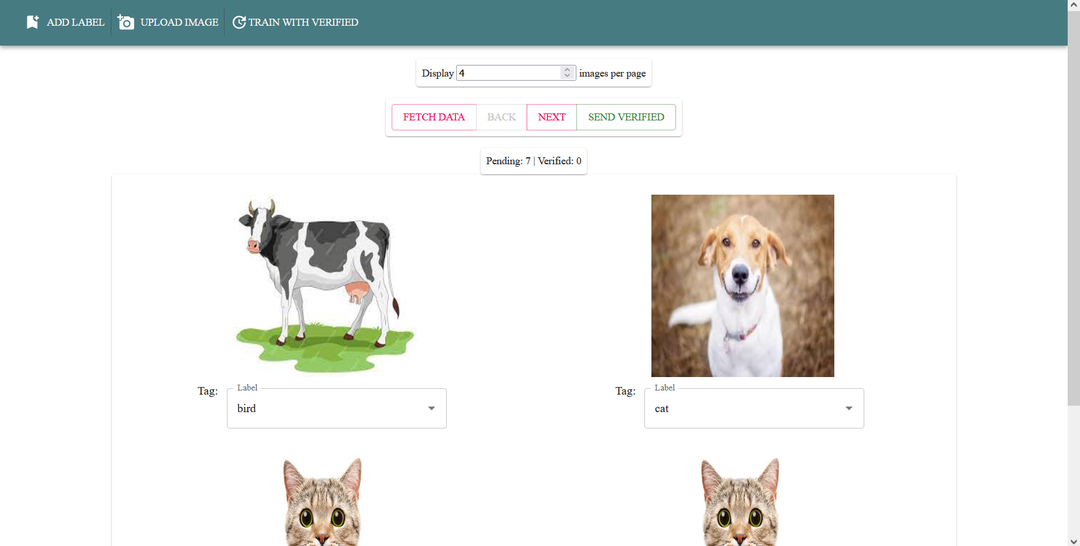
Web Client
Howard Nguyen

Slide 24
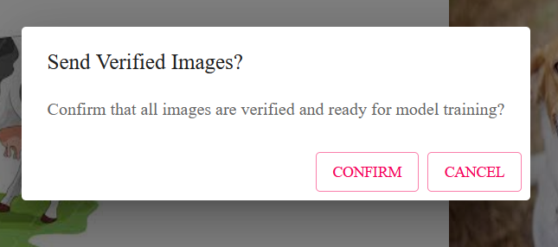
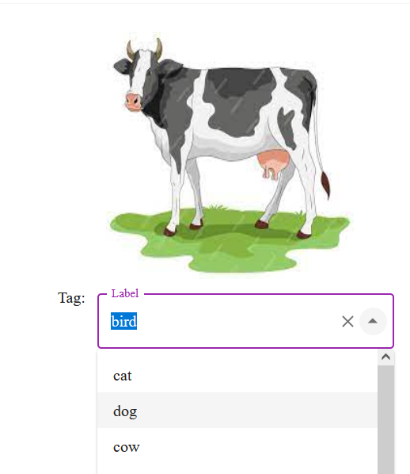
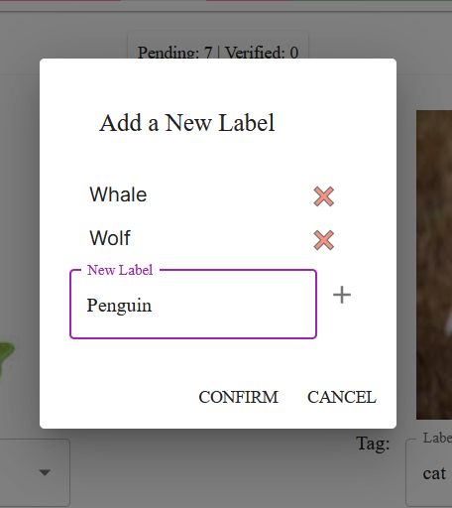
Verification and Labeling Features
Add and manage labels
Edit labels on unverified images
Stage verified images for training
Nisapat Poolkwan

Slide 25
Future Goals for Web
Optimize and manage internal web API
Add different functions to the web page to facilitate user use
Image uploading
Model use
GUIs to display information and statistics about users and the model
Interface for dataset management
Nisapat Poolkwan

Slide 26
Q&A
Any Questions?

