Slide 1
Box.com & eDefender Integration
.SPONSOR.
.LIAISONS.
.ADVISOR.
Santa Barbara Public Defender’s Office
JungSoo Lim
Deepak Budwani
Luis Ramirez
AJ Voisan
Angie Stokke
Sarah Rothschild

Slide 2
01
02
03
MEET
THE TEAM
ABOUT
SBPD
PROJECT
DESCRIPTION
04
05
SEMESTER OVERVIEW
CONCLUSION

Slide 3
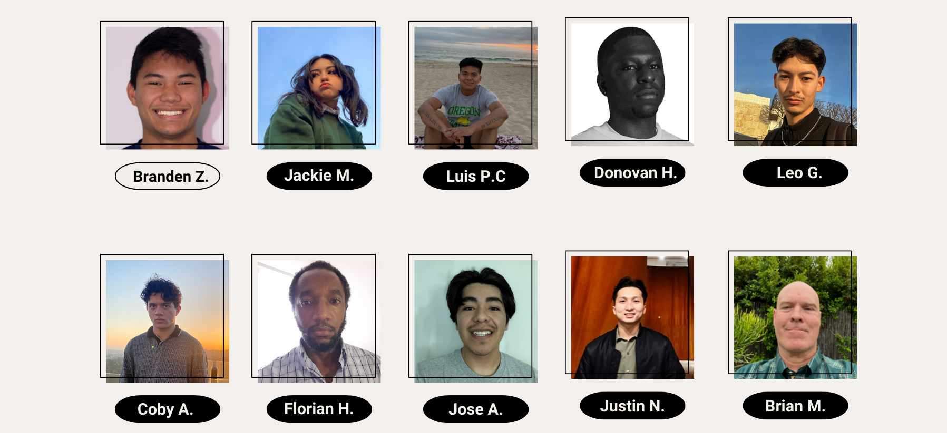
Branden Z.
—MEET THE TEAM— | ABOUT SBPD | PROJECT DESCRIPTION | SEMESTER OVERVIEW | CONCLUSION

Slide 4
Branden Z.
WHO THEY ARE AND WHAT THEY DO
The Santa Barbara Public Defender’s office has a content management system called “eDefender”; they are currently leveraging Box.com to build an infrastructure to support their networks where they’ll be able to migrate terabytes of data to the cloud.
MEET THE TEAM | —ABOUT SBPD— | PROJECT DESCRIPTION | SEMESTER OVERVIEW | CONCLUSION

Slide 5
Branden Z.
THEIR CURRENT PROCESS
Can currently ONLY handle English content (Video Indexer Language Model)
Code needs better error handling and logging. Contains many vulnerabilities
AWS Lambda function is a public endpoint (dangerous/unsafe)
Hopes to deploy next year
MEET THE TEAM | —ABOUT SBPD— | PROJECT DESCRIPTION | SEMESTER OVERVIEW | CONCLUSION

Slide 6
Branden Z.
IMPORTANCE OF THE PROJECT
GOAL: Reduce the amount of time lawyers spend organizing and analyzing electronic media; in turn making the process more efficient and effective.
CURRENT IMPLEMENTATION:
MEET THE TEAM | ABOUT SBPD | –-PROJECT DESCRIPTION–- | SEMESTER OVERVIEW | CONCLUSION

Slide 7
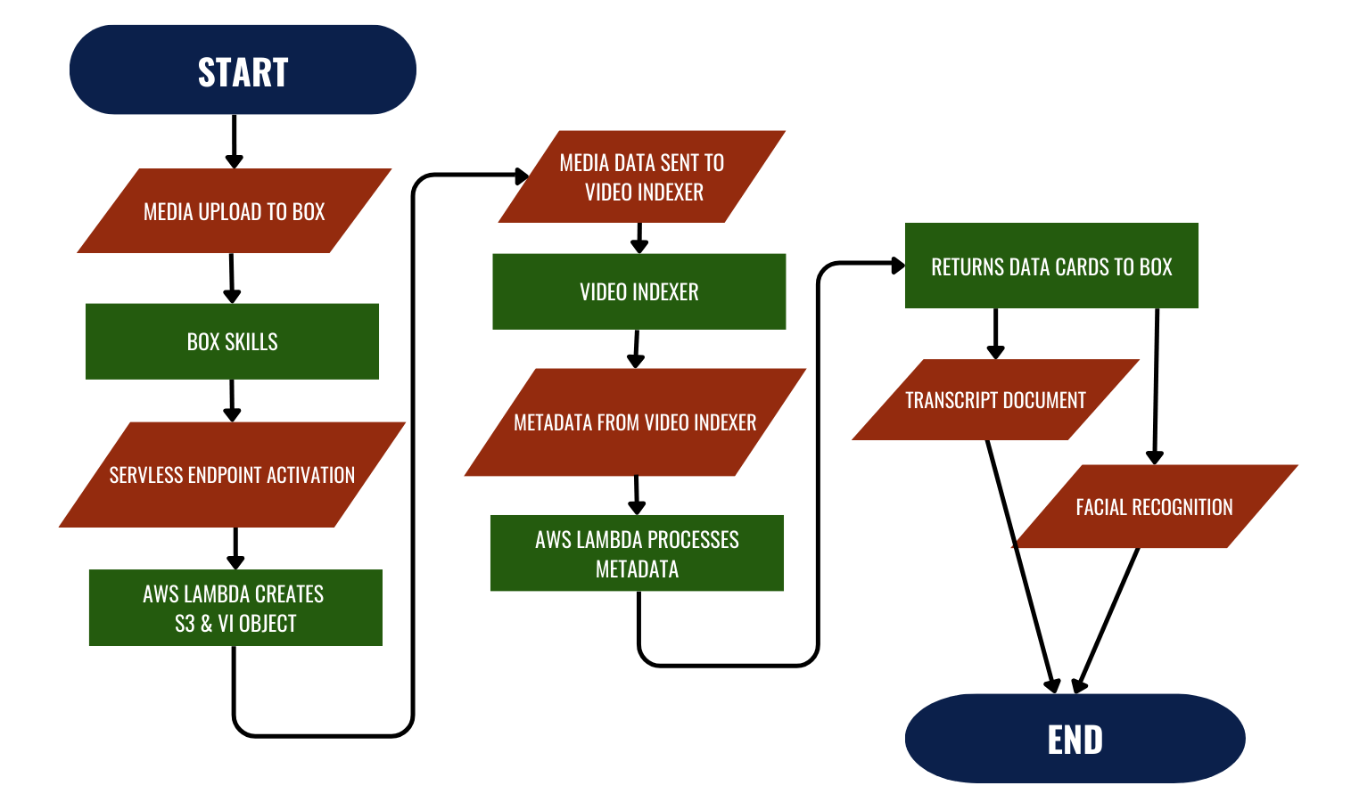
Branden Z.
OVERVIEW
Secure lambda endpoint, configuration files, and private data.
Refactor and organize code, limit vulnerabilities, and implement error handling
Improve transcript accuracy, marking, and correction abilities
Create AI custom models for increased accuracy
MEET THE TEAM | ABOUT SBPD | –-PROJECT DESCRIPTION–- | SEMESTER OVERVIEW | CONCLUSION

Slide 8
Jose A.
AWS TEAM
Improve security by implementing
AWS Secrets Manager
Clean up remaining S3 buckets after 30 days
(set an expiration date)
Minimize information being breached through the implementation of API Gateway
MEET THE TEAM | ABOUT SBPD | PROJECT DESCRIPTION | —SEMESTER OVERVIEW— | CONCLUSION

Slide 9
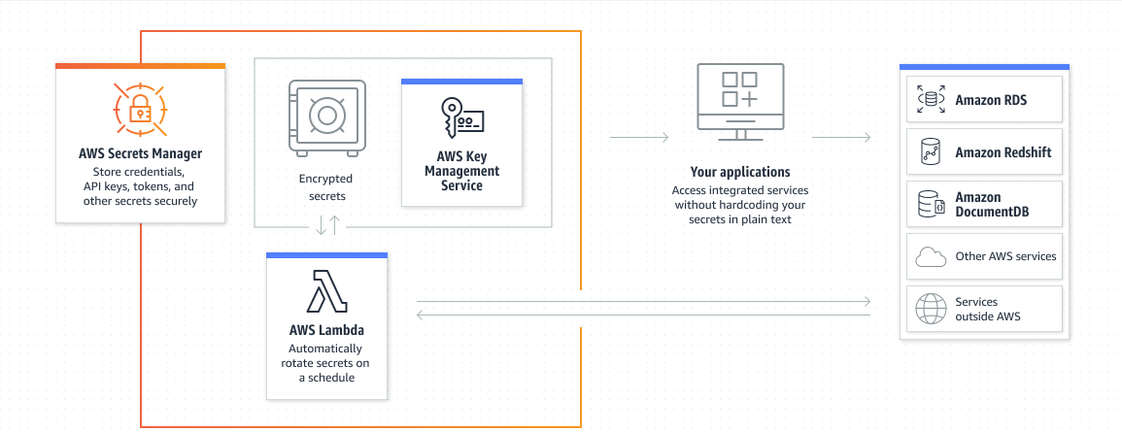
Donovan H.
Secrets Manager
Secrets Manager is an essential AWS service designed to safeguard sensitive data by encrypting it as a Secret
We utilize this service to store the API key required for connecting our Lambda function with Box.com.
Our Lambda function uses a key generated by AWS Key Management Service (KMS) to encrypt/decrypt the Secret and use it in our code
MEET THE TEAM | ABOUT SBPD | PROJECT DESCRIPTION | —SEMESTER OVERVIEW— | CONCLUSION

Slide 10
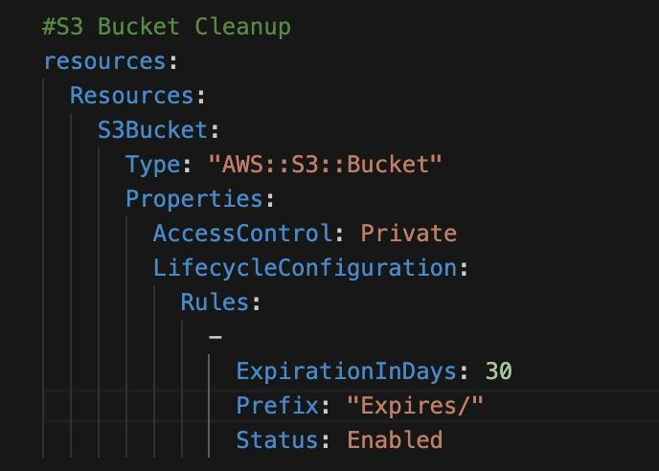
Coby A.
S3 Bucket Cleanup
What is S3 Bucket Cleanup?
What is the purpose?
How is it important?
How is it implemented into the application?
MEET THE TEAM | ABOUT SBPD | PROJECT DESCRIPTION | —SEMESTER OVERVIEW— | CONCLUSION

Slide 11
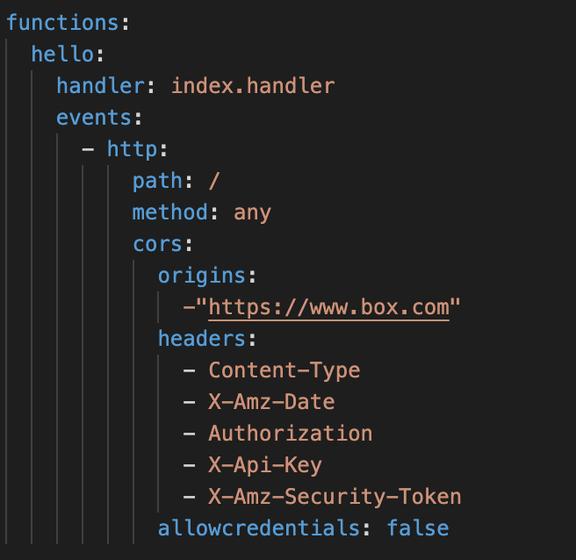
Luis P.
API Gateway
What is API GateWay?
What resources are being used?
How are we improving Security?
MEET THE TEAM | ABOUT SBPD | PROJECT DESCRIPTION | —SEMESTER OVERVIEW— | CONCLUSION

Slide 12
Jose A.
FUTURE GOALS
Expand upon our work and ensure security frameworks are in place for protecting user information
Ensure there are no bugs that will prohibit users from using the application
Address problems that’ll be brought up from the team at the Santa Barbara’s Public Defender's Office
MEET THE TEAM | ABOUT SBPD | PROJECT DESCRIPTION | —SEMESTER OVERVIEW— | CONCLUSION

Slide 13
Justin N.
CODEBASE TEAM
Works directly with the code and finds new approaches to make the
program more efficient
Modularizing
Error Handling & Logging
Updating Versions
Verifying Box Requests
S3 Bucket Deletion
MEET THE TEAM | ABOUT SBPD | PROJECT DESCRIPTION | —SEMESTER OVERVIEW— | CONCLUSION
Notes:
Introduce the team name
Go over the members (mention who the lead is)
Talk about the purpose of this subgroup (basically just saying the subtitle)
Go over the 5 tasks that were given to us and maybe talk through on how we decided to approach them (doing the easier tasks first, going for updates first and leaving error handling till last, etc,.)
That should be enough to cover ~1/1.30 minutes. Try not to go over time pls.

Slide 14
Jackie M.
SEMESTER ACHIEVEMENTS
Updating Versions
59 vulnerabilities → 0 vulnerabilities
NodeJS v14.x.x → NodeJS v18.x.x
AWS v2 → AWS v3
S3 Bucket Deletion
After program termination
MEET THE TEAM | ABOUT SBPD | PROJECT DESCRIPTION | —SEMESTER OVERVIEW— | CONCLUSION
Notes:
1 minute
Script: For this semester, we were able to accomplish about four of the five tasks we were given. The first task that we approached was updating versions which included lowering dependency vulnerabilities from the original 59 to 0. Which we were able to do. Another important update was the migration of our code from AWS version 2 to version 3, which included a bit of code refactoring on our part. The most notable change was the dependency injection of the entire aws-sdk to a more modular version with only the needed libraries and components being installed. The second task that we approached was deleting the storage bucket once the program has finished execution. Prior to this change, all data incoming from Box or Video Indexer was kept in the AWS S3 service, which is helpful during program execution, but not necessary to store after we’ve received our modified media. Hence why the deletion was necessary to do.
(50 seconds - 1 minute)

Slide 15
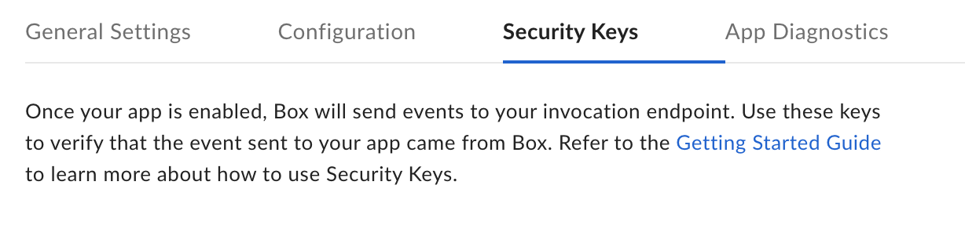
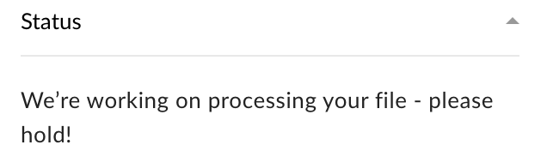
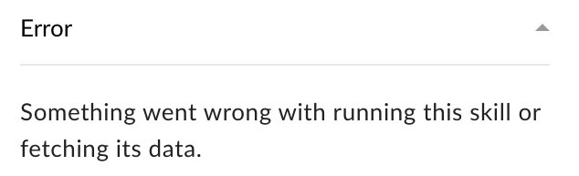
Jackie M.
SEMESTER ACHIEVEMENTS
Verifying Box Requests
Utilized Box Security Keys
Initial Error Handling and Logging
Error Messages to User
Deleting S3 Bucket
MEET THE TEAM | ABOUT SBPD | PROJECT DESCRIPTION | —SEMESTER OVERVIEW— | CONCLUSION
Notes:
1 minute
The third task we set out to accomplish was verifying incoming requests and making sure they actually came from Box. We were able to use the provided Security Keys and verification function to complete this task. It sort of bleeds into our final accomplishment which is our initial approach to error handling and logging. And so, in the case that the security keys are not correct, or that the request didn’t come from box, then an error message is dispatched to the console and an error card is displayed to the user on Box. Our most notable error handling accomplishment had to be displaying that error card to the user. Prior to this, if an error occurred at any point during the process, the user would not be notified of it and instead would think that their media is continuing to process when in reality the program has stopped running. Finally, we were also able to begin to create more accurate logs, so that developers would have an easier time figuring out where and when an error occurred. I will now pass it on to Florian.

Slide 16
Florian H.
FUTURE GOALS
Github Branches
Handle any merging errors
Continue Error Handling and Logging
Finish existing files + begin on new code (written this semester)
Begin Modularizing
Create new functions + new files
MEET THE TEAM | ABOUT SBPD | PROJECT DESCRIPTION | —SEMESTER OVERVIEW— | CONCLUSION
Notes:
Go through our future goals for spring semester (maybe 20-25 seconds on each of the three)
Wrap up our little subsection and pass it on to the next subgroup/speaker (transcript team)
I know you have to speak for your group as well so i think this should only take >1 minute
For the next semester we have three main goals. THe first goal is to merge all of the subteams github branches and then handle any resulting errors that come from that. Our second goal is to continue error handling and logging which includes finishing working on our existing files and then starting on new files that we created this semester. Our final goal is to begin modularizing which includes creating new functions, refactoring, and making the code more accessible to developers overall.

Slide 17
Leo G.
TRANSCRIPT TEAM
Revise and modify the code that transcribes the
case videos onto a document
Debug document line numbering
Rework parsing format
Implement confidence marking
MEET THE TEAM | ABOUT SBPD | PROJECT DESCRIPTION | —SEMESTER OVERVIEW— | CONCLUSION

Slide 18
Brian M
SEMESTER ACHIEVEMENTS
Challenges:
What level of confidence should be used?
When multiple teams are working on the same code, how to decide who makes last changes.
Learning new programming language and becoming acquainted with new libraries
The first achievement was to create code that placed “Highlight” tags before and after any code that did not measure up to a predetermined percentage level.
CONFIDENCE MARKING
Highlighting text that
Video Indexer is not sure of
MEET THE TEAM | ABOUT SBPD | PROJECT DESCRIPTION | —SEMESTER OVERVIEW— | CONCLUSION

Slide 19
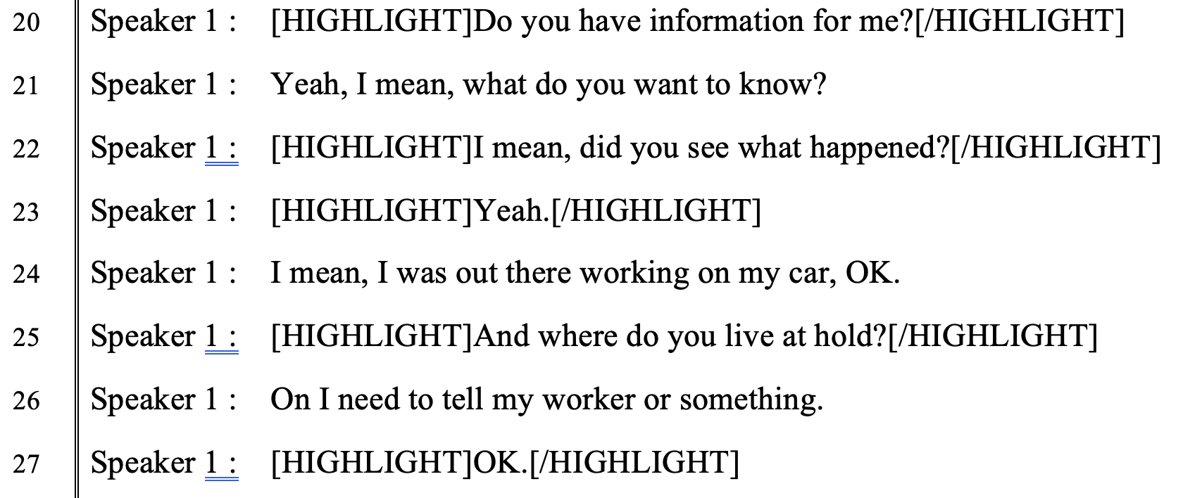
Brian M
SEMESTER ACHIEVEMENTS
FIRST
ITERATION
MEET THE TEAM | ABOUT SBPD | PROJECT DESCRIPTION | —SEMESTER OVERVIEW— | CONCLUSION

Slide 20
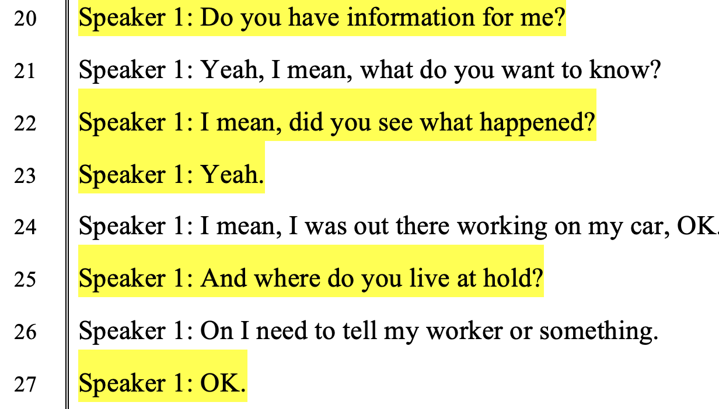
Brian M
SEMESTER ACHIEVEMENTS
CURRENT VERSION
MEET THE TEAM | ABOUT SBPD | PROJECT DESCRIPTION | —SEMESTER OVERVIEW— | CONCLUSION

Slide 21
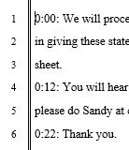
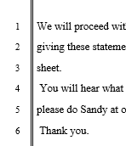
Branden Z
SEMESTER ACHIEVEMENTS
–OLD PARSING–
–NEW PARSING–
Fixed document parsing for Text Files
No longer a single string
Parsing is more elaborate
MEET THE TEAM | ABOUT SBPD | PROJECT DESCRIPTION | —SEMESTER OVERVIEW— | CONCLUSION

Slide 22
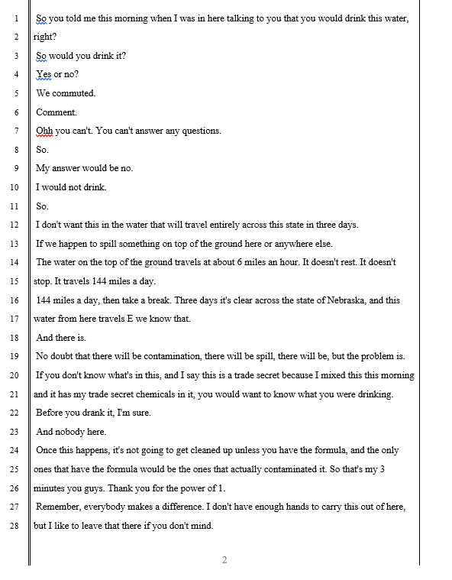
Branden Z
SEMESTER ACHIEVEMENTS
Fixed line numbering for Text Files
Maximum line limit of 28
Removed extra blank page
–OLD LAST PAGE–
–NEW LAST PAGE–
MEET THE TEAM | ABOUT SBPD | PROJECT DESCRIPTION | —SEMESTER OVERVIEW— | CONCLUSION

Slide 23
Leo G.
FUTURE GOALS
Finish confidence marking
Fix Line numbering with Json Files
Use more test files to parse documents
Research methods for code efficiency
MEET THE TEAM | ABOUT SBPD | PROJECT DESCRIPTION | —SEMESTER OVERVIEW— | CONCLUSION

Slide 24
Florian H
CUSTOM MODELS TEAM
Research methods and approaches on creating custom models
for efficient recognition
Use transcript updates to add into the
customized model
Expose model to a variety of scenarios
from our dataset
Create performance metrics to track
the reliability of our custom model
MEET THE TEAM | ABOUT SBPD | PROJECT DESCRIPTION | —SEMESTER OVERVIEW— | CONCLUSION

Slide 25
Jose A.
SEMESTER ACHIEVEMENTS
--Before Training–
Materials for test and development are ready
Manually trained the language model to observe accuracy rates
Compare human transcripts with
Video Indexer transcripts and with
source media
--After Training–
MEET THE TEAM | ABOUT SBPD | PROJECT DESCRIPTION | —SEMESTER OVERVIEW— | CONCLUSION

Slide 26
Branden Z.
FUTURE GOALS
Have a fully functional custom language model delivered
Continue to train the Video Indexer language model
and identify ways to improve the transcription accuracy
Migrate the Custom Model Language to using an API
MEET THE TEAM | ABOUT SBPD | PROJECT DESCRIPTION | —SEMESTER OVERVIEW— | CONCLUSION

Slide 27
THANK YOU
–Questions?--
This presentation template was created by slidesgo, including icons by flaticon, infographics and images by freepik
MEET THE TEAM | ABOUT SBPD | PROJECT DESCRIPTION | SEMESTER OVERVIEW | —CONCLUSION—

