Slide 1
RoboSubLA
CS Senior Design Team
Soaring to new heights... or depths?
Notes:
Made the bird guy a little cuter, maybe hotter too?

Slide 2
Advisors & Members
Advisors:
Richard Cross
Special Thanks:
Michael Thorburn, Mark Tufenkjian
Members:
Alexandra Barahona Amador, Joshua Chavez, Kevin Chun Celis, Jordan Doose, Edward Eckle, Justin Guerra, Jason Ha, Daniel Jimenez Dexter Kale, Sebastian Luna, Minh Ngo, Lizbeth Vargas-Martinez

Slide 3
What Is RoboSubLA?
Purpose - To strengthen engineering skills and encourage interdisciplinary experience in young engineers, and foster ties to organizations developing autonomous underwater vehicles (AUVs)
Competition Goal - Design & develop an AUV, demonstrate its abilities and autonomous capabilities by performing a series of tasks

Slide 4
Our Tasks
Based on last year’s competition handbook, develop a software package capable of driving submarine hardware through all competition tasks
When this year’s competition handbook is released, modify and continue to develop software to accommodate new challenges
Ensure compatibility between various software subcomponents by using a common communications library (ROS2 Iron)
Test software intensively both on and off actual vehicle hardware

Slide 5
The Competition

Slide 6
RoboSub
International competition hosted by RoboNation
Collegiate & high school teams from around the world
Typically 30-40 teams in attendance (more online)
Usually hosted at NIWC Pacific’s TRANSDEC facility in San Diego
This year: Irvine!

Slide 7
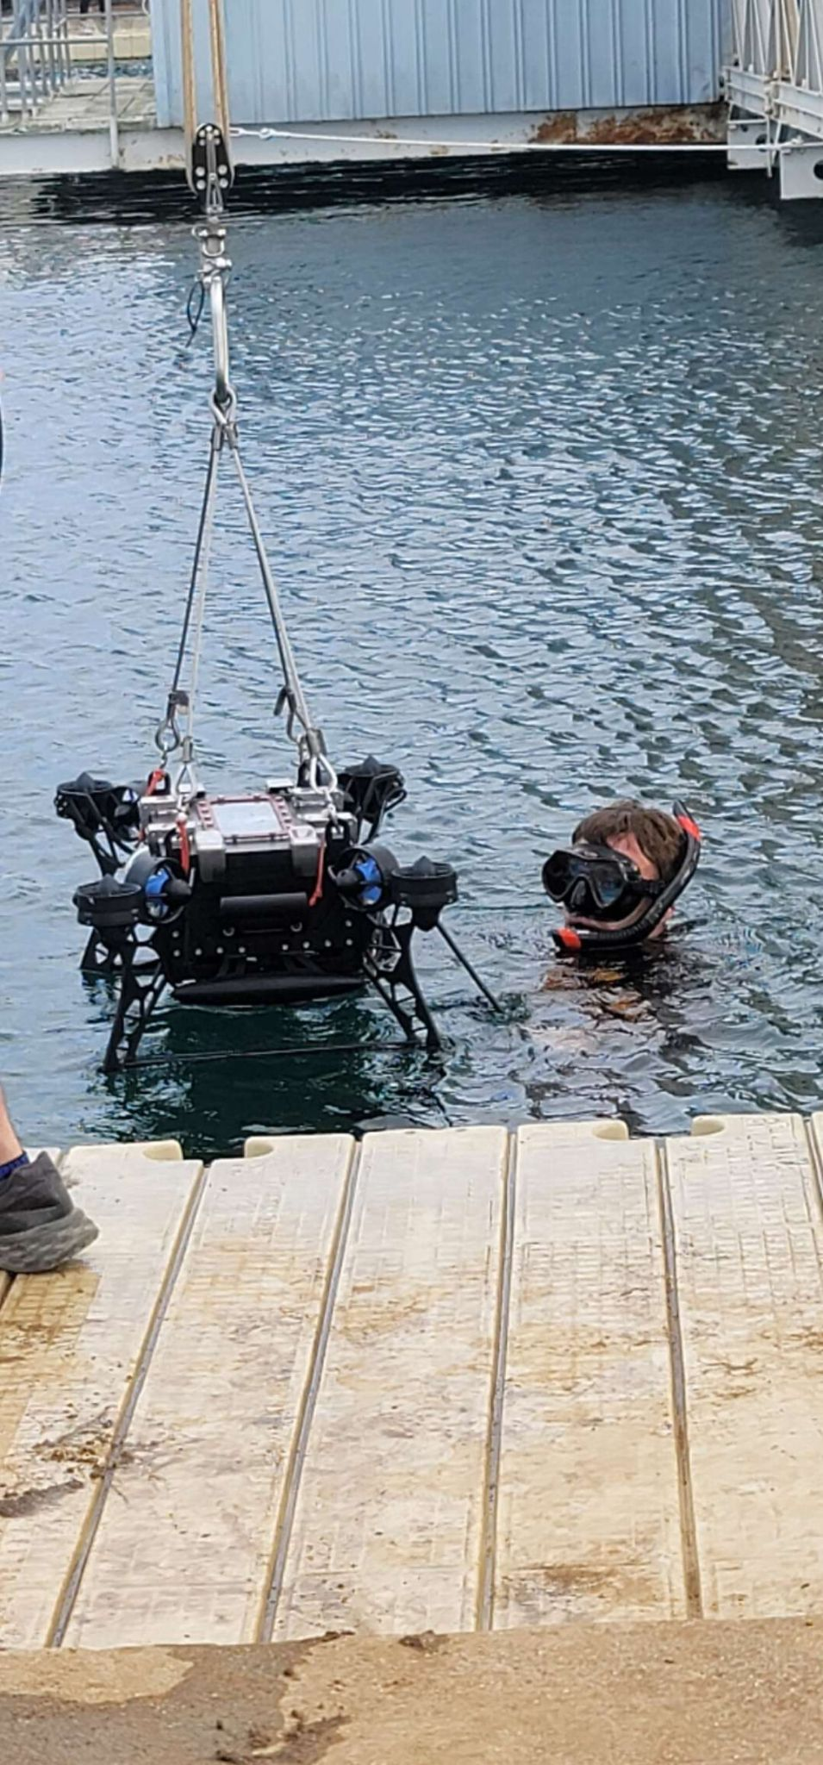
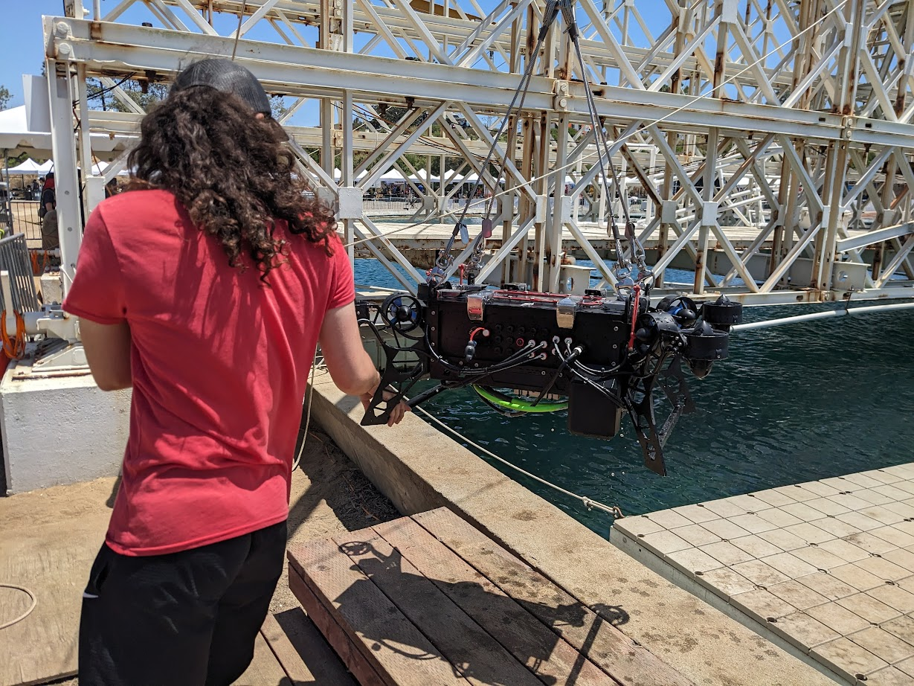
RoboSub

Slide 8
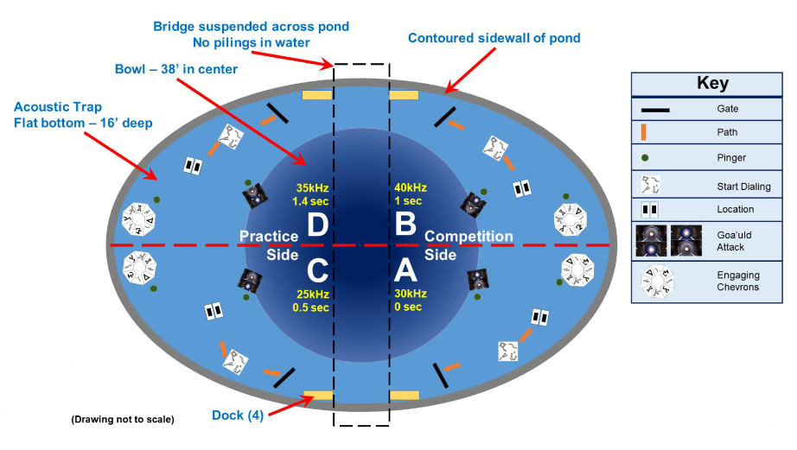
Competition Layout

Slide 9
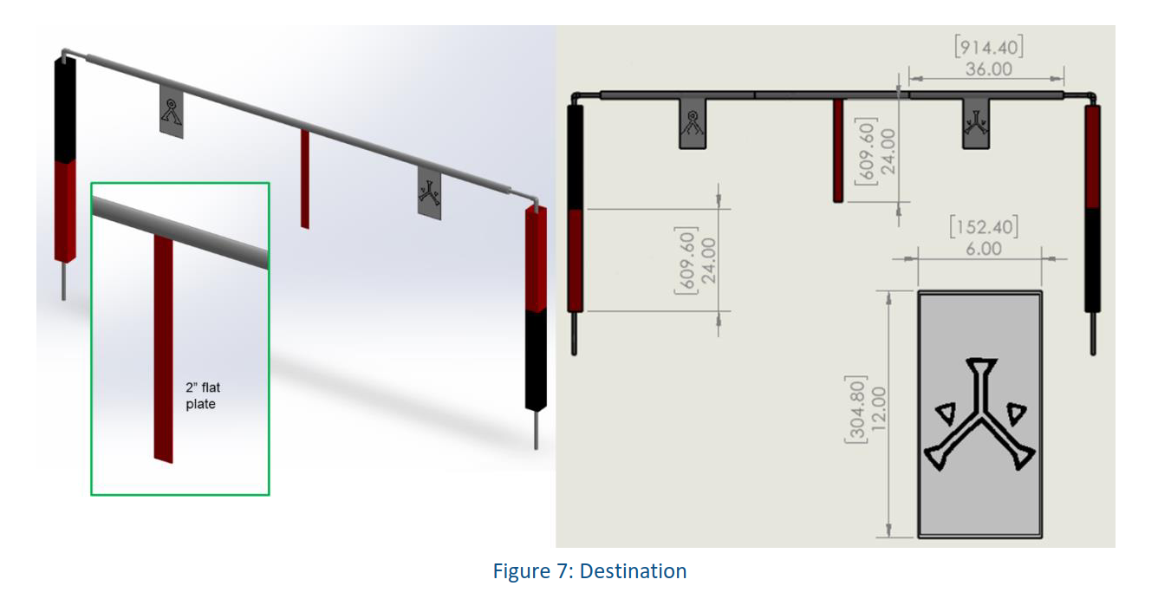
Tasks - Gate

Slide 10
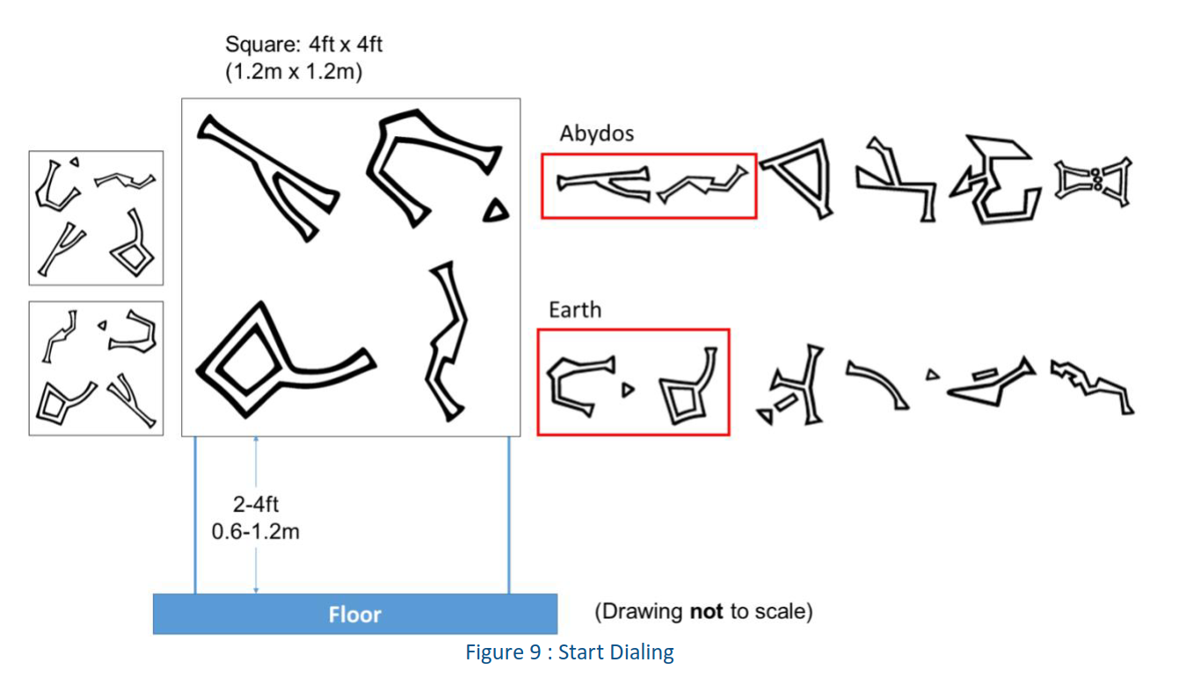
Tasks - Buoy

Slide 11
Tasks - Bins

Slide 12
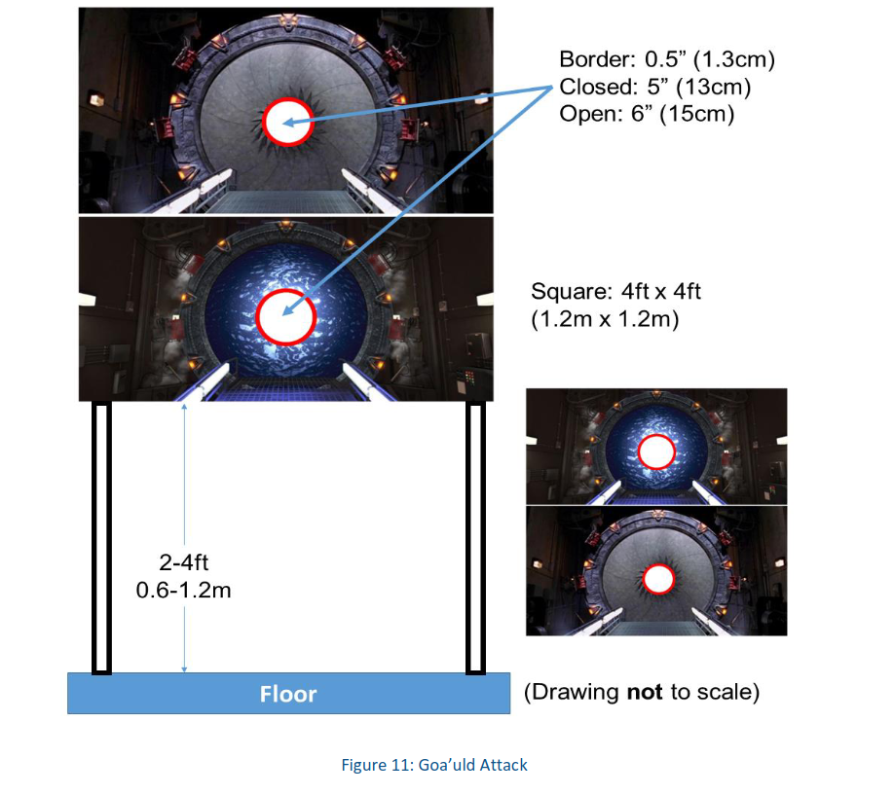
Tasks - Torpedoes

Slide 13
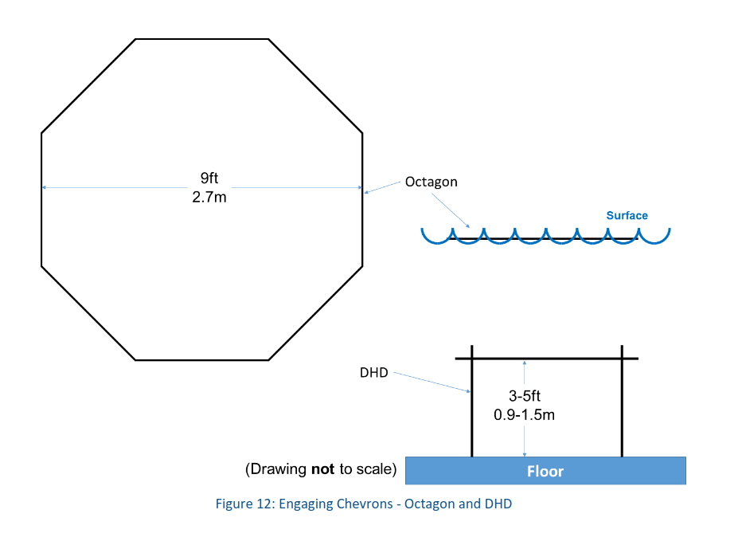
Tasks - Octagon

Slide 14
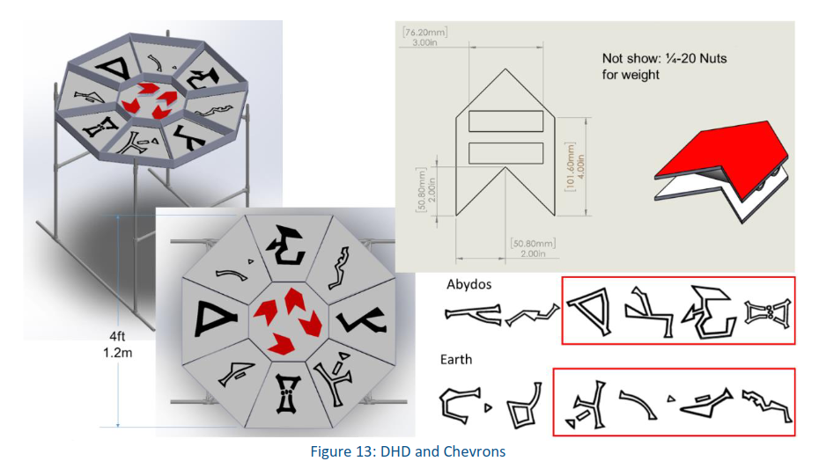
Tasks - DHD

Slide 15
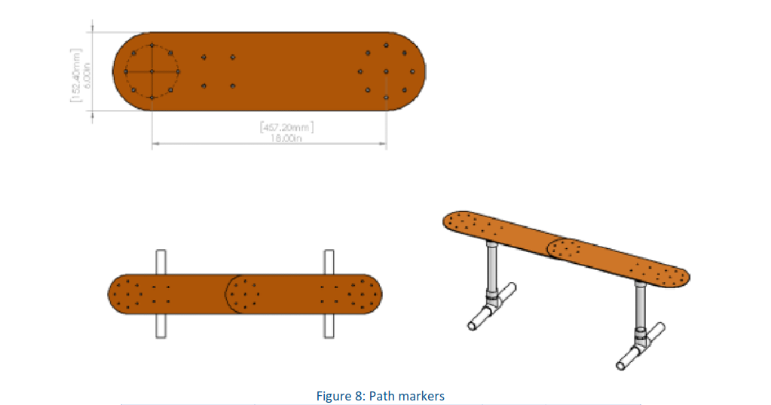
Aids - Path

Slide 16
Aids - Pinger
2 tasks with underwater acoustic pingers - Torpedoes and Octagon
Pingers can be used to locate the tasks
Random Pinger - One of the two pingers is randomly selected and turned on, we must go to that task and complete it next
Additional points for random pinger successful completion

Slide 17
Tech - Intervehicular Communication
Two robots allowed per team in competition
Robots are allowed to communicate with one another
Useful for sharing task location data, improving position estimates
LOTS of points for successful complex intervehicular communication

Slide 18
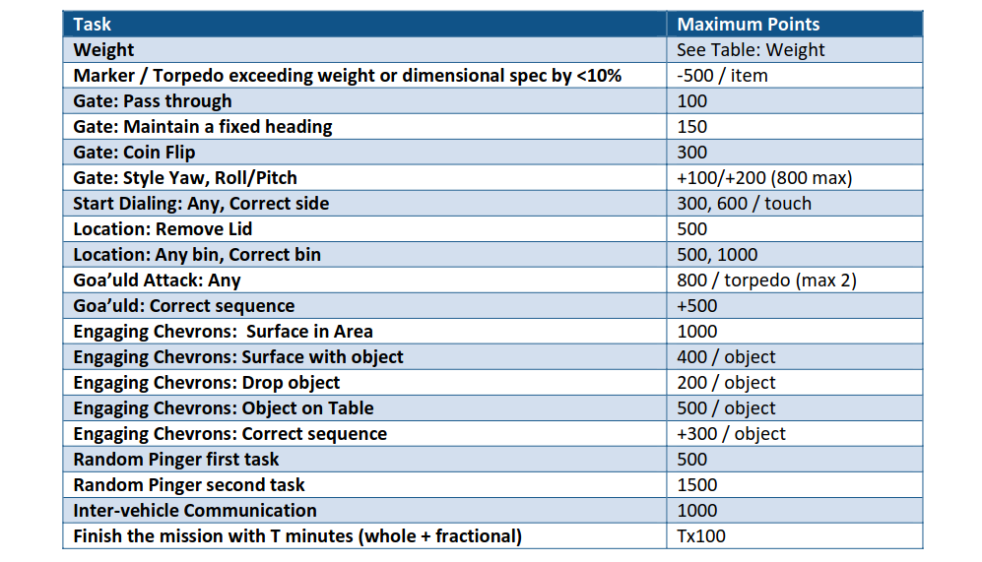
Point Values

Slide 19
Team Breakdown
Student Organization
ME/EE/CS/other students
~30 members
Freshman-Senior standing
Design & build Wailord
Develop some software systems
Fundraise, outreach, and perform admin duties
ME/EE Senior Design
ME/EE seniors
4 members
Design & build Lanturn’s mechanical and electrical systems
Support student org with advanced knowledge
CS Senior Design
CS seniors
12 members
Design & develop the bulk of submarine software
Support student org with software components & development efforts on co-developed systems

Slide 20
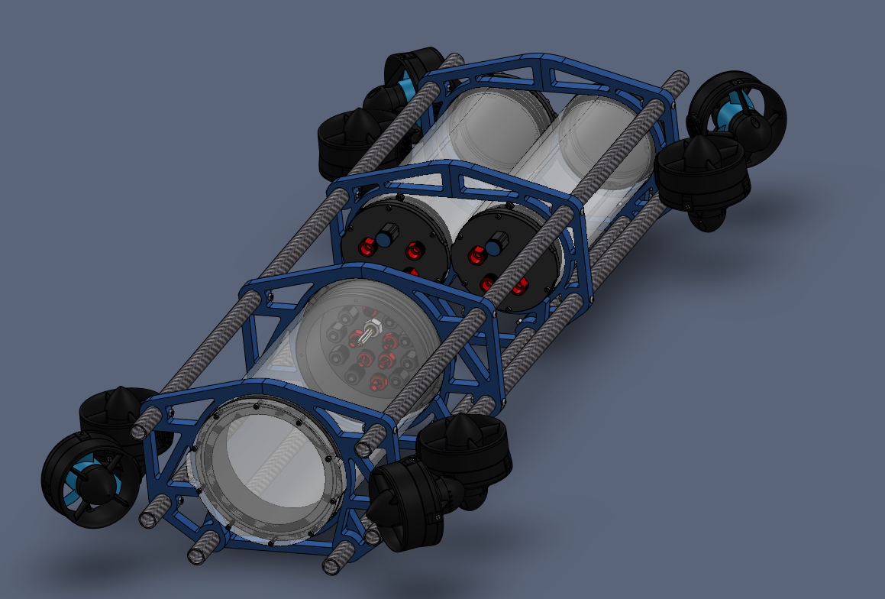
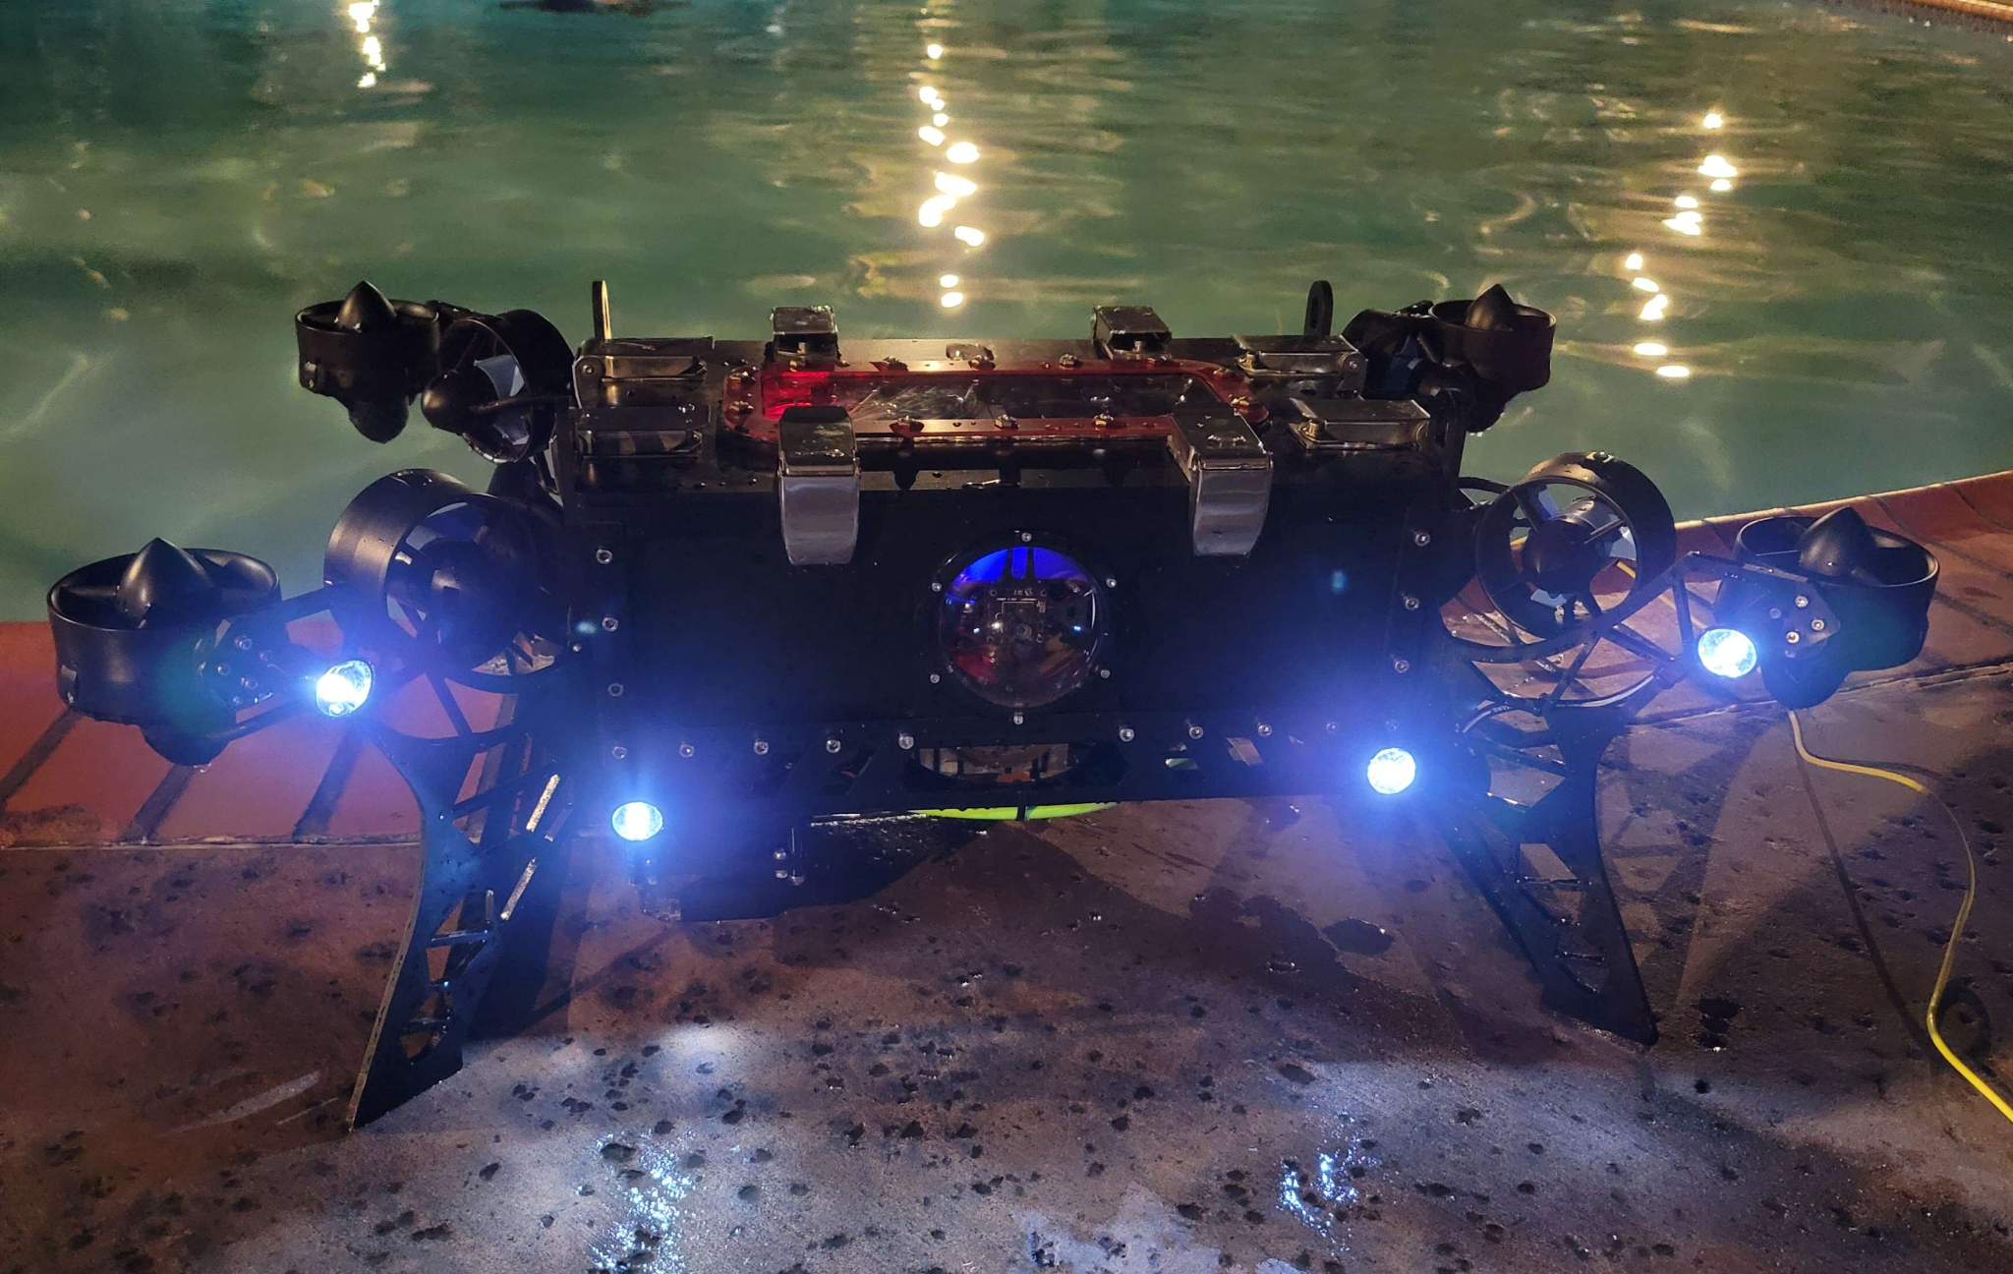
Submarine Hardware
Wailord
Lanturn

Slide 21
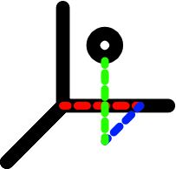
Computer Science Sub Teams
Localization
Computer Vision
Test Fixtures
Mapping
Autonomy
Simulation

Slide 22
Localization

Slide 23
What is Localization
Localization is a process that gathers information from sensors to continually determine a submarine's precise condition, including its location, direction, and velocity. This data is then shared with mapping and autonomy systems, likely implemented in C++, and can run on either desktop or embedded platforms.
Notes:
Joshua Slide

Slide 24
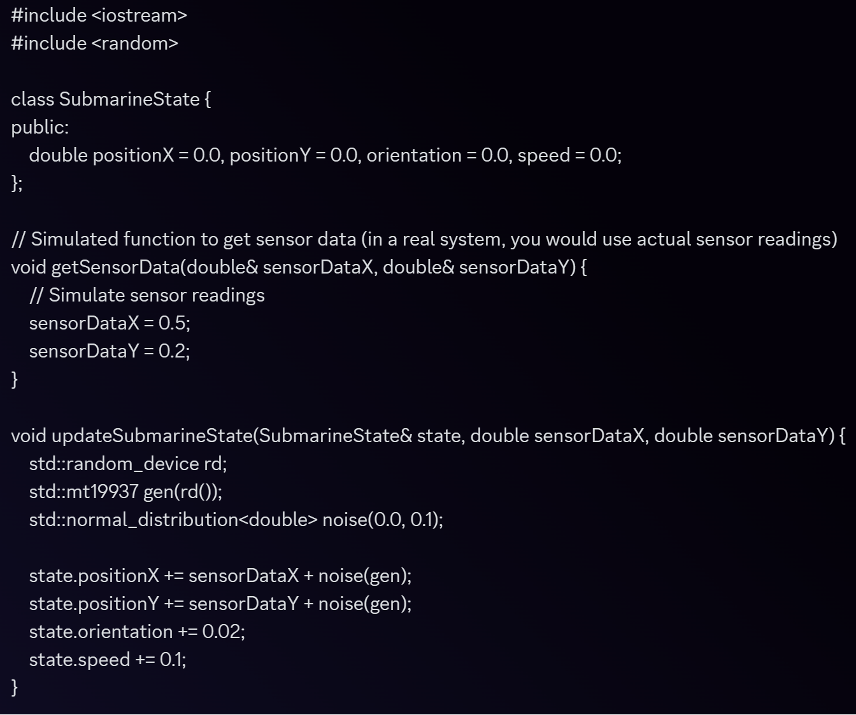
Localization - Research
What we have
As we are starting fresh with localization we started with heavy research, setup a ROS and environment and currently working on usable code.
Code

Slide 25
Localization - Goals
Our main goal is to provide the submarine with an accurate understanding of its position and orientation within the underwater environment to enable safe, effective, and precise navigation and mission execution.
Some of our primary goals are, but not limited to:
Precise Location
Integration
Real-Time Performance

Slide 26
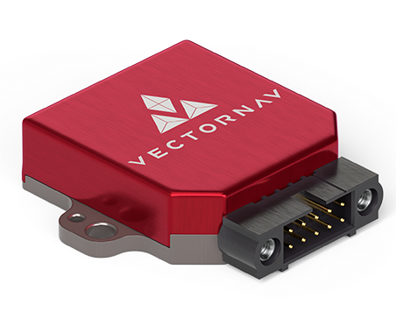
Localization - Sensors
Some of the tasks we want to perform using the VN-100:
Sensor Fusion and Data Integration
Kalman Filtering
Continuous Sampling and Real-Time Processing
We are actively working on the implementation of sensors, specifically, the VN-100 which will significantly contribute to achieve our established goals.

Slide 27
Mapping

Slide 28
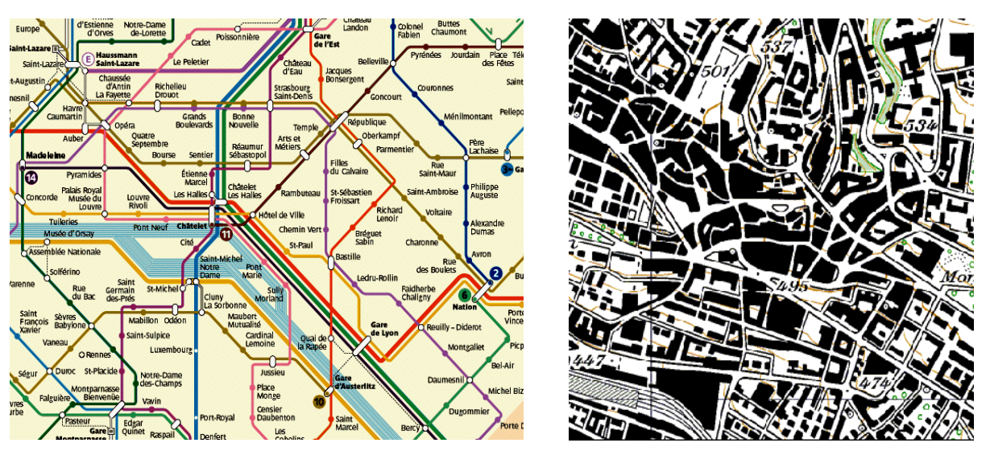
Mapping
Our Job:
Collect data from localization and computer vision modules, use them to create a map to navigate the Arena
Spatial Map - a map representing the physical space
(e.g. Goal 2 meters away, in direction v)
Contextual Map - a map representing the abstract space
(e.g. Closest element is Wall, Closest objective is Goal)

Slide 29
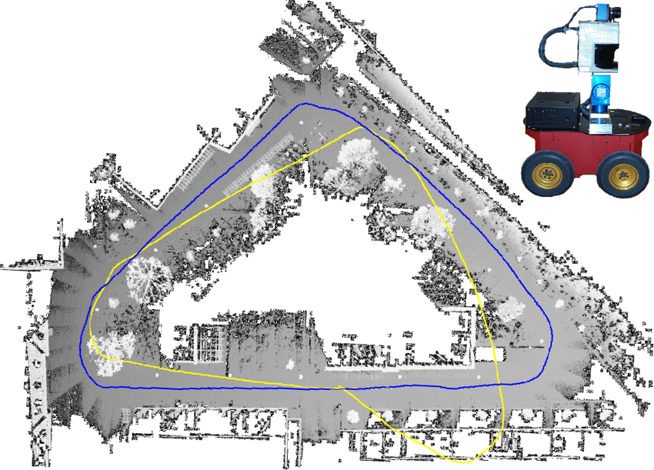
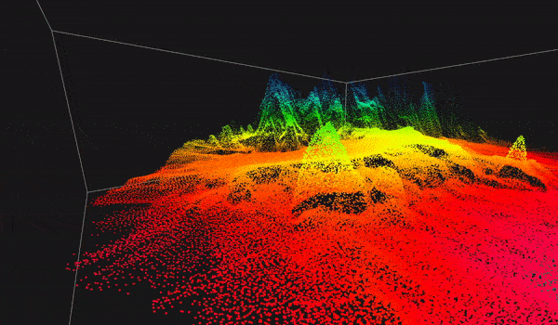
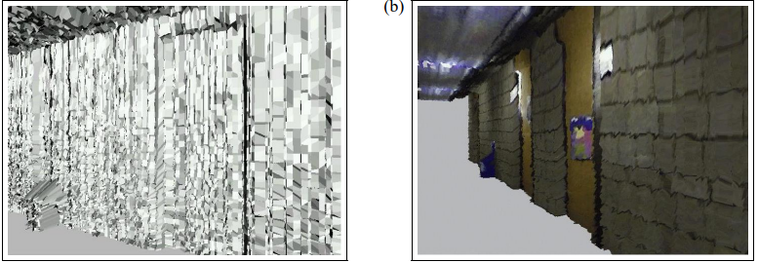
Mapping - Research
Different sensors and data structures to store a map
Lidar is commonly used to create point cloud maps
Many land autonomous vehicles can go 2D
Traditional Geometric approach, dynamically drawing triangles and meshes.

Slide 30
Mapping - High Level Design
ROS2 OpenGL Eigen
Spatial Map
MapCell
Resolution 1 cubic meter
3D array through indexing
The Pointer points to the pointed thing that we point...
SDF type
Transform
Next Cell
SharedData
Std::vector
Contextual Map
Graph data structure
Rules based
More research needed

Slide 31
Mapping - SDF Spatial Map
Using SDF’s to create the map
SDF - Signed Distance Function (or Fields)
Can be parallelized on GPU (OpenGL Shaders)
Data is shared between Map Types
Saves space, can be as inexpensive as we need.
Create one “EmptyCell”
point every Empty spot To it!!!

Slide 32
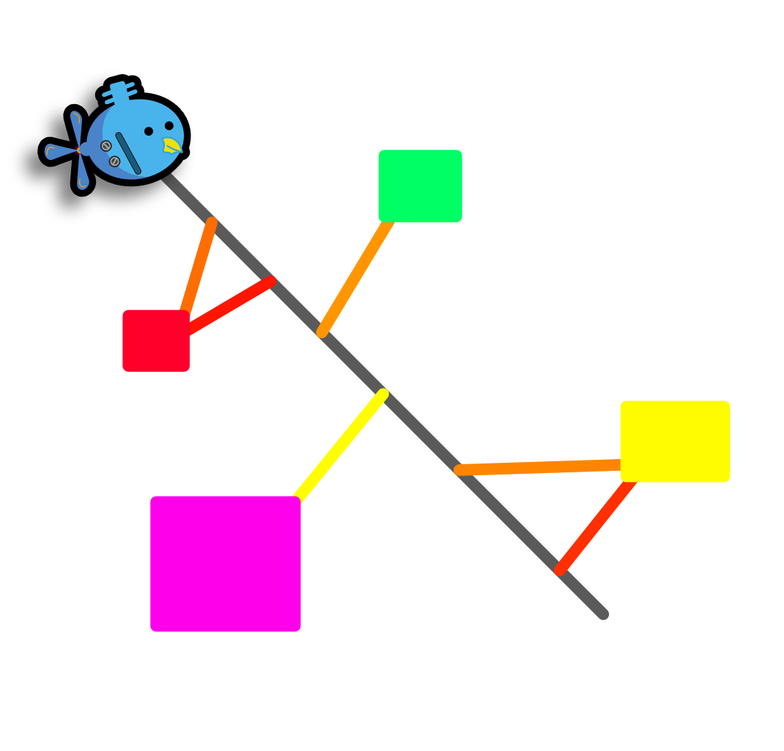
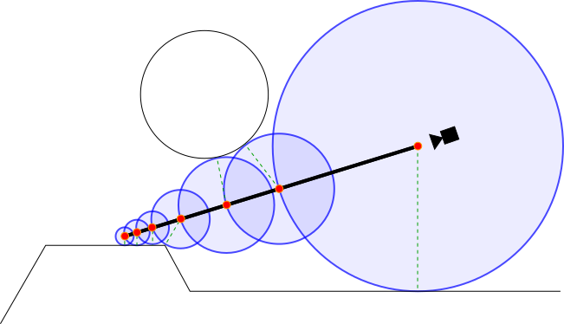
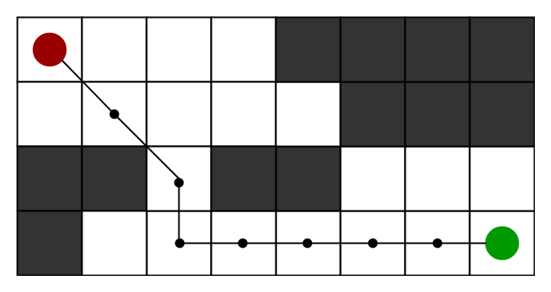
Mapping - Pathfinding
Using SDF, we can always know how far away we are from any obstacles
Sphere Tracing Accelerated Ray Marching
Alternatively use the Spatial Map Layout to perform A* Search
Simple point sampling

Slide 33
Computer Vision

Slide 34
Computer Vision
Our mission: if we choose to accept it
Adapt computer vision for object detection to wailord
Implemented the latest computer vision technology YOLOV7 for image detection in ROS environment
Annotated 300 images and trained custom dataset for image recognition
Using Roboflow- Box and label x-amount of images
Train Yolov7 on custom dataset
Research methods on different platforms, images, video, and live feed
Compose ROS output interface with C++ modules

Slide 35
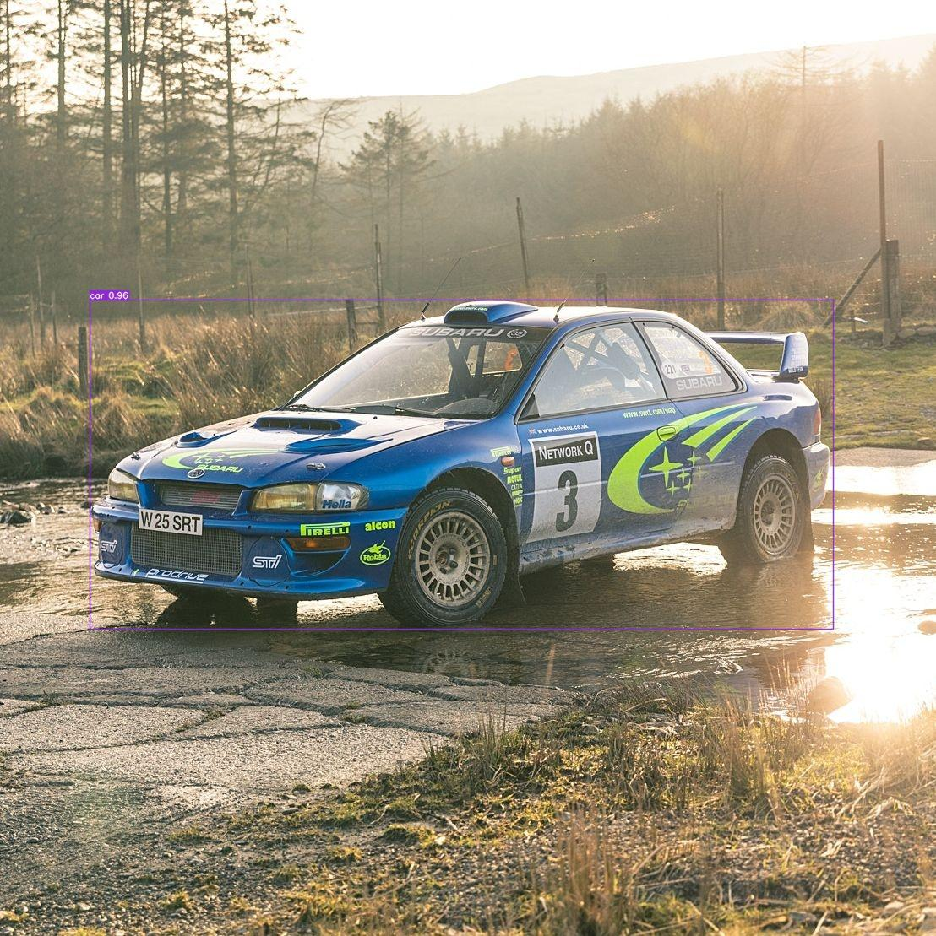
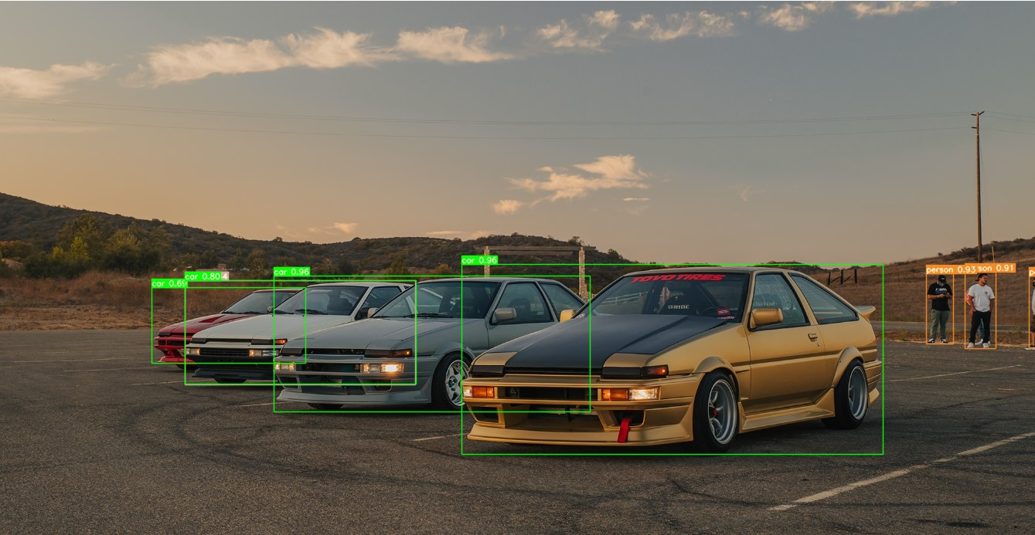
Computer Vision
Sample custom dataset

Slide 36
Autonomy

Slide 37
Autonomy
Our Job:
Gather all relevant sensor & estimator data
Keep track of the robot’s current state
Make high-level decisions on robot’s next action
Send required commands to achieve that action

Slide 38
Communication
Data in:
Position, orientation, rates (from Localization)
Hardware telemetry (from Controls)
Contextual map (from Mapping)
Currently visible objects (from Computer Vision)
Data out:
Controller setpoints (to Controls)
State (to hardware indicators)

Slide 39
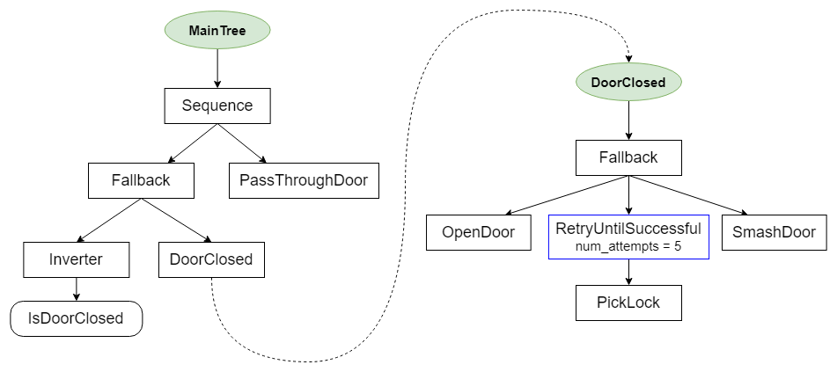
BehaviorTree.CPP
Library framework for building behavior trees
Only need to develop simple actions/conditions
Complex behavior results from tree structure
ROS built-in!

Slide 40
Actions & Conditions
Move to Pose
Go to a given position & orientation
Configurable mask for axes
Relative/absolute modes
Move at Twist
Translate at a given speed/spin
Configurable mask for axes
Relative/absolute modes
Move to object
Position relative to a given object
Configurable mask, object class
Relative to object orientation or no
Set gripper angle
Drop ball
Selectable by index
Fire torpedo
Selectable by index
Can see object?
Reports if object is currently seen
Configurable confidence threshold
Have seen object?
Reports if object has ever been seen
Configurable confidence threshold
Have remaining markers?
Reports if more than N markers remain
Configurable threshold
Have remaining torpedoes?
Reports if more than N torpedoes remain
Configurable threshold

Slide 41
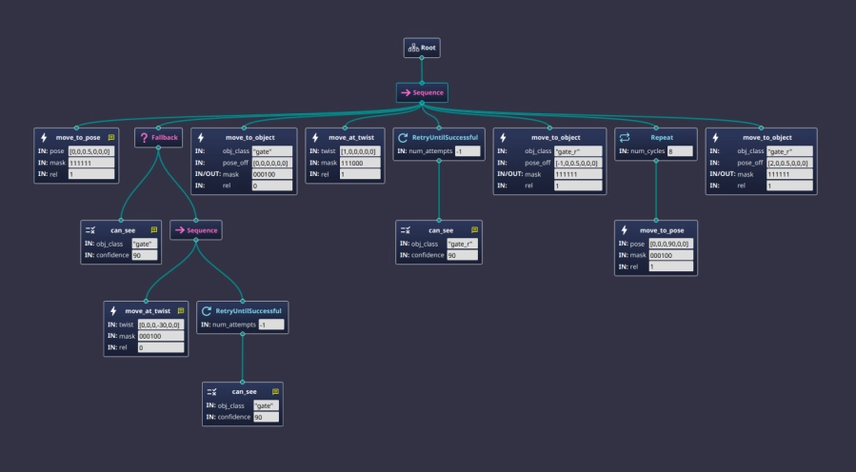
Behavior Trees - Gate Task
Dive 0.5 meters
Can we see the gate?
If no, turn right until we do
Look directly at the gate
Move forwards until we can see the gate posters
Position 1 meter in front of the gate poster and 0.5 meters below to avoid gate poster
Spin 2 times
Move through the gate

Slide 42
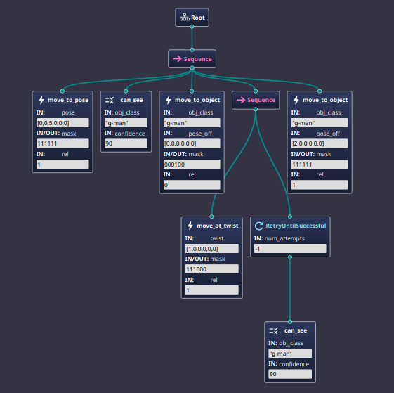
Behavior Trees - Buoy Task
Dive 0.5 meters
Can we see the symbol [Hard-Coded]?
(Should always be yes)
Look directly at the symbol
Move forwards until we can see the symbol
Move towards symbol till it’s touched
(2 meters for ensuring it does)
4
1
2
3
5

Slide 43
Last Year’s Lessons Learned
Write as little code as possible
Create complexity within trees, not nodes
Full system testing is vital, complete with arm/disarm actions
Full system testing is difficult and requires a pool
We will also be making a simplified simulator for testing autonomous functions only

Slide 44
Test Fixtures

Slide 45
Test Fixtures
-Established a connection with EE
-Set Goals with EE
-Established a Library were going to use for testing fixtures
-Settled with what hardware were going to be using for testing fixture
-Researched on how we would approach and complete goals

Slide 46
Test Fixtures
A few goals we set with EE were
Implementing led status indicators to visually have the status of robot
Have arduino and micro ros work together(we've achieved this by using Rosserial )
Build a test fixture to test components for ee team parts like torpedo

Slide 47
Test Fixtures
Library we've been using to accomplish this:
Micro ROS
What is Micro ROS?
micro-ROS is a set of software libraries that allow robotic applications to be deployed on microcontrollers with limited computational resources

Slide 48
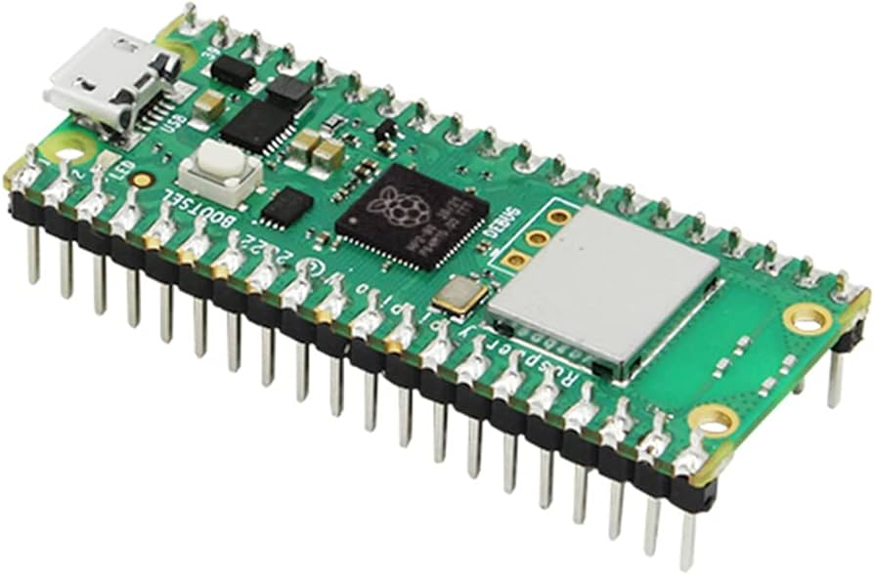
Test Fixtures
What hardware is being used to accomplish this?
Raspberry Pi Pico
Why?
Low-cost microcontroller with wireless capabilities
Takes heavyweight computation
Low Latency
Energy efficient

Slide 49
Simulation

Slide 50
Simulation
Our Job: Our task is to develop a simulation of our submarine that will provide us with an estimate or idea of how our submarine would perform in a real-life environment.
Goals
Continue development of our world
Make system autonomous
Create models based on submarines

Slide 51
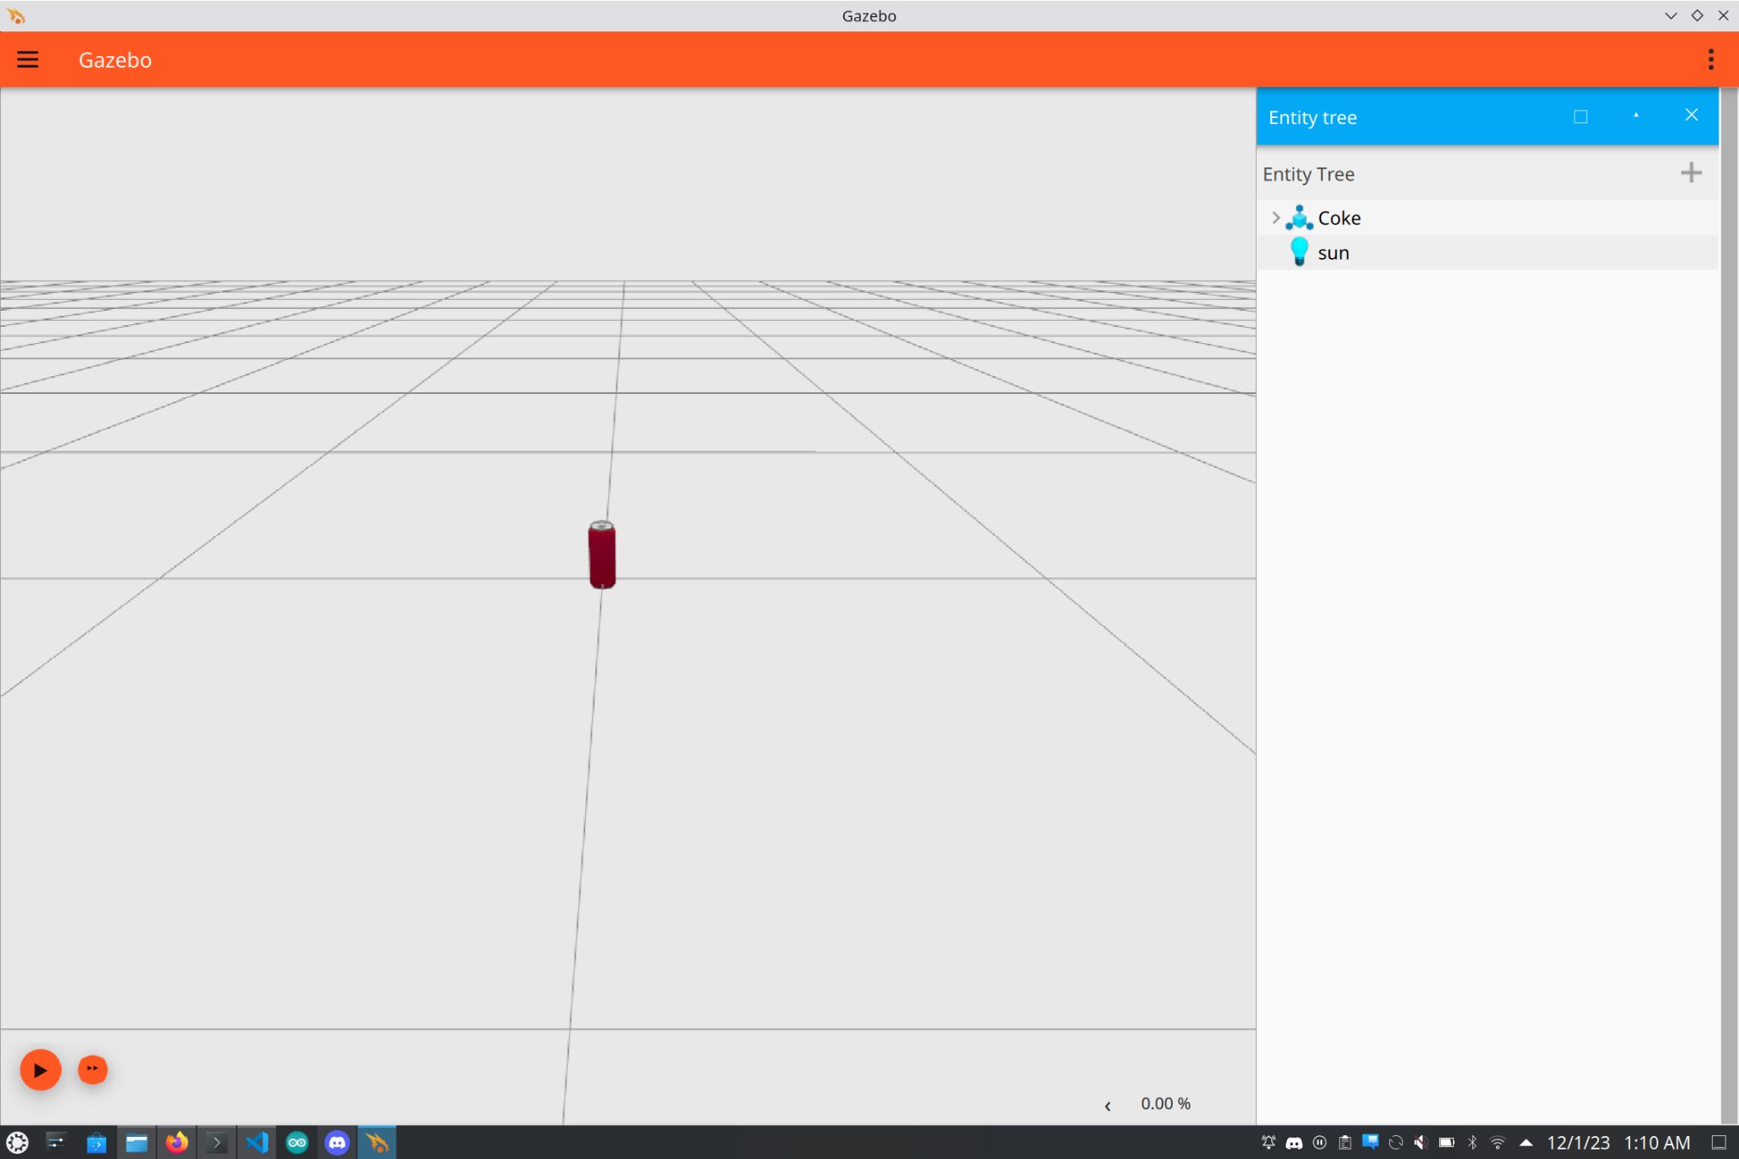
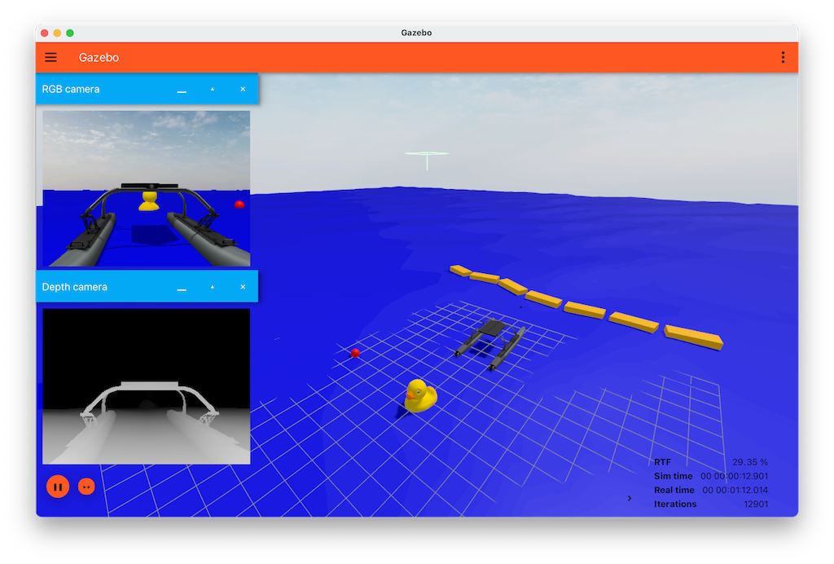
Simulation
What software is being used to make this:
Ignition Gazebo
Ignition Gazebo is a simulation tool used for modeling and simulating robotic systems, including sensors, actuators, and environments.

Slide 52
Simulation
How does it work?
Everything is loaded in as a plugin library
User must define the properties in the world
Real-time interactions
User can control the robot or any sensors in real time
Integration with ROS
Enables communication between environment and ROS
Ignition plugins enable direct interaction with ROS topics and services which allows the user to send/receive commands to the robot in the simulation and allows user to receive more specific information.

Slide 53
Simulation
Our Current Autonomous Model:

