Slide 1
Secure Module/Key Management Application
Notes:
Andy Munoz

Slide 2
Project Members
QTC Liaisons
Francisco Guzman
Julian Gutierrez
Faculty Advisor
Dr. Huiping Guo
Documentation Team
Brian Tang
Angel Serrano
Anthony Ortega
Jason Schmidt
Victor Liang
Design Team
Andy Muñoz
Alexander Raya
Angel Peñate
Jorge España
Gabriel Espejel
Notes:
Victor

Slide 3
QTC - A Leidos Company
QTC Management, acquired by Leidos in 2016, is at the forefront of providing specialized medical examination and diagnostic services, with a focus on disability assessments.
Notes:
Victor

Slide 4
Agile Methodology
Notes:
Anthony

Slide 5
Project Goal
QTC transfers sensitive data (PHI/PII) between systems through online connections.
The application must protect data from being seen by untrusted parties and users.
This project seeks to prevent this by encrypting the data before it is sent and/or stored.
We also want to use certificates to authenticate 3rd party applications when sending them data.
Notes:
Brian Tang

Slide 6
Project Requirements
This application will:
Validate credentials to allow authorized users to log in
Implement key rotation
Encrypt user generated data
Save the encrypted data to the database
Send the encrypted data to a user who requests it
Allow certain users to access and handle the data
Validate 3rd party before the data is sent to them
Notes:
Jason Schmidt

Slide 7
Technology
Symmetric Key Algorithm
Asymmetric Key Algorithm
C# , HTML, CSS
Microsoft Visual Studio
ASP.NET MVC [.NET 6.0]
Microsoft SQL Server
Frontend & Backend
Azure Key Vault
Notes:
Anthony

Slide 8
Starting the Application
All use cases follows these steps. They diverge at the generate data page.
Notes:
Alex Raya

Slide 9
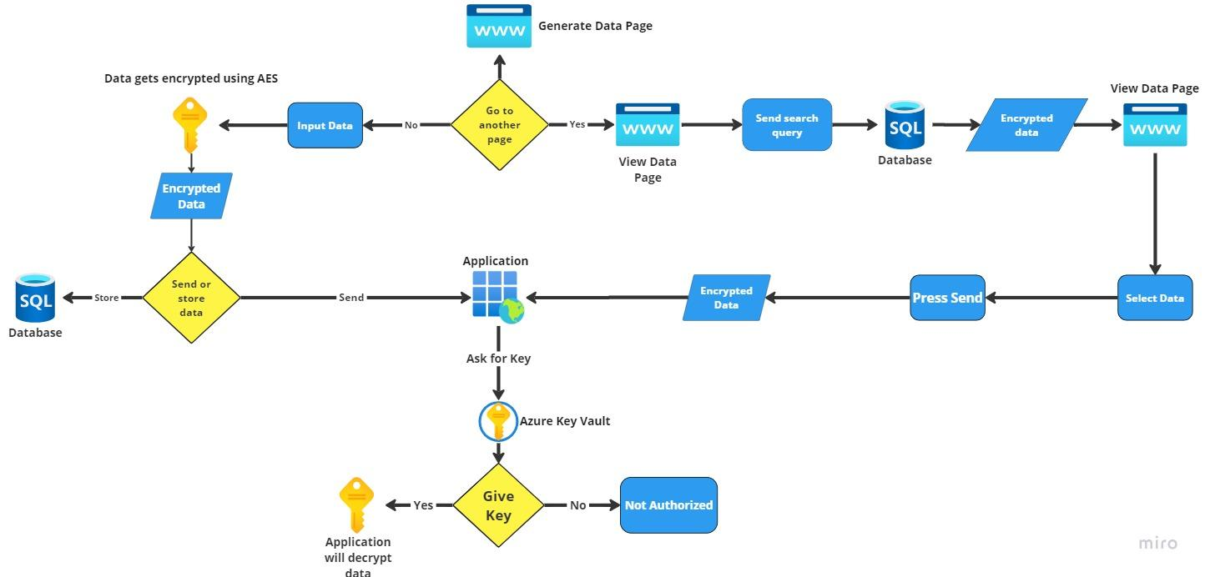
Use Case 1
Input Data Overview
1. Login using user credentials.
2. Input data.
3. Data encryption algorithm is determined based on the use case of the data.
4. Data is encrypted.
5. Data is stored in SQL Server or sent to another QTC application.
6. QTC application where the data was sent will get the key from Azure Key Vault to decrypt the data.
Notes:
Alex Raya

Slide 10
Use Case 1 Continued
Search Data Overview
1. Login using user credentials.
2. Go to View Data Page.
3. Input Search Query
4. Select Data.
5. Press Send.
6. Encrypted Data is sent to application.
7. Application will ask for key to decrypt data.
Notes:
Andy Munoz

Slide 11
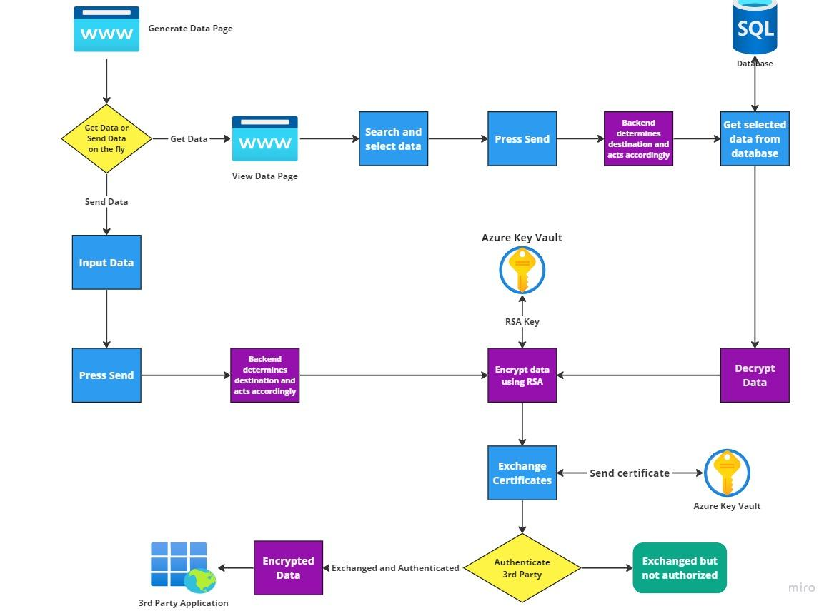
Use Case 2 & 3
Overview - Sending data on the fly
1. Login using user credentials.
2. Input data.
3. Data encryption algorithm is determined based on the use case of the data.
4. Data is encrypted using an asymmetric key.
5. QTC and the 3rd party application will exchange SSL certificates.
6. Encrypted data is sent to the 3rd party application if certificates are authenticated.
Notes:
Angel Penate

Slide 12
Use Case 2 & 3 Continued
Overview - Sending data that is already stored in the database
1. Login using user credentials.
2. Search and select data you want to send.
3. Data is retrieved from database and decrypted.
4. Data is encrypted using asymmetric keys.
5. QTC and the 3rd party application will exchange SSL certificates.
6. Encrypted data is sent to the 3rd party application if certificates are authenticated.
Notes:
Andy Munoz

Slide 13
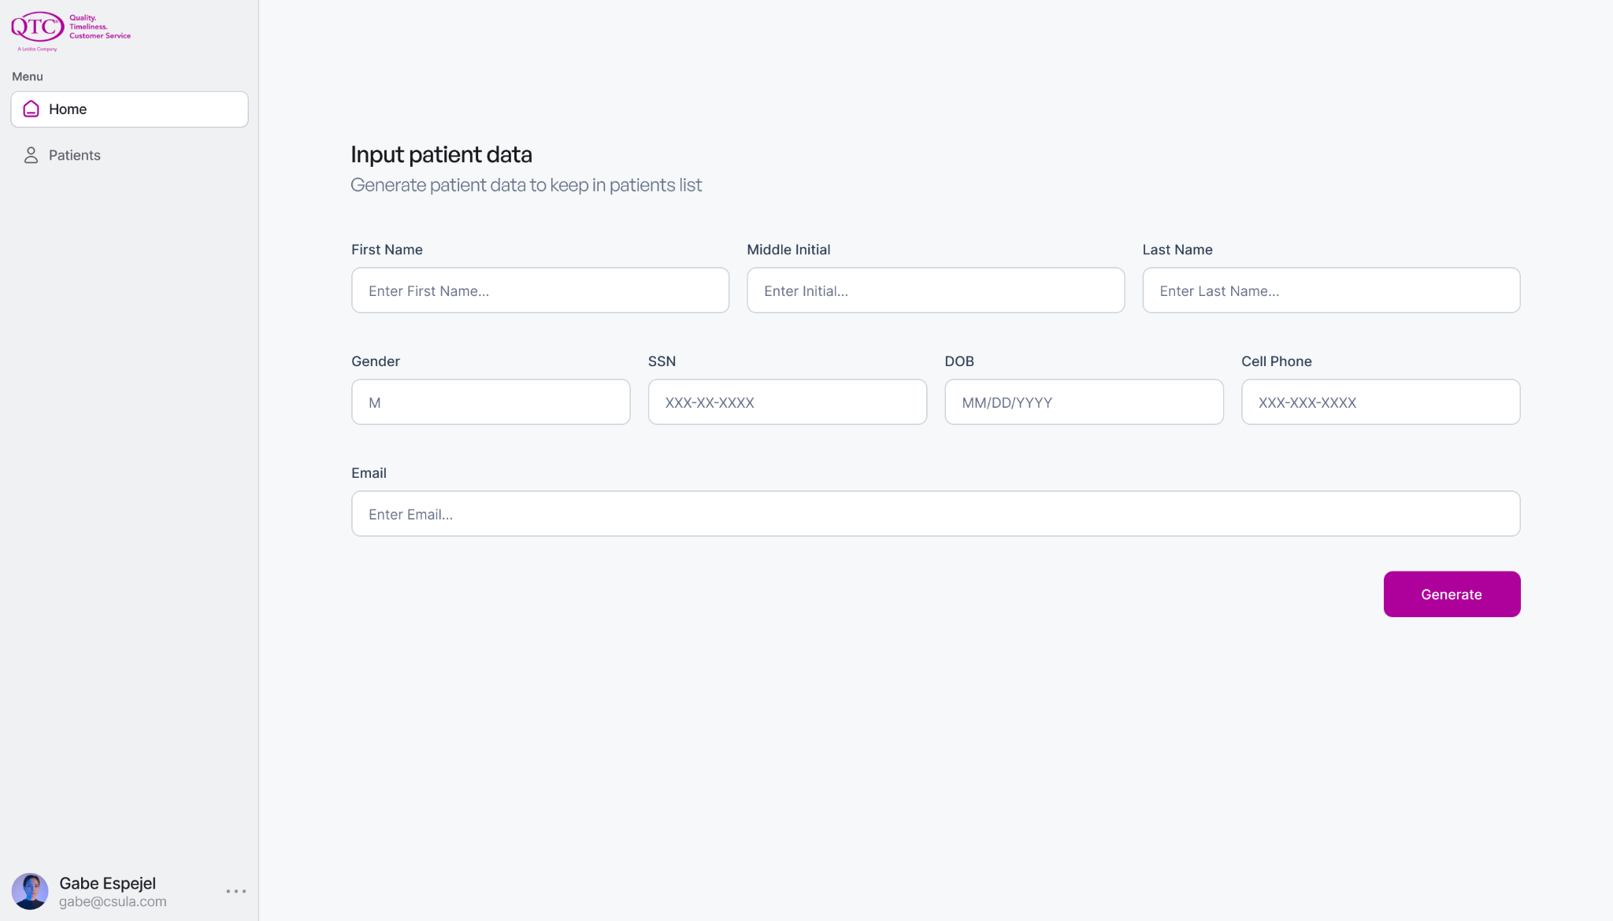
Input Data View
Notes:
gabe

Slide 14
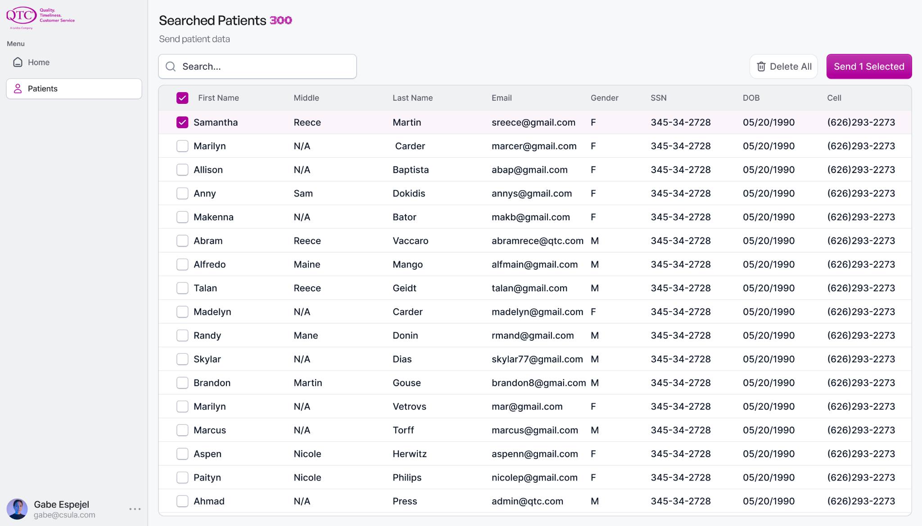
Patient Data Page
Notes:
gabe

Slide 15
Challenges
Design and Apportioning of Requirements
Application Security
User Authentication
Data Integrity
Monitoring/Logging Application Activity
Level of Security for the data
Notes:
Angel Serrano

Slide 16
Next Steps
Notes:
Transition

Slide 17
Scrum In The Future
Jira
Sprints
Sprint Planning
Backlogs
Sprint Reviews.
User Stories
Stand Ups
Scrum Master
Retrospectives
Roles
Notes:
Jorge Espana

Slide 18
Development Stage
Code
Test
Review
Continue Weekly Team Meetings
Continue Weekly Meetings with QTC
Notes:
Jorge Espana

Slide 19
Thank you
Questions?

