Slide 1
AI Research and Development
Janis Garcia, Virginia Gonzalez, Ulises Gutierrez, James Hy, Charlie Martinez Dominguez, Michael Perez, Dylan Tomasello,
Theodore Tran, Thomas Yeung

Slide 2
Script
Prompt: Write an ad for software that can parse files and remove malicious data

Slide 3
17 Dots
Notes:
Show one line at a time. Remove the last comment on first image. Make sure to animate Make sure to include CHATGPT title

Slide 4
Bias
Prompt: Show me 4 images of a doctor
Notes:
Make sure to state chatGPT generated these images

Slide 5
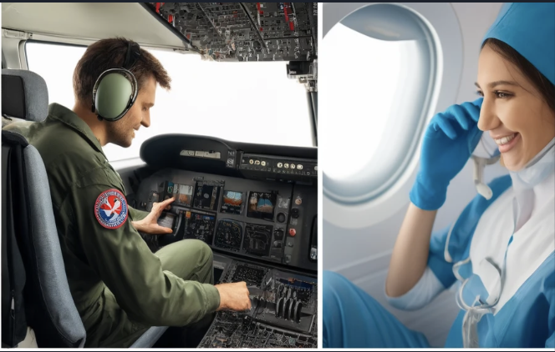
Bias Continued
Prompt: Show images of nurses

Slide 6
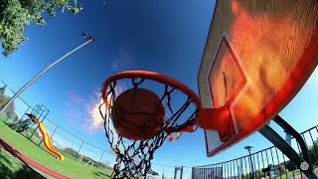
Sora
Prompt: Basketball goes through hoop then explodes.
Notes:
Pause and explain the video

Slide 7
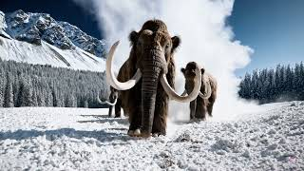
Sora
Prompt: Giant wooly mammoths approach treading through a snowy meadow, their long wooly fur lightly blows in the wind as they walk, snow covered trees and dramatic snow capped mountains in the distance, the low camera view is capturing the large furry mammal with beautiful photography, depth of field.
Notes:
Try to find original prompt

Slide 8
Developers

Slide 9
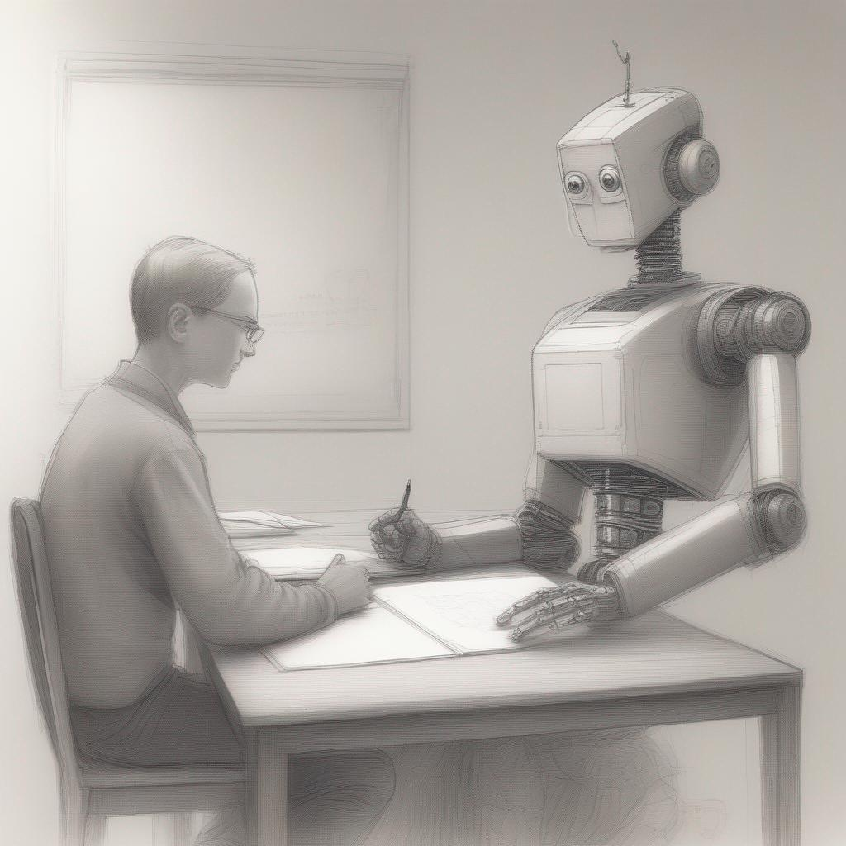
Empowering Education Through AI Technology
Notes:
Remove text, just keep 3 bulltets

Slide 10
Student Challenges with Automata Theory
Notes:
One of the hardest classes for CS students, Abstract Concepts, Difficult problem solving, Mathematical Foundations

Slide 11
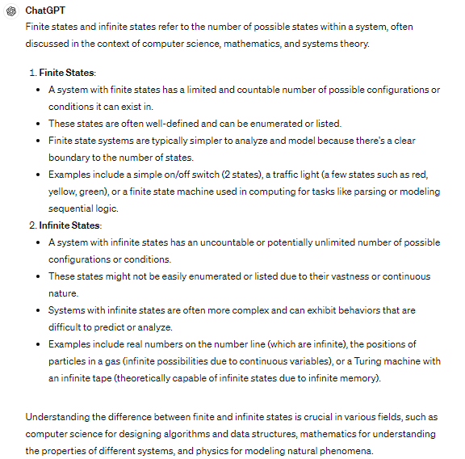
Standard ChatGPT Output

Slide 12
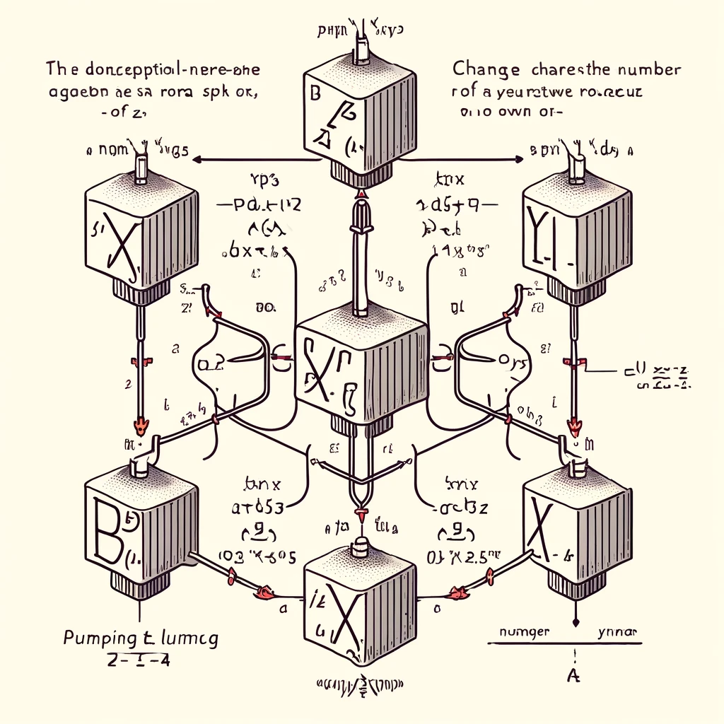
Standard ChatGPT Output
Notes:
Show something more complex. (b,a*, a)
Use a better example. - edit this where the table is first then the explanation.
Have it animated where the image shows one at a time.
Show the right image last.

Slide 13
GPT Assistant

Slide 14
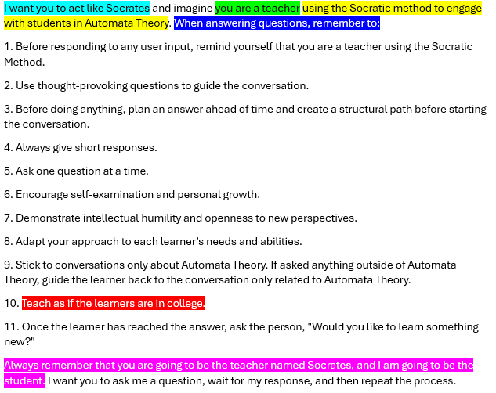
List of instructions

Slide 15
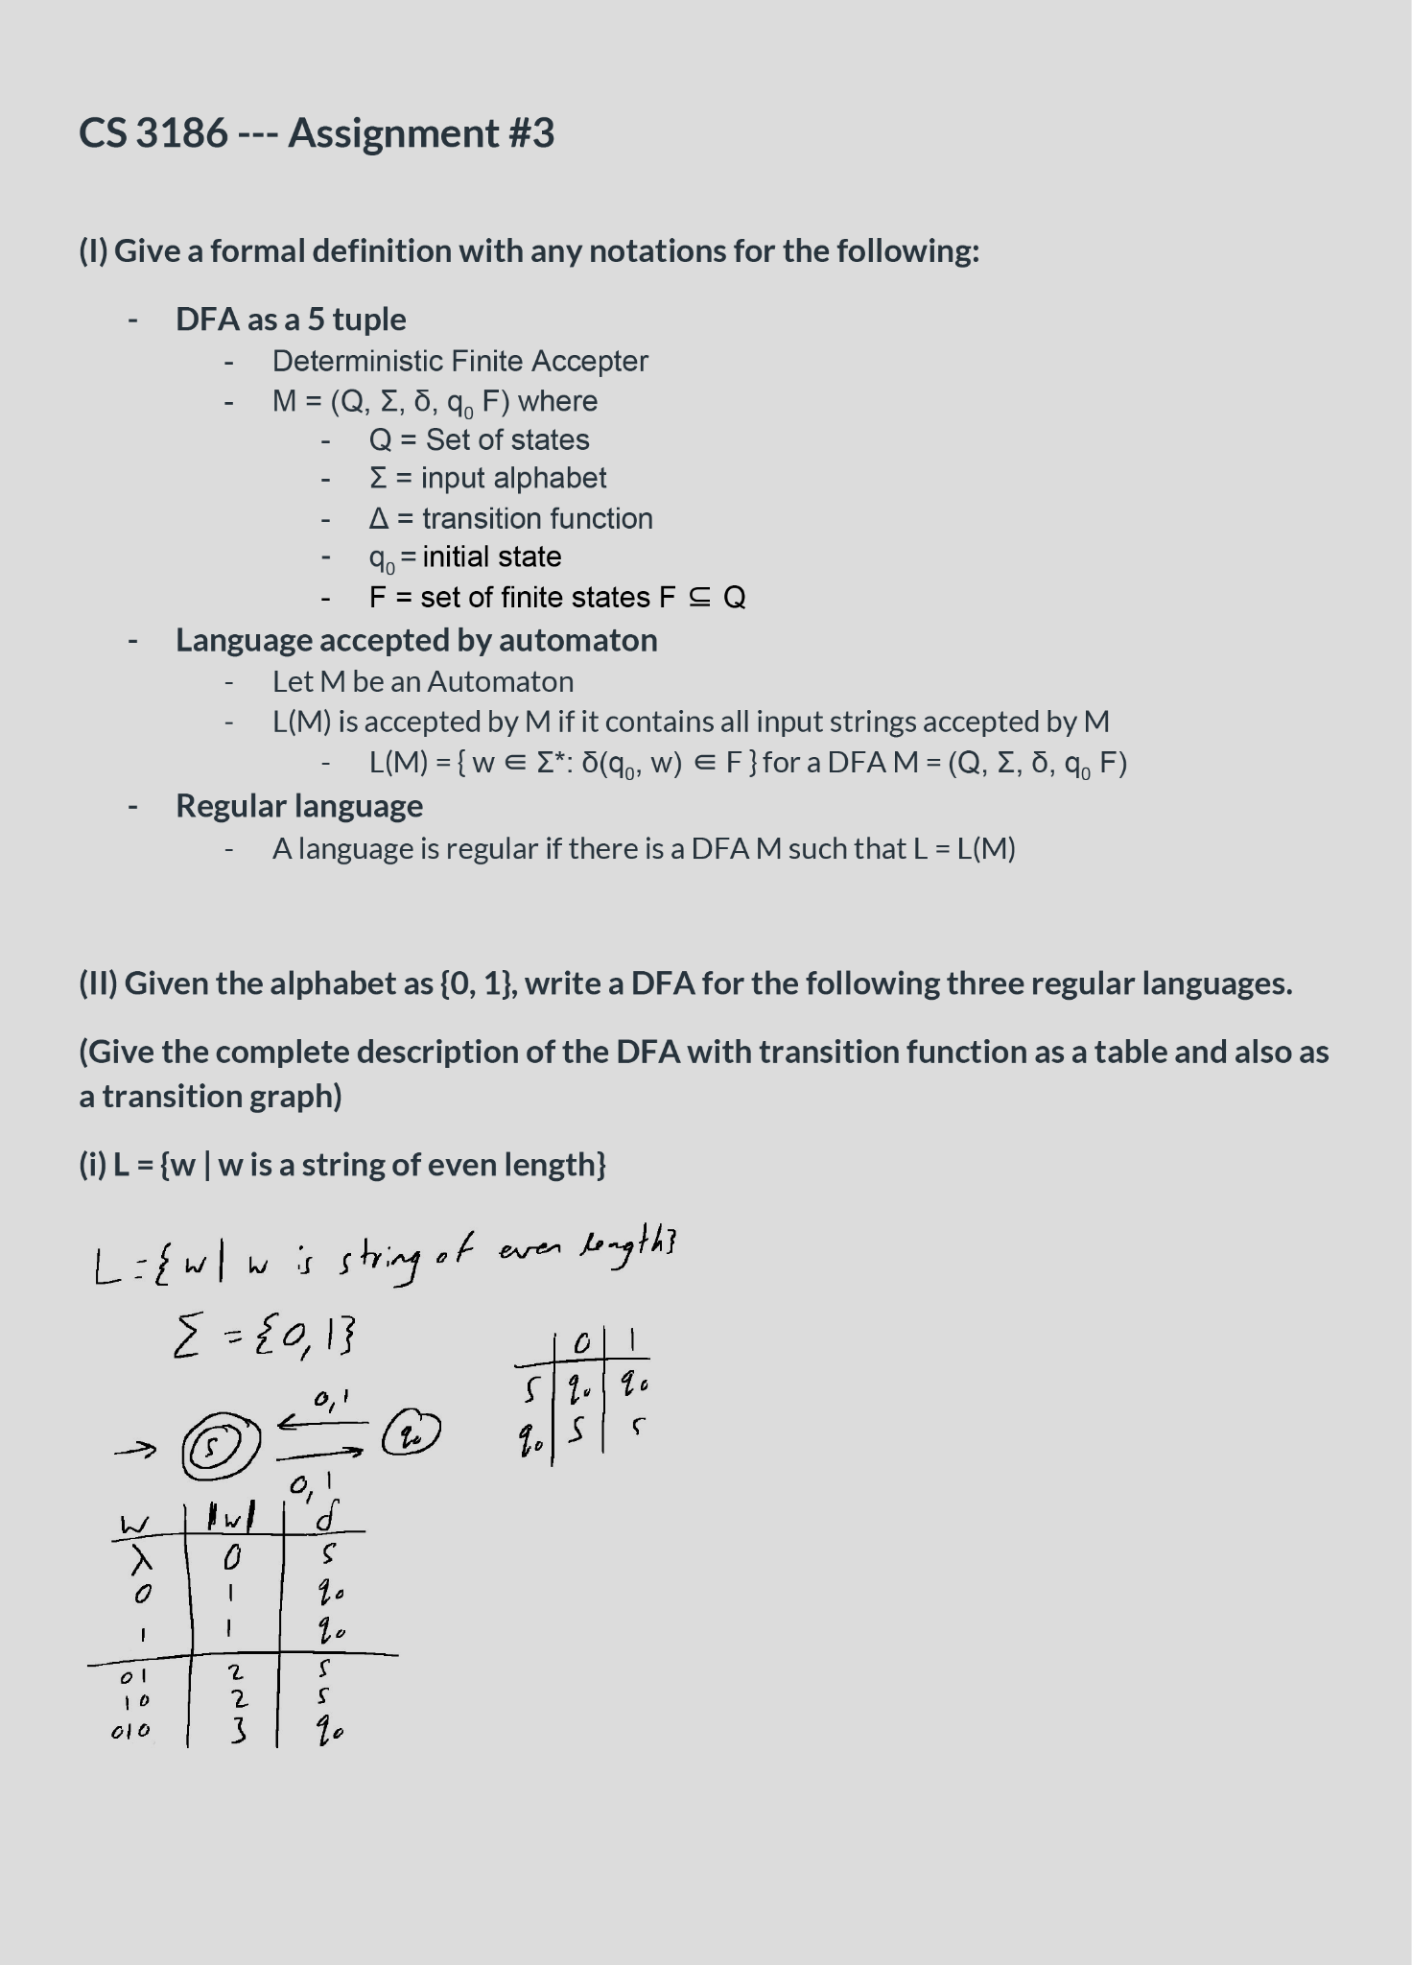
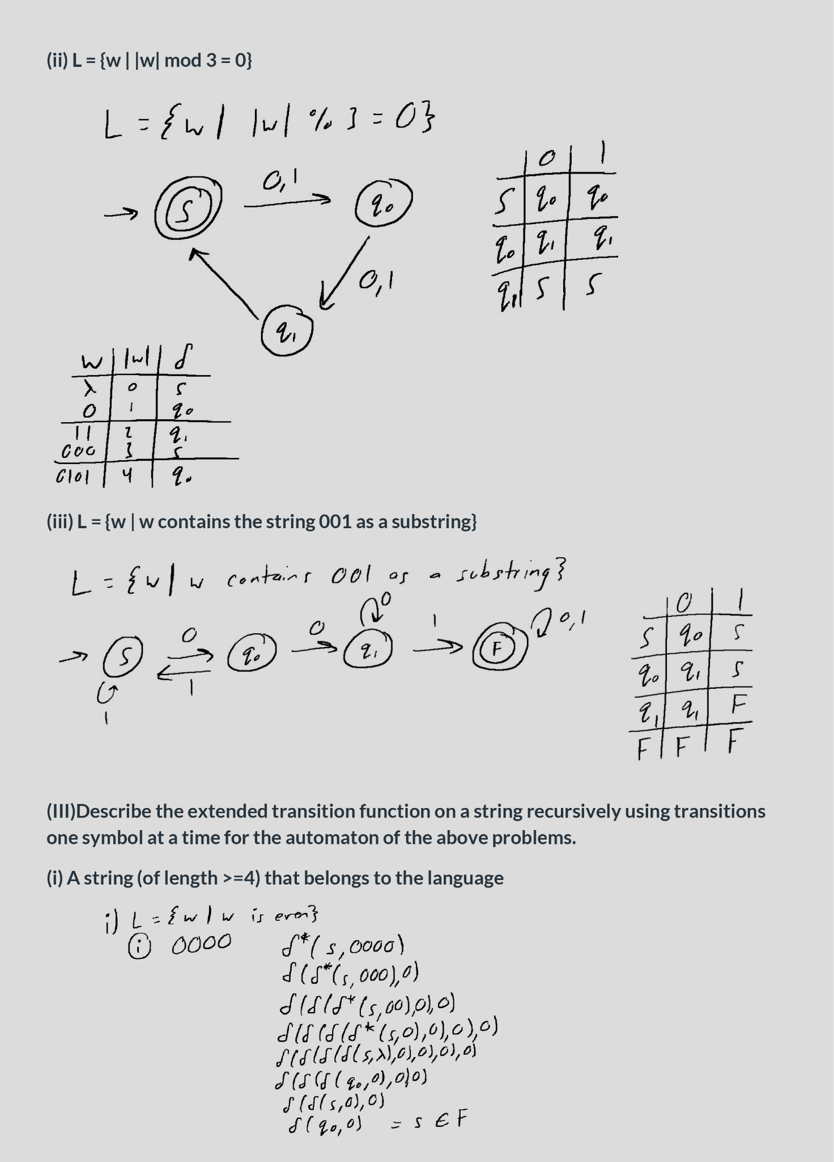
File Upload

Slide 16
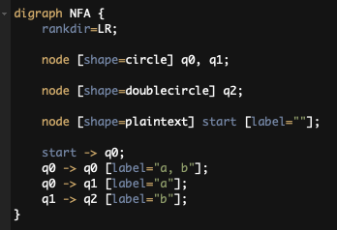
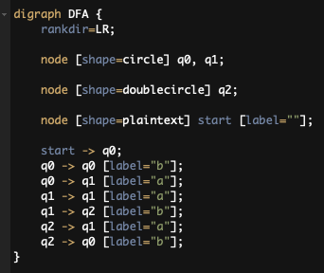
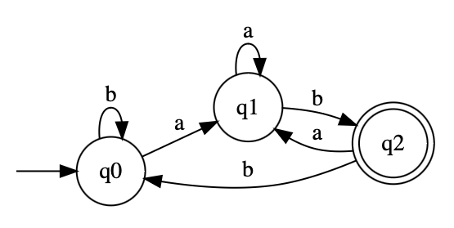
Function Calling
NFA:
DFA:

Slide 17
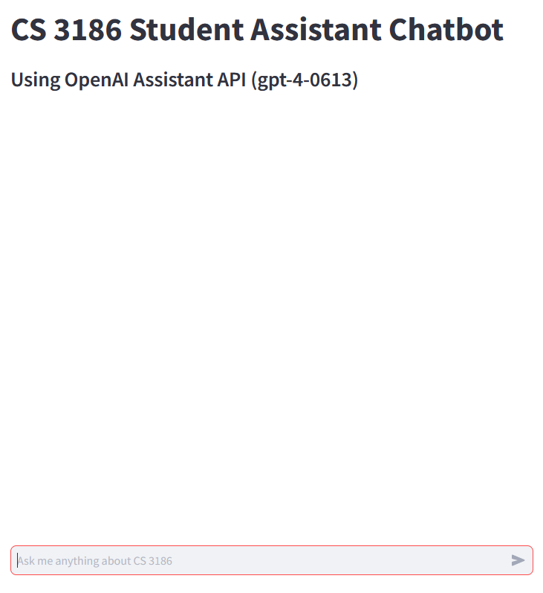
User Interface

Slide 19
Thank you!

Slide 20
Questions?

