Slide 1
Aerospace Senior Design
Team: John Chen, Phong Diep, Matthew Franco, Roaf Htun, Steven Lopez Carachure, Andrew Mendiola, Natalie Perales, Cindy Rodriguez, Steven Yuen
Adviser: Zilong Ye Liaisons: Pablo Settecase, Karina Martinez, Dearo Yam, Denny Ly

Slide 2
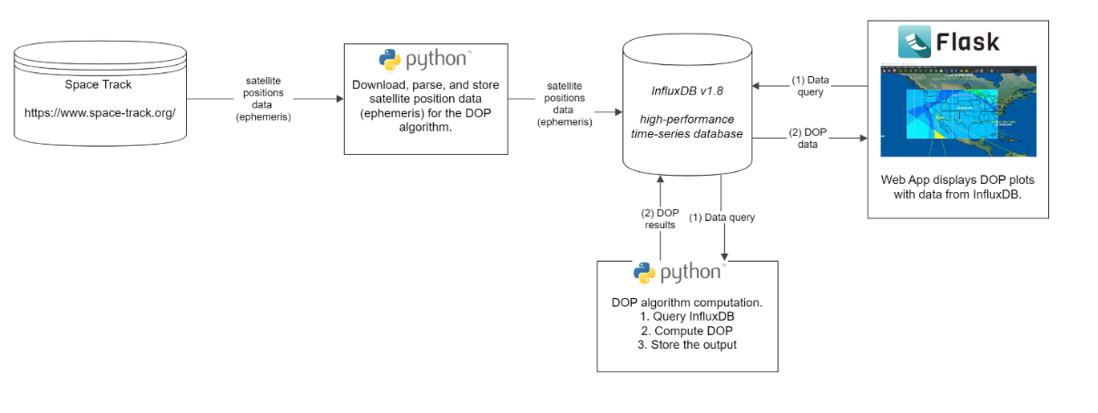
Project Overview
Develop a web application to display DOP data
The web application should allow the user to select a date to display DOP data
Notes:
Merge with Architecture
We grab the data from https://www.navcen.uscg.gov/ not space-track it has changed.
Then we use python to webcrawl, parse data, calculate dop then send it to InfluxDB
Then frontend query those data from DB to visualize.
Influxdb was chosen for us by liaisons

Slide 3
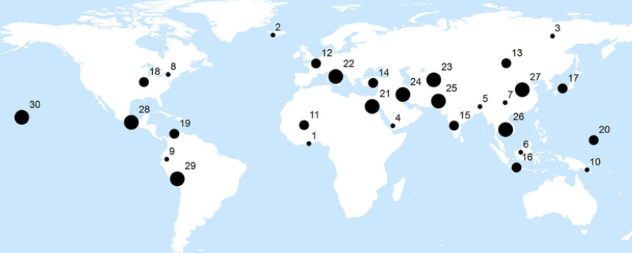
Web App Interface Requirements
DOP Map
Datepicker for user to select a single date
Points of Interest
Notes:
Merge with slide 2

Slide 4
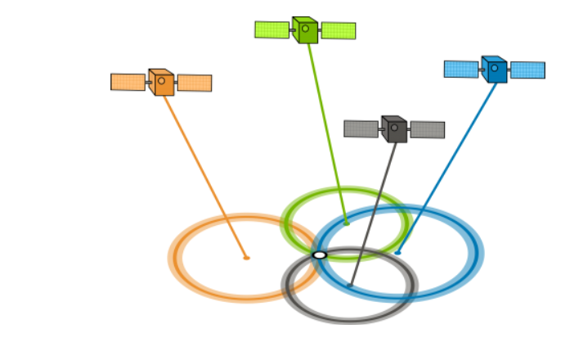
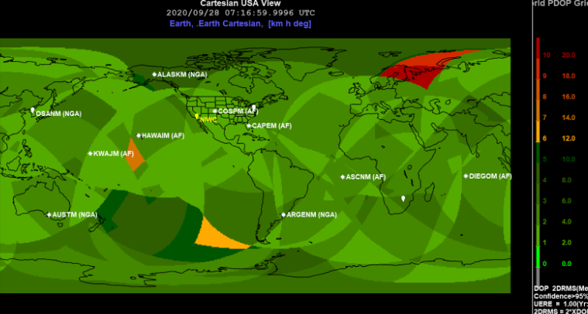
What is DOP data?
DOP = dilution of precision includes:
GDOP (Geometric DOP): Overall precision in 3D position and time.
PDOP (Position DOP): Precision in 3D position (latitude, longitude, altitude).
HDOP (Horizontal DOP): Precision in horizontal position (latitude, longitude).
VDOP (Vertical DOP): Precision in vertical position (altitude).
A geometric measurement of GPS accuracy
Used to gauge GPS performance
Low DOP data is good

Slide 5
BackEnd

Slide 6
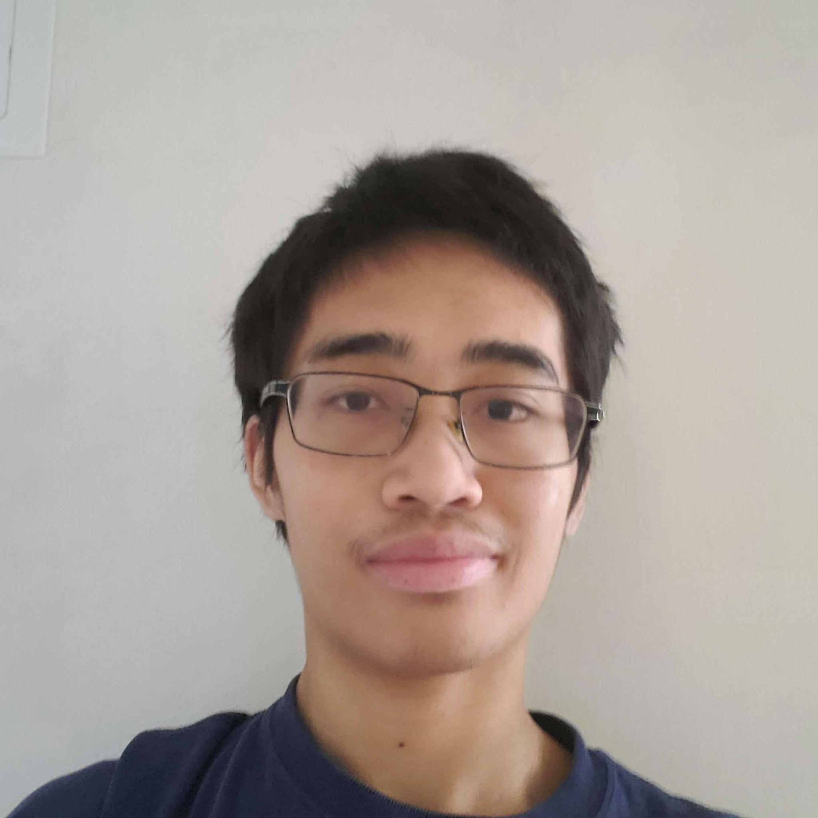
Contact Information
Roaf Htun
Zhtun@calstatela.edu
John Chen
itsjohnchen@gmail.com
Steven Yuen
syuen5@calstatela.edu
We Are Team BackEnd

Slide 7
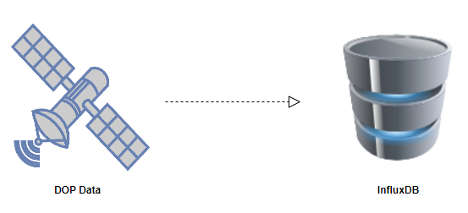
Our Progress
Python 3 and InfluxDB for data processing.
Webcrawl updated datas from the navcen.uscg.gov website.
Calculate DOP using the algorithm.
Calculate date and time using GPS week and seconds.
Sent calculated DOP datas, date, and time to influxDB.
Roaf Htun
Notes:
Add what kind of techniques; show icons code snapshot(?)

Slide 8
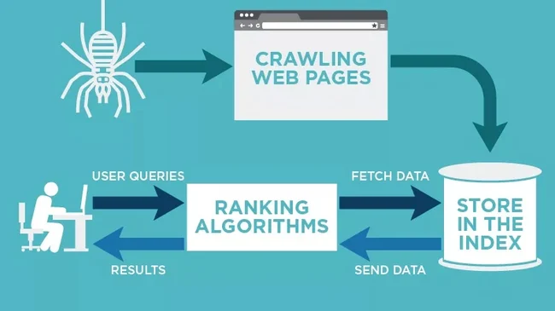
What is Web Crawling?
Program retrieves data from the internet
Index and gather info from website
Organize
User Queries
Steps:
Web Page
Links
Collect Data (i.e images)
John Chen

Slide 9
Live Demo/Recorded demo

Slide 10
Future Steps
Work with Frontend and InfluxDB team to help query the data they need for the DOP map.
Roaf and John will merge with frontend team.
Steven Yuen will merge with InfluxDB team.
Steven Yuen

Slide 11
Database

Slide 12
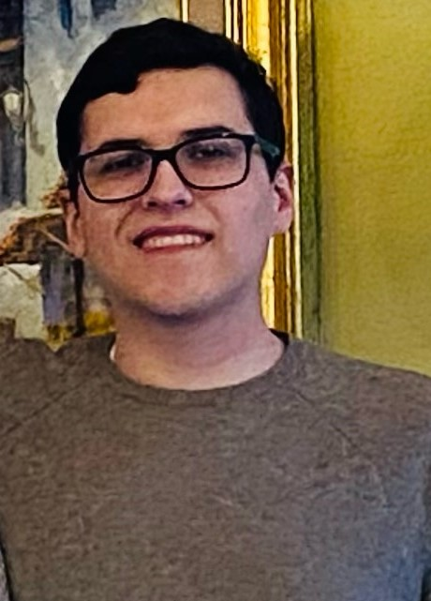
Contact Information
Cindy Rodriguez
crodr164@calstatela.edu
Phong Diep
pdiep4@calstatela.edu
Matthew Franco
mfranc71@calstatela.edu
We Are Team Influx DB

Slide 13
What is InfluxDB?
A Time-series database designed for fast, high-availability storage and retrieval of time series data.
Time series data is data organized in a sequence over time
Temperature every minute
Stock prices every second
Our project
Provides real-time query and has built-in data compression for efficient storage.
Phong Diep
Notes:
Explain why we chose InfluxDB

Slide 14
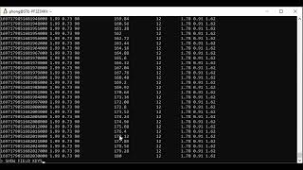

Slide 15
What is Chronograf?
A web-based graphical user interface (GUI) & visualization tool for displaying time series data stored in InfluxDB.
Allows for queries and alerts to be built.
Pre-built charts, graphs, and dashboards for creating custom visualizations.
Matthew Franco

Slide 16
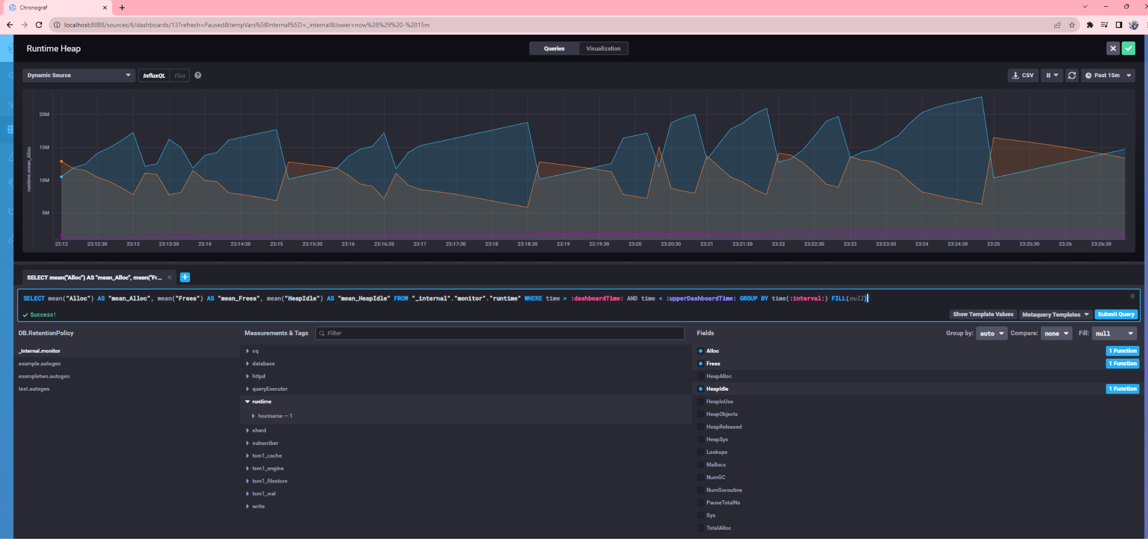
Example of Chronograf Visualization
Matthew Franco
Notes:
Add bulletpoints

Slide 17
Our Progress
Store the data into it, retrieve with python to calculate.
Use Python to automate query searches.
Worked with back-end to store converted data into InfluxDB.
Worked with back-end team to query data being sent for DOP mapping.

Slide 18
Next Steps
Work with front-end team to see how they will want to query the data and adjust accordingly.
Put it all together.

Slide 19
FrontEnd

Slide 20
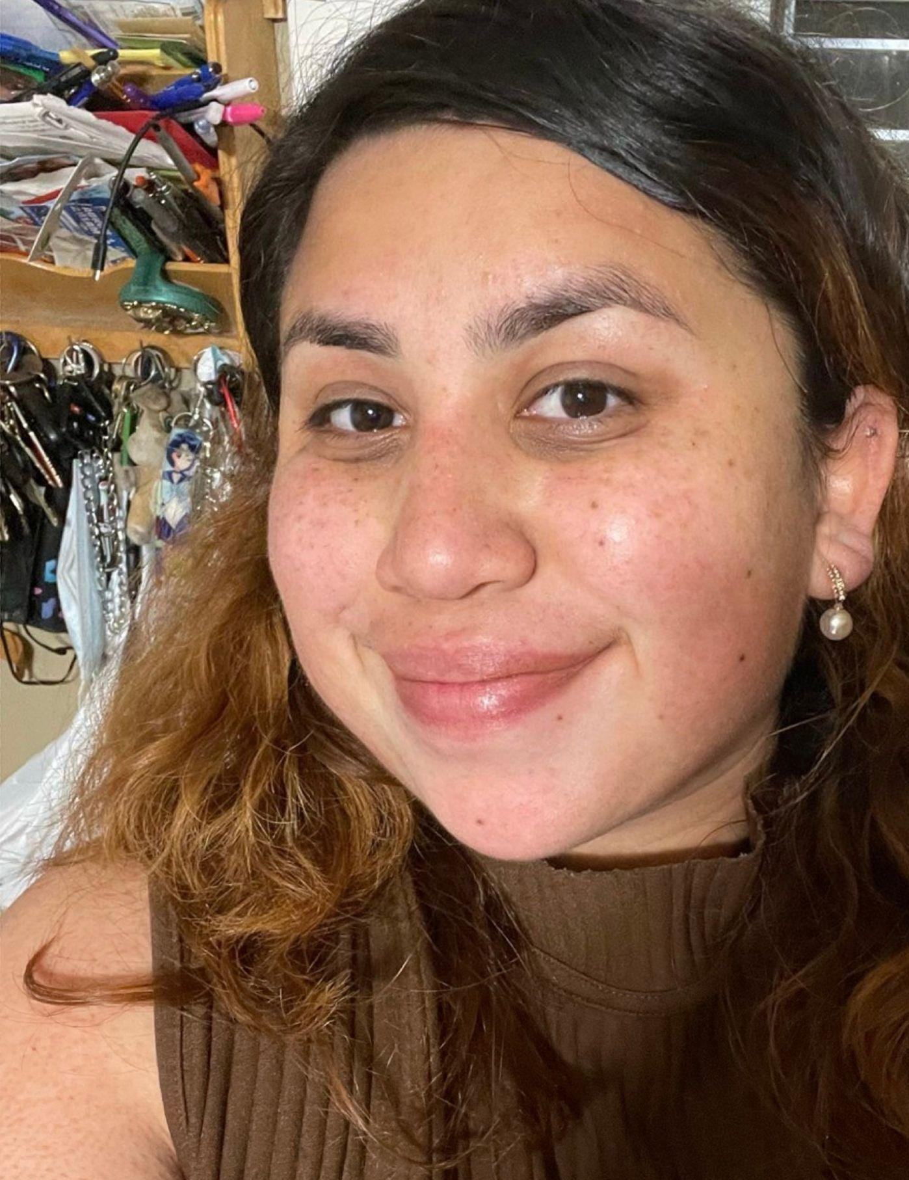
Contact Information
Natalie Perales
nperale5@calstatela.edu
Steven Lopez
stevo2195@gmail.com
Andrew Mendiola
amendi14@calstatela.edu
We Are Team FrontEnd

Slide 21
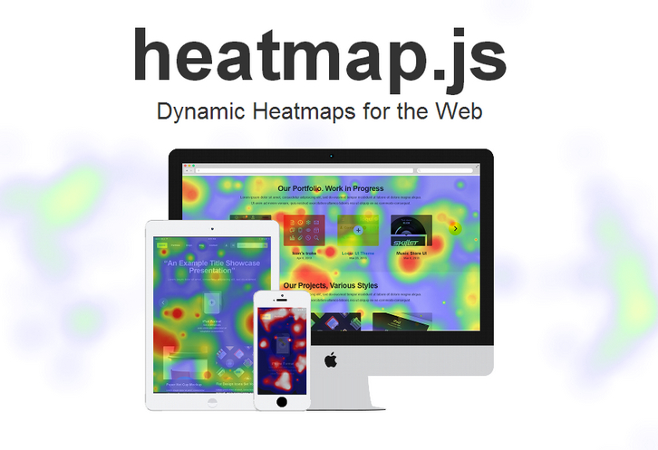
Our Progress/Setbacks
Originally d3.js was difficult to use
We instead used leaflet.js as the main library for the map
Also used heatmap.js to overlay example data
React is used for most of UI
Front page has date picker, download screen, home, about, and contacts page
Natalie Perales
Notes:
Add techniques/white space/icons 20-22

Slide 22
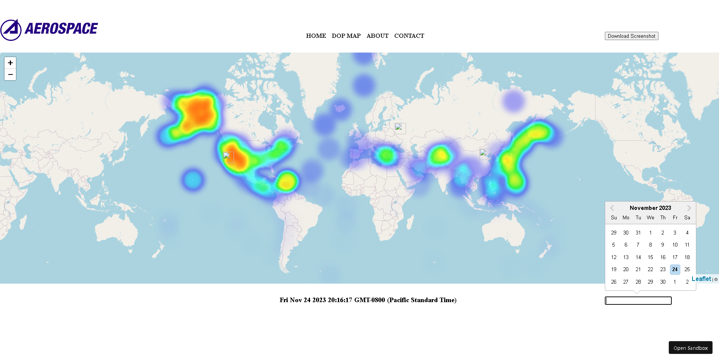
Picture of our Map
Natalie Perales

Slide 23
Live Demonstration
STEVEN LOPEZ

Slide 24
Next Steps
Set up Flask to connect with database
Turn data received from database into Geojson object
Overlay geojson object using heatmap.js
Lastly fine tune UI/UX with other groups
Notes:
Use bullet points

Slide 25
Project Stretch goals
Fine tune zoom in feature for map
Export the DOP map to an image
Zoom into the DOP map to view new, increased resolution DOP map
DOP algorithm optimization
Playback feature that plays back DOP data for a time window, like a movie.

Slide 26
Questions?

Slide 27
Thank you!

