Slide 1
Sponsors
Cynthia Wang, Zachary Vernon
Current Developers
Team 1: Melissa Hernandez, Antonio Vazquez Bravo, Channing Jou, Thien Ho, Stephanie Tan
Team 2: Juan Alcobas, Hak Beak, Ryan Goshorn, Daniel Alfonso Rodas, Raul Sanchez Martinez
Advisor
John Hurley
Notes:
Jorge -

Slide 2
Agenda:
Stephanie
What is The arqive?
Project Goals
Project Challenges
Demonstration
Goals Moving Forward

Slide 3
What is The Arqive?
Daniel
The Arqive is a digital online storytelling map that facilitates the sharing of LGBTQ+ stories. It provides a platform for queer individuals to create and collect stories that are geolocated and digitally preserve
Users from all around the world have a safe platform where they can share personal, historical, and community stories, as well as have access to information about safe spaces.
“By sharing stories, we can give each other hope.”
-Cynthia Wang

Slide 4
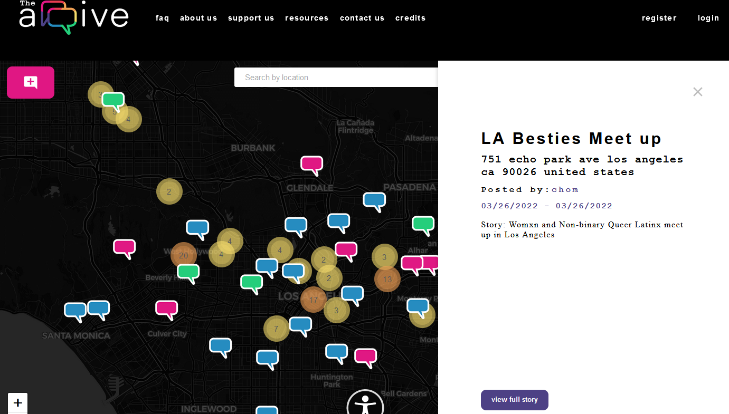
Overview of The Arqive:
Daniel
Users
Login
Add/Edit/Delete/Tag stories
Block/Unblock Users
Flag Posts
Manage Profile
Anonymity Feature
Admin
Login
Add/Edit/Delete/Tag Story
Delete Users
Review/Remove Flagged Posts
Review/Remove Flagged Comments

Slide 5
Current Project Goals

Slide 6
Team 1’s Goals
Antonio
Throughout the semester team 1 was assigned two main functions for the website.
Our original goal was to implement multimedia upload which included: images, gifs, videos, and audio.
Our second function, which was assigned later in the semester, was implementing a nsfw (not safe for work tag) for any posts made on the website. This took priority due to the fact that The Arqive sponsors were trying to launch their mobile app and needed to meet specific criteria to be approved for the app store.

Slide 7
Team 2’s Goals
Hak
Similarly team 2 was also assigned two main functions to implement.
Provide our users with a secure authentication process. Ensures their information is safe and protected from unauthorized access.
Add a block function that allows users to block another user and prevent them from seeing their posts and comments. Enhance user control over their online experience.

Slide 8
Project Challenges
Thien Ho

Slide 9
Team 1’s Challenges - Linux
Thien Ho
Setting up the Environment (Linux)
GitHub (SSH keys) and cloning
WSL and Linux commands
Putty and Droplet
Docker (Container)

Slide 10
Team 1’s Challenges - Frameworks
Thien Ho
Adjusting to New Web Developments and Frameworks
Django REST (Backend)
React (Frontend)
PostgreSQL (Database)
Postman API

Slide 11
Team 2’s Challenges - Block
Ryan Goshorn
Build Blocking Function
Adding a functional block database to store a users blocks.
Adding functions to the backend API to allow the backend and frontend to communicate.

Slide 12
Team 2’s Challenges - Authentication
Ryan Goshorn
Update Authentication method
Identify Authentication vulnerabilities of older script and find solutions.
Redefined user database models with new permissions.

Slide 13
Demonstration

Slide 14
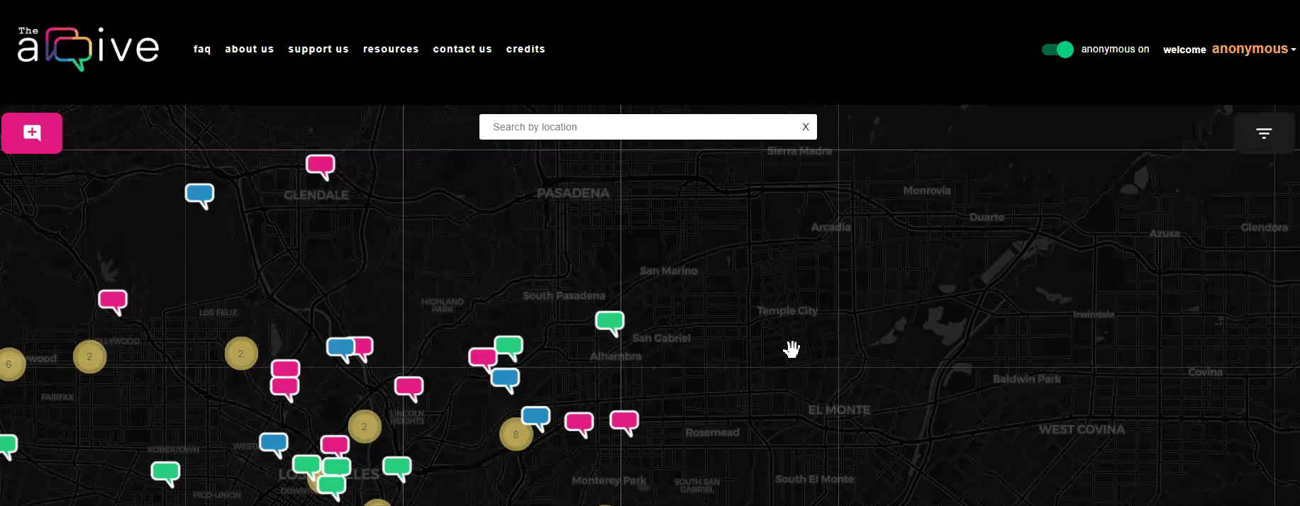
Team 1’s Demo
Channing

Slide 15
Authentication
Raul
Why it matters:
Authentication is used everywhere to prevent unauthorized users from making requests to the server in order to retrieve, modify or delete information they should not have access to.
Due to the nature of the site, most of our users are part of the LGBTQ+ community. The information stored is very sensitive data; many parts of the world are not as tolerant to the community, so a leak of user information can have serious repercussions to our users.

Slide 16
Authentication - Current Model
Raul
User(AbstractUser):
int: id(PK)
String: fname, lname, username, password
Boolean: isAdmin, isMod, isAnonymous
Permissions: add a story, edit their own story, delete their own story, delete
other stories, edit other stories, ban users, ban moderators,
add moderators, add admins
(fields simplified from actual implementation)

Slide 17
Authentication - Proposed Model
Raul
User(AbstractUser):
int: id(PK)
String: fname, lname, username, password
Permissions: add a story, edit their own story, delete their own story
ModUser(User):
int: id(FK)
Permissions: add a story, edit their own story, delete their own story, delete other
stories, edit other stories, ban users
AdminUser(User):
int: id(FK)
Permissions: add a story, edit their own story, delete their own story, delete other
stories, edit other stories, ban users, ban moderators, add moderators, add admins

Slide 18
Authentication - Proposed Model
Raul
How it will work:
User registers for an account: An instance of the “user” class is created using information input by user. Most users will stay at this level.
An admin selects a user to receive mod permissions: An instance of the “moderator” class will be generated with information populated from the “user” class record. There will be a one-to-one reference to the ID of the user record. This enables admins to revoke admin privileges by deleting the record of the “moderator” record while keeping the “user” record intact. Similarly, deleting the user will also delete their “moderator” record.
An admin selects a user/moderator to receive admin permissions: An instance of the “admin” class will be created with a reference to the “user” record as listed above.

Slide 19
Authentication - Strengths of Proposed Model
Raul
Users have the minimum level permissions needed to function; helps prevent malicious activity on the user’s end
Reduced ambiguity; class permissions will be clearly defined
Modular; improved scalability by making it easier for future Arqive developers to implement new classes and manage their permissions

Slide 20
Blocking Function progress
Ryan Goshorn
As of now blocks created by users are able to be stored in the backend database.
The frontend has methods to receive and post information from the backend.
Demo

Slide 21
Blocking Function - Proposed
Ryan Goshorn
The goal is the blocking function will be available for any user to apply to any pin or comment using a button located on the pin or comment.
A blocker will have any pins and comments from that component’s author blocked.
The blocker will have permission to remove that block from a list available on the blocker’s profile page.

Slide 22
Goals Moving Forward

Slide 23
Goals for Team 1
Melissa
Now that an NSFW function has been implemented to individual posts we will be using this function to add three different settings in users personal accounts. This will give them control over what media they would like to see.
Tagging function will expand past just “nsfw”. New tags for different topics will be added such as storytime, queer bar, questions. This will help users consume media that they are interested without having to scroll excessively.
We will also resume working on multimedia upload and build on the code that was left to us by previous students.

Slide 24
Goals for Team 2
Juan
Refine blocking on the website: add UI features
Enhance user safety on the website:
Ensure users have proper permissions to only their content
Maintain user anonymity

Slide 25
Conclusion: Overall Project Goals
Stephanie
Give users control over their online experience when using The Arqive.
Provide a safe and secure online space, where we can foster a stronger and more inclusive community.
Avoid online harassment, a growing issue in the digital world, and navigate sensitive topics.
Build a beautiful and user friendly website that will welcome new members to The Arqive.

Slide 26
Thank you!
Any Questions?

