Slide 1
Using Digital Phenotyping to
Support Patients with Glaucoma
Presenters: Stellina Ao, Luis Ayala-Saldivar, Edson Castellanos, Mengying Chen,
John Huang, Jooeun Jeon, Desiree Ramirez, Ashley Tran, Thang Tran
Advisors: Dr. Navid Amini, Dikshant Sagar

Slide 2
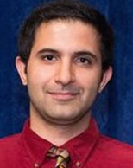
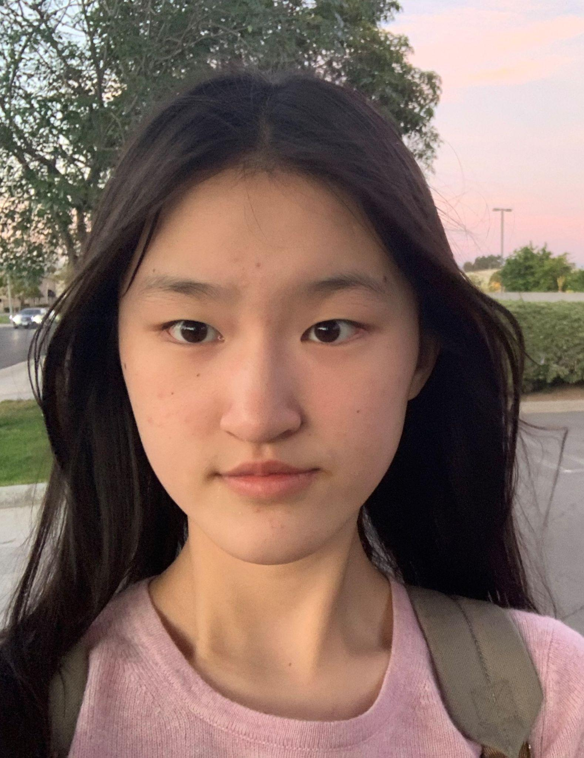
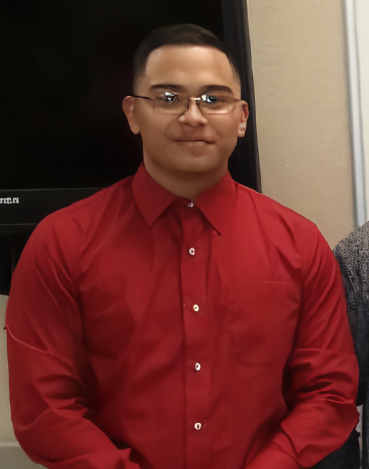
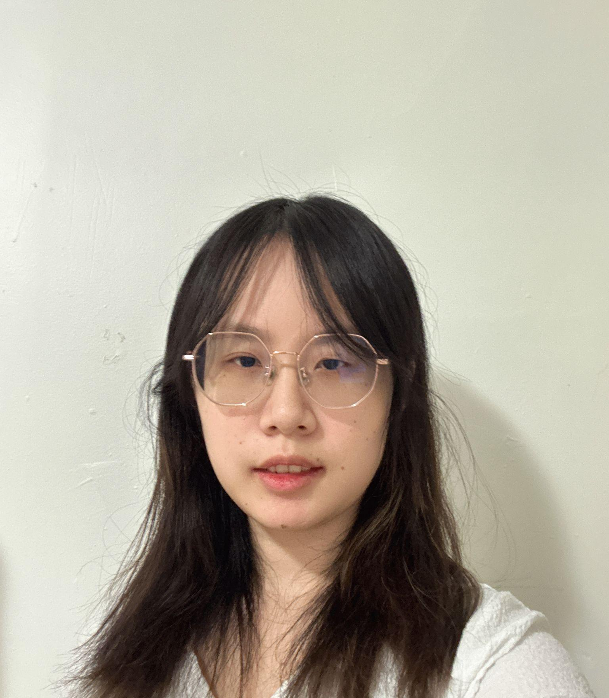
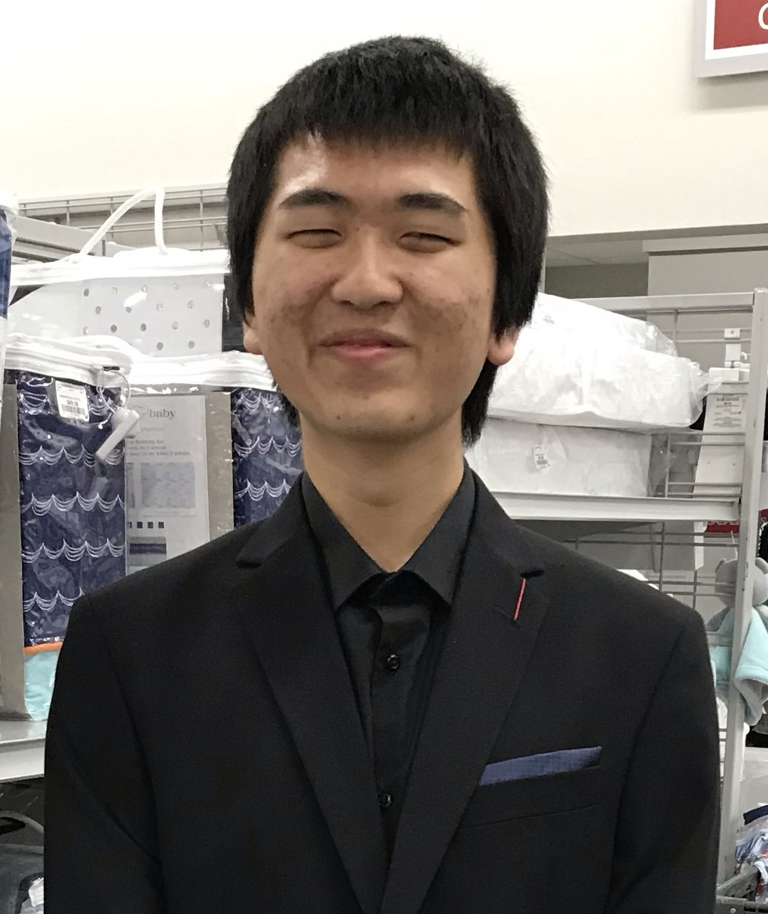
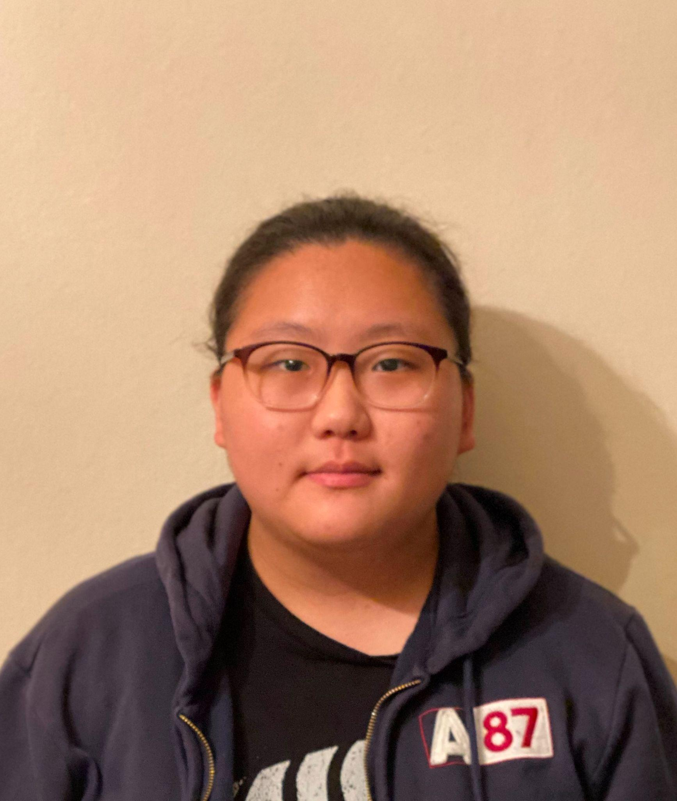
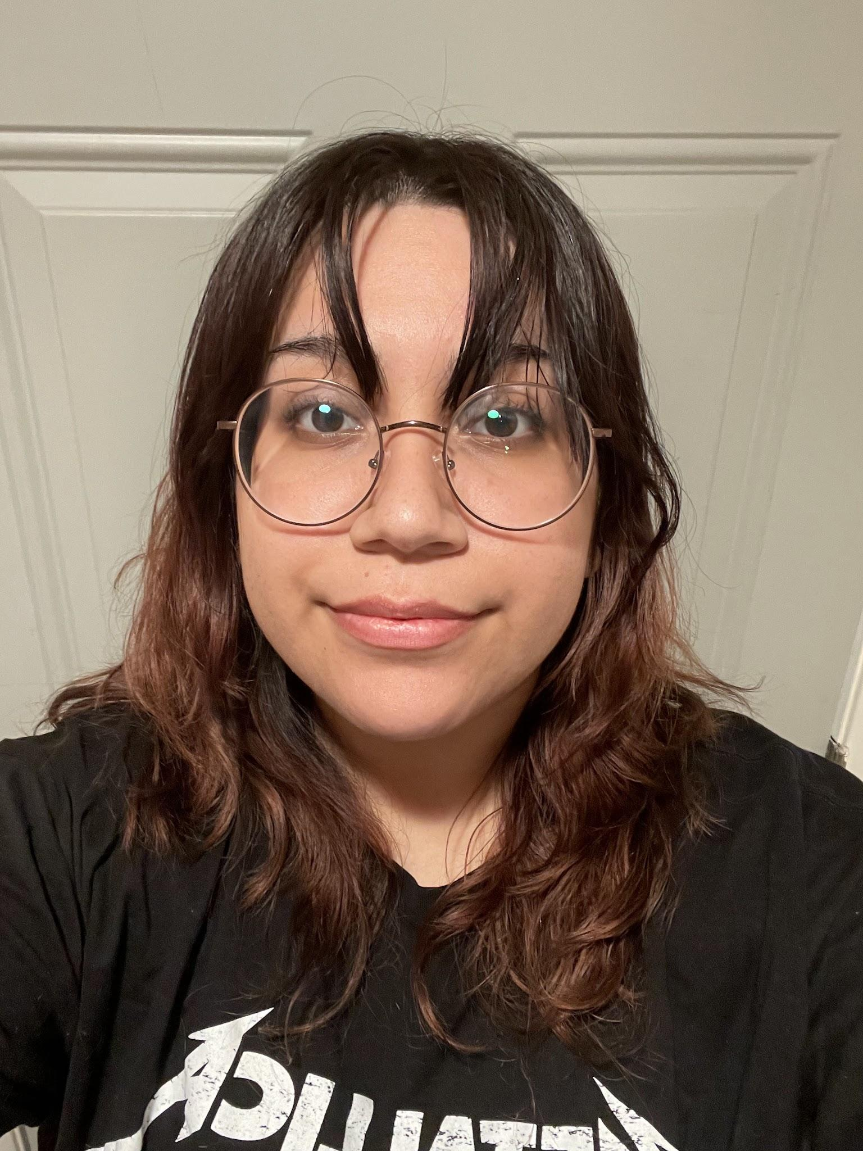
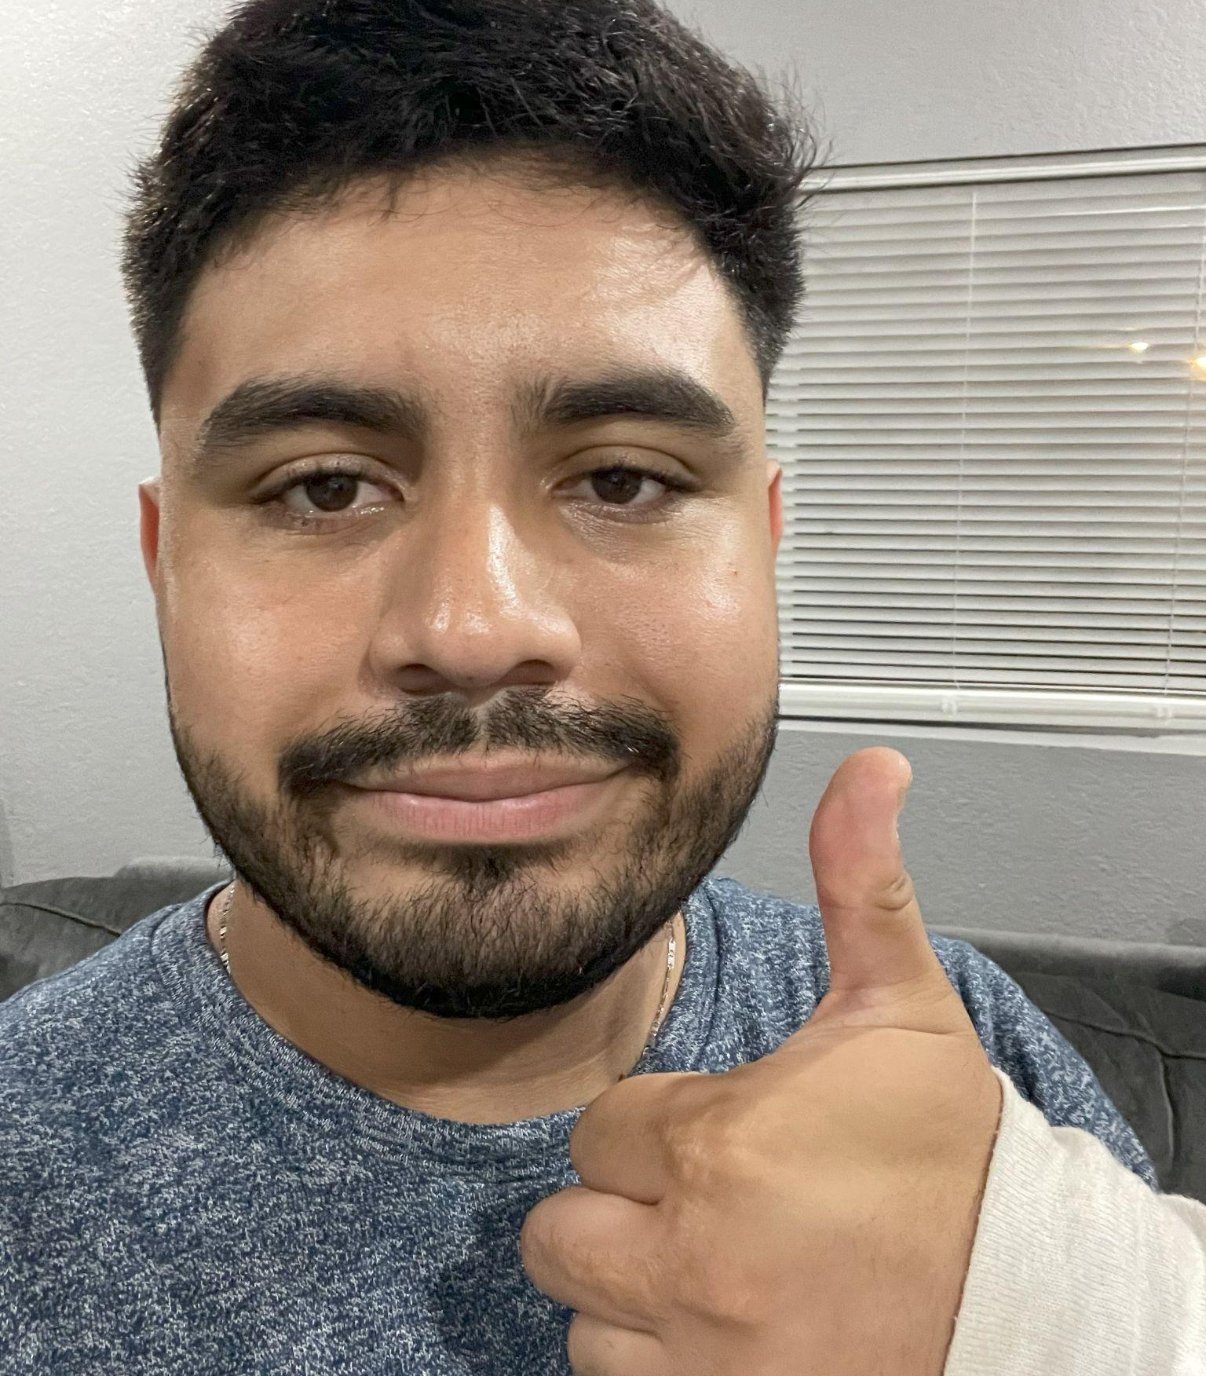
Members
Dr. Navid Amini
Dikshant Sagar
Stellina Ao
Thang Tran
Edson Castellanos
Mengying Chen
Faculty Advisor
Graduate Advisor
Group Member
Group Member
Group Member
Group Member
John Huang
Jooeun Jeon
Desiree Ramirez
Ashley Tran
Luis Ayala-Saldivar
Group Member
Group Member
Group Member
Group Member
Group Member

Slide 3
Outline
Motivation
Digital Phenotyping
Glaucoma
Research
Technologies/Libraries Used
Progress Update

Slide 4
Motivation

Slide 5
What is Digital Phenotyping?
Digital Phenotyping: studying behavior using data from personal devices
Devices: cell phones, smart wearables
Data:
Active/Real inputs (e.g., texts, social media posts, etc.)
Passive (e.g., accelerometer, gyroscope, etc.)
Edson Castellanos

Slide 6
Digital Phenotyping Studies
Boamente: Suicidal Ideation - Virtual Keyboard
Active inputs
Replace standard keyboard with their virtual keyboard
Checking texts
mindLAMP: Monitoring college students
Active and passive inputs
Questionnaires (active)
Accelerometer, GPS (passive)
Diniz EJS, Fontenele JE, de Oliveira AC, Bastos VH, Teixeira S, Rabêlo RL, Calçada DB, dos Santos RM, de Oliveira AK, Teles AS. Boamente: A Natural Language Processing-Based Digital Phenotyping Tool for Smart Monitoring of Suicidal Ideation. Healthcare. 2022; 10(4):698. https://doi.org/10.3390/healthcare10040698
Currey D, Hays R, Torous J. Digital Phenotyping Models of Symptom Improvement in College Mental Health: Generalizability Across Two Cohorts. J Technol Behav Sci. 2023;1-14. doi:10.1007/s41347-023-00310-9
Edson Castellanos

Slide 7
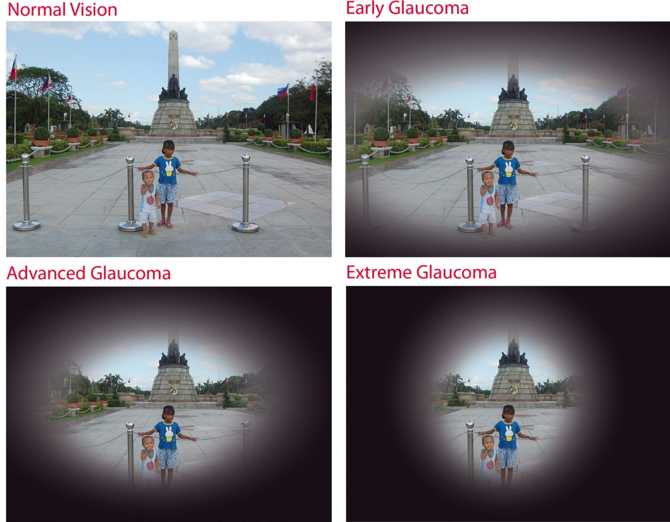
Glaucoma
Glaucoma: group of chronic eye diseases caused by increased intraocular pressure
Causes damage to optic nerve → visual field loss → blindness
Asymptomatic, painless, irreversible
Affects more than 60 million individuals globally
Primary cause of blindness for people aged 60 and over
Can appear in anybody at any age
Most are unaware of their affliction
Solution: leverage digital phenotyping!
Figure 01: Vision at Various Stages of Glaucoma
Glaucoma. (2019). Eye & I Eye Hospital and IVF (Fertility) Centre. https://eyeandivfhospital.com/glaucoma/
John Huang
Notes:
https://eyeandivfhospital.com/glaucoma/

Slide 8
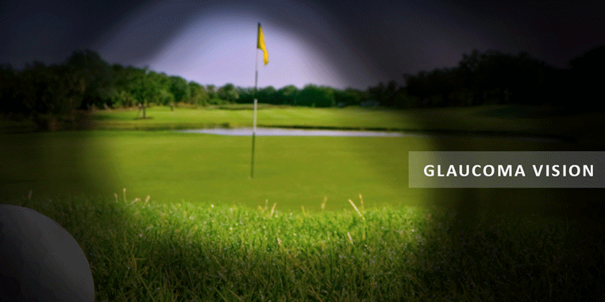
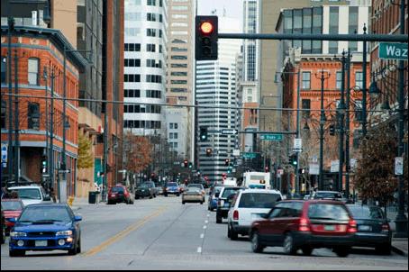
Glaucoma
Figure 02: Normal vs Glaucoma vision
Figure 03: Progressive Stages of Glaucoma
Admin, N. E. (2019, February 21). Glaucoma Treatment - Technology, Risks and Benefits. NQ Eye Specialists. https://nqeyespecialists.com.au/glaucoma-treatment/
Glaucoma Vision Simulator. (2019, January 18). American Academy of Ophthalmology. https://www.aao.org/eye-health/drugs/glaucoma-vision-simulator
John Huang

Slide 9
Glaucoma
Negative impacts on quality of life
Psychologically burdening
Increase in anxiety, depression, fear
Difficulty performing daily activities
e.g., reading, driving, walking, and navigating
Treatment leads to change in routine
e.g., eye drops
Inconvenient side effects
Financial costs
John Huang
Notes:
https://www.forneyeyeassociates.com/eye-disease-management/co-management-glaucoma/glaucoma-causes-and-risk-factors/

Slide 10
Glaucoma and Driving Event Relationship
Wood (et al.):
Self-report driving abilities ~ healthy individuals → 2x critical errors
Driving errors more likely to occur at traffic lights & yield/give-way intersections
Haymes (et al.):
~ healthy individuals in overall driving abilities and satisfactory maneuvers
Within glaucoma patients: ↑ visual field loss ~ ↓ overall driving score
Critical at-fault interventions: 12 patients with glaucoma vs 4 without
Predominant cause: failing to see and yield to a pedestrian
J. M. Wood, A. A. Black, K. Mallon, R. Thomas, and C. Owsley, “Glaucoma and Driving: On-Road Driving Characteristics,” PLOS ONE, vol. 11, no. 7, p. e0158318, Jul. 2016, doi: https://doi.org/10.1371/journal.pone.0158318.
S. A. Haymes, R. P. LeBlanc, M. T. Nicolela, L. A. Chiasson, and B. C. Chauhan, “Glaucoma and On-Road Driving Performance,” Investigative Ophthalmology & Visual Science, vol. 49, no. 7, p. 3035, Jul. 2008, doi: https://doi.org/10.1167/iovs.07-1609.
Stellina Ao

Slide 11
Glaucoma and Driving Event Relationship
van Landingham (et al.):
Driving cessation: 23% glaucoma subjects vs 6.9% of control (individuals 60-80 yo)
Likelihood of driving cessations: 2x ~ 5 dB ↓ of better-eye visual field mean deviation
Visual field mean deviation: sensitivity of visual field compared to same age group
Blane (review article, 2013):
Literature highly inconsistent on correlation of glaucoma with…
Crash risk, driving habits, & cognitive demand
S. W. van Landingham, C. Hochberg, R. W. Massof, E. Chan, D. S. Friedman, and P. Y. Ramulu, “Driving Patterns in Older Adults with Glaucoma,” BMC Ophthalmology, vol. 13, no. 1, Feb. 2013, doi: https://doi.org/10.1186/1471-2415-13-4.
A. Blane, “Through the Looking Glass: a Review of the Literature Investigating the Impact of Glaucoma on Crash Risk, Driving Performance, and Driver Self-Regulation in Older Drivers,” Journal of Glaucoma, 2016.
Stellina Ao

Slide 12
Glaucoma and Driving Event Relationship
Blane (review article, 2013) [cont]:
But, glaucoma is negatively correlated with overall driver performance
Perform poorly on driving assessments (on/off-road)
Generally, glaucoma patients find driving at night exceedingly difficult
Also tend to alter driving practices/cease driving
Results differ on degree of visual field loss
A. Blane, “Through the Looking Glass: a Review of the Literature Investigating the Impact of Glaucoma on Crash Risk, Driving Performance, and Driver Self-Regulation in Older Drivers,” Journal of Glaucoma, 2016.
Stellina Ao

Slide 13
Project Outline
Mission:
Use digital phenotyping to detect and monitor glaucoma through driving behaviors
Project:
Mobile application using smartphone sensors to characterize driving events
Use collected data to monitor glaucoma severity
Report condition to patients, doctors, and DMV
Stellina Ao

Slide 14
Research

Slide 15
Important Considerations
Seamless integration into user’s lifestyle
No additional steps needed to operate
e.g., specific placement of smartphone within car, questionnaire before each drive, etc
Otherwise, decrease likelihood of use
Unobtrusive as to not alter driving style
e.g., no cameras, visual reminders of monitoring, etc.
Luis Ayala

Slide 16
Data Requirements
Smartphone sensor data collected while driving
Duration of drive
Individuals with glaucoma → shorter drive times
Time/weather of drive
Individuals with glaucoma → driving during high daylight, sunny weather
Number of sudden driving events
Individuals with glaucoma → brake often due to last-minute crash aversions
Individuals with glaucoma → accelerate/decelerate due to missed speed limit signs
Ideally, data collected from reputable sources with 10+ participants
Luis Ayala

Slide 17
Datasets
Kaggle: Traffic, Driving Style, and Road Surface Condition Dataset
Unknown number of participants → assume 1
Recorded using OBD-II and smartphone sensors
Kaggle: Driving Behavior Analysis Using Sensor
Appears to be collected from one user
Uses accelerometer, gyroscope, and proximity sensors
Smartphone position may not be ideal for detecting events such as smartphone use
Mengying Chen

Slide 18
Datasets
HCRL: Human Behavior Characterization for Driving Style
~ 23 hours of Drive time for ~ 46 km total (round-trip)
Ten drivers
Applied to user classification and personalized services
Harvard Dataverse: Real-time Monitoring for Identifying Different Driving Events
Unknown hours of drive time and number of participants
Uses accelerometer and gyroscope smartphone sensors
Characterizes driving events
Normal/aggressive → turning / accelerating / braking
Mengying Chen

Slide 19
Telematics

Slide 20
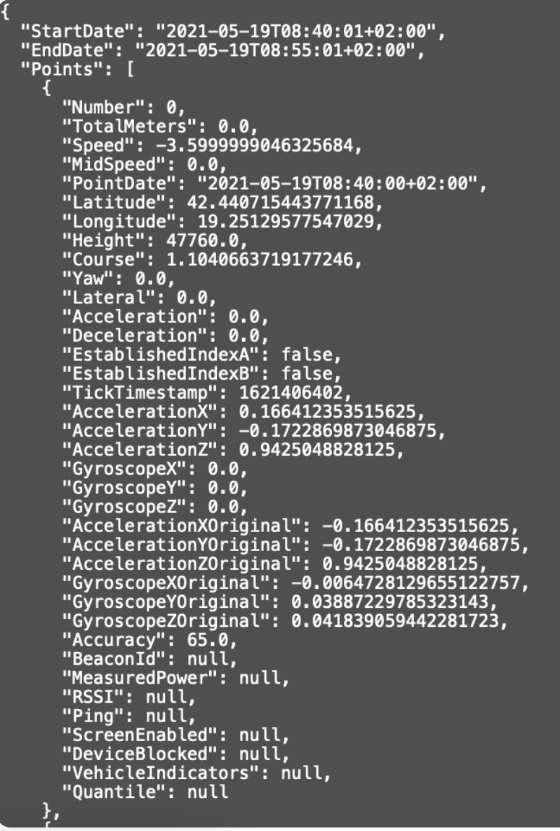
Mobile Telematics
Mobile Telematics: telecommunications & informatics where driving data is collected and processed
General smartphone data - GPS, time, screen status
Triaxial - acceleration, vibrations, tilt
Gyroscope, magnetometer, etc.
Figure 04: Sample Raw Data
Ashley Tran

Slide 21
Telematics Software Development Kits
SDKs | Open Source | Cross-Platform | Data Suitability | Use of Data
OSeven |  |  | X | X
MapBox | X | X
Damoov | X | X | X | X
GeoTab | X |  | X
DriveKit | X |  | X | X
ZenDrive | X | X | X
Ashley Tran

Slide 22
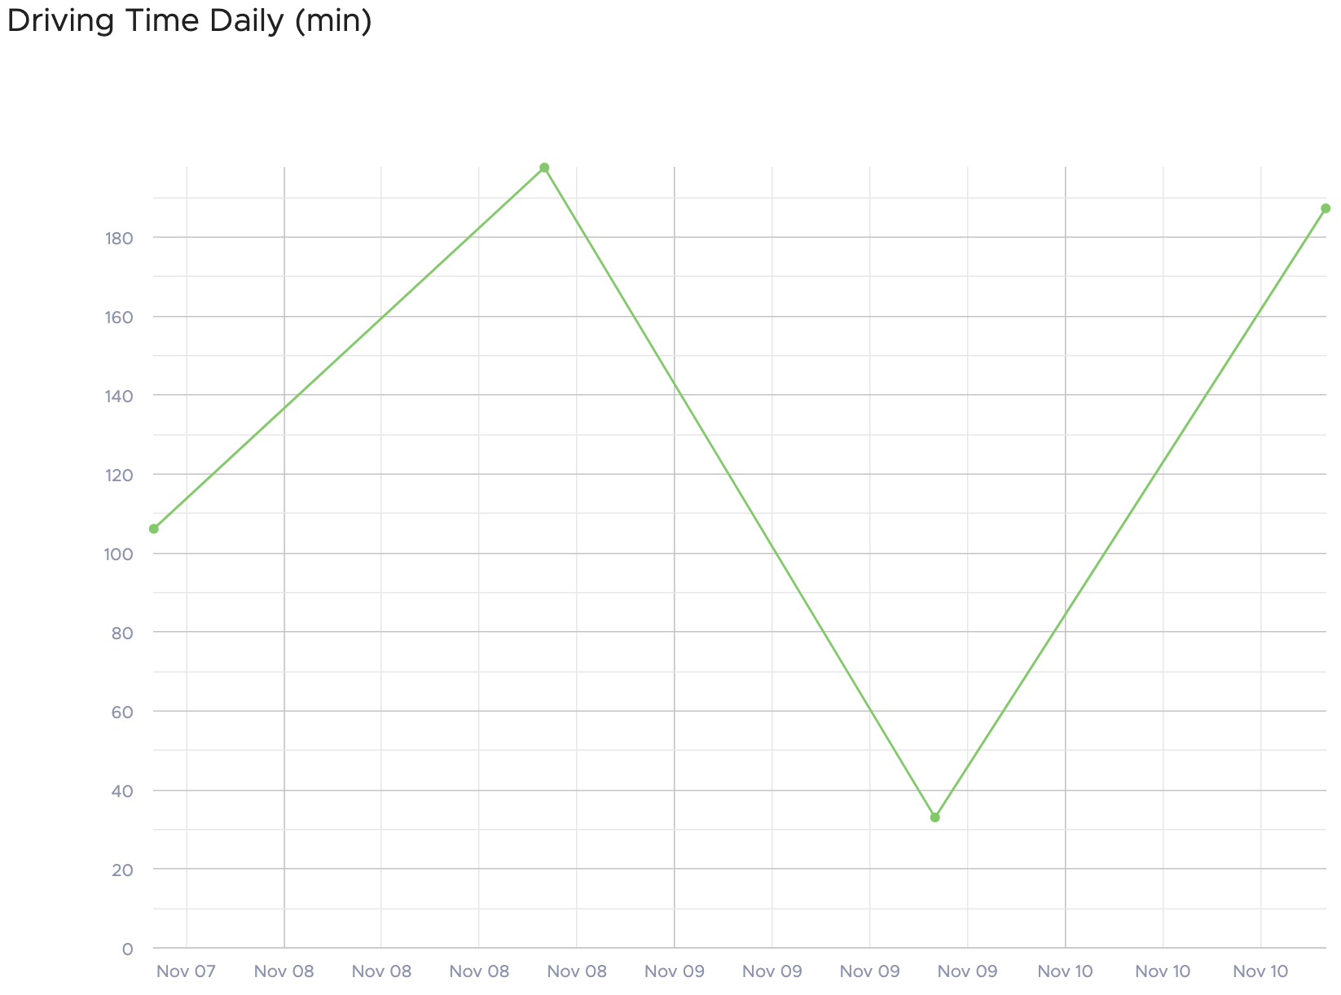
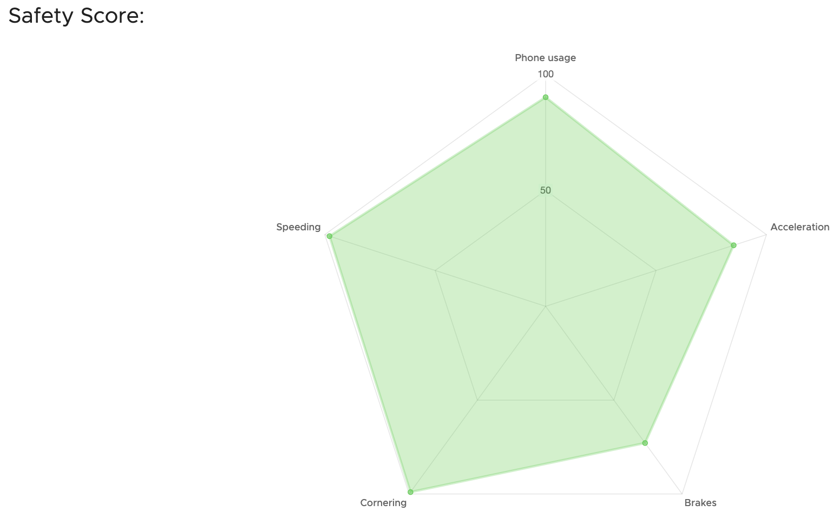
Processed Driving Events
Drive Distance and Duration
Time of Drive and Route - ‘frequent routes’
Avoidance of highways
Nighttime driving
Braking/Deceleration, Speeding/Acceleration
Overtly slow driving
Yielding + stops
Cornering - distinguish between turns (L & R)
Sharpness of turns
Trip, Safety, Distracted Driving, and Eco Driving Scores
Figure 05: Daily Driving Time over three days
Figure 06: Calculated Safety Score
Ashley Tran

Slide 23
Damoov Telematics
Advantages:
Access to all data at any stage with on-demand data destruction
Customizable driving events and data processing
License to distribute SDK within mobile application
Disadvantages:
No introduction of service automation
Generally, telematics may hold some inaccuracies for crash detection
Reliance on internal data platform
Ashley Tran

Slide 24
Data Storage

Slide 25
BEIWE
Advantages:
Tailored for health research data collection
Emphasizes patient data privacy
Supports a wide range of data types
Disadvantages:
Setup can be complex for non-researchers
Not suited for general data storage needs
Costs can be significant for large-scale studies
Thang Tran

Slide 26
AWS
Advantages:
Highly scalable for any workload
Offers a broad range of storage services
Global infrastructure for high availability
Disadvantages:
Complex pricing structure
Learning curve for effective service management
Users must ensure proper security configuration
Thang Tran

Slide 27
REDCap
Advantages:
Geared toward academic and biomedical research
Meets regulatory compliance standards
User-friendly for survey and data management
Disadvantages:
Primarily for research contexts
Local hosting may add complexity
Might lack advanced features of larger platforms
Thang Tran

Slide 28
Damoov DataHub
Advantages:
May offer good data integration and analytics tools
Meets regulatory compliance standards
User-friendly interface for specific tasks
Disadvantages:
Vendor dependency for updates and support
Uncertain scalability compared to major cloud services
Thang Tran

Slide 29
Tools and Technologies

Slide 30
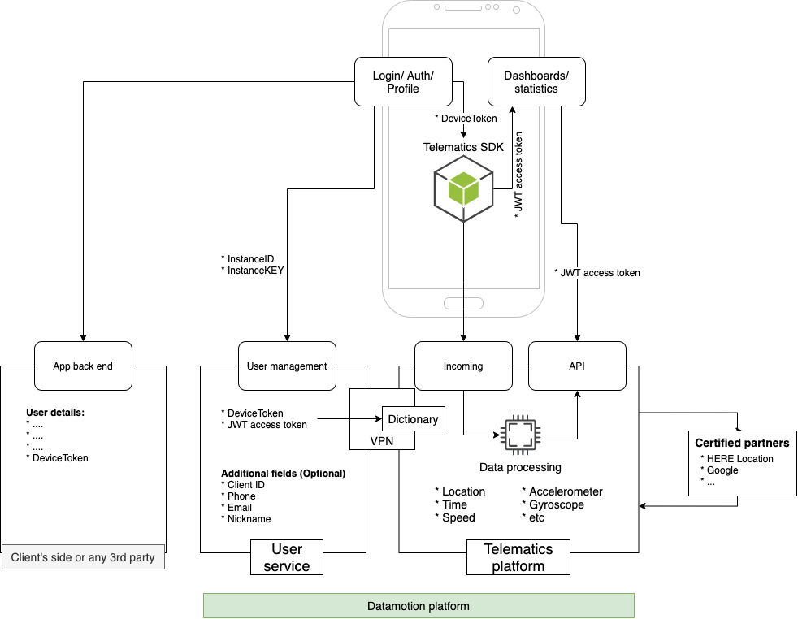
Damoov SDK Integration
User Service - generates user ID and JSON web token for user authentication & refresh
Damoov’s DataHub - data management platform that processes data from SDK that verifies JSON web token
Can either integrate into a new app or use their existing app as a base
Figure 07: Damoov SDK Integration Architecture
Desiree Ramirez

Slide 31
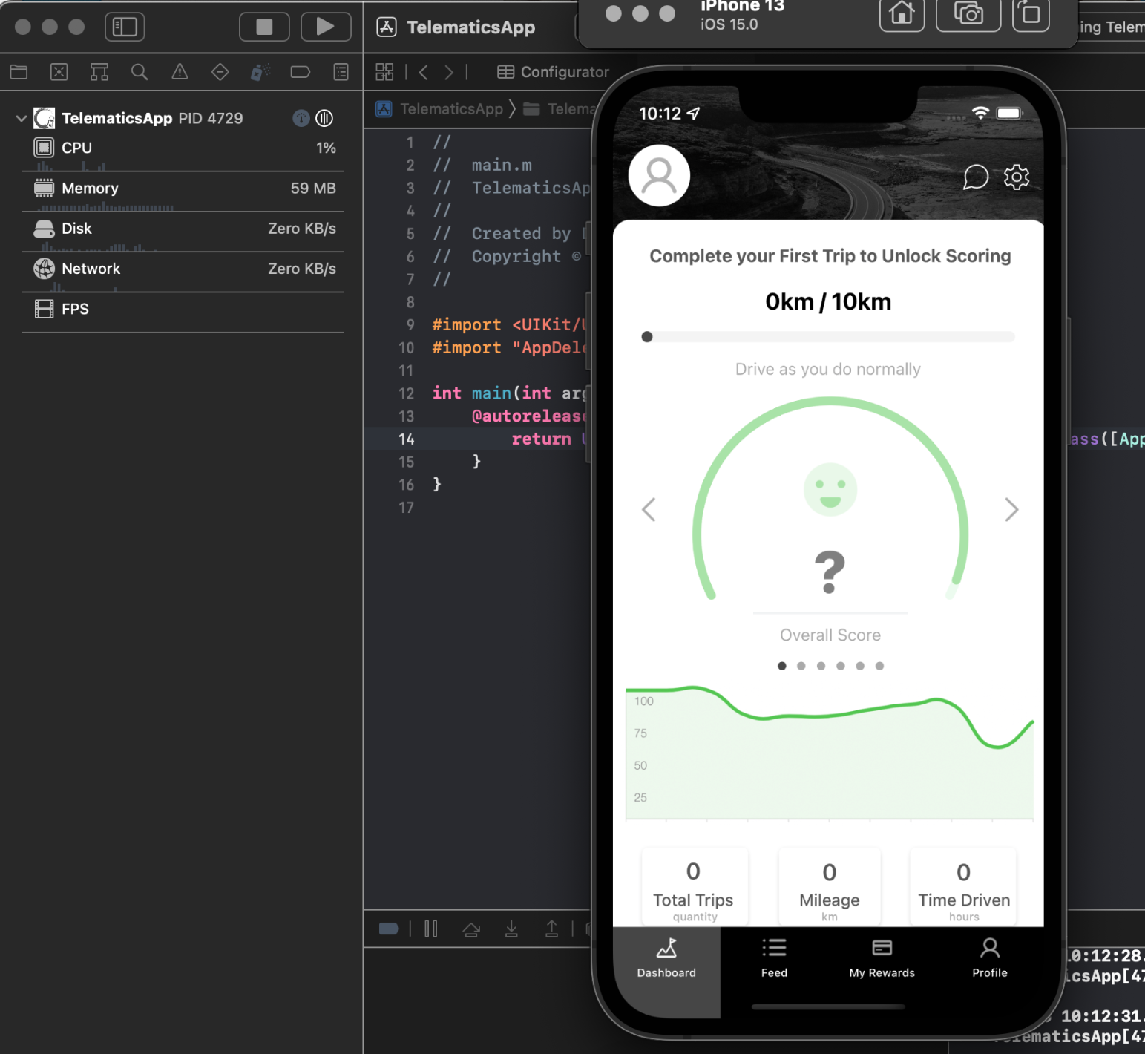
Damoov SDK Integration Options
Use ZenRoad as the base
Integration with an existing app
iOS, Android & cross-platform options
Flutter or React Native
Choose platform for data storage
Internal DataHub or external source
Figure 08: Zenroad Application
https://docs.damoov.com/docs/set-up-the-sdk-login-and-api-authentication
Desiree Ramirez

Slide 32
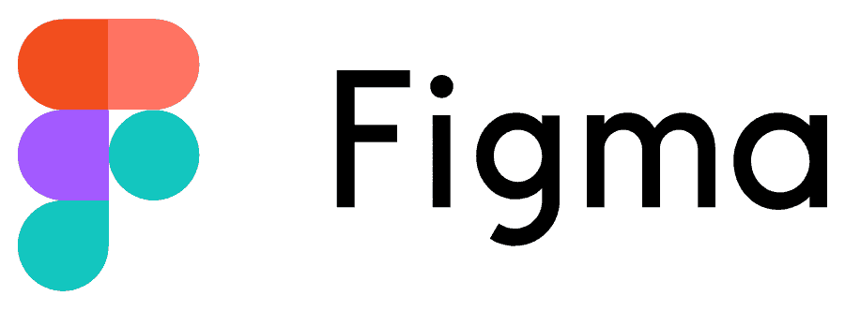
Other Tools
Desiree Ramirez

Slide 33
Progress Update

Slide 34
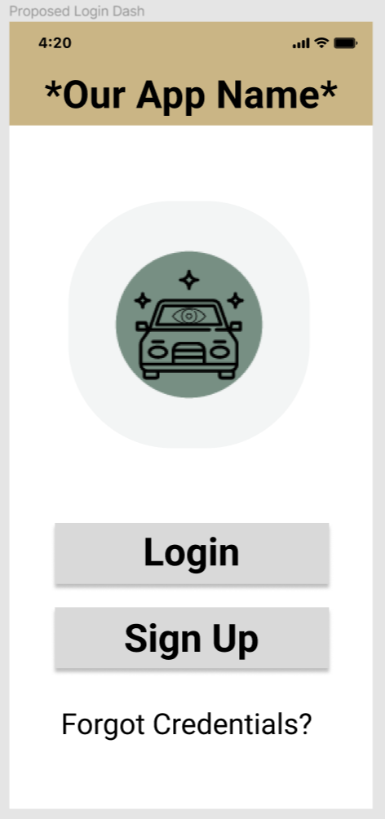
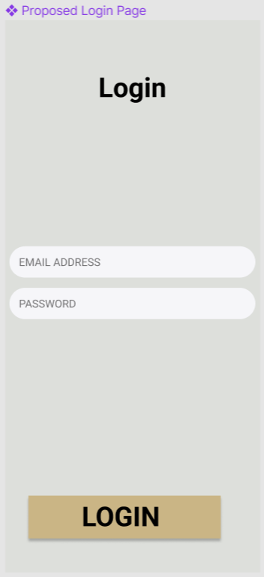
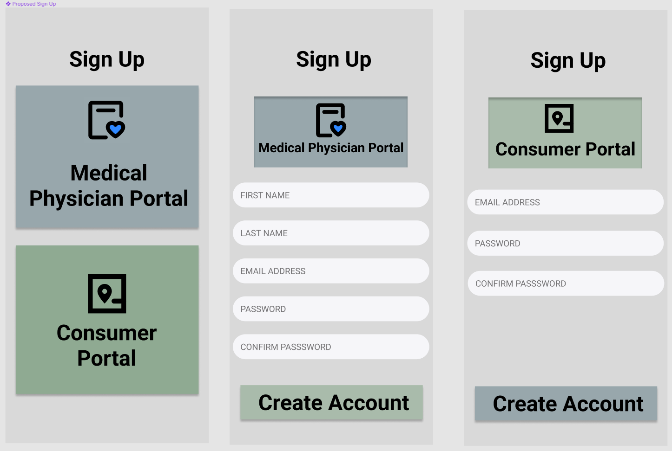
Proposed Application
Jooeun Jeon
Notes:
https://www.figma.com/file/O4WXOnoCvunyOiHmzYUBKz/Design-an-iOS-app-(Community)?type=design&node-id=40-857&mode=design

Slide 35
Mockup Application
General view:
Visual design → gold, sepia, brown
Ideal palette for individuals with glaucoma
No harsh colors!
Otherwise, decrease likelihood of use
Patient’s view:
Patients should not see statistics in real time
Patients may try to correct their driving behavior
Physician’s view:
Physicians should see detailed information
Raw data, driving statistics, and detailed score
Jooeun Jeon

Slide 36
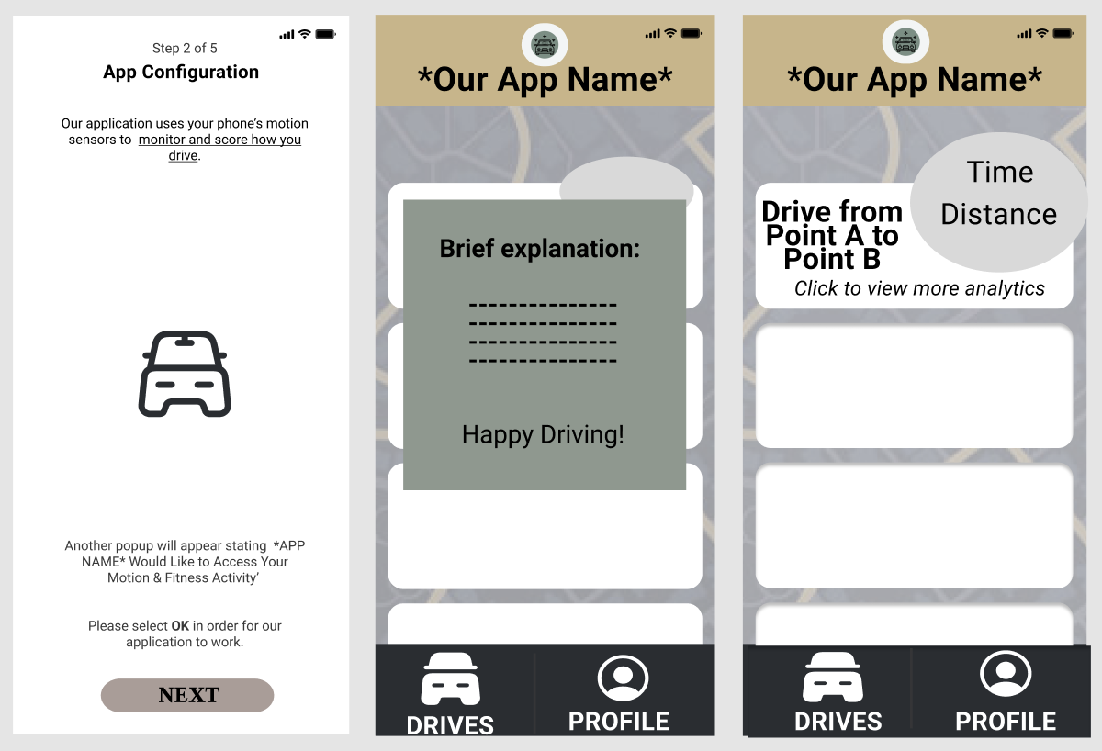
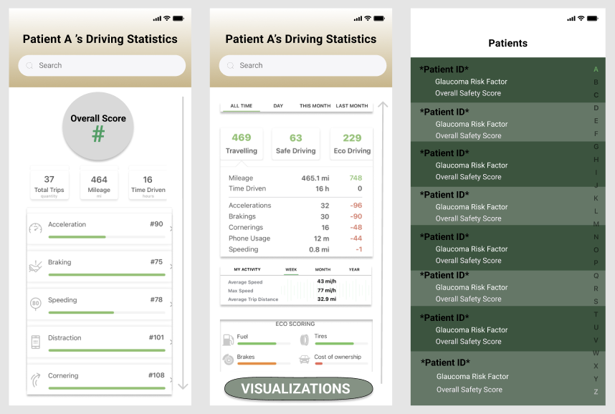
Mockup Application
Jooeun Jeon

Slide 37
Thank You
Questions are welcomed—

Slide 38
Digital Phenotyping Studies Cont.
Jenciūtė G, Kasputytė G, Bunevičienė I, (et al.):
LAIMA
Monitors cancer patients with smartphone devices sensors
Weekly questionnaires
No results
Jenciūtė G, Kasputytė G, Bunevičienė I, et al. Digital Phenotyping for Monitoring and Disease Trajectory Prediction of Patients With Cancer: Protocol for a Prospective Observational Cohort Study. JMIR Res Protoc. 2023;12:e49096. Published 2023 Oct 10. doi:10.2196/49096
Edson Castellanos

