Slide 1
Behavioral Cognition Project
December 1, 2023
Notes:
Deep Bhakta

Slide 2
Our Team
Advisor/Liaison:
John Tran
Coding:
Arturo
Deep
Shant
Yizhang
Erick
Jorge
Testing:
David
Izeth
Research:
Danny
Deep
Jorge
Documentation:
Iris
Notes:
The whole team

Slide 3
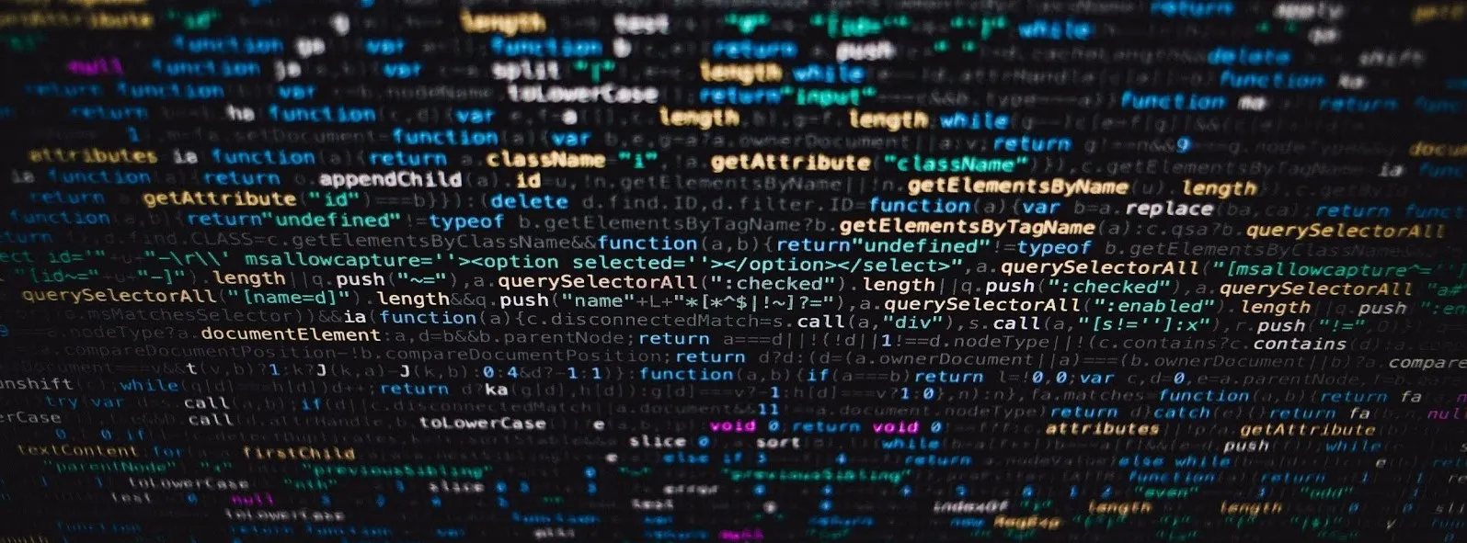
The Big Picture
An AI toolkit
Easy to use
Little to no programing knowledge needed
Similar to ChatGPT/ Bard
Creating based for web program
Single command executable project
Notes:
Iris

Slide 4
TABLE OF CONTENTS
01
02
03
Background
Progress
Future Steps
Notes:
Izeth

Slide 5
Background
01
Notes:
Izeth (Sample/Rough intro for this slide: “Moving on for this slide, For the background of this project the core foundation has been set by researching different variants for things such as model and for that i would pass it on to the research team”

Slide 6
Research
Daniel : React Hooks (useLLM), GPT 3
useLLM is a React Library that allows the user to integrate LLM models like OpenAI’s ChatGPT and add AI-Powered features within your React App with only few lines of codes.(Able to use any LLM)
Supports message streaming, prompt engineering,audio transcription, text-to-speech and much more.
Deep: LLaMa Model
Ollama allows you to run open-source large language models, such as Llama 2, locally.
It optimizes setup and configuration details, including GPU usage.
Recreate one of the most popular LangChain use-cases with open source, locally running software - a chain that performs Retrieval - Augmented Generation, or RAG for short, and allows you to “chat with your documents”
Research Team are investigating/testing different open source LLM (Large Language Models) to see which one will satisfy our standards.
LangChain is an AI tool that allows the user to build new apps using existing A.I models.
LangChain helps user have an easier time deploying models such as GPT-4 LLaMa to their projects, apps services etc.
Notes:
Deep, Daniel

Slide 7
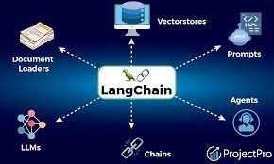
LangChain
LangChain is a framework facilitating the development of context-aware applications powered by large language models (LLMs), enabling reasoning capabilities based on contextual information. In essence a toolchain.
LangChain provides a collection of very helpful high-level abstractions - with help of external tools - when we build LLM based applications. Langchain to LLM is like React to JavaScript or Pandas to Python, is it a tool that abstracts away some of the complexities of their underlying languages. Efficiency is key.
IMPLEMENTED: Prompt Template, OpenAI Integration
FURTHER IMPLEMENTATION: Vector Database (MongoDB Atlas), Document Extractors, Memory
Notes:
Jorge

Slide 8
Progress
02
Notes:
Izeth

Slide 9
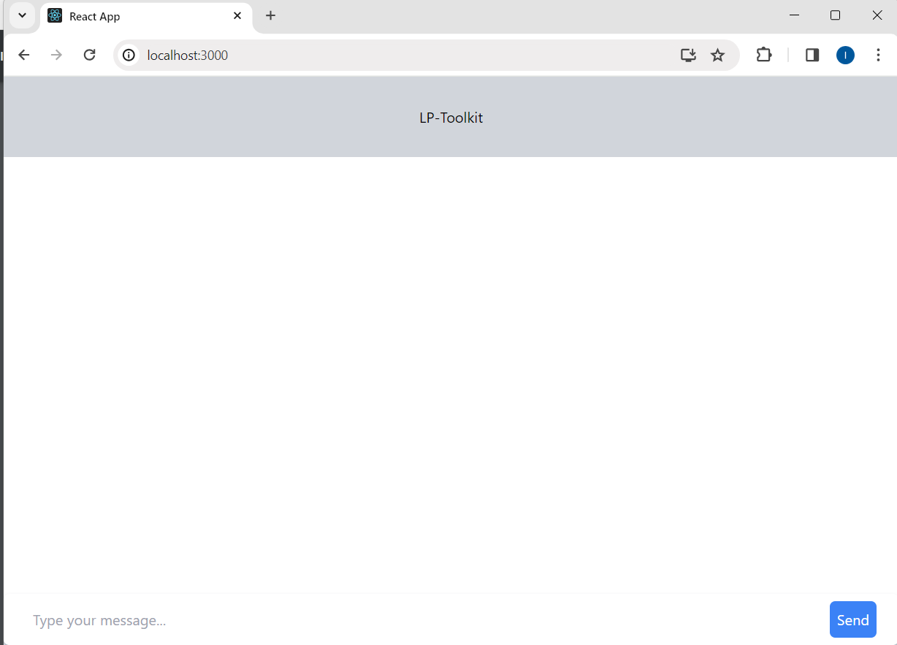
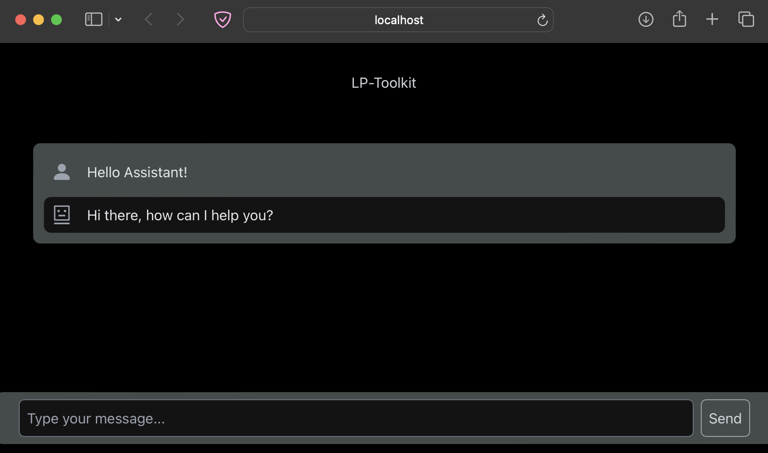
Frontend
Language Used
Javascript
HTML / CSS
Frameworks/Libraries
React.js
Node
TailwindCSS
MongoDB
Structure Files:
server.js
Frontend_ChatBox.html
style.css
chat.js
index.css
Chat.css
etc…
Notes:
Yizhang and Arturo

Slide 10
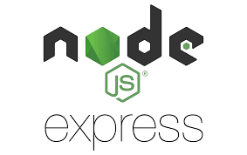
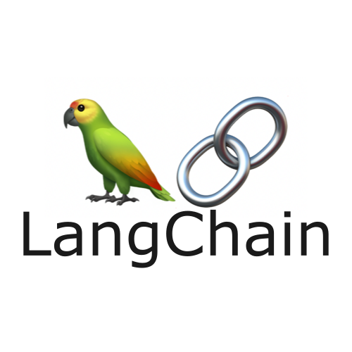
Backend | Langchain
Express Server (Node.js)
Connected to the frontend of the application
Connects to Langchain through an API call
No direct relationship
Connected to MongoDB
Langchain (Python)
Communication done through a FastAPI server created in python
Digests information and returns generative text
Notes:
Shant and Arturo

Slide 11
Docker | Microservers
Allows for running the application with a single command: “Docker Compose”
Containers for each microcenter
Frontend
Backend
Database
Langchain API
Docker Compose
Vectorizer
Notes:
Shant and Arturo

Slide 12
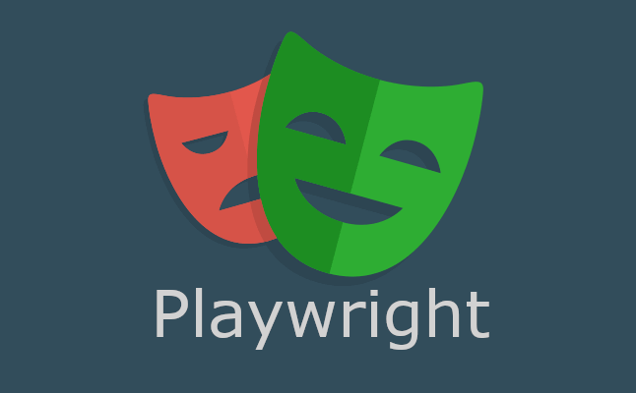
Testing
Current Status:
Testing Frameworks installed (in collaboration with coding team):
Unit Testing: Jest
Will be used for unit testing critical functions and modules
End-to-End Testing: Playwright
Will be used to ensure that our user-facing elements are working as intended
Can be used to test forms/buttons/page navigation/etc.
Simulates the behavior of an actual user
CD/CI Initial Setup (in collaboration with coding team):
Frontend/Backend workflows driven by GitHub Actions
Tests will be run automatically on push to repository, pull-request, etc.
Notes:
David and Izeth

Slide 13
Testing
Web app
Docker
Postman (Backend API Server)
GitHub Documentation
Testing and approving push requests
Collaborating with Coding Team
Frontend/Backend functionality
Future Testing
Framework for testing
Test case and planing
Review and analyze
Troubleshoot end user issues quicker
Work as intended
Notes:
David and Izeth

Slide 14
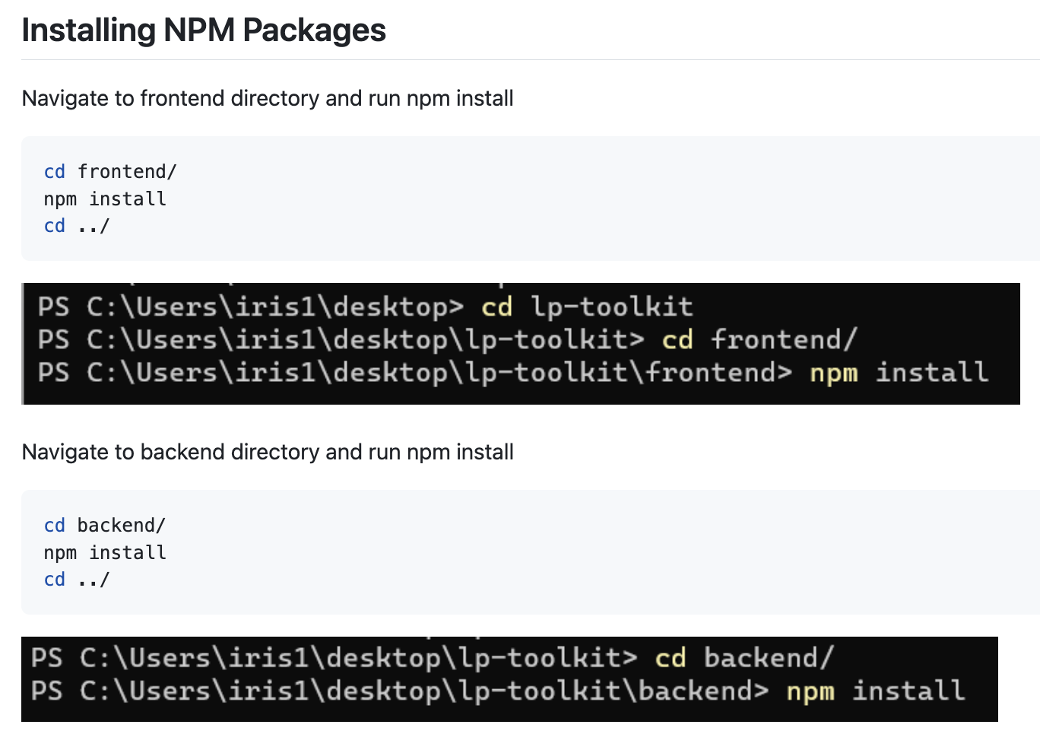
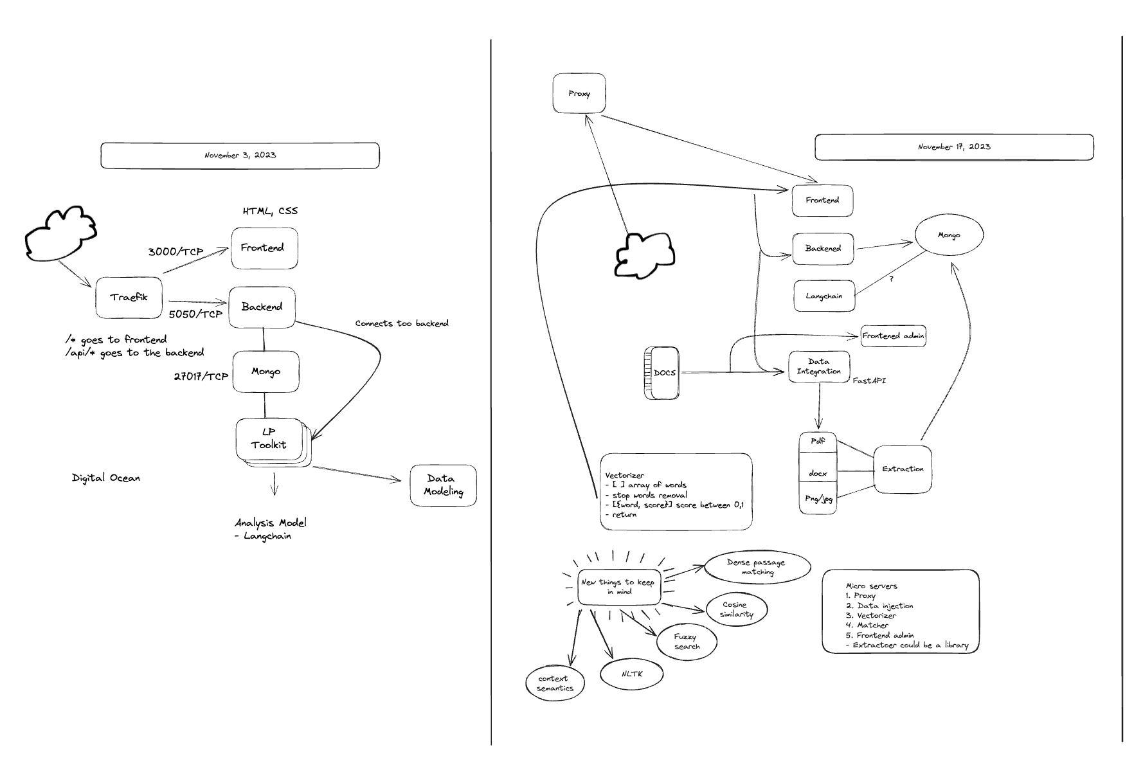
Documentation
Notes:
Iris and Erick

Slide 15
Future Steps
03
Notes:
Iris

Slide 16
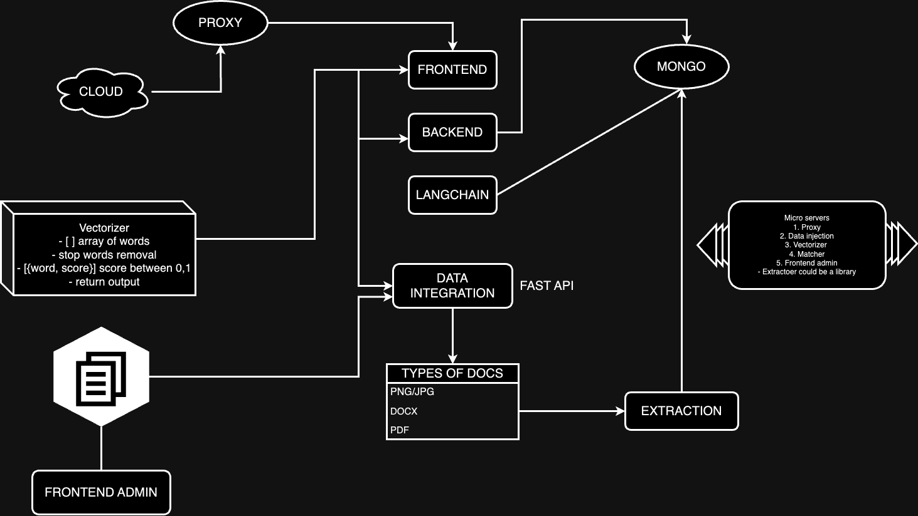
Architecture
Notes:
Iris

Slide 17
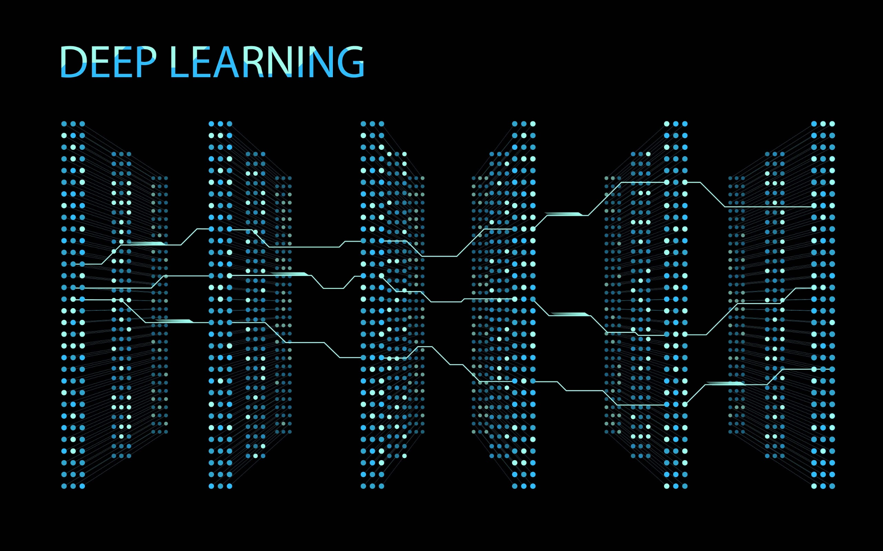
Large Language Model
Open AI
GPT-3.5/4
LangChain
Vectorizor
Notes:
Deep and Erick

Slide 18
Large Language Model
LLM are programs that can understand text and output human-like text
OpenAI is an artificial intelligence research laboratory that created the GPT (Generative Pre-trained Transformer) series
GPT 3 and 4 are language models developed by OpenAI
LangChain is an open source framework that allows the combination of LLM’s with other external components in order to develop LLM powered applications
Vectorizer is an algorithm that allows the conversion of text into numerical representation
Notes:
Erick

Slide 19
Thank You
All Knowledge Professor Tran!
Notes:
Deep

