Slide 1
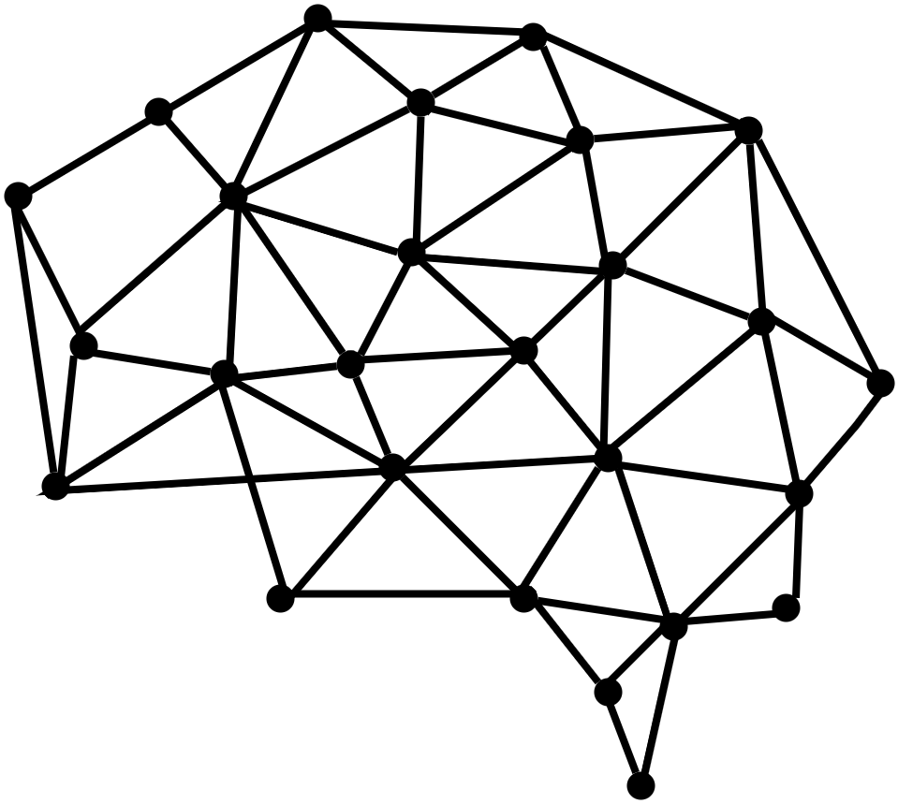
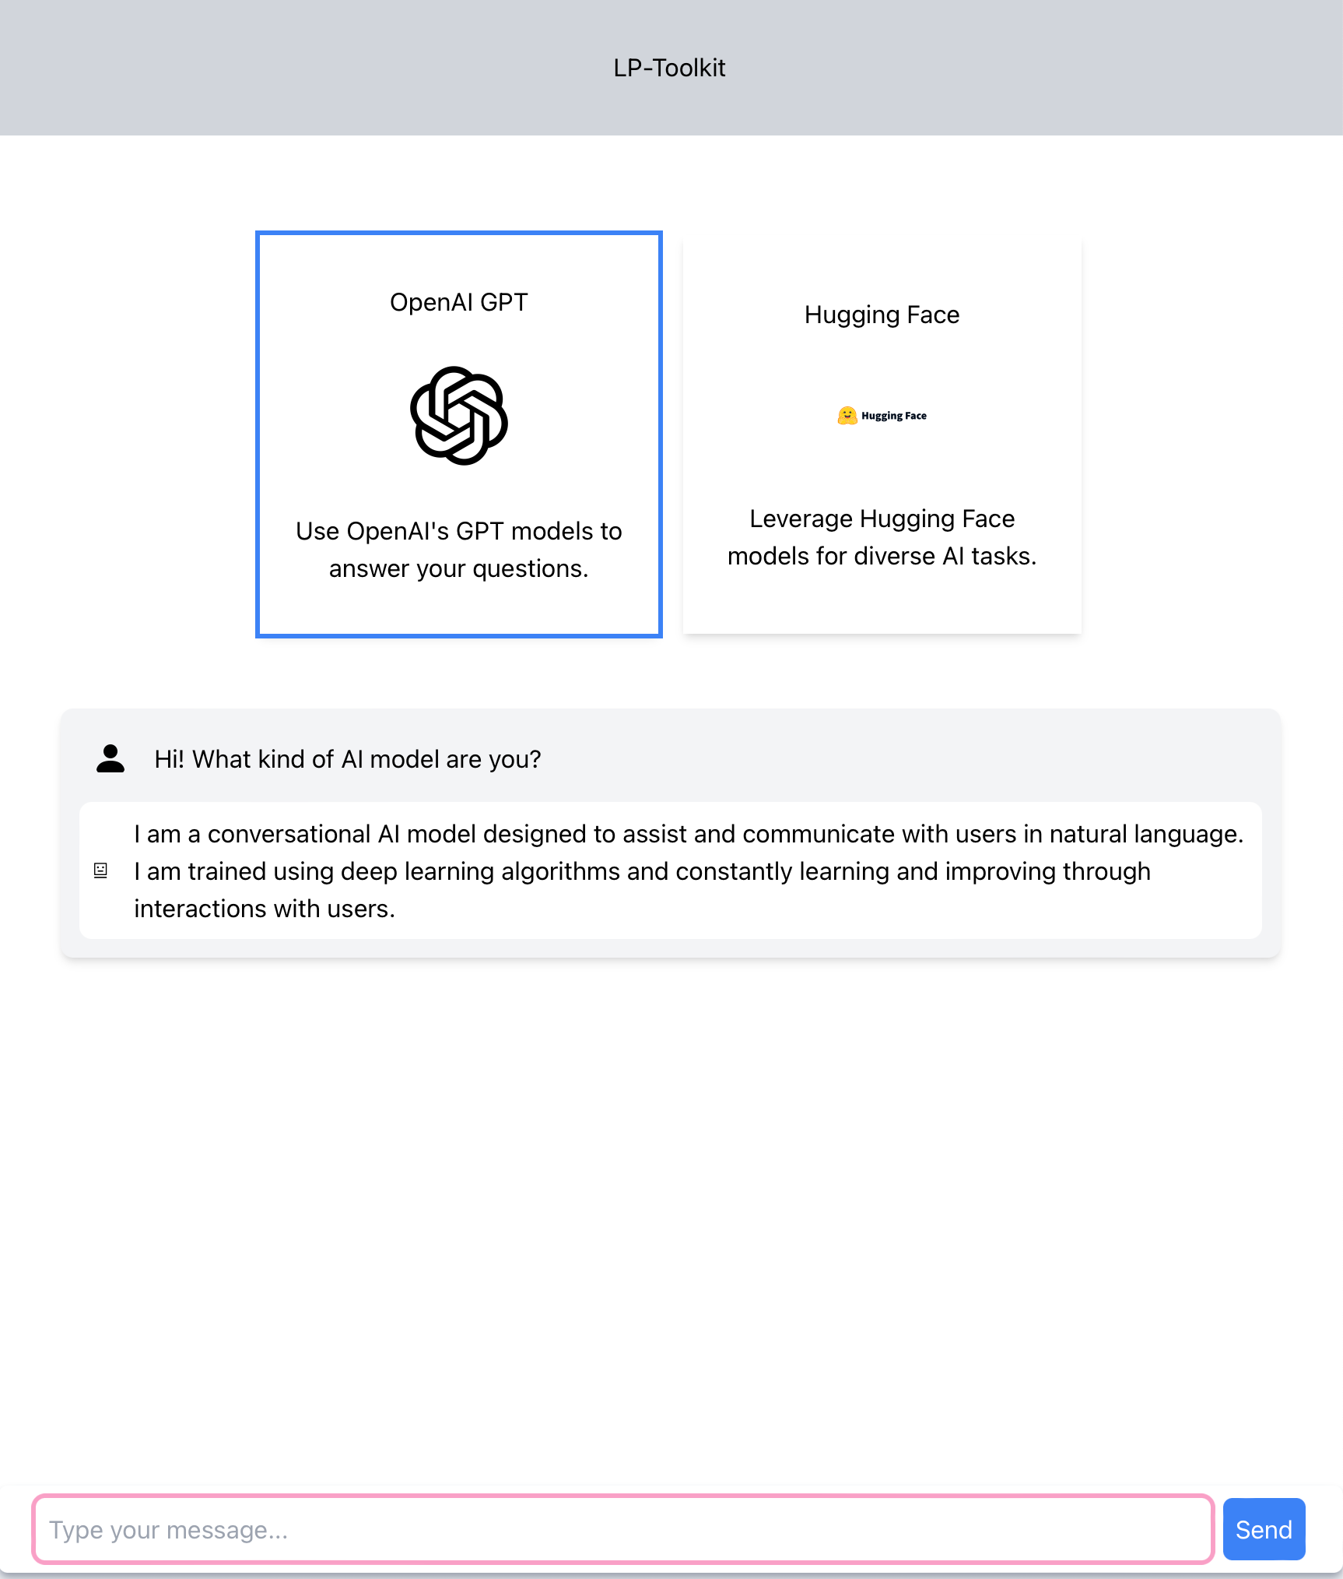
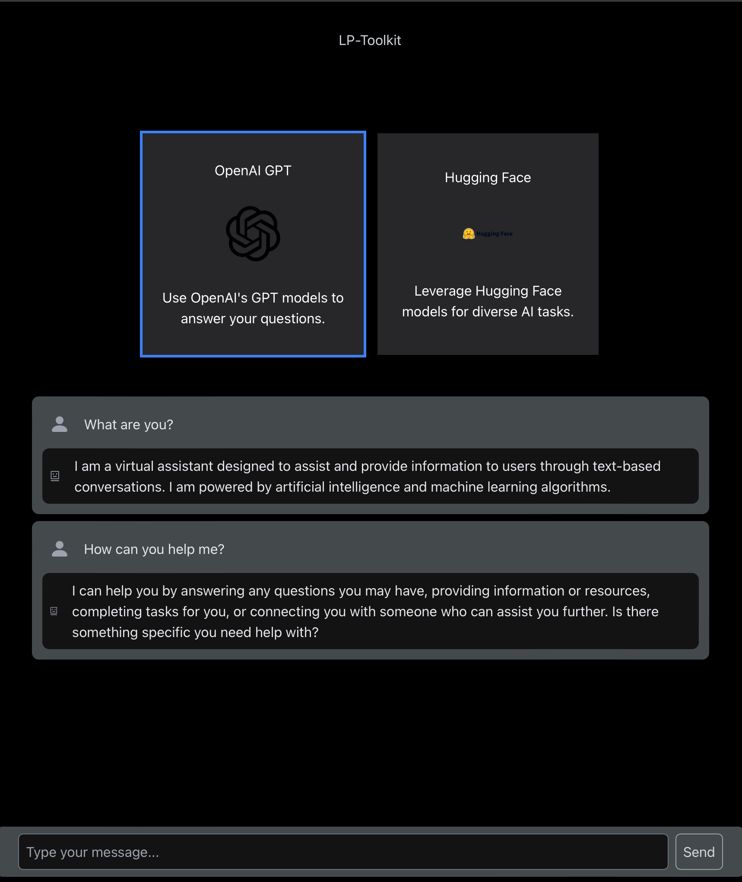
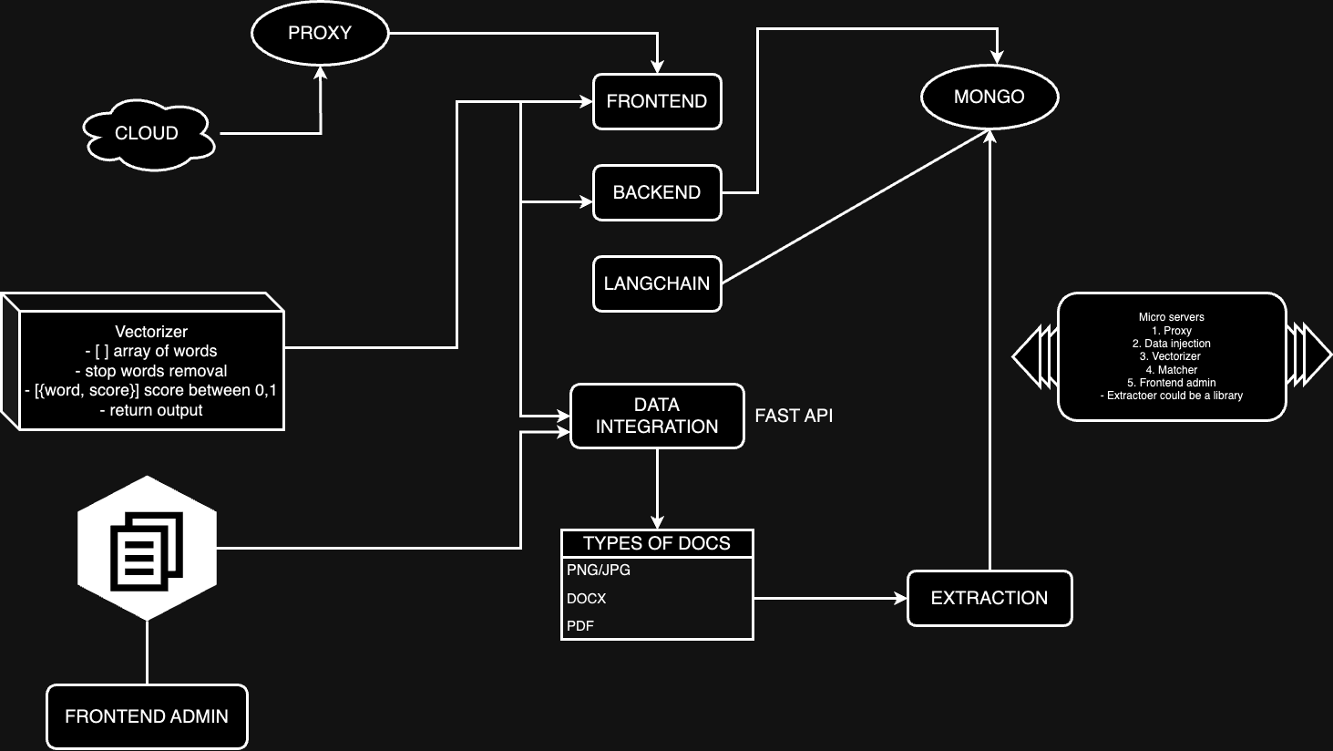
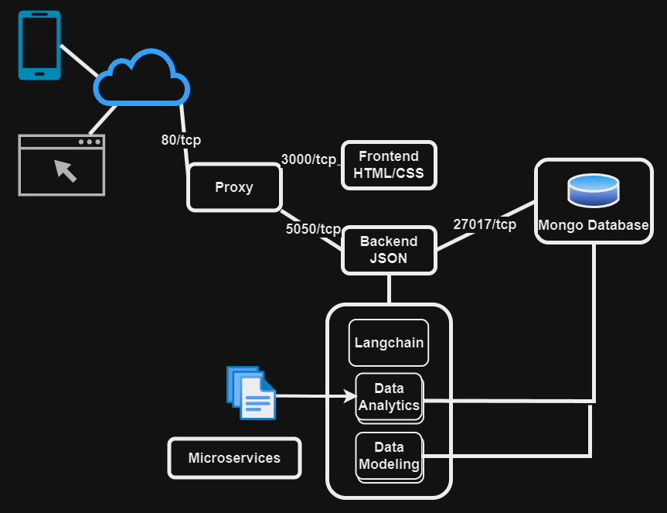
BEHAVIORAL COGNITION PROJECT Team Members: Arturo Rodriguez, Daniel Ontiveros, David Santini,
Deep Bhakta, Erick Herrera, Iris Ha, Izeth Torres,
Jorge Pena, Shant Hovagimian, Yizhang Cao Faculty Advisor: Dr. John Tran Behavioral Cognition Liaison: Dr. John Tran Department of Computer Science
College of Engineering, Computer Science, and Technology California State University, Los Angeles
Objective
Our team sought to meticulously design and develop a production-ready system with surrounding frameworks, ensuring seamless integration into any existing infrastructure. The architecture had to be designed to be self contained and easy to deploy. Thus, offering users a plug-and-play experience that expedites the development of GPT models across a diverse range of platforms.
Background
Developing a conversational GPT model framework is time-intensive and complex, challenging for individuals and small businesses seeking to integrate GPT features. Our solution is a streamlined framework that simplifies this process, enabling quick and easy deployment of the toolkit.
Methodology
Database: MongoDB for document operations.
Integration: Incorporates LangChain for analytics and modeling.
Backend: JSON-powered for data management.
Communication: Proxy interface between frontend and GUI.
Testing: Ensures local execution and prompt validation for seamless component interaction.
Implementation
Testing
Local Execution: Run the LP toolkit on their local computer.
Setup Process: Downloading toolkit files and initializing Docker.
Instructions Provided: Detailed guidance for setup.
Docker Utilization: Packages software into containers.
Jest: Handles unit testing, catching early bugs.
Playwright: Conducts end-to-end testing across browsers and devices.
Ease of Use: Simple syntax for Jest and high-level API for Playwright.
Comprehensive Coverage: Ensures thorough testing and maintenance.
Solution
Our toolkit offers a production system with a deployment time of under 5 minutes, supporting user customization such as model uploads and conversation switching. The GUI is flexible, allowing adjustments to temperature and roles making you go from zero to hero.
Future Work
Looking ahead, our team is focused on enhancing our toolkit by adding new AI models to expand functionality and improve user experience. Future updates will include real-time feedback and adaptive learning features to optimize and personalize model performance using a vectorizer schema.
Conclusion
Technologies
Simplified Integration: Eases the integration process for GPT models.
Reduced Requirements: Lowers the time and expertise needed for deployment.
Broad Accessibility: Makes conversational AI accessible to developers, researchers, and businesses.
Hugging Face, Langchain, FastAPI, ExpressJs, React, MongoDB, OpenAI, Docker
Notes:
‹#›
Draft3

