Slide 1
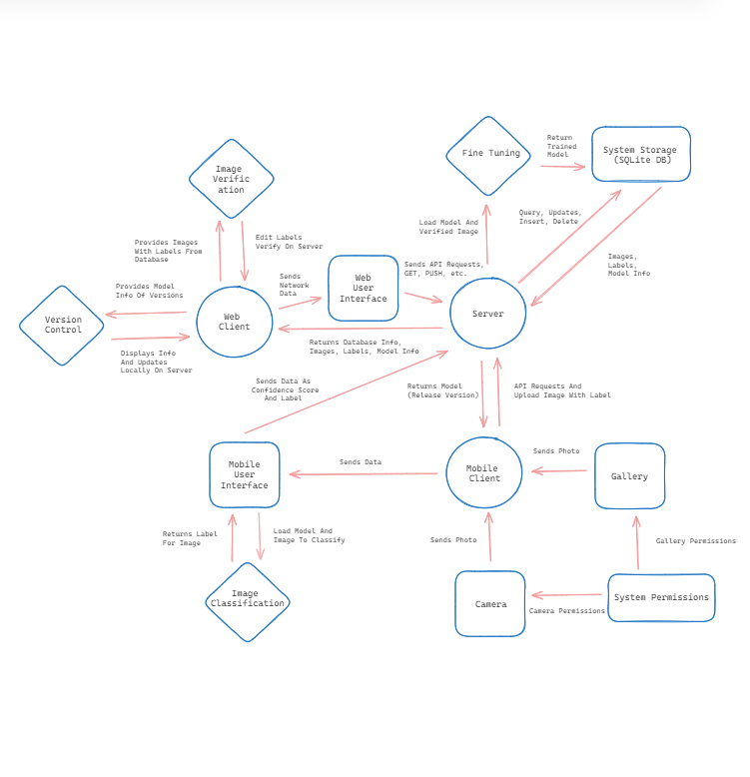
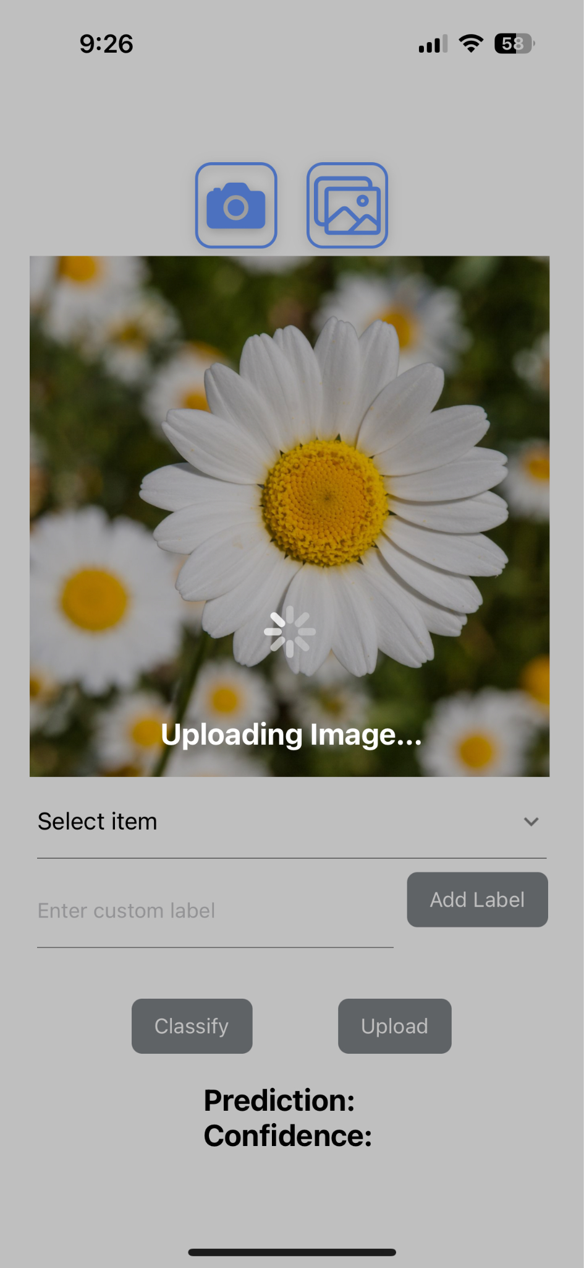
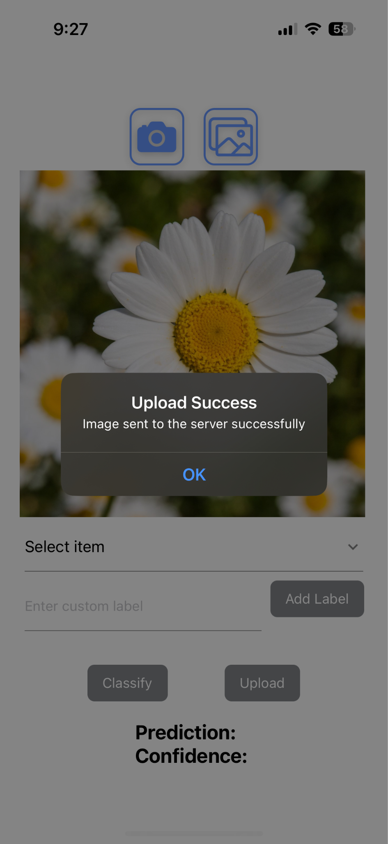
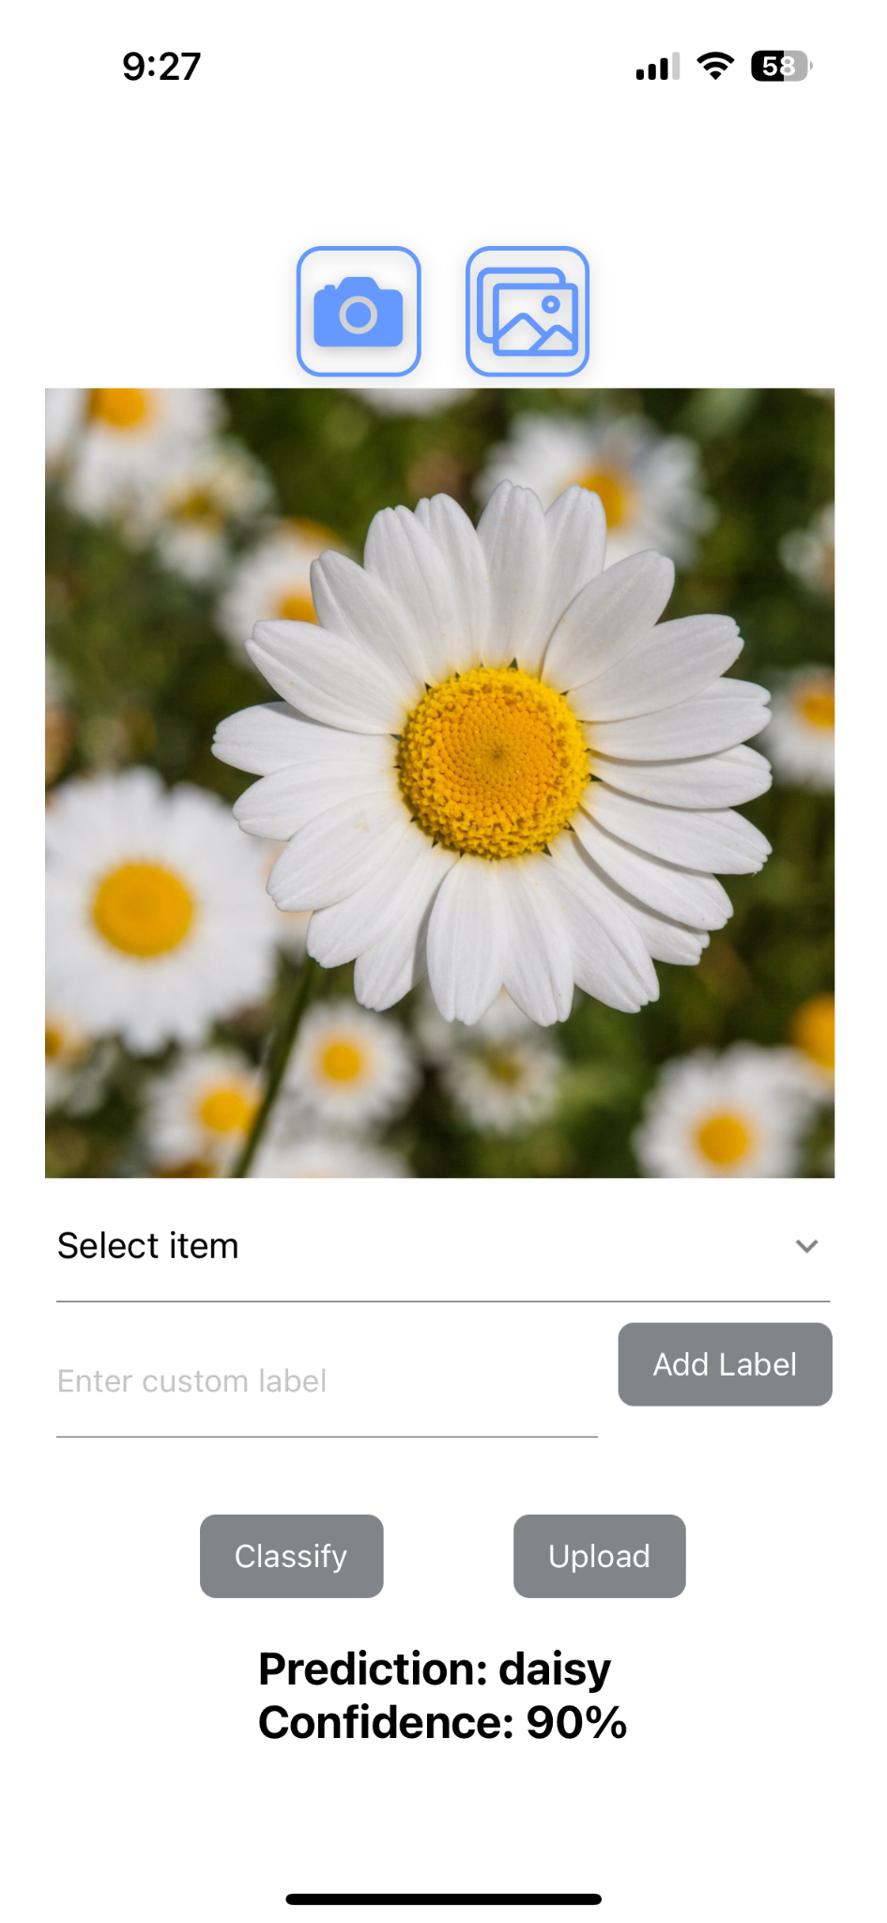
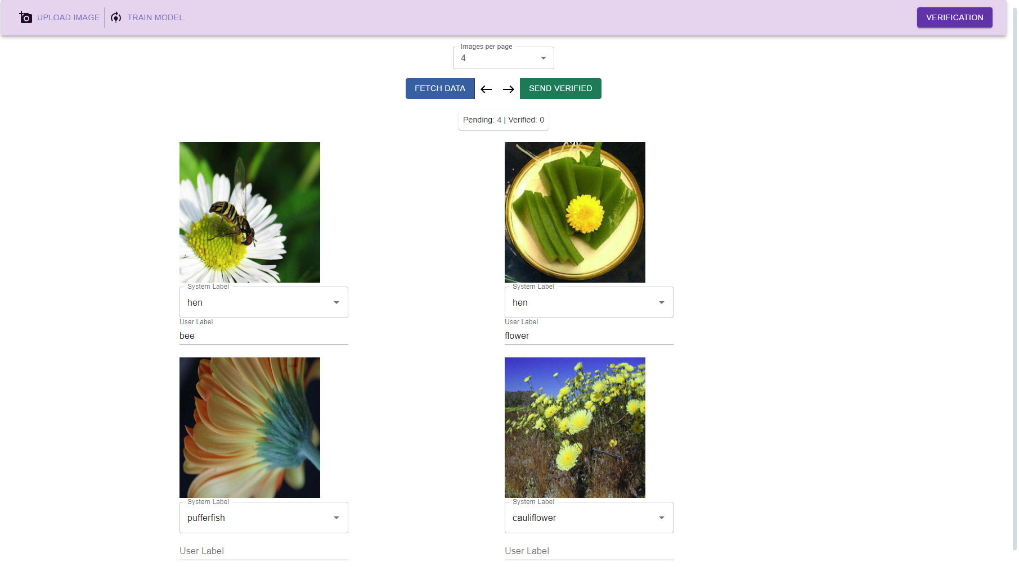
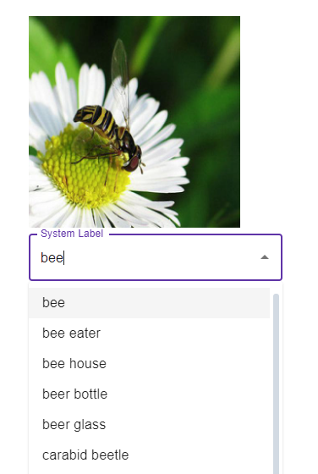
Machine Learning for Network-Denied Environment Team Members: Sanjog Baniya, Jonathon Dooley, Enrico Efendi, Wilson Gan,
Xavier Lara, Kevin Maravillas, Howard Nguyen, Nisapat Poolkwan,
Johnson Tan, Justin To, Alvin Yu Faculty Advisor: Dr. Chengyu Sun NSIN/ICT Liaison: Dr. Benjamin Nye, Dr. Mark Core Department of Computer Science College of Engineering, Computer Science, and Technology California State University, Los Angeles
Sponsor Logo
Background
Objective
AI and Machine Learning heavily depend on cloud processing, vulnerable to connectivity interruptions. Yet, in critical areas like conflict zones, major disaster areas, and under-developed regions, networks are often unavailable. Cloud-based AI/ML solutions are potent but need network access. Client-based solutions like MobileNet work offline but are hard to update in such environments.
Machine learning In Network-Denied Environments (MINDE) aims to demonstrate a hybrid system for offline image classification, combining a cloud server, web client, and offline-capable mobile client:
Mobile client: collecting and classifying images directly from the phone’s camera or from its photo library. When a connection is available, the mobile client will upload new images to the server along with any user-supplied labels.
Server: retrain/fine-tune the classification model with new data from the mobile client and send back new models. If server communication fails, the mobile client can exchange data directly
Web client: acts as an interface for the server’s interactions with the model.
System Architecture
Screenshots of web client
Mobile Client
Web Client
Conclusion
Mobile client is able to add custom labels and trains the model when the new data is sent to the server
Created an API that allows for image receiving and trains the model at certain increments
Used Flask to integrate server functions through endpoints
Used MobileNet due to its emphasis on mobile and embedded devices
Web client is able to retrain/fine-tune model
Learned Flask, MobileNet, SQLite, TensorFlow, and Keras for the server, React Native and ExpoGo for the mobile client, and React, NextJS, and Material UI
Tools / Technologies
Notes:
‹#›
Have students check that the logo is the appropriate one to use.

