Slide 1
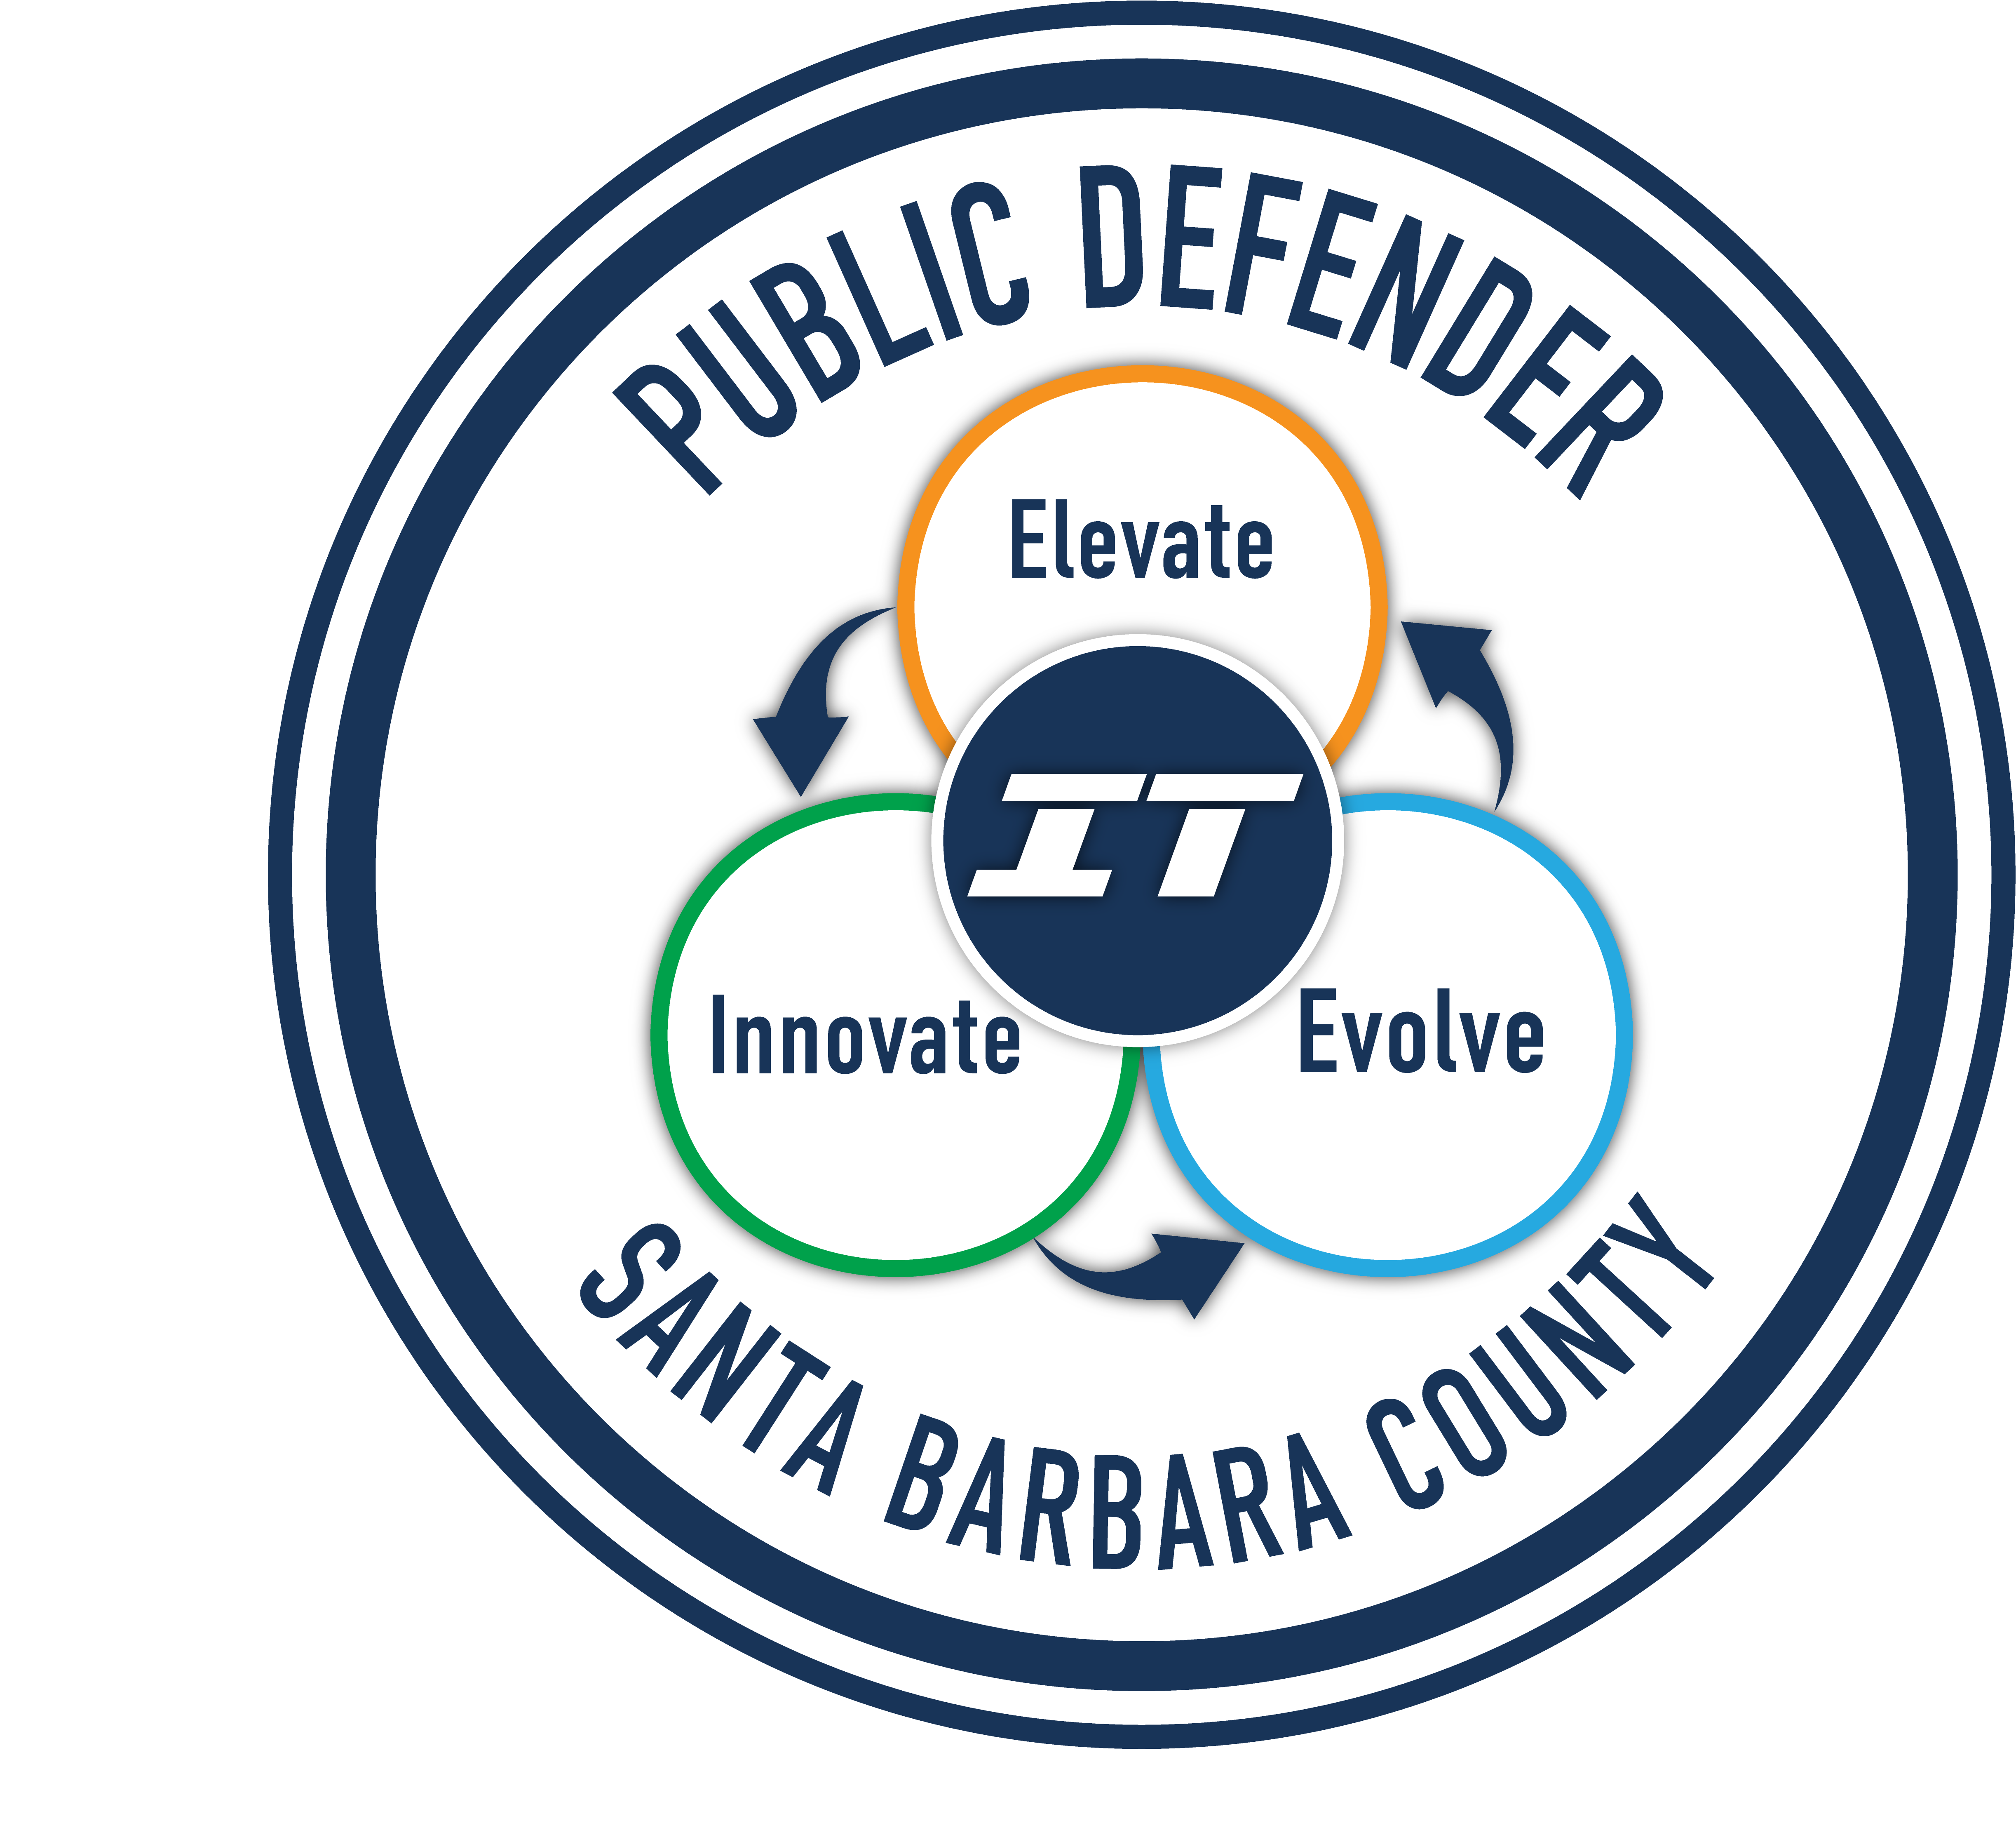
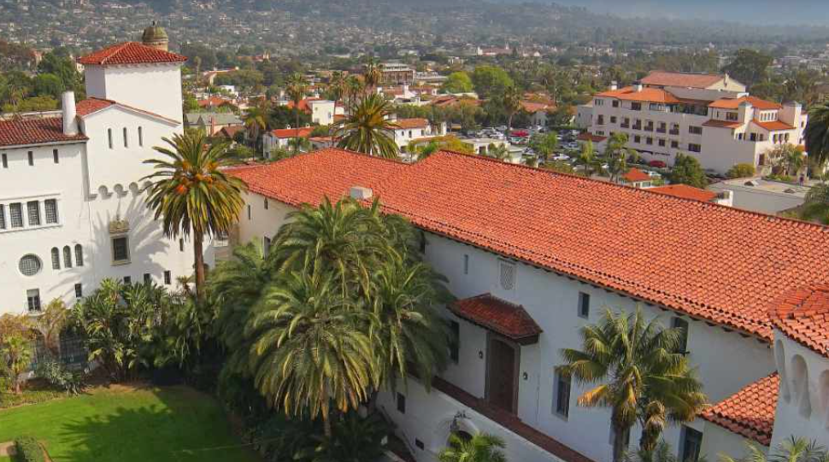
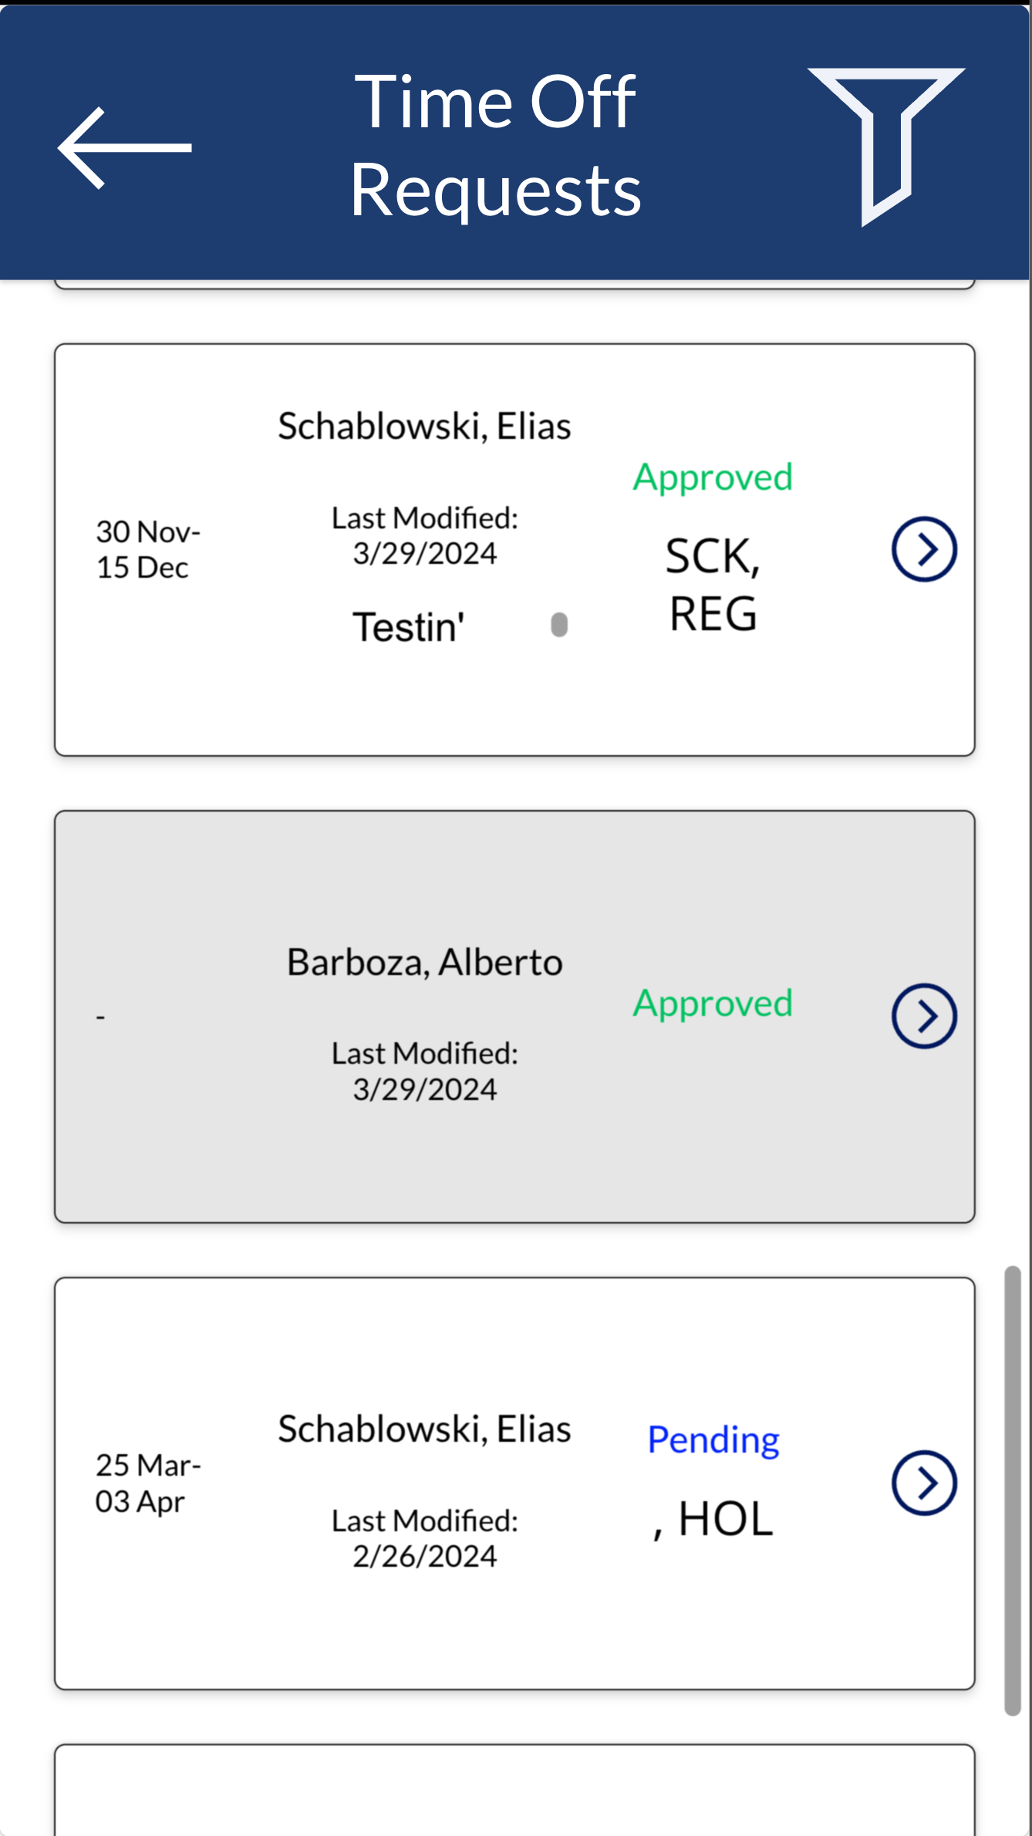
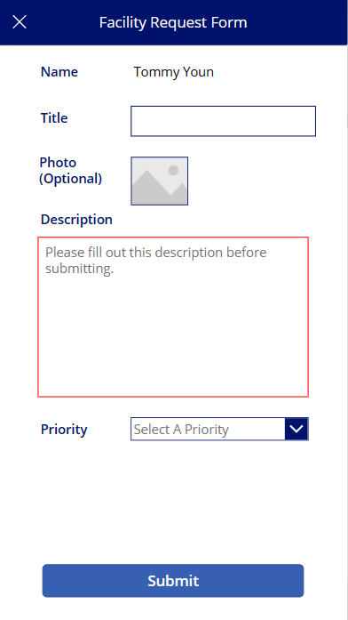
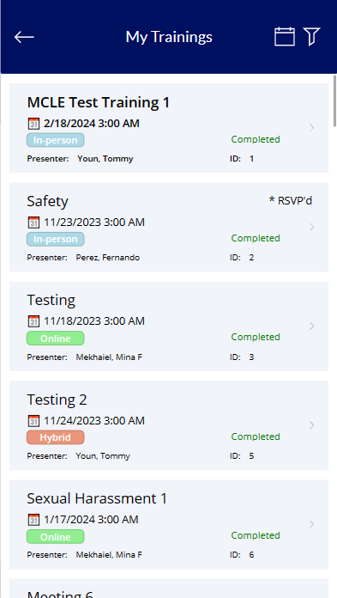
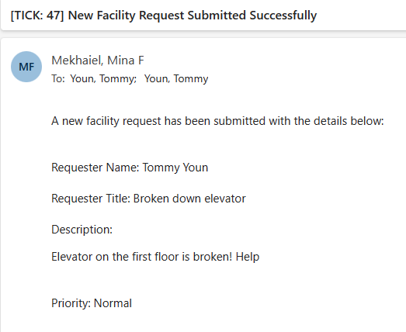
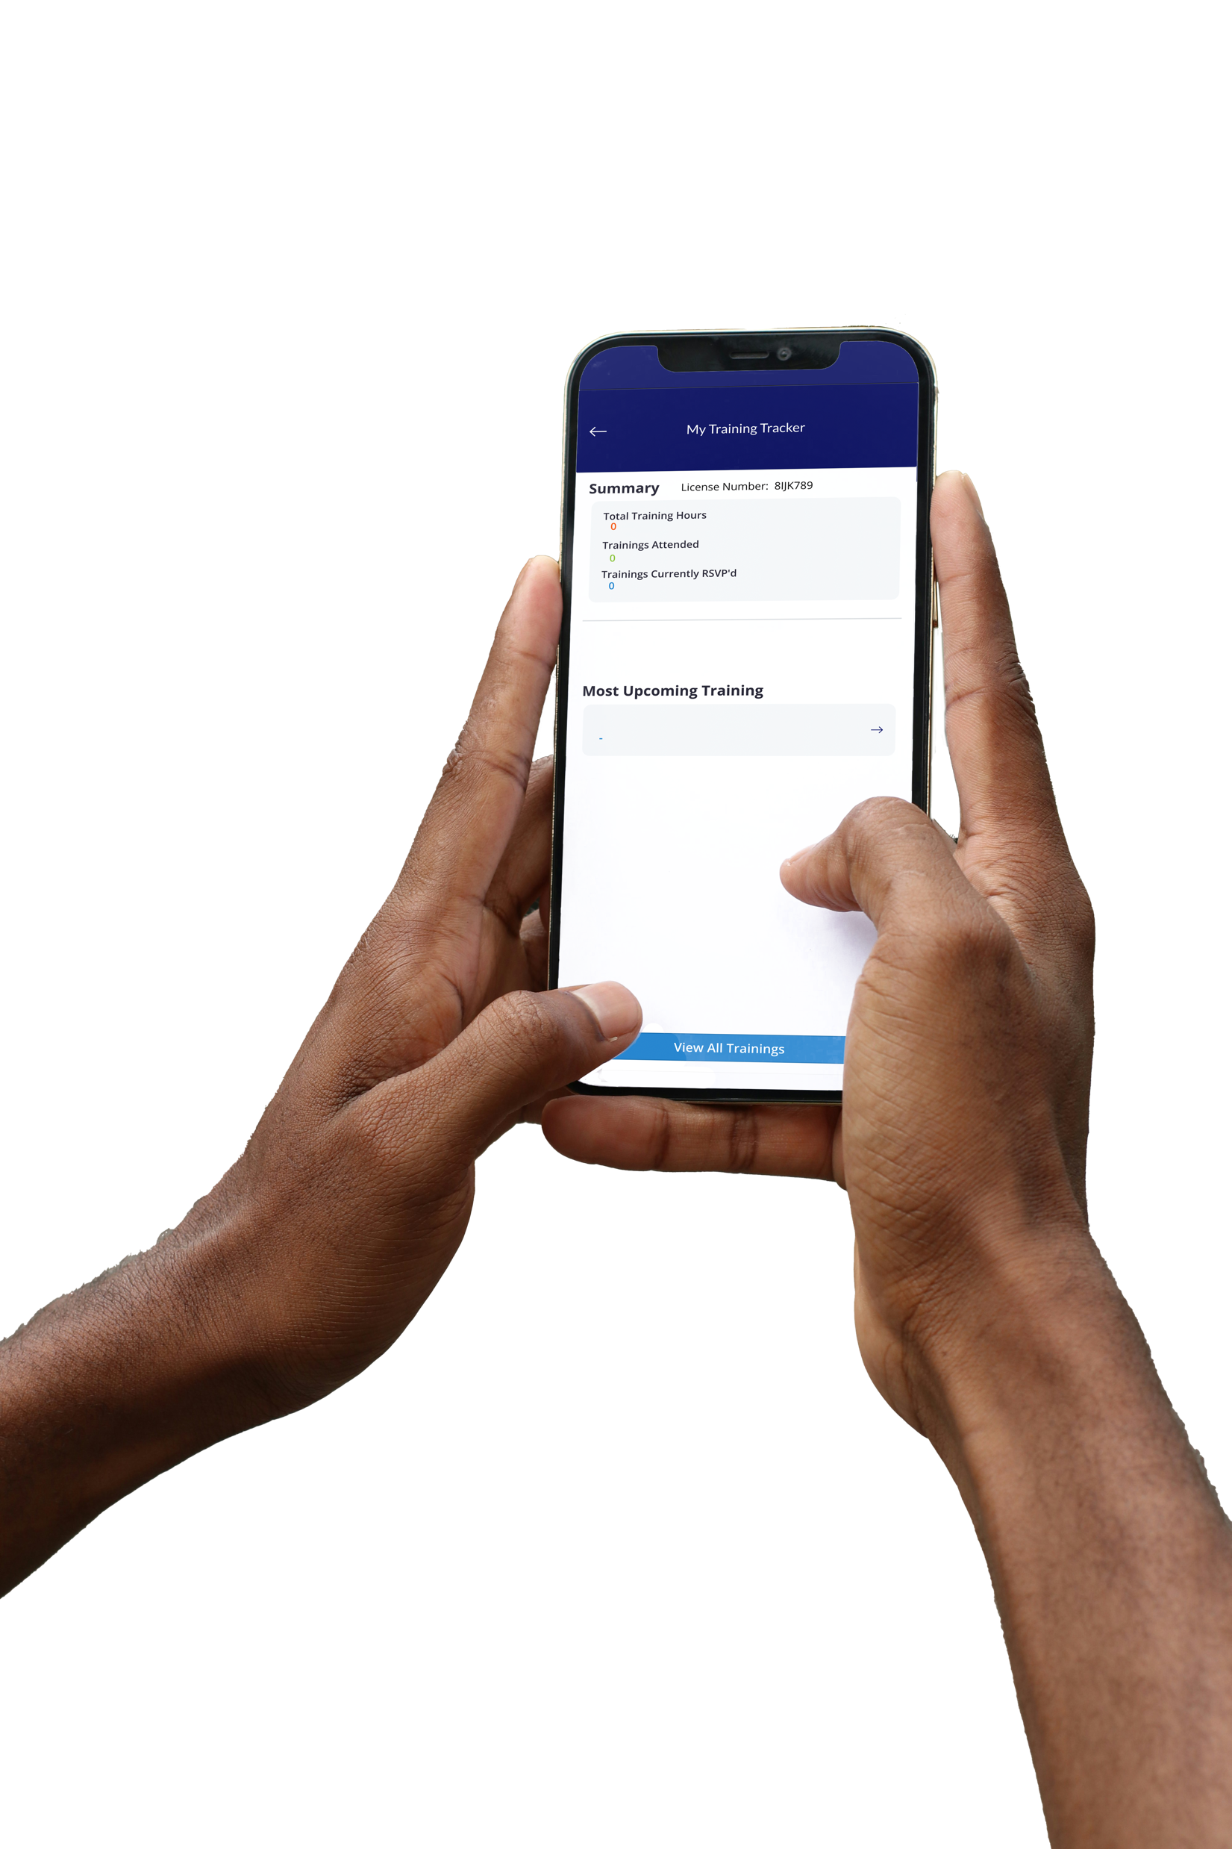
PDGo Team Members: Alberto Barboza, Cassidy Barron, Mina Mekhaiel, Kevin Ornelas, Fernando Perez, Elias Schablowski, Elizabeth Silvestre, Qian Wang, Yin Thuzar Win, Tommy Youn Faculty Advisor: Dr. Chengyu Sun Santa Barbara Public Defenders Office Liaisons: Deepak Budwani, Jalena Jones, Brent Modell, Xavier Navarro, Mark Perez, Alexander Voisan Department of Computer Science College of Engineering, Computer Science, and Technology California State University, Los Angeles
Background
Santa Barbara Public Defender Office manually manages a large portion of their internal administrative systems. These systems work, but take an excessive amount of time to administer due to their manual and outdated methods that rely on emails and honor systems.
Objective
Automate all administrative systems to drastically reduce time spent, record all reports, and enable users to receive status updates on their internal requests related to Time-Off Requests, Facility-related requests, and Trainings instantaneously. The project aims to minimize overhead and maximize recording.
Time-Off Requests
Facility Requests
Training Tracker
Easy Forms
Email and Mobile Notifications
Easy Listing
Audit Logs
Easy Approval and Denial of Requests
Easy Forms
Email Notifications
Status Updates
Group Requests by custom categories
Easy Entry
Check-in/Check-out functionality
Certificate Generation
Data Retention Requirements met
Links events to Outlook Calendars
Technologies Used
Icons by Icons8. Images by Unsplash and the PDGo team. Illustrations by Storyset by Flaticon. Sharepoint, Forms, PowerApps, PowerAutomate, and Github are are trademark of Microsoft Inc. including the Octocat logo. ClickUp logo is a trademark of ClickUp inc.
Notes:
Have students check that the logo is the appropriate one to use.

