Slide 1
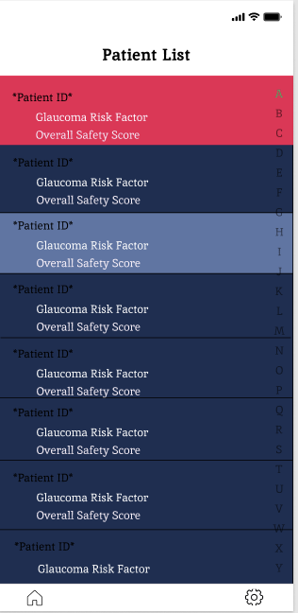
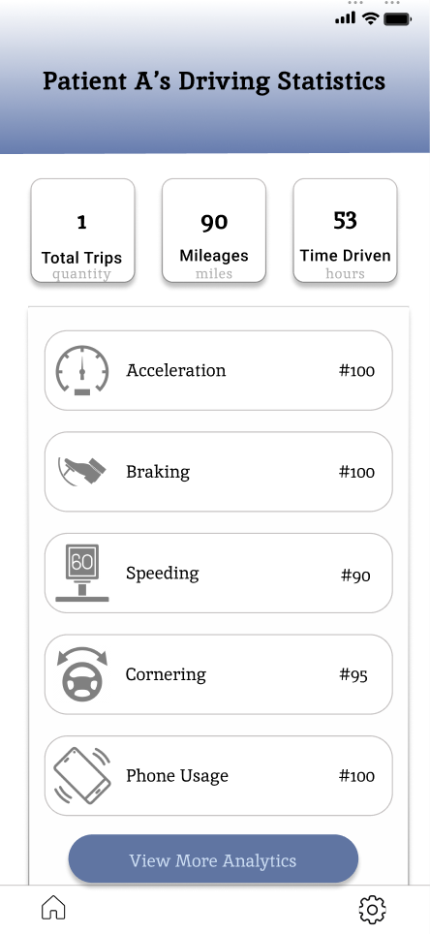
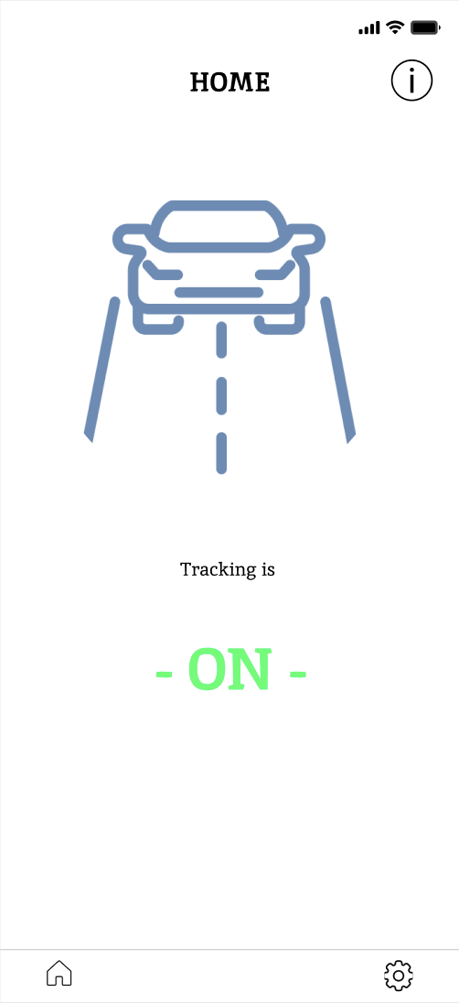
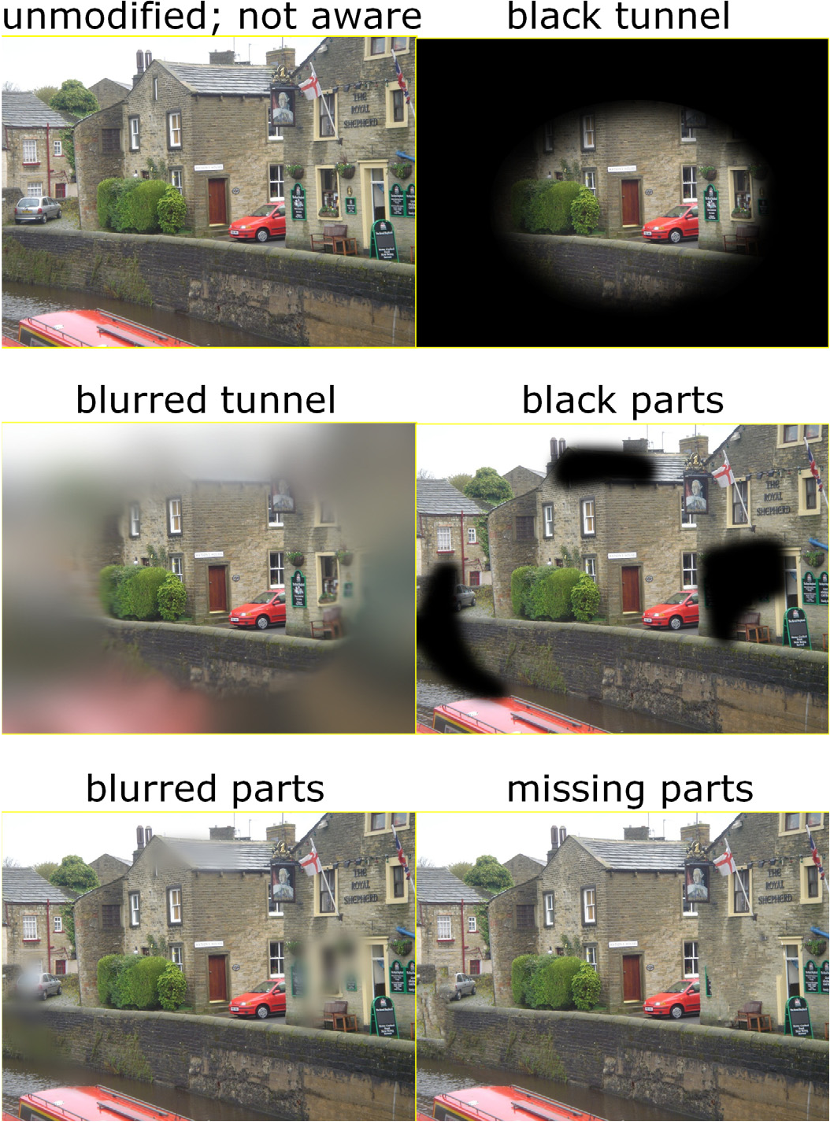
Eyesight Data Link —Leveraging Digital Phenotyping to Support Patients with Visual Field Loss—
Team Members: Stellina Ao, Luis Ayala-Saldivar, Edson Castellanos, Mengying Chen, John Huang, Jooeun Jeon, Desiree Ramirez, Ashley Tran, Thang Tran,
Faculty Advisors: Dr. Navid Amini, Dikshant Sagar
David Geffen School of Medicine, University of California, Los Angeles Liaisons: Dr.Sajad Besharati, Kouros Nouri-Mahdavi Department of College of Engineering, Computer Science, and Technology California State University, Los Angeles
Motivation & Background
Glaucoma and Driving Events
Results
Our mission is to utilize digital phenotyping to detect and monitor glaucoma by analyzing driving behaviors through a mobile application that leverages smartphone sensors to characterize driving events. The collected data will be used to monitor the severity of glaucoma and provide reports on the condition to patients, doctors, and the Department of Motor Vehicles (DMV).
There exists a well-documented relationship between driving habits and glaucoma presence and severity. Glaucoma is negatively correlated with overall driver performance in both on-road (i.e., driving a predetermined course) and off-road (e.g., simulated driving or questionnaires) assessments.
Significant Drive Metrics
Problem Statement
Metric | Expected Patient Pattern
Acceleration | Abrupt accelerations/decelerations
Brakes | Sudden braking due to missed road signs
Cornering | Jerky cornering due to peripheral vision loss
Speeding | Cautious driving under speed limit
Phone usage | Slower reaction times during phone usage
Glaucoma can have severe implications for individuals, impacting their vision and daily lives. Currently, there is no known cure, making early detection and monitoring crucial for managing the condition. Digital phenotyping offers a promising approach in this regard.
Discussion & Future Work
Impact
To the authors’ knowledge, this application is the first digital phenotyping software to monitor glaucoma through an individual’s driving habits. This application will also contribute insights to the relationship of driving habits and glaucoma severity through the vast longitudinal driving data collected from its user base.
Future Work
— Stage 02
This study should recruit a sufficient amount of beta-testers to curate a substantial dataset.
— Stage 03
Data analysis should focus on temporal relationships, analyzing how driving behavior is affected over time.
— Stage 04
Finally, a machine learning algorithm should be implemented and integrated with the application to determine glaucoma severity through an individual’s driving habits.
Glaucoma
Research Question
Q1: Can digital phenotyping be utilized to leverage the relationship between glaucoma and driving events as a tool to monitor glaucoma?
Methods
Dart
Programming language with cross-platform capability, to reduce time and make our application accessible on both Android and iOS devices.
Damoov’s Telematics SDK
Provided the infrastructure to detect and automatically track driving events and process driving data.
Firebase
Secure backend service for user authentication, user role assignment, and enabling the SDK for smartphone drive monitoring.
Awesome Notifications
Flutter package provides framework to customize the local and push notifications.
Conclusion
By providing a platform to monitor glaucoma and longitudinally collect driving data, the application contributes to the early detection and further scientific understanding of glaucoma.
Glaucoma is a group of eye conditions that damages the optic nerve, causing vision loss and blindness. Symptoms of glaucoma can start slowly and can be so gradual that symptoms remain undetected before prevention and treatment can be administered.
References
Results
[1] David P. Crabb, et al. Ophthalmology, Feb. 2013, doi:https://doi.org/10.1016/j.ophtha.2012.11.04.
[2] J. M. Wood, et al. PLOS ONE, Jul. 2016, doi: https://doi.org/10.1371/journal.pone.0158318.
[3] S. A. Haymes, et al. Inv Ophth & Vis Sci, Jul. 2008, doi: https://doi.org/10.1167/iovs.07-1609.
[4] Onnela JP., Neuropsychopharmacology, Jan. 2021, doi: 10.1038/s41386-020-0771-3.
Digital Phenotyping
Digital phenotyping uses data from personal devices to track and analyze behavior patterns [4].
Affiliations
1 Department of Computer Science, California State University–Los Angeles
2 David Geffen School of Medicine, University of California, Los Angeles * corresponding author
This work is approved by the UCLA IRB & sponsored by CSUBIOTECH
Notes:
‹#›

