Slide 1
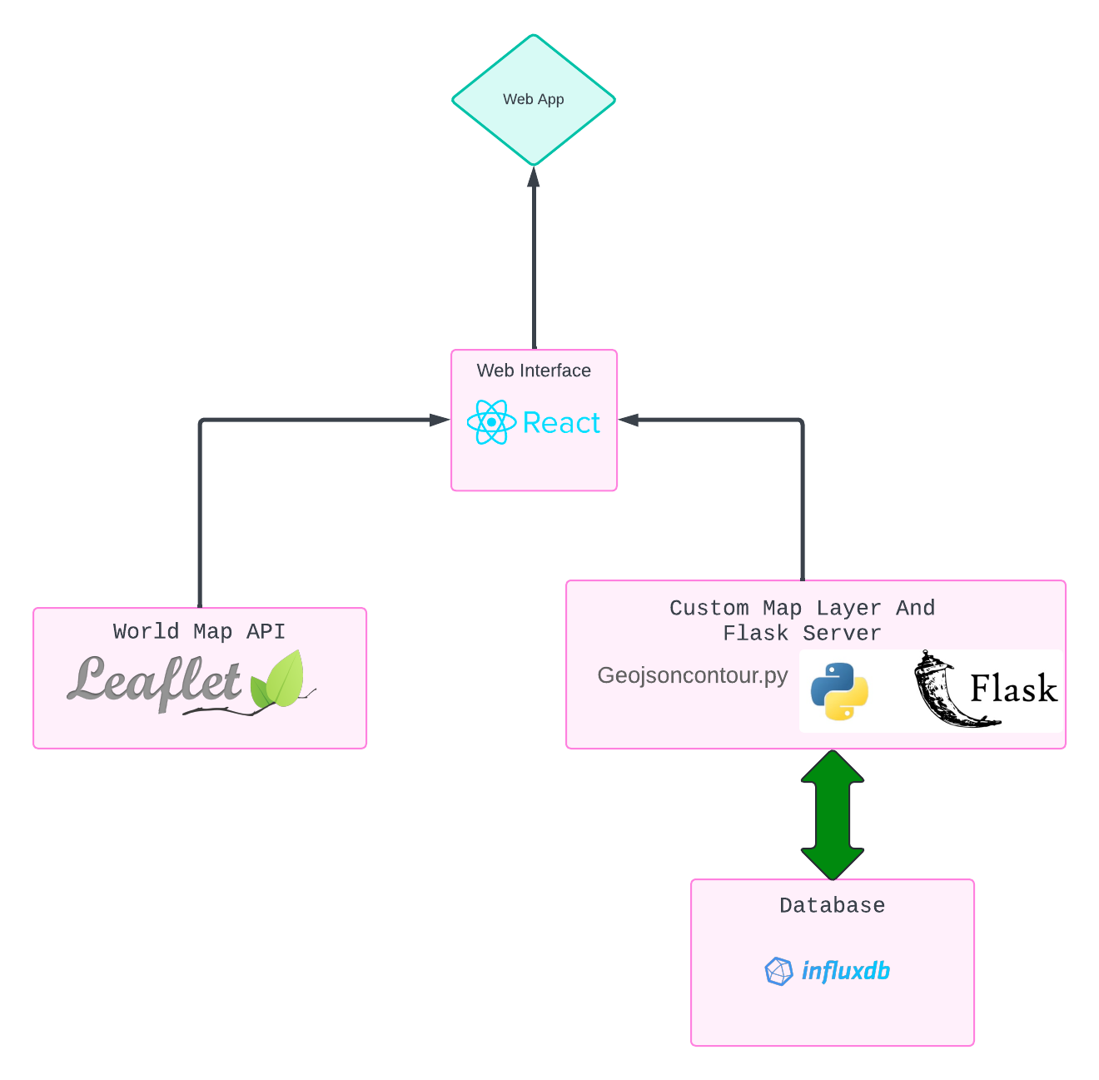
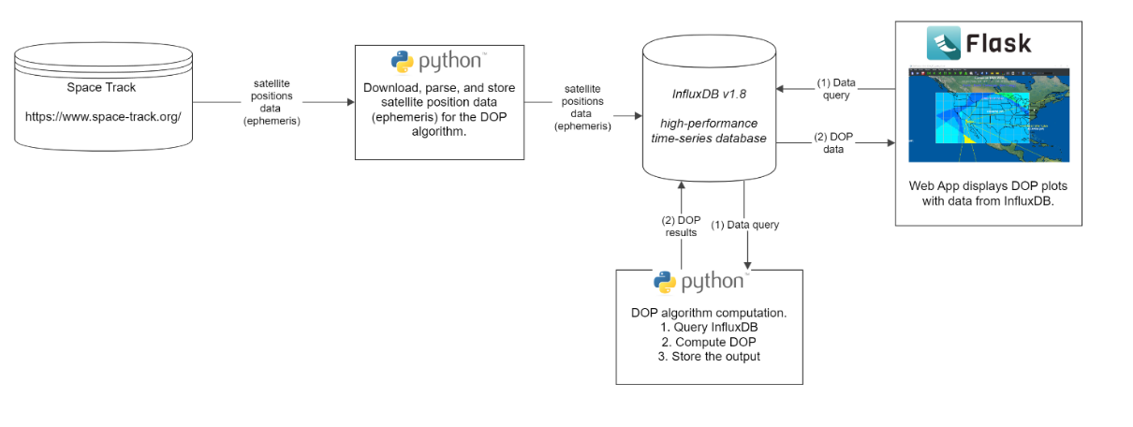
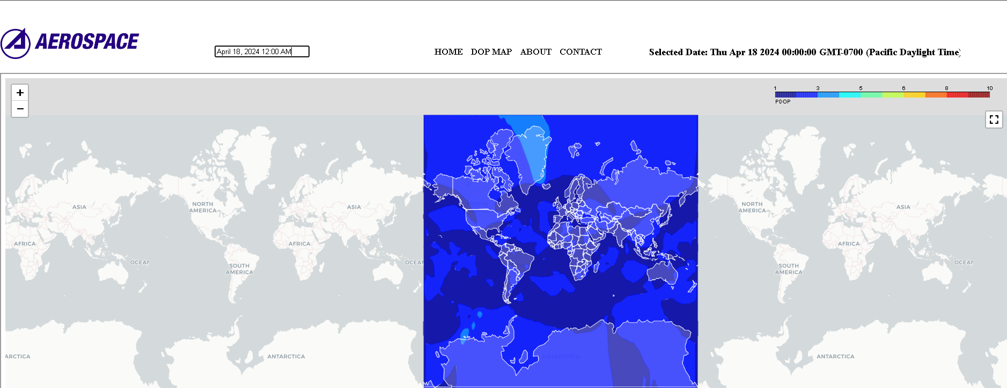
GPS Performance, Analysis and Visualization Team Members: John Chen, Phong Diep, Matthew Franco, Roaf Htun, Steven Lopez Carachure, Andrew Mendiola, Natalie Perales, Cindy Rodriguez, Steven Yuen Faculty Advisor: Dr. Zilong Ye Aerospace Corporation Liaisons: Pablo Settecase,Dearo Yam, & Denny Ly Department of Computer Science College of Engineering, Computer Science, and Technology California State University, Los Angeles
Sponsor Logo
Aerospace Co. Senior Design
Project Background:
Objective
Web application for measuring Dilution of Precision (DOP) to visualize GPS accuracy on a global map.
DOP values range from 1 to 10, with lower values indicating higher accuracy.
Color-coded interface to indicate performance levels based on DOP values.
Users can examine DOP maps and select a specific date/time.
Optimal satellite location leads to lower DOP values and improved GPS signal quality.
.
Objective: Provide a user-friendly interface for exploring the importance of DOP.
Features include:
View archived and live data with a date/time picker.
Zoom in/out functionality for points of interest.
The interface aims to facilitate exploration and understanding of DOP's significance.
Front-End Diagram
Project Overview Diagram
Future Improvements to our Project:
Enhancement plan for the project:
Incorporate a playback feature to visualize DOP data over a specified time window, similar to a movie.
Develop functionality to capture screenshots of DOP data with timestamps.
Implement a comparative analysis tool for viewing DOP data from two different dates simultaneously.
Notes:
‹#›
Have students check that the logo is the appropriate one to use.

