Slide 1
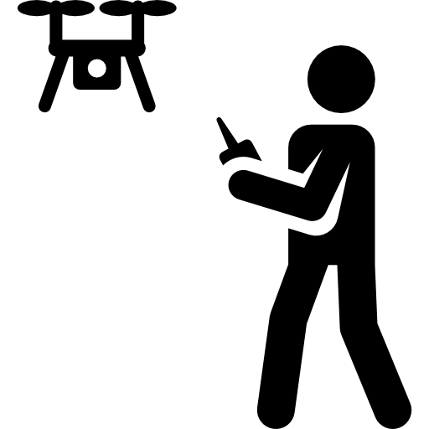
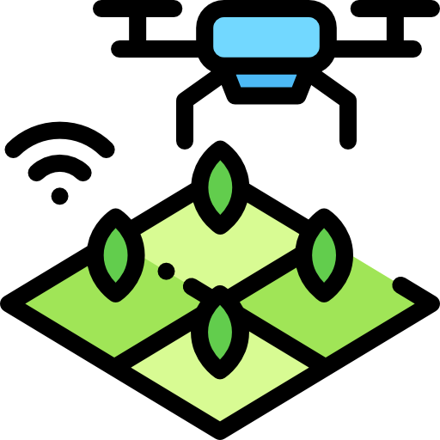
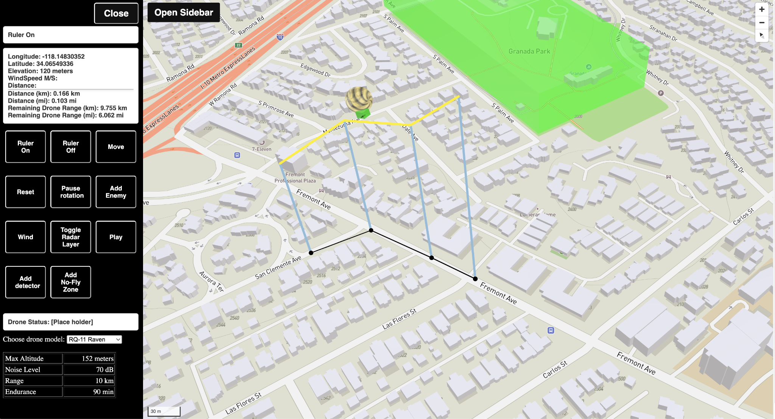
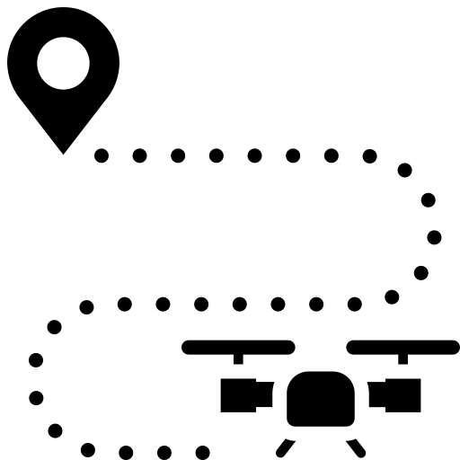
SUAS Flight Path Visualization
Team Members: Alex Alcazar, Francisco Brito, Helen Dam,
Alex Gaeta, Alberto Gonzalez, Sergio Maradiaga, Thaddeus Owens,
Mychal Salgado, Kevin Tang, Sergio Valadez Faculty Advisor: Dr. David Krum Army Research Laboratory Liaison: Dr. Paul Fedele & Dr. Eric Holder Department(s) of Computer Science College of Engineering, Computer Science, and Technology California State University, Los Angeles
Background:
Drones and unmanned aircraft systems give military groups critical intelligence. However, minimizing detection is essential when taking
into account several factors, such as drone sensors, noise, visibility, and ambient conditions. Our application takes these factors into consideration, which results in the most effective flight path.
Objective:
Deploy a 3D visualization utilizing Mapbox APIs
to provide operators to plan, visualize, and modify drone flight paths over selected terrain to meet
the mission’s criteria.
Results:
Process:
Communicate with Liaisons every Friday
Additional guests for user stories
Group meetings 2-3 hrs. / week
Check-ins weekly
Task Completion Progress
Communication of Challenges
Developments on GitHub:
Demonstration(s)
Debugging of the simulation
Enables the creation of individual branches
for the addition of new features
Facilitating isolated testing prior to merging branches into the main codebase
(Left) Side bar for display & user interaction
(Right) Mapbox to display the program
Features:
Interactive world map
3D Flight Path creation with Altitude
Selection of different drones for distance
Controls: Zoom (+/-), Compass, Map Rotation
Movable buildings & objects
Creation drone detectors
Dynamic objective point creation
Conclusion:
Our team was able to successfully implement
the foundations of a simulation of a drone
doing reconnaissance on a map.
The next steps future teams can focus on is
the refinement of the 3D objects, integrating
a drone database and upgrading the UI to
include new features.
Tools & Technologies

