Slide 1
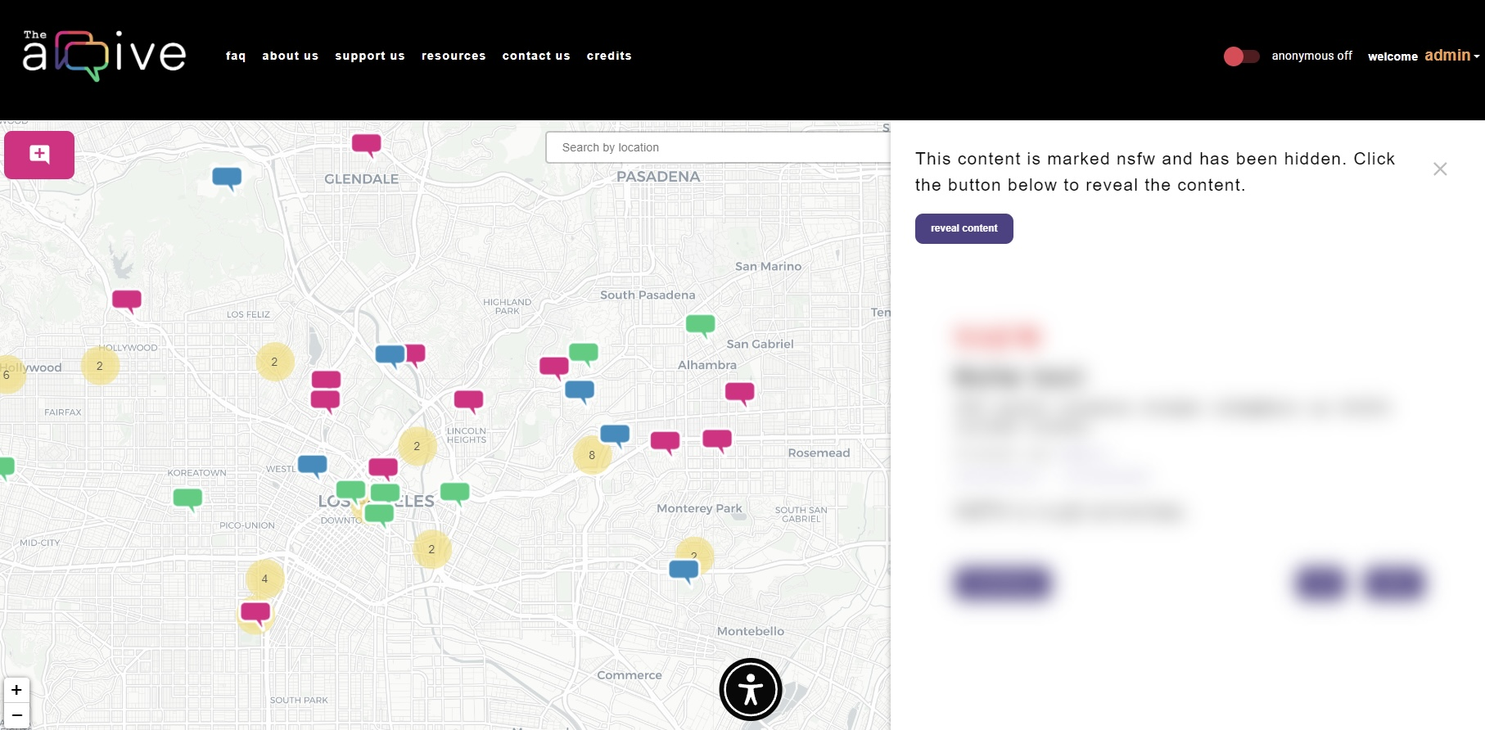
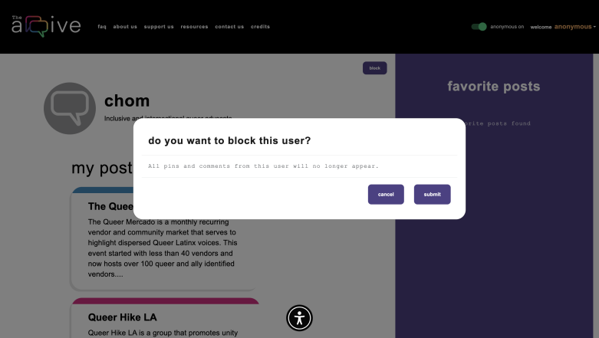
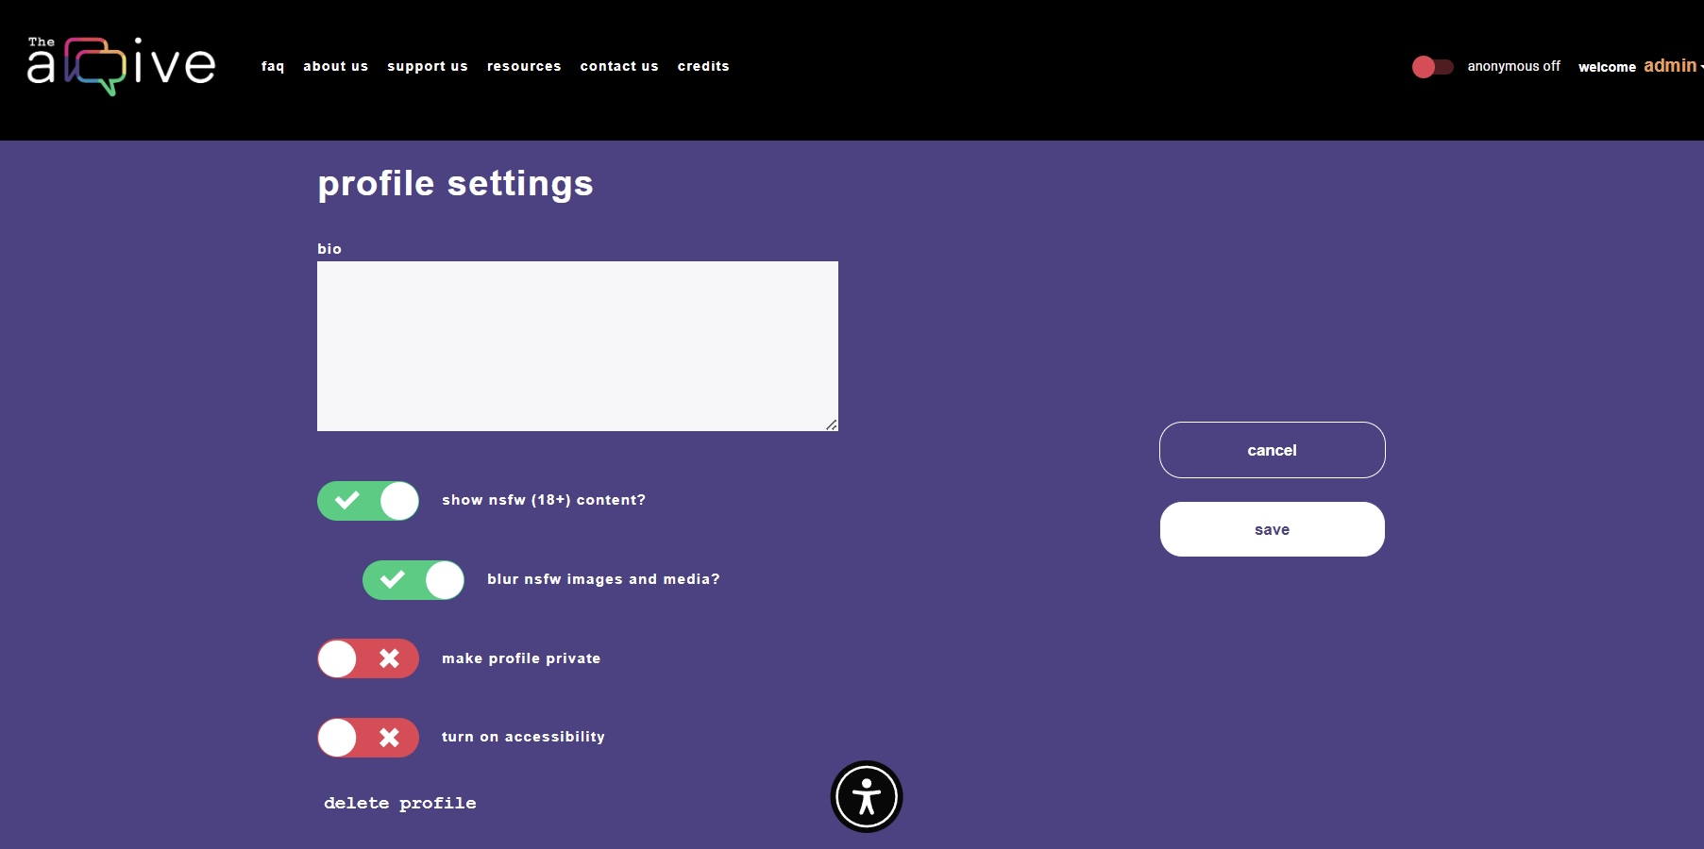
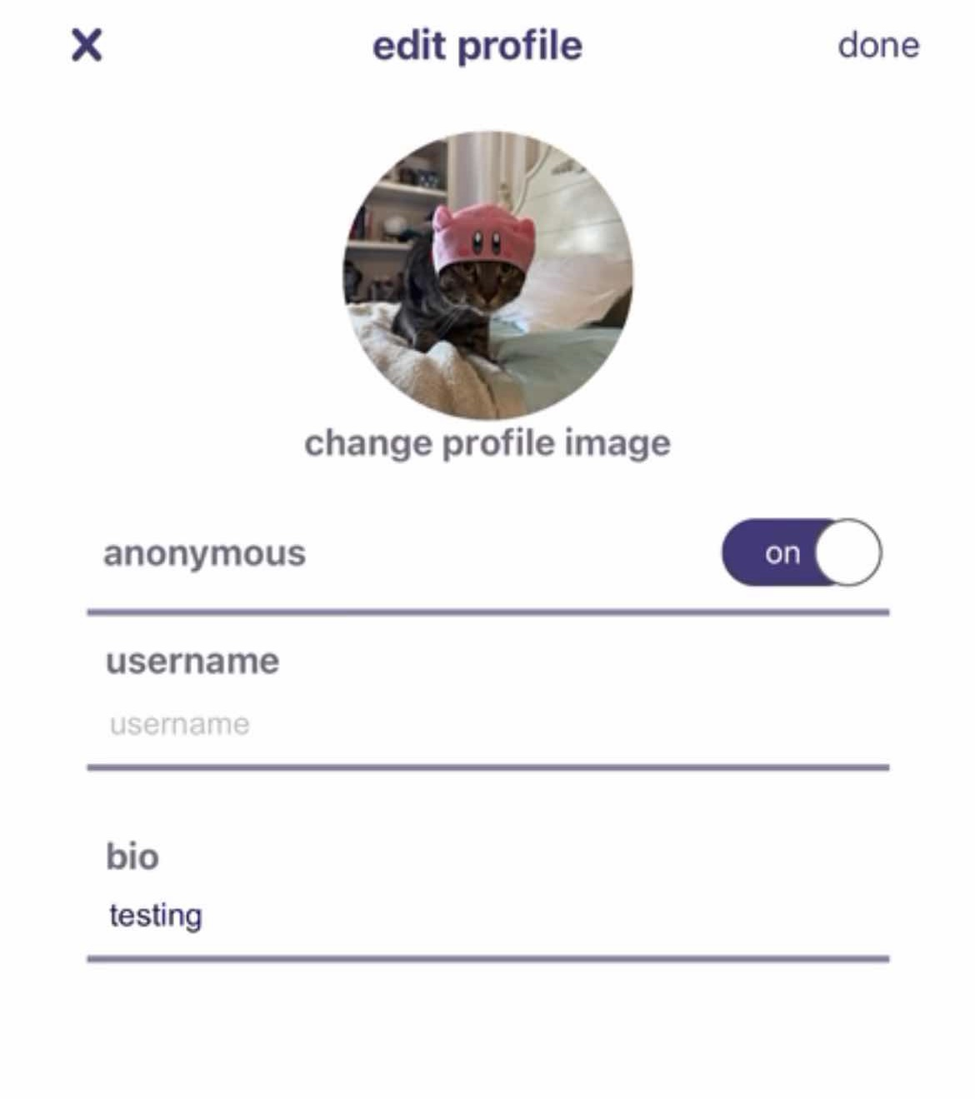
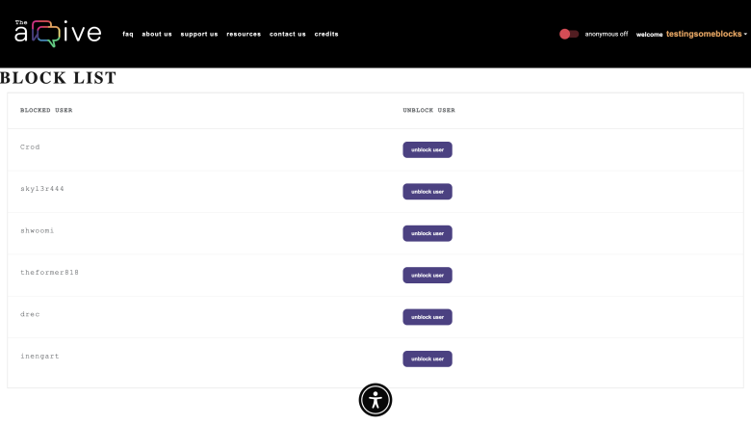
Team Members: Melissa Hernandez, Channing Jou, Thien Ho, Stephanie Tan, Juan Alcobas, Hak Beak, Ryan Goshorn, Daniel Rodas, Raul Sanchez Martinez Faculty Advisor: John Hurley The arqive Liaisons: Dr. Cynthia Wang & Zachary Vernon Department of Computer Science College of Engineering, Computer Science, and Technology California State University, Los Angeles
The arqive is a digital online storytelling map for LGBTQ+ stories that seeks to provide the full range of queer stories and then geolocates them and digitally preserves them. Users have a safe platform where they can share personal, historical, and community stories, as well as have access to information about safe spaces.
The arqive is both a web and mobile application.
As a continuing project our goal was to expand on the progress made in the previous years:
Securing Authentication Process
Block Function
Media Upload
NSFW Function
UX/UI Improvements
Refining Mobile App
background
project goals
technologies
results
On the left we have the front end for our nsfw function.
The first screenshot shows how the blurred nsfw setting looks like when activated.
The second screenshot shows what the nsfw options look like in profile settings.
Below we have what a user sees when they click the block button on someone’s profile.
Below is an example of a users block list. This list can be viewed in a profile settings.
Here (left) we have some updates to our mobile app.
We can see a user’s profile settings.
Notes:
1
Have students check that the logo is the appropriate one to use.
2020: https://csns.cysun.org/department/cs/project/resource/view?projectId=7248602&resourceId=7735064
Red: e63f52
Orange: f0a055
Yellow: f5dc6d
Green: 00ce7d
Blue: 248dc1
Purple: 4d4185
Pink: e01783
Grey: 98999b
Black: 0b0b0e
https://www.fontshmonts.com/text-fonts/eina/

