Slide 1


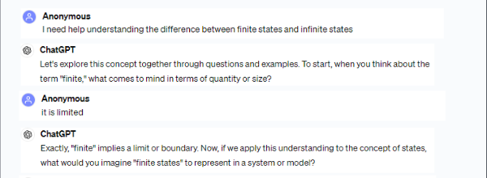






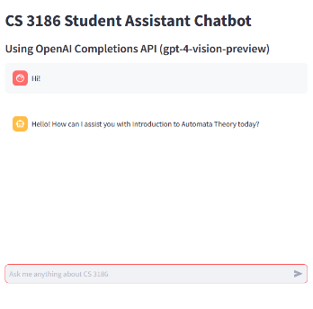


AI Research and Development
Team Members: Janis Garcia, Virginia Guadalupe Gonzalez, Ulises Gutierrez, James Hy, Charlie Martinez Dominguez, Michael Perez, Dylan Paul Tomasello, Omar Tovar, Theodore Tran, Thomas Yeung
Faculty Advisor: Dr. Zhu
Abbott and Shuger Liaison: Russ Abbott
College of Computer Science, Technology and Engineering
California State University, Los Angeles
1
BACKGROUND
As students familiar with the complexities of automata theory, we were motivated to ease the challenges our peers encountered in mastering this subject. We embarked on a mission to utilize our collective knowledge and expertise to develop a solution, with the aim of integrating AI into the educational landscape.
2
OBJECTIVE
Show how AI technology can help students learn automata theory better. By utilizing our application, we can make a complex subject easier to learn and be more interactive with visual understandings.
3
CAPABILITIES AND LIMITATIONS OF LLMS
Large Language Models such as GPT-4 excel in producing information, generating ideas, and assisting with documentation. However, they lack expertise and the ability to conduct research, relying solely on patterns learned from data.
DESIGNING CHATBOT
4
We used a combination of OpenAi’s Assistant API and Streamlit’s user interface to create a custom chatbot that could be used to assist students taking Automata Theory. We used the function calling, file retrieval, and custom prompting to make the assistant give useful and accurate results to students.
5
RESULTS
Through our project, we have witnessed remarkable results in empowering students to master Automata Theory. By customizing our AI Teacher's Assistant we've enhanced the learning experience for students. Our project stands as a testament to the potential of using AI as a tool for education. With further development of our program we hope to make this educational assistant widely available to all students.

