Slide 1
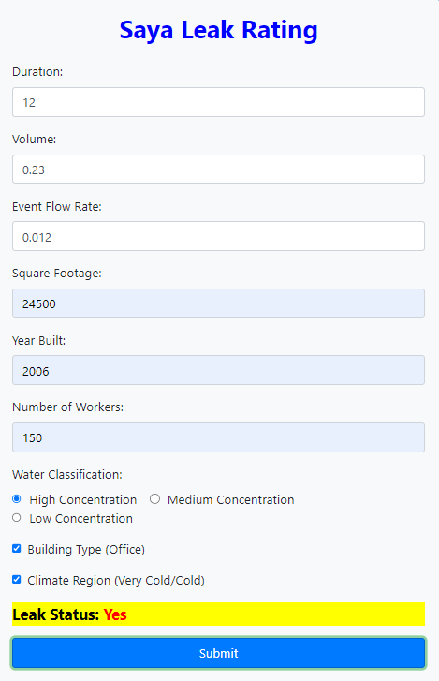
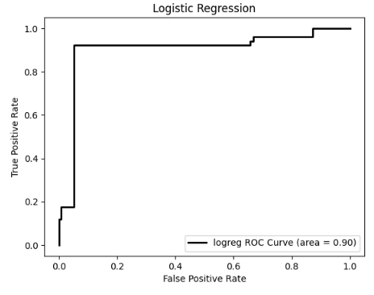
Machine Learning Platform for Intelligent Water Systems Management
Team Members: Daniel Castillo, Arron Diu, Gabriel Garcia, Matthew Kim, Kobe Martinez,
Isaac Mendoza, Jimmy Nguyen, Daniel Ramirez, Jonathan Tirado, Andres Vicente Faculty Advisor: Dr. Manveen Kaur (Saya Life) Liaison: Sanjay Poojary California State University, Los Angeles
Department of Computer Science
Objective
Use a machine learning model to determine whether a building is at risk of a water leakage
Artificially extend Saya Life’s raw data for training and testing
Design and develop an online dashboard to generate a building assessment report
Dashboard consults the machine learning model for the risk assessment
Dashboard displays result and important water usage information
About Saya
Saya Life is a water information company specializing in providing water data from sensors. Their installations are used for water management in urban residential and commercial buildings.
One of Saya Life’s business use-cases in utilizing the collected data to allow insurance companies to have insight into the buildings they insure. For this service, collected water data must be processed and analyzed to predict water usage patterns based on historical data.
Water Usage Dataset
Saya Life’s dataset included information regarding:
Waterflow duration
Volume
Flow rate
Water Classification
High, Medium, Low Consumptions
Outliers
Our team tried to improve the data by adding:
Building type, size, and age
Number of people in the building
Climate region
Machine Learning Algorithms
We focused on two algorithms: Artificial Neural Network and Logistic Regression. ANNs mimic the human brain by connecting layers of digital neurons that learn patterns from data. Logistic regression classifies data by calculating the probability of an event happening.
Results Logistic Regression gave us the best results with 93%
accuracy
and an
AUC
score of
0.90.
Dashboard Designed an intuitive interface for data input, integrating with our machine learning server to process information swiftly and deliver accurate results.
Technologies:
Notes:
‹#›

