Slide 1
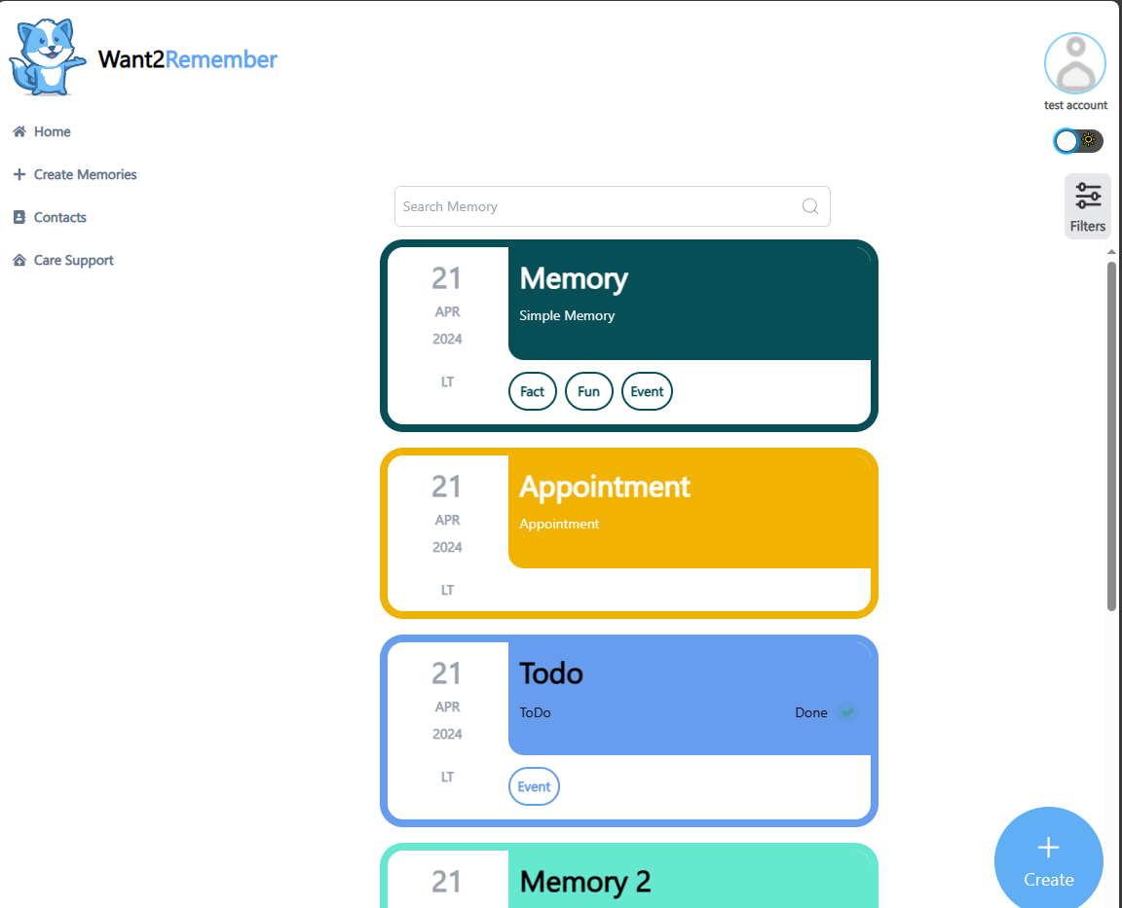
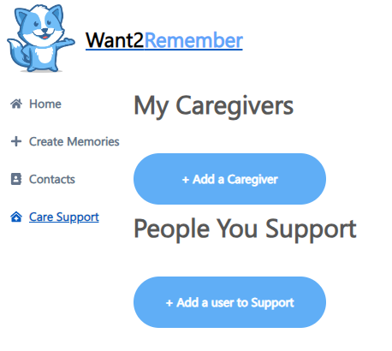
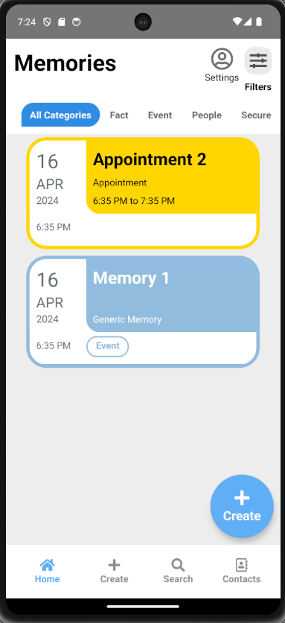
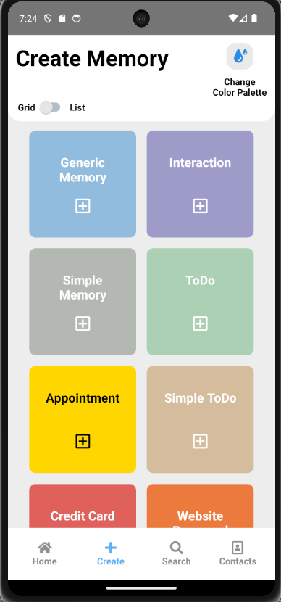
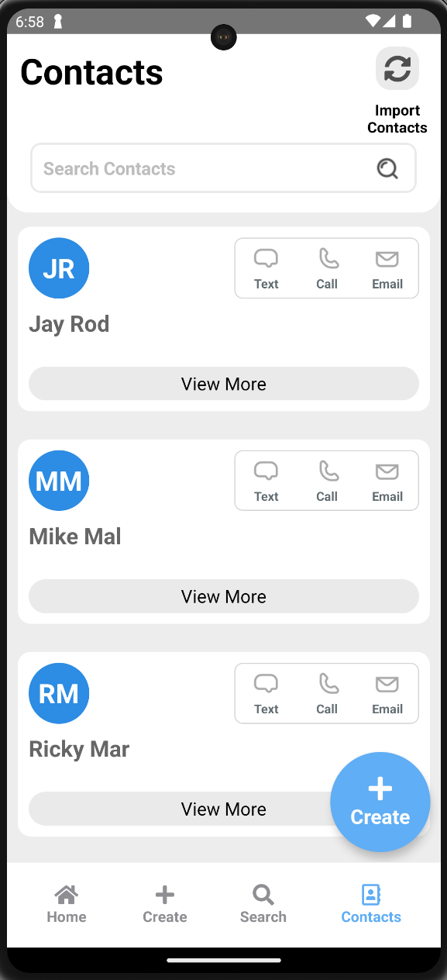
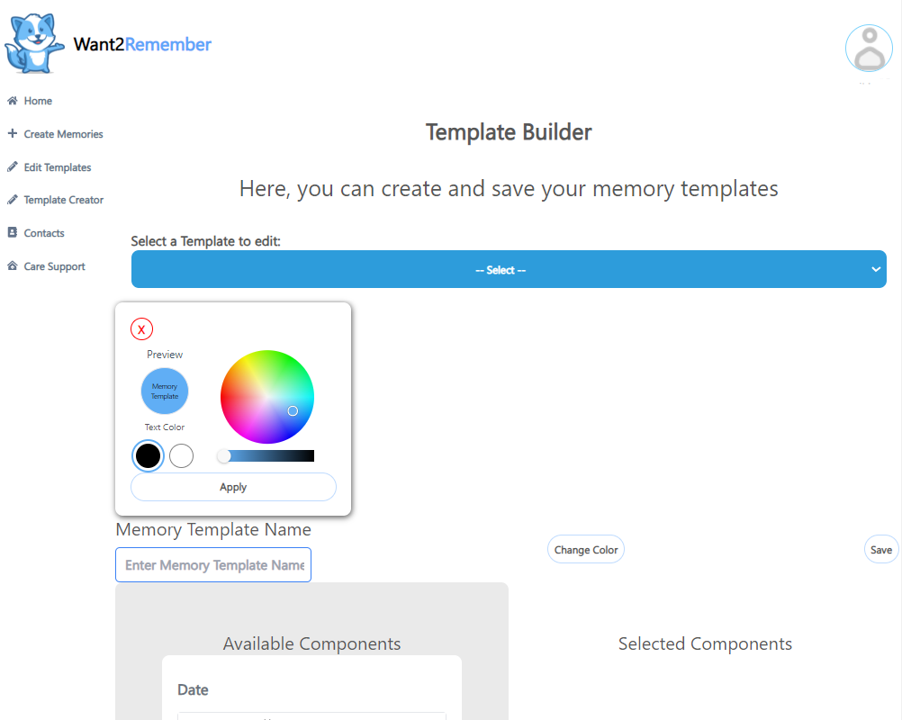
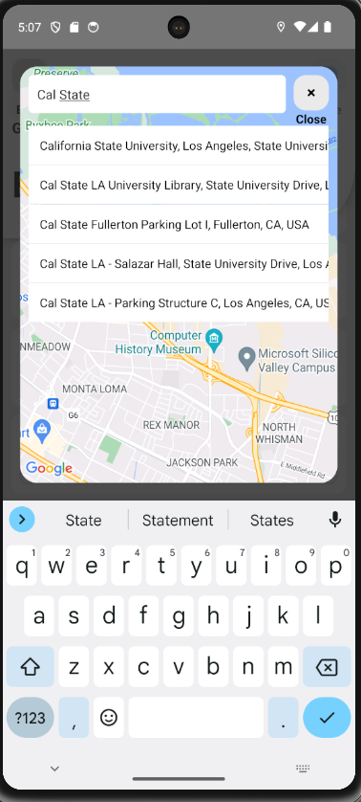
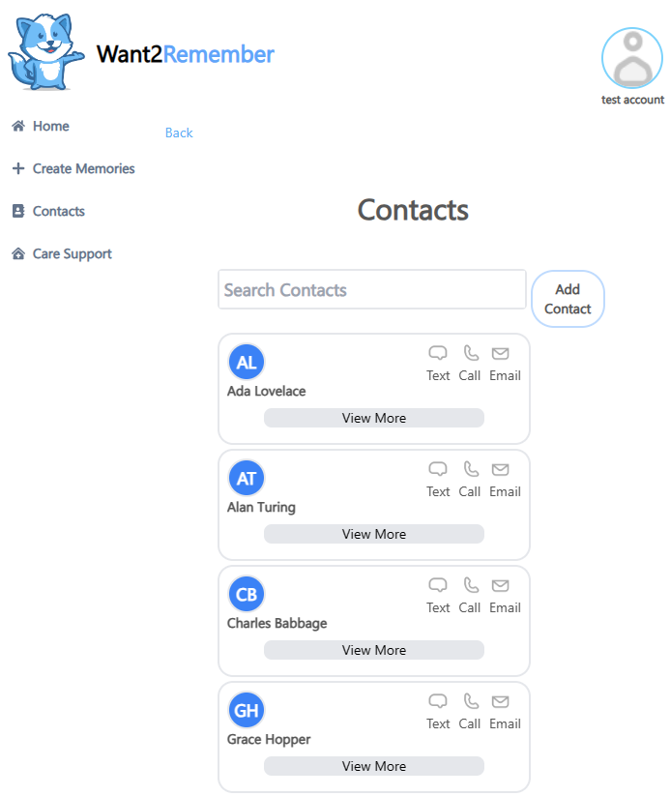
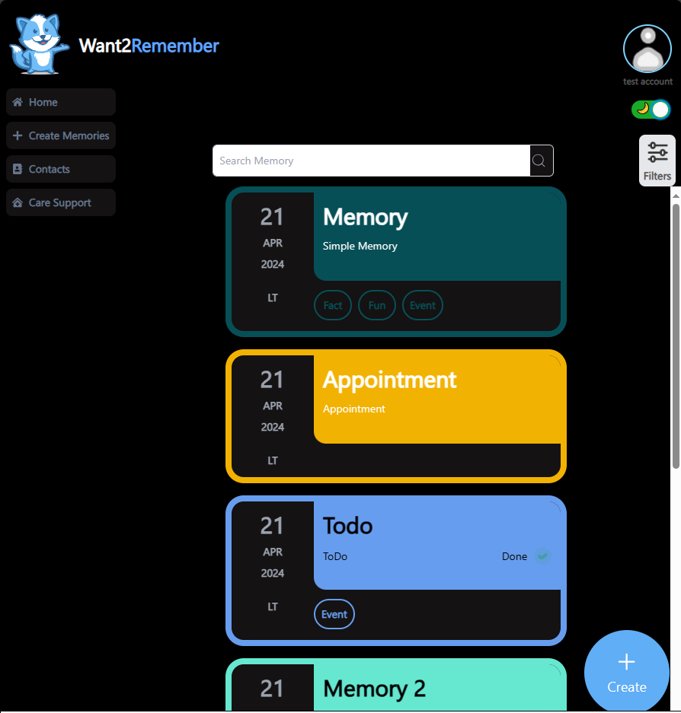
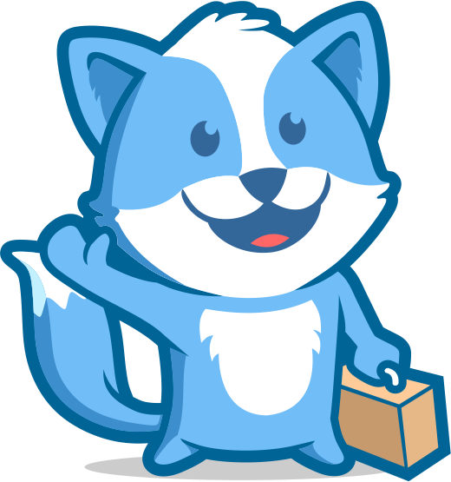
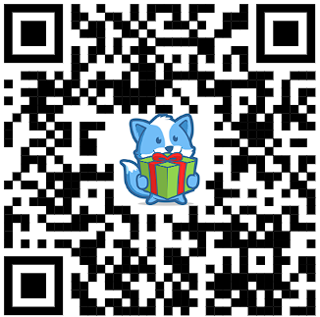
Want 2 Remember®
Powered by We2Link®
College of Engineering, Computer Science, and Technology
California State University, Los Angeles
®
Team Members
Liaison
Dr. Huiping Guo - Faculty Advisor
Software Developers
Adrian Soria - Team Co-Lead
Zain Syed - Scribe
Carlos Ramirez
Ivan Wang
Jennifer Lizárraga
Davy Chi - Team Co-Lead
Joanne Wu - Scribe
Hein Htet
Kevin Fong
Nicholas Barger
Michael Malone
Ricardo Marroquin
Jay Rodriguez
Sponsor / CEO
Senior Developer
Project Manager
Project Background
Create an app to fill the gap in support for people with cognitive impairments and memory problems.
Colonel(ret) Michael Malone served 32 Year in the Army and sustained a
Traumatic Brain Injury (TBI).
Inspired by his experience, he developed an app to assist those with cognitive impairments and memory problems, now known as Want2Remember App®
​​
Achieved Objectives
New features added and bug fixes
Implemented Template Creator
Dark Mode for Web and Mobile (soon)
Location picker for Web and Mobile
Contacts screen and Homepage overhaul for web and mobile
Search and Filter options for memories
Developed the option to add custom color palettes for accounts on both web and mobile
Project Overview
Teams are split into two groups: mobile team and web team.
Each team involves a pair of teammates who work on tasks that are assigned to them.
Each team would review other peer’s task if assigned.
Teams work on tasks that are assigned by the liaison on the Jira software board.
Home Page
Caregiver Support
Home Page
®
Keep Track
Of Memories!
Mobile
®
Sync your Contacts!
Template Creator
Web
®
Contacts Page
Dark Mode
®
Places to see, places to be!

