Slide 1
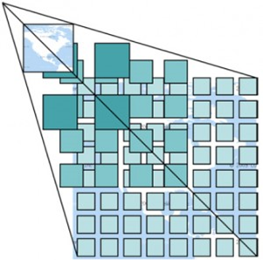
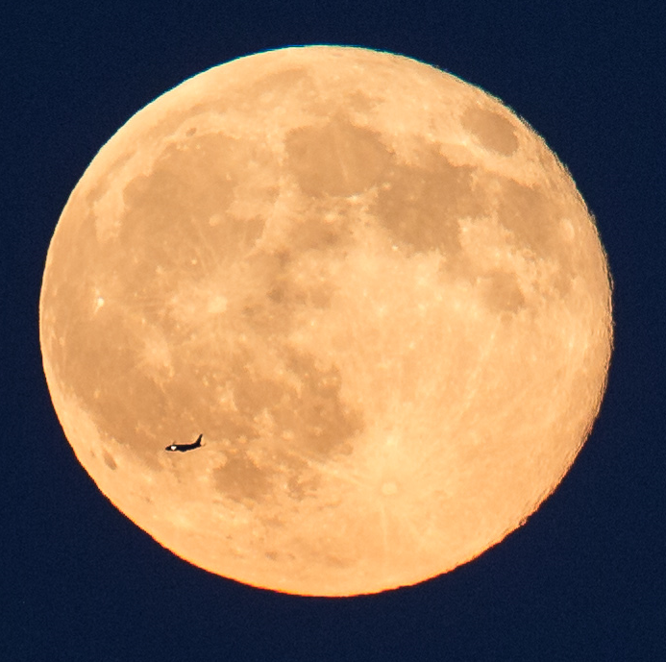
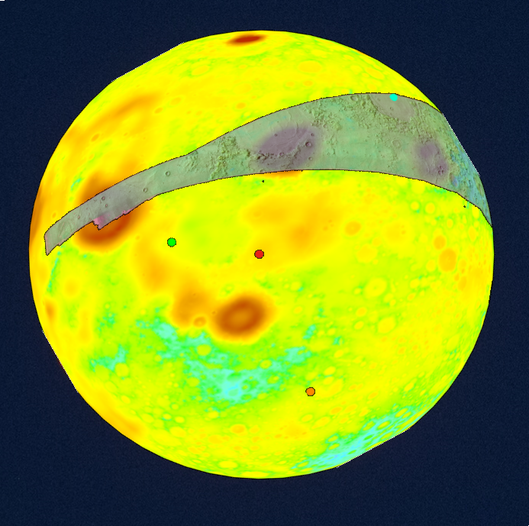
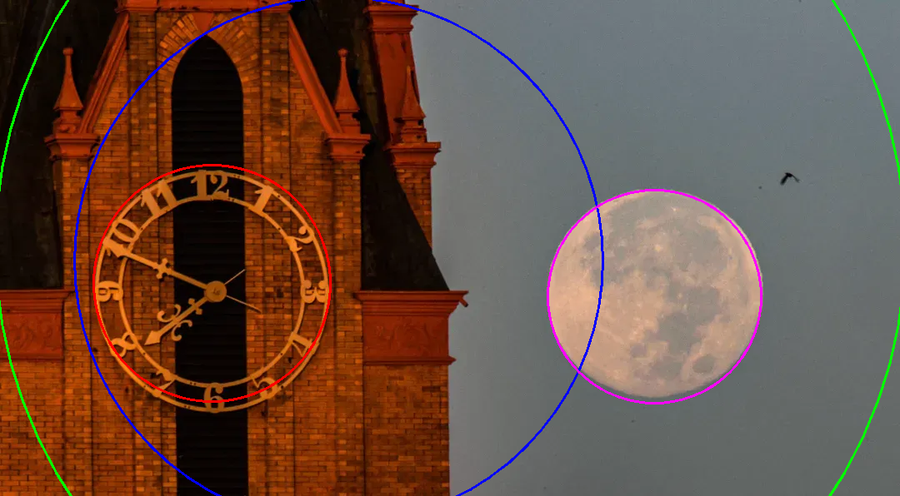
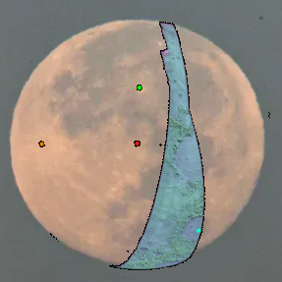
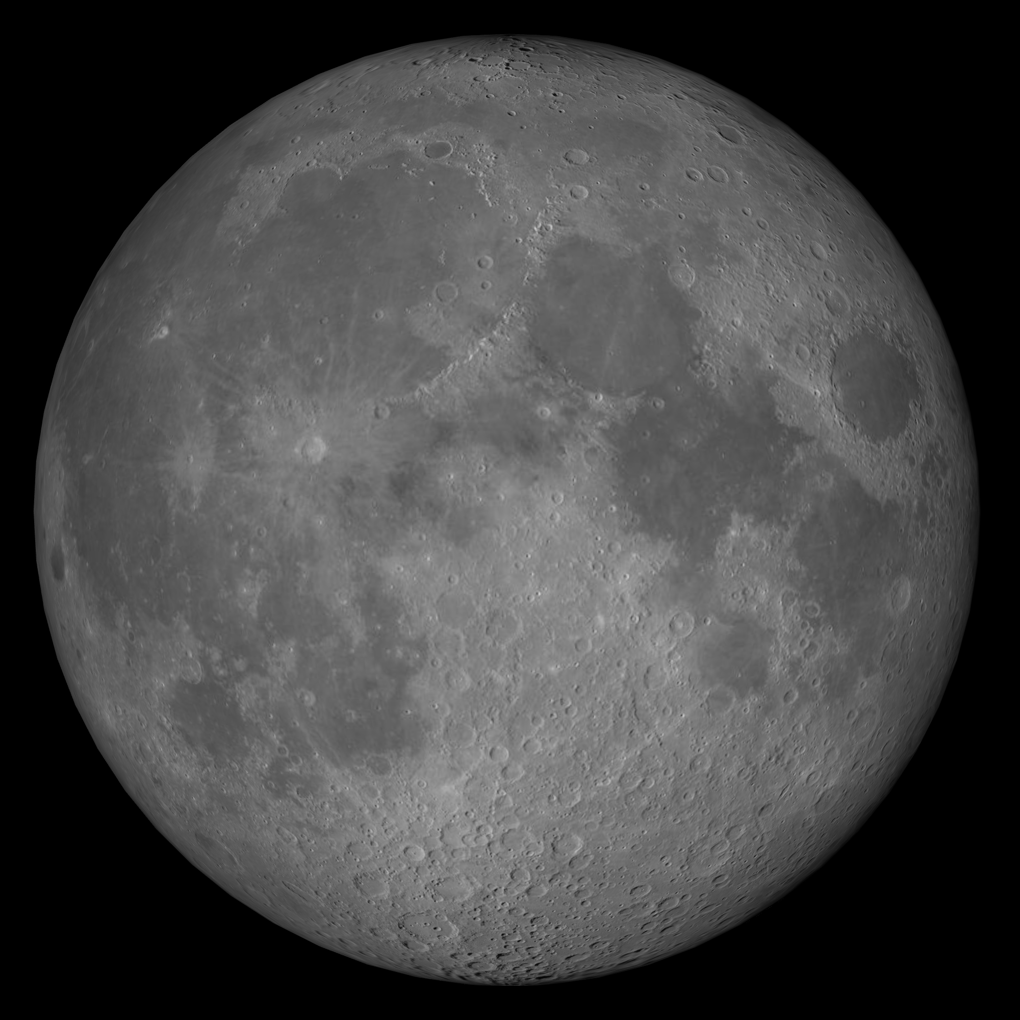
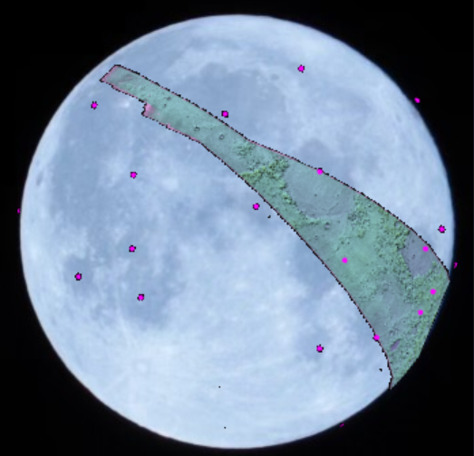
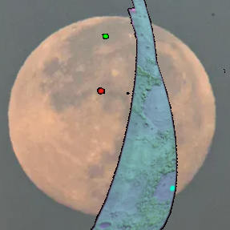
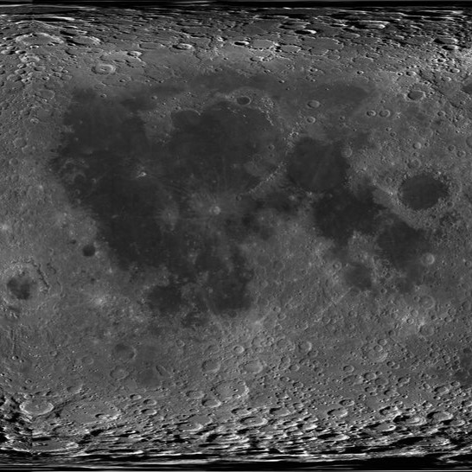
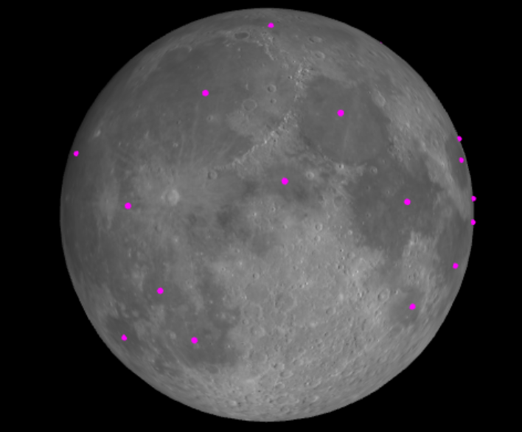
Team Members: Mike De Pacina, Isabel Gonzalez, Gavin Guo, Olga Garcia, Simon Johansen, Sebastian Kane, Breck Miner, Karl Sia, Jacob Valenzuela, Joan Zaldivar Faculty Advisor: Jackson Bently, Youssef El-Zein & Weronika Cwir Jet Propulsion Laboratory Liaisons: Natalie Gallegos, Shan Malhotra & Syed Sadaqathullah College of Engineering, Computer Science, and Technology California State University, Los Angeles
Team Members: Mike De Pacina, Isabel Gonzalez, Gavin Guo, Olga Garcia,
Simon Johansen, Sebastian Kane, Breck Miner, Karl Sia, Jacob Valenzuela, Joan Zaldivar Faculty Advisor: Weronika Cwir
Graduate Advisors: Jackson Bentley, Jesus Cruz, Youssef El-Zein
JPL Liaisons: Natalie Gallegos, Shan Malhotra & Syed Sadaqathullah
College of Engineering, Computer Science, and Technology California State University, Los Angeles
Background & Objectives
Jet Propulsion Laboratory partnered with CSULA aim to build a web application that seeks to enhance public engagement in lunar exploration by exploring the Moon through augmented reality. When images from a telescope are routed to a laptop or a smartphone, users will have the ability to view a version of their image annotated with various useful and interesting data - including lunar features and landmarks, local temperature, chemical makeup of the soil or any available information the user chooses.
Visualization of Algorithms:
Building off the context aware image registration algorithm the previous team built, our current team aims to enhance and implement the following:
Allow the placement and opacity control of multiple overlays on the user’s image
Implement infinite zoom on the user’s image
Improve efficiency and accuracy of the image registration process
Add craters, maria, and landing sites as points of interest
Allow for registration of a live video feed
Results
Infinite Zoom
Multiple Layers
Zoom is done by narrowing the field of view. As the user zooms in, the Web Map Tile Service loads in the higher resolution tiles
Before and after overlays are applied. Overlays: Kaguya LGM2011 Surface Gravity, Colorized and Apollo 15 Metric Cam DEM, ColorHillshade
Circle Detection
Context Aware
Figure 1a
Figure 1b
Figure 3a
Shows the improvement of moon circle detection algorithm with different implementation and optimization. Pink circle is the best one.
Figure 2a
Figure 2b
Figure 3b
Figures 1a and 2a display results from context-aware and static image registrations, respectively, with 1b and 2b as their reference images.
Figure 3a and 3b illustrate the points of interest in both the user image and generated image.
Notes:
Have students check that the logo is the appropriate one to use.

