Slide 1
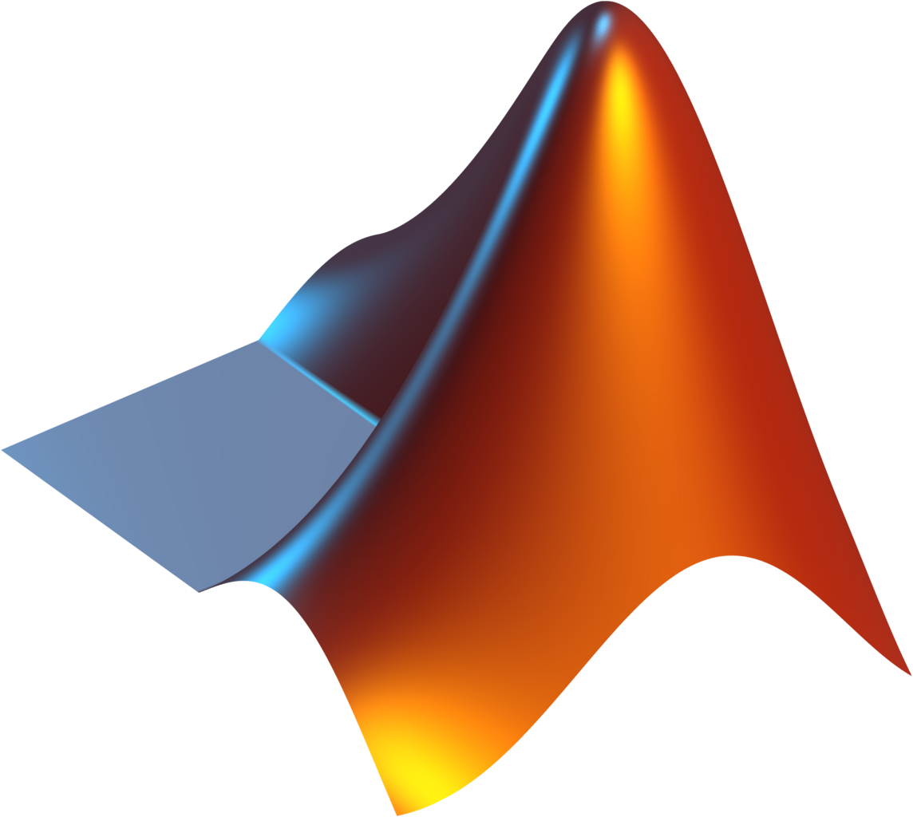
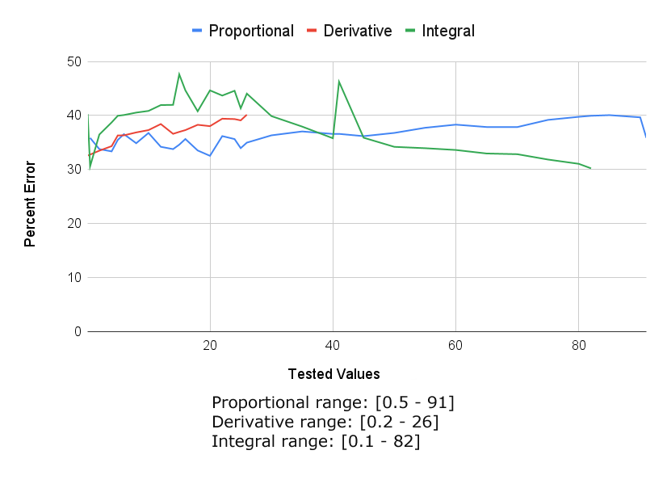
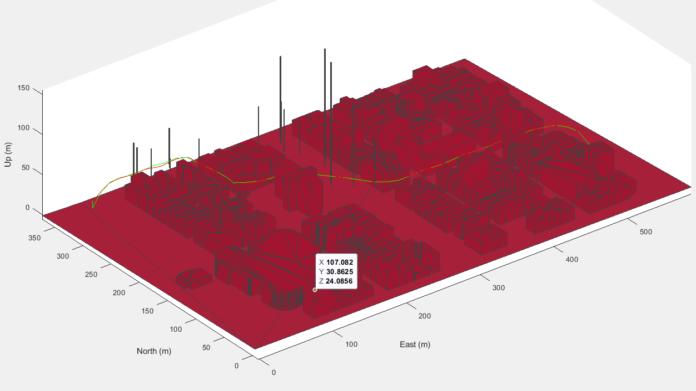
Autonomous Path Planning for
Unmanned Aerial Vehicles Team Members: Jason Alvarez, Jonathan Dang, Lara de Jesus, Abraham Diaz, Marcos Olvera,
Bryan Alfonso Segovia, Prashant Tewary, Juan Tiguila Sajche, Kevin Angel Velez, Erick Vergara
Faculty Advisor: Dr. Manveen Kaur MathWorks Liaison: Dr. Michael Thorburn Department of Computer Science College of Engineering, Computer Science, and Technology California State University, Los Angeles
Background
1
Objective
Path planning for Urban Air Mobility (UAM), such as drone deliveries, poses a critical challenge in transportation. As UAM continues to rapidly expand, there is a pressing need for advanced path-planning algorithms to optimize operations. This project aims to develop a cutting-edge algorithm, utilizing the A* (A-star) algorithm, for coordinating collision-free paths for multiple drones. A* is a widely used search algorithm that efficiently finds the shortest path between nodes in a graph. The goal is to enhance UAM efficiency and sustainability by leveraging the innovative capabilities of the A* algorithm for path planning in complex urban environments.
Drone simulation^{[1]} using path planning algorithm capable of obstacle detection and avoidance.
Design and optimize an efficient drone path planning algorithm.
Implement collision avoidance^{[3]} strategies to ensure safe drone navigation.
Validate the algorithm's effectiveness through comprehensive simulation tests.
Demonstrate the algorithm's capabilities in a simulated environment.
2
Algorithm
3
Testing Methodology
Generate/Obtain a 3D render of urban/suburban geographical area
Apply any variant map data to specified pointers within launch files.
Initialize starting and ending positions with orientation in radians as well as cruising altitude.
Scan the 3D render to obtain a rough 3D occupancy map.
Take a 2D map from the 3D occupancy map at cruising altitude.
Apply A*^{[2]} Algorithm upon the 2D Occupancy map.
Build UAVs with mandatory Lidar Sensors.
Implementation
While the simulation is running:
Attempt to follow the AStar path in 3D space.
If (The Lidar detects any objects intersecting
path and it’s buffer radius)
Turn the drone around the object and
continue to follow the path.
Record path taken.
INPUT: 3D Render of Geographical Area
OUTPUT: A figure file that displays both projected path and path taken.
Collision Avoidance: Evaluate the UAV's capability to safely navigate around obstacles while in motion.
Urban Navigation: Assess the UAV's performance in urban environments characterized by tall buildings, narrow passages, and other urban features.
Dynamic Interaction: Test how the UAV responds to dynamic objects, ensuring it halts when necessary for safety before continuing its route.
4
Results
Sample Output
Application Flow
References
[1] GitHub - https://github.com/tiguila/UAVPathPlanning
[2] Hybrid A* path planner - https://www.mathworks.com/help/nav/ref/plannerhybridastar.html
[3] UAV Obstacle Avoidance in Simulink - https://www.mathworks.com/help/uav/ug/uav-obstacle-avoidance-in-simulink.html
Notes:
‹#›
Have students check that the logo is the appropriate one to use.

