Slide 1
BOX.COM & eDEFENDER INTEGRATION
SPONSOR
Santa Barbara Public Defender’s Office
LIAISONS
Deepak Budwani | Luis Ramirez
AJ Voisan | Angie Stokke | Sarah Rothschild
ADVISOR
JungSoo Lim

Slide 2
01
04
02
05
03
06
ACCOMPLISHMENTS
MEET THE TEAM
ABOUT SBPD
EXAMPLE
PROJECT DESCRIPTION
CONCLUSION

Slide 3
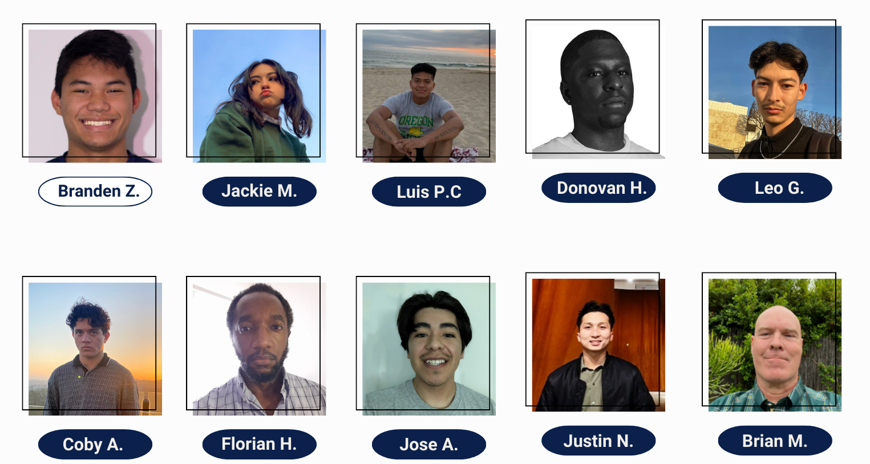
—MEET THE TEAM— | ABOUT SBPD | PROJECT DESCRIPTION | ACCOMPLISHMENTS | EXAMPLE | CONCLUSION

Slide 4
WHO THEY ARE AND WHAT THEY DO
The Santa Barbara Public Defender’s office has a content management system called “eDefender”; they are currently using Box.com to build an infrastructure to support their networks where they’ll be able to migrate terabytes of data to the cloud for easy and convenient access.
MEET THE TEAM | —ABOUT SBPD— | PROJECT DESCRIPTION | ACCOMPLISHMENTS | EXAMPLE | CONCLUSION

Slide 5
CURRENT PROCESS
WHAT WE OFFER
Terabytes of Discovery Media
Exponentially Growing
Manual Processing of all Media
Extra Cost per Needed Feature
Transcription Services
Keyword Locator
Facial Recognition
Time Constraint Preparing per Case
Cloud Based Storage System (Box.com)
Automated Processing of Media
Implementation of Needed Features
Transcription Service
(video insights/docx file)
Keywords/Facial Recognition
Reduced Time Preparing per Case
MEET THE TEAM | —ABOUT SBPD— | PROJECT DESCRIPTION | ACCOMPLISHMENTS | EXAMPLE | CONCLUSION

Slide 6
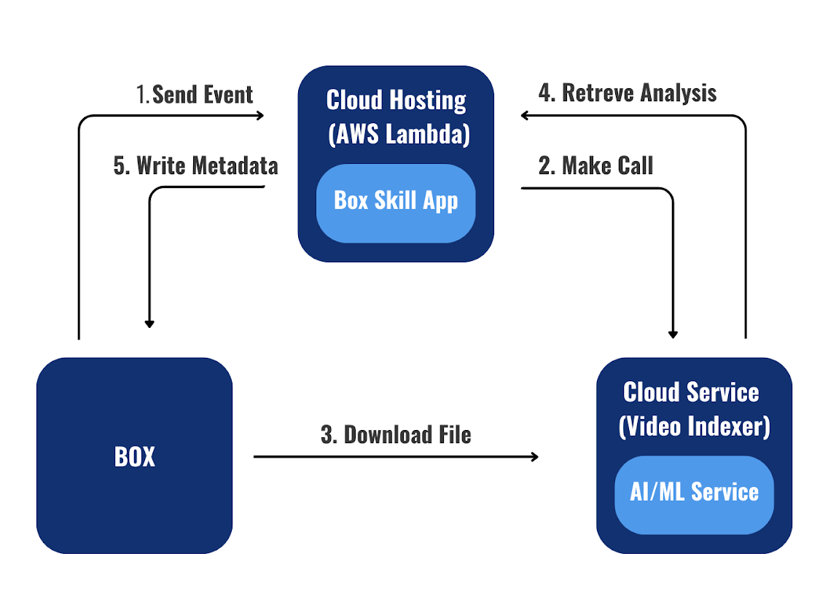
OVERVIEW
Secure lambda endpoint, configuration files, and private data.
Refactor and organize code, limit vulnerabilities, and implement error handling
Improve transcript accuracy, marking, and correction abilities
Create AI custom models for increased accuracy
GOAL: Reduce the amount of time public defenders spend organizing and analyzing electronic media; in turn making the process more efficient and effective
MEET THE TEAM | ABOUT SBPD | —PROJECT DESCRIPTION— | ACCOMPLISHMENTS | EXAMPLE | CONCLUSION

Slide 7
AWS TEAM
Improve security by implementing
AWS Secrets Manager
Minimize information being breached through the implementation of API Gateway
Clean up remaining S3 buckets after 30 days
(set an expiration date)
MEET THE TEAM | ABOUT SBPD | PROJECT DESCRIPTION | -–ACCOMPLISHMENTS— | EXAMPLE | CONCLUSION

Slide 8
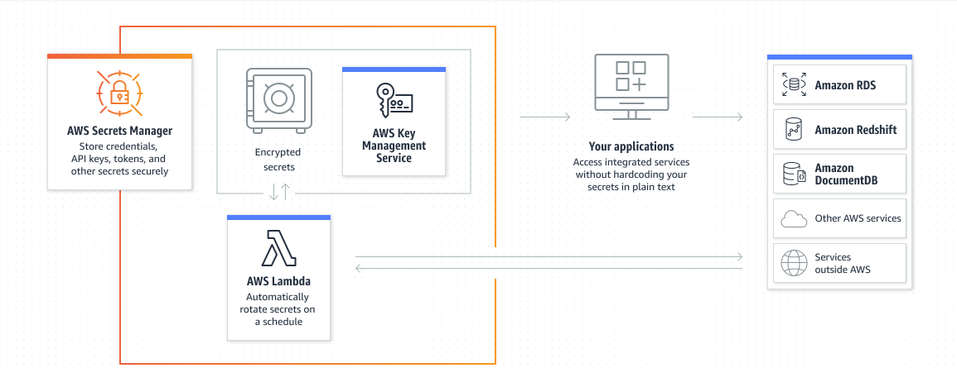
Donovan H.
Secrets Manager
Secrets Manager is an essential AWS service designed to safeguard sensitive data by encrypting it as a Secret
We utilize this service to store the API key required for connecting our Lambda function with Box.com.
Our Lambda function uses a key generated by AWS Key Management Service (KMS) to encrypt/decrypt the Secret and use it in our code
MEET THE TEAM | ABOUT SBPD | PROJECT DESCRIPTION | -–ACCOMPLISHMENTS— | EXAMPLE | CONCLUSION

Slide 9
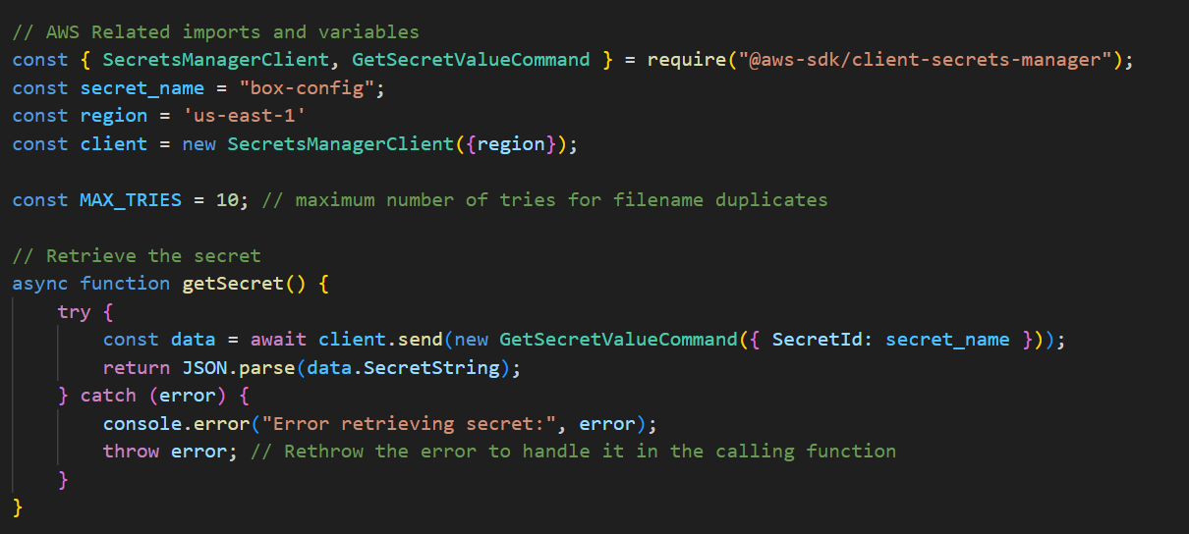
Donovan H.
Secrets Manager
Attached IAM policies to Lambda function
Added functions to codebase that handle new functionality
Helps with modularity of codebase to assist with debugging and readability
MEET THE TEAM | ABOUT SBPD | PROJECT DESCRIPTION | -–ACCOMPLISHMENTS— | EXAMPLE | CONCLUSION

Slide 10
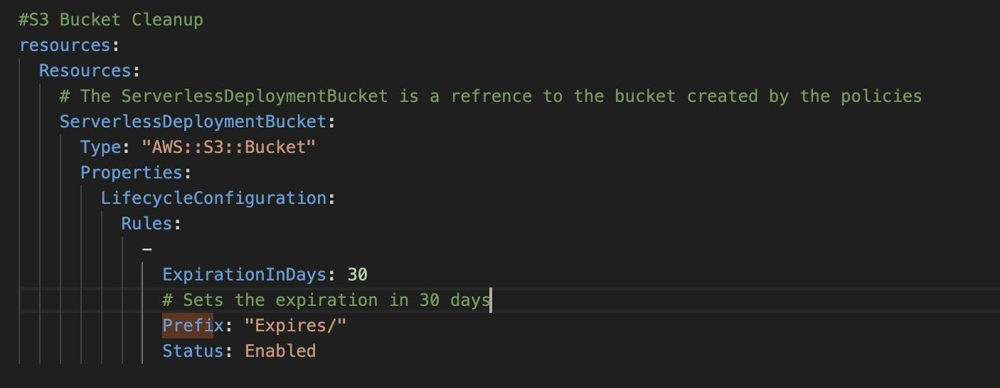
S3 Bucket Cleanup
What is S3 Bucket Cleanup?
What is the purpose?
How is it important?
How is it implemented into the application?
MEET THE TEAM | ABOUT SBPD | PROJECT DESCRIPTION | -–ACCOMPLISHMENTS— | EXAMPLE | CONCLUSION

Slide 11
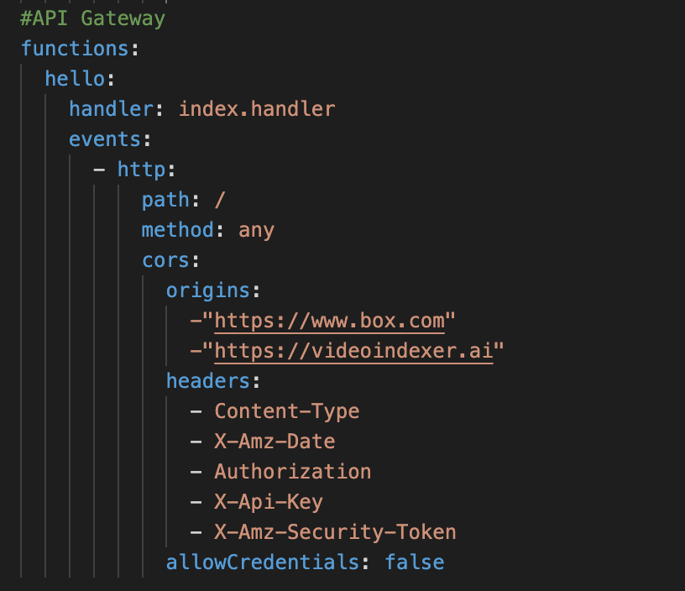
API Gateway
What is API GateWay?
What resources are being used?
How are we improving Security?
MEET THE TEAM | ABOUT SBPD | PROJECT DESCRIPTION | -–ACCOMPLISHMENTS— | EXAMPLE | CONCLUSION

Slide 12
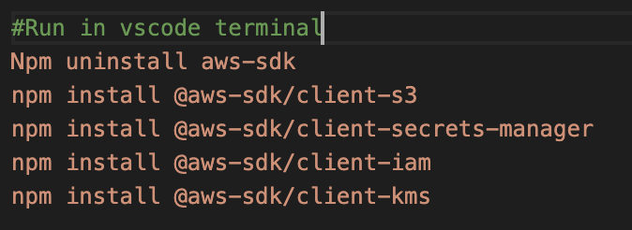
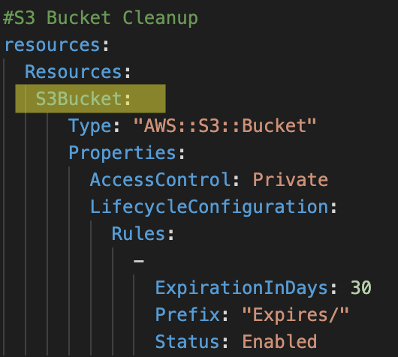
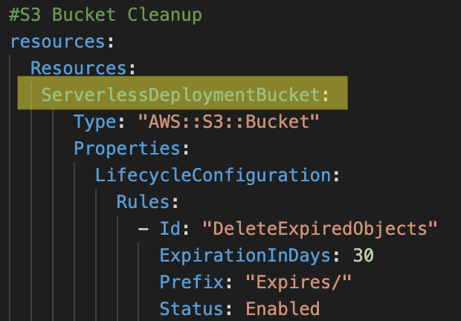
AWS Team Accomplishments
AWS SDK MIGRATION
S3 Bucket
MEET THE TEAM | ABOUT SBPD | PROJECT DESCRIPTION | -–ACCOMPLISHMENTS— | EXAMPLE | CONCLUSION

Slide 13
TRANSCRIPT TEAM
Debug document line numbering
Rework parsing format
Implement confidence marking
MEET THE TEAM | ABOUT SBPD | PROJECT DESCRIPTION | -–ACCOMPLISHMENTS— | EXAMPLE | CONCLUSION

Slide 14
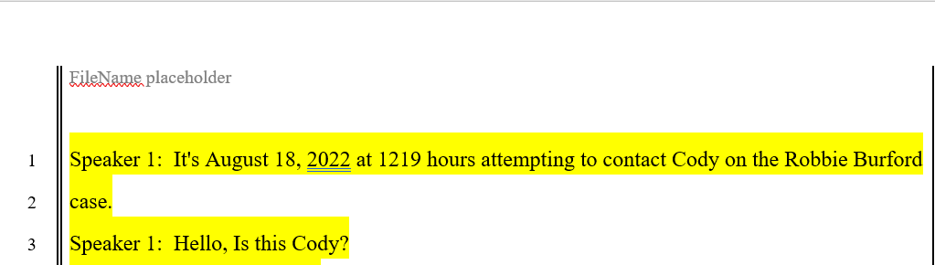
Line One Rendering
Before
if-else statement to check first line
set “break” as false
After
MEET THE TEAM | ABOUT SBPD | PROJECT DESCRIPTION | -–ACCOMPLISHMENTS— | EXAMPLE | CONCLUSION

Slide 15
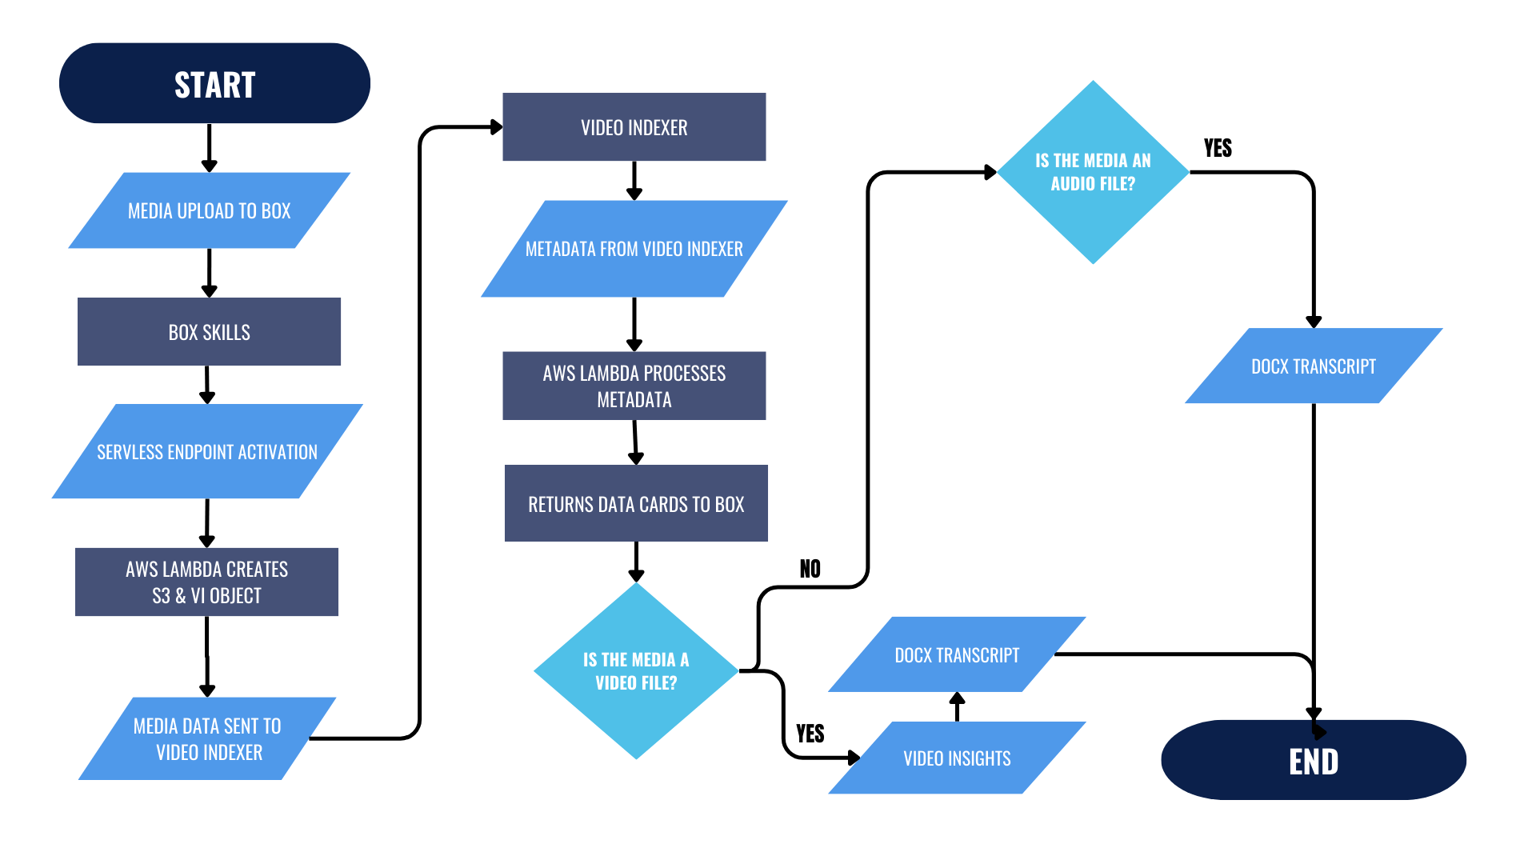
FLOW OF CONTROL
File Is Uploaded To Cloud
Lambda Function Is Activated
Transcript Is Created From
Dialogue In The Recording
Transcript Is Then Attached
And Stored With Recording
On Box.Com
MEET THE TEAM | ABOUT SBPD | PROJECT DESCRIPTION | -–ACCOMPLISHMENTS— | EXAMPLE | CONCLUSION

Slide 16
CONFIDENCE MARKING
EARLY IN THE PROJECT:
FINALLY ACHIEVED:
MEET THE TEAM | ABOUT SBPD | PROJECT DESCRIPTION | -–ACCOMPLISHMENTS— | EXAMPLE | CONCLUSION

Slide 17
DYNAMIC ALLOCATION OF LOW CONFIDENCE:
Documents Have Varying Ranges Of Confidence Markings
Highs And Lows Can Average Anywhere From All Above 90% To All Below 40%
How Is Consistency In Deciding What To Highlight Achieved?
MEET THE TEAM | ABOUT SBPD | PROJECT DESCRIPTION | -–ACCOMPLISHMENTS— | EXAMPLE | CONCLUSION

Slide 18
CODEBASE TEAM
Modularizing
Error Handling & Logging
Updating Versions
Verifying Box Requests
S3 Bucket Deletion
MEET THE TEAM | ABOUT SBPD | PROJECT DESCRIPTION | -–ACCOMPLISHMENTS— | EXAMPLE | CONCLUSION

Slide 19
ACHIEVEMENTS
Updating Versions
59 vulnerabilities → 0 vulnerabilities
NodeJS v14.x.x → NodeJS v18.x.x
AWS v2 → AWS v3
S3 Bucket Deletion
After program termination
After code-breaking error
MEET THE TEAM | ABOUT SBPD | PROJECT DESCRIPTION | -–ACCOMPLISHMENTS— | EXAMPLE | CONCLUSION

Slide 20
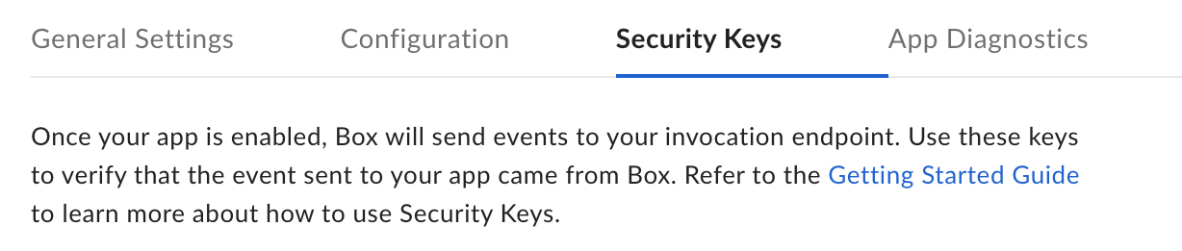
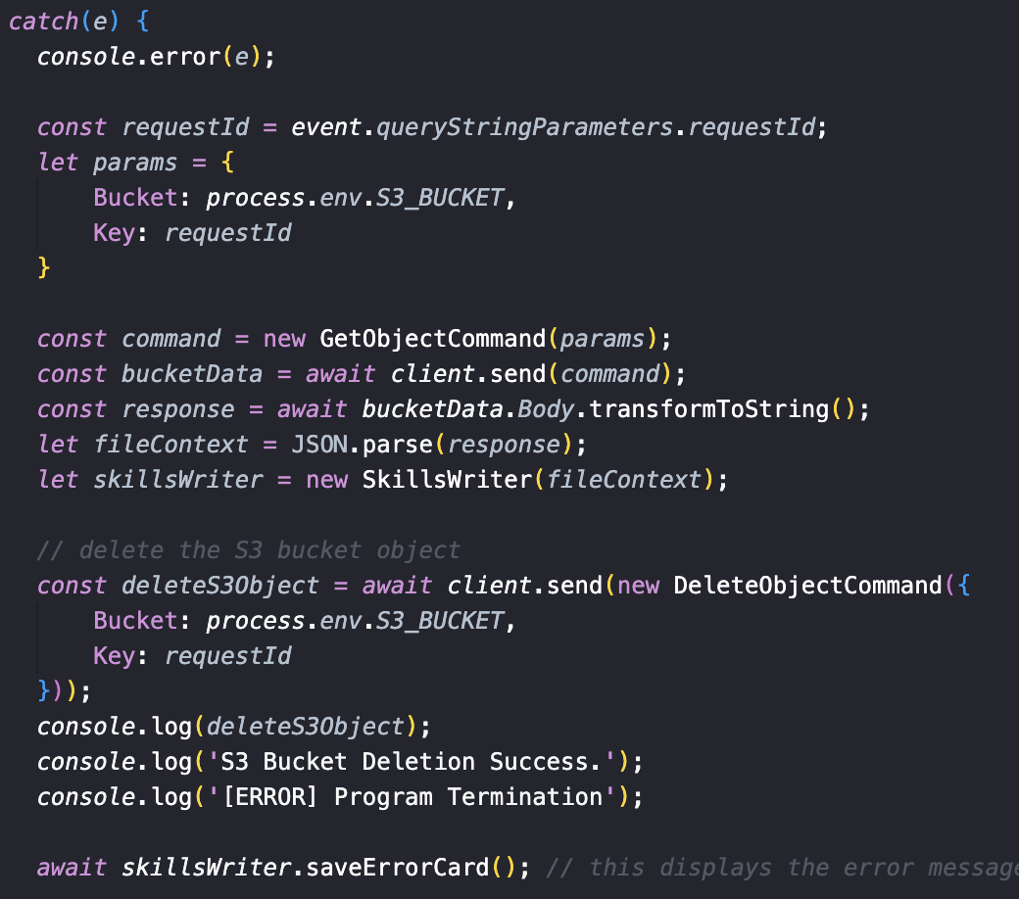
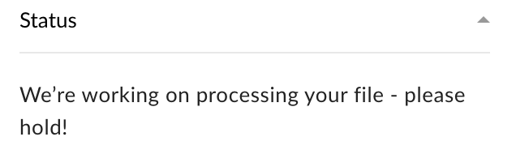
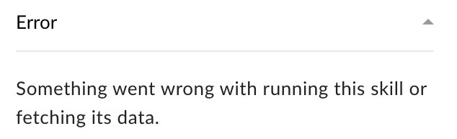
ACHIEVEMENTS
Verifying Box Requests
Utilized Box Security Keys
Implemented as Env. variables
Error Handling and Logging
Error Messages to User
Proper Logging to console
Deleting S3 Bucket (if error)
MEET THE TEAM | ABOUT SBPD | PROJECT DESCRIPTION | -–ACCOMPLISHMENTS— | EXAMPLE | CONCLUSION

Slide 21
CUSTOM MODELS TEAM
Developed a model for more accurate transcripts
Metric development to keep track of model accuracy
Documented project progress and methodologies
MEET THE TEAM | ABOUT SBPD | PROJECT DESCRIPTION | -–ACCOMPLISHMENTS— | EXAMPLE | CONCLUSION

Slide 22
ACHIEVEMENTS
Metrics: Accuracy
Accuracy of Baseline Model (Average): 78.67%
Accuracy of Custom Model (Average): 84.96%
Measured 5 transcripts
MEET THE TEAM | ABOUT SBPD | PROJECT DESCRIPTION | -–ACCOMPLISHMENTS— | EXAMPLE | CONCLUSION

Slide 23
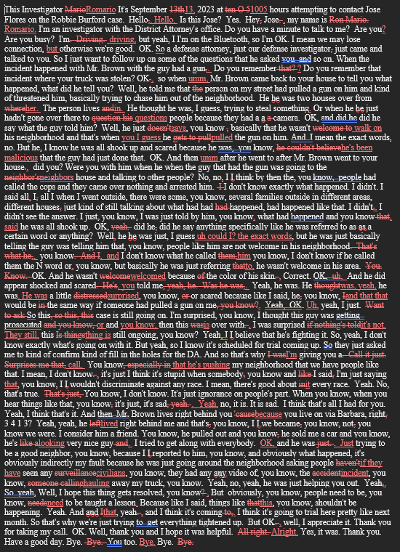
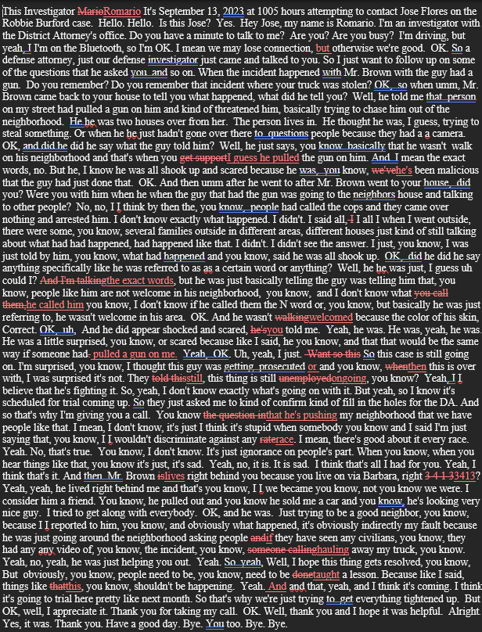
Baseline model:
(Left) 81.44%
Custom model
(Right): 95.45%
MEET THE TEAM | ABOUT SBPD | PROJECT DESCRIPTION | -–ACCOMPLISHMENTS— | EXAMPLE | CONCLUSION

Slide 24
ACHIEVEMENTS
Documentation and Methodologies
Created documents + code to help with modeling issues
ex. (Work we’ve done, code logic to integrate model into the project)
MEET THE TEAM | ABOUT SBPD | PROJECT DESCRIPTION | -–ACCOMPLISHMENTS— | EXAMPLE | CONCLUSION

Slide 25
Modeling Team Challenges
Accuracy metrics it too sensitive
Commas, Capitalized Letters, filler words will negatively impact accuracy for custom model
Implementation of model into the project
MEET THE TEAM | ABOUT SBPD | PROJECT DESCRIPTION | -–ACCOMPLISHMENTS— | EXAMPLE | CONCLUSION

Slide 26
Visualization
MEET THE TEAM | ABOUT SBPD | PROJECT DESCRIPTION | ACCOMPLISHMENTS | –EXAMPLE– | CONCLUSION

Slide 27
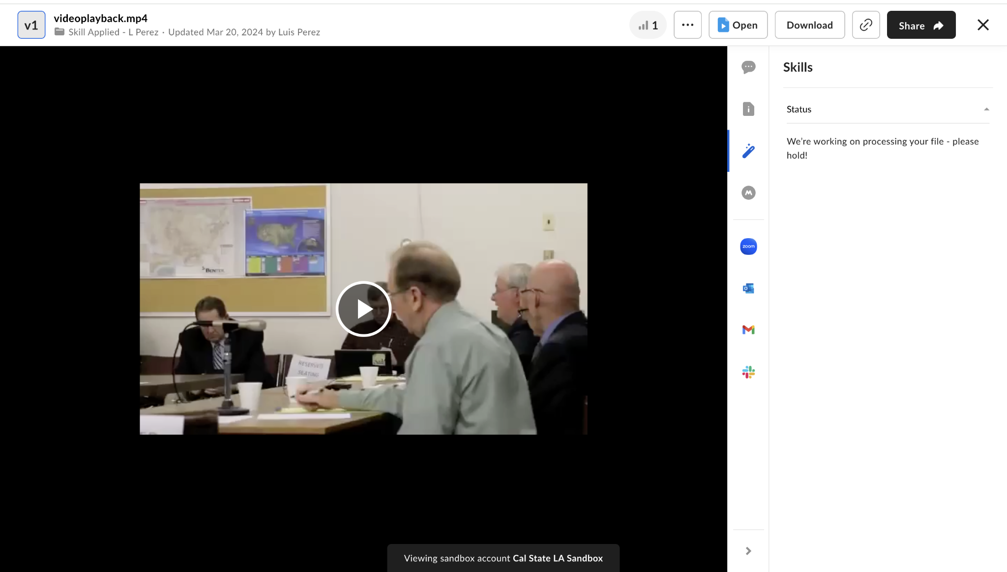
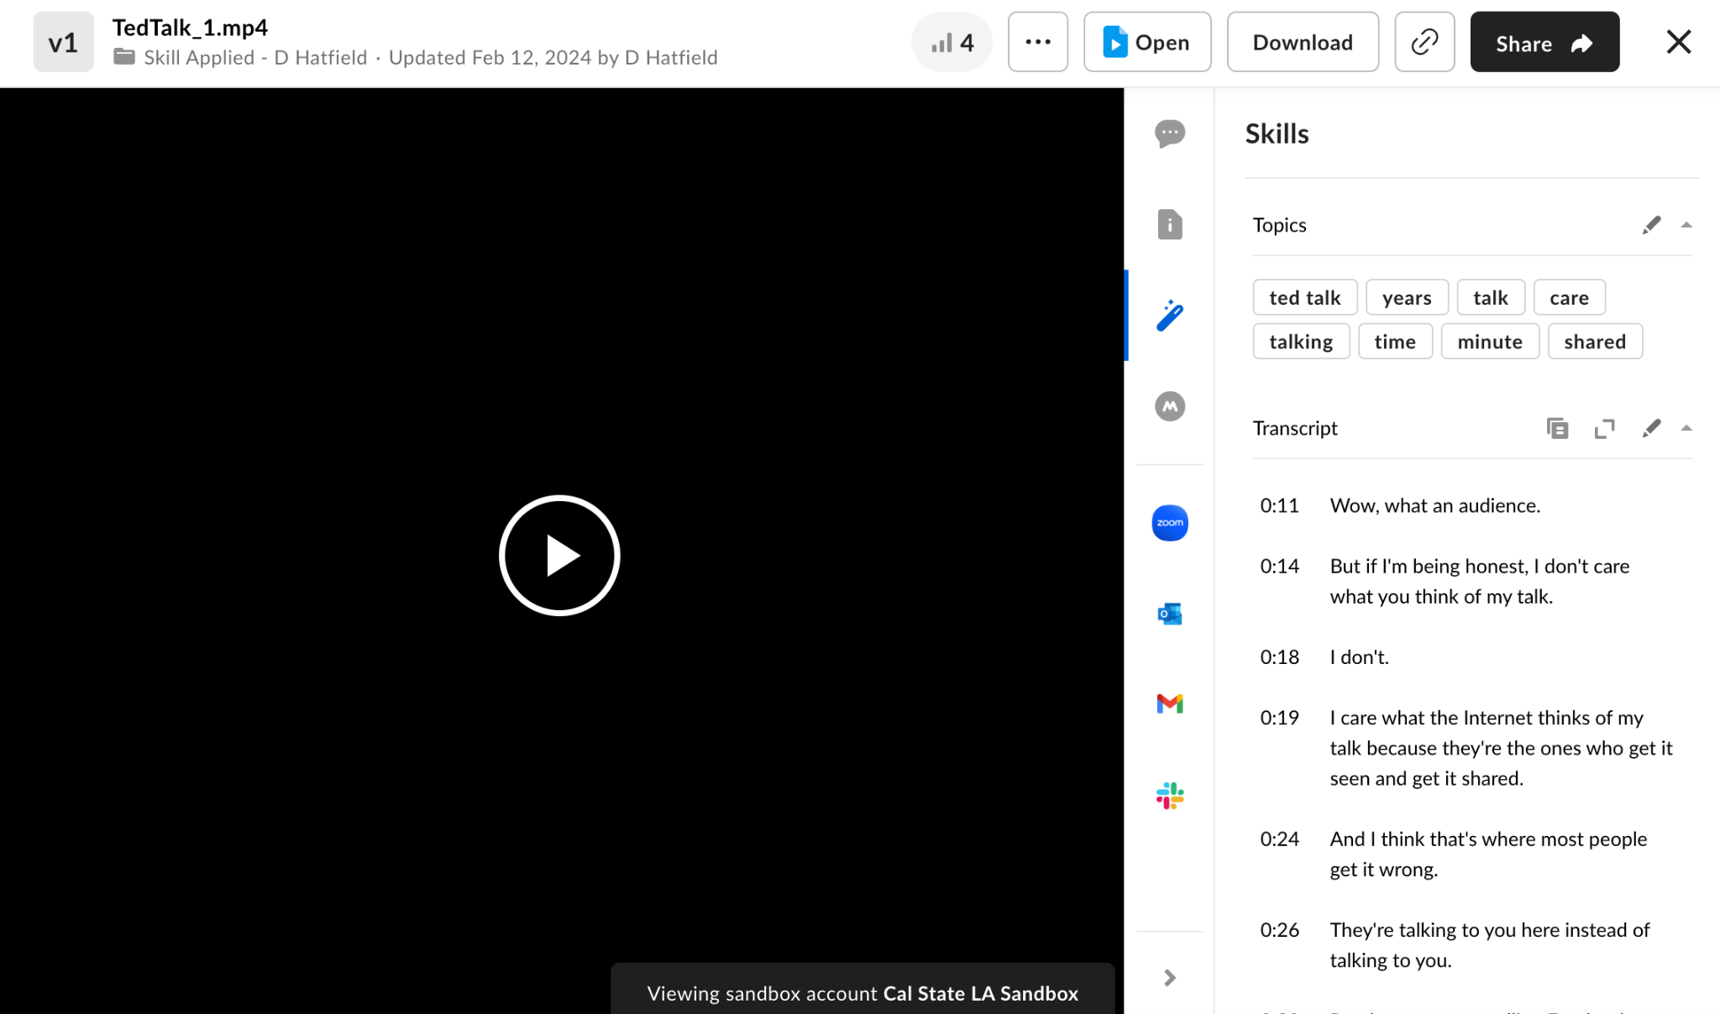
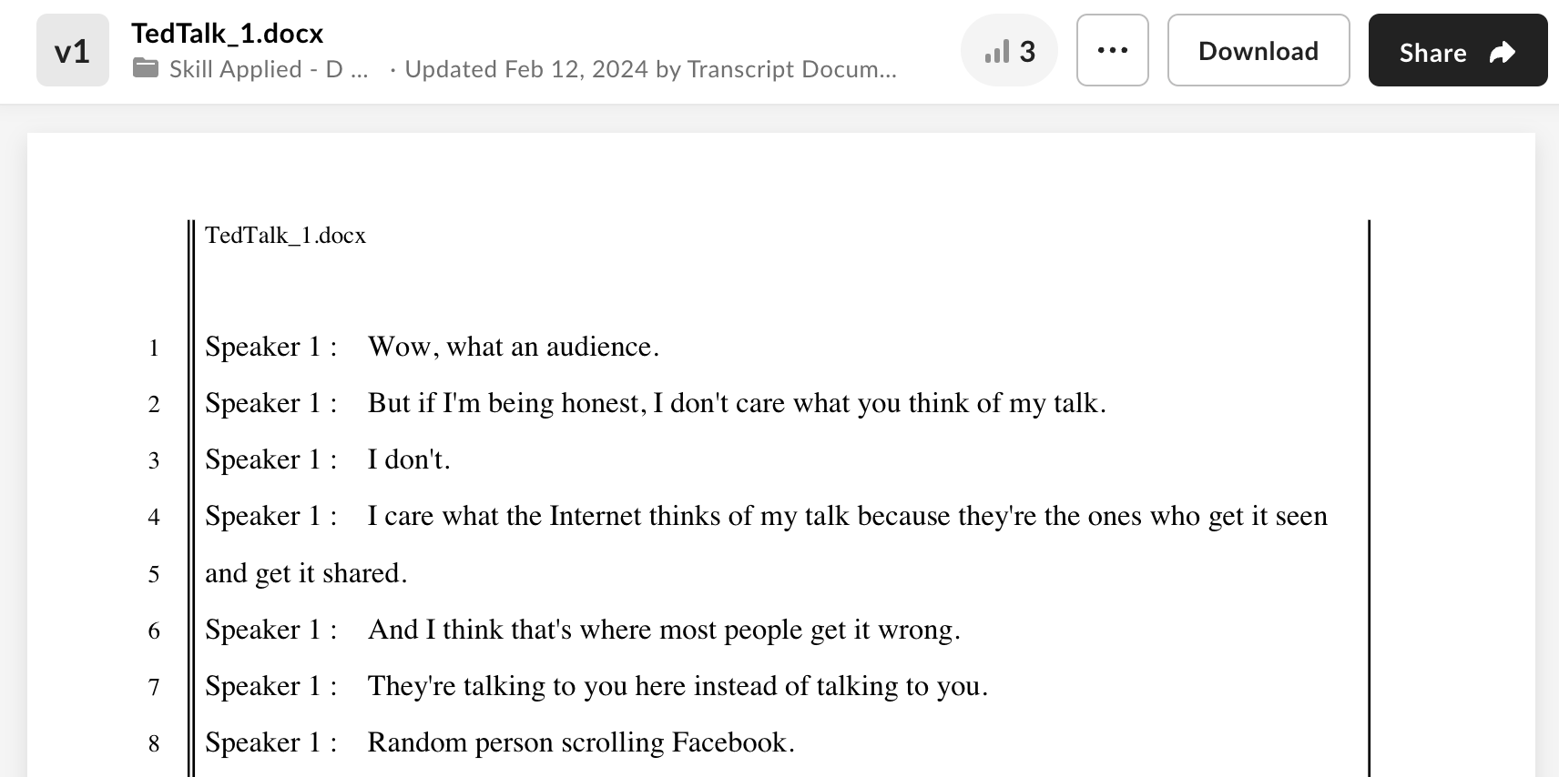
Visualization
MEET THE TEAM | ABOUT SBPD | PROJECT DESCRIPTION | ACCOMPLISHMENTS | –EXAMPLE– | CONCLUSION

Slide 28
FUTURE GOALS
Send custom notifications/messages to the Box UI interface
Migrate code to be in compliance with updated Video Indexer API
Creating a subscription based account for Video Indexer
Modularization of code, creating two files (one for each event call)
Fully integrate custom model into the project
MEET THE TEAM | ABOUT SBPD | PROJECT DESCRIPTION | ACCOMPLISHMENTS | EXAMPLE | —CONCLUSION—

Slide 29
THANK YOU
QUESTIONS?
This presentation template was created by slides, including icons by flaticon, infographics and images by freepik

