Slide 1
Want2Remember® App
by We2Link®
®
Notes:
Kevin

Slide 2
01
Introduction
®
Notes:
Kevin

Slide 3
Sponsor, CEO, Michael C. Malone
Founder of We2Link, Inc.®
A Disabled Army Veteran
Developed Traumatic Brain Injury [TBI] while serving in the military
Works with TBI
Interviewed people who had TBI
Designated that this has impacted the Quality of Life [QoL] of people
Notes:
Kevin

Slide 4
Team Members
Advisor:
Huiping Guo
Senior Developer:
Ricardo Marroquin
Project Manager:
Jay Rodriguez
Web Team:
Hein Htet, Ivan Wang
Zain Syed (Scribe), Jennifer Lizárraga
Mobile Team:
Davy Chi (Co-Lead), Joanne Wu (Scribe)
Adrian Soria (Co-Lead), Kevin Fong
Carlos Ramirez, Nicholas Barger
®
Notes:
Everyone

Slide 5
Presentation Outline
About Want2Remember®
Purpose
Software
Project Requirements
Firebase
React/React Native
Application Map
Project Workload Overview
Spring 2024 Updates and Features
WorkFlow
QA/Peer Review
Communication
Work Environment
Closing Remarks
Q&A
®
Notes:
Nicholas

Slide 6
02
About Want2Remember®
Notes:
Nicholas

Slide 7
About Want2Remember® / Purpose
Quality of life app to assist those who suffer from cognitive difficulties
Examples:
Traumatic Brain Injuries [TBI]
Alzheimer's Disease
Dementia
The main purpose:
Help those with cognitive impairments and daily living challenges
The overall goal:
Reduce Isolation
Ease the burden on caregivers
Reduce Suicide Rate
Achieve Greater Independence
Notes:
HH

Slide 8
03
Software
Notes:
HH

Slide 9
Project Requirements/Tech Stack
Programming/Development:
Firebase
HTML
Tailwind CSS
Visual Studio Code
Javascript/React
React Native
Android Studio/Xcode
Source Control:
GitHub
Jira (Agile Tracking)
Communication:
Slack
Notes:
HH

Slide 10
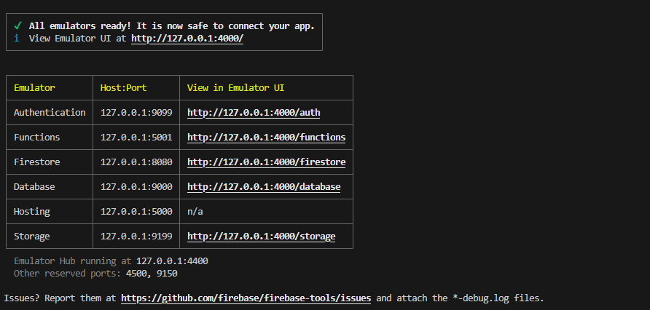
Why Firebase for Want2Remember®️?
Was documented very well and was an easy option
Affordable and offered many advantages, such as web hosting, firebase storage, cloud functions
The database emulator on firestore allows devs to edit and view the web application in real time.
Notes:
Zain

Slide 11
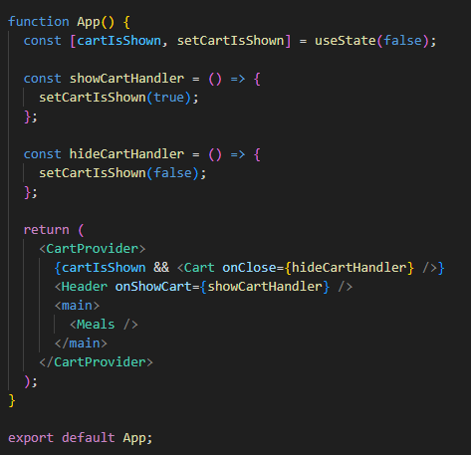
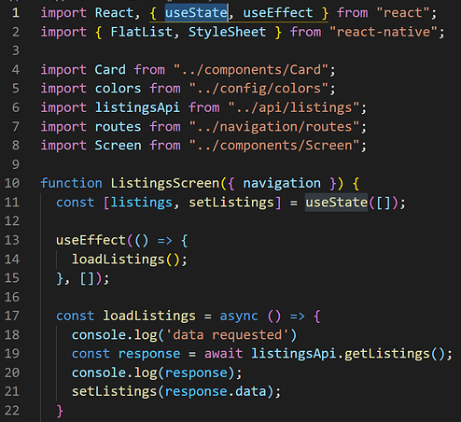
Why React/React Native for Want2Remember®️?
We can utilize React components like building blocks
React native allows for flexibility between ios and android development at the same time since its the same syntax
React works through both jsx and javascript so you can implement front end as well as events and other features at the same time
We can manage the state and effects of each component
← Web
Mobile →
Notes:
Zain

Slide 12
04
Application Map
Notes:
Zain

Slide 13
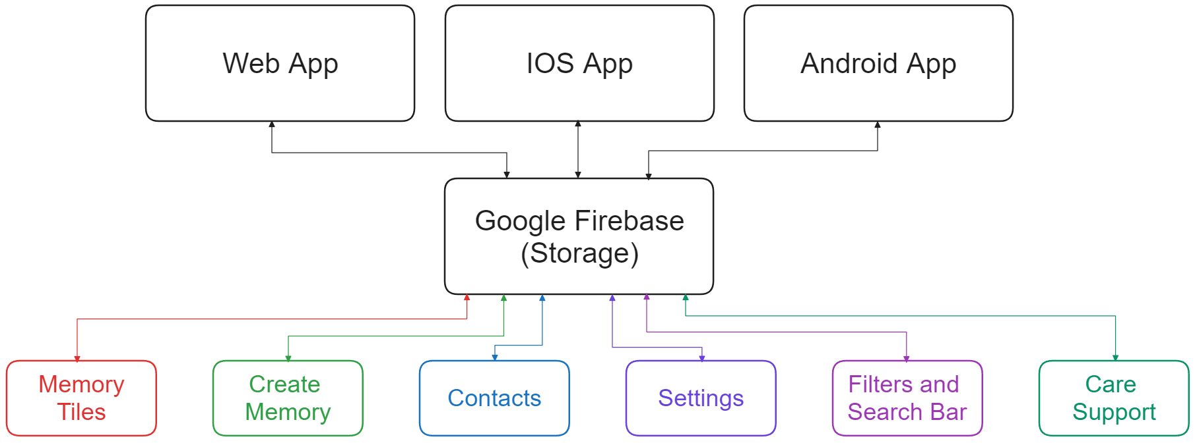
Application Map
Notes:
Davy
Sitting at the top of the Application Map we have three versions of Want2Remember, the web app, ios app, and android app. Next is Google Firebase which is what we use to store user data in.The components making up Want2Remember consist of Memory Tiles, Create Memory, Contacts, Settings, Filters and Search Bar, and Care Support.

Slide 14
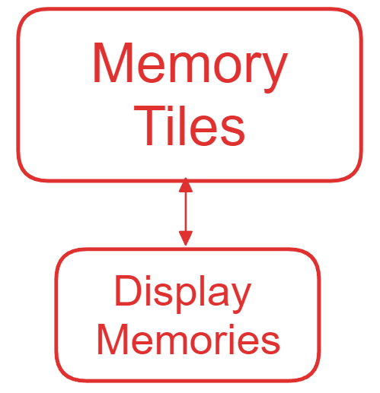
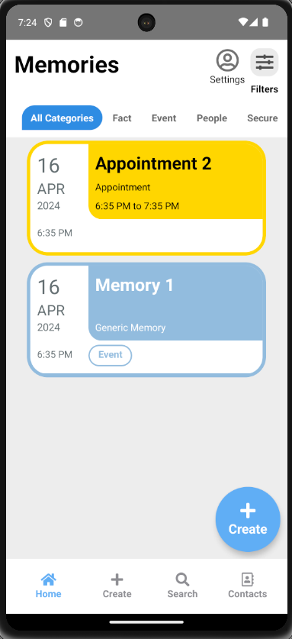
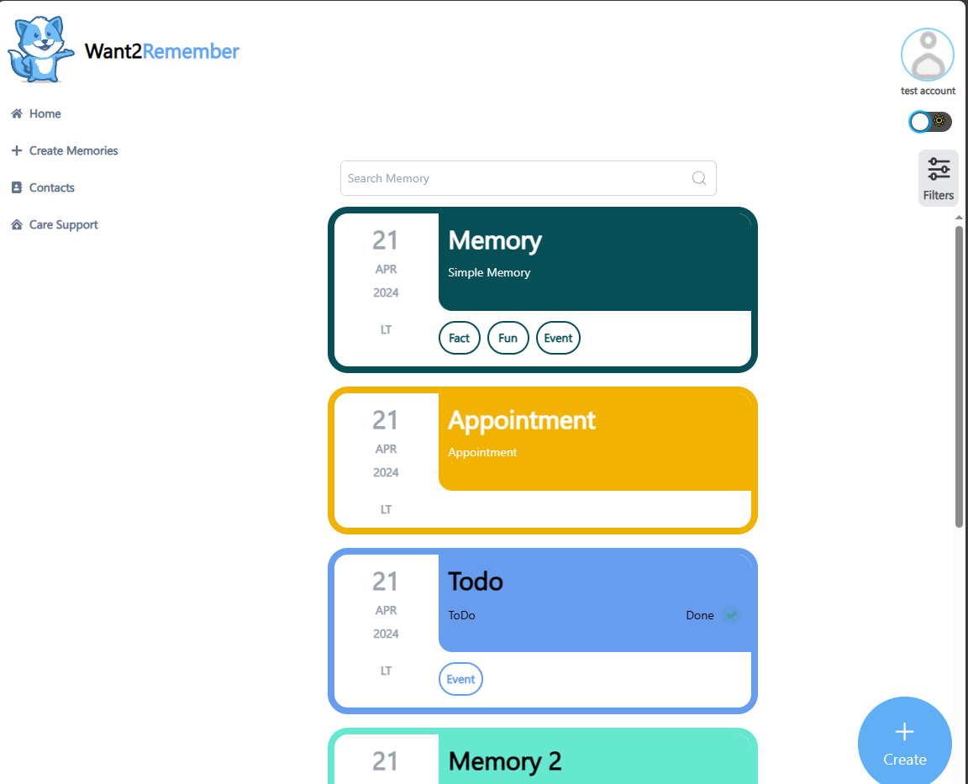
Mobile
Web
Notes:
Davy
For Memory Tiles, their job is to Display the Memories Created by the user. The memory tiles don't have to be specifically memories, they can also act as reminders. As you can see, the picture on the left is web version of the app and the picture on the right is an android version of the app.

Slide 15
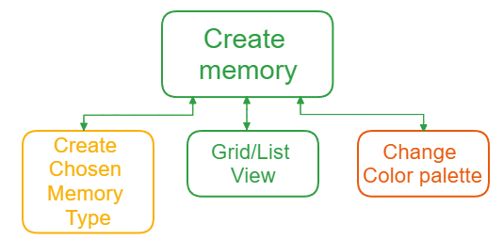
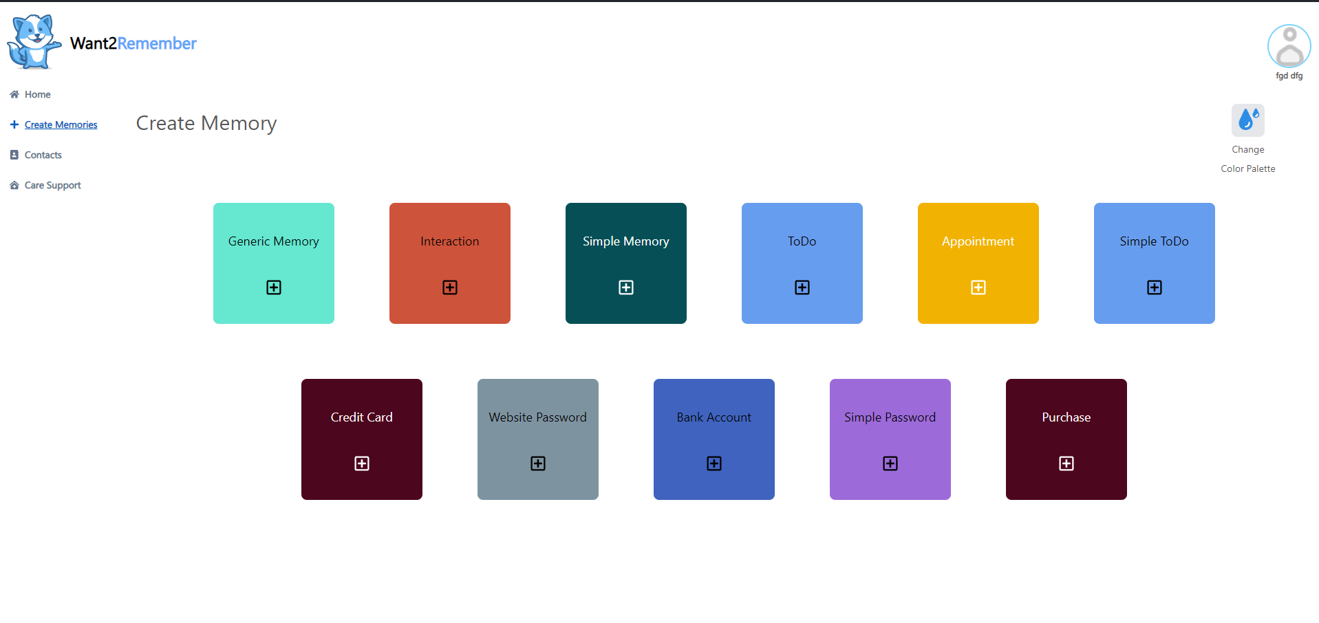
Mobile
Web
Notes:
Davy
Here is the Create Memory Screen. On both the Web and Mobile Version, You can select a Memory Type to create as well as Changing your Color Palette on the top right corner of the screen. On the left side is the Web App which is using the default color palette while on the right side, the mobile app is using another preset color palette. Normally, the color palette between the web and mobile version are synced.

Slide 16
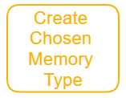
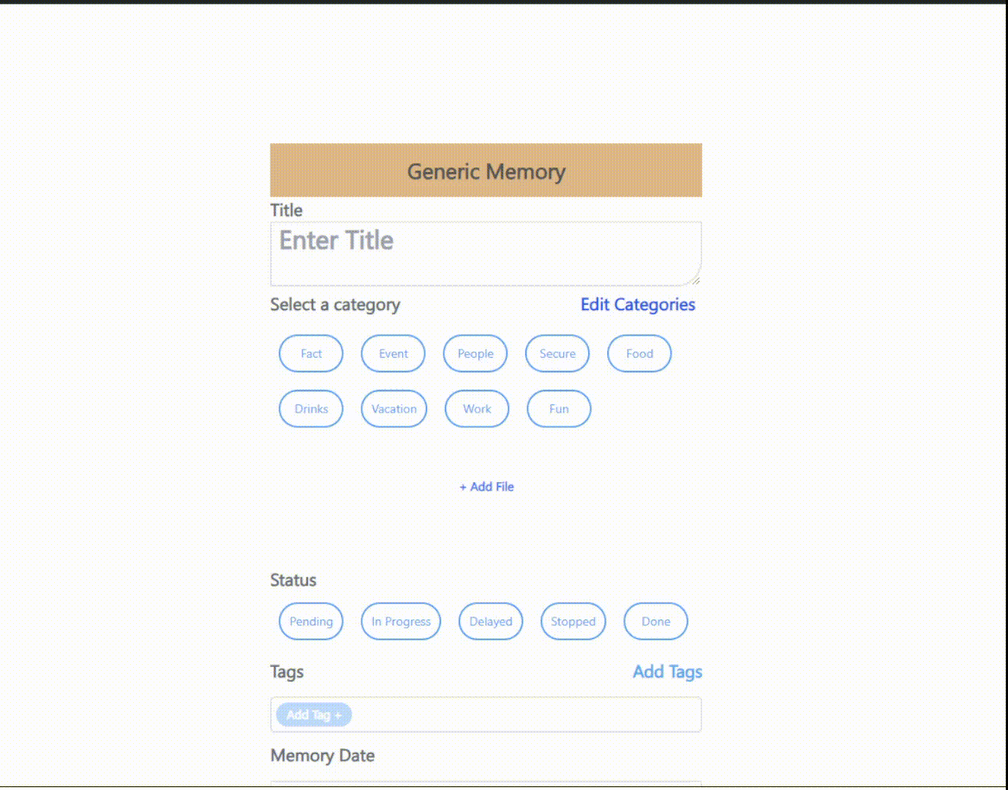
Mobile
Types of Memories
Generic Memory
SimpleMemory
ToDo
SimpleToDo
Appointment
Interaction
Website Password
Simple Password
Credit Card
Bank Account
Purchase
Web
Notes:
Zain

Slide 17
Mobile
Web
Color Palettes
Default
Pantone
Rainbow
Deuteranopia (red-green blind)
Protanopia (red blind)
Tritanopia (blue-yellow blind)
Custom
Notes:
Carlos

Slide 18
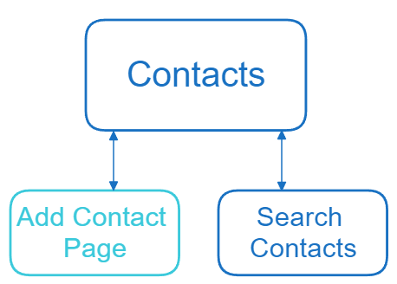
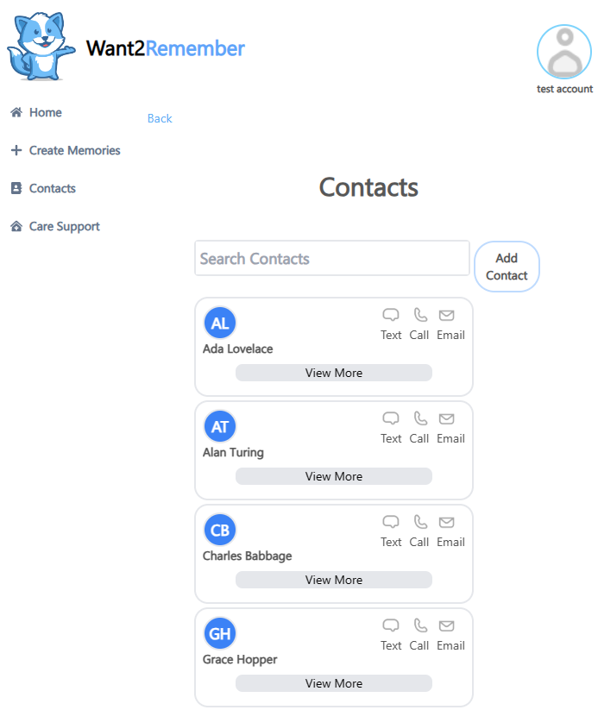
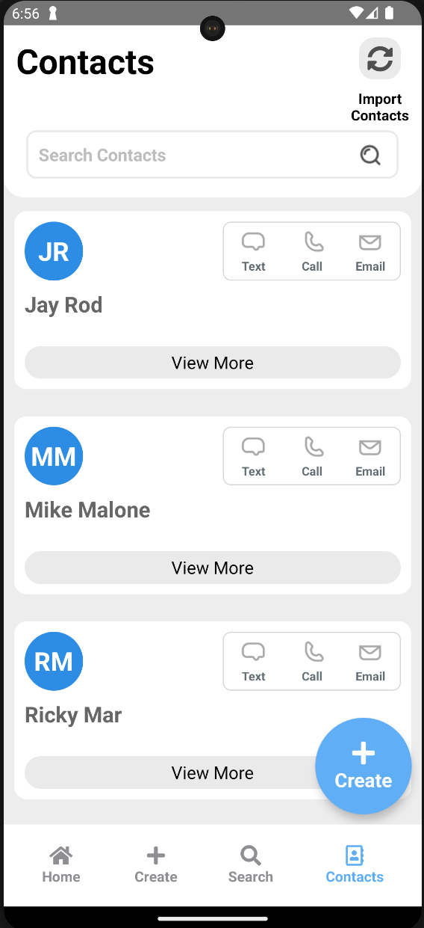
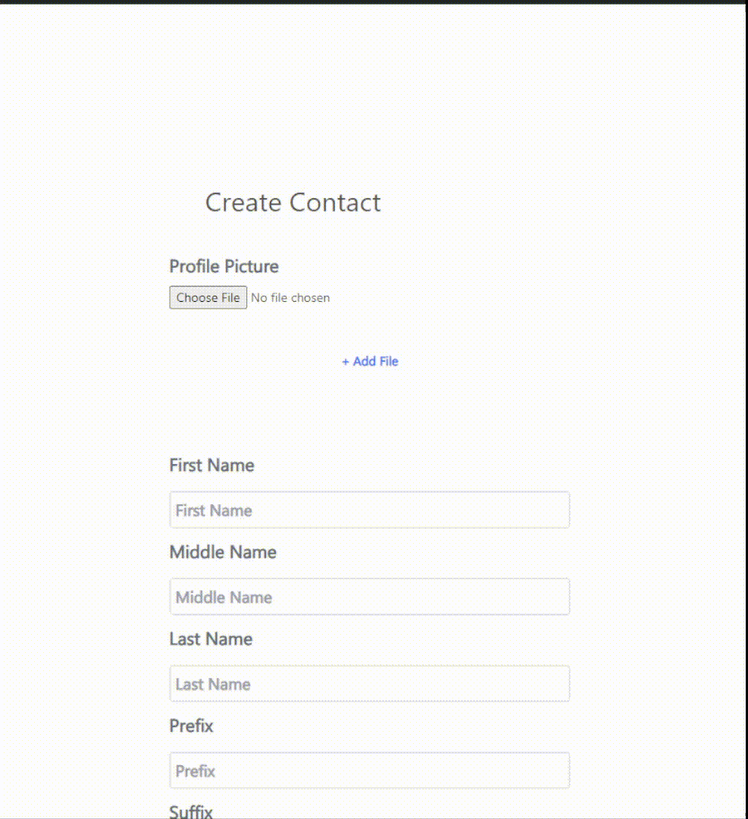
Web
Mobile
Notes:
Jennifer

Slide 19
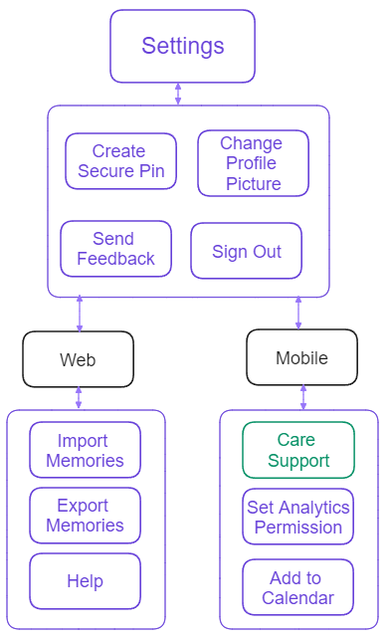
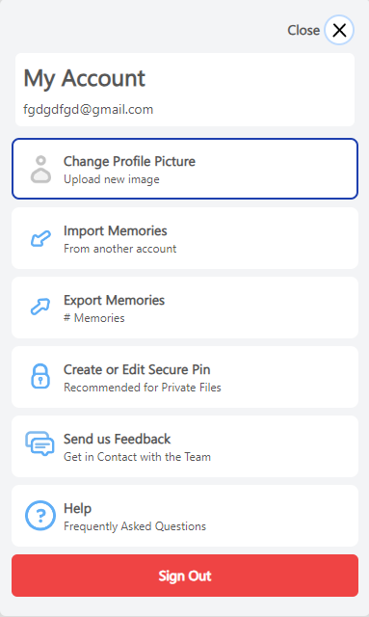
Web
Mobile
Notes:
Joanne: Here, is the settings page, where users can access essential app utilities such as creating a secure pin, changing profile picture, sending customer feedback as well as signing in and out.
For web, the user can import memories from another account and export memories to a different account. As for mobile, the user can manage caregivers as well as setting app permissions for accessing user data.

Slide 20
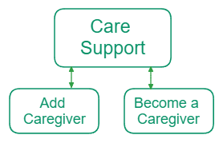
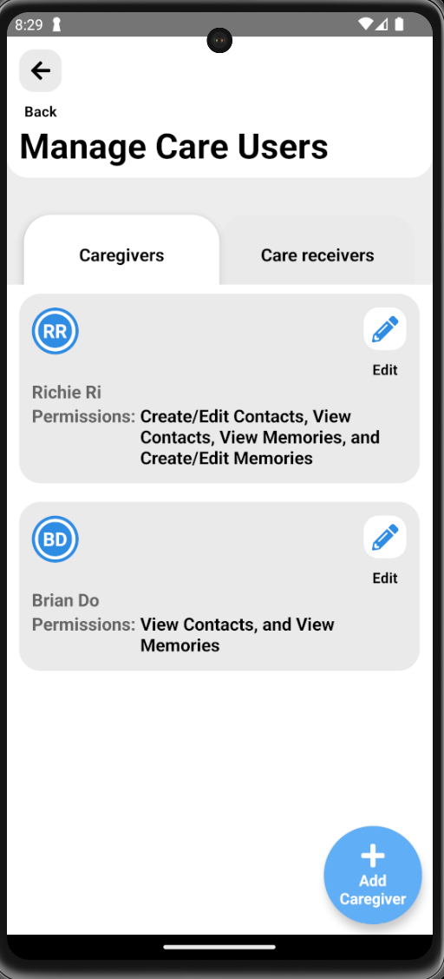
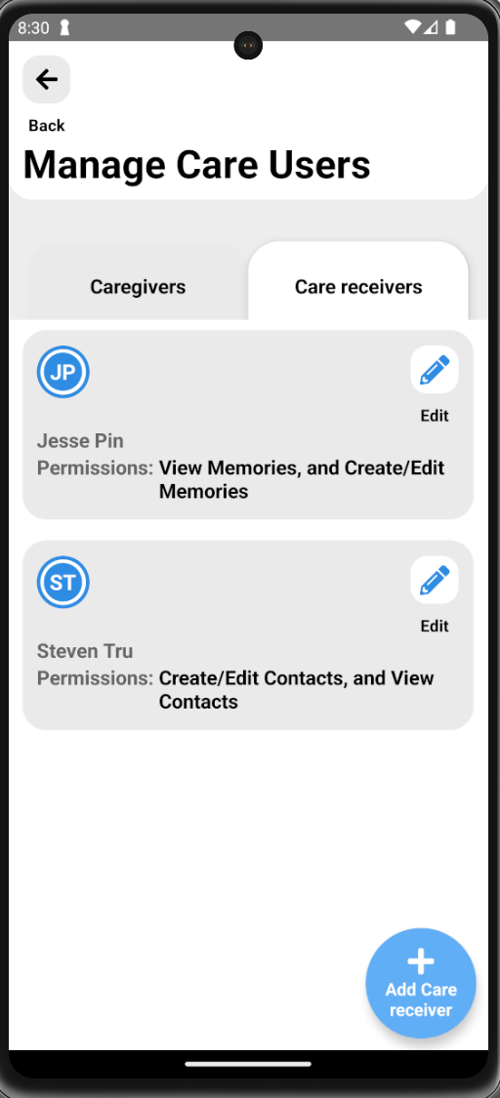
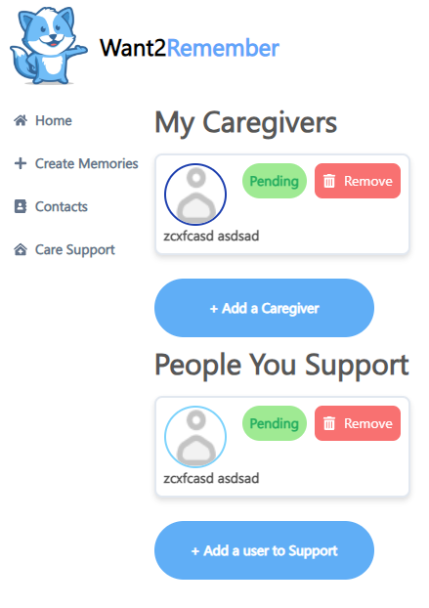
Mobile
Mobile
Web
Notes:
Adrian

Slide 21
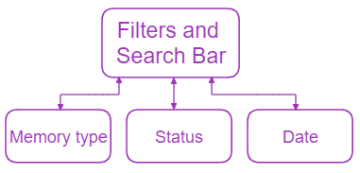
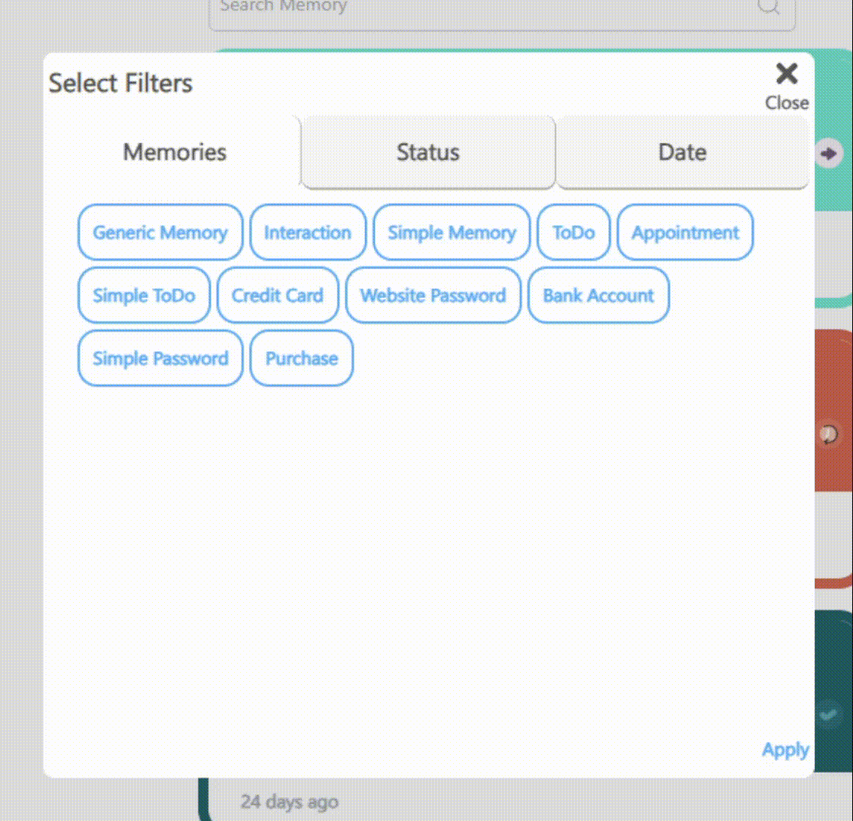
Mobile
Web
Notes:
Kevin
On the Home Page, we have a filters and a search bar component that allows you to search for specific memories. With the filters, you’ll be able to select memory type, the status, and the date of the memory. You can the web version on the left side and mobile on the right side.

Slide 22
05
Project Workload Overview
Notes:
Kevin

Slide 23
Project Workload Overview
Udemy Courses
28+ hours
Total Tasks Completed
16 web tasks
15 mobile tasks
750+ hours spent coding and testing
Sprints Completed
10 sprints
®
Notes:
Adrian
On the Home Page, we have a filters and a search bar component that allows you to search for specific memories. With the filters, you’ll be able to select memory type, the status, and the date of the memory. You can the web version on the left side and mobile on the right side.

Slide 24
06
Spring 2024 Update
Notes:
Adrian

Slide 25
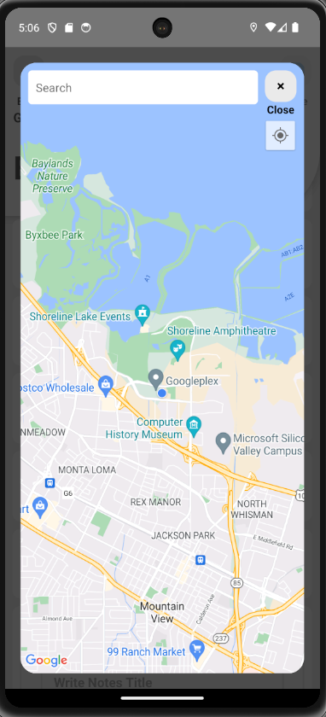
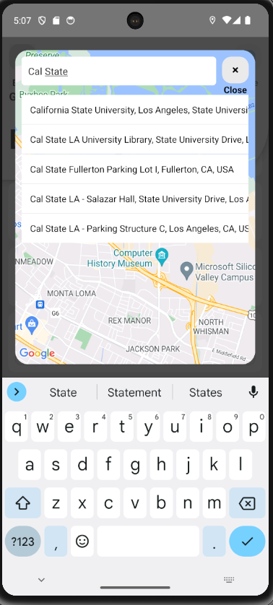
Mobile Team: Davy & Joanne
Location Picker:
Edit Memory Template Order:
Completed Features:
Location Picker
Uses Google Maps API
Edit Memory Template Order
®
Notes:
Joanne(LocationPicker)/Davy(Edit Memory Template Order)
Davy: The Edit Memory Template Order Task is to allow the user to customize the order of the memory tiles. We used a package that works for both the grid and list version of the memory types. You can see the memory types being dragged around on the right side.

Slide 26
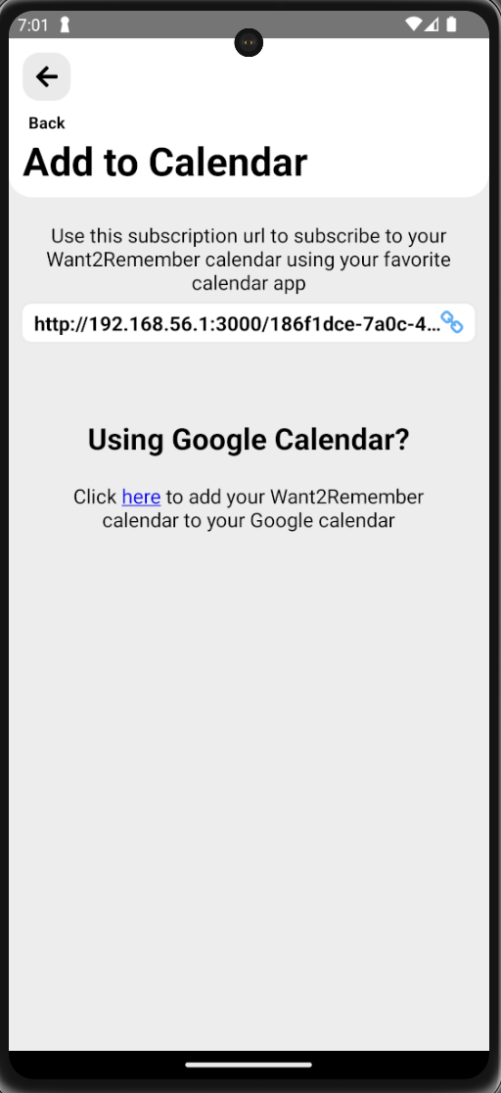
Mobile Team: Kevin & Adrian
Completed Features:
Android export permission
Categories preview
Calendar url screen
In progress:
Dark mode
®
Notes:
Adrian & Kevin

Slide 27
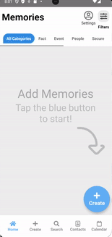
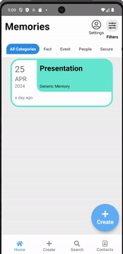
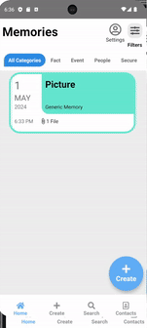
Mobile Team: Carlos & Nicholas
Completed Features:
In App Calendar
Customization Screen
Save files locally to device
Mapping integration for locations.
Notes:
Nicholas & carlos

Slide 28
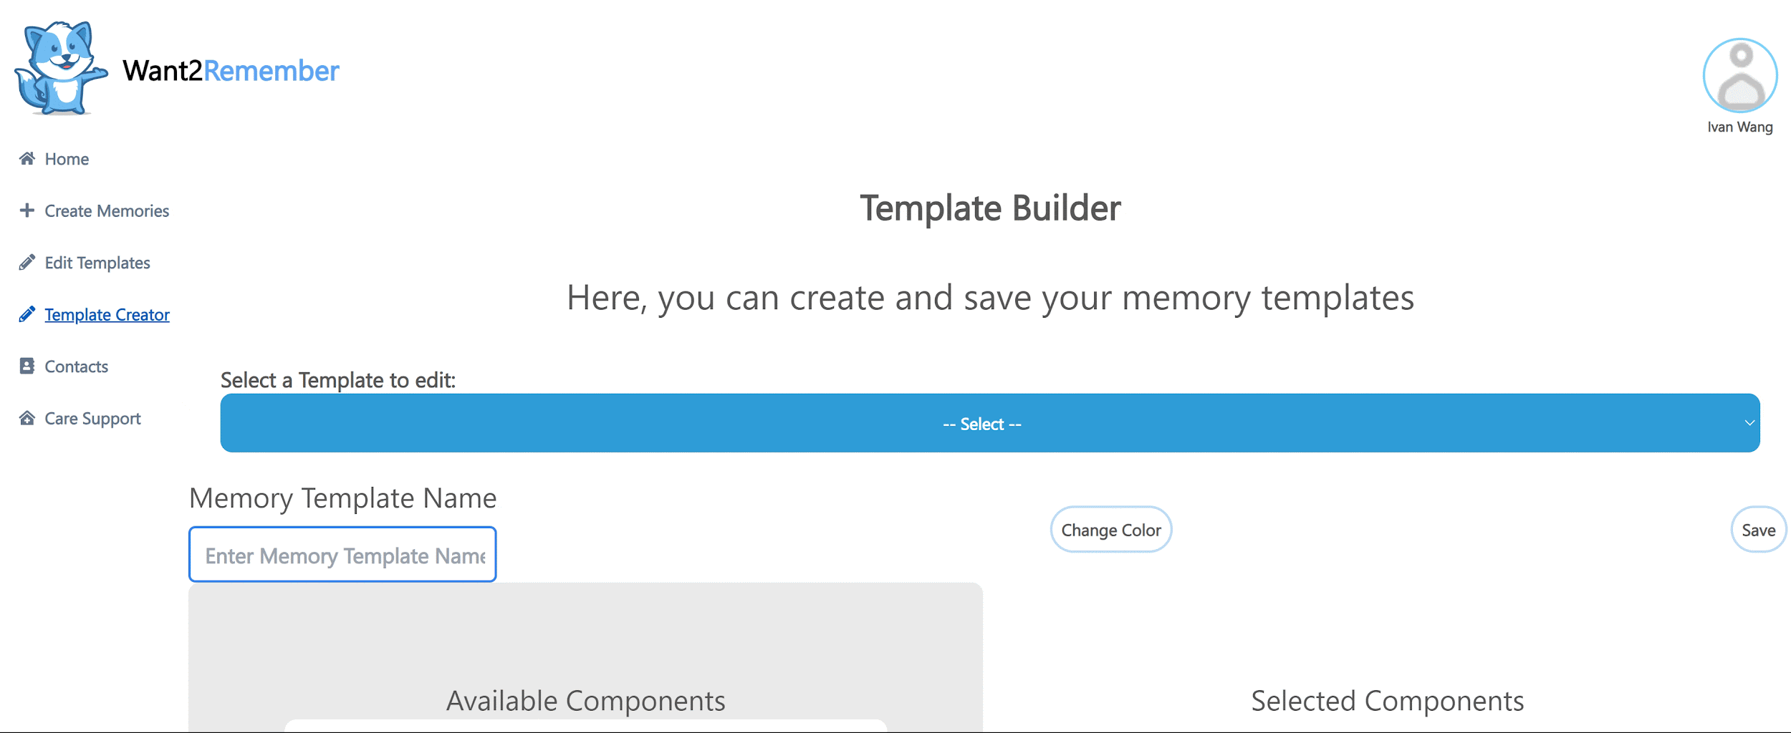
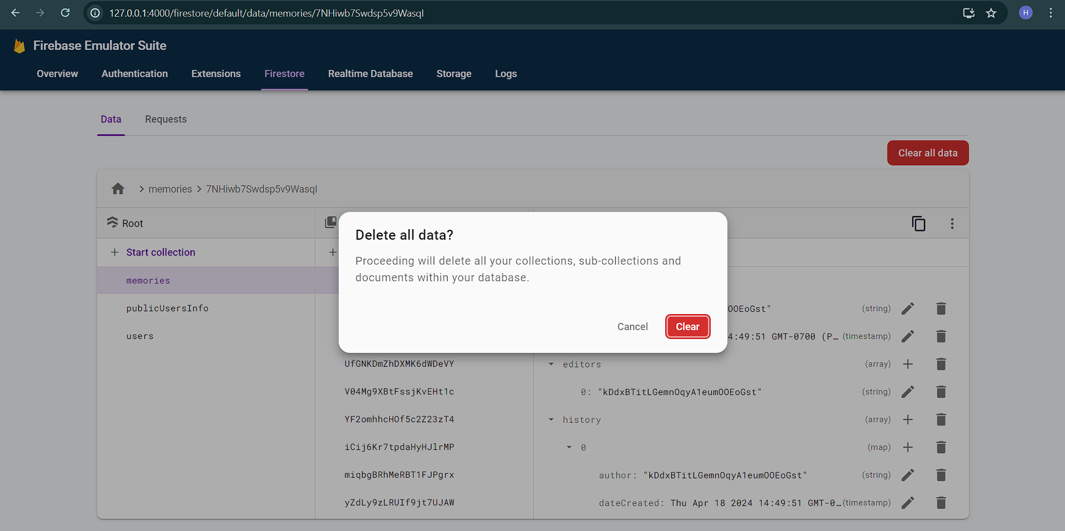
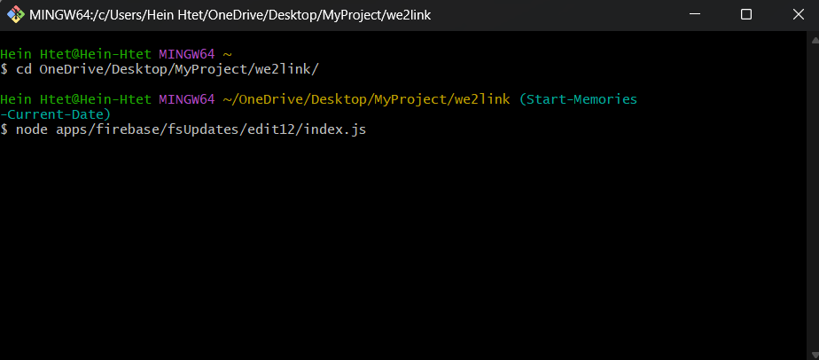
Web Team: Hein & Ivan
Completed Features :
Memory Template Builder
Single Source Palette
Fix file documents for Users
onDelete Auth
Notes:
Ivan (Memory Template & Single Source) & Hein (Fix file doc & onDelete Auth)

Slide 29
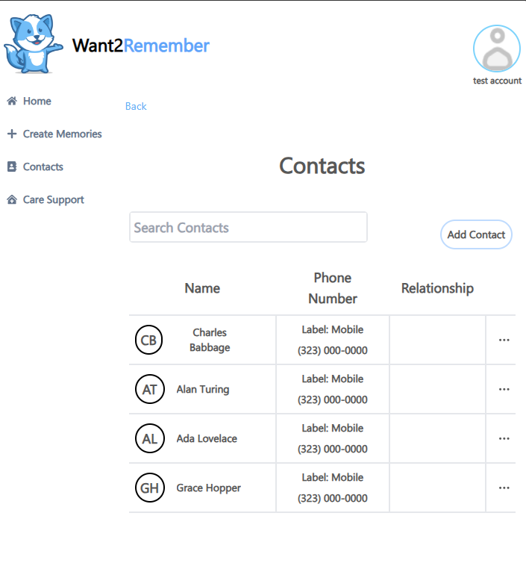
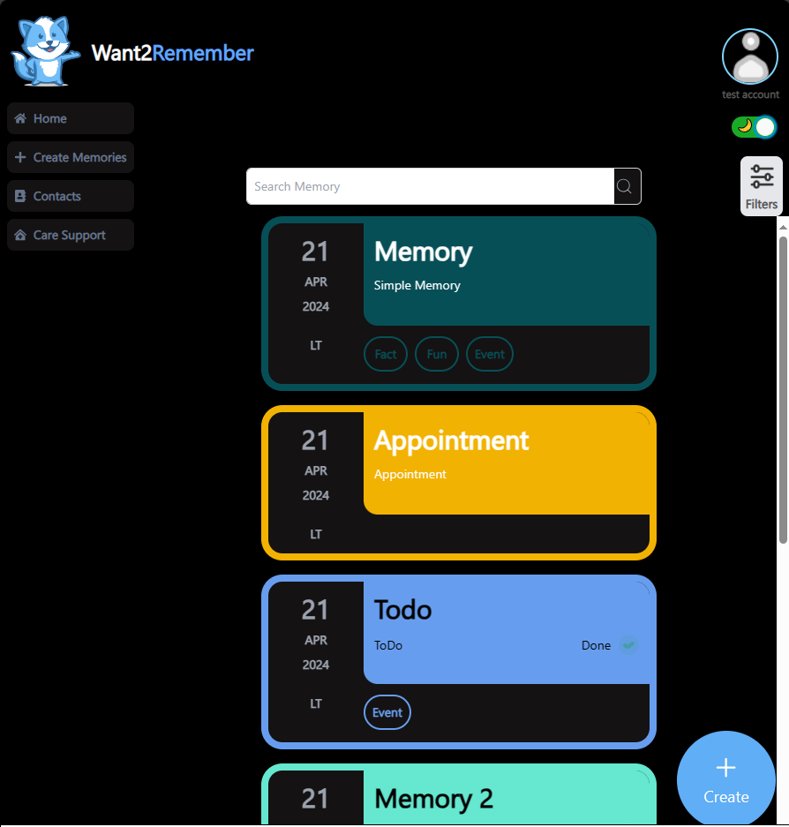
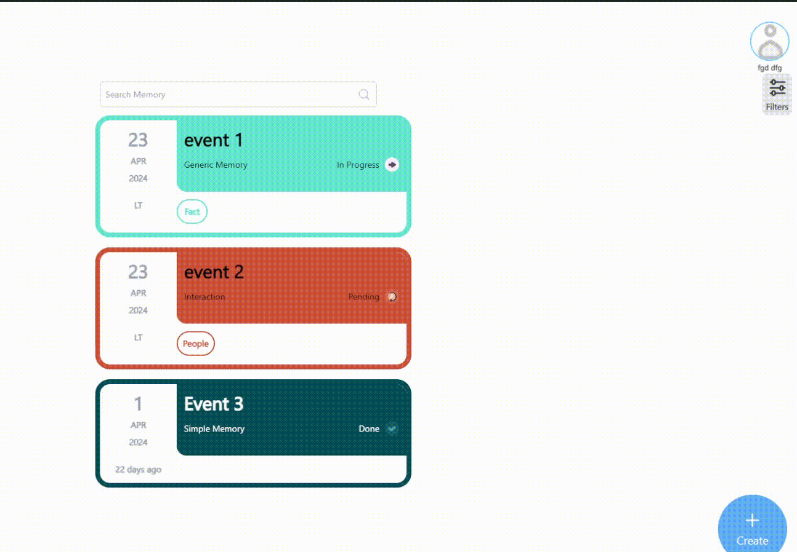
Web Team: Jennifer & Zain
Old Look
New Look
Completed Features this semester:
Web Dark Mode
Search and Filter functionality
Email Verification upon signup
Contact Quicklooks overhaul
Notes:
Jennifer and Zain

Slide 30
07
Workflow
Notes:
Jennifer or Zain

Slide 31
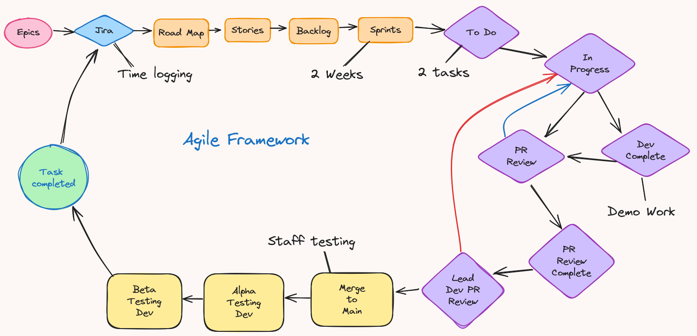
Workflow
Notes:
Jennifer

Slide 32
QA / Peer Reviews
Peer review task assigned to one team from Mobile and Web
Rotates between teams every Sprint (every 2 weeks)
Both members from the team will review the pull request on github and either raise conflicts for the team to fix or approve it
Approved pull requests will then be sent to the lead developer to either finalize and push to alpha/beta testing or if errors are found it will be sent back
®
®
Notes:
Ivan

Slide 33
08
Communication
Notes:
Ivan

Slide 34
Our Communication
Slack
Communicate with Stakeholders
Discord
Communication among Team Members
Zoom
Project meetings with Stakeholders and Team Members
Github
Code updates for current tasks
Notes:
Ivan can do this again

Slide 35
09
Work Environment
Notes:
Ivan

Slide 36
Work Environment
Virtual Work Environment
Visual Studio Code offers Live Share
Github Desktop
2 Zoom meetings weekly
Progress updates
What works
Report issues
Next steps
Sprint Retrospectives
Demo completed tasks
Briefed on new tasks
Notes:
carlos

Slide 37
10
Closing Remarks
Notes:
HH

Slide 38
Closing Remarks/Overall Experience
Gained experience with industry standard tools/methods
Learned one of the most popular front end libraries in web/mobile app development as well as a popular back end/database service
Attended and participated in scrum meetings twice a week
Engaged in pair programming to better develop our programming skills
®
Notes:
Nicholas

Slide 39
Demo Link: https://www.want2remember.com/
Q & A
®
Notes:
Nicholas

Slide 40
THANK YOU
®
®

