Slide 1
Machine
Learning For Network-Denied Environments

Slide 2
Team Members
Server Team
Mobile Team
Web Team
Advisor
Johnson Tan (Leader)
Alvin Yu
Sanjog Baniya
Jonathon M Dooley
Xavier Lara
Justin To
Wilson Gan
Enrico Efendi
Kevin Maravillas.
Howard Nguyen
Nisapat Poolkwan
Dr. Chengyu Sun
Liaisons
Dr. Ben Nye
Dr. Mark Core
Johnson Tan

Slide 3
Background
AI and Machine Learning have become increasingly reliant on cloud processing, which is brittle even against brief interruptions in connectivity
Client-based AI/ML solutions (e.g. MobileNet) can run without network connection but cannot be updated very easily in such environments.
Unavailability of networks is common in areas where needs are most urgent, such as in conflict zones, major disaster areas, and under-developed regions
Cloud-based AI/ML solutions are powerful and up-to-date but rely on network availability to operate
Sanjog Baniya

Slide 4
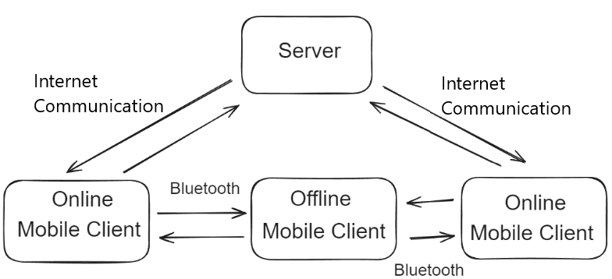
Proposed Solution
Website
Internet
Communication
Server
Internet
Communication
Internet
Communication
Online
Mobile Client
Offline
Mobile Client
Online
Mobile Client
Bluetooth
Bluetooth
Wilson

Slide 5
Goals of the Project
Mobile Client: ​
User takes a picture or uploads image for classification
Client classifies image but the user is able to correct that label
Client updates model via communication with server or other client​
Client collects and manages both new labeled and unlabeled data reliably
Client shares information via Bluetooth
Server / Cloud Training: ​
Allows mobile and web client to upload new data
Retrieving latest model, uploading data, etc.
Retrains most recent ML model or fine-tunes it​
Allows mobile client to download retrained models
Kevin

Slide 6
System Architecture
Return Trained Model
Image
Verification
Fine
Tuning
Database
Provides Images with labels
Load Model
And verified image
Query, Updates
Edit Labels
And Verify
Model Info
Images,
Labels,
Model Info
Sends API requests
Server
Web
Client
Version
Control
Model info and updates on server
Return Database Info
Returns Model
API Requests and Upload image with label
Sends data as confidence score, and label
Mobile
Client
Image
Classification
Sends data to classify
Xavier
Notes:
Redraw in slides, simplify

Slide 7
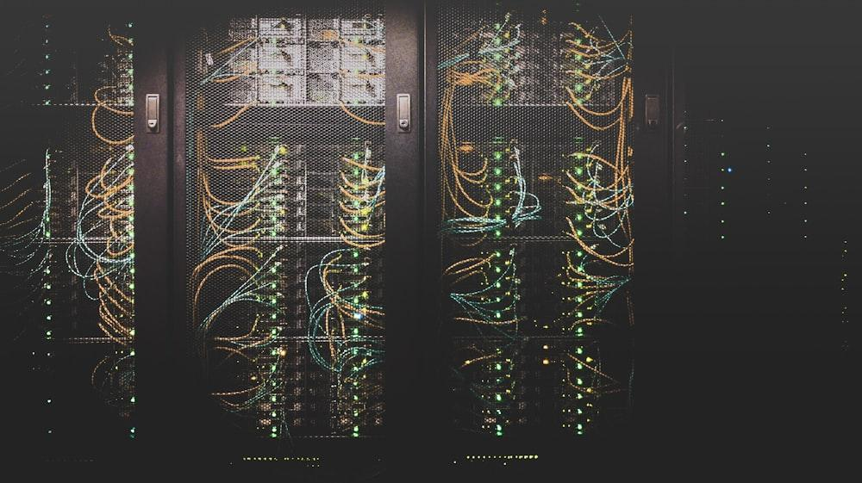
Server Team
01.
Web API | Model

Slide 8
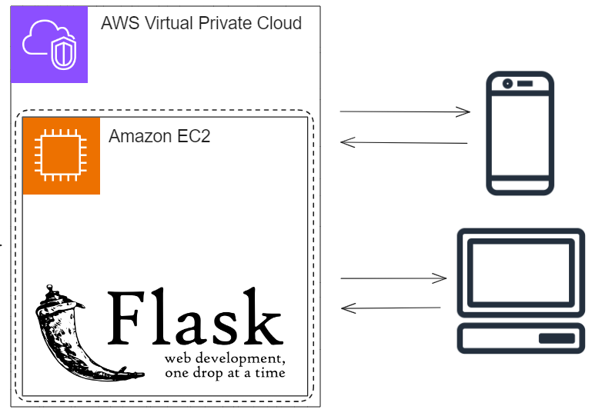
Server - Web API
AWS EC2 server for model training and hosting HTTP endpoints
Image objects saved to local directory
Metadata stored in SQLite Database
Flask Server Environment
Allows for native interaction with ML libraries
Integrate server functions for client access via developer defined endpoints
Jonathon

Slide 9
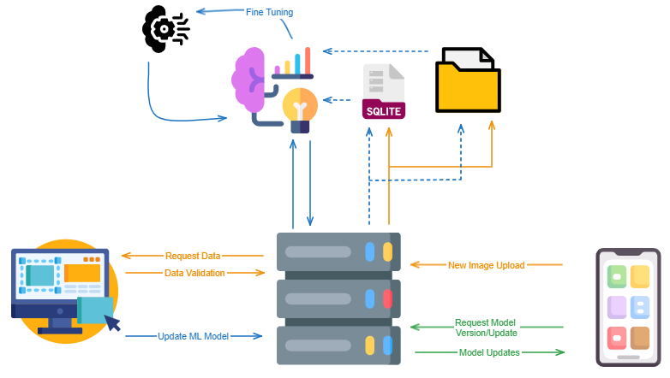
Server - Web API
Server Web API will has these capabilities:
Receive data from mobile devices (new images and their labels) and incorporate into the training set
Retrain the model at defined increments
Send over updated versions of the model (ideally new layers) to the mobile client
Jonathon

Slide 10
Model Requirements
Model Requirements:
Lightweight enough to deploy on mobile devices
Be able to be incrementally updated
A good model candidate found in MobileNet
Not surpass a certain file size to store
Have relatively good accuracy for image classification
Alvin
Notes:
Objective

Slide 11
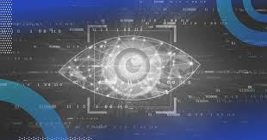
MobileNet
MobileNet:
Open-source model developed by Google for image classification
Chosen due to its emphasis on deployment on mobile and embedded devices
Very lightweight, meaning less storage requirement for mobile devices
Balances computational needs and accuracy
Alvin
Notes:
Objective

Slide 12
Fine Tuning
Fine Tuning:
Project approach to tackling image classification
A machine learning technique in which a model is re-trained with a lower learning rate to boost performance for a certain type of image
e.g. MobileNet classifies an image wrong, fine tuning is performed using images of the correct class, and now the model can classify it correctly
Used alongside Data Augmentation to generate the training set
Johnson
Notes:
Objective

Slide 13
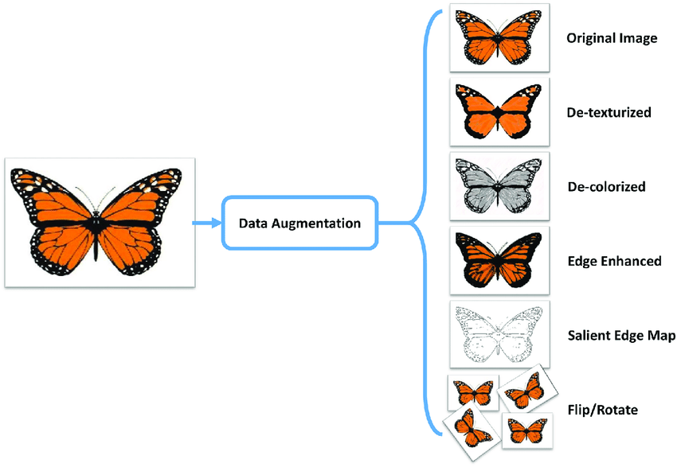
Data Augmentation
Data Augmentation:
Technique in which existing data is modified to artificially generate new data samples
Used to increase the amount of usable photos to perform fine tuning
For this project, it would be taking an imageset and horizontally flipping it (mirror effect)
Other forms of augmentation are available including: grayscale, saturation, vertical flipping
Johnson
Notes:
Objective

Slide 14
Mobile Client
02.
App code | Model

Slide 15
Mobile Client
Classification through a Machine-Learning Model of any general objects.
User verification of Label and Confidence Numbers displayed
Stored data for training the Machine-Learning Model is sent to server
User can switch the classifier model
Technologies used
React Native
Tensorflow
Expo Go (ImagePicker)
Wilson

Slide 16
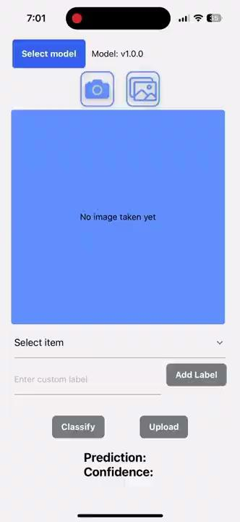
Classify with camera and gallery function
Justin

Slide 17
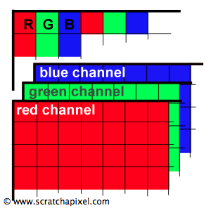
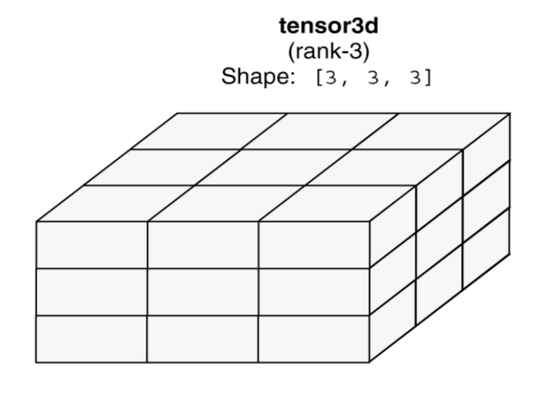
Image Classification Process
1. Fetch Image
Data
2. Convert to
Binary
3. Convert to
RGB Values
5. Resize,
Batch,
Normalize
4. Convert to
Tensor
Justin
Notes:
To give a rundown of how our image classification process looks like:

Slide 18
Image failed to classify
Mobile send image with label to server endpoint
Justin

Slide 19
Web Client Team
03.
Goals | Technologies | Features

Slide 20
Web Client
Goals
create admin client to serve as a main interface to the server
Verification for new incoming images
Display information about the Model
Dataset and model version management
Technologies
React
NextJS
Material UI
Howard Nguyen

Slide 21
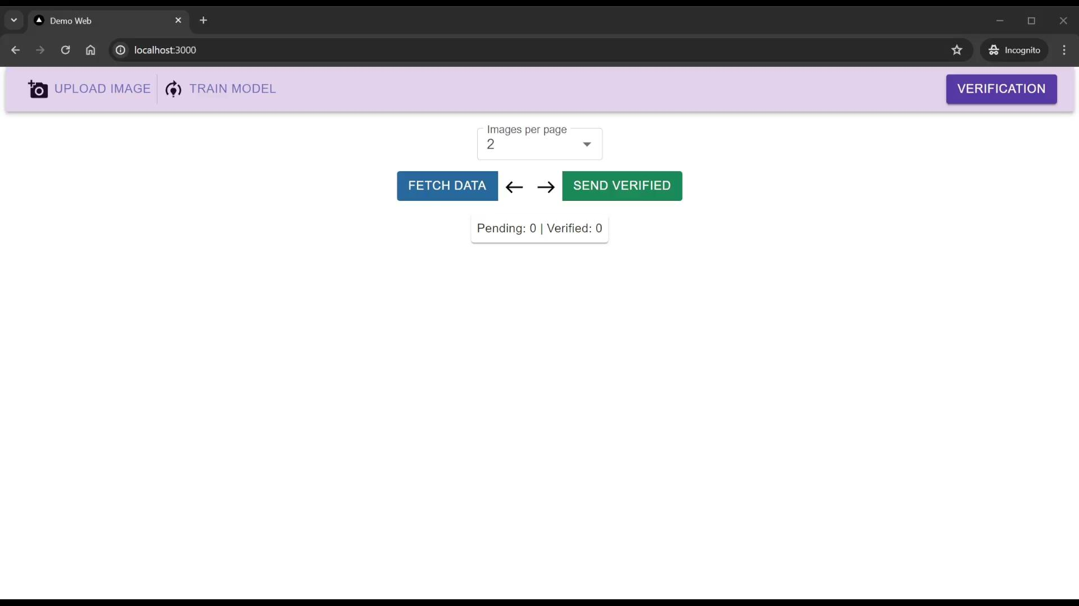
Verification
Howard Nguyen

Slide 22
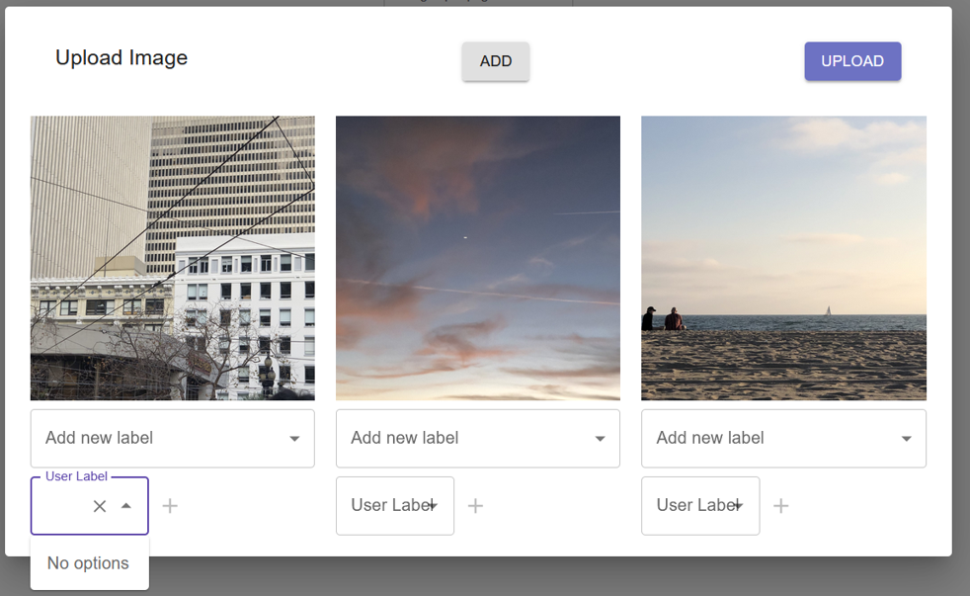
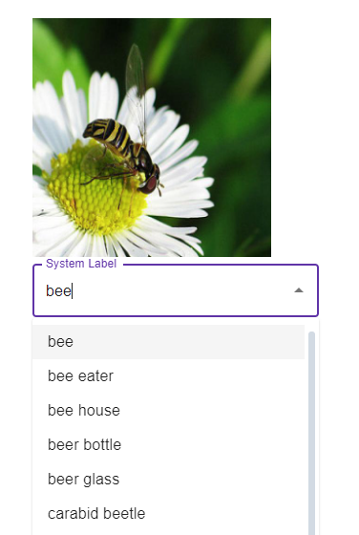
Other Features
Upload Images
System and User Labeling
Nisapat Poolkwan

Slide 23
Version Control
Nisapat Poolkwan

Slide 24
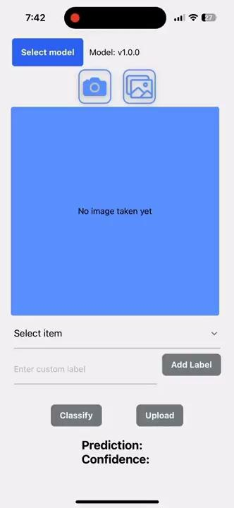
Switch model
Classify again with similar image
Kevin

Slide 25
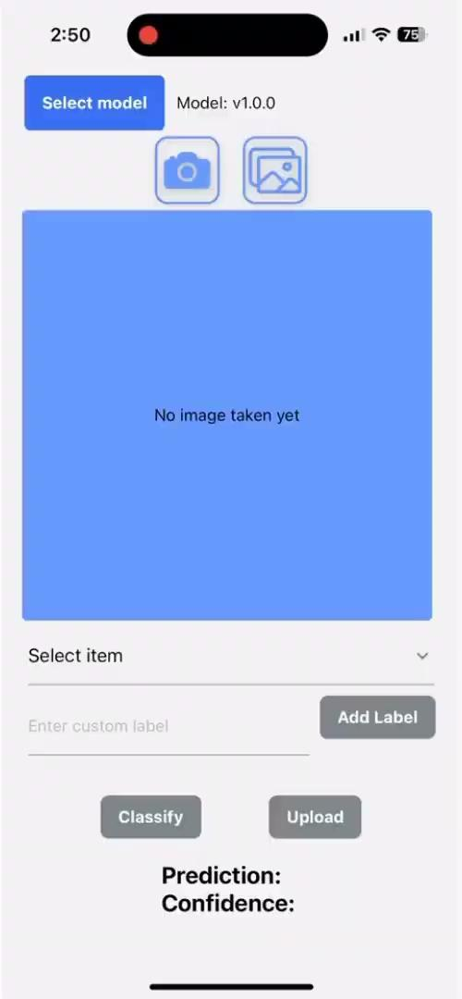
Offline Mode
Enrico
Notes:
Here is our demo of the offline aspect of our mobile application. In the beginning, you may note that the WiFi gets disabled. Then we will classify any images taken by the phone’s camera or photo gallery. In a few seconds, the model will return the prediction without the need for a WiFi connection just as it would if it was online. The few times that a WiFi connection will be required is when the user would like to upload the classified image to our server or when the user would like to update the version model as shown towards the end.

Slide 26
Achievements
Web/mobile can send and handle images on the server
Mobile client can retrieve model and use it
Web can control model version and release
Server is able to retrain/fine-tune model
Xavier

Slide 27
Future Improvement
Peer-to-peer data exchange between mobile clients through use of Bluetooth
App can run completely offline and provide preloading function
Adding new system labels
Sanjog

Slide 28
Significance
More applications and tools require the support of network or cloud computing to run smoothly.
Software that supports network-free operation can support users in their education, finance, medical and other fields.
This approach of cloud-based and client-based ML solutions can be key to effective distribution in network denied locations.
Enrico
Notes:
With all that being said, we do believe our project will remain significant for years to come, especially with the accelerating development of modern network AI technology. More applications and tools will eventually require the support of network or cloud computing to run and operate smoothly.
In addition, the impact the application will have on people in environments where the Internet is scarce will be immense. A software powered by machine learning and artificial intelligence that supports network-free operation can greatly support a user’s education, finances, and other applicable aspects of a user’s life.
Our approach, which blends cloud-based and client-based Machine Learning solutions, could serve as a pivotal factor in enabling efficient distribution to areas with limited or no Internet connectivity.
Summary at end, future work

Slide 29
NSIN/ICT
THANK YOU!
Any questions?

