Slide 1
RoboSubLA
CS Senior Design Team
Notes:
Made the bird guy a little cuter, maybe hotter too?

Slide 2
Advisors & Members
Advisors:
Richard Cross
Special Thanks:
Salvador Rojas, Michael Thorburn, Mark Tufenkjian
Members:
Alexandra Barahona Amador, Joshua Chavez, Kevin Chun Celis, Jordan Doose, Edward Eckle, Justin Guerra, Jason Ha, Daniel Jimenez Dexter Kale, Sebastian Luna, Minh Ngo, Lizbeth Vargas-Martinez

Slide 3
What Is RoboSubLA?
Purpose - To strengthen engineering skills and encourage interdisciplinary experience in young engineers, and foster ties to organizations developing autonomous underwater vehicles (AUVs)
Competition Goal - Design & develop an AUV, demonstrate its abilities and autonomous capabilities by performing a series of tasks

Slide 4
Our Tasks
Based on last year’s competition handbook, develop a software package capable of driving submarine hardware through all competition tasks
When this year’s competition handbook is released, modify and continue to develop software to accommodate new challenges
Ensure compatibility between various software subcomponents by using a common communications library (ROS2 Iron)
Test software intensively both on and off actual vehicle hardware

Slide 5
The Competition

Slide 6
RoboSub
International competition hosted by RoboNation
Collegiate & high school teams from around the world
Typically 30-40 teams in attendance (more online)
Usually hosted at NIWC Pacific’s TRANSDEC facility in San Diego
This year: Irvine!

Slide 7
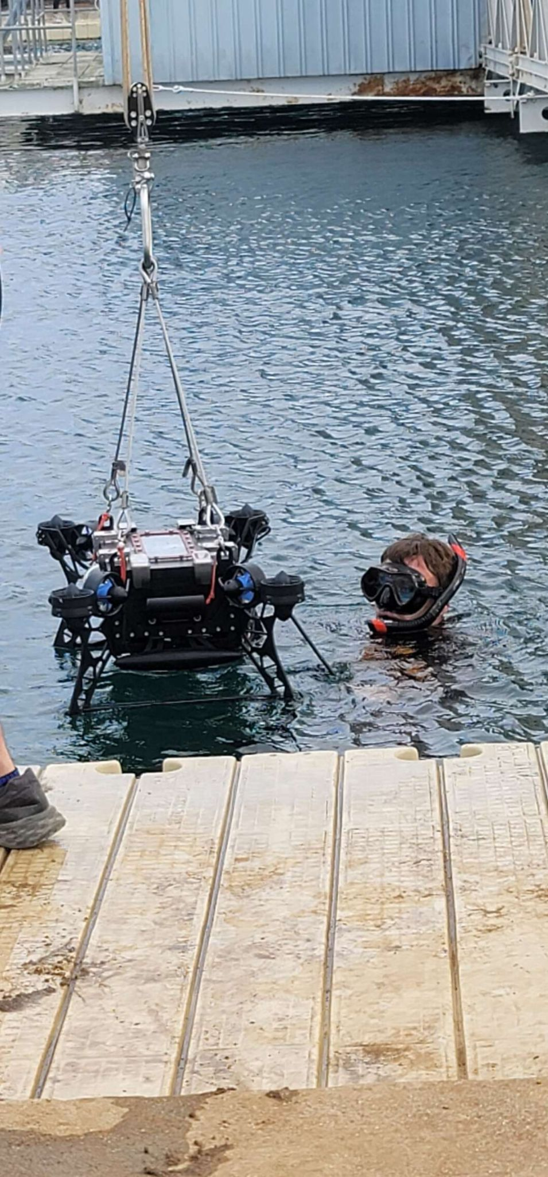
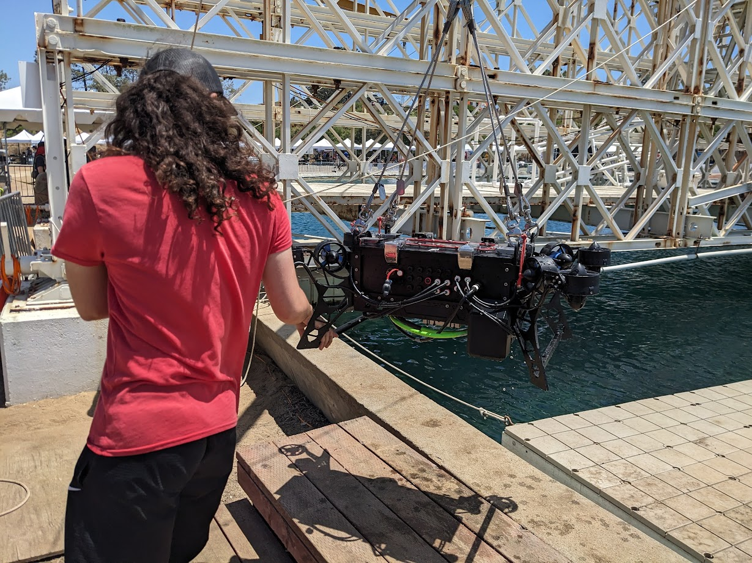
RoboSub

Slide 8
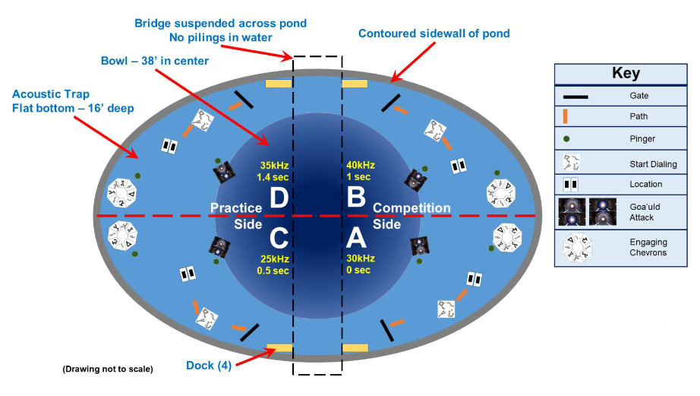
Competition Layout

Slide 9
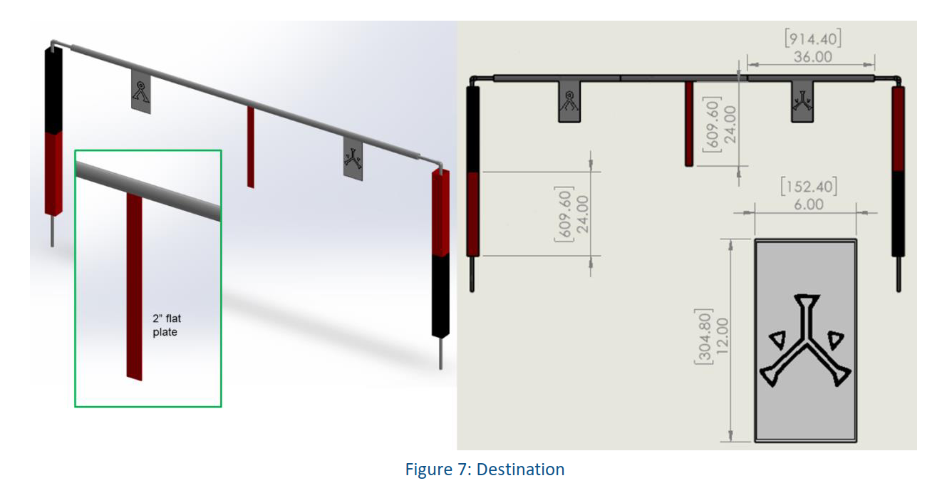
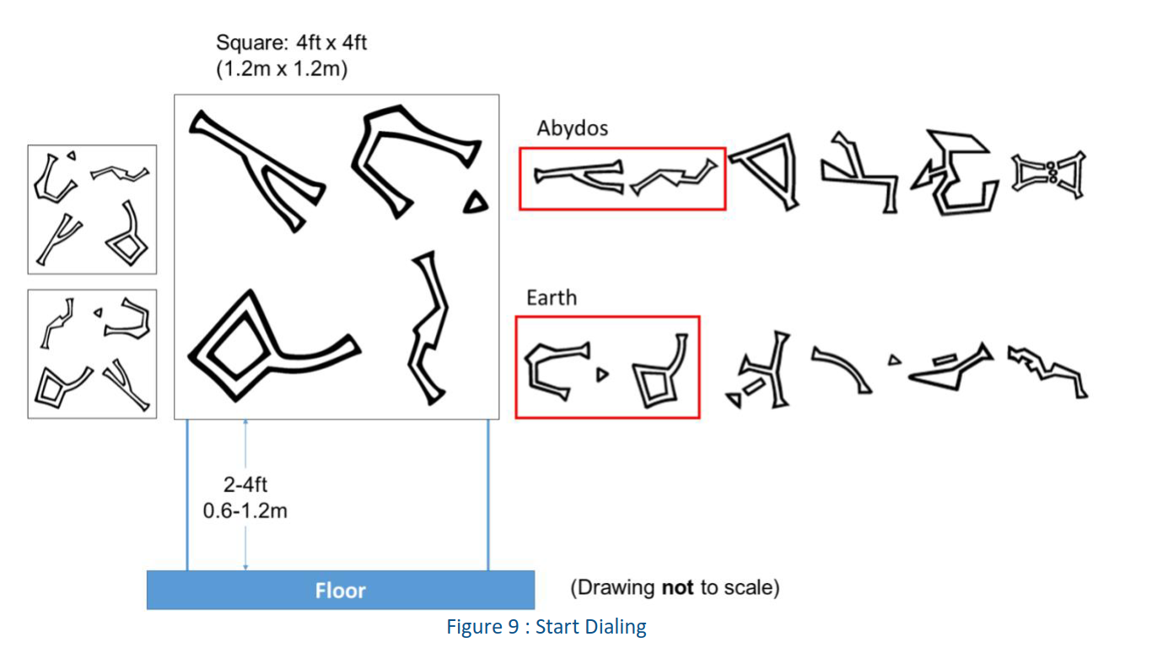
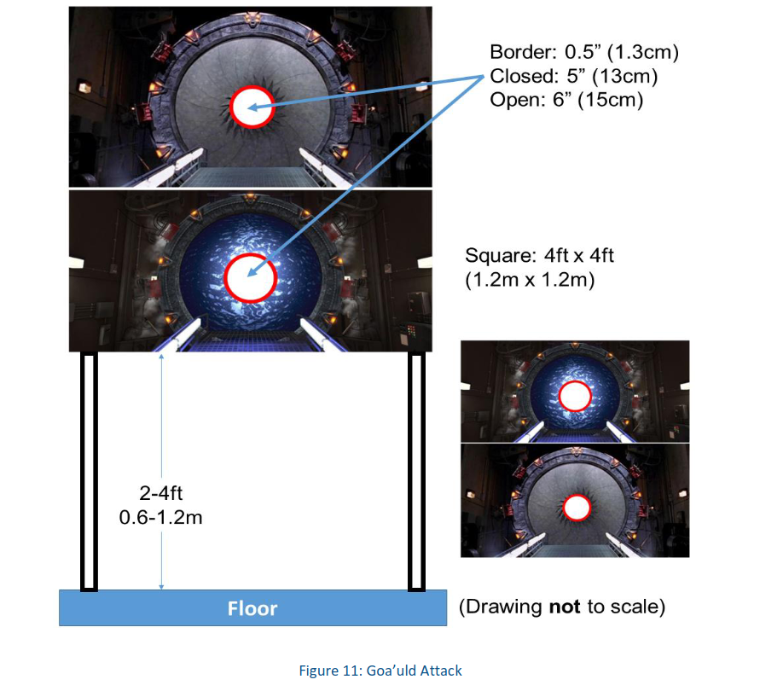
Tasks - Gate, Buoy, Bins, Torpedoes

Slide 10
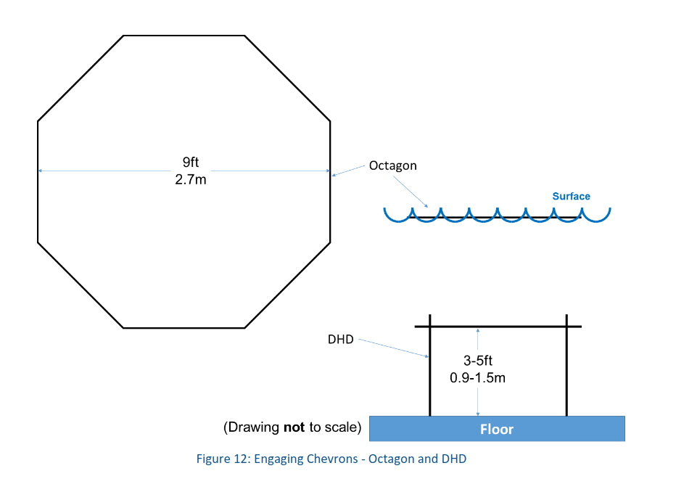
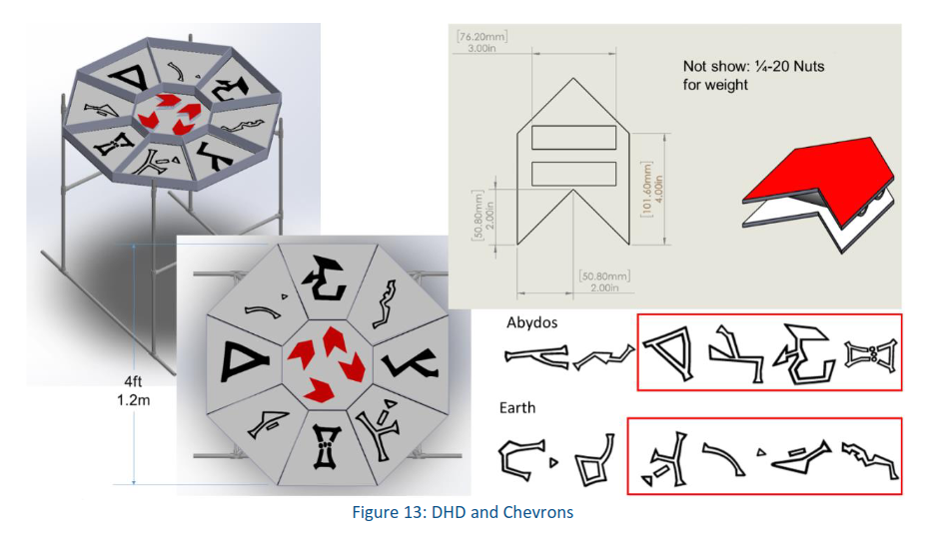
Tasks - Octagon, DHD

Slide 11
Team Breakdown
Student Organization
ME/EE/CS/other students
~30 members
Freshman-Senior standing
Design & build Wailord
Develop some software systems
Fundraise, outreach, and perform admin duties
ME/EE Senior Design
ME/EE seniors
4 members
Design & build Lanturn’s mechanical and electrical systems
Support student org with advanced knowledge
CS Senior Design
CS seniors
12 members
Design & develop the bulk of submarine software
Support student org with software components & development efforts on co-developed systems

Slide 12
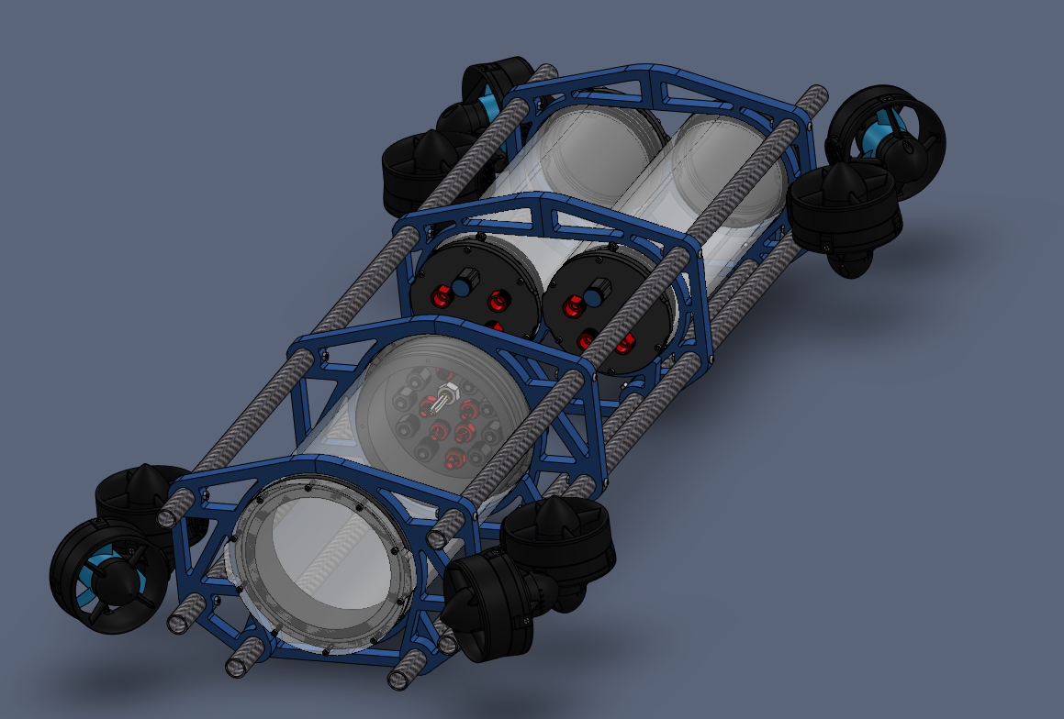
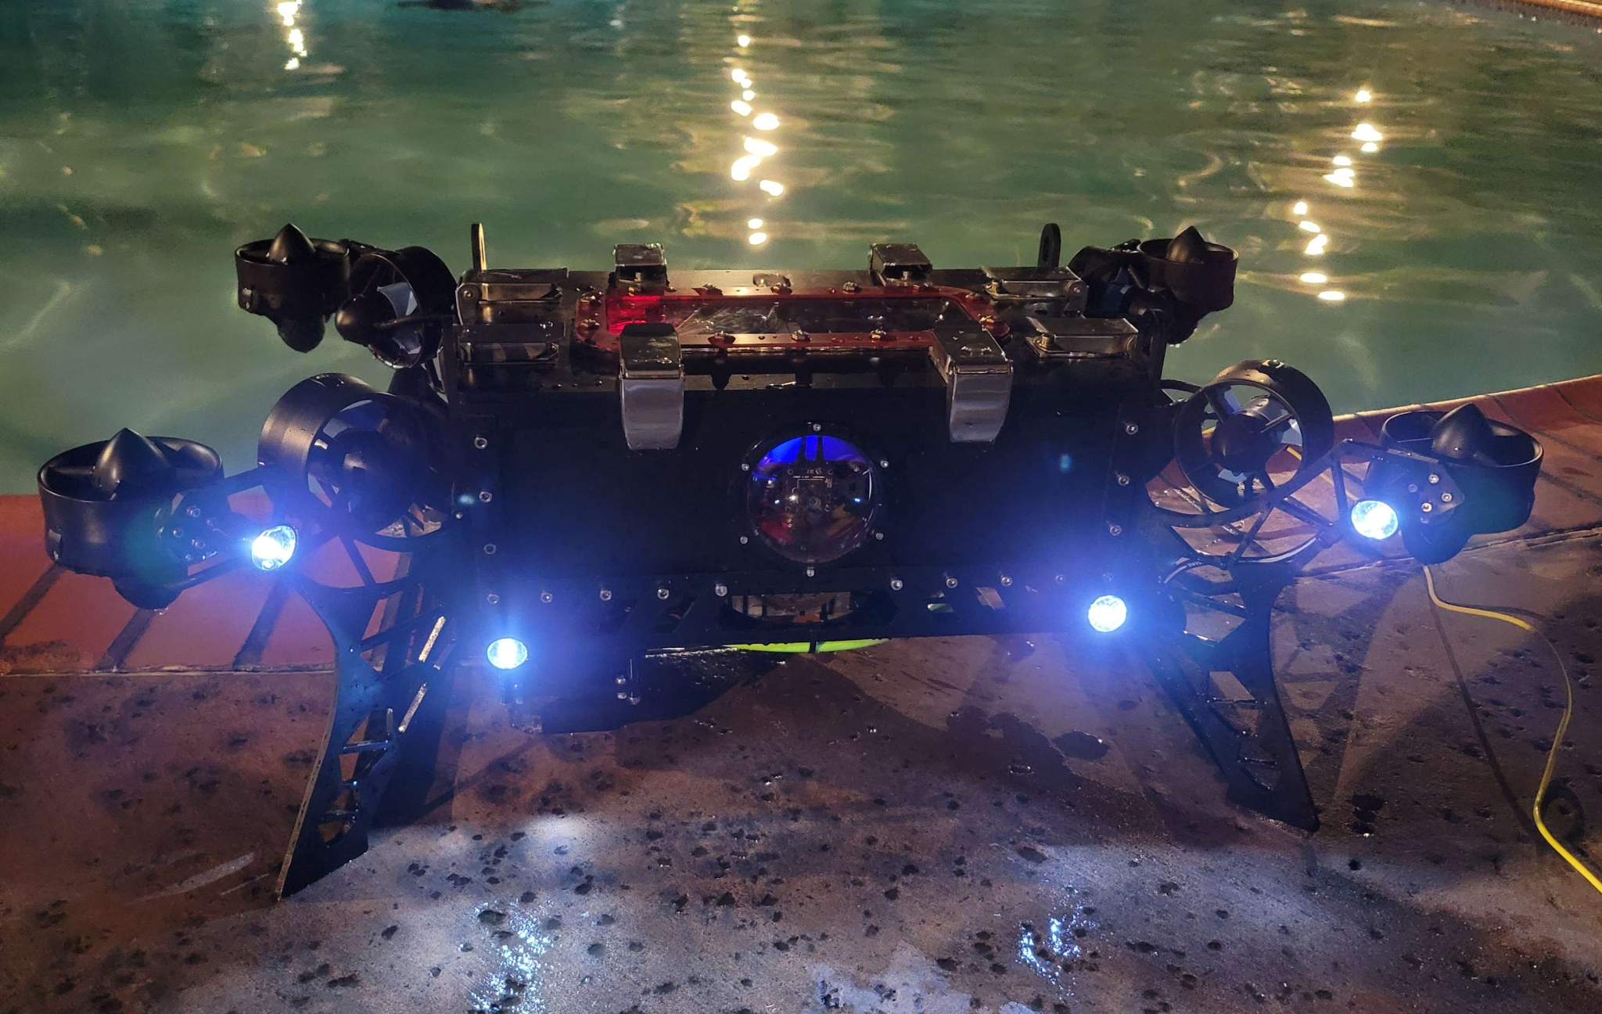
Submarine Hardware
Wailord
Lanturn

Slide 13
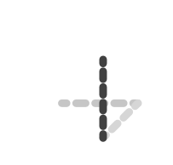
Computer Science Sub Teams
Localization
Computer Vision
Test Fixtures
Mapping
Autonomy
Simulation

Slide 14
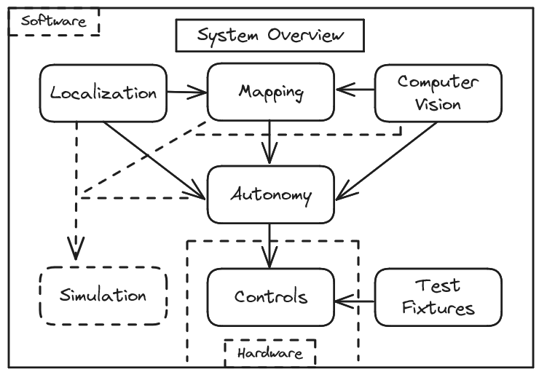
Computer Science Breakdown

Slide 15
Subteam Results

Slide 16
Localization

Slide 17
What is Localization
Localization is a process that gathers information from sensors to continually determine a submarine's precise condition, including its location, direction, and velocity. This data is then shared with mapping and autonomy systems, implemented in C++, and can run on either desktop or embedded platforms.
Notes:
Joshua Slide

Slide 18
Localization - Goals
Our main goal is to provide the submarine with an accurate understanding of its position and orientation within the underwater environment to enable safe, effective, and precise navigation and mission execution.
Some of our primary goals are, but not limited to:
Precise Location
Integration
Real-Time Performance

Slide 19
Localization - Sensors
Some of the tasks we want to perform using the BNO055:
Position and Orientation Tracking
Autonomous Navigation
Integration with Mapping Systems
We implemented the Adafruit BNO055 sensor, which serves as the heart of our localization system.

Slide 20
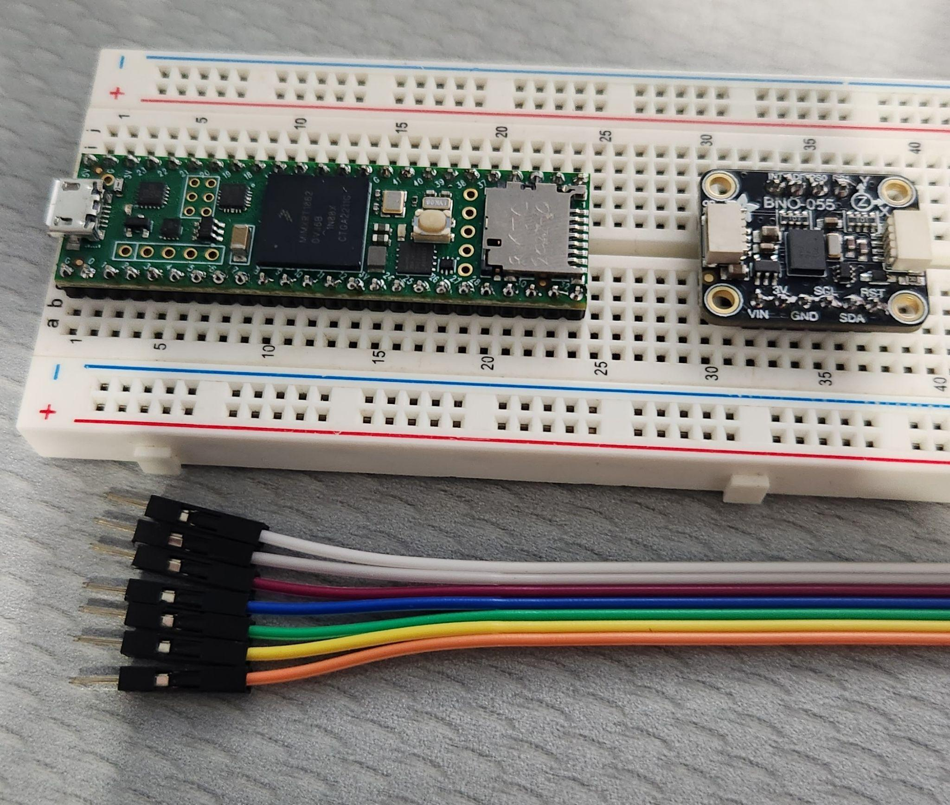
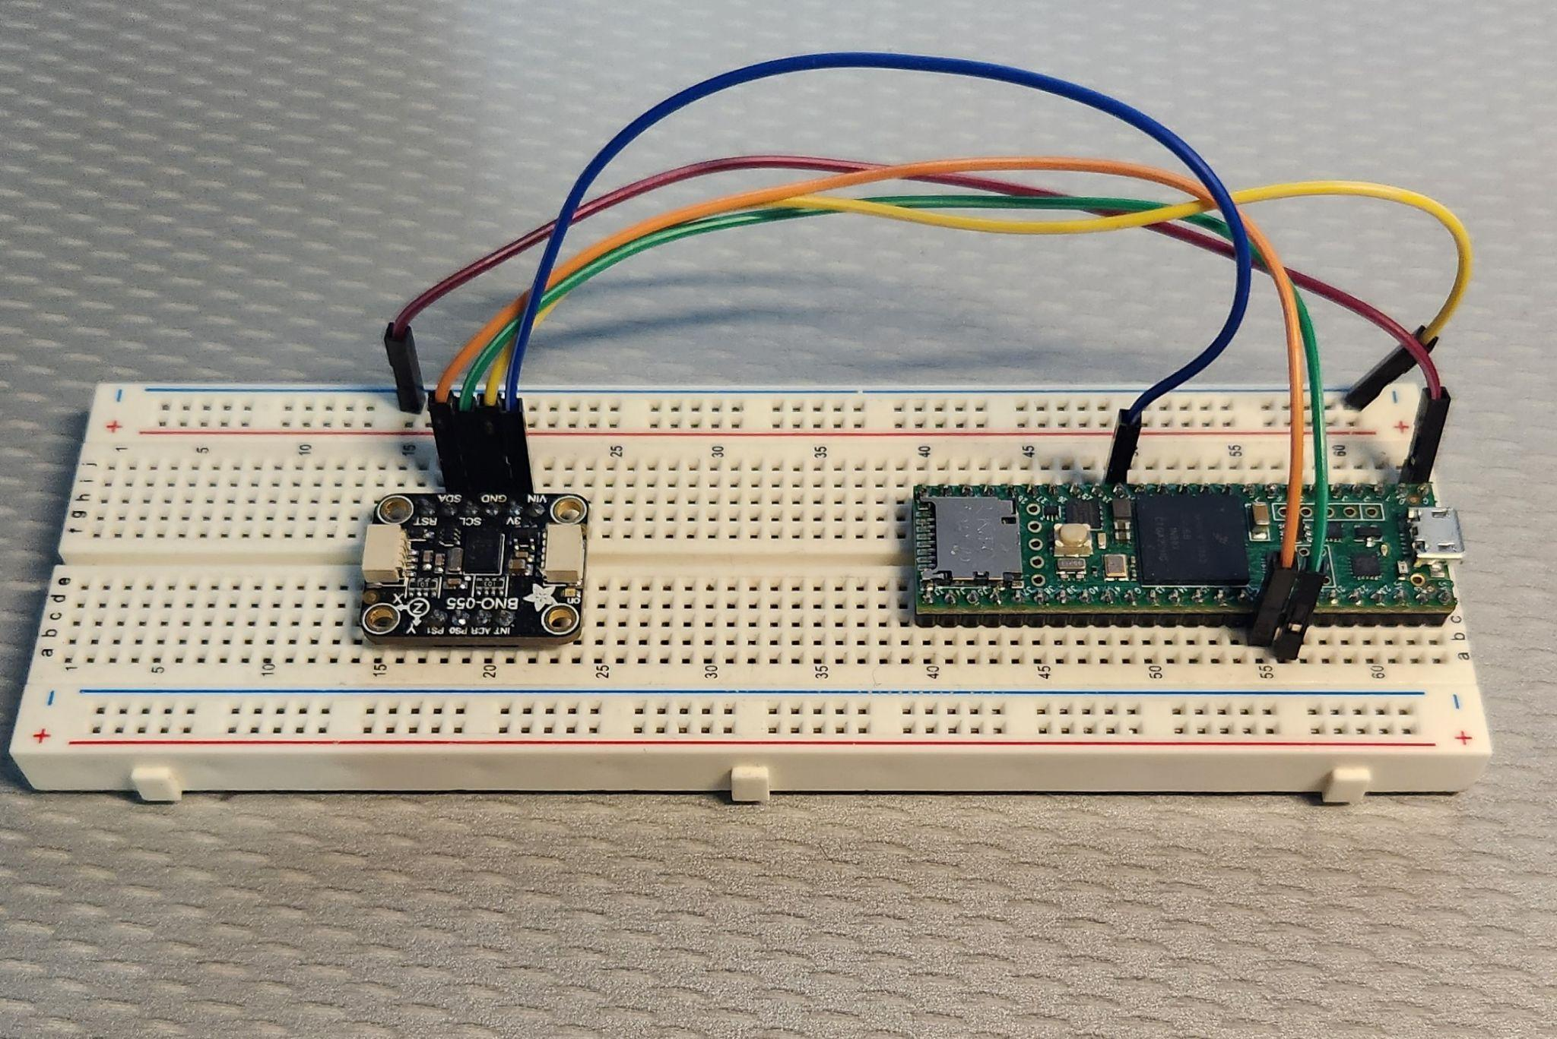
Localization - Our Sensor Setup
Our Setup to work with code consist of a breadboard, teensy 4.0/4.1, and wires.

Slide 21
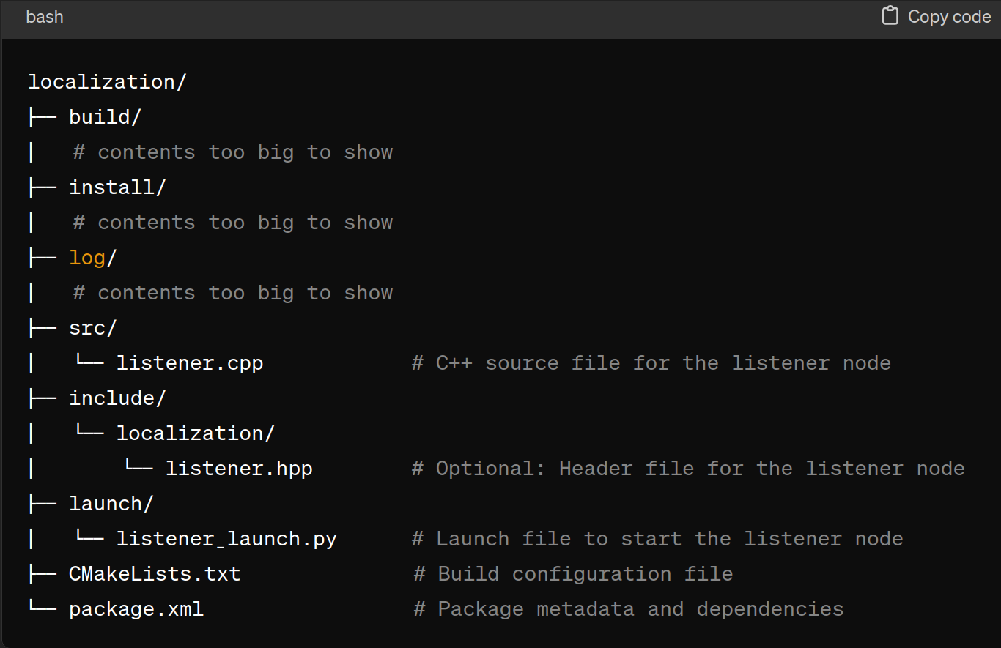
Localization - ROS
Localization Hierarchy

Slide 22
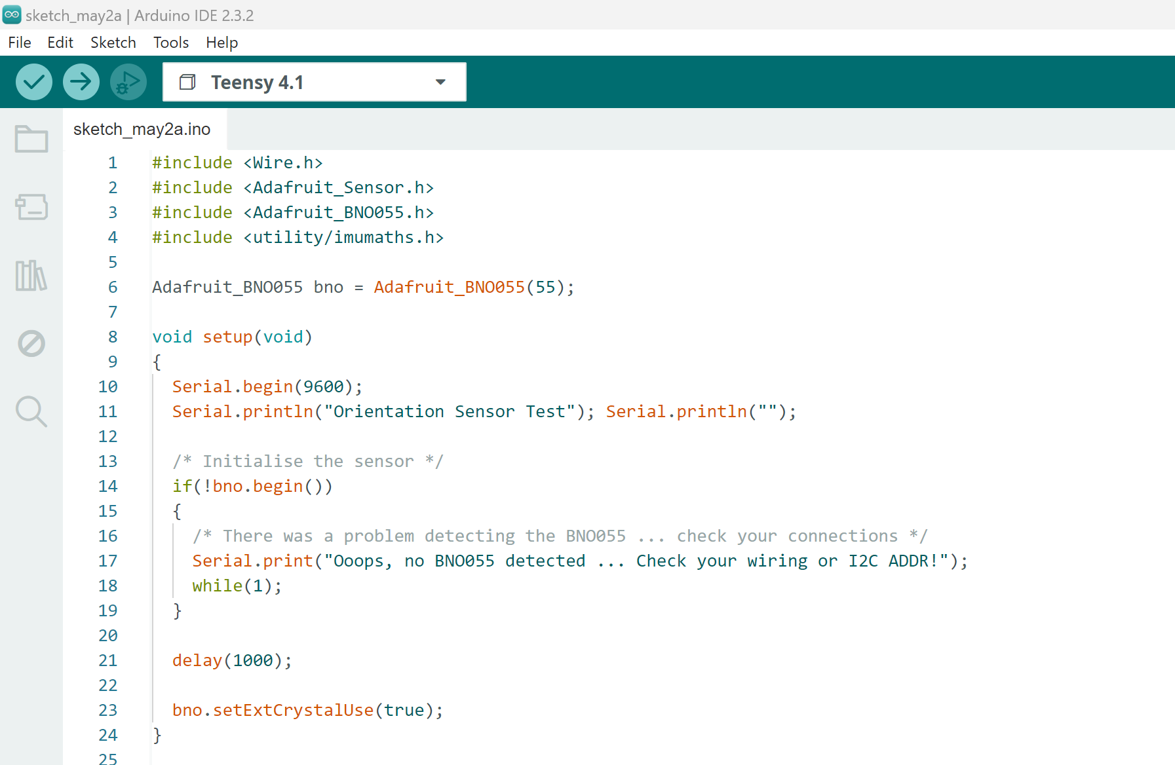
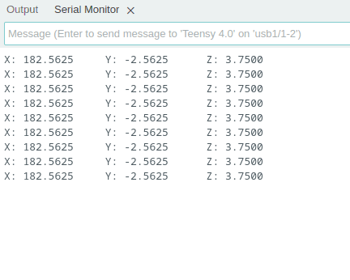
Localization - Our Running Code
Our Code
Serial Monitor

Slide 23
Mapping

Slide 24
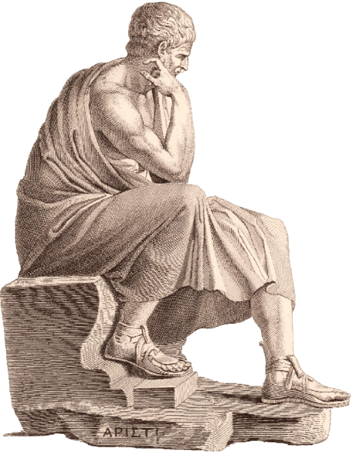
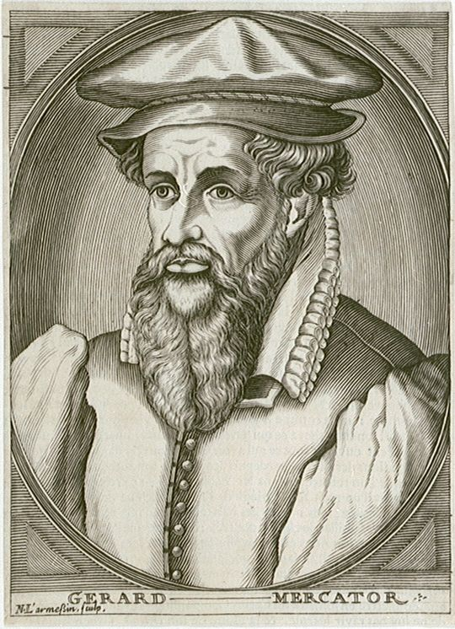
Mapping - For Dummies
What is Mapping?
I make ah the map ah

Slide 25
Mapping
Our Job:
Receive relevant data from localization, computer vision or requests from autonomy
Keep track of the existing obstacles and targets
Maintain a physically spaced map, as well as an “Conceptual” map
Develop and implement pathfinding algorithms
The best part: Figure it all out from scratch

Slide 26
Mapping - Design Overview
Entry point
Mapping Node
rclcpp ( ROS ) glfw3 + glew (OpenGL)
glm (linear algebra)
Mapping
Subsystem data management and logic
Hybrid Map
Lowest level data std::vector
3d struct * array
SDF Visualizer
Process Monitor
Map Cell
LOTS OF DATA AT ONE LOW PRICE
Written with C++ & GLSL

Slide 27
Mapping - Physicality
The Map physically maps on a 3d grid
Unit = 1x1x1 Meter
Sub Unit Data in Struct, Data is not Directly stored in Map structure
Sub Unit Precision very high, objects can be offset within (or with-out?)
Collision/Object detection through SDF shapes

Slide 28
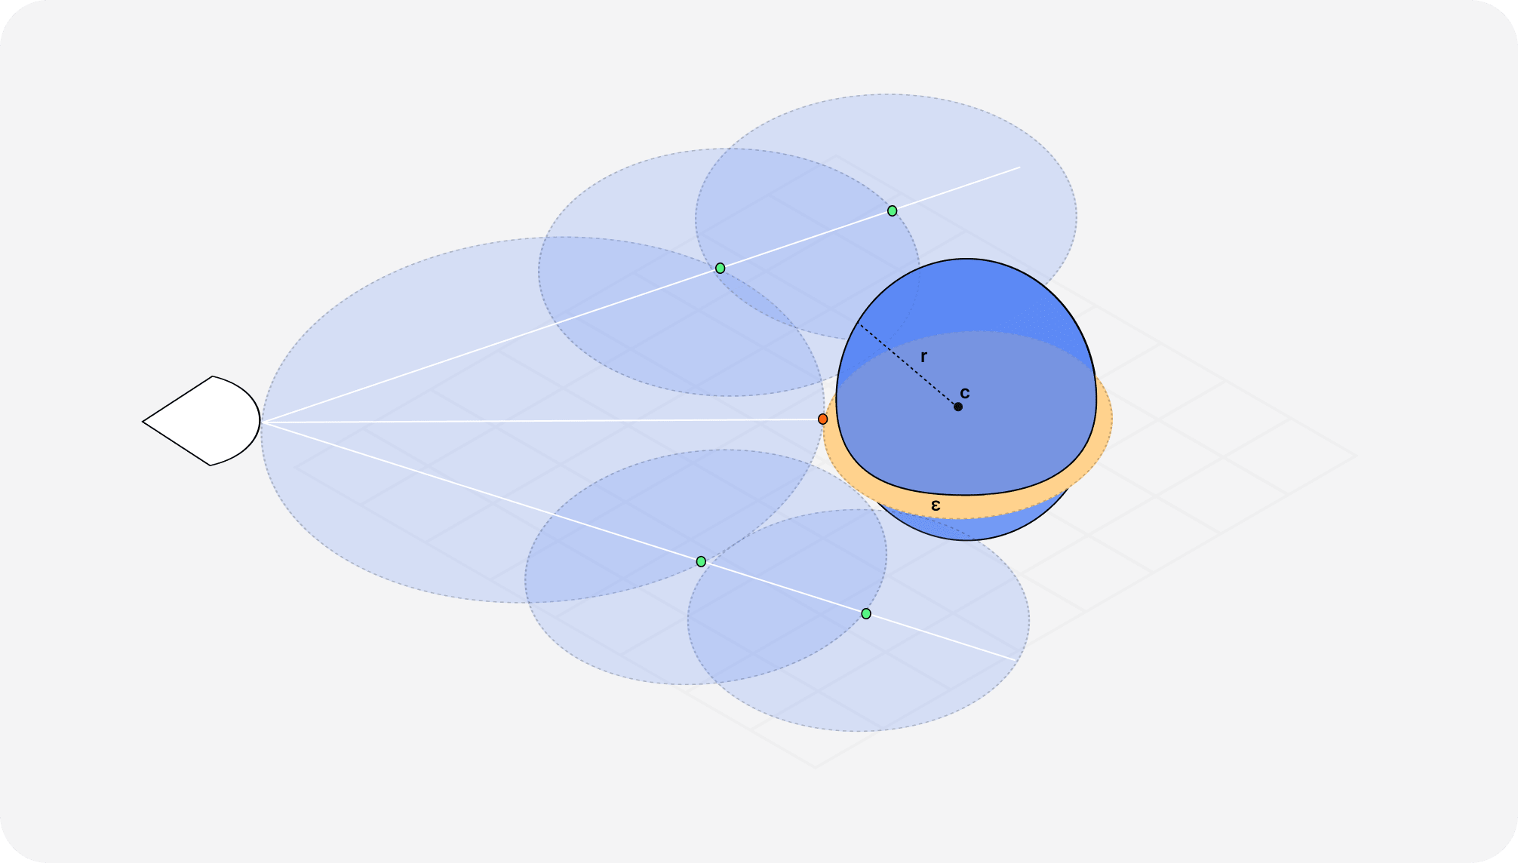
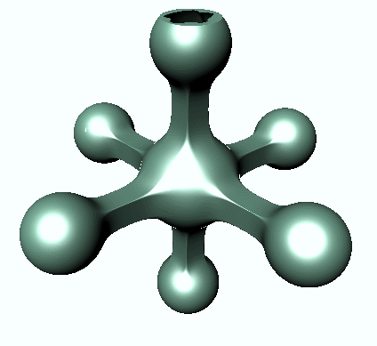
Mapping - SDF
SDF - Signed Distance Function
(or signed distance field sometimes)
Quick easy collision detection
Ray Marched Collisions. Done on gpu very fast.
float sdSphere( in vec3 position, in float radius )
{
return length(position)-radius;
}

Slide 29
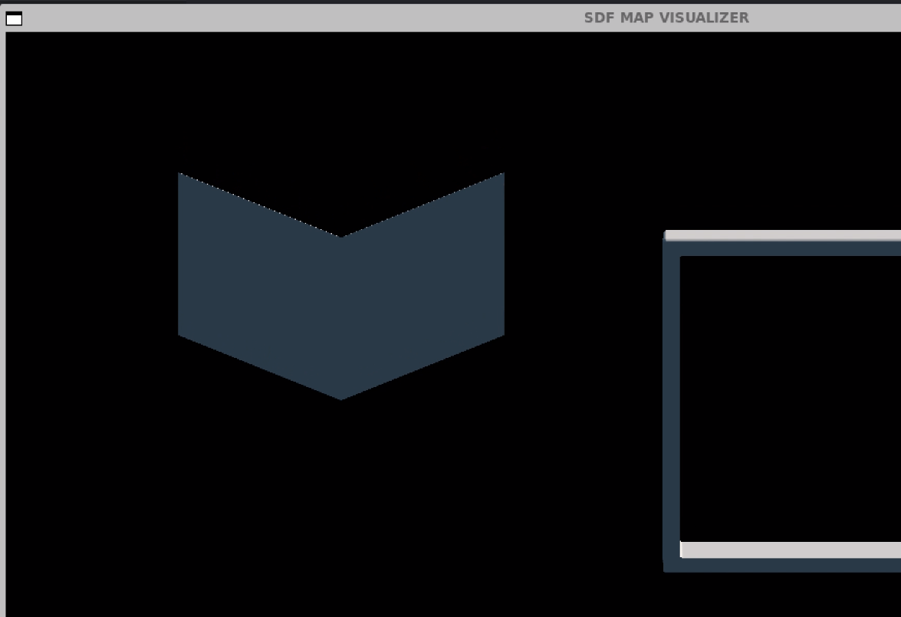
Mapping - Visualizer
This line keeps going lol
float sdQuad(vec3 p, vec3 a, vec3 b, vec3 c, vec3 d) {
vec3 ba = b - a;
vec3 pa = p - a;
vec3 cb = c - b;
vec3 pb = p - b;
vec3 dc = d - c;
vec3 pc = p - c;
vec3 ad = a - d;
vec3 pd = p - d;
vec3 nor = cross(ba, ad);
return sqrt((sign(dot(cross(ba, nor), pa)) +
sign(dot(cross(cb, nor), pb)) +
sign(dot(cross(dc, nor), pc)) +
sign(dot(cross(ad, nor), pd)) < 3.0) ? min(min(min(dot2(ba * clamp(dot(ba, pa) / dot2(ba), 0.0, 1.0) - pa), dot2(cb * clamp(dot(cb, pb) / dot2(cb), 0.0, 1.0) - pb)), dot2(dc * clamp(dot(dc, pc) / dot2(dc), 0.0, 1.0) - pc)), dot2(ad * clamp(dot(ad, pd) / dot2(ad), 0.0, 1.0) - pd)) : dot(nor, pa) * dot(nor, pa) / dot2(nor));
}
float sdChevron(in vec3 p) {
float left = sdQuad(p, vec3(0, 0, 0), vec3(-1, 0.4, 0), vec3(-1, 1.4, 0), vec3(0, 1, 0));
float right = sdQuad(p, vec3(0, 0, 0), vec3(1, 0.4, 0), vec3(1, 1.4, 0), vec3(0, 1, 0));
return min(left, right);
}

Slide 30
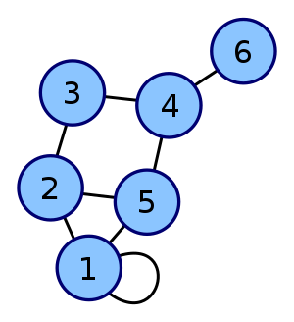
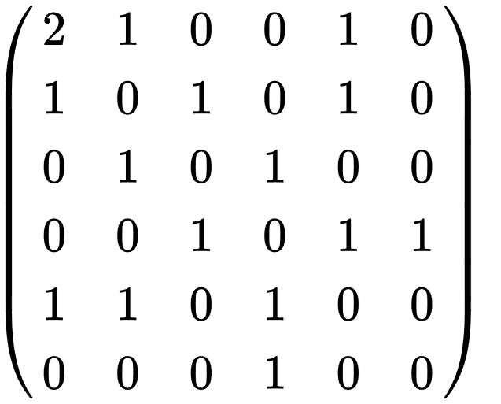
Mapping - Conceptual
Boundary
Data is shared between physical aspect of map
Weighted edges determine “Favorability”
Weight determination by distance, “do ability”, etc
Each value in adjacency Matrix is [float weight, *Map Cell pointer to cell]
Sub
Marker not seen
Bin
Gate

Slide 31
Computer Vision

Slide 32
Computer Vision
Our mission:
Adapt computer vision for object detection to wailord
Implement the latest computer vision technology YOLOV7 for image detection in ROS2 environment
Annotate thousands images and train custom datasets for image recognition
Using Roboflow- Box and label x-amount of images
Train Yolov7 on custom dataset
Research methods on different platforms, images, video, and live feed
Compose ROS2 interface output

Slide 33
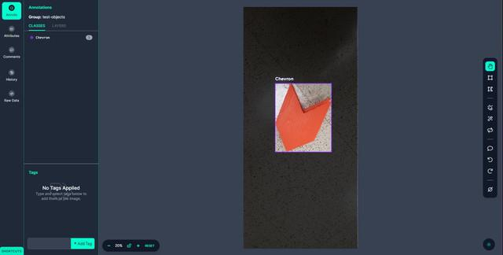
Data collection
Annotation
Roboflow is used for annotation. For best accuracy, annotate the image as close to its borders as possible, otherwise, the model will train on background pixels.
This is done for thousands of images for each object that needs to be trained

Slide 34
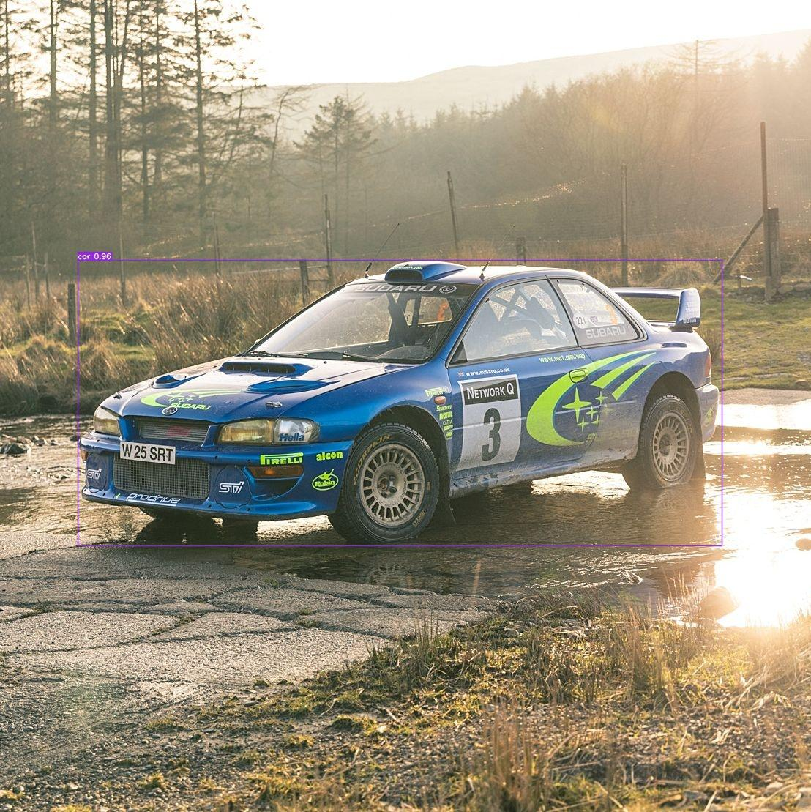
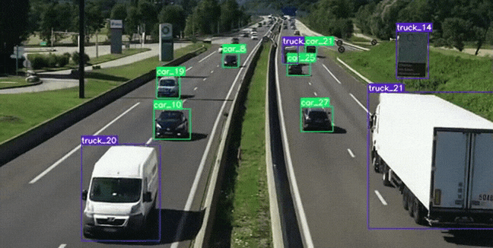
YOLOv7
YOLOv7 (You Only Look Once)
Fastest and Most Accurate Real Time Object Detection
Custom Dataset/Modules
Chevron Models

Slide 35
Training Process
Single-Stage Detection:
YOLO divides the image into grids and detects objects in one stage.
Bounding Box Predictions:
Each grid predicts object location, label, and probability.
Non-Maximal Suppression (NMS):
NMS reduces redundant predictions by suppressing low-probability bounding boxes.
How NMS Works:
YOLO selects the highest-scoring prediction and removes redundant 1’s based on overlap.
This process repeats until only the most confident predictions remain.
Visual Aid:
Image shows grids, predictions before NMS, and final output after NMS.
YOLO simplifies object detection with its single-stage approach and smart use of NMS, making it easier to identify objects in images.

Slide 36
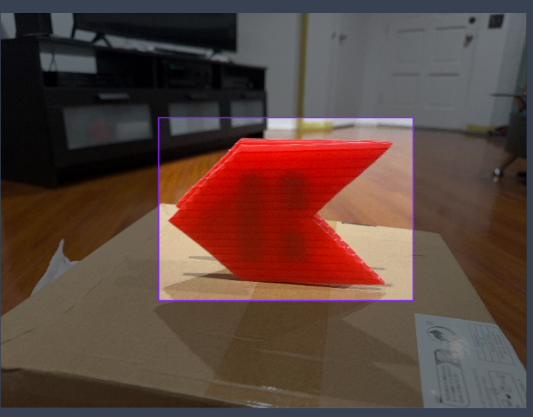
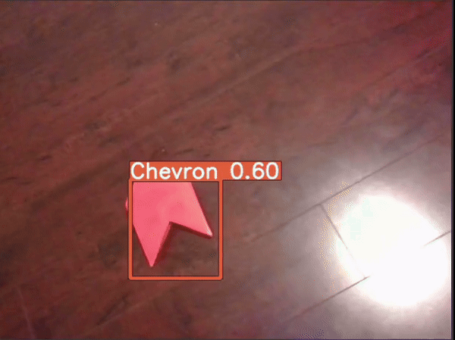
Trial and Error

Slide 37
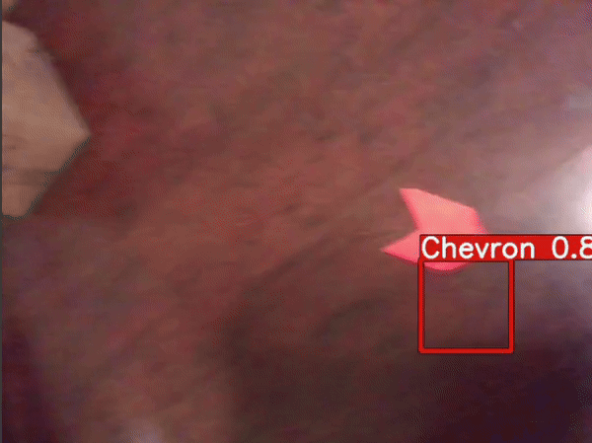
Trial and Error
Increased accuracy

Slide 38
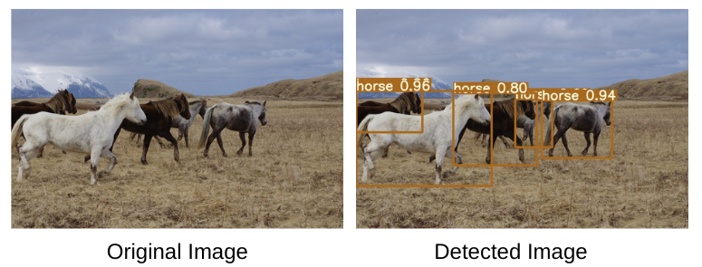
Classes and Functions (Object-Oriented Programming)
Define classes(YOLOv7 and Object_Publisher)
YOLOv7: Provide weights and performs inferences
Object_Publisher: Process Images, Object Detection, Publish Detection Results
Define helper functions(parse_classes_file)
Parse class labels from a text file
Resize bounding boxes

Slide 39
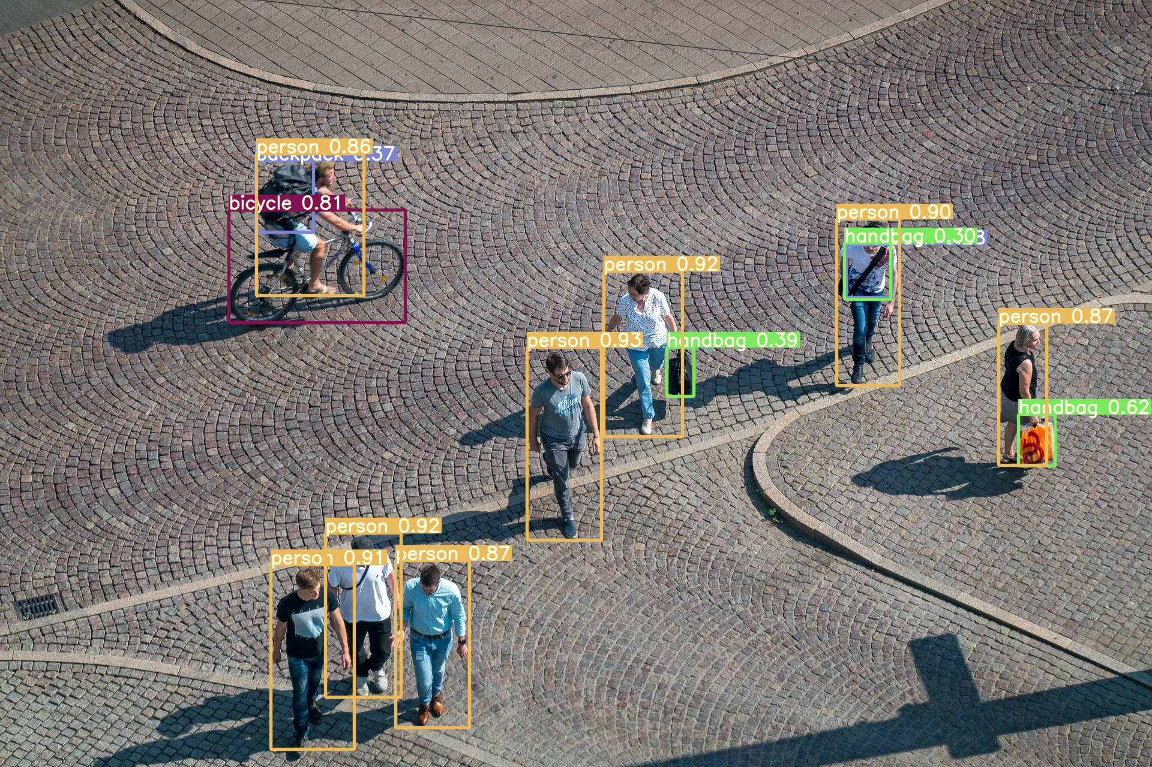
Initialization and Execution
Spin the ROS2 node and start the Object_Publisher
Creating an object called Object_Publisher
Object Recognition Complete
Detection 2D Array
Filters a confidence rating of over 80%

Slide 40
Autonomy

Slide 41
Autonomy
Our Job:
Gather all relevant sensor & estimator data
Keep track of the robot’s current state
Make high-level decisions on robot’s next action
Send the required commands to achieve that action

Slide 42
Subsystem Requirements
Must be able to:
Command the vehicle’s position & velocity
Make decisions based on position/orientations of competition objects
Make decisions based on stored data from previously seen objects
Command the vehicle’s actuated systems (claw, torpedo, etc.)
Must run on Linux 22.04 LTS using ROS Iron
Must be lightweight and fast (>20Hz loop rate if desired)

Slide 43
Implementation - Programming Language
C++ vs. Python
Python
Easy to write and read
Autonomous systems implementable using rclpy and SMACH/Py_Trees
Interpreted language, so lower possible loop bandwidth
C++
More difficult to develop, but more rigidly structured
Autonomous systems implementable using rclcpp (ROS client library) and BT.CPP
Low-overhead compiled language, very efficient and fast
C++ chosen for speed

Slide 44
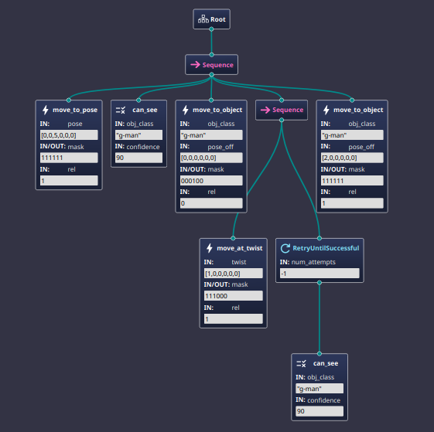
Implementation - Behavior Tree Library
BehaviorTree.CPP
Powerful and easy to use
Graphical editor (Groot2) for making behavior trees
Many built-in node decorators and control structures
Easy to create synchronous, asynchronous actions and conditions
ROS2 integration
Easily debuggable over local socket connection
Example of Behavior Tree in Groot2

Slide 45
Implementation - Main Program Flow
Import/include all necessary libraries
Create one shared ROS node
Spun up in a concurrent thread to the tree execution
Register all tree node types to the BT.CPP factory
Pass tree schema XML file to factory, resulting in final behavior tree
Execute that tree
While the tree is still running, keep respinning the tree in the main program thread
Upon completion, shutdown the ROS node and terminate the thread

Slide 46
Implementation - ROS Node
A custom object that extends RCLCPP’s Node implementation
Private publisher & subscriber objects for ROS topics
Public functions to send data from publishers
Public variables & callbacks to receive data from subscribers
1s interval heartbeat to signal that the node is working to others
Asynchronous function calls, actual communication only happens once our secondary thread calls .spin()

Slide 47
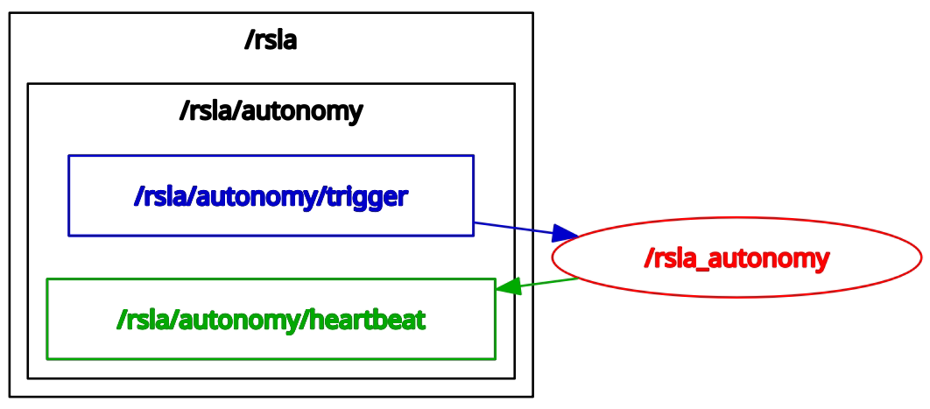
Implementation - ROS Node Example
Trigger subscribes, heartbeat publishes, interpreted via ROS Node

Slide 48
Implementation - Actions
Custom objects that extend BT.CPP’s Action class
Constructor with name, config, & other optional parameters
We use this to pass a shared pointer to the ROS node for all actions/conditions that need it
Functions for onStart(), onRunning(), and onHalted() [Stateful]
onStart() called once when the action begins, useful for sending commands
onRunning() called repeatedly until SUCCESS or FAILURE returned, useful for listening for an echo back from sent commands
onHalted() called if the action is ever stopped mid-execution (timeout & other decorators can do this) and is useful for cancelling any sent commands

Slide 49
Implementation - Conditions
Similar to actions, but cannot return RUNNING (must be sync)
Must access existing data and return SUCCESS or FAILURE based on the result of conditional implementations
Used to check for objects we have seen, current state of the robot being within some parameters, etc.

Slide 50
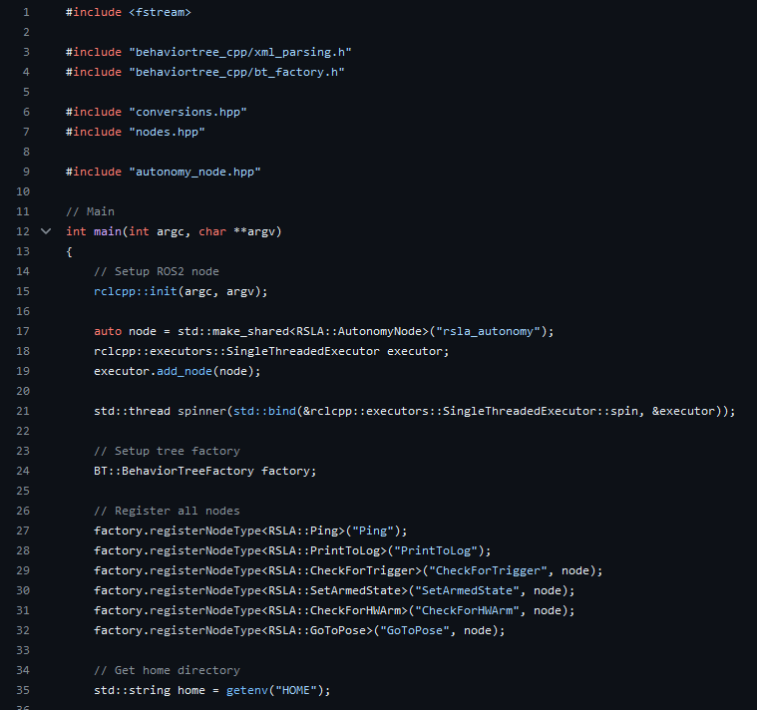
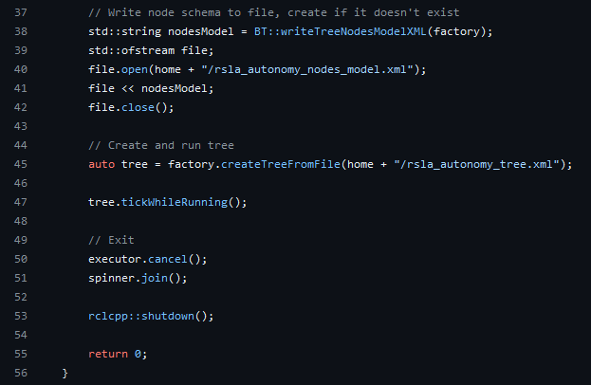
Results - main.cpp
Create the tree from XML
Create the ROS Node
Run everything until tree completes
Register the tree nodes

Slide 51
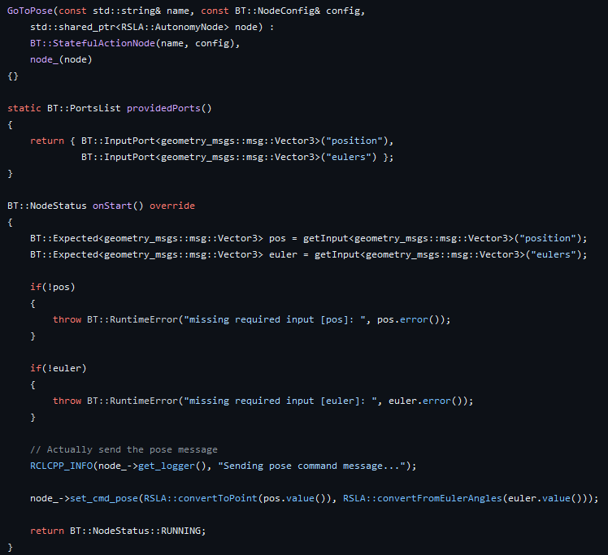
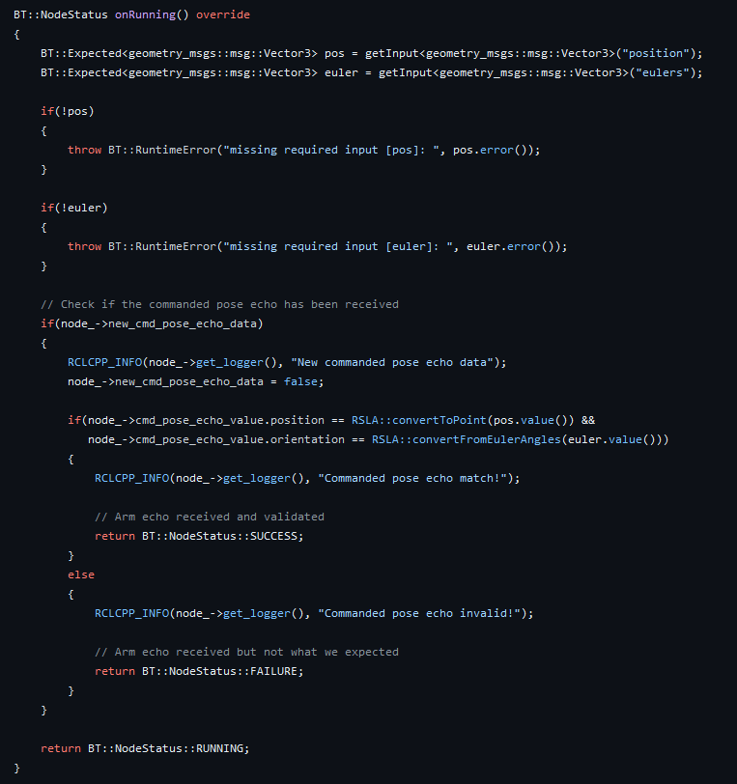
Results - GoToPose Action
Send the message
Listen for echo

Slide 52
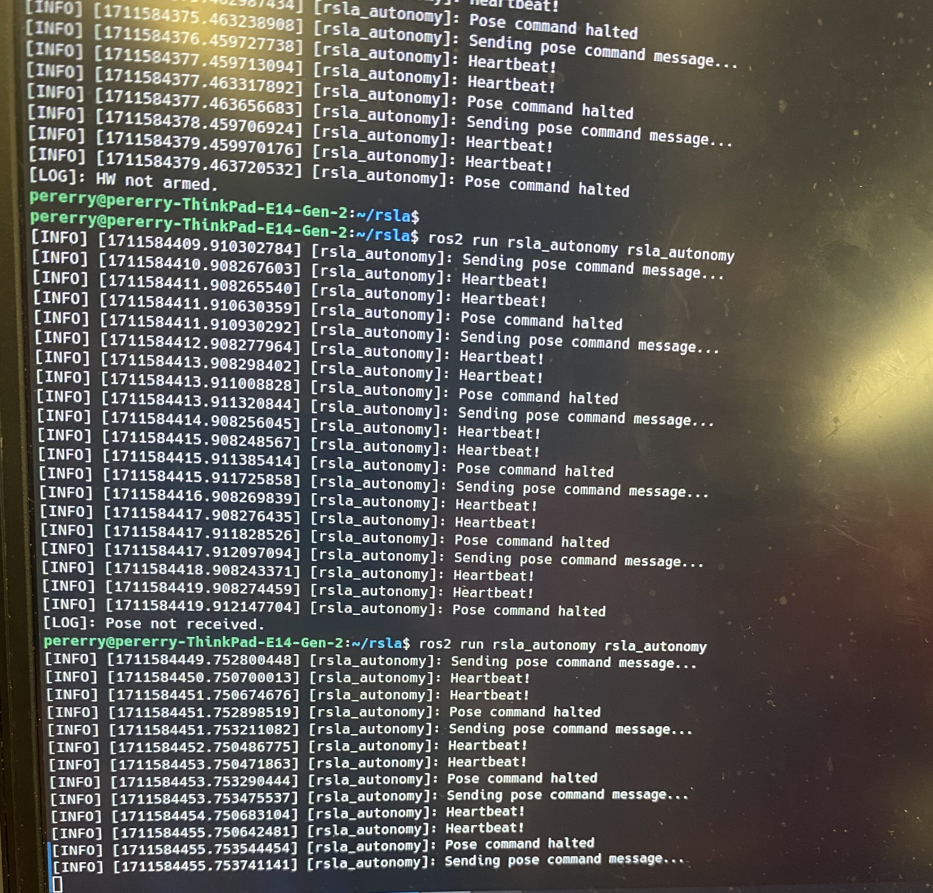
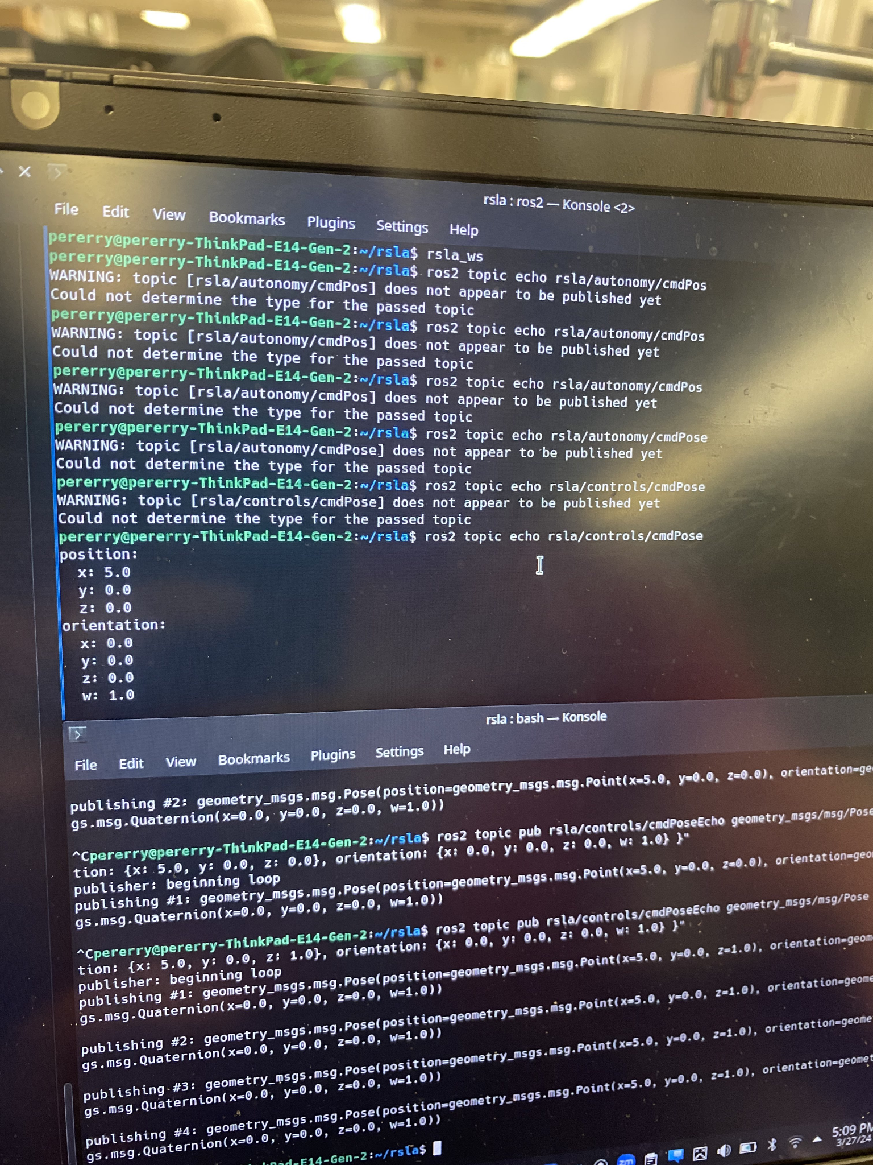
Results - Tree Execution

Slide 53
Test Fixtures

Slide 54
Test Fixtures
-Established a connection with EE
-Set Goals with EE
-Established a Library were going to use for testing fixtures
-Settled with what hardware were going to be using for testing fixture
-Researched on how we would approach and complete goals

Slide 55
Test Fixtures
A few goals we set with EE were
Implementing led status indicators to visually have the status of robot
Have arduino and micro ros work together(we've achieved this by using Rosserial )
Build a test fixture to test components for ee team parts like torpedo

Slide 56
Test Fixtures
Library we've been using to accomplish this:
Micro ROS
What is Micro ROS?
micro-ROS is a set of software libraries that allow robotic applications to be deployed on microcontrollers with limited computational resources

Slide 57
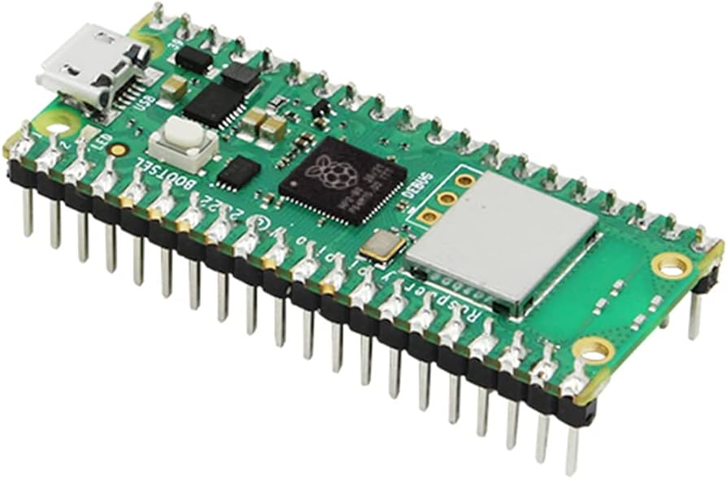
Test Fixtures
What hardware is being used to accomplish this?
Raspberry Pi Pico
Why?
Low-cost microcontroller with wireless capabilities
Takes heavyweight computation
Low Latency
Energy efficient

Slide 58
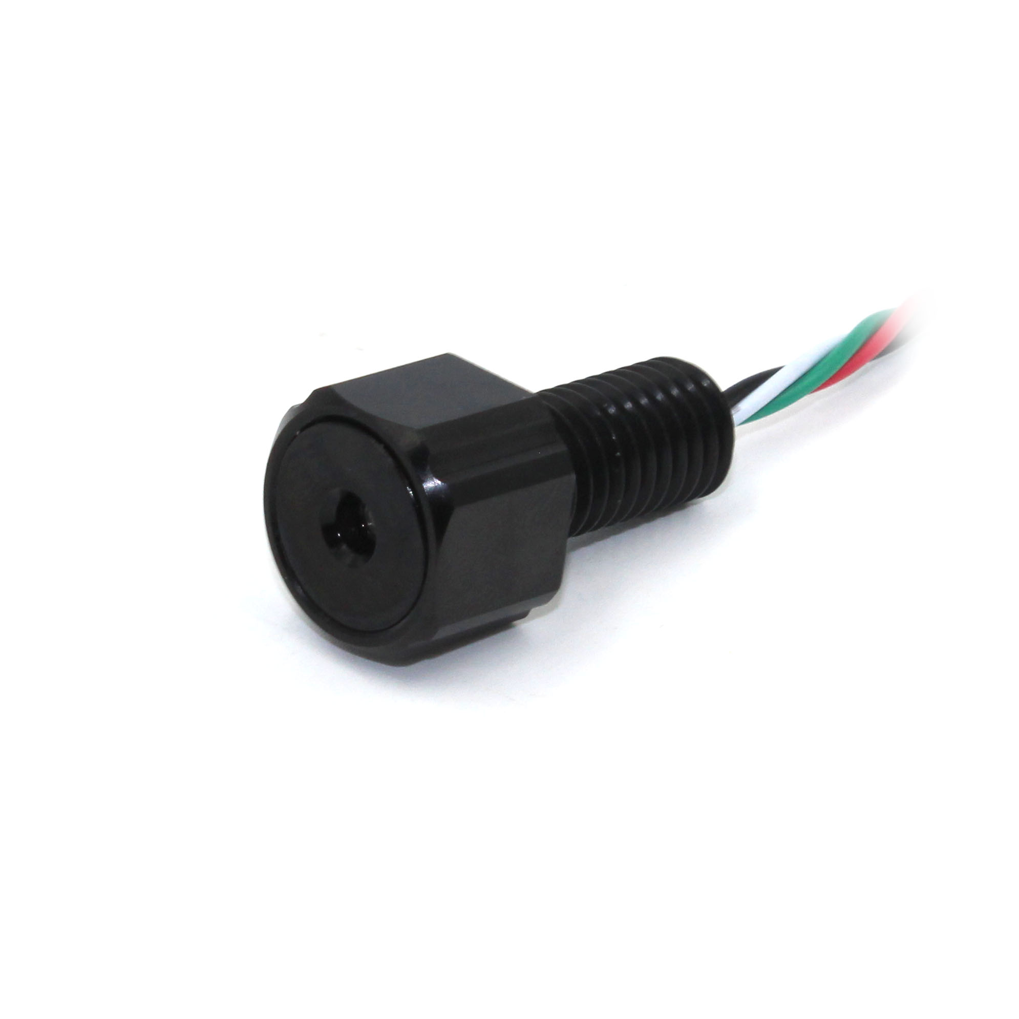
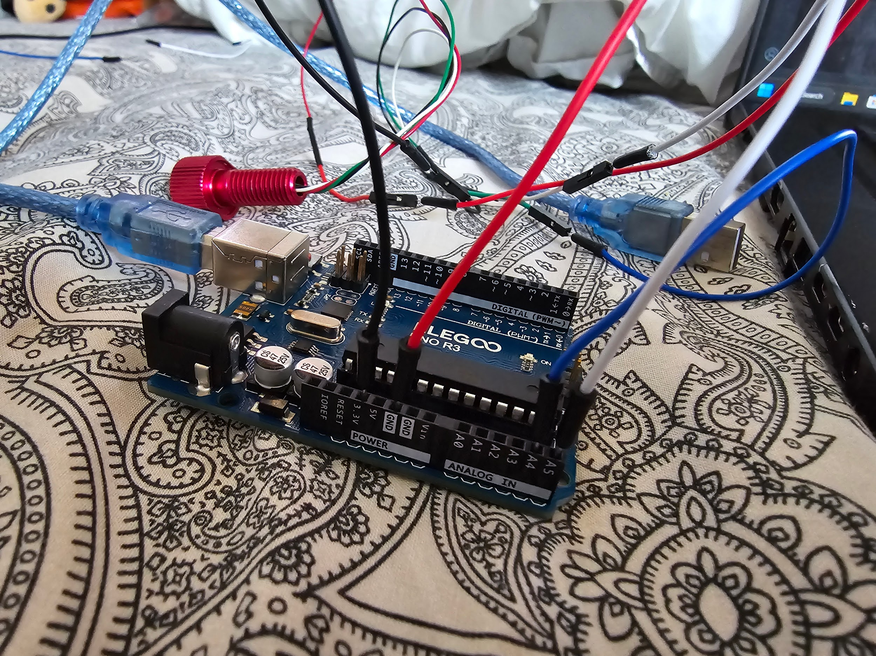
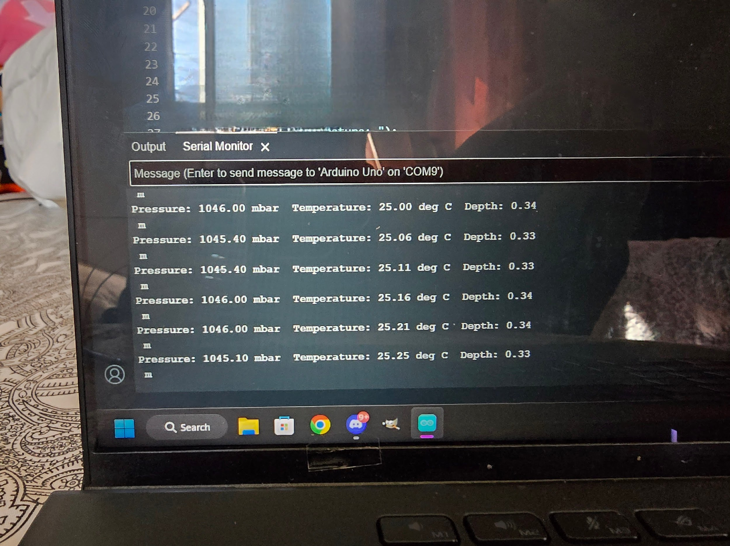
Test Fixture-Journey with Depth Sensor
The purpose of the depth sensor :
The sole purpose of the depth sensor is for the robot to measure how deep we’re underwater
Connection was established for testing purposes in arduino.
Software created was added to configure and calibrate Depth sensor

Slide 59
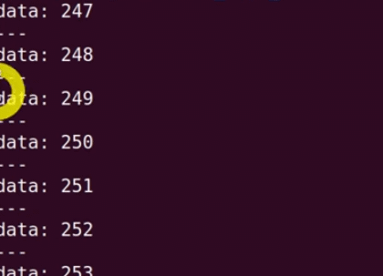
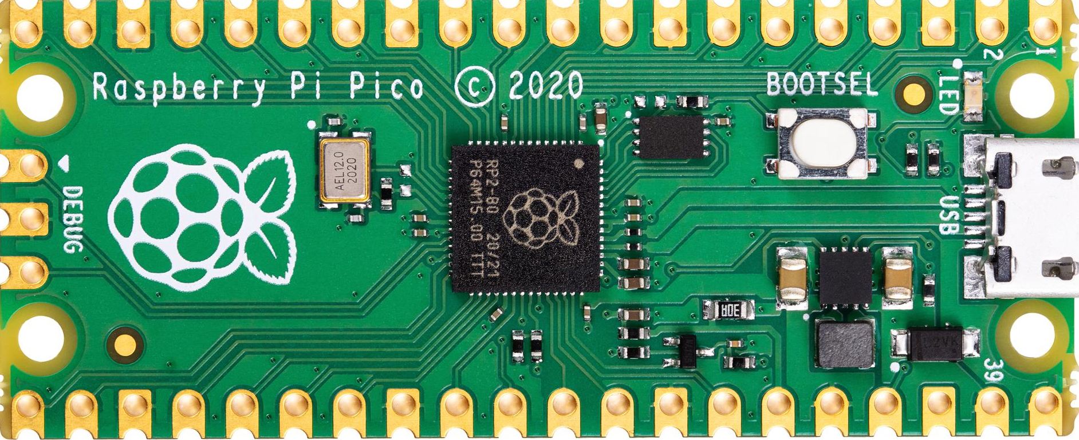
Test fixture - Micro Ros connection with arduino
what was done to accomplish and what research:
To achieve this we used the micro ros arduino github(right a long with a few forums and videos) for raspberry pi pico and were able to get communication from arduino to Ros2 micros
Purpose:
Purpose of this is to have a test fixture were we can establish a connection between micro ros and ros2 to control test fixture parts like, arm, torpedo, ball dropper, etc.

Slide 60
Test fixture - Arduino journey
Matrix LED indicator with ball dropper servo
Arm Movement
Ball Dropper
Torpedo
Led Matrix Indicator
With the Help of the arduino community programming(and wokwi website) these components were swift and straight to the point in to figure out movements.
All these components were up and running and tested thanks to the ME&EE team !

Slide 61
Simulation

Slide 62
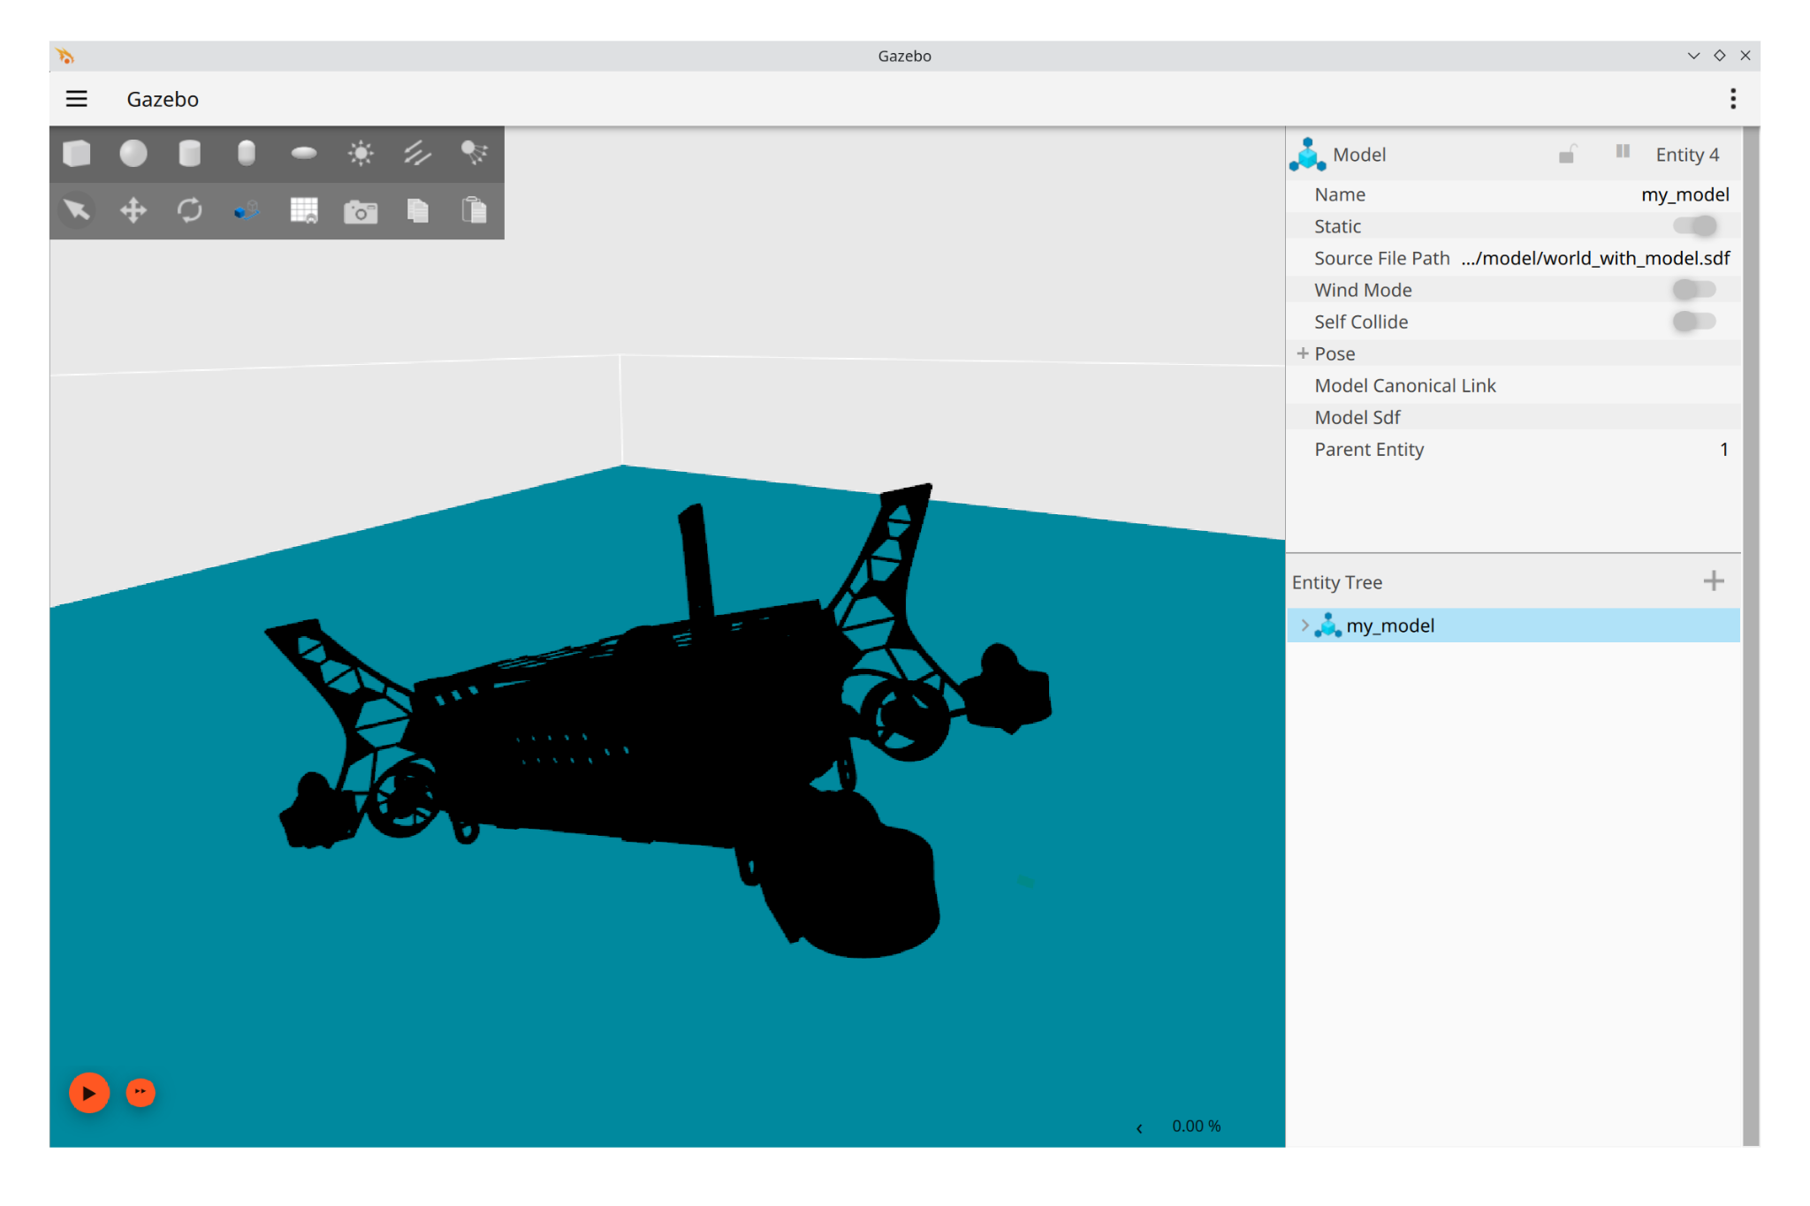
Simulation
Our Job: Our task is to develop a simulation of our submarine that will provide us with an estimate or idea of how our submarine would perform in a real-life environment.
Goals
Continue development of our world
Make system autonomous
Create models based on submarines

Slide 63
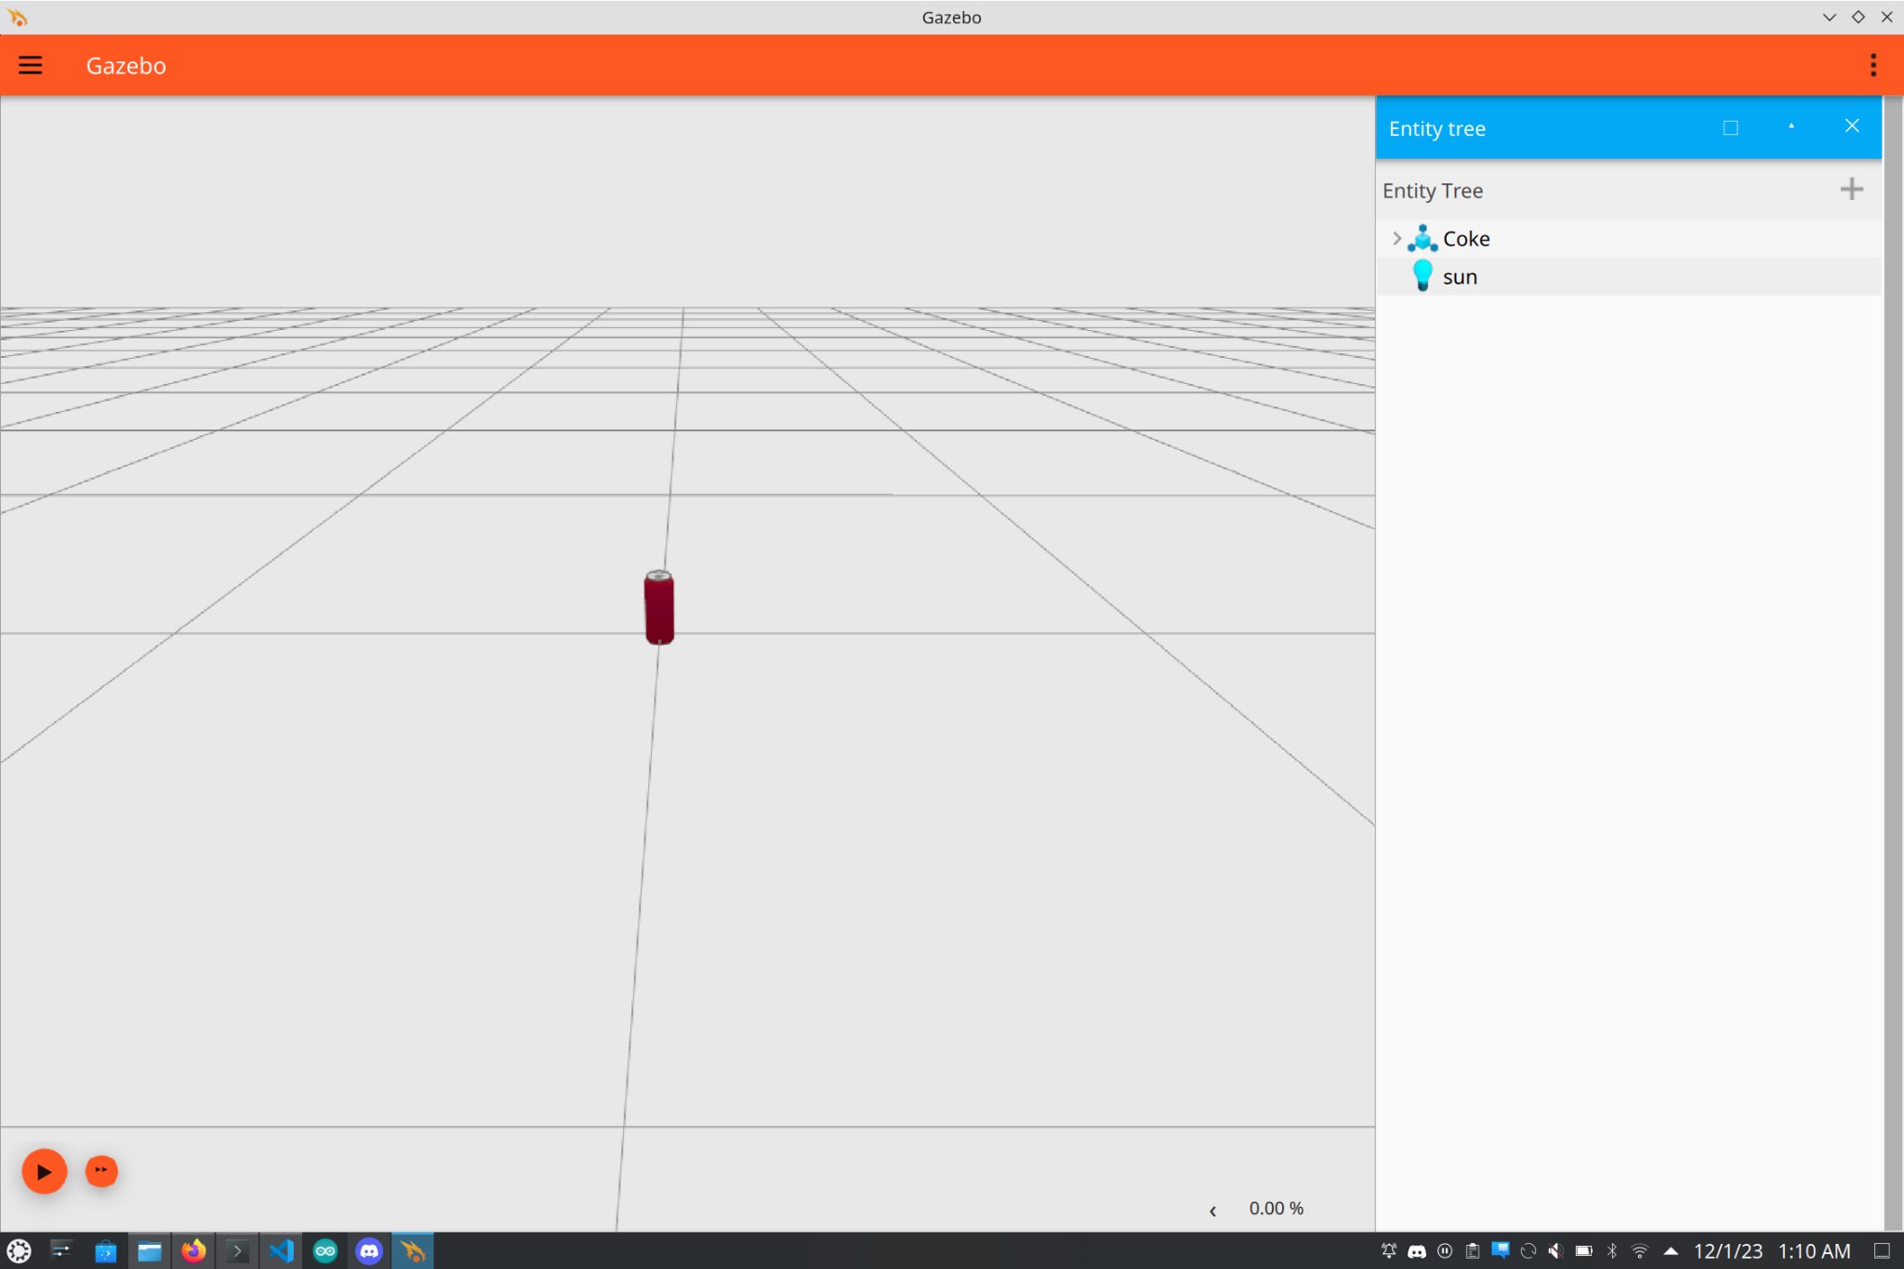
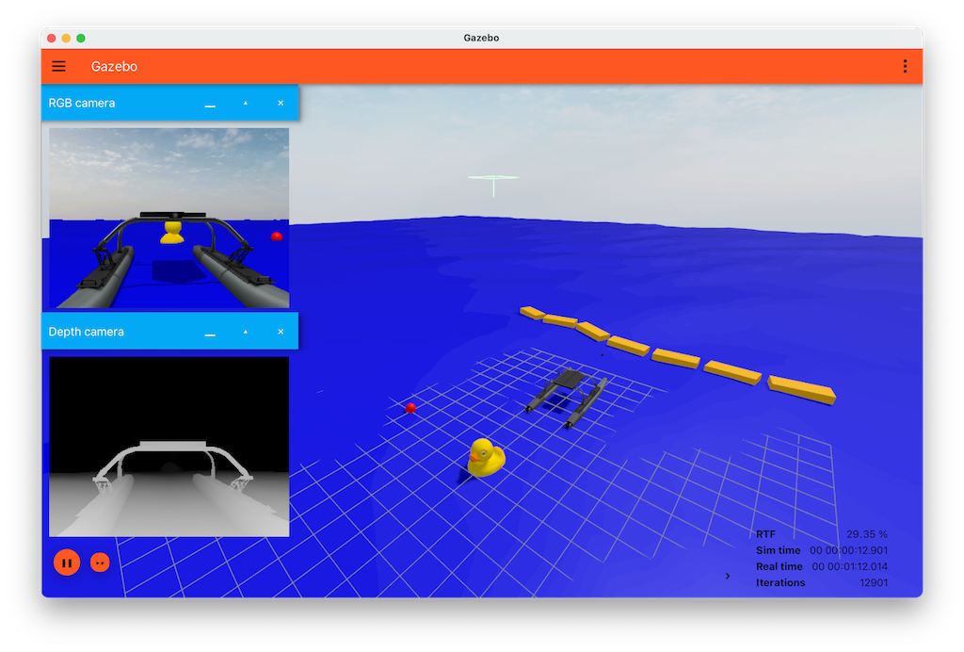
Simulation
What software is being used to make this:
Ignition Gazebo
Ignition Gazebo is a simulation tool used for modeling and simulating robotic systems, including sensors, actuators, and environments.

Slide 64
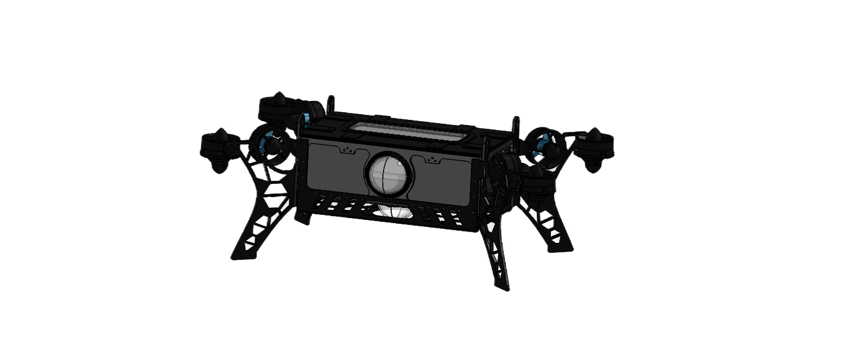
Simulation
How does it work?
Everything is loaded in as a plugin library
User must define the properties in the world
Real-time interactions
User can control the robot or any sensors in real time
Integration with ROS
Enables communication between environment and ROS
Ignition plugins enable direct interaction with ROS topics and services which allows the user to send/receive commands to the robot in the simulation and allows user to receive more specific information.

Slide 65
Simulation
Plugins/Nodes Used
Ignition Gazebo
Hydrodynamics System
Buoyancy System
Camera System
ROS
Camera Node

Slide 66
Simulation
Our Simulation:

Slide 67
Closing

Slide 68
Results
Successfully developed a software package for both vehicles
Developed with modularity in mind so the RoboSubLA team can continue development over the summer
Simulated the behavior of autonomous systems, vehicle subsystems, and the competition environment to validate our work

Slide 69
Thank you!
Special thanks to
Prof. Richard Cross
Dr. Michael Thorburn
Dr. Mark Tufenkjian
RoboSubLA team leadership
Our sponsors and industry partners

