Slide 1
A Machine Learning Platform for Intelligent Water Management
Liaison:
Sanjay Poojary
Senior Design Advisor:
Manveen Kaur
Team Members:
Gabriel Garcia Daniel Castillo Kobe Martinez
Isaac Mendoza Arron Diu Daniel Ramirez
Jimmy Nguyen Jonathan Tirado Andres Vicente
Matthew Kim
Notes:
A Machine Learning platform for Intelligent Water Systems Management

Slide 2
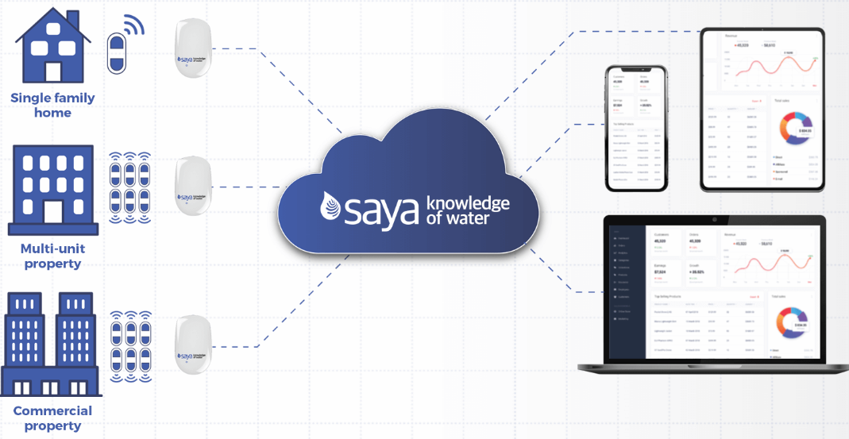
Saya.Life
Saya.Life (Saya) is a company that specializes in water monitoring and leak detection systems for commercial or personal properties.
2 Jimmy

Slide 3
Saya.Life
Saya wishes to extend its service by using water data to predict and prevent significant building damage from pipe leaks.
They have tasked us to write software that can produce a dynamic report that lists a building’s risk of a water leak.
3 Jimmy

Slide 4
Objective
Create a Machine Learning (ML) algorithm to determine whether a building is a safe investment for insurance companies by using building metrics and water flow data and applying:
Logistic Regression
Forward-Feed Neural Network
Create a web-based dashboard that connects with the ML algorithms and displays the likelihood of leaks in a building
Raw data provided by Saya.Life and extended artificially for testing.
4 Isaac
Notes:
Talk about how you divided your work how you divided the team into three subteams:
Front end metrics and algorithms create a flow chart Members team

Slide 5
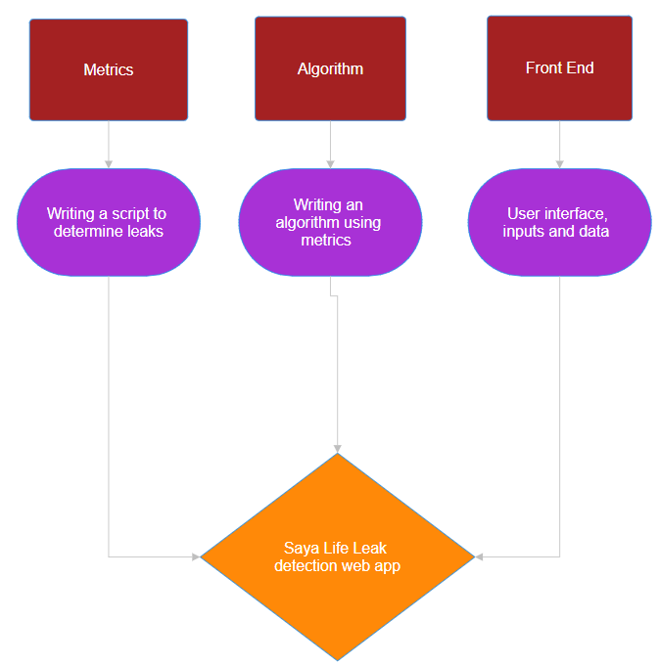
5 Isaac
Notes:
Isaac In this presentation we are going to explain what each team did in the order of metrics,algorithm, and frontend

Slide 6
Data Management Team
Members: Isaac Mendoza, Matthew Kim,
Daniel Ramirez
Programs used: Excel, Jupyter Notebook
Libraries used: Smote
6 Isaac
Notes:
Isaac

Slide 7
Saya Data
Data taken from Saya sensors
Spans over exactly one year
Water Classify(provided with Sayalife dataset)
Algorithm that classifies water type
based on flow rate,volume,duration
Ranges from low,medium,high, and unclassified
Meter Number (non user identifiable)
Each sensor is attached to a specific pipe
Meter number determines pipe and location
7 Isaac
Notes:
Show image of excel heading of the column names to show users Water classify is an algorithm
Isaac

Slide 8
Data sanitization:Flow Data
We used Saya data to determine whether leak occurred based on:
Water classification: Determines the type of flow
Volume: How much water was used
Duration: Time-span of water usage
Flow Rate: Rate at which water was used based on duration and volume
8 Matthew
Notes:
Here talk about how we extract the data, Matthew Kim “gw - gateway”

Slide 9
Data Sanitization:Building
Created our own dummy data for important building metrics:
Age: The older the building is, likelihood of leaks increases
Climate: Different climates sets conditions on what constitutes as a leak
Occupants: The more occupants, the more water usage
Building type: Different types of buildings have different conditions for leaks
9 Matthew
Notes:
Why we added building statics because it helps determines/impact the events in the longevity of pipes,
Matthew Kim - add our motivation for adding dummy data, because we wanted to include more parameters/metrics

Slide 10
Challenges in Data Collection and Sanitization
Flow data from Saya did not report any leaks for the data we used
Created dummy data
Not enough Yes leaks compared to No
Used Smote to extend data
Building data so far only covered one building
10 Daniel R
Notes:
Daniel R

Slide 11
Smote: What is it
Artificially extends the data by checking the nearest identical samples near it
Generates a sample based on the nearest samples.
11 Daniel R

Slide 12
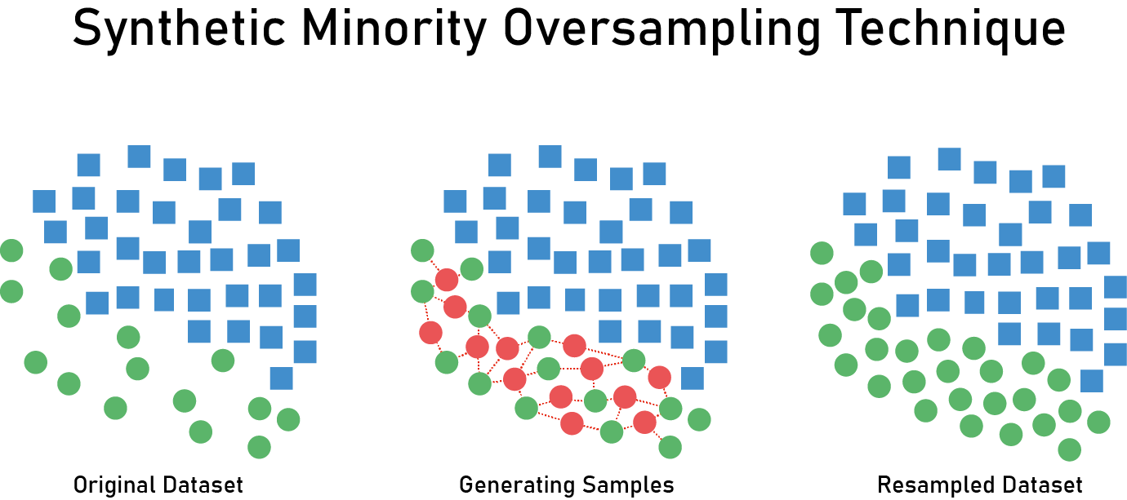
Smote
12 Daniel R
Notes:
Daniel R

Slide 13
13 Daniel R
Notes:
Put this somewhere beginning middle or end Daniel R

Slide 14
Algorithms Team
Members:
Daniel Castillo, Gabriel Garcia, Kobe Martinez
Languages: Python
Libraries: numpy - pandas - sklearn - imblearn.over_sampling - matplotlib
14 Kobe
Notes:
Kobe
We use python because it is the most popular in the data science and machine learning world

Slide 15
Original Plan
Assign a risk factor to a building based on predictions of water leaks
Linear Regression and Feed-Forward Neural Networks
Risk factor range from 1-10
Linear Regression supported our approach since it provides numerical output
Obstacle: Couldn't clearly define a risk scale
Too many variables in the real world to take into account
15 Kobe
Notes:
Kobe

Slide 16
Regression -> Classification
Alternate path from Regression models:
Display whether or not a leak will occur
No longer need numerical output
Discard regression models
Continued with Feed-forward NN and Logistic Regression
Classification
16 Kobe
Notes:
Kobe
Can mention Original Plan was to create a risk rating for buildings
But I removed it from slide since it looks out of place. It’s already in previous slide

Slide 17
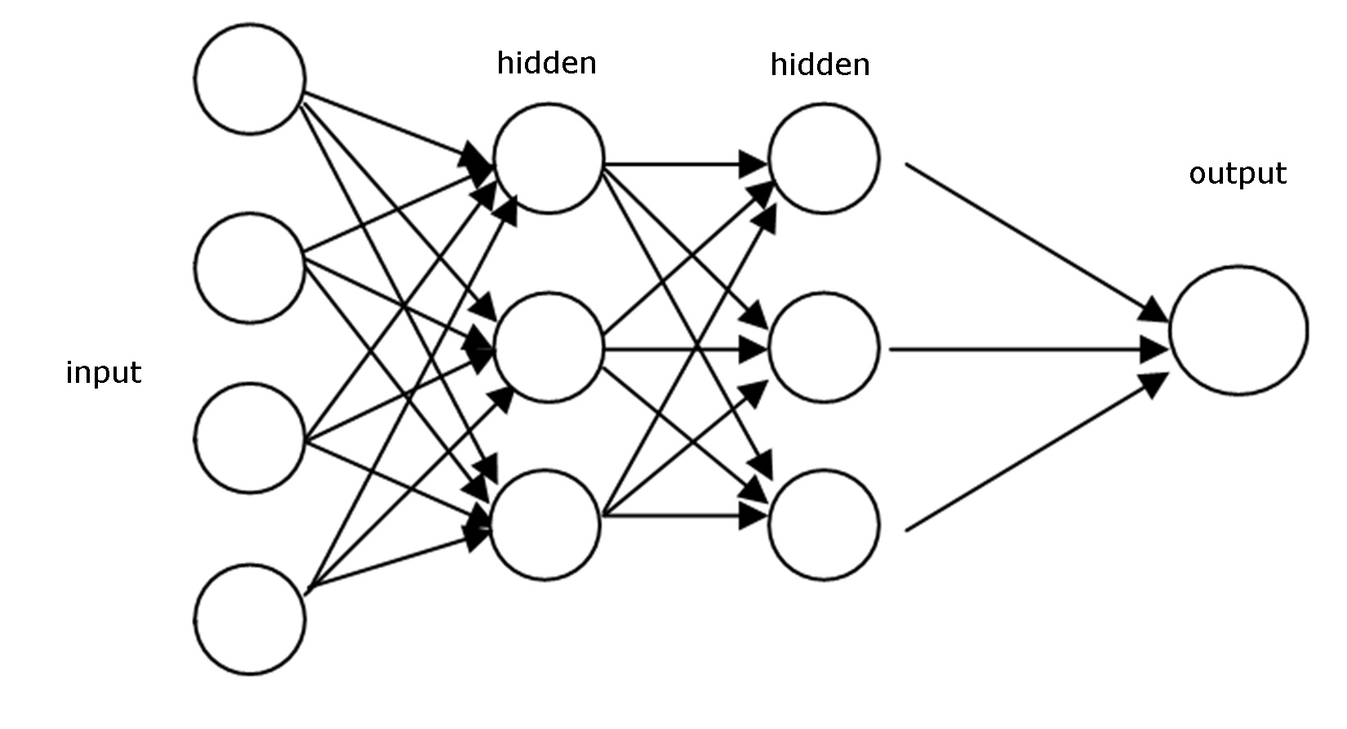
Feed-forward Neural Network
Tried and tested in many applications
Very effective
As data is processed in training
Weight of each connection changes
Changes based on error of the expected result
Learns on its own
17 Daniel
Notes:
FFNNs are the simplest types of neural networks.
They have been tried and tested for many years over many applications and have been found to be very effective.
What makes them so effective is their structure.
To summarize it, this type of NN has layers of neurons that are connected by weights.
As data is propagated forward, the model changes its weights based off the error it makes when compared to the expected output.
This allows the NN to learn on its own, without any external help.
We were very excited to use this neural network, but we faced some challenges.

Slide 18
Challenges
Small dataset
Leaks are a rare event
Less than 5 leaks per 1000 samples
Makes the problem worse
Need to make new, artificial data
18 Daniel
Notes:
Daniel
Three challenges in particular affected our NN’s performance.
First, we have a small dataset to work with.
But to make matters worse, leaks are actually a very rare event.
To give you guys an idea of how rare leaks are, for every 1000 times water was used, only 5 of those instances led to a leak.
So the data we’re trying to identify is extremely small, and that led us to create new, artificial data that is similar to current leak data.

Slide 19
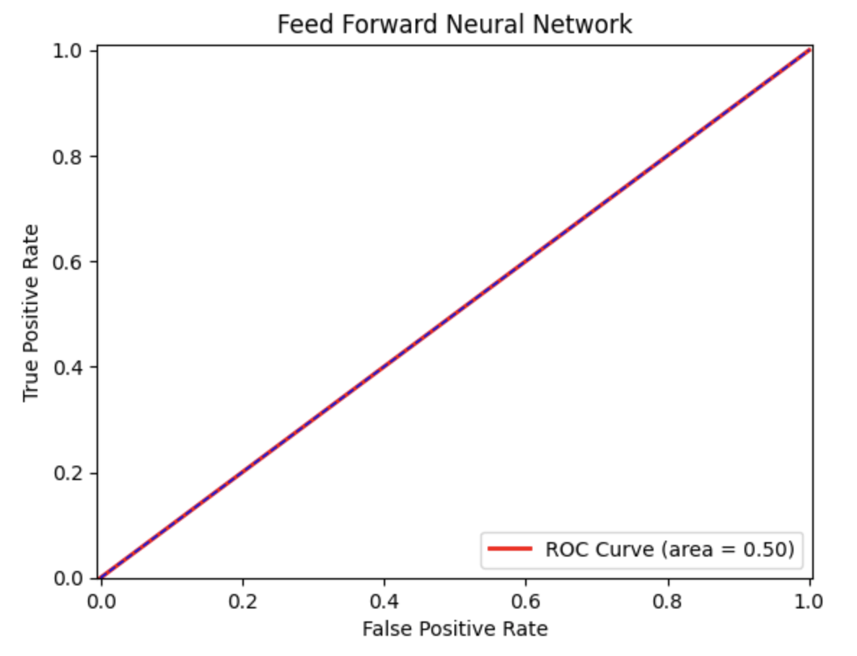
Lessons and Results
Neural networks require a large amount of data
Model doesn’t learn without data
Our neural network models were underfit
Average accuracy of 55%
Max 60%
ROC curve reveals random guessing
19 Daniel
Notes:
Daniel
Despite our efforts, we could not get a neural network model to perform well.
This was mainly due to the size of the data.
It was too small, and our model was underfit.
We achieved an average accuracy of 55%, and a maximum of 60%.
Furthermore, our ROC curve revealed that our models were randomly guessing.
The figure on the right shows this random guessing behavior, and in a few minutes it will become clear why this perfect line is bad.

Slide 20
What is Logistic Regression
A simpler ML model used for binary classification
E.g. Identifying whether an email is spam or not
20 Daniel
Notes:
Daniel
So, because we could not find success with the feed forward neural network, we divided to try simpler models.
Logistic regression gave us the best results.
This is a simpler machine learning model that is used for binary classification, such as identifying whether an email is spam or not.
It does this by taking inputs, it processes them in training, and runs every output through a function that gives the probability of the event occurring.
The model makes its classification based off the probability.
We hoped that this type of model would better suit our small dataset.
I now pass your attention to Gabriel, who will talk more about our application and results.

Slide 21
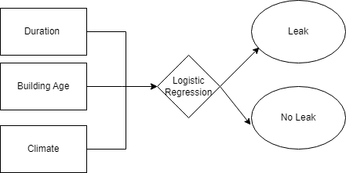
Data used
21 Gabriel
Notes:
Gabriel

Slide 22
Our Application
Logistic Regression
Logistic Regression uses the past data (features) and calculates to determine if the building has a leak.
Checked the accuracy by testing the trained model with the testing data and checking if the label produced was the same
22 Gabriel
Notes:
Daniel

Slide 23
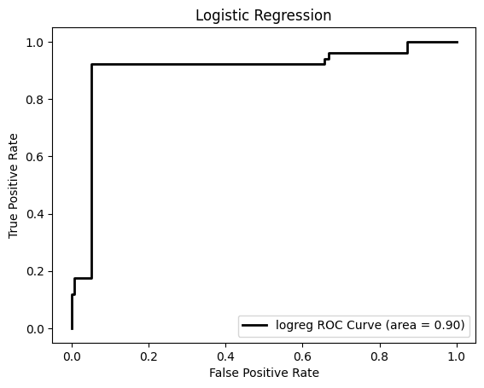
Logistic Regression ROC
True positive rate is the amount of yes that were guessed correctly
False positive rate is the amount of yes that were guessed wrongly
Accuracy is the rate of correct guesses
The Area under the Curve (AUC): higher number indicates excellent classification while lower represents poor performance
AUC Curve: 90%
Accuracy: 94%
23 Gabriel
Notes:
gabriel

Slide 24
Front end team
Members: Andres Vicente, Arron Diu, Jonathan Tirado, Jimmy Nguyen
24 Arron

Slide 25
Languages and Libraries
User interface: HTML, CSS, Javascript, Bootstrap
Back-end: Python, Flask, Pickle, and Numpy
25 Arron

Slide 26
User Interface
Designed an intuitive user interface for data input
Integrated with our machine learning server for efficient data processing
Enabled swift transmission of user input and retrieval of accurate results
26 Arron
Notes:
Add a small video to show wha the front end did

Slide 27
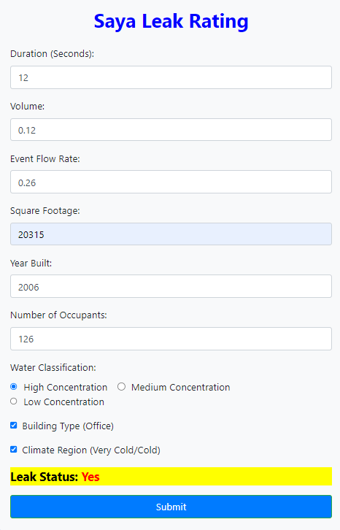
Dashboard
Efficiently gathers and organizes user input
Sends POST request to back-end server
Displays result
27 Jonathan
Notes:
Add units for the features this dashboard shows how data put but the dashboard works with the algorithm but one day a user will be able to use extract by a csv file, the reason why we didnt implement it but we do not know what is important So this is a general prototype that can later be personalized by whoever the new user of the code is. Flowe chart of how the front end is working with the back end show code of the pickel?

Slide 28
Result
When a POST request is made, the server will handle the input data and forward it to the machine learning algorithm.
Server will receive the algorithm's result and send a response to the front-end.
The result will be displayed on the dashboard for user viewing.
28 Jonathan

Slide 29
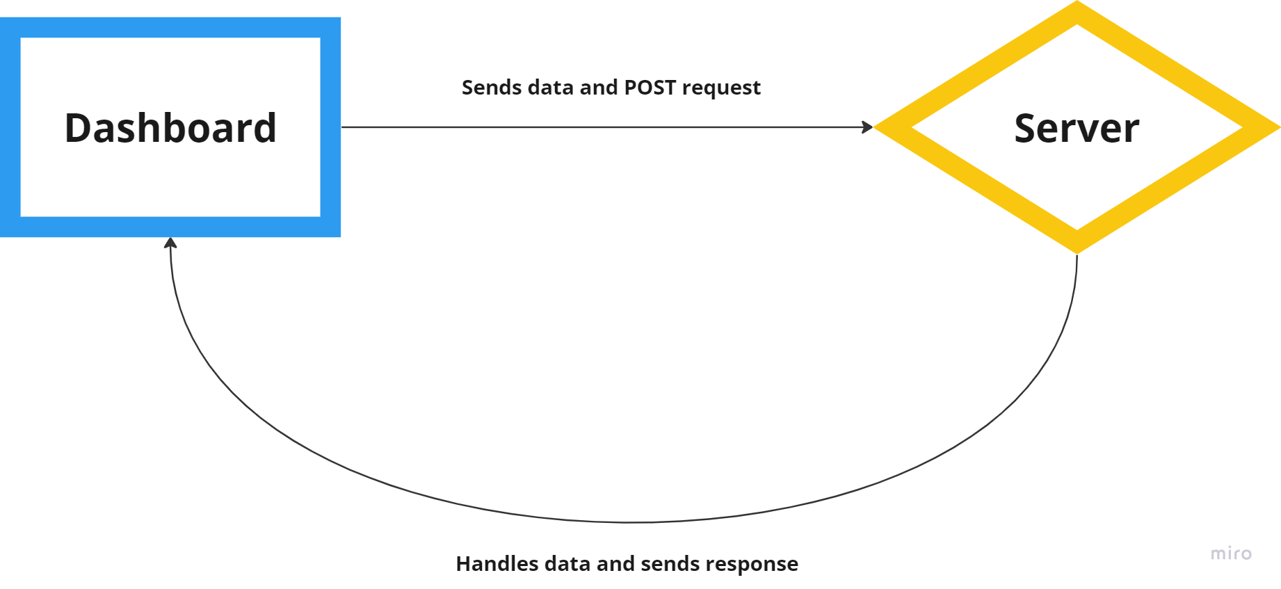
UI Diagram
29 Jonathan

Slide 30
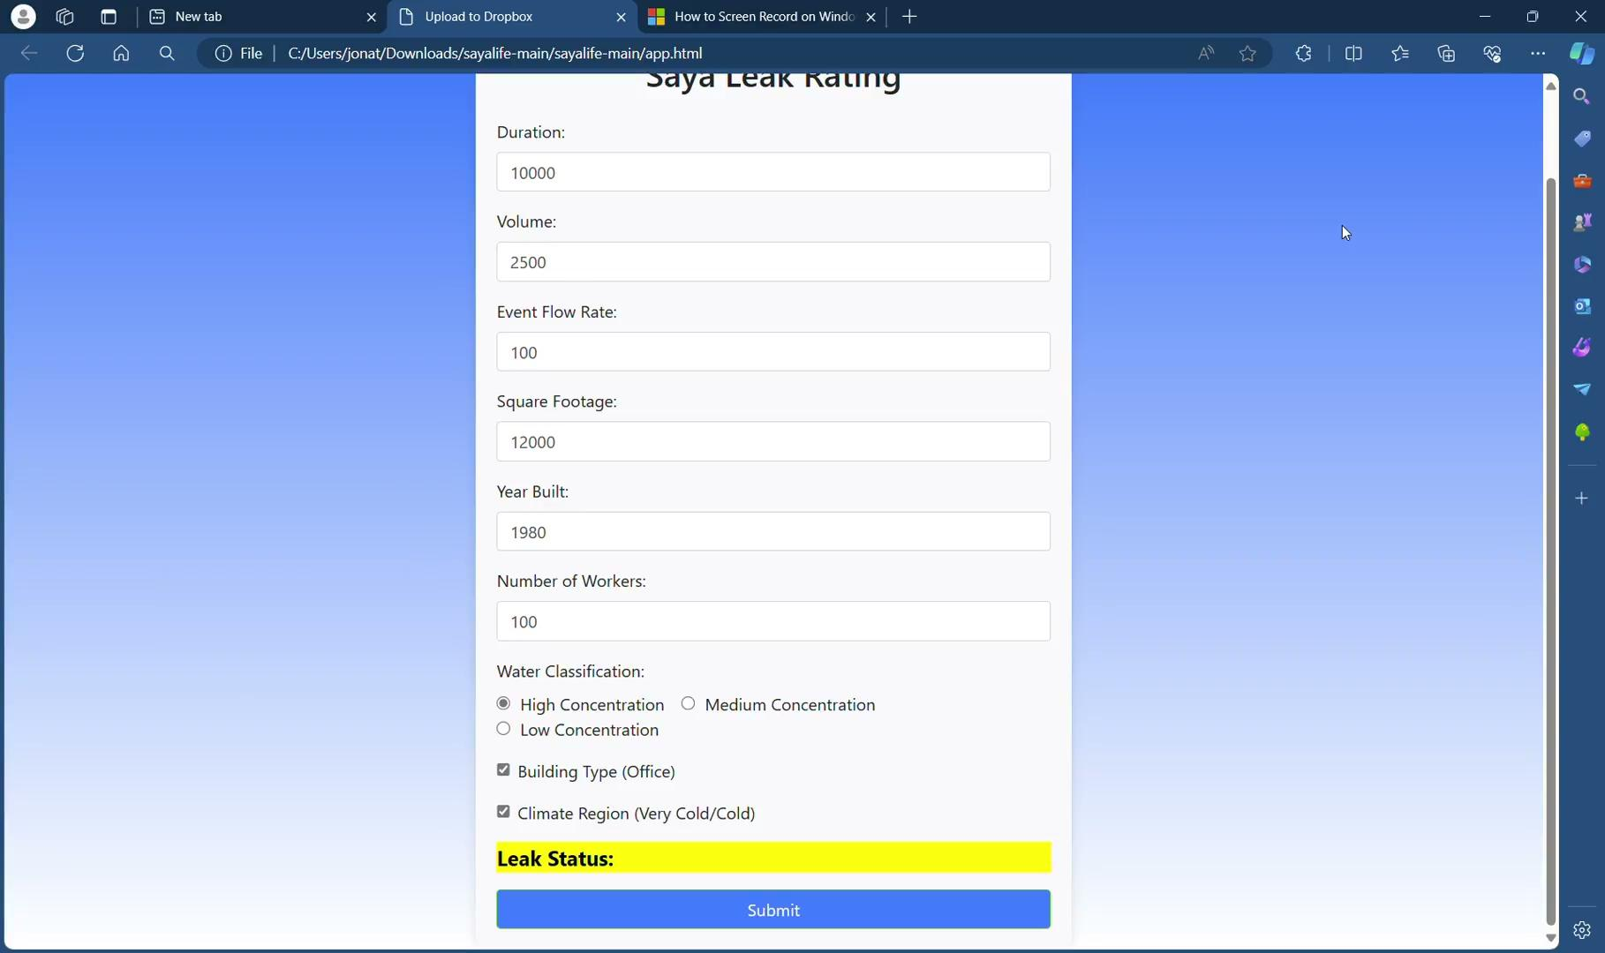
Demo Video
30 Jonathan

Slide 31
Incorporate to Saya website
Fit into current existing web structure
Adjust style sheet so it can fit seamlessly with their current design
31 Jonathan

Slide 32
Conclusion Data Management
Data Management:
Sanitized the data as well as created our own dummy data
Created artificial building data for one building
Used Smote to artificially extend the data
32 Andres
Notes:
Recap of what we talked about

Slide 33
Conclusion Machine Learning
Machine Learning:
Our previous attempt in linear regression was changed to logistic regression because the changes of classification which lead to a success results for logistic.
Feed-Forward Neural Network had tons of problems that we could not successfully run with a rate higher than 50% for the AUC curve.
33 Andres

Slide 34
Conclusion Front-End
Created a dashboard
Successfully display prediction
34 Andres

Slide 35
Recommendations for Future Work
Large data
Have a way to differentiate multiple buildings
Connecting to servers
Improve data classification
Way to determine pipe features
35 Andres
Notes:
In the next phase of our project, we plan to make big improvements in how we manage and use our data. We'll process large amounts of data more efficiently, use new methods to manage data from different buildings separately, and connect to stronger servers for faster and more reliable performance. We'll also use advanced machine learning to better understand and organize our data, and develop new tools to check and maintain pipes more effectively. These upgrades will make our system much more powerful and ready to handle future challenges in managing building operations.

Slide 36
Thank you!
Any questions?

