Slide 1
Viper Rocks!
CS 4962
CSULA - Spring Semester 2024
May 3, 2024
Zainab Sulaiman

Slide 2
MEET THE TEAM
UI/UX DESIGN:
Diana Arteaga-Andrade
Cristian Gomez
Santiago Bautista
Angy Xajil
Tammy Xaypraseuth
DATABASE DESIGN:
Kevin Andrade
Michael Gibson
Nida Sheikh
Zainab Sulaiman
Diane Tabilas
PROJECT SPONSOR: JPL
PROJECT LIAISONS: Shan Malhotra
Mike Rueckert
Richard Kim
Emily Law
FACULTY ADVISOR: David Krum
GRADUATE ASSISTANT: Jerome Pineda
Note:
Everyone may contribute to multiple roles.
Zainab Sulaiman
Santiago Bautista

Slide 3
Table of contents
01
02
03
04
05
06
Background
Core Features
Implementation
Video Demo
Future Work
Conclusion
Zainab Sulaiman

Slide 4
01
Background
Here’s what you need to know.
Angy Xajil

Slide 5
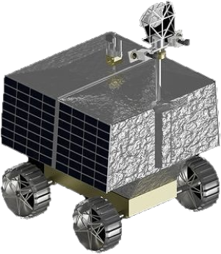
VIPER
Volatiles Investigating Polar Exploration Rover
The first rover to explore the Moon’s polar terrain.
Mission: Gather crucial data about composition and formation of the lunar surface
Paving the way for a future where the Moon can be a valuable resource for humanity.
Angy Xajil

Slide 6
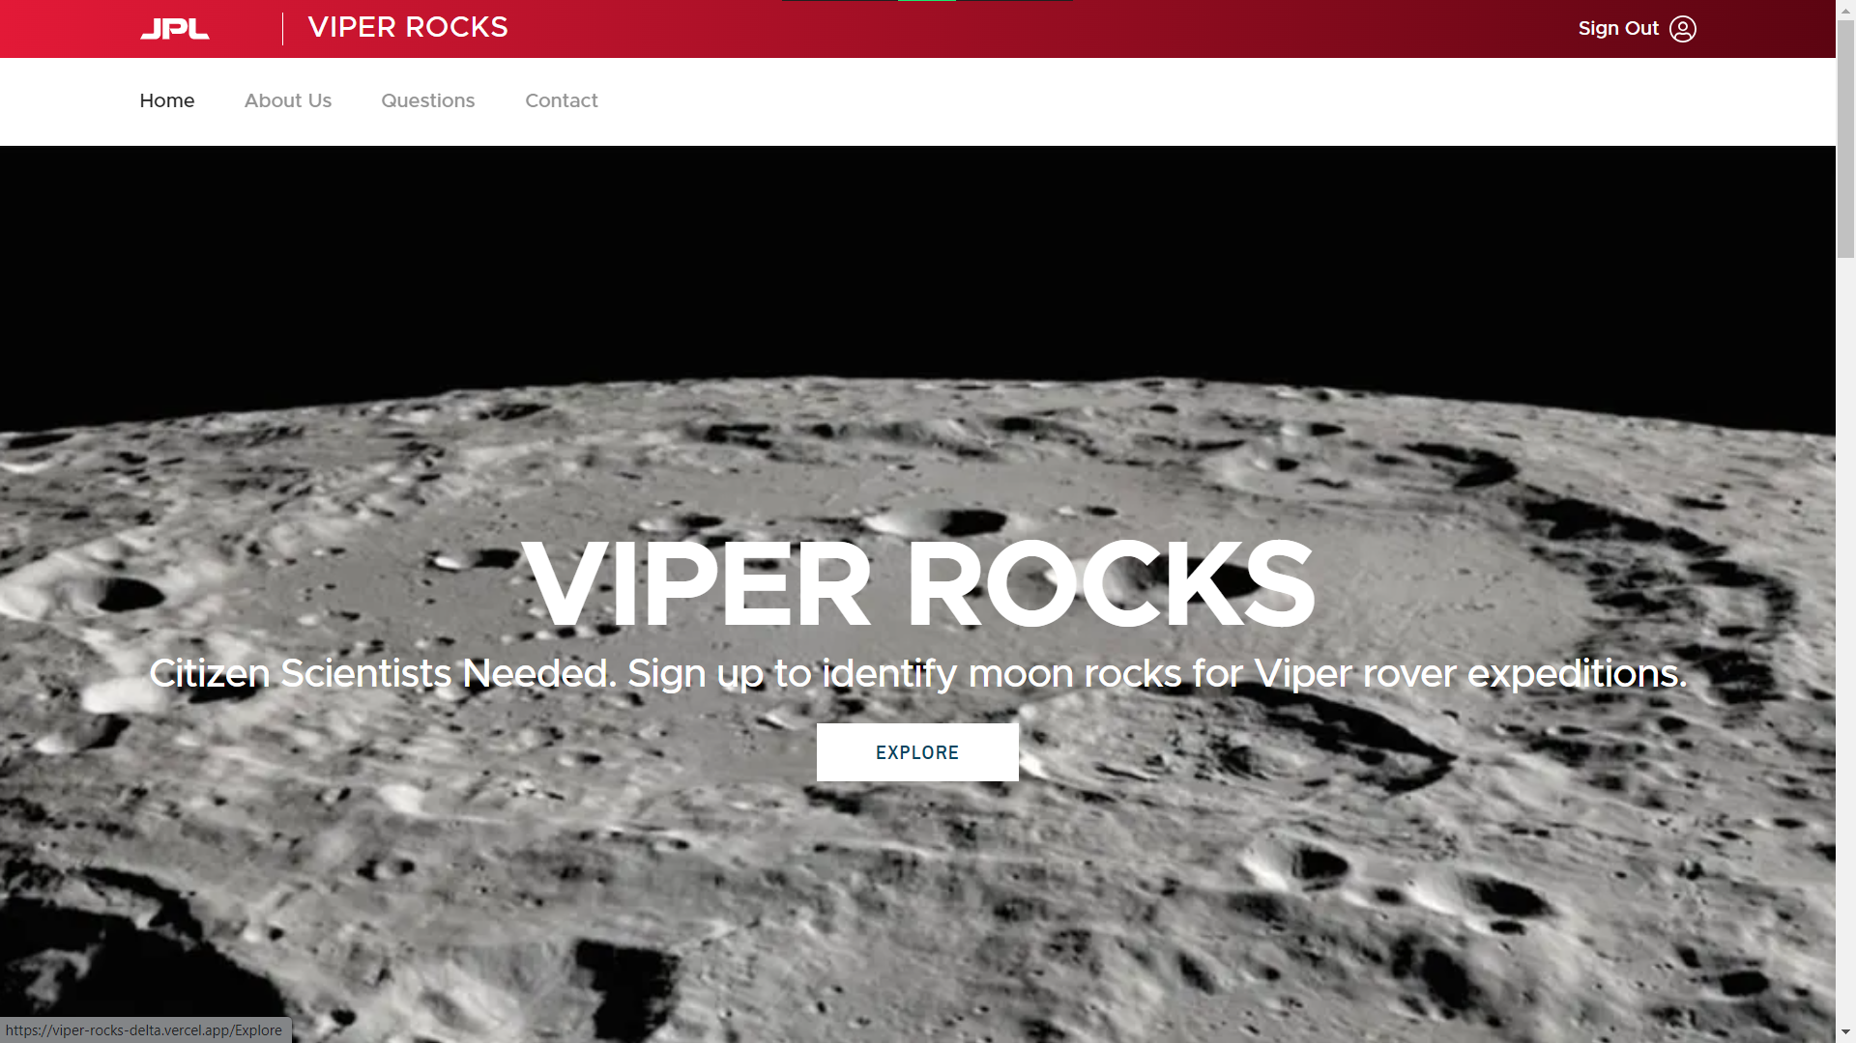
VIPER Rocks!
What is VIPER Rocks!?
A web-based application designed to analyze images captured by VIPER’s cameras, focusing on lunar rocks
Relies on user engagement for rock analysis
Angy Xajil

Slide 7
VIPER Rocks!
Who is a Citizen Scientist?
Any person participating in the VIPER mission
Will contribute to mapping and classifying rocks encountered by VIPER
Three tasks:
counting amount of rocks
determining size
determining shape
Angy Xajil

Slide 8
Core Features
02
Nida Sheikh

Slide 9
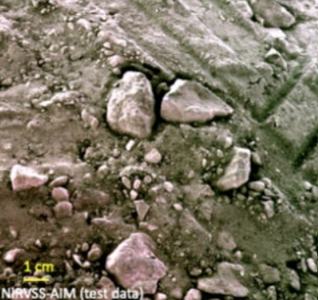
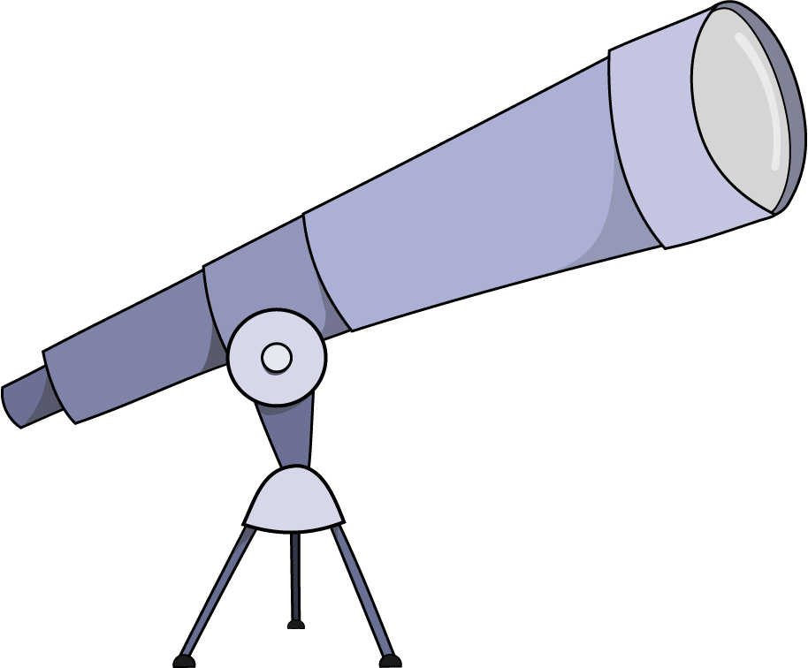
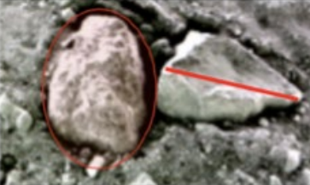
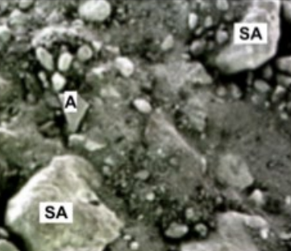
Core Features
Scouting
Task 1: Count the Rocks
Sizing
Task 2: Trace the Rocks
Classification
Task 3: Determine Rock Shape
Nida Sheikh

Slide 10
03
Implementation
How did we do it?
Tammy Xaypraseuth

Slide 11
DFD
Tammy Xaypraseuth
Notes:
https://www.canva.com/design/DAGD7n5_CkA/h_jAU329nF2Cy2uY3CVikg/edit

Slide 12
Main Tasks
Note:
Built for AIM cameras
Scouting | Sizing | Classification
Diana Arteaga-Andrade

Slide 13
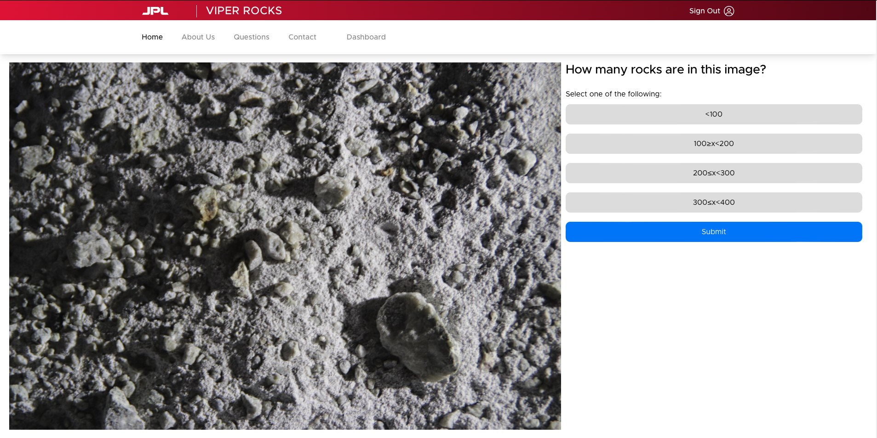
Scouting
What is it?
Citizen scientists will explore various images to determine an approximate number of rocks.
Why is it important?
From the approximate number of rocks, we can break up the original image into smaller subimages. This will help partition the workload evenly for the sizing task.
Diana Arteaga-Andrade

Slide 14
Scouting
Early Iteration
Click on all the rocks!
Advantages:
More likely to get accurate representation of rock quantity
Know location of rocks
“Simple”
Diana Arteaga-Andrade

Slide 15
Scouting
Early Iteration
Click on all the rocks!
Disadvantages:
User fatigue
Time consuming
May cause pain
Diana Arteaga-Andrade

Slide 16
Scouting
Final Iteration
Straightforward survey!
Advantages:
Simple
Less clicking
Disadvantages:
Less accurate
Don’t know where the rocks are
Diana Arteaga-Andrade

Slide 17
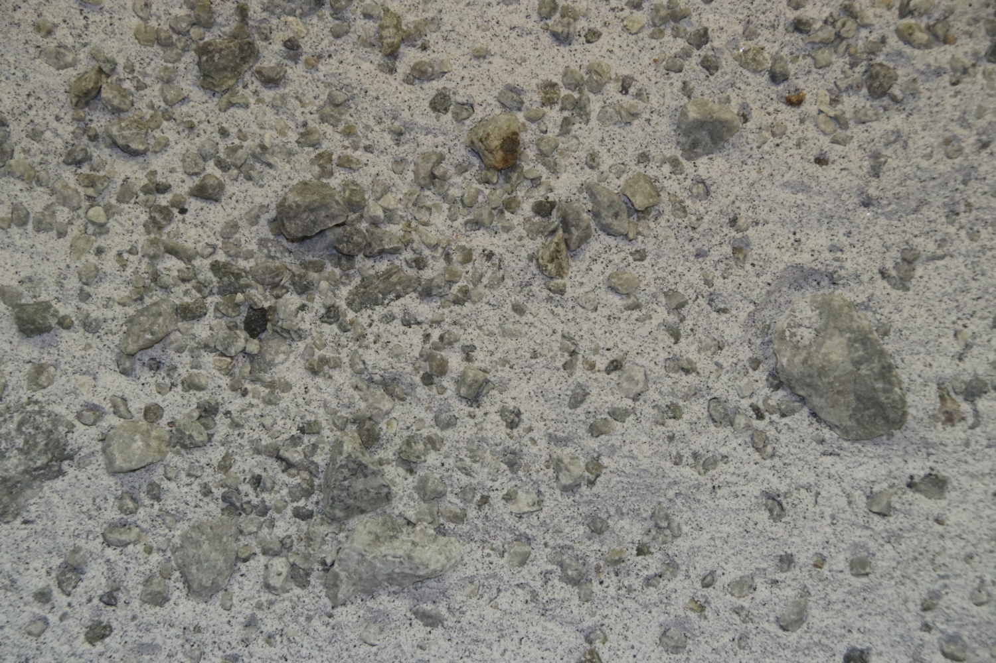
Scouting
Final Iteration
Straightforward survey!
Based on the average response from citizen scientists, the application will subdivide the original image into a more manageable partition.
Diana Arteaga-Andrade

Slide 18
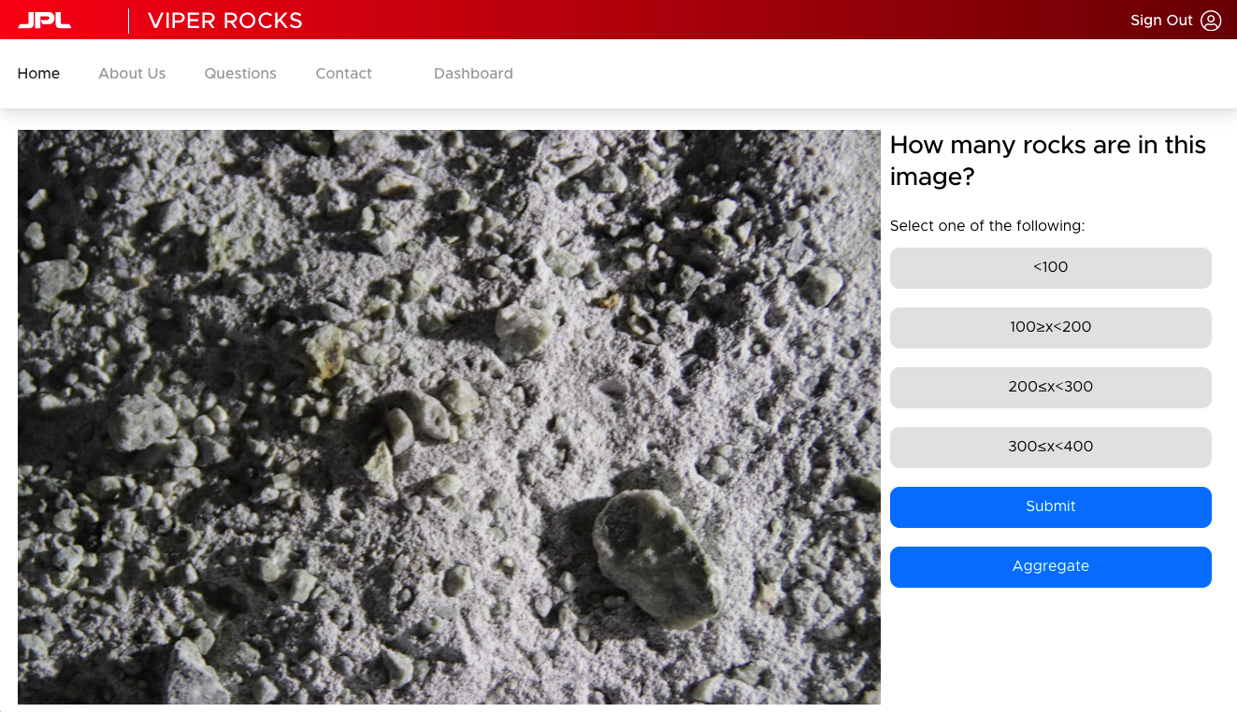
Sizing
What is it?
Using subdivided images from the scouting task.
Citizen Scientist will utilize our sizing tool to measure various rocks.
Why is it important?
By analyzing rock size, scientists can map the lunar surface, determine rock size-frequency distributions (providing information on age, exposure history, and regolith maturity).
Kevin Andrade

Slide 19
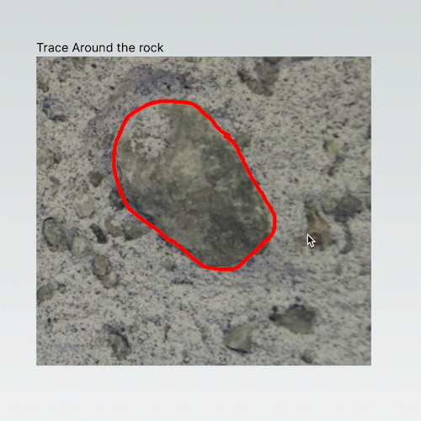
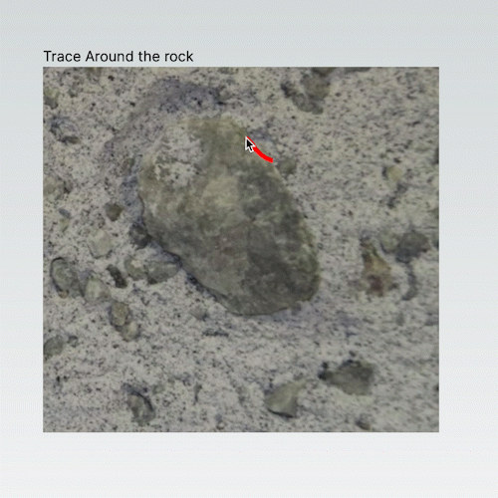
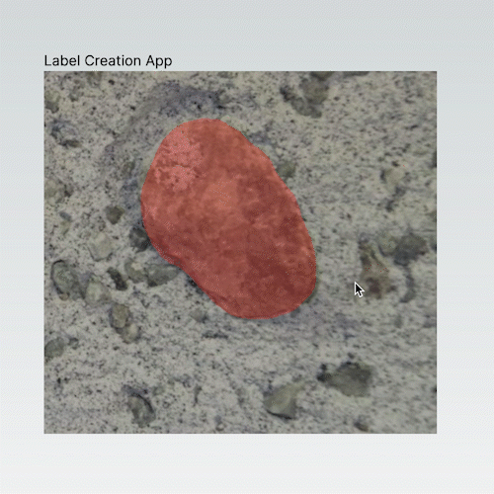
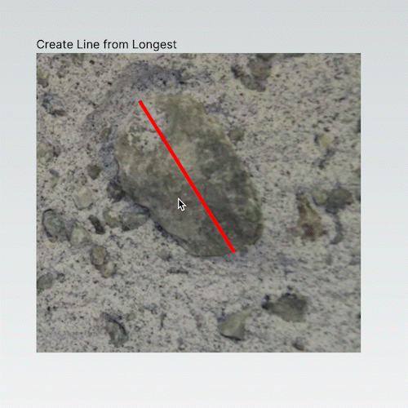
Sizing
Early Iterations
Tracing:
allowed to user to trace along a rock
Line:
create a line along from the longest point
Rectangles:
using rectangles fill in the area of the rock
Polygons:
Using multiple points along the rock create a polygon shape
Needs a balance between simplicity and gathering enough data
Kevin Andrade
Notes:
Notes (JP):
Line: Create a line for longest diameter
Trace: Trace around the rock (free hand draw)
Custom Polygon: Click on the canvas to create points for the polygons that will highlight the region. Wanted to reduce the amount of points needed
Rectangles: This is a bug. Originally wanted to be able to trace the region from the inside out. Ended up with this thing that will fill in the inside with rectangles.
Trace and Highlight: Finalized version, same as trace but will highlight the region that was traced over.

Slide 20
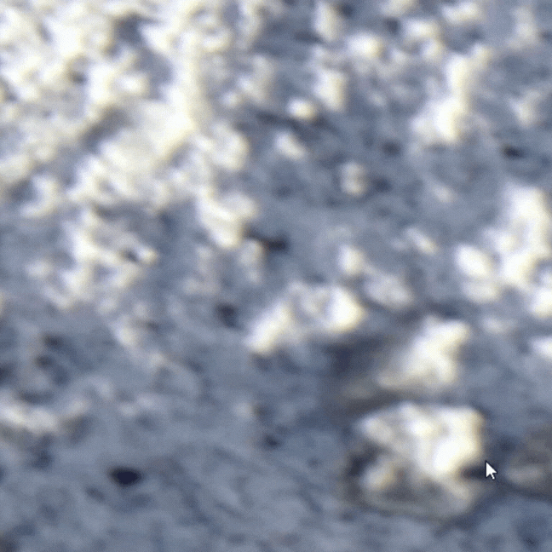
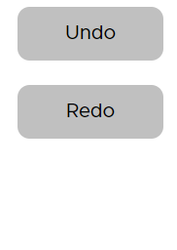
Sizing
Final Iteration
Trace and highlight
Used Konva to develop tool
Simply click, hold, and drag your mouse to draw the exact shape of any rock in the image
Extra functionality to undo, redo, and autosave progress
Citizen scientists will be able to get the measurement and location of individual rocks.
Kevin Andrade

Slide 21
Classification
What is it?
Citizen scientists will classify the shapes of individual rocks on the Moon into categories like angular, sub-angular, sub-rounded, and rounded.
Why is it important?
Analyzing rock shapes from VIPER images will reveal how different shapes are distributed (shape-frequency distributions). This unveils clues about how the harsh polar environment breaks down rocks (structural degradation) and allows for comparisons between polar and non-polar surfaces.
Cristian Gomez

Slide 22
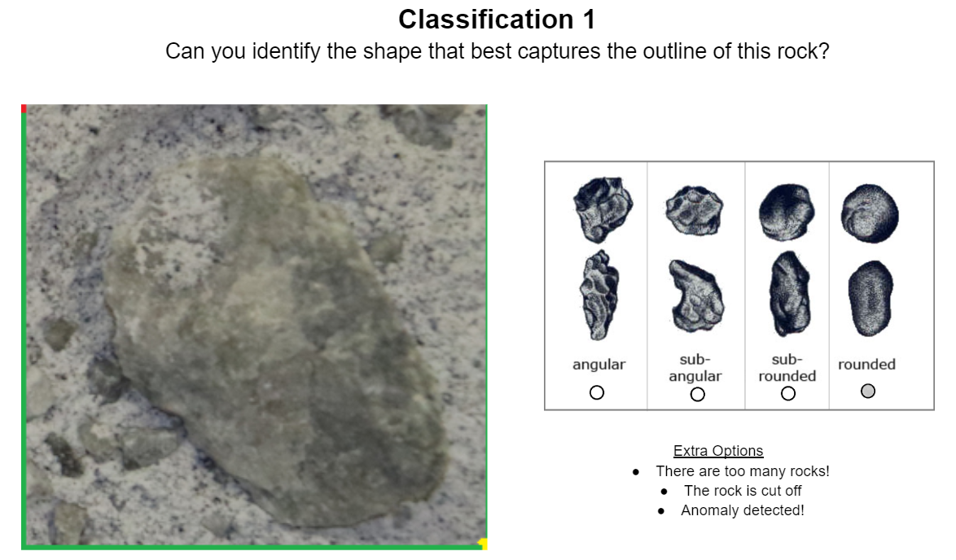
Classification
Goal
Citizen scientists will classify the shapes of individual rocks on the Moon by choosing the best match from a provided list.
We use the information from the sizing task to determine the boundaries of an individual rock
Cristian Gomez
Notes:
Citizen scientists will classify the shapes of individual rocks on the Moon by choosing from categories like angular, sub-angular, sub-rounded, and rounded. An "ambiguous" category is available for rocks that are difficult to classify definitively.

Slide 23
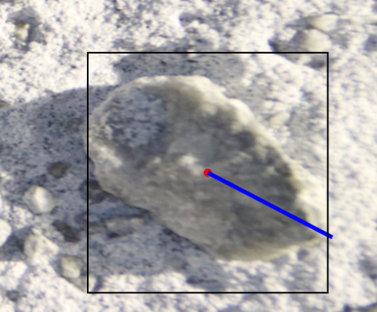
Creating a boundary box using longest line from center
Cristian Gomez

Slide 24
Database/
Backend
Michael Gibson

Slide 25
Technologies Used
PostgreSQL
PostGIS
Konvajs
QGIS
Database Provider
Spatial Database Extension
(Geographic Information System)
Canvas drawing tool
Geometry Visualization Software
Michael Gibson

Slide 26
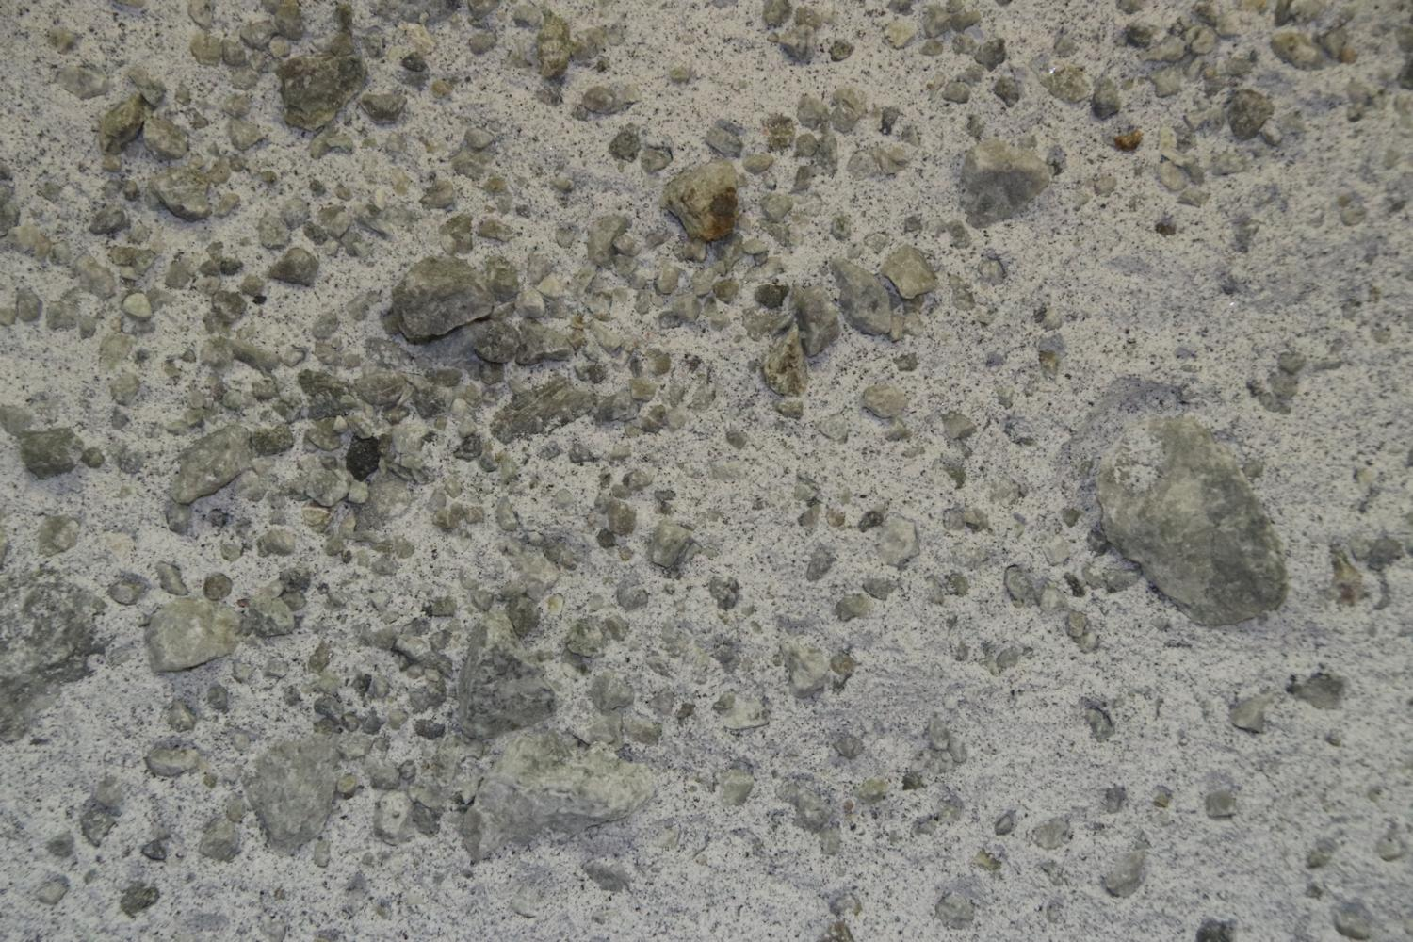
Testbed Example Image

Slide 32
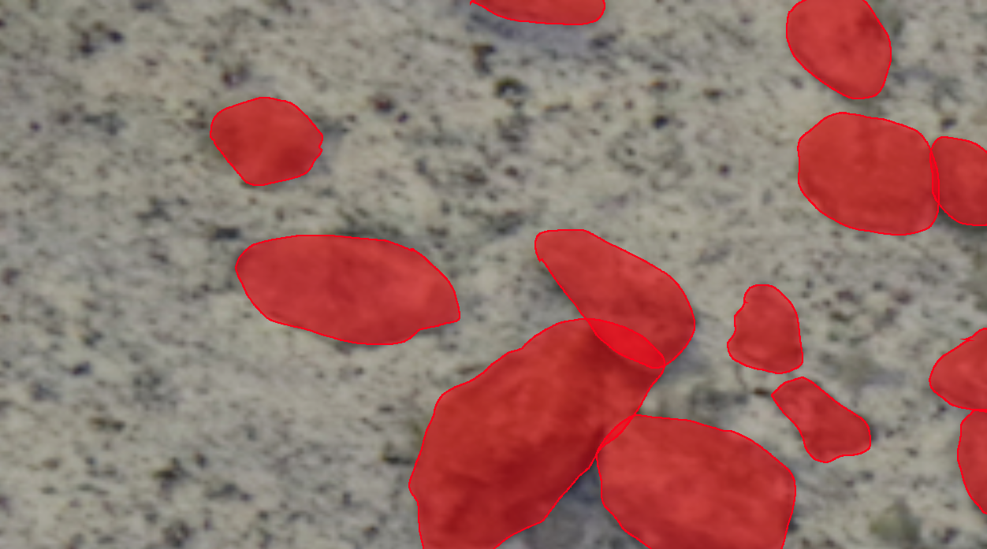
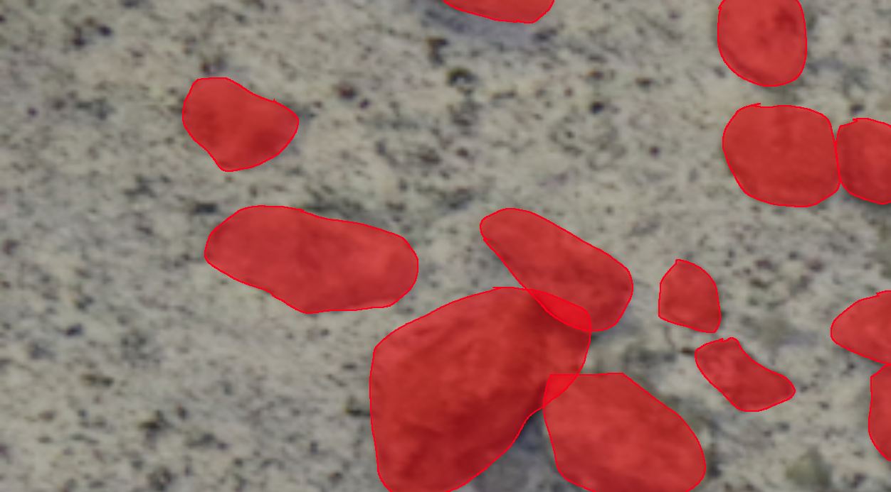
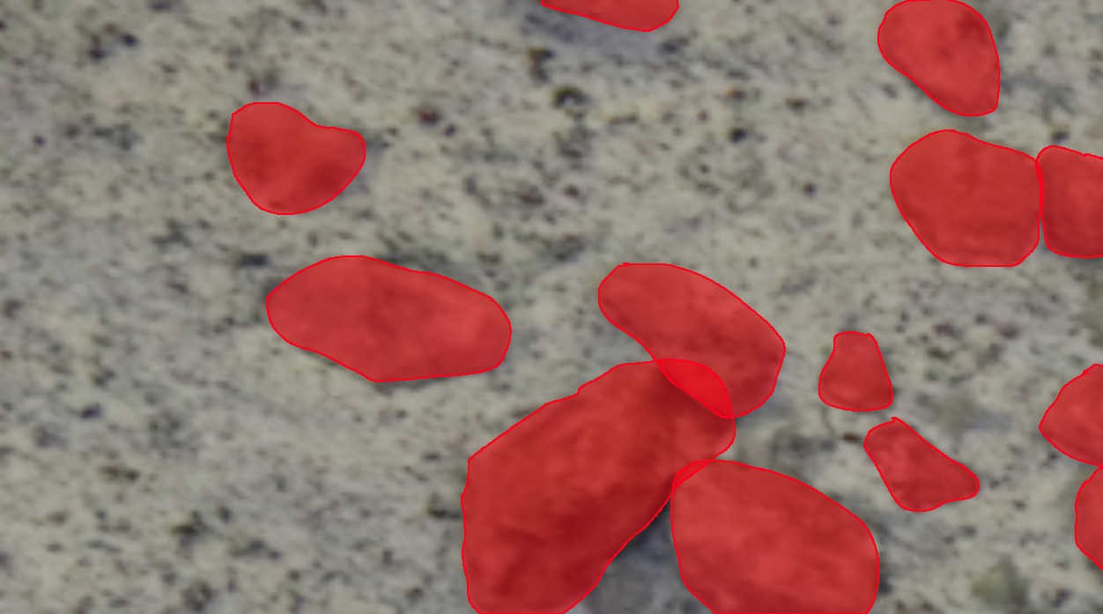
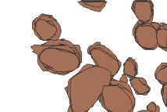

Slide 34
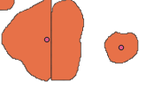

Slide 35
Deployment
Tammy Xaypraseuth

Slide 36
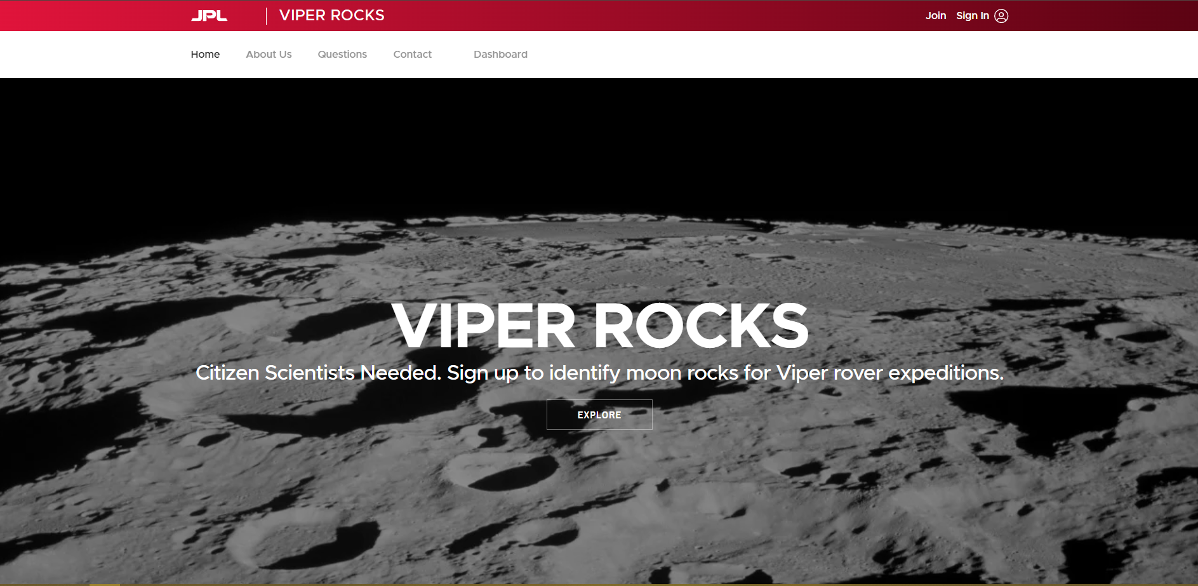
Site at First Glance
Tammy Xaypraseuth

Slide 37
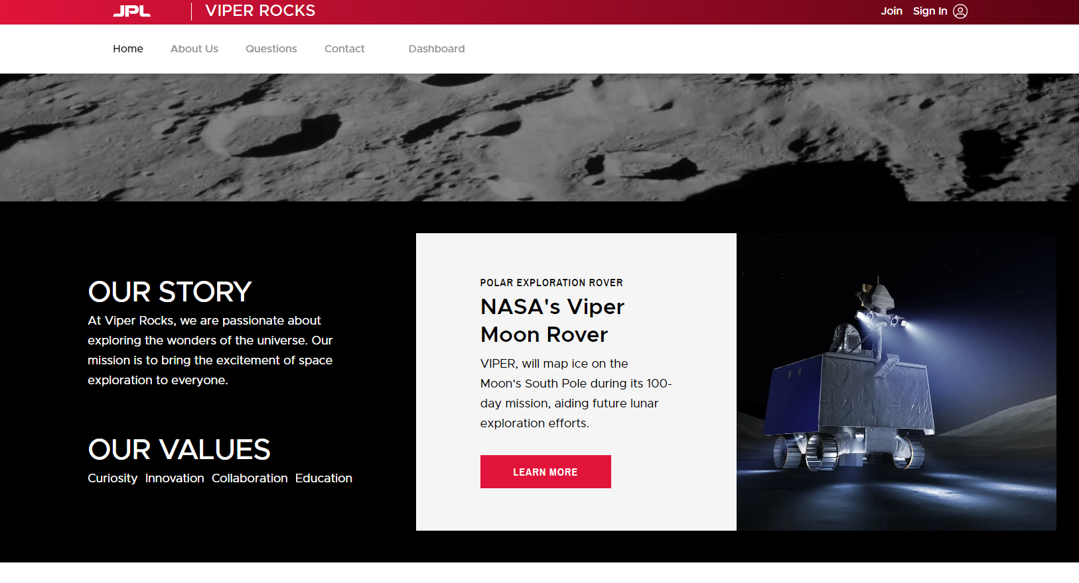
Site at First Glance
Tammy Xaypraseuth

Slide 38
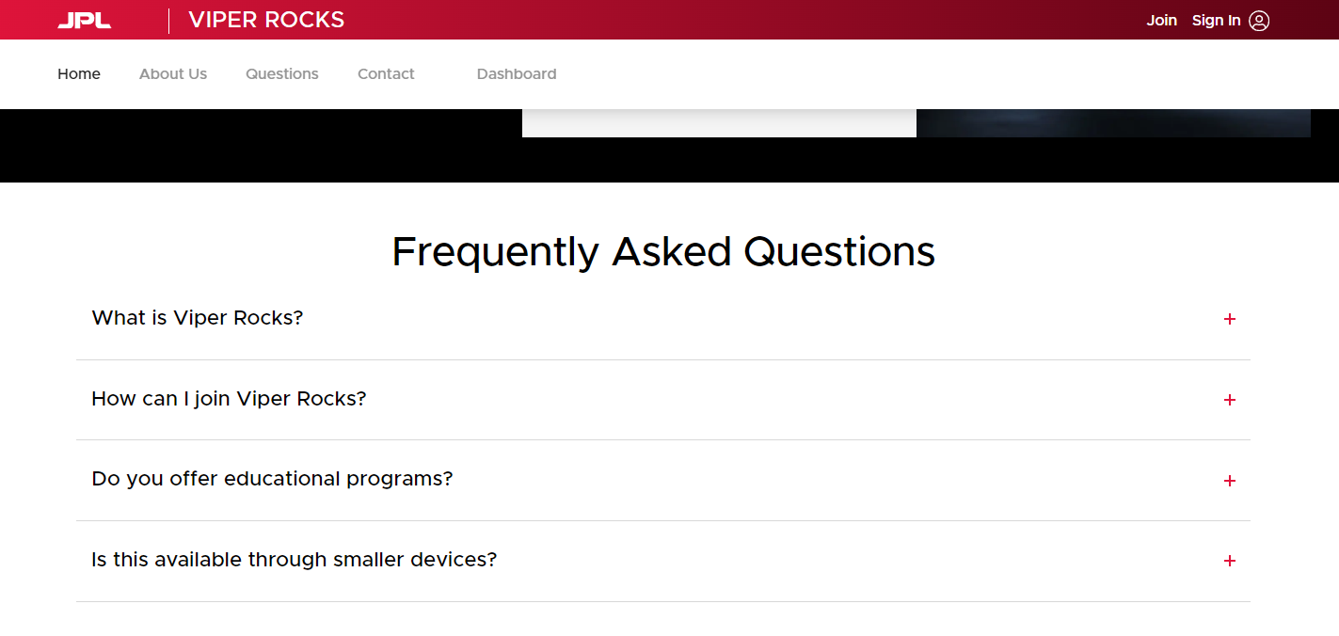
Site at First Glance
Tammy Xaypraseuth

Slide 39
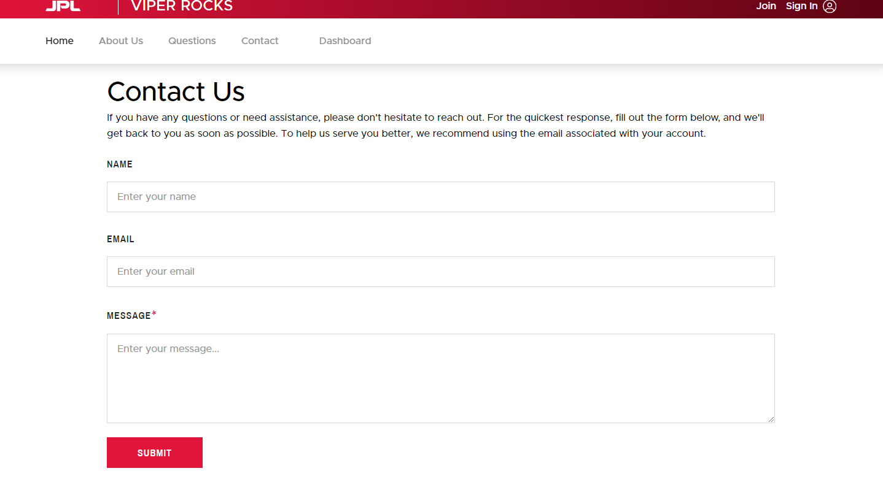
Site at First Glance
Tammy Xaypraseuth

Slide 40
Deployment on Vercel
Why Vercel and what were its benefits?
Tammy Xaypraseuth

Slide 41
Extra Features
Santiago Bautista

Slide 42
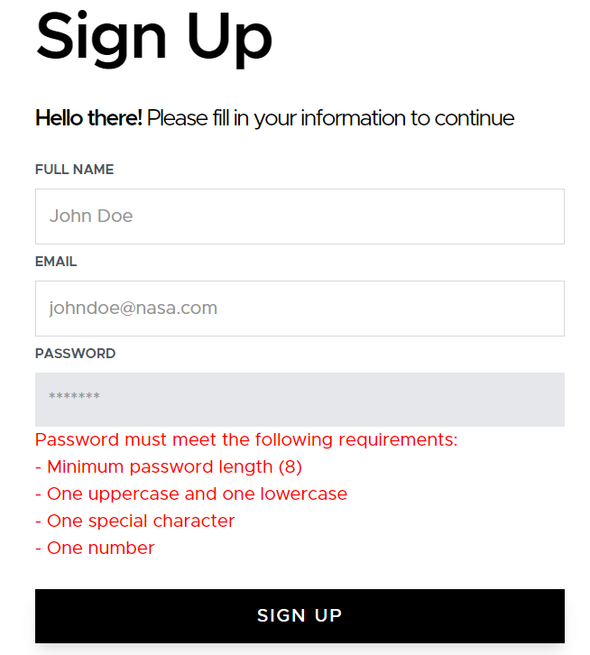
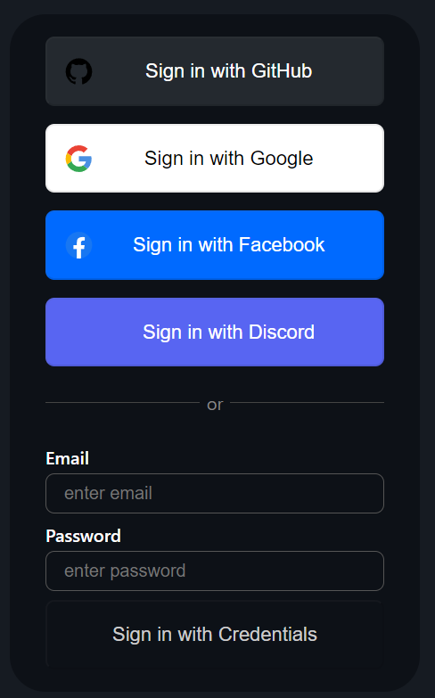
Join / Sign In
Classic email and password, OAuth, and strong password
Santiago Bautista

Slide 43
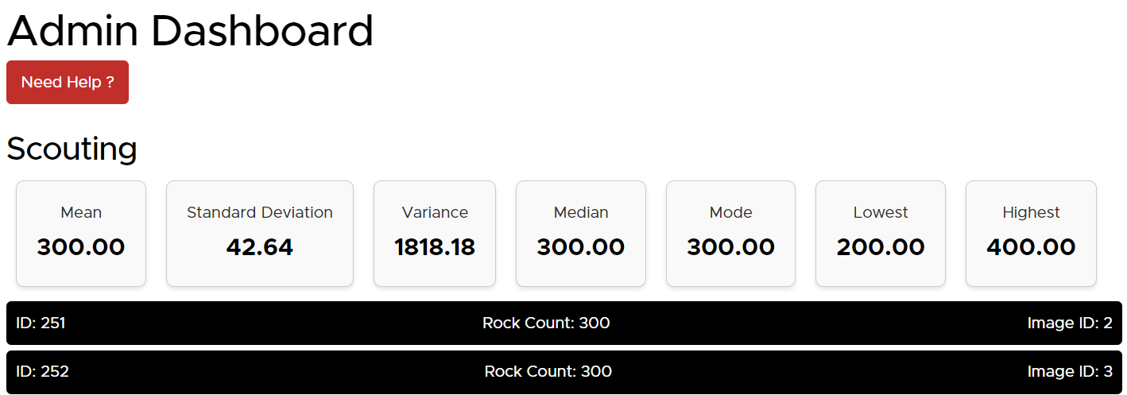
Main Dashboard
Tutorial, task checklist, leaderboard, image tag history, news feed for citizen scientists
Admin Dashboard
Data from different tasks for administrator use, aggregate inputs
Santiago Bautista
Notes:
https://viper-rocks-delta.vercel.app/Dashboard/Admin
https://viper-rocks-delta.vercel.app/Dashboard/User

Slide 44
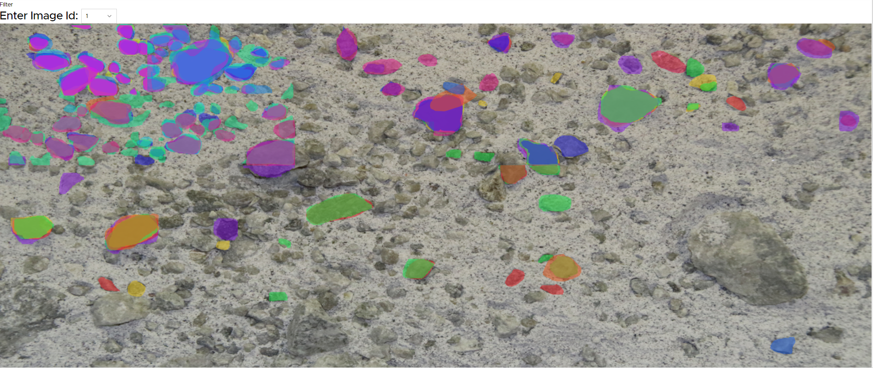
Admin Sizing
See all user marks on the sizing page
Notes:
Everything done in the sizing task will be displayed in full
Each color corresponds to a User

Slide 45
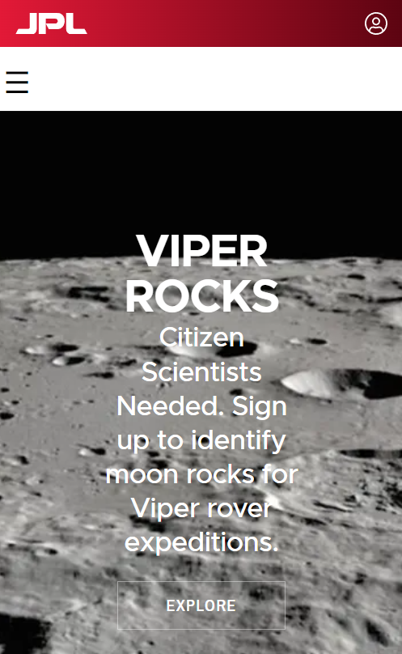
Loading Screen
Partial Mobile Support
Reliability Score
Loading visual between submissions
Some functionality on mobile devices
Measurement of a user’s consistency in comparison to the average user
Santiago Bautista
Notes:
https://www.flaticon.com/free-icon/reliability_10635046
Mobile support: Scouting can be done on mobile as well.

Slide 46
04
Video Demo
Let’s try it out!
Zainab Sulaiman

Slide 47
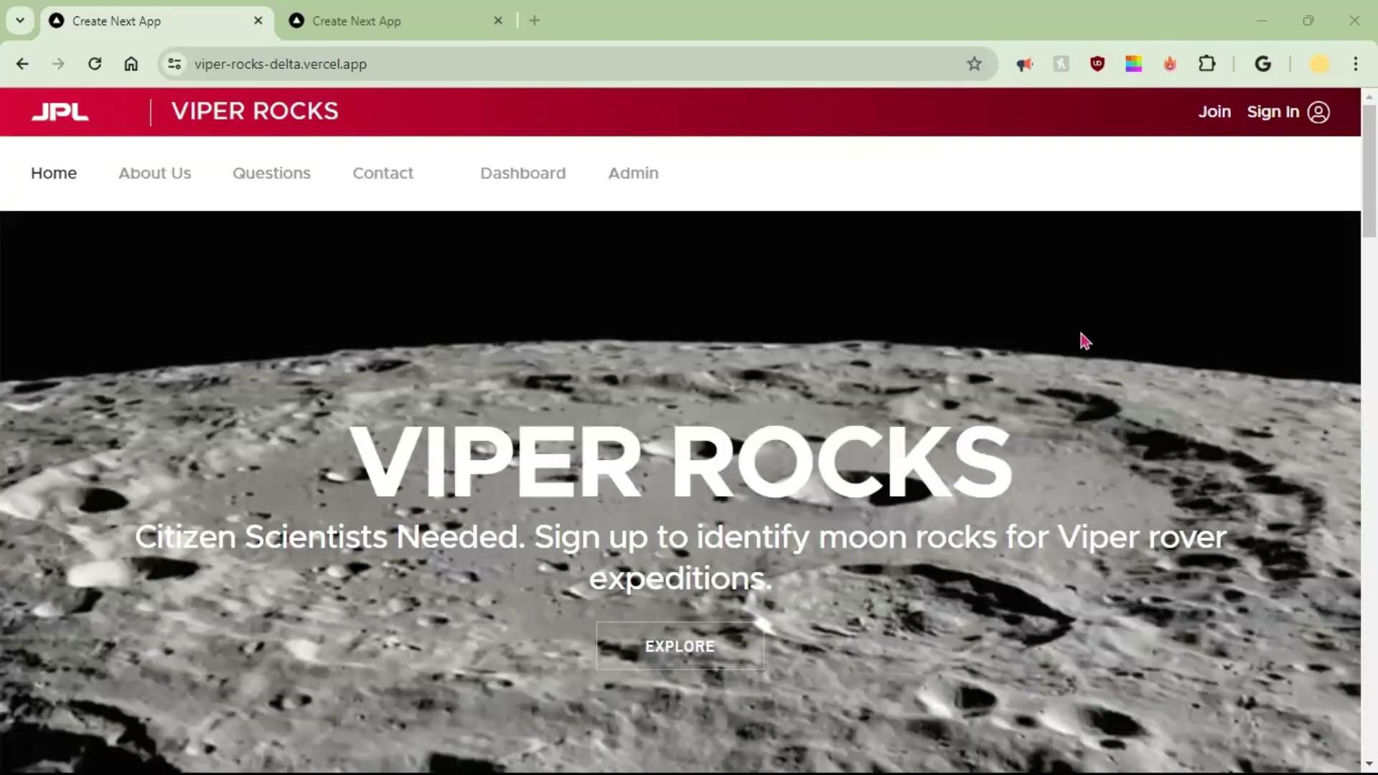
Zainab Sulaiman

Slide 48
05
Future Work
What’s next with VIPER Rocks!?
Diane Tabilas

Slide 49
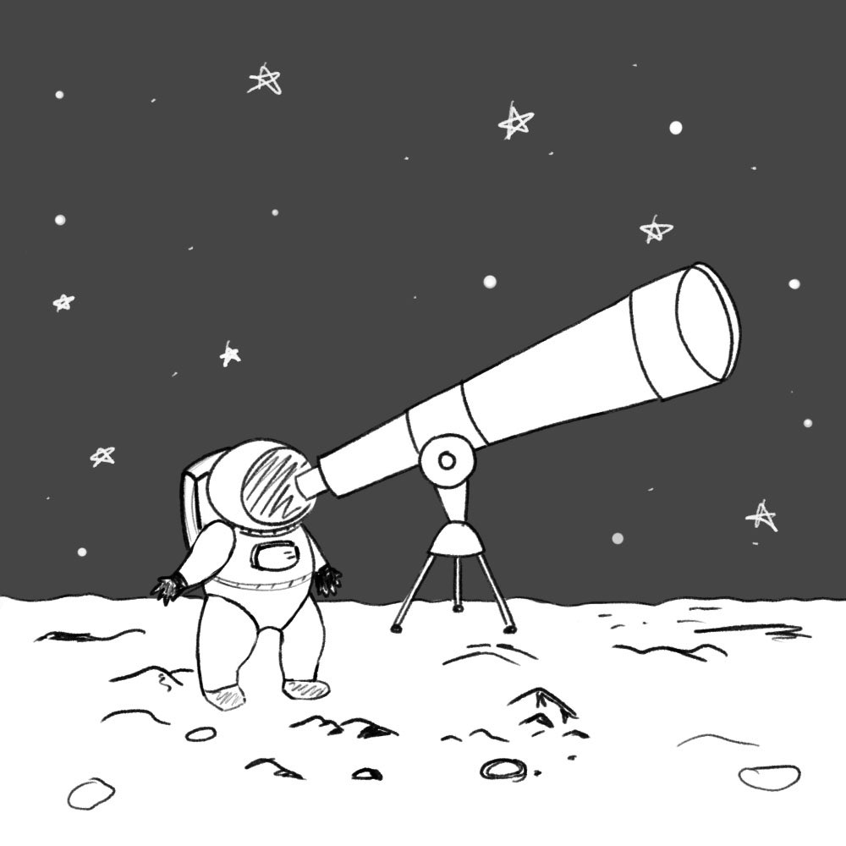
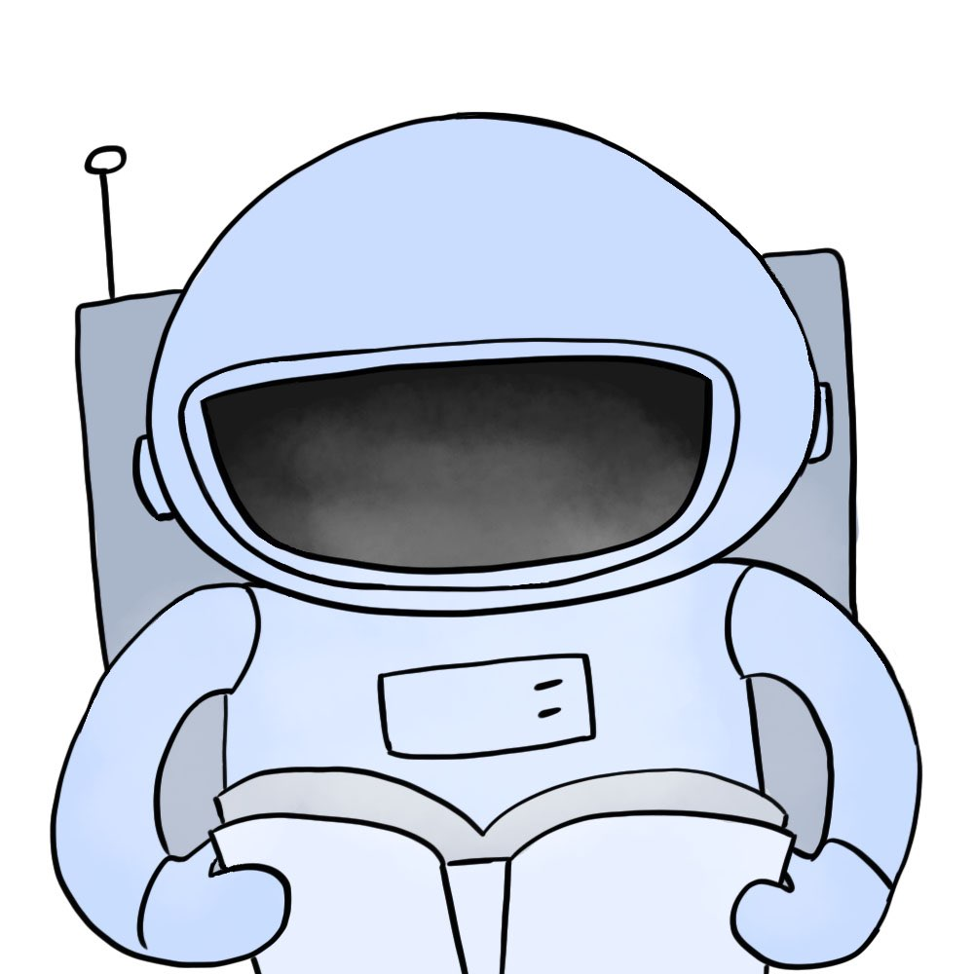
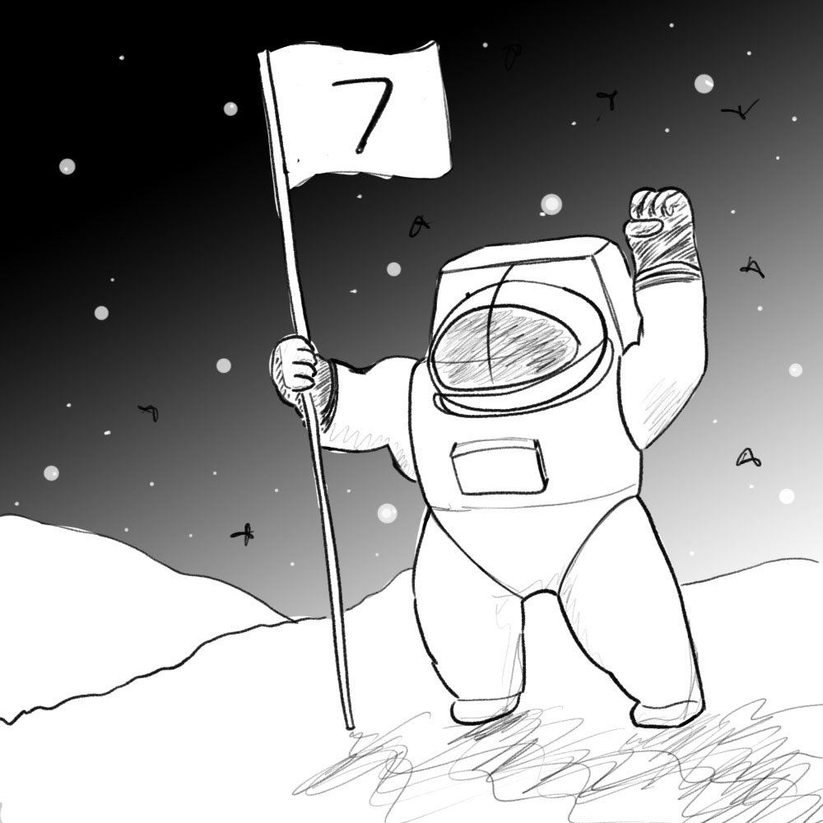
How can we make VIPER Rocks! better?
Human Centered Design Principles
Enhanced user experience
Compatibility with multiple devices
Ease of use
ADA compliance
Younger and older users
Incentives and Rewards -> Motivation
Diane Tabilas

Slide 50
And more!
Security
Reliability Score
NAVCAM
Enhanced security procedures and protocols
Currently implemented for scouting. Add Sizing and Classification.
Additional compatibility with VIPER’s other cameras
Tutorials
Statistics & Data
Display statistics and data such as size of rocks in different measuring systems
Simple “how to” for each task
Diane Tabilas

Slide 51
Conclusion
06
Nida Sheikh

Slide 52
Citizen Science for Lunar Exploration with Focus on Lunar Rocks!
Scouting
Sizing
Classification
We learned and accomplished a lot!
Nida Sheikh
Notes:
VIPER Rocks! is a web application designed for citizen science participation. This means anyone, regardless of scientific background, can contribute to the VIPER mission. The application centers around analyzing data captured by the VIPER rover on the Moon, specifically focusing on the rocks encountered on the lunar surface. Rock data gathered by citizen scientists from the three tasks (scouting, sizing, and classification) will get more people involved in the mission and significantly enhance the scientific output.

Slide 53
Thanks!
Acknowledgements:
Thank you to our:
JPL liaisons: Shan Malhotra
Mike Rueckert
Richard Kim
Emily Law
Graduate Assistant: Jerome Pineda
Advisor: Dr. David Krum
Angy Xajil

