Slide 1
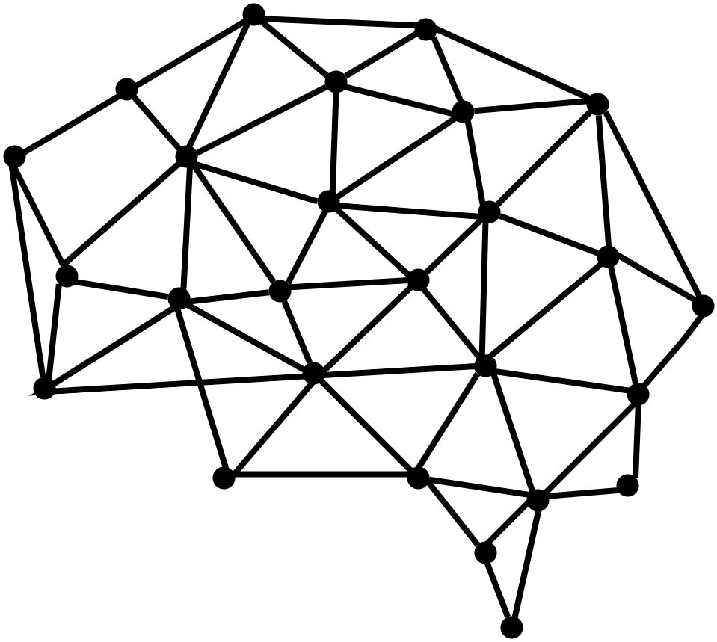
Behavioral Cognition
Project LP-Toolkit
May 3, 2024
Notes:
Deep

Slide 2
Meet Our Team
Advisor/Liaison
Dr. John Tran
Deep Bhakta
Yizhang Cao
Iris Ha
Erick Agustin Herrera
Shant Hovagimian
Daniel Ontiveros
Jorge Pena
Arturo Rodriguez
David Santini
Izeth Torres
Notes:
Deep

Slide 3
The Big Picture
An AI toolkit
Easy to use
Deploy within minutes
Little to no programing knowledge needed
Similar to ChatGPT/ Bard
Creating web based program
Single command executable project
Notes:
Deep

Slide 4
01
02
03
Background
Data Structure
Future Steps
Research
Frontend
Backend
Testing
Vectorization
Notes:
Deep

Slide 5
Background
01
Research
Notes:
Deep

Slide 6
Research
React Hooks (useLLM), GPT 3
useLLM is a React Library that allows the user to integrate LLM models like OpenAI’s ChatGPT and add AI-Powered features within your React App with only few lines of codes.(Able to use any LLM)
Supports message streaming, prompt engineering, audio transcription, text-to-speech and much more.
Hugging Face
Comprehensive Model Hub: Access to a wide range of pre-trained models for natural language processing (NLP), supporting quick deployment and seamless integration in diverse applications.
Transformers Library: Features robust support for major deep learning frameworks, enabling easy model training, fine-tuning, and deployment across multiple platforms.
LangChain
LangChain provides a framework that simplifies the development of LLM-powered applications for developers.
Acts as a toolchain, by providing a set of tools and components that can be combined to create complex workflows efficiently.
Notes:
Daniel, Jorge

Slide 7
LangChain
- LangChain is an open-source framework that streamlines the development of Large Language Model (LLM) applications, providing a flexible environment for creating context-aware, reasoning applications that leverage multiple LLM integrations along with your data and APIs.
- Abstracts complexities of the underlying languages much like React does for JavaScript or Pandas for Python.
- Offers tools like PromptTemplate for easy prompt creation and automates workflows through chains, links, and an agent module that enables LLMs to determine optimal actions for problem-solving.
- Features a memory module for context retention in user interactions and supports fine-tuning LLMs on custom datasets for enhanced model performance.
- Integrates with external data sources and cloud platforms like AWS, Google Search/Cloud, and Azure, for versatile development.
Notes:
Jorge

Slide 8
HuggingFace(NLP)
- Hugging Face's open-source library supports PyTorch, TensorFlow, and JAX, facilitating accessibility and versatility for developers.
- The Transformers library, at the core of Hugging Face's ecosystem, offers thousands of pre-trained models for various tasks, from text classification to text generation.
- Users can easily fine-tune these models on custom datasets and deploy them in production environments with provided tools.
- Additional features include out-of-the-box support for token classification, sentence classification, and feature extraction.
- Hugging Face's platform extends beyond text-based tasks, offering capabilities for audio and vision models, thus becoming a multi-modal platform.
- The ecosystem's user-friendly interface and comprehensive documentation further enhance its appeal for developers of all skill levels.
Notes:
Daniel

Slide 9
Data Structure
02
Frontend, Backend, Testing
Notes:
Yizhang

Slide 10
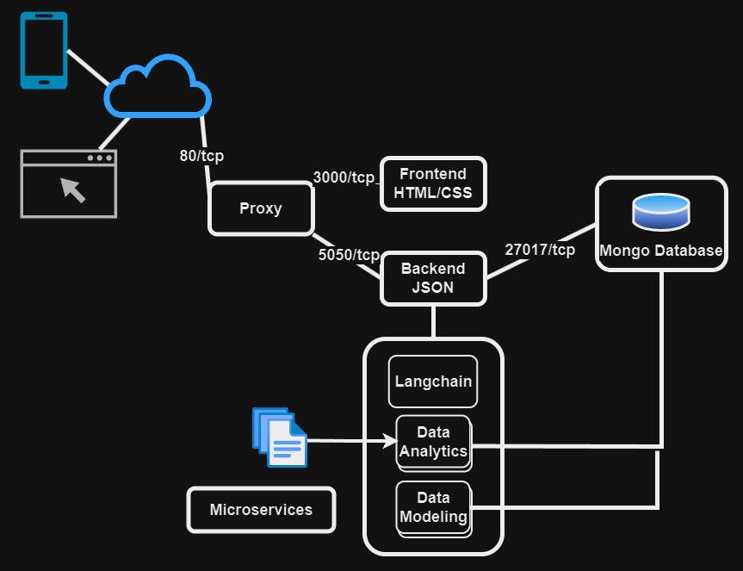
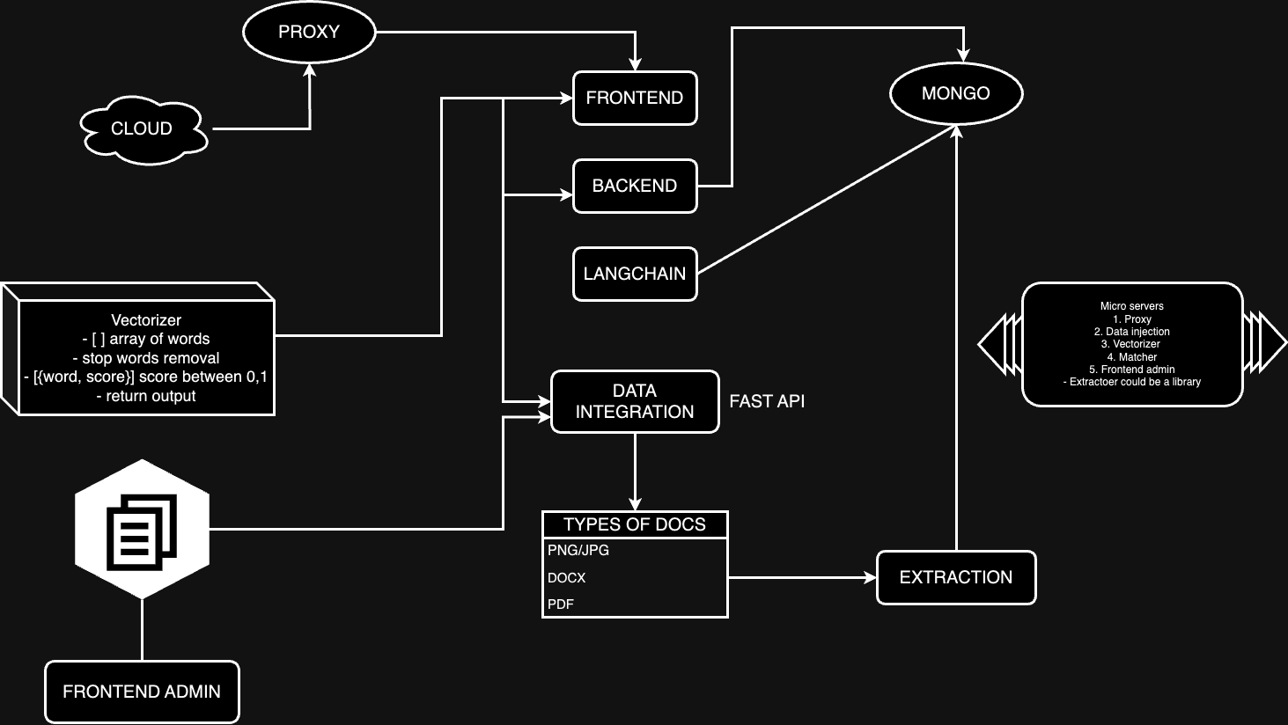
Architecture
Notes:
Yizhang

Slide 11
Docker | Mircoservers
What is Docker?
Docker is a powerful tool that helps us package our software into containers
Why We Use Docker?
Using Docker has revolutionized the way we deploy and manage our software.
Docker in Our Project
We use Docker containers to host each of our application's components, this includes separate containers for the frontend, backend, database, and the Langchain API.
Containers for each microcenter
Frontend
Backend
Database
Langchain API
Docker Compose
Notes:
Yizhang

Slide 12
Frontend
Languages Used
Javascript
HTML / CSS
Frameworks/Libraries
React.js
Node
TailwindCSS
MongoDB
Structure Files:
server.js
Frontend_ChatBox.html
Style.css
chat.js
Index.css
Chat.css
State Management
Integration of Headless UI
Conditional Menu
VisibilityDynamic Routing with Hooks
Notes:
Shant and Arturo

Slide 13
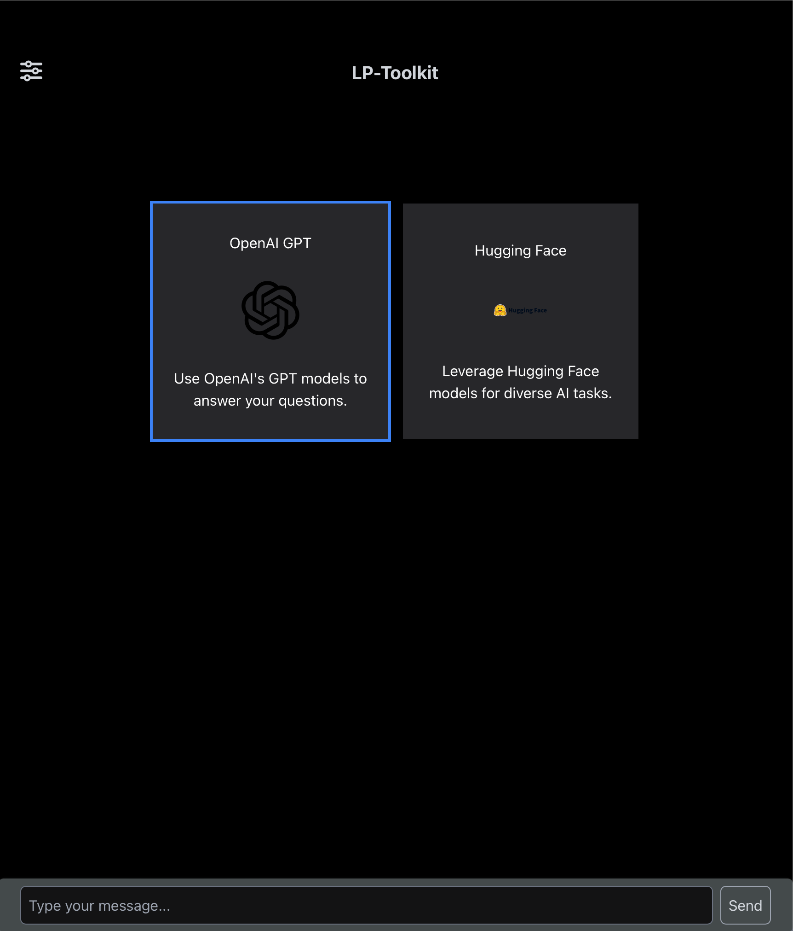
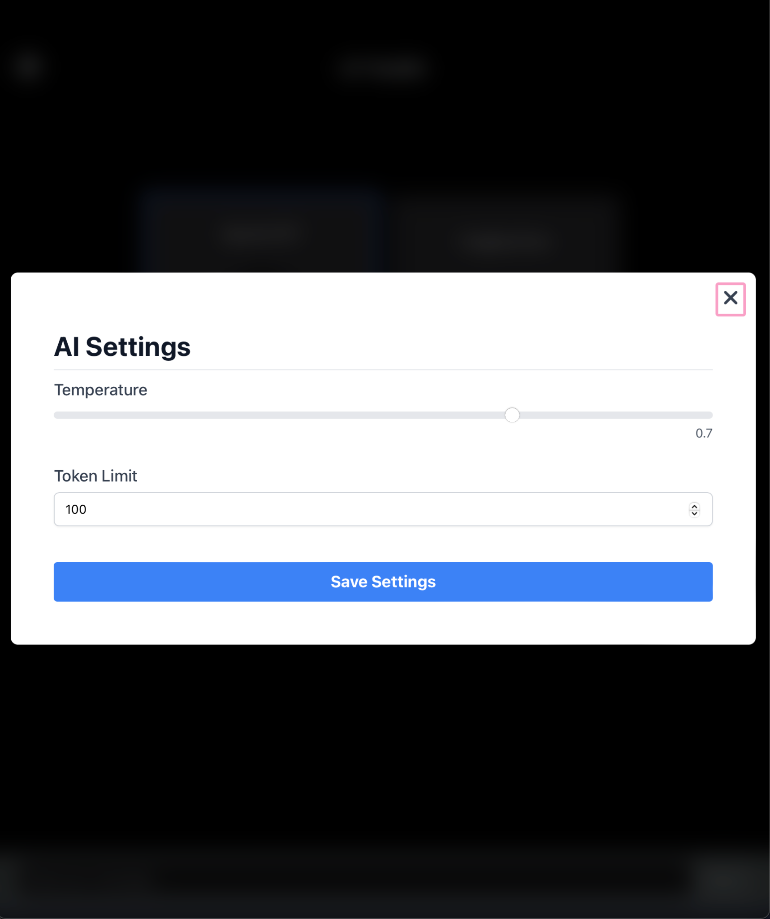
Notes:
Shant and Arturo

Slide 14
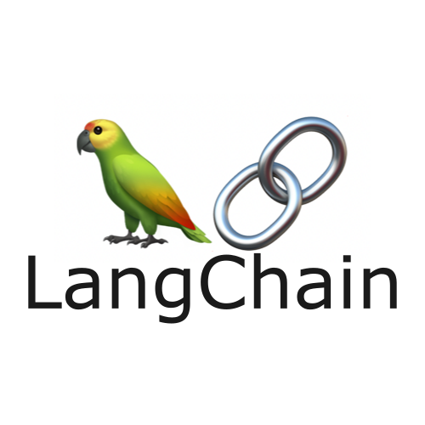
Backend
Express Server (Node.js)
Connected to the frontend of the application
Connects to Langchain through an API call
No direct relationship
Connected to MongoDB
Langchain (Python)
Communication done through a FastAPI server created in python
Digests information and returns generative text
Notes:
Shant

Slide 15
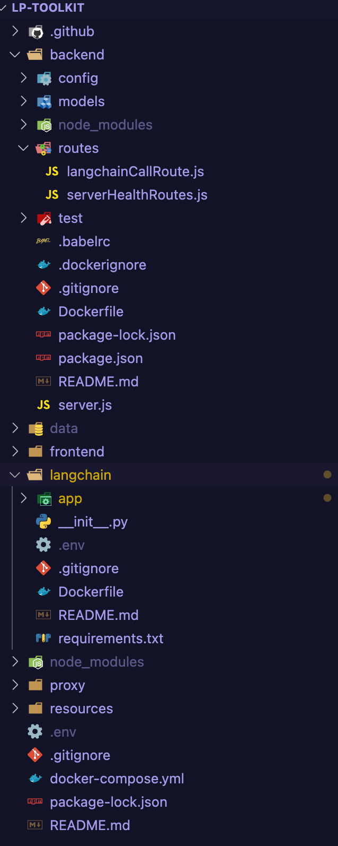
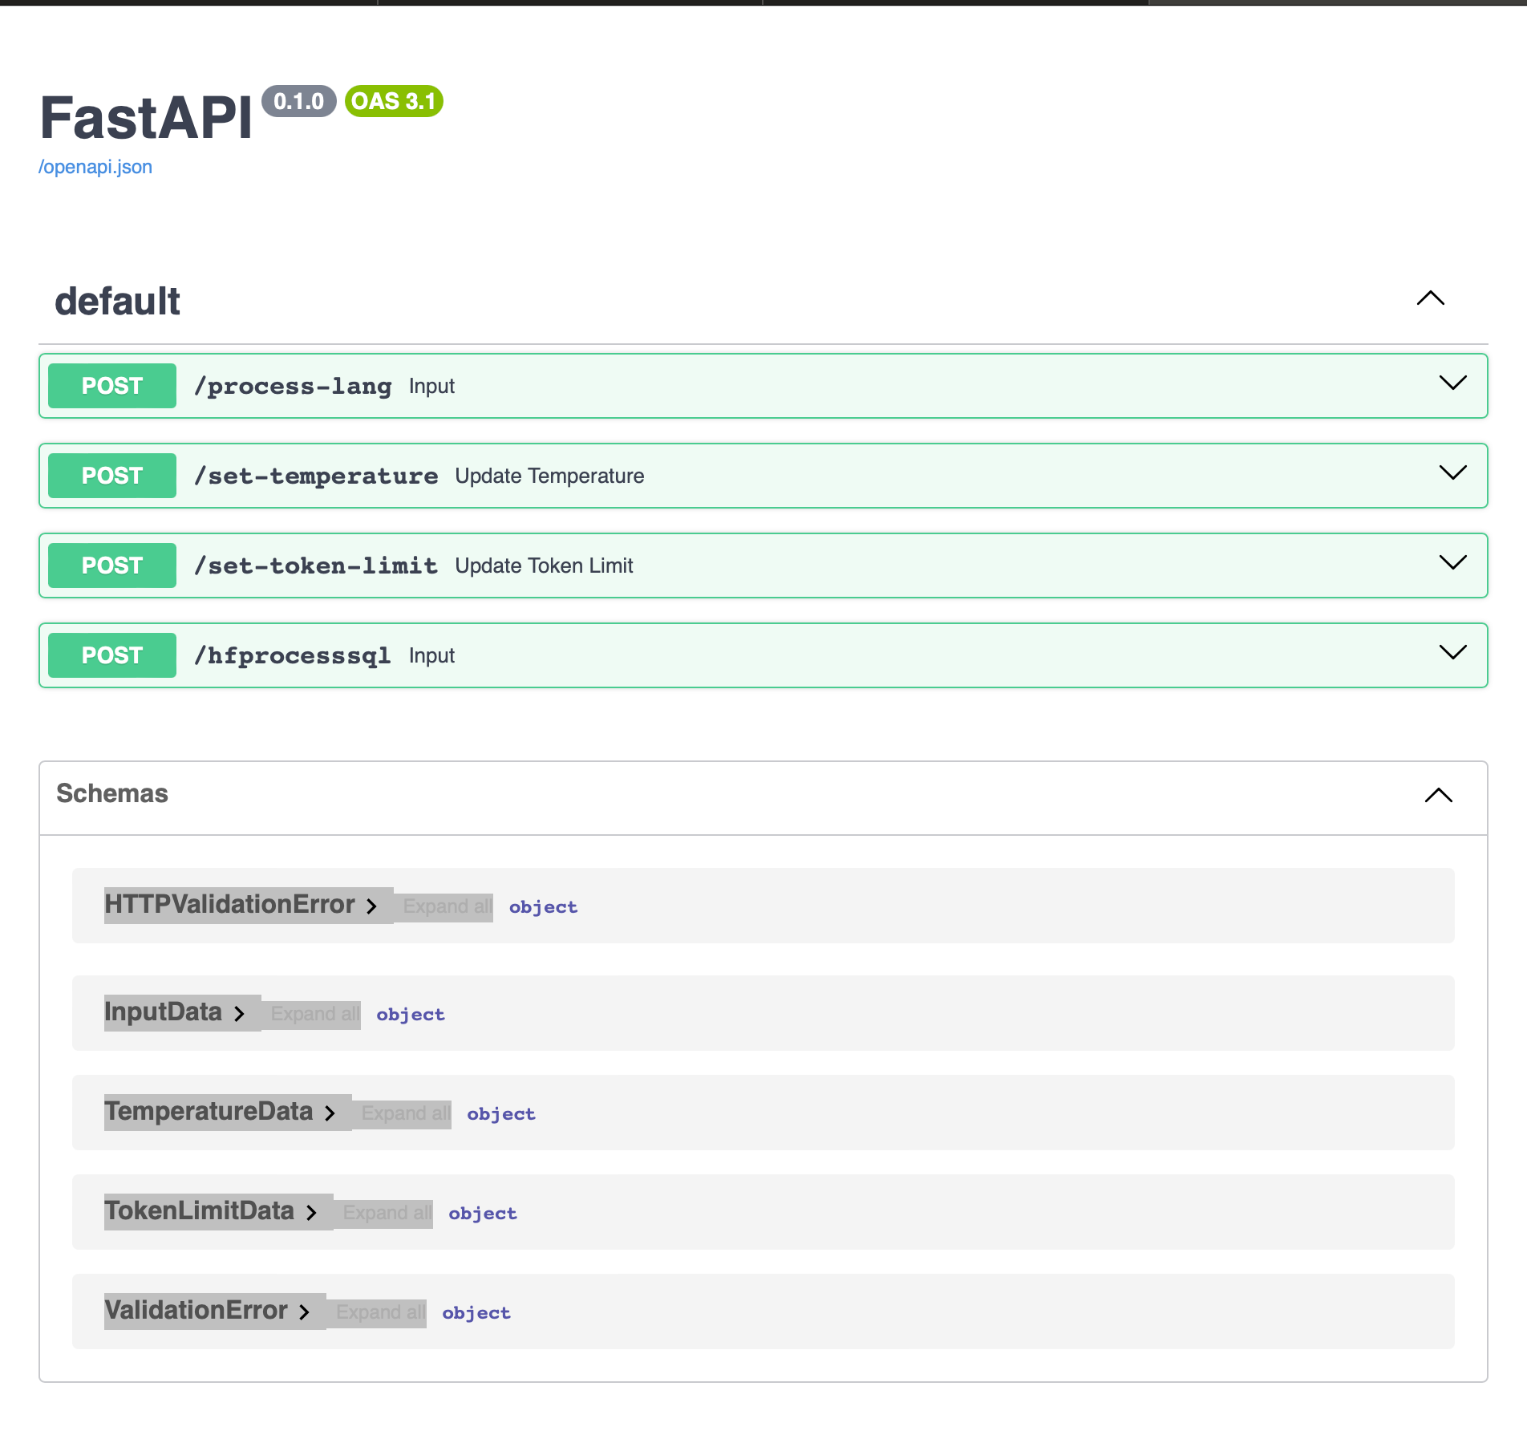
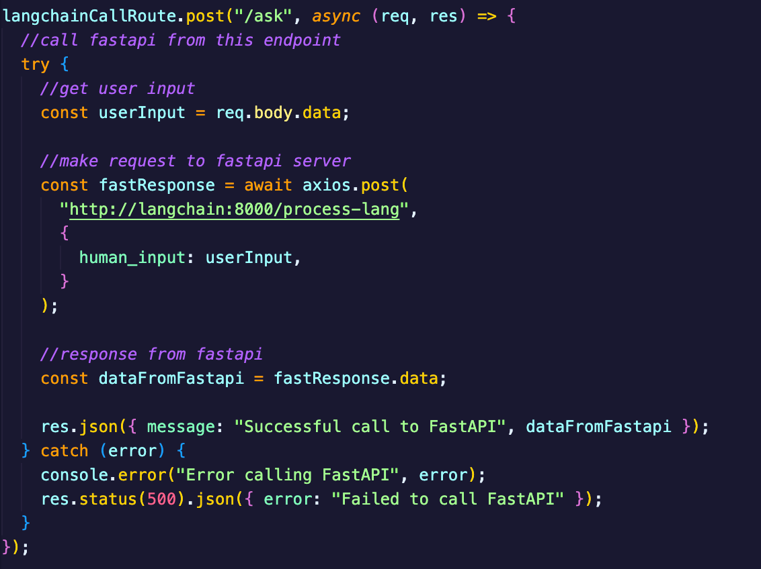
Backend
Notes:
Shant and Arturo

Slide 16
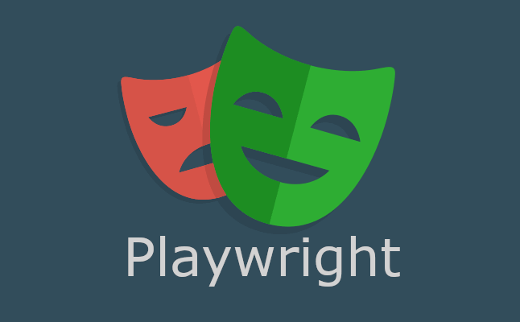
Testing
Testing Frameworks installed (in collaboration with coding team):
Unit Testing: Jest
For testing critical functions and modules
Request handling
Data validation
Dependency mocking
End-to-End Testing: Playwright
To ensure that user-facing elements are working as intended
Simulates the behavior of an actual user
CD/CI Initial Setup (in collaboration with coding team):
Various workflows driven by GitHub Actions
Tests will be run automatically on push to repository, pull-request, etc.
Notes:
David

Slide 17
Testing
Web Apps
Docker
Needs to be deployed in background
GitHub Documentation
Testing and approving push requests
Future Testing
Planning and implementing Test Case
Review and analyze
Troubleshoot end user issues quicker
Unit testing
Notes:
Izeth

Slide 18
Future Steps
03
Vectorization
Notes:
Erick

Slide 19
Vectorizer
A vectorizer is a component/technique that converts raw textual data into a numerical representation, typically in the form of a vector
To enhance text analysis capabilities, we developed a vectorizer tool leveraging Natural Language Toolkit (NLTK)
This tool scores textual data by tokenizing input texts and filtering out stopwords, applying a sentiment score using NLTK’s opinion lexicon
The project aims to integrate this vectorizer with AI APIs from OpenAI and Hugging Face. Through these APIs, we aim to enrich our tool’s linguistic models and expand its applicability to more complex text analysis tasks
FastAPI allows us to streamline the deployment of our service, ensuring scalable and efficient real-time text processing. This will enhance our ability to deliver sentiment insights, creating more data-driven decisions in business and research
Notes:
Erick

Slide 20
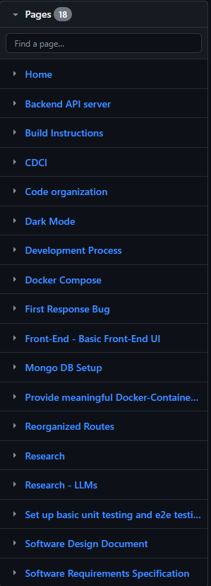
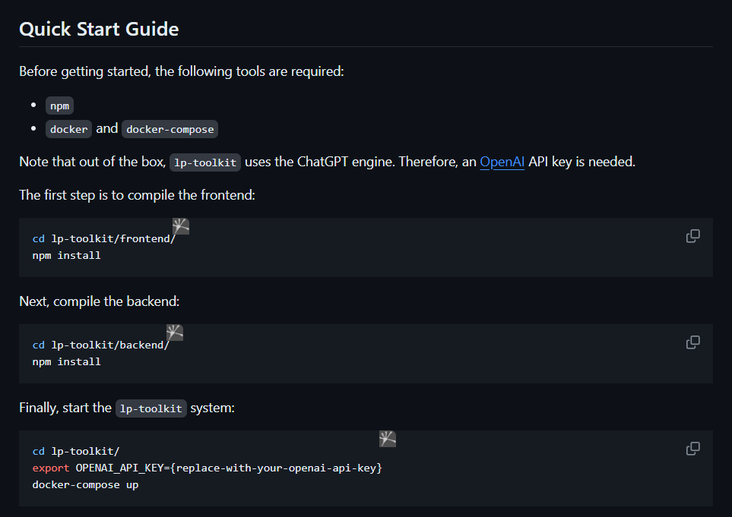
Documentation
Notes:
Iris

Slide 21
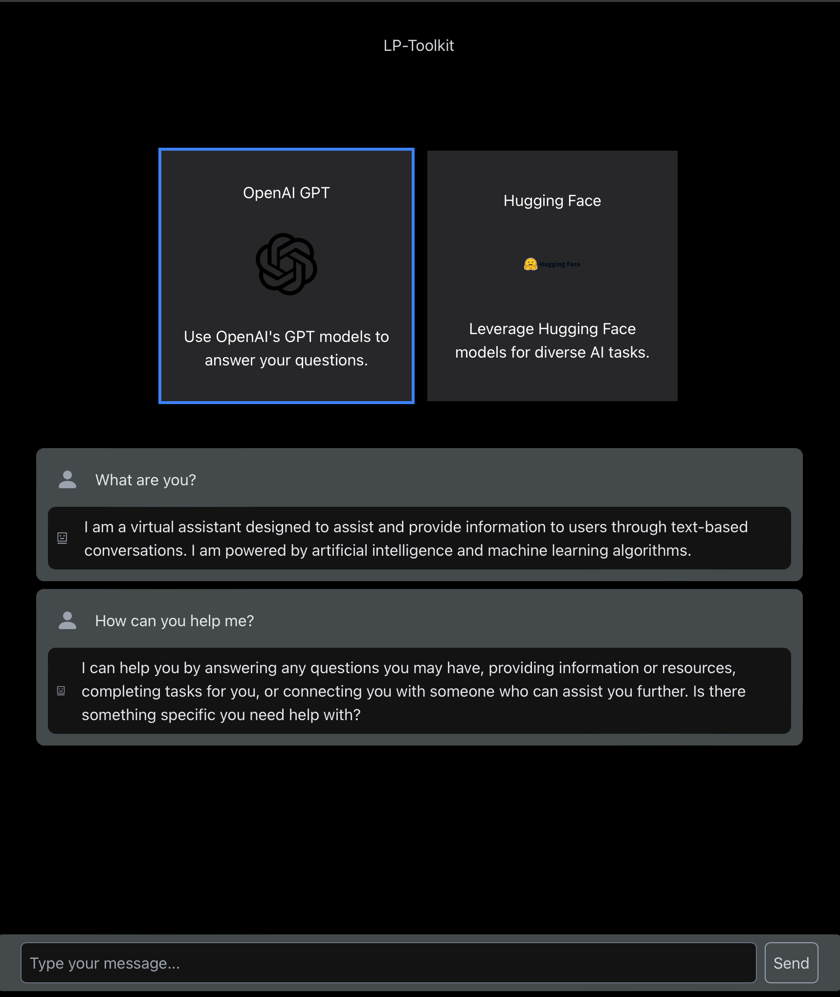
Demo Time
Notes:
Arturo

Slide 22
Thank You
Feel free to ask any questions
Notes:
Erick

